Slide 1
Reusable maps and graphs from ECDC Communicable Disease Threats Report Week 7, 2021
You are encouraged to reuse our maps and graphs for your own purposes and free to translate, provided the content is not altered and the source is acknowledged.

Slide 2
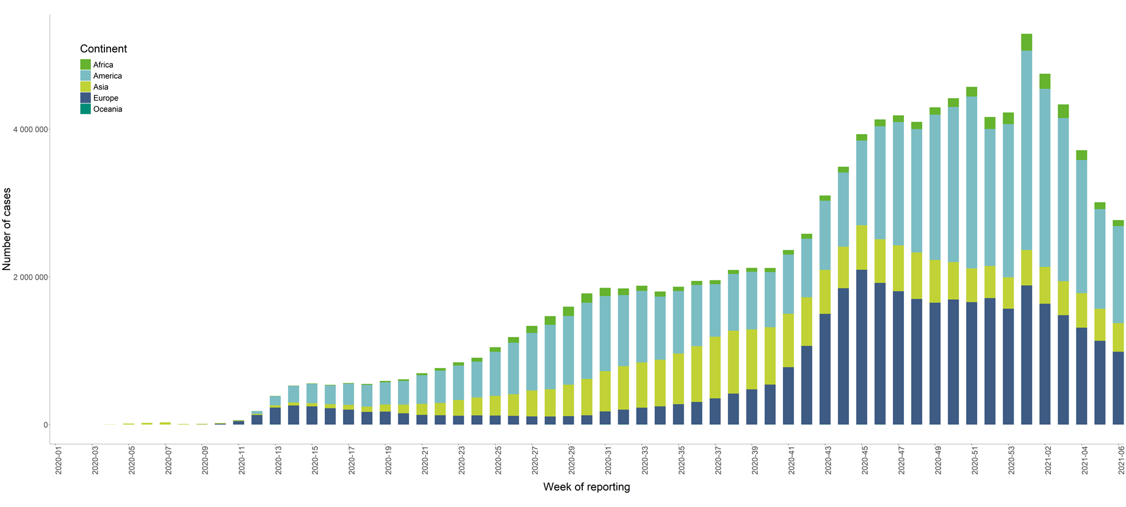
Distribution of COVID-19 cases worldwide in accordance with the applied case definitions in the affected countries, as of week 6, 2021

Slide 3
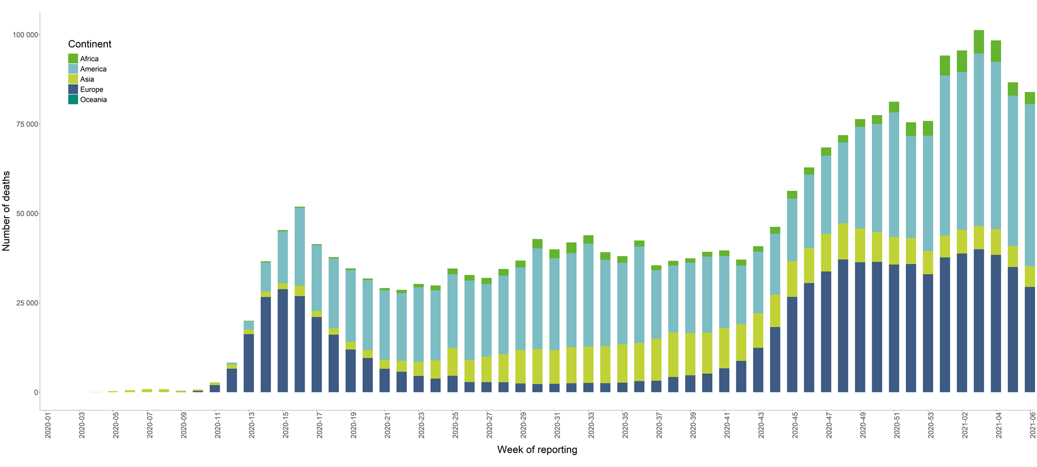
Distribution of COVID-19 deaths worldwide, as of Week 6, 2021

Slide 4
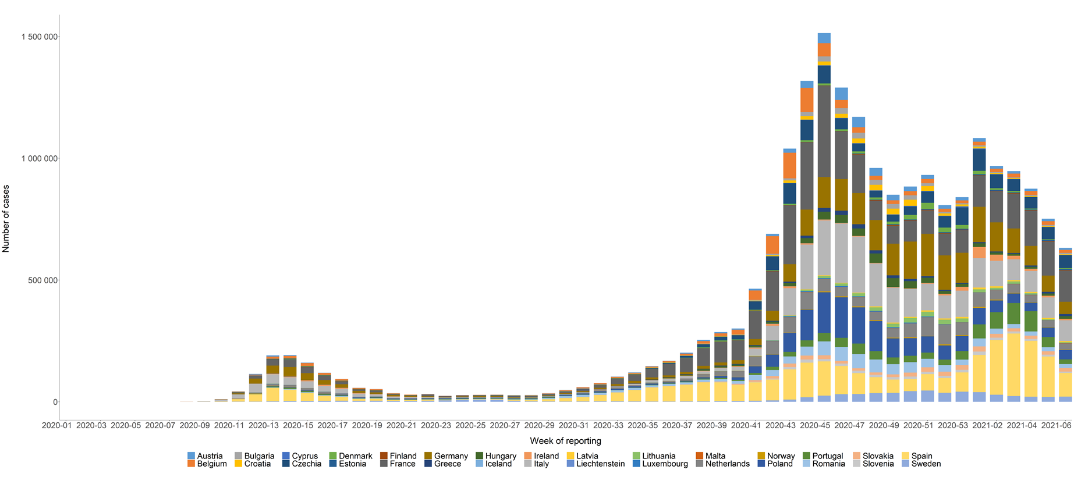
Distribution of laboratory-confirmed cases of COVID-19 in the EU/EEA, as of Week 6, 2021

Slide 5
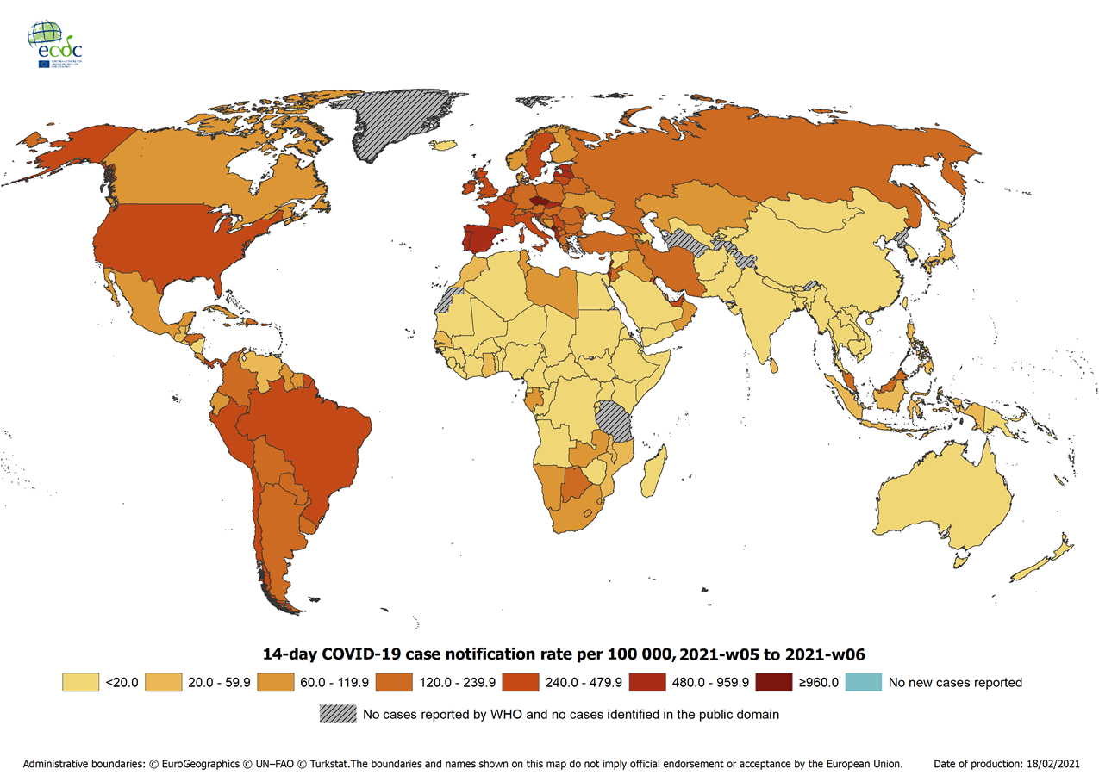
Geographic distribution of 14-day cumulative number of reported COVID-19 cases per 100 000 population, worldwide, as of Week 6, 2021
14-day notification rates and trends are collected using epidemic intelligence from various sources and are affected by the testing strategy, laboratory capacity and the effectiveness of surveillance systems. As all of these factors can differ greatly between countries, ECDC does not recommend using notification rates to directly compare countries. Particular caution is needed when interpreting reported rates from areas with small populations, where small changes in the numbers of reported cases can have a large impact on the notification rate. In addition, the retrospective adjustment of data by reporting authorities is possible. Negative counts of new cases can arise if countries or subnational areas report cumulative totals that are lower than those reported previously, which can affect the presentation of data in maps and time-series plots.

Slide 6
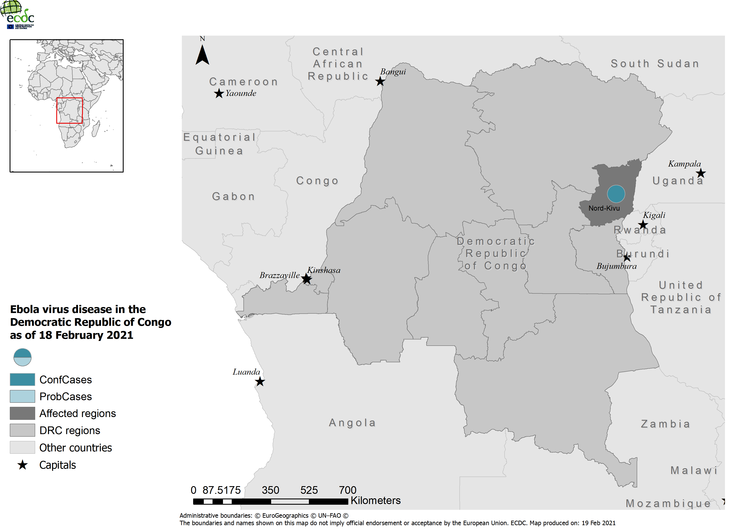
Geographic distribution of Ebola virus disease in the Democratic Republic of the Congo in 2021, as of 18 February 2021

Slide 7
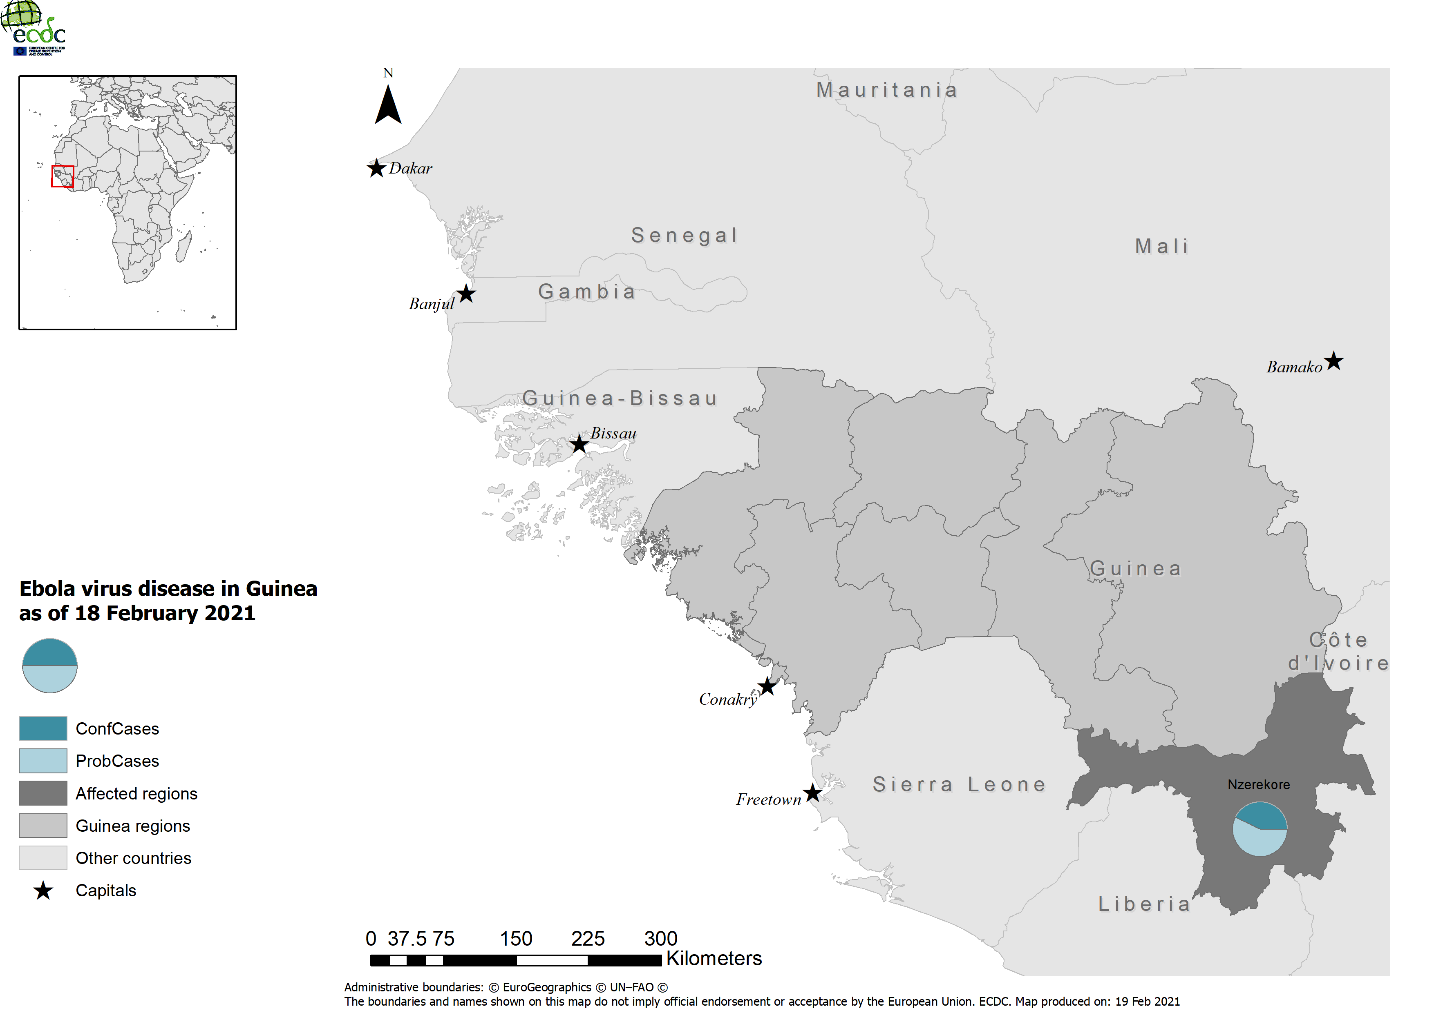
Geographic distribution of Ebola virus disease in Guinea in 2021, as of 18 February 2021

