Slide 1
Reusable maps and graphs from ECDC Communicable Disease Threats Report
Week 7, 2020
You are encouraged to reuse our maps and graphs for your own purposes and free to translate, provided the content is not altered and the source is acknowledged.

Slide 2
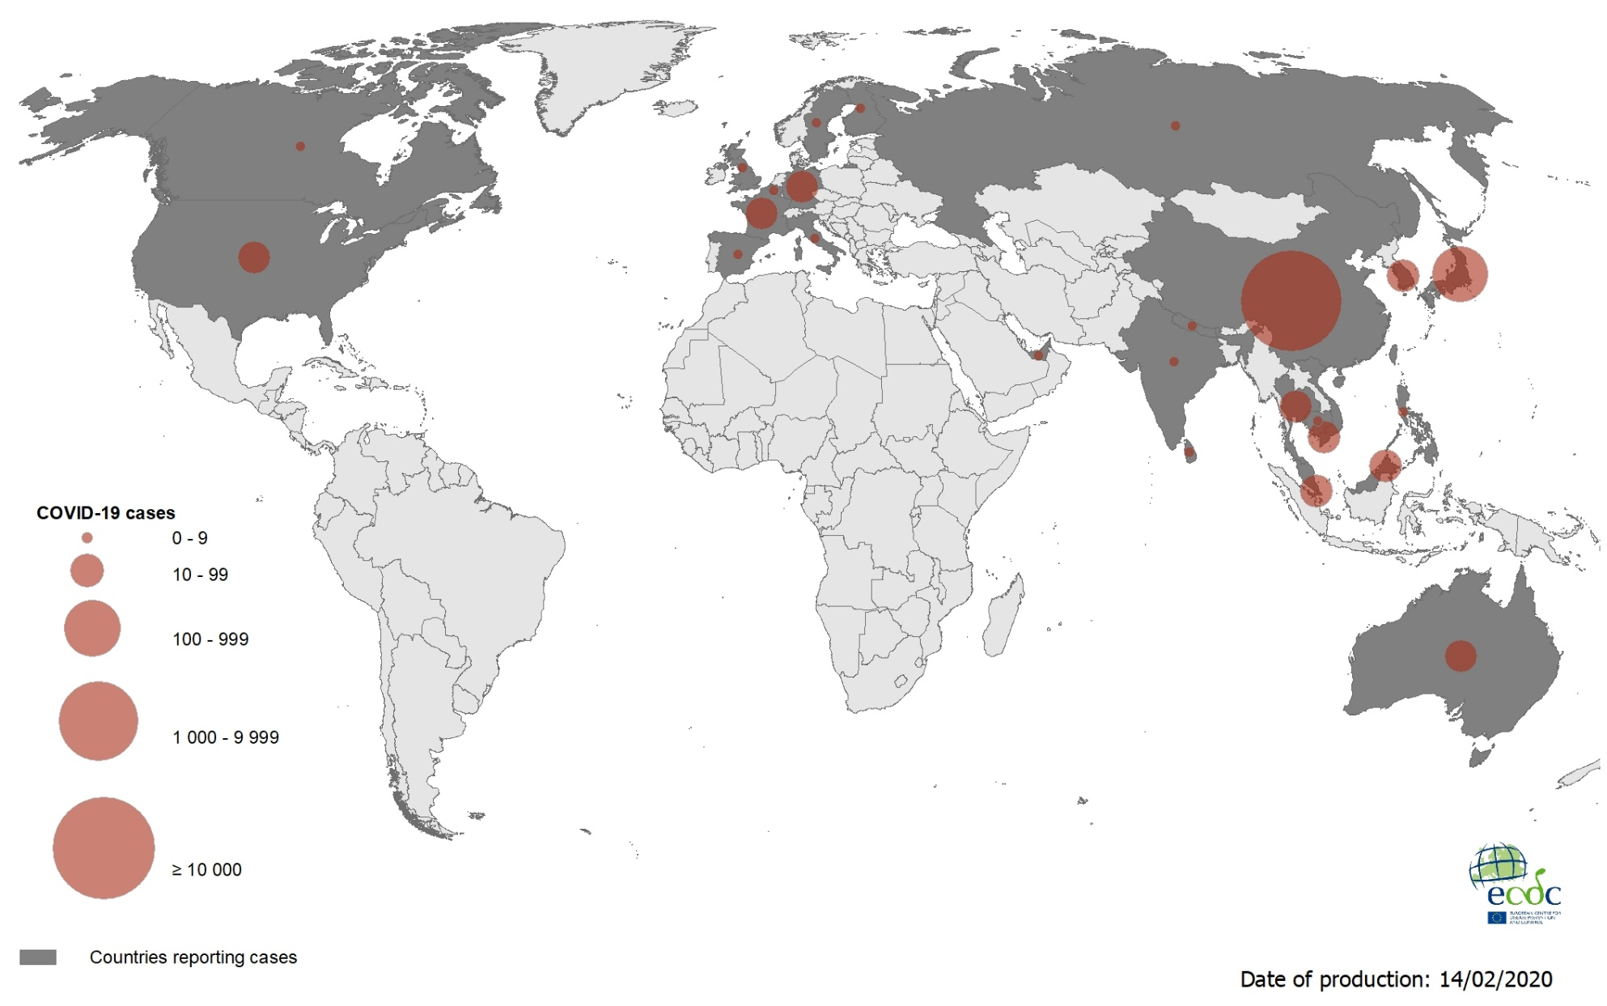
Geographical distribution of COVID-19 cases (according to the applied case definition in the country), as of 14 February 2020

Slide 3
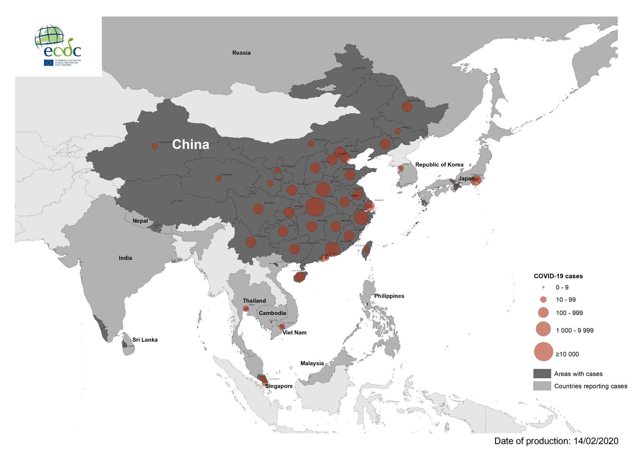
Geographical distribution of COVID-19 cases (according to the applied case definition in the country) in South-East Asia, as of 14 February 2020

Slide 4
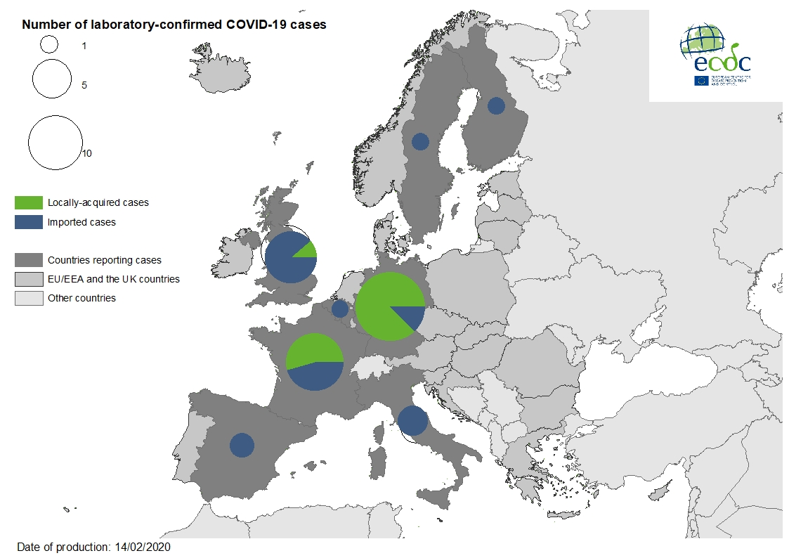
Geographic distribution of laboratory confirmed COVID-19 cases in the EU/EEA and the UK, as of 14 February 2020

Slide 5
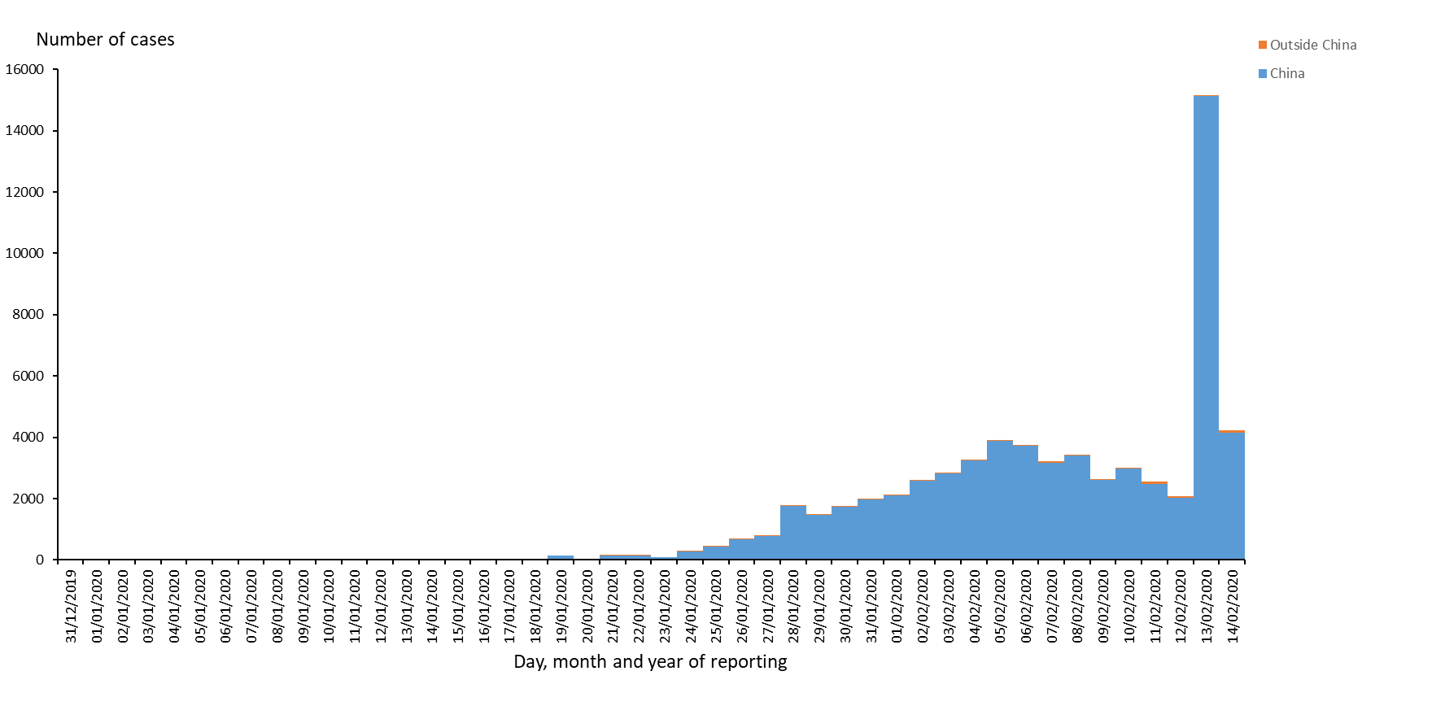
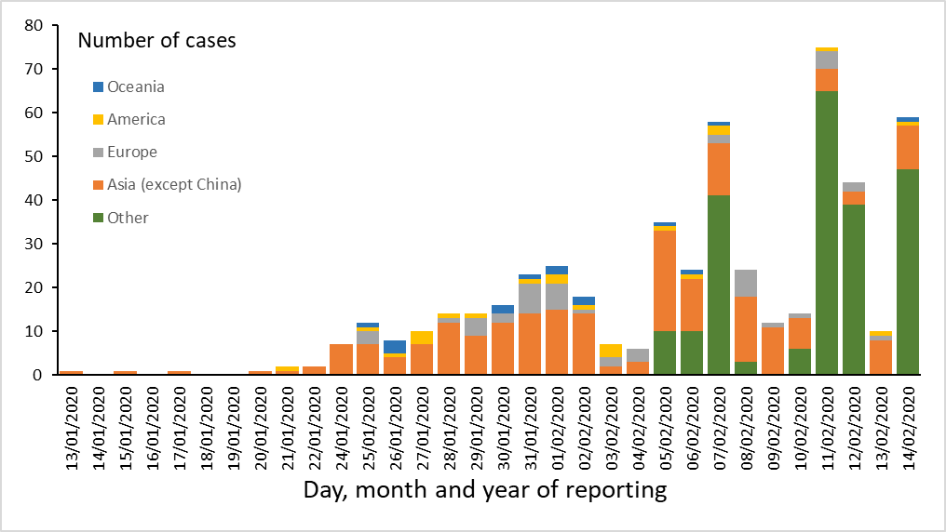
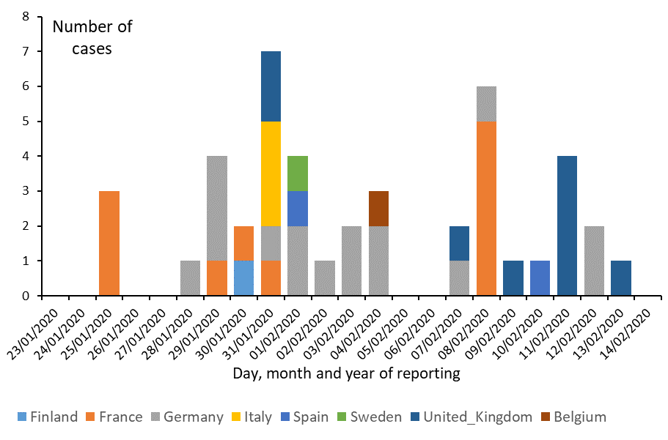
Distribution of COVID-19 cases (according to the applied case definition in the country) by country and region, as of 14 February 2020
All countries
Countries outside China Mainland
EU/EEA and the UK

Slide 6
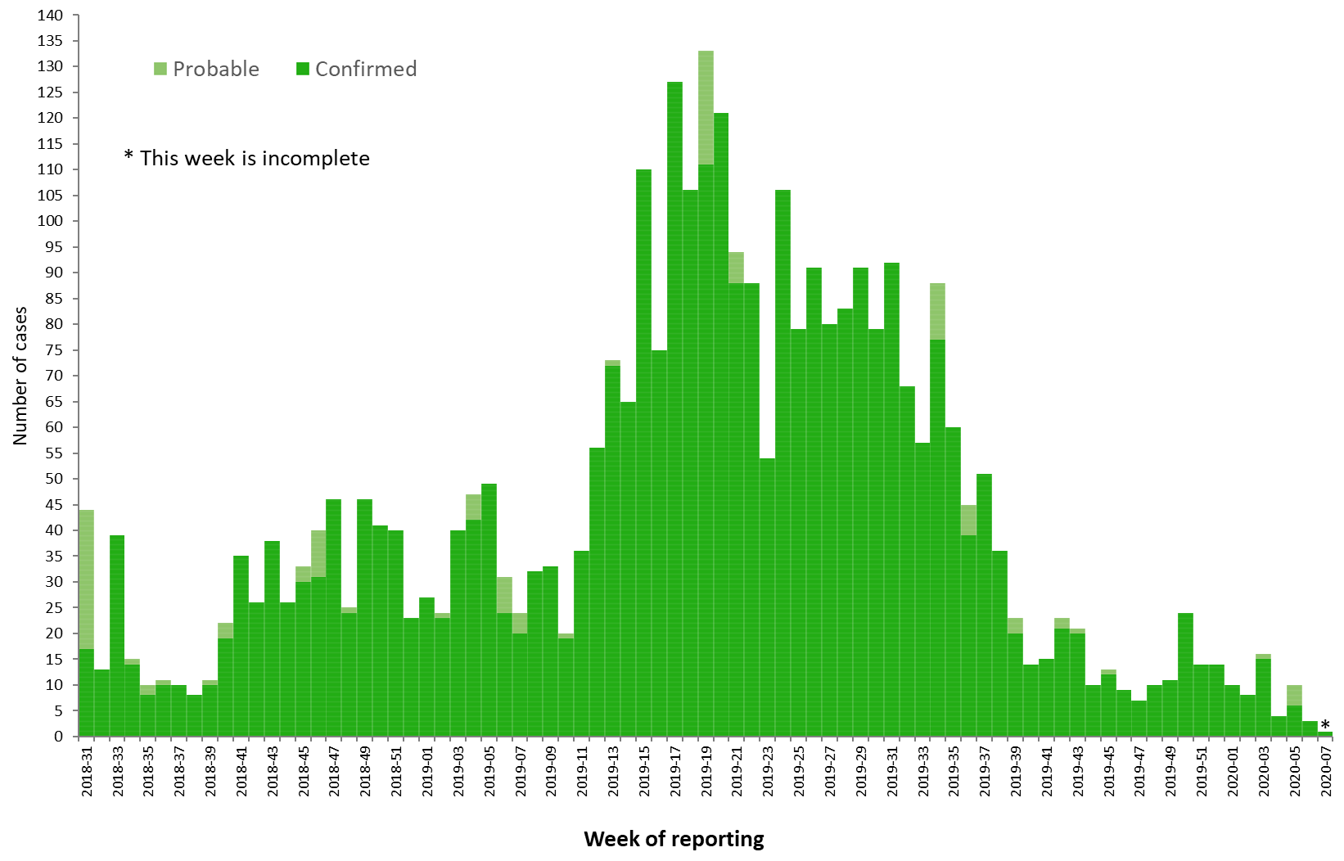
Distribution of confirmed and probable cases of Ebola virus disease by week of reporting, Democratic Republic of the Congo and Uganda, as of 11 February 2020

Slide 7
Ebola Virus Disease case distribution in DRC and Uganda as of 11 February 2020

Slide 8
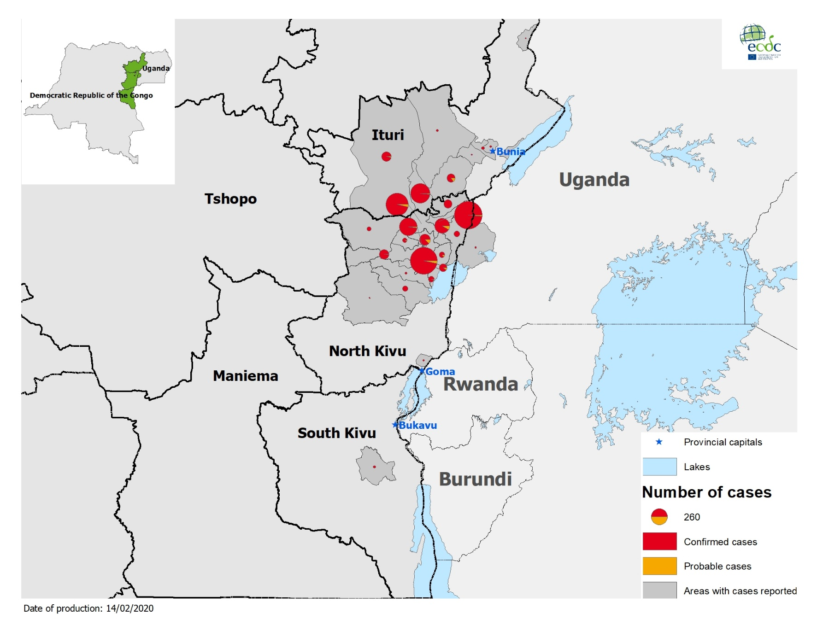
Geographical distribution of confirmed and probable cases of Ebola virus disease, Democratic Republic of the Congo and Uganda as of 11 February 2020

