Slide 1
Reusable maps and graphs from ECDC Communicable Disease Threats Report
Week 6, 2020
You are encouraged to reuse our maps and graphs for your own purposes and free to translate, provided the content is not altered and the source is acknowledged.

Slide 2
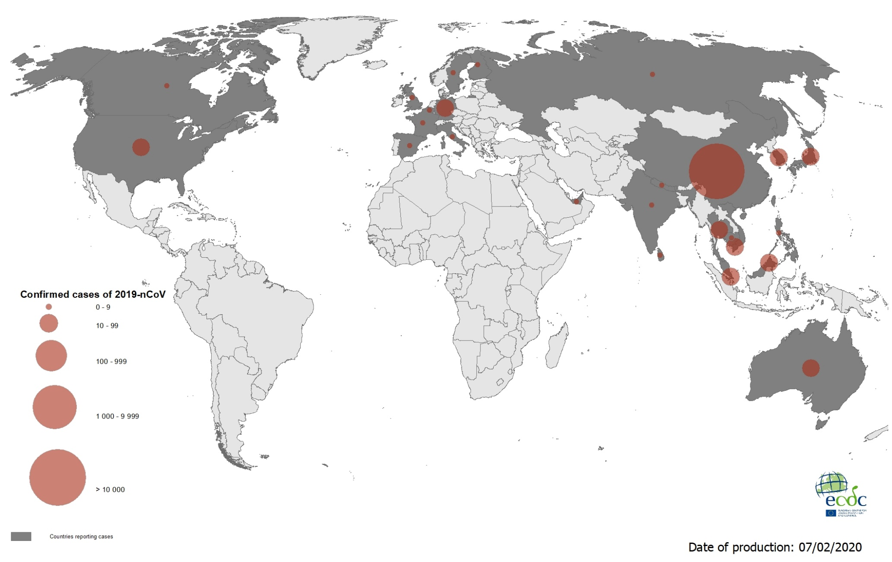
Geographical distribution of laboratory confirmed cases of 2019-nCoV, as of 7 February 2020

Slide 3
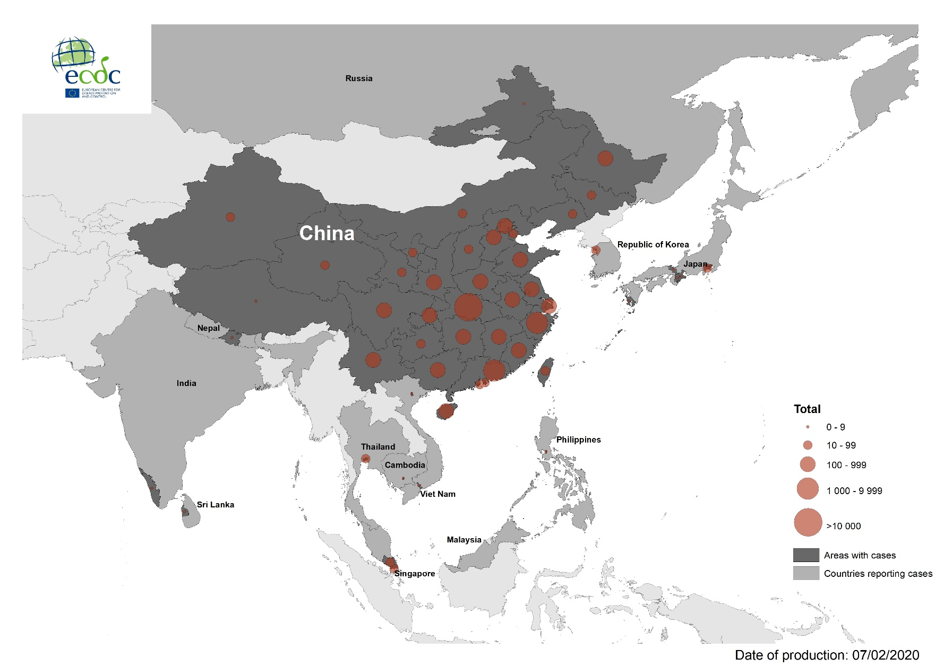
Geographical distribution of laboratory confirmed cases of 2019-nCoV in South-East Asia, as of 7 February 2020

Slide 4
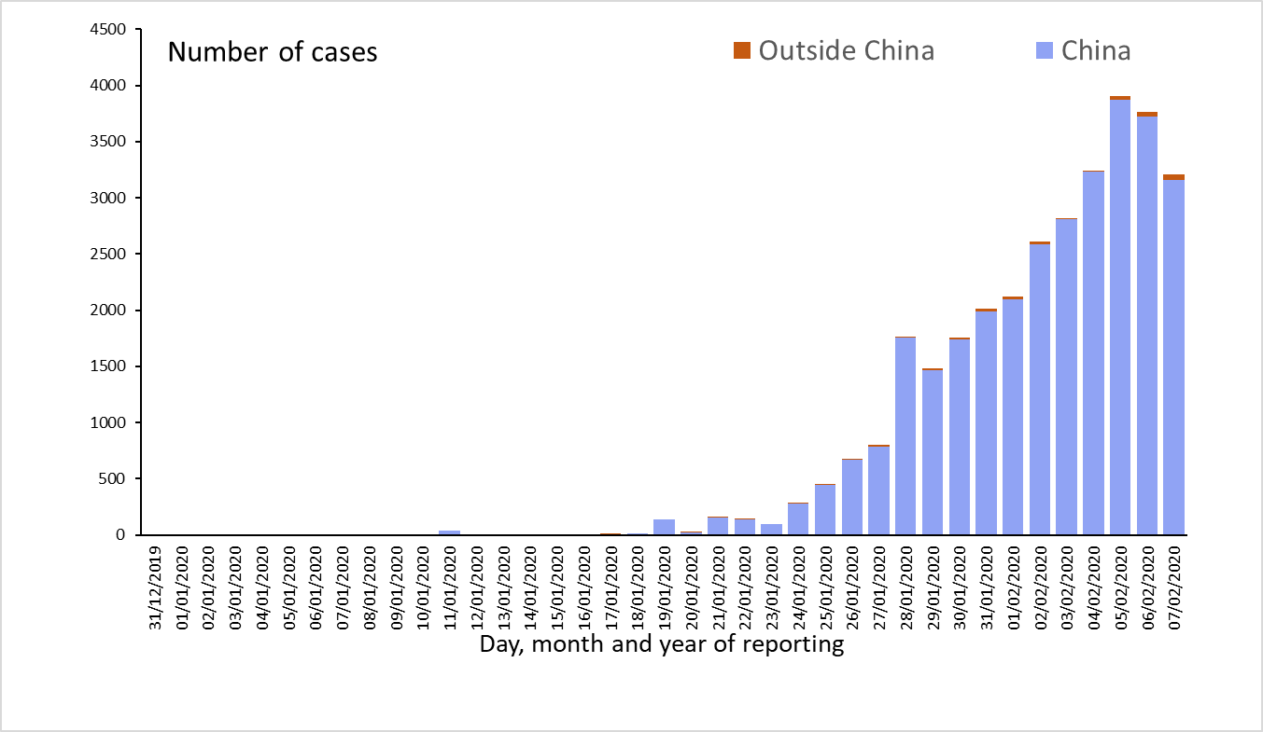
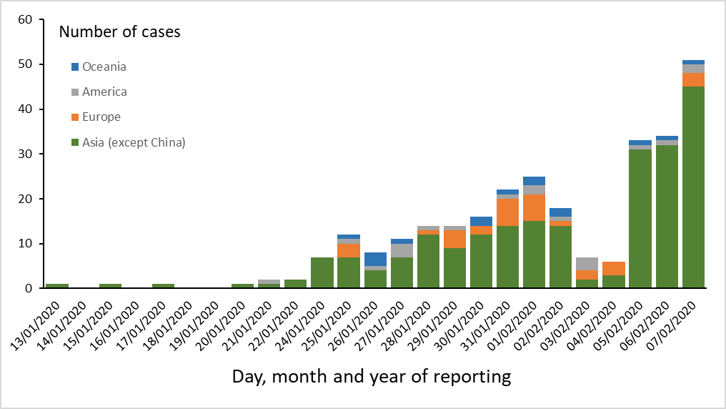
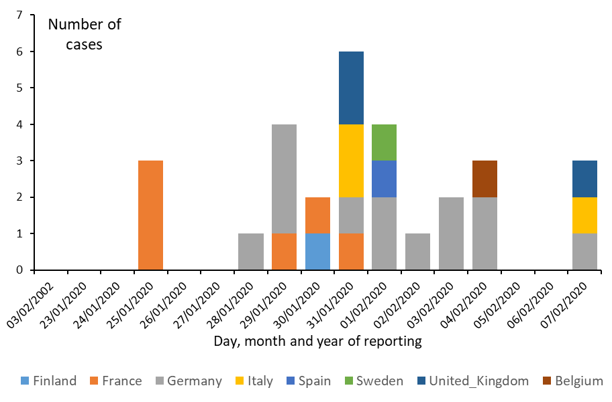
Distribution of laboratory confirmed cases of 2019-nCoV by country and region, as of 7 February 2020
All countries
Countries outside China Mainland
EU/EEA and the UK

Slide 5
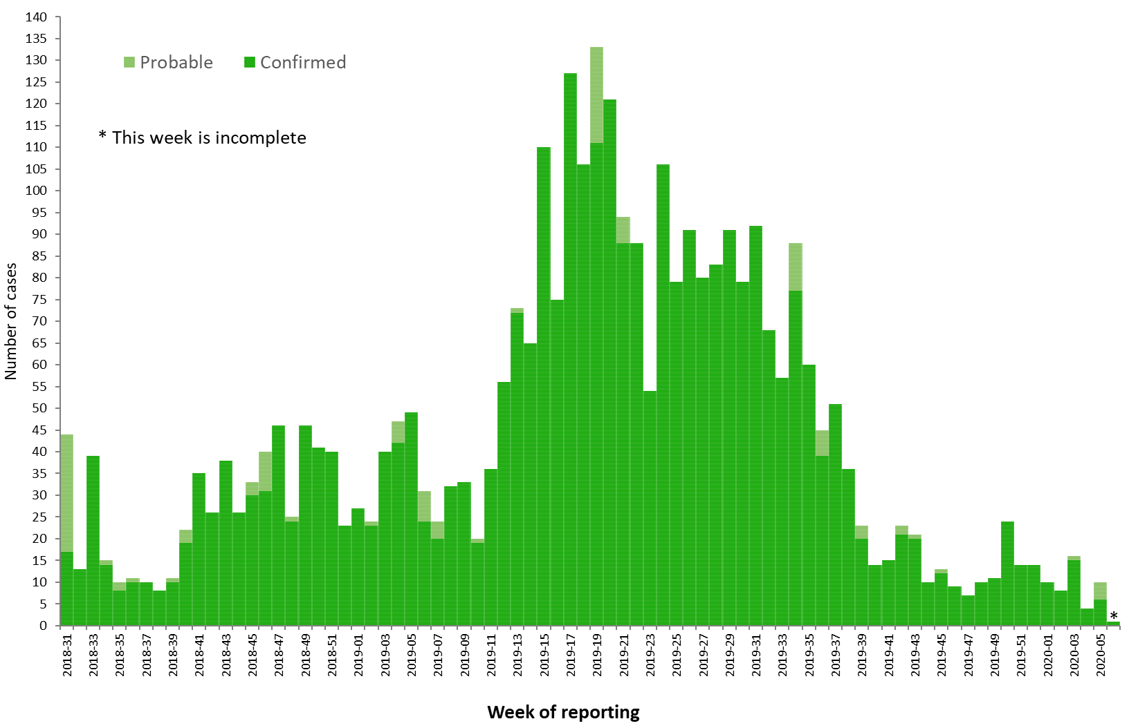
Distribution of confirmed and probable cases of Ebola virus disease by week of reporting, Democratic Republic of the Congo and Uganda, as of 4 February 2020

Slide 6
Ebola Virus Disease case distribution in DRC and Uganda as of 4 February 2020

Slide 7
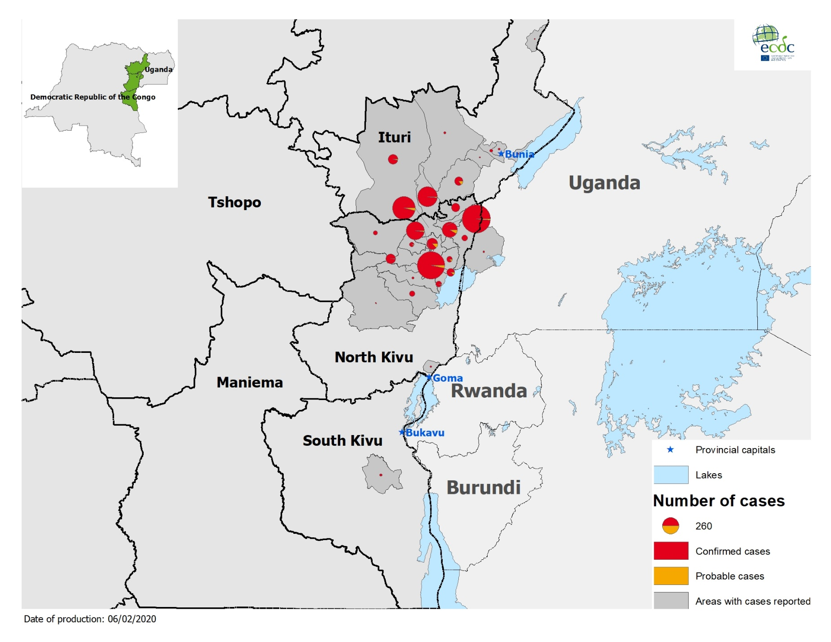
Geographical distribution of confirmed and probable cases of Ebola virus disease, Democratic Republic of the Congo and Uganda as of 4 February 2020

Slide 8
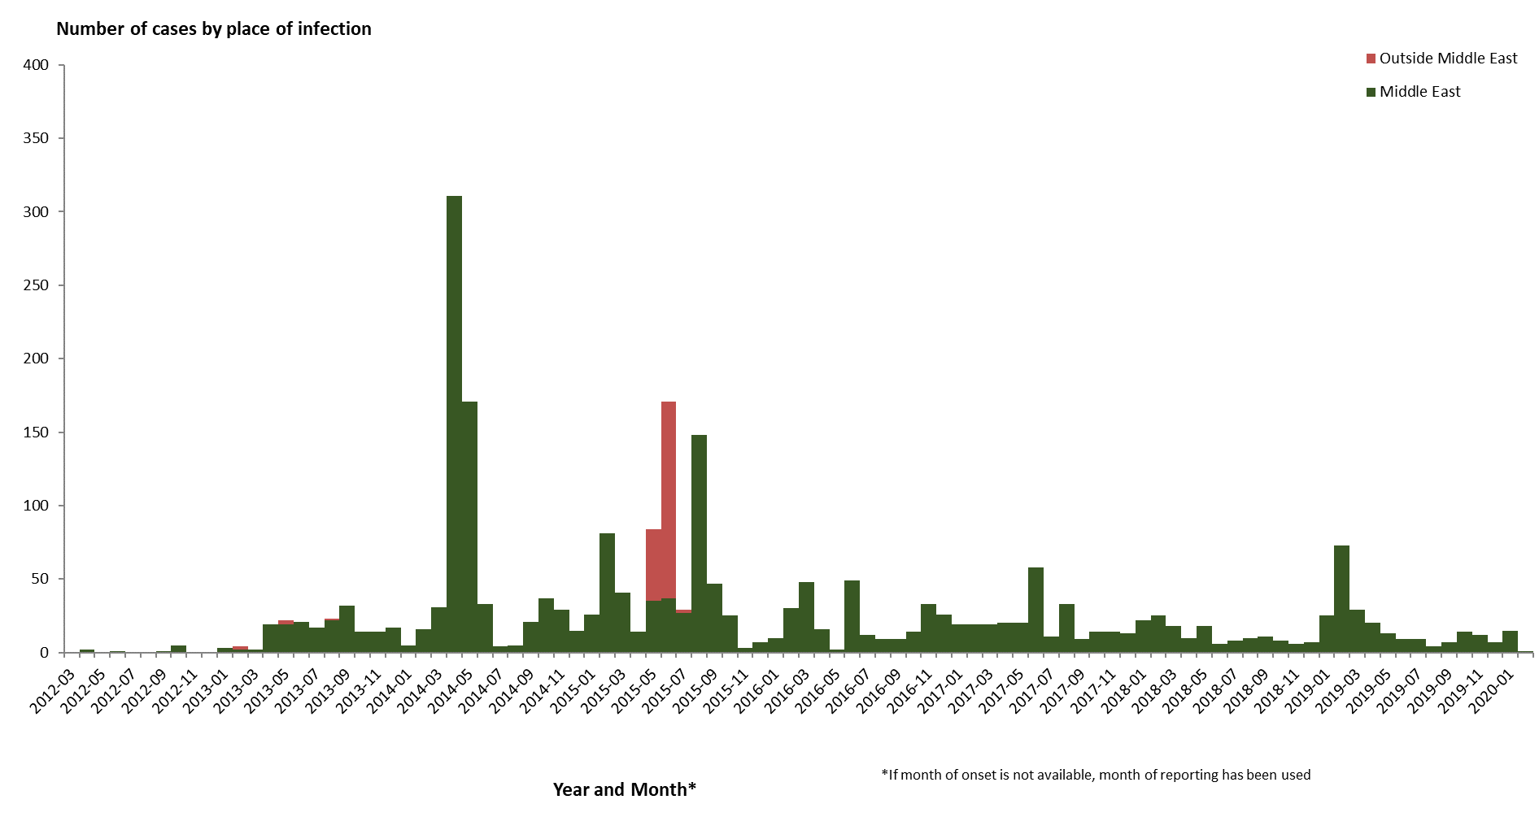
Distribution of confirmed cases of MERS-CoV by place of infection and month of onset, March 2012 – 3 February 2020

Slide 9
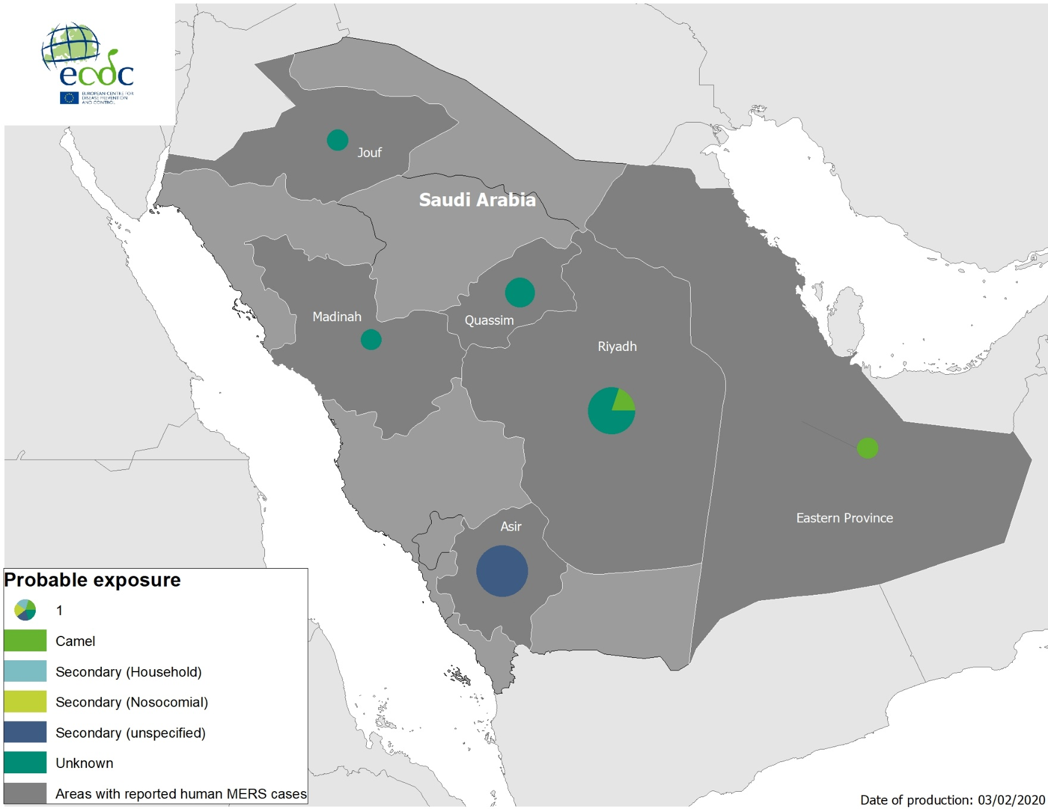
Geographical distribution of confirmed MERS-CoV cases by probable region of infection and exposure, from 1 January 2019 to 3 February 2020

Slide 10
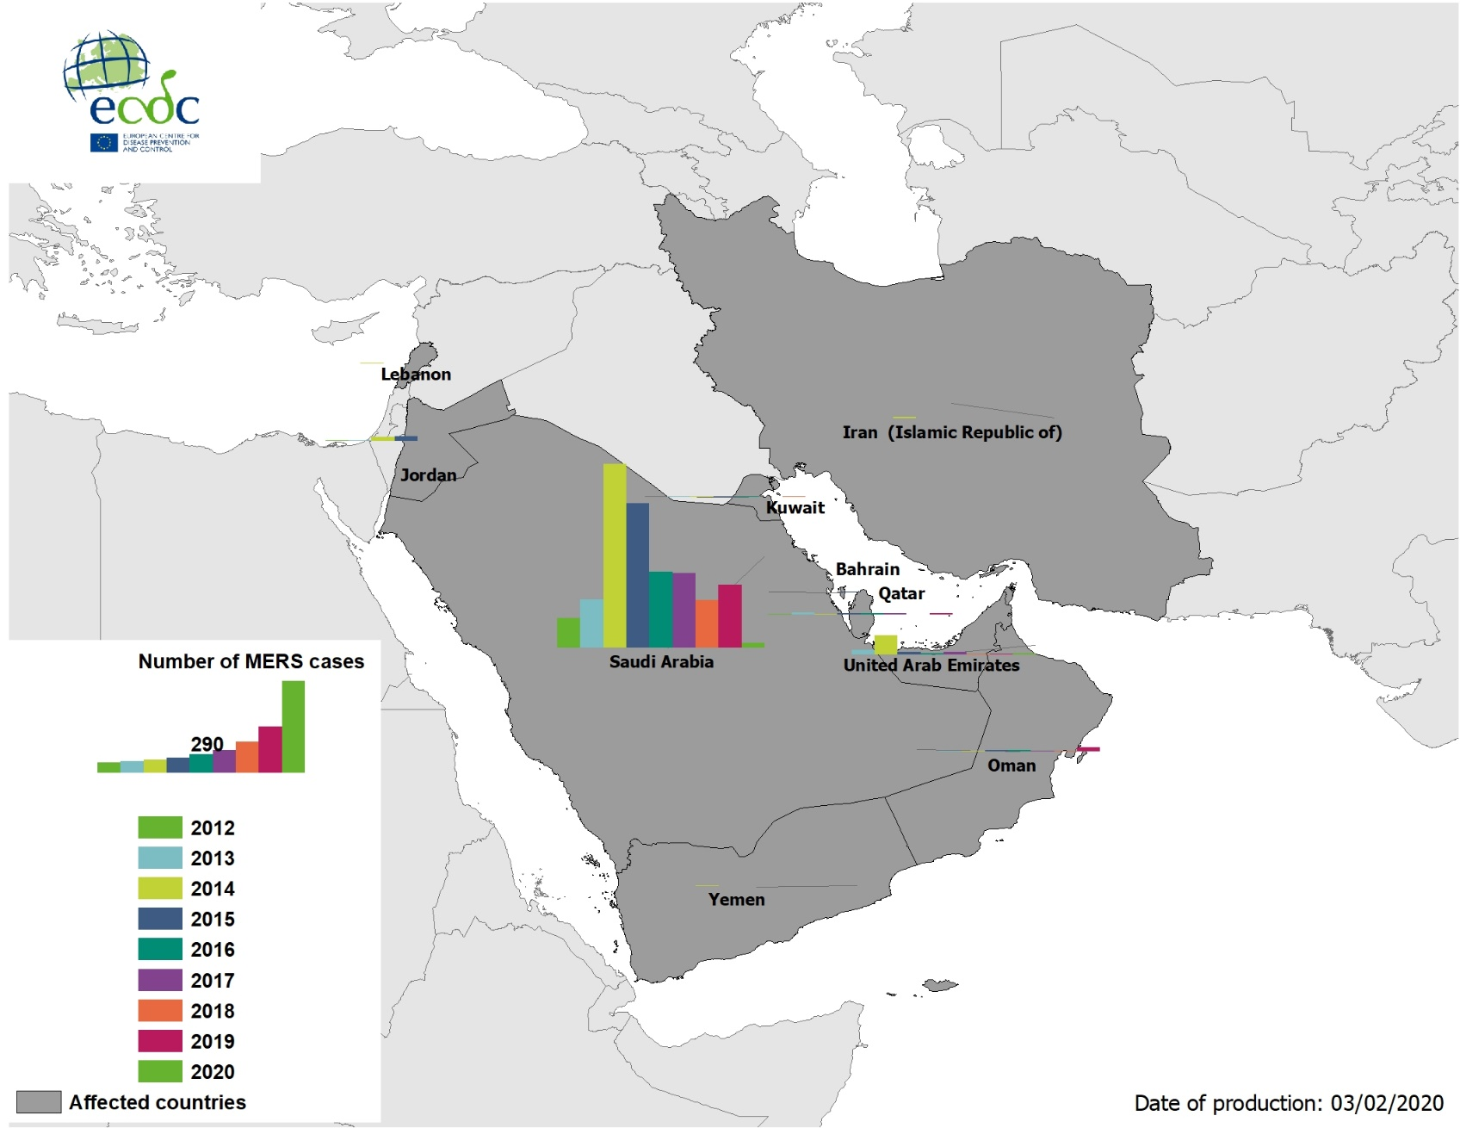
Geographical distribution of confirmed MERS-CoV cases by country of infection and year, from April 2012 to 3 February 2020

Slide 11
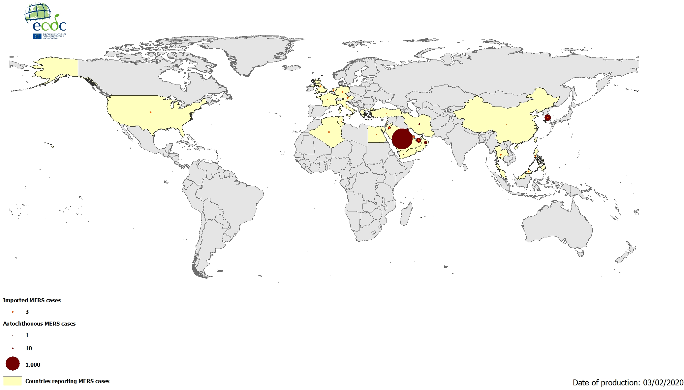
Geographical distribution of confirmed MERS-CoV cases by reporting country from April 2012 to 3 February 2020

