Slide 1
Reusable maps and graphs from ECDC Communicable Disease Threats Report
Week 50, 2019
You are encouraged to reuse our maps and graphs for your own purposes and free to translate, provided the content is not altered and the source is acknowledged.

Slide 2
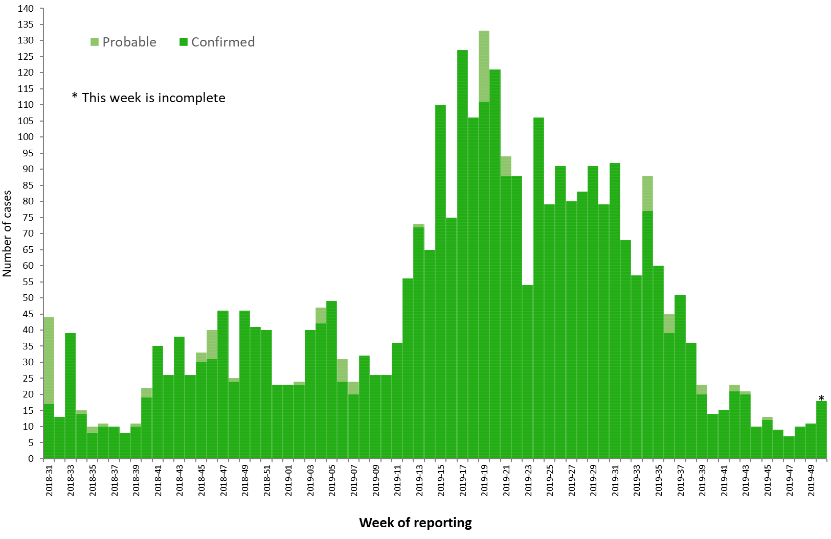
Distribution of confirmed and probable cases of Ebola virus disease by week of reporting, Democratic Republic of the Congo and Uganda, as of 11 December 2019

Slide 3
Ebola Virus Disease case distribution in DRC and Uganda as of 11 December 2019

Slide 4
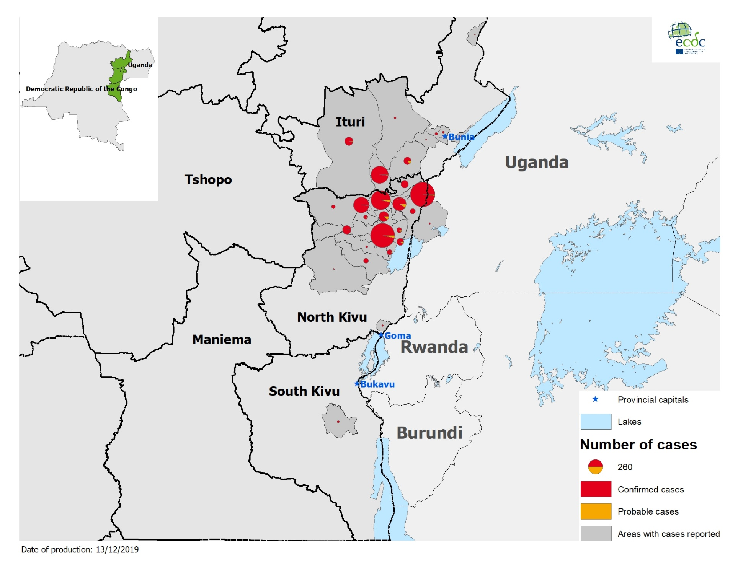
Geographical distribution of confirmed and probable cases of Ebola virus disease,
Democratic Republic of the Congo and Uganda as of 11 December 2019

Slide 5
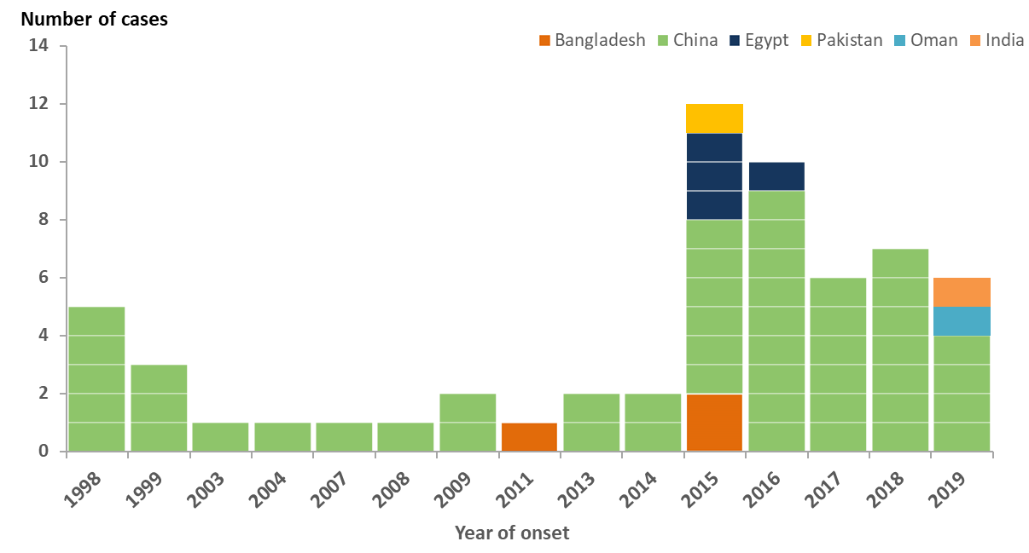
Distribution of confirmed human cases of A(H9N2) by reporting country, since 1998 and as of 11 December 2019

Slide 6
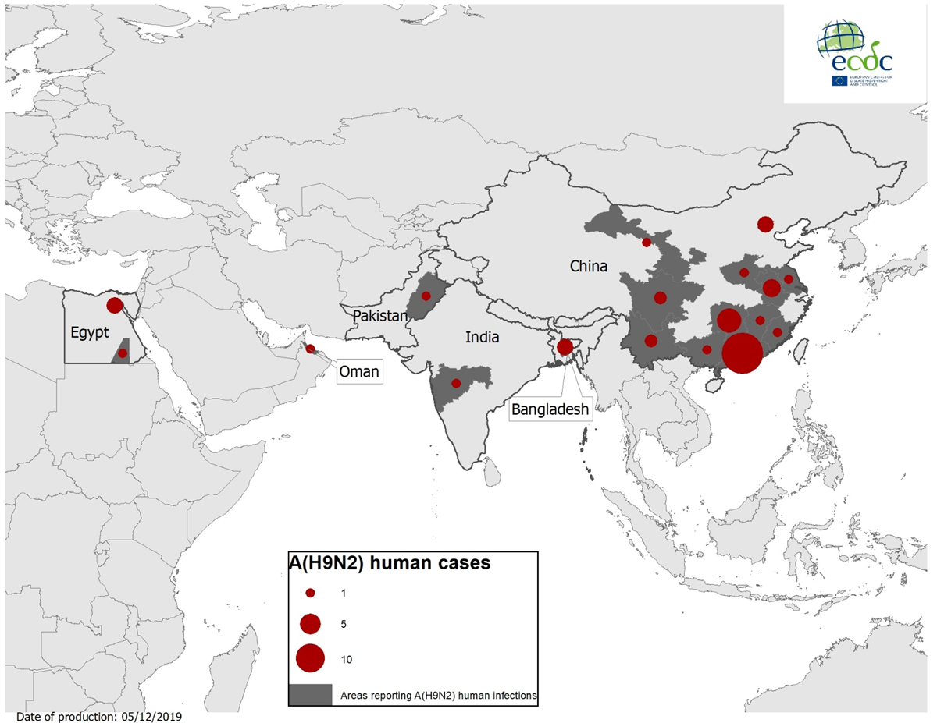
Geographical distribution of confirmed human cases of A(H9N2), since 1998 – and as of 11 December 2019

Slide 7
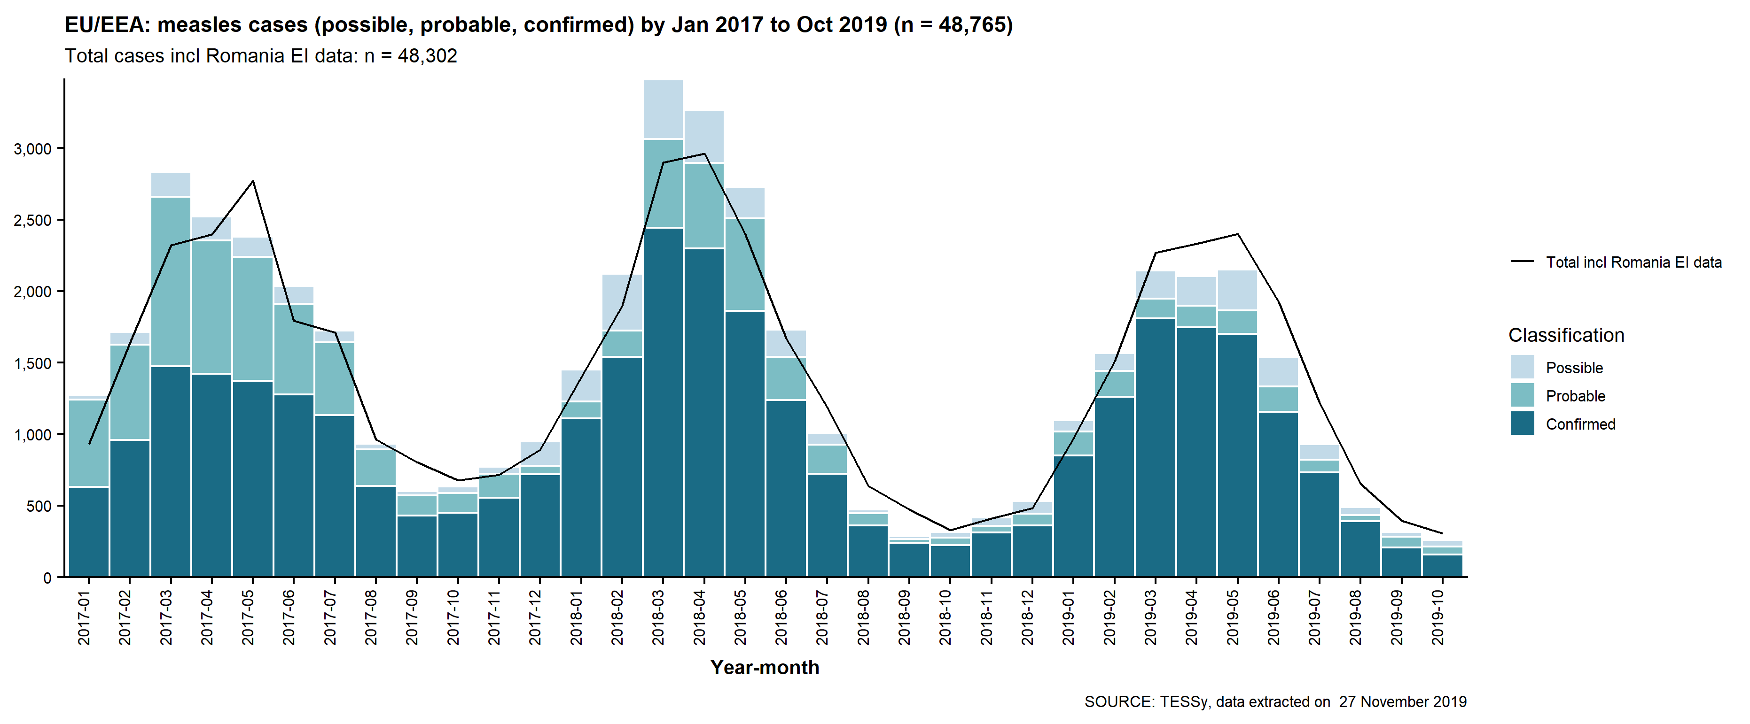
Measles cases reported in EU/EEA countries, January 2017- October 2019

Slide 8
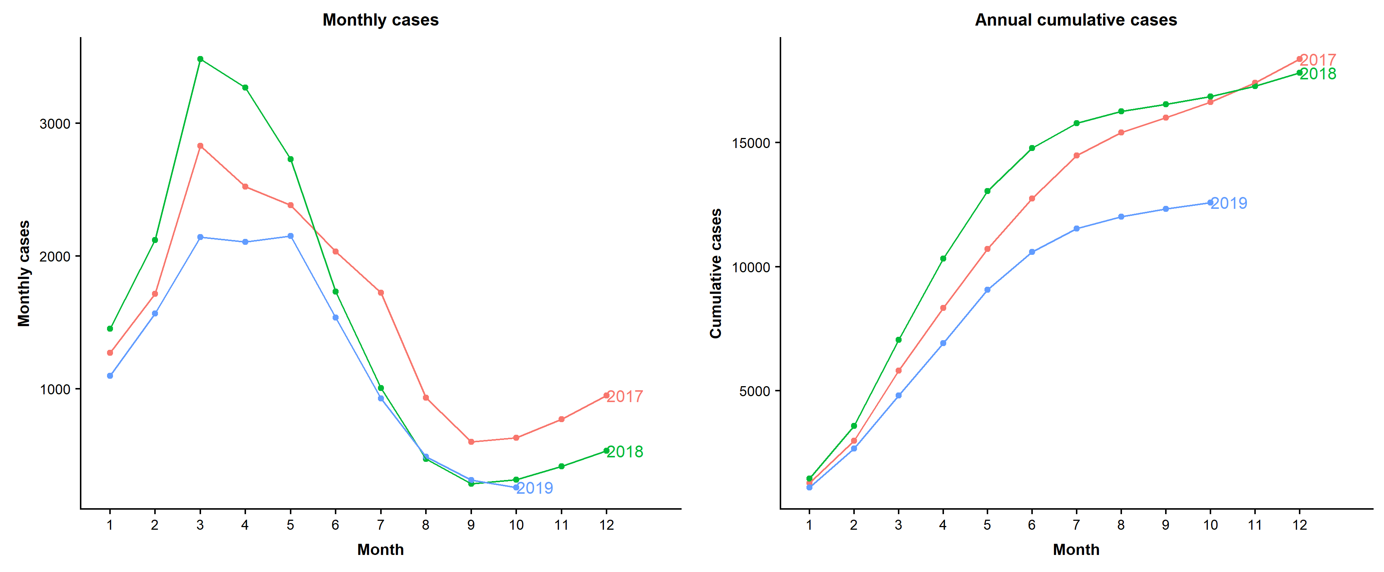
Seasonality and annual cumulative number of measles cases in EU/EEA countries, January 2017- October 2019

