Slide 1
Reusable maps and graphs from ECDC Communicable Disease Threats Report Week 50, 2023
You are encouraged to reuse our maps and graphs for your own purposes and are free to translate them, provided the content is not altered and the source is acknowledged.

Slide 2
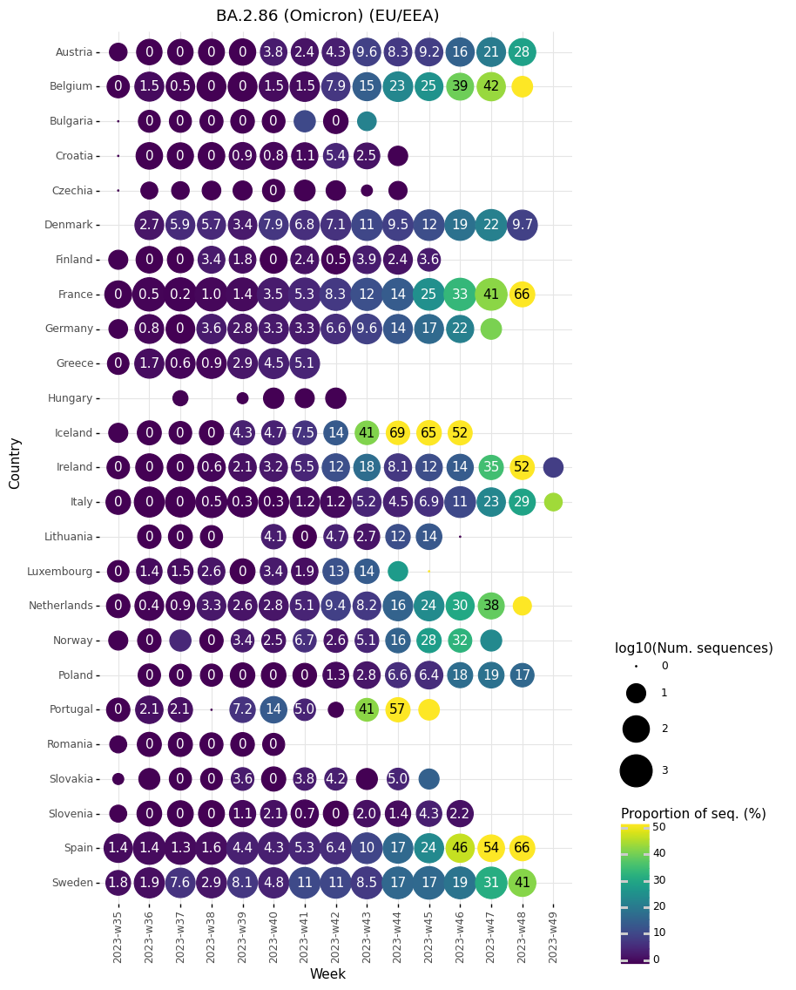
Proportion of sequences belonging to BA.2.86 lineages per sample collection week, reported by EU/EEA countries to GISAID EpiCoV as of 11 December 2023

Slide 3
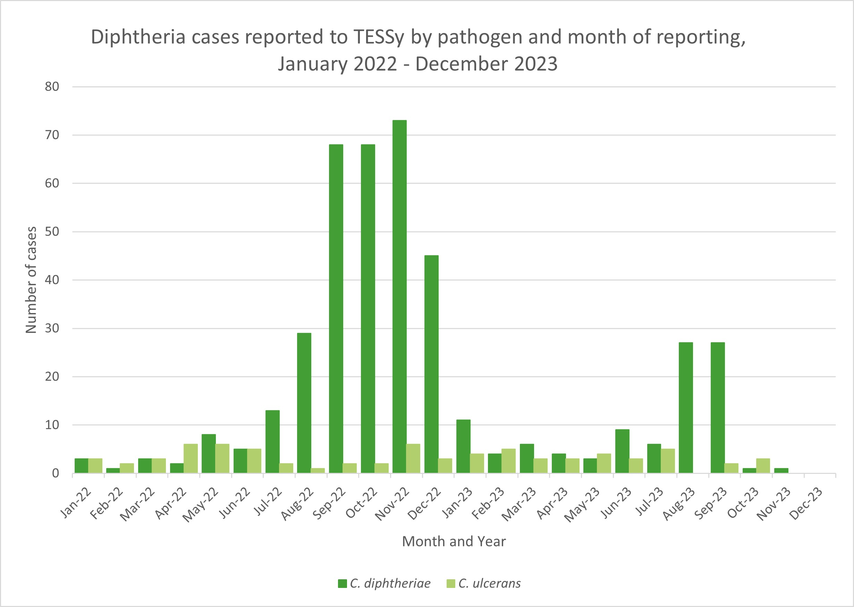
Diphtheria cases reported to TESSy by pathogen and month of reporting, January 2022 - December 2023

Slide 4
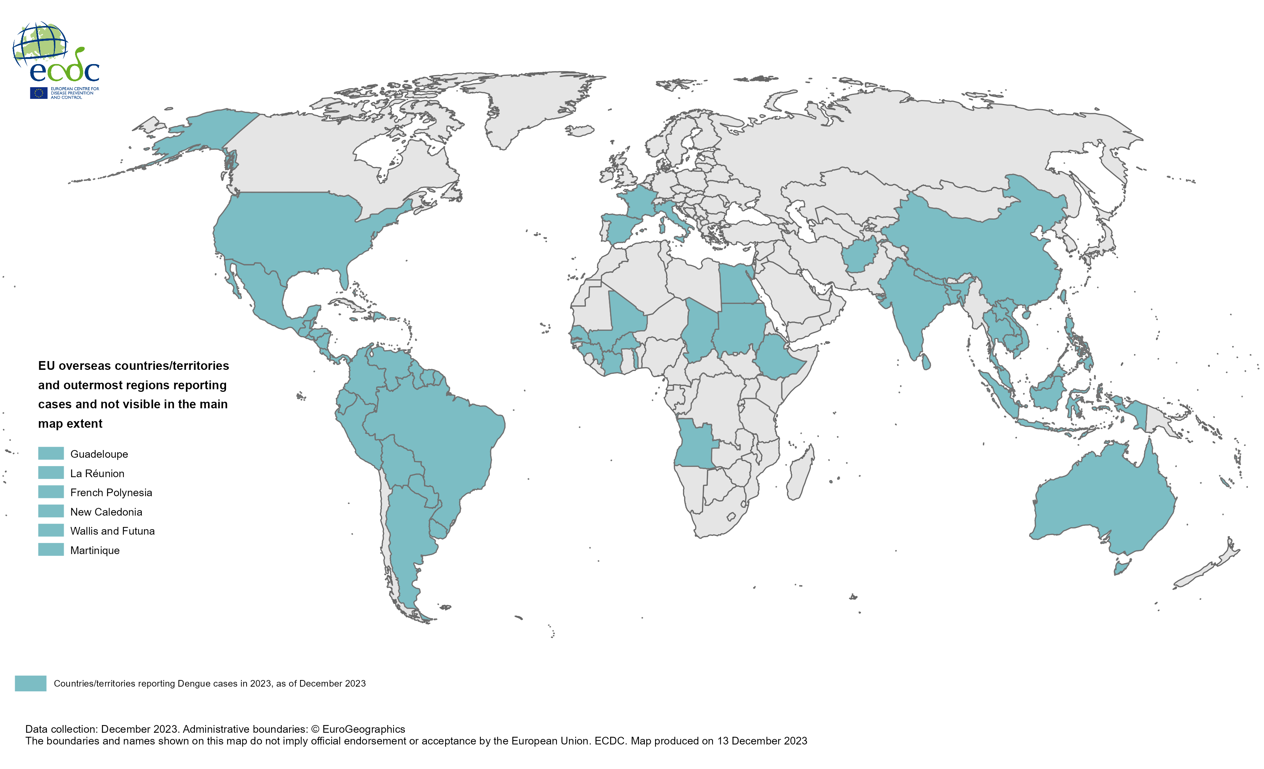
Countries/territories reporting dengue cases since the beginning of 2023 and as of December 2023

Slide 5
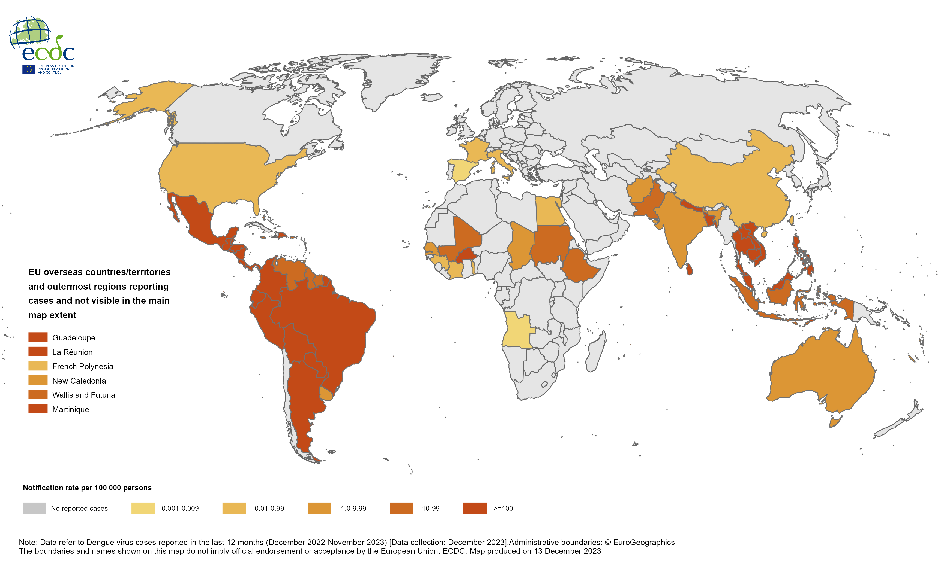
12-month dengue virus disease case notification rate per 100 000 population, December 2022-November 2023

Slide 6
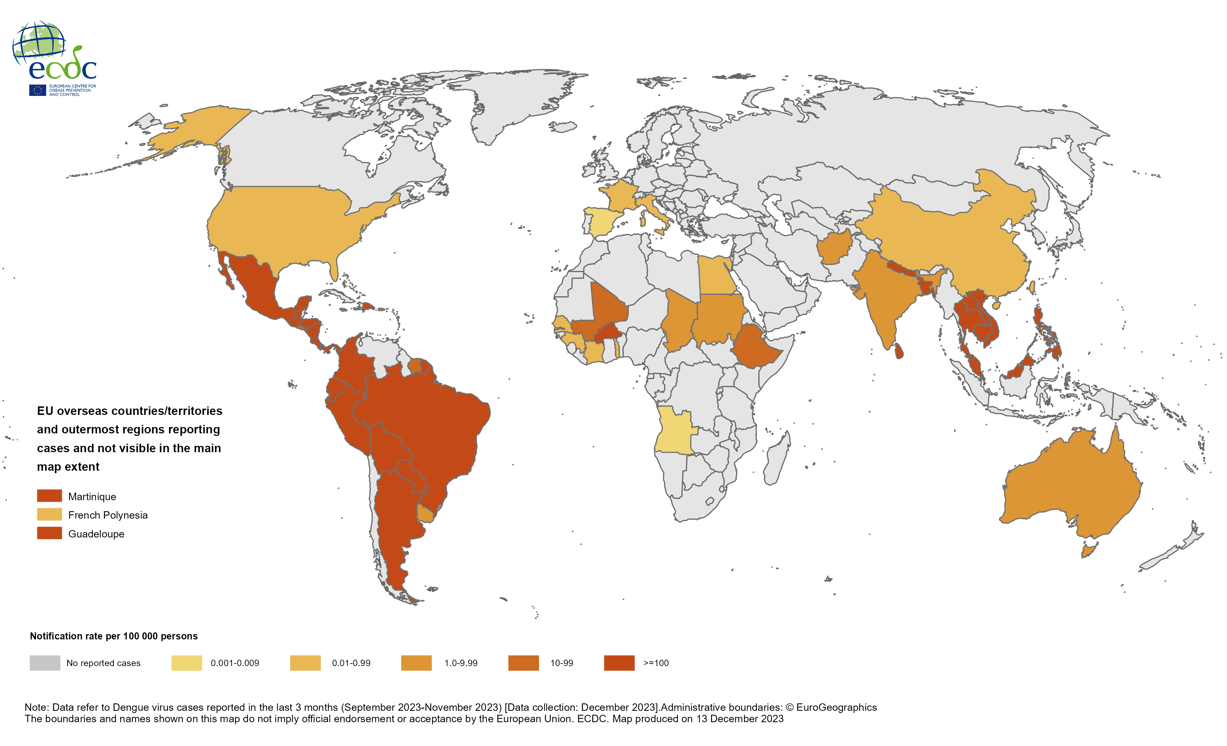
Three-month dengue virus disease case notification rate per 100 000 population, September-November 2023

Slide 7
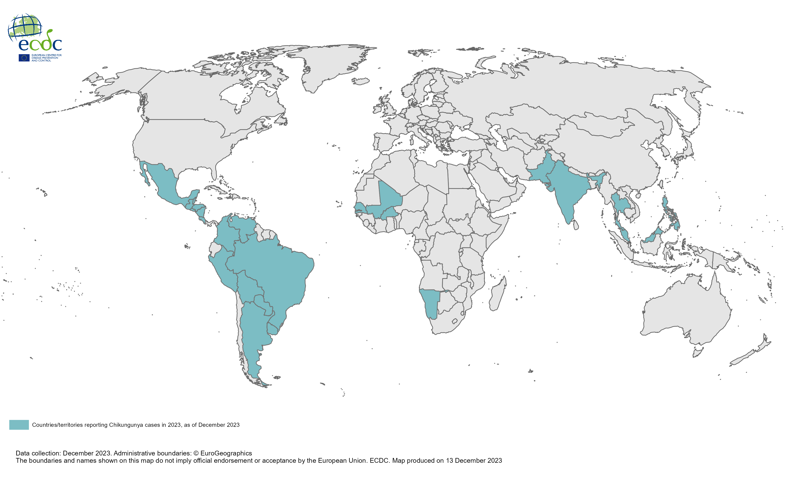
Countries/territories reporting Chikungunya cases since the beginning of 2023 and as of December 2023

Slide 8
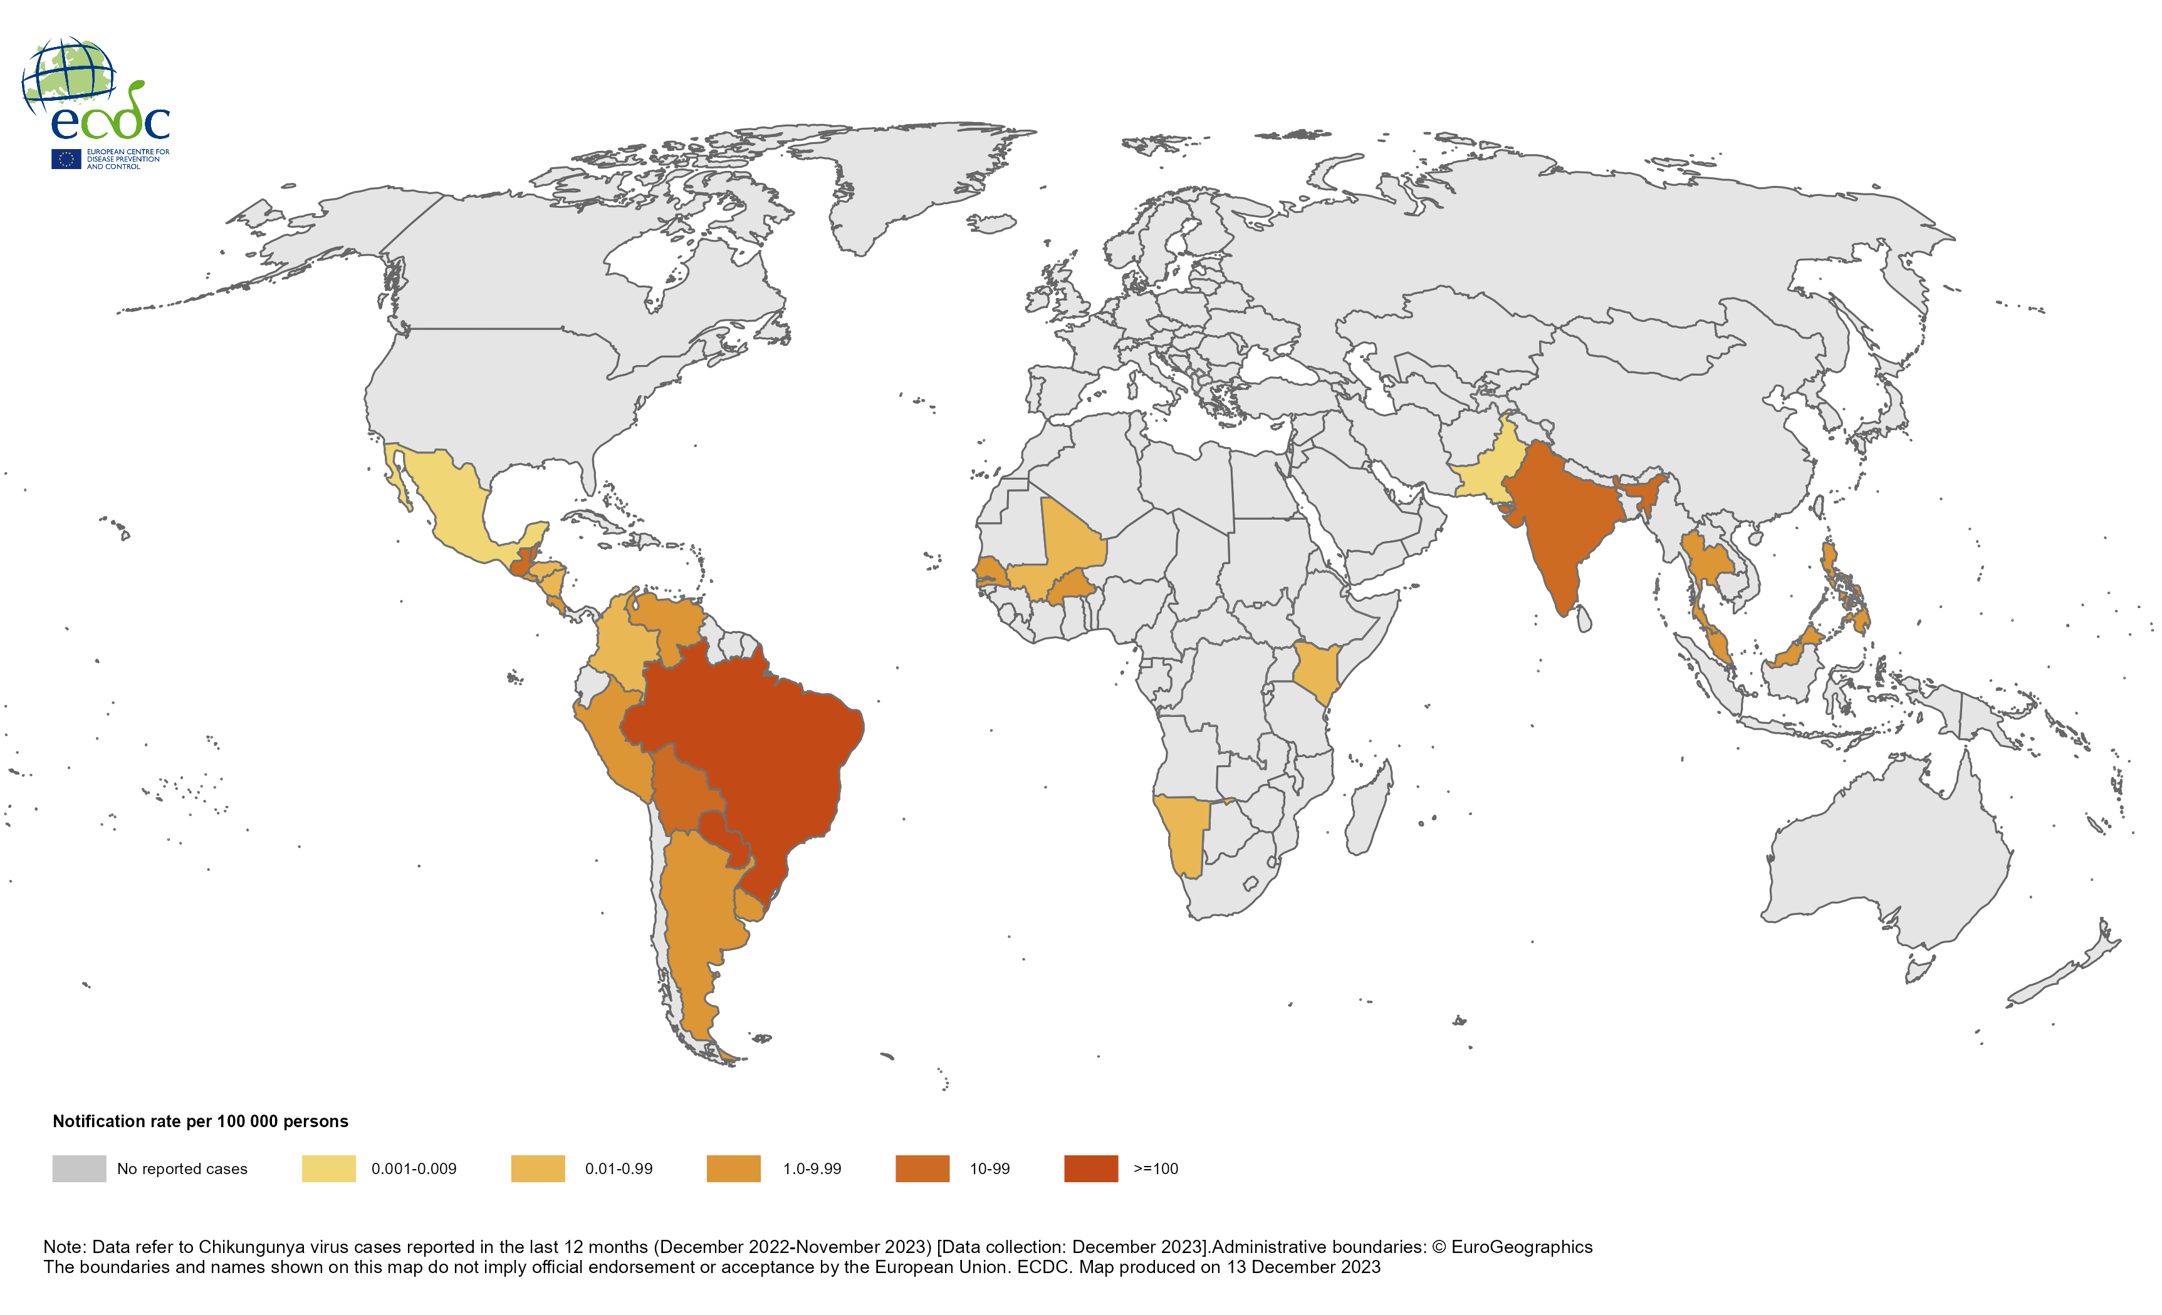
12-month Chikungunya virus disease case notification rate per 100 000 population, December 2022-November 2023

Slide 9
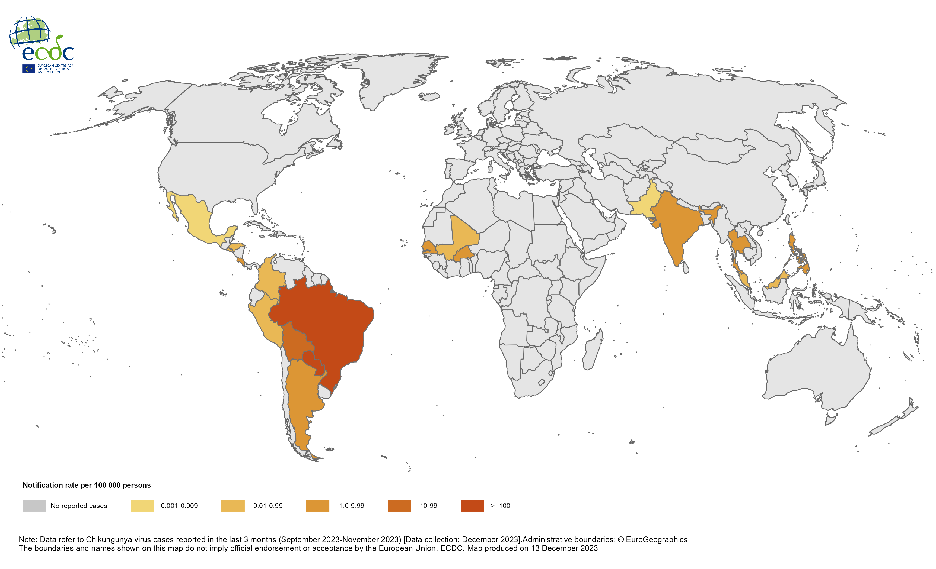
Three-month Chikungunya virus disease case notification rate per 100 000 population, September-November 2023

