Slide 1
Reusable maps and graphs from ECDC Communicable Disease Threats Report Week 5, 2019
You are encouraged to reuse our maps and graphs for your own purposes and free to translate, provided the content is not altered and the source is acknowledged.

Slide 2
Distribution of confirmed and probable cases of Ebola virus disease, North Kivu and Ituri Provinces, Democratic Republic of the Congo, as of 30 January 2019

Slide 3
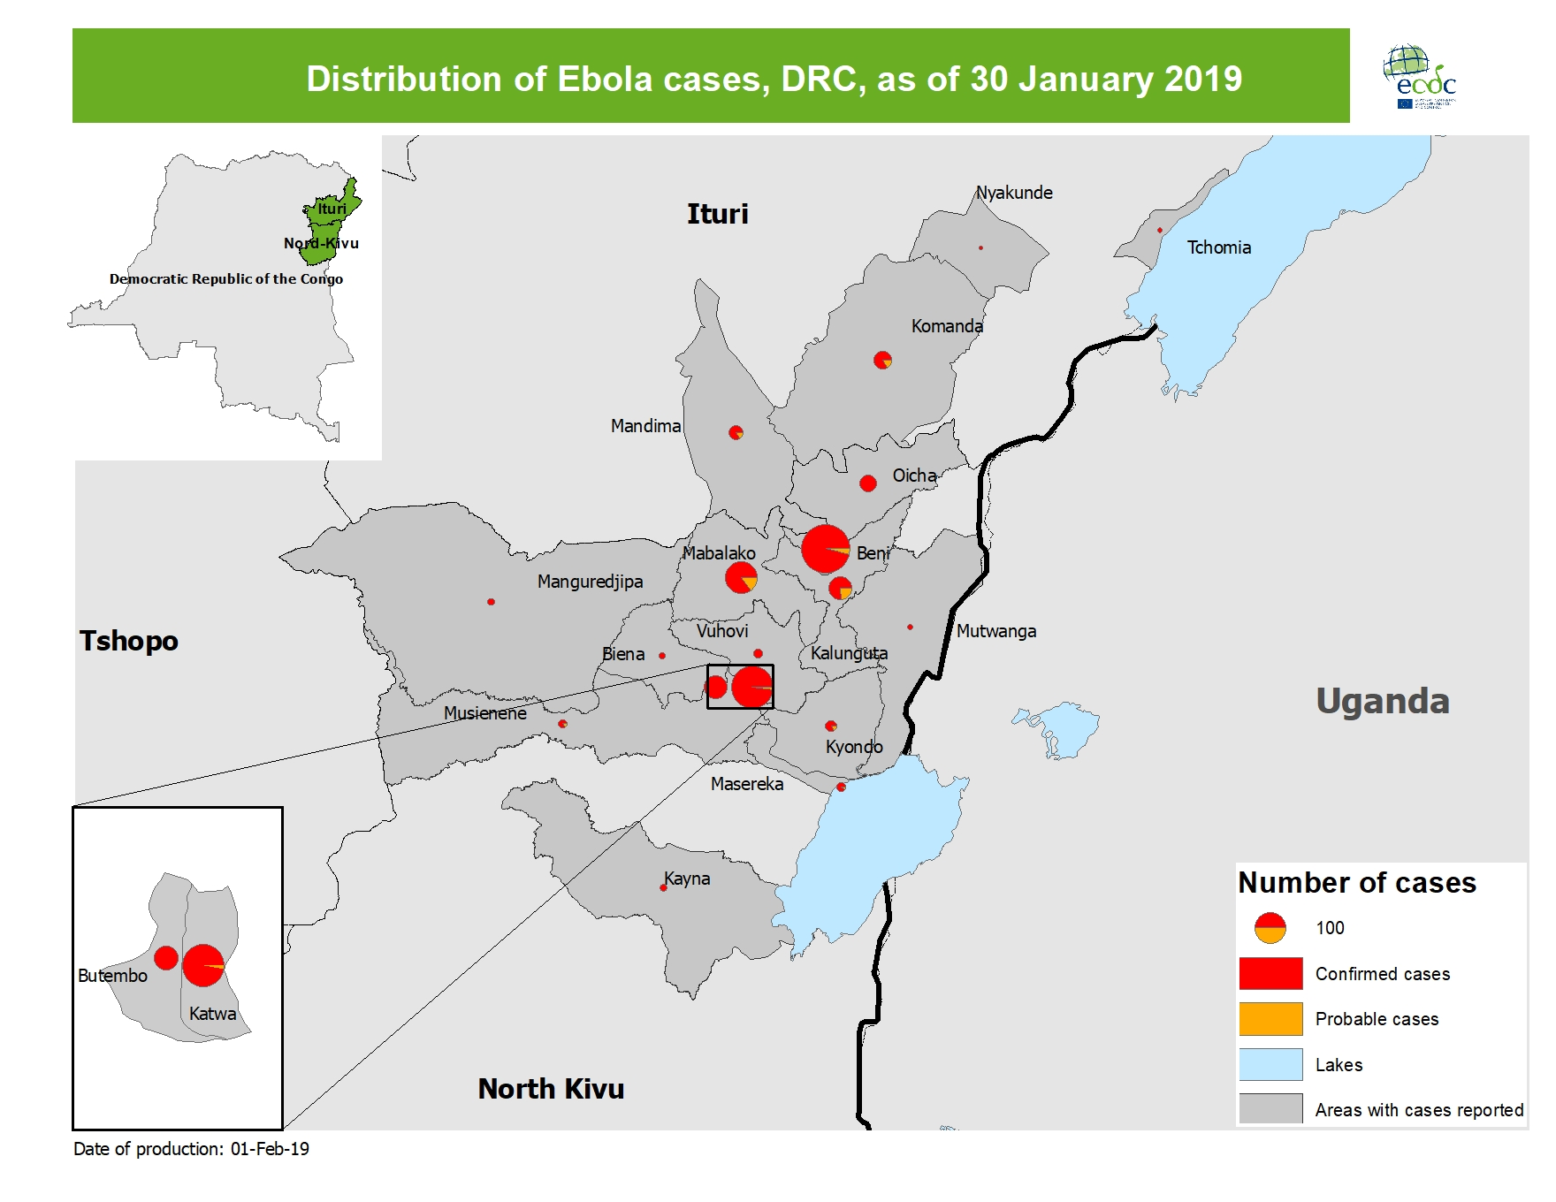
Geographical distribution of confirmed and probable cases of Ebola virus disease, North Kivu and Ituri Provinces, Democratic Republic of the Congo, as of week 5, 2019

Slide 4
Distribution of confirmed human Rift Valley fever cases, Mayotte,
11 December 2018 to 28 January 2019
Adapted from CIRE Océan Indien

Slide 5
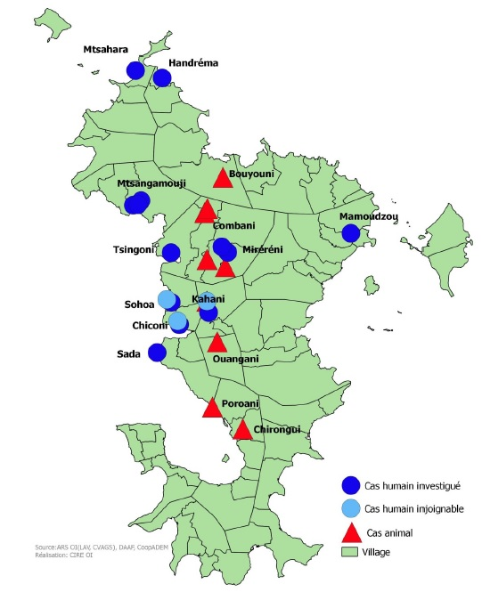
Distribution of human Rift Valley fever cases and ruminants, Mayotte, 11 December 2018 to 28 January 2019
Adapted from CIRE Océan Indien

Slide 6
Distribution of confirmed human cases of A(H9N2) by reporting country, 1998–31 January 2019

Slide 7
Geographical distribution of confirmed human cases of A(H9N2), 1998–31 January 2019

Slide 8
Yellow fever risk areas in Brazil, as of 30 January 2019

