Slide 1
Reusable maps and graphs from ECDC Communicable Disease Threats Report
Week 5, 2024
You are encouraged to reuse our maps and graphs for your own purposes and are free to translate them, provided the content is not altered and the source is acknowledged.

Slide 2
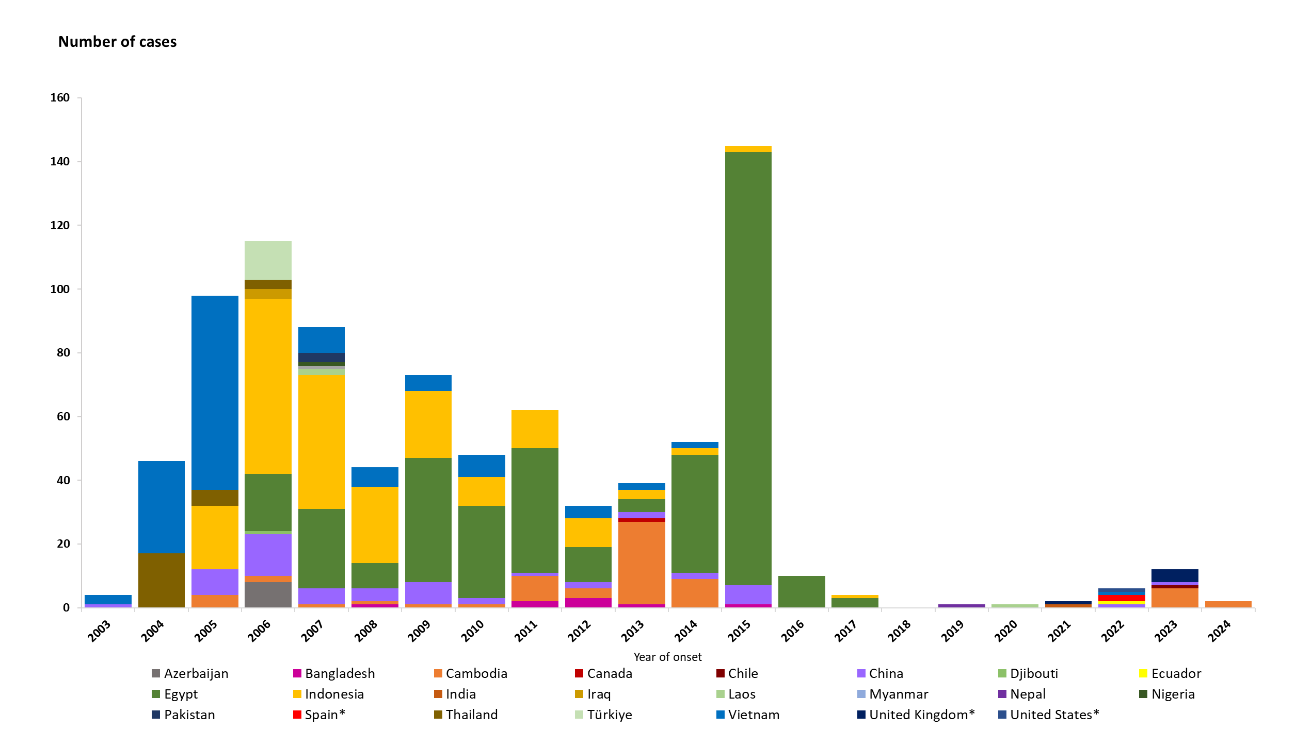
Confirmed human cases of avian influenza A(H5N1) virus infection by year of onset and country, 2003 to 29 January 2024 (n = 884*)
* Includes six detections due to suspected environmental contamination and no evidence of infection reported in 2022 from Spain (2) and the United States (1), and in 2023 from the United Kingdom (3).

Slide 3
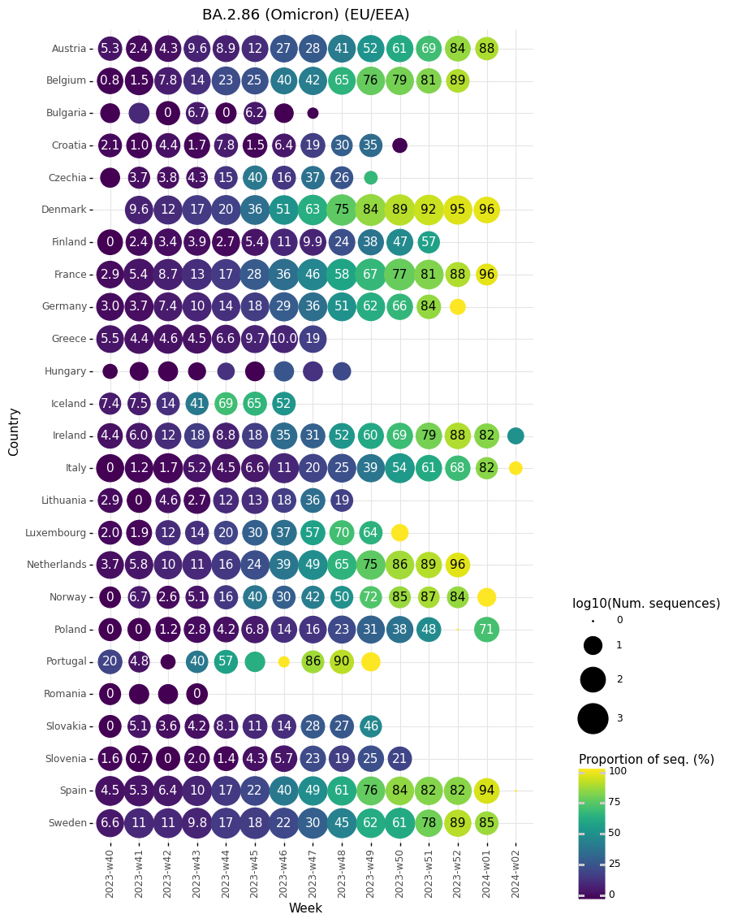
Proportion of sequences belonging to BA.2.86 lineages per sample collection week, reported by EU/EEA countries to GISAID EpiCoV as of 15 January 2024

