Slide 1
Reusable maps and graphs from ECDC Communicable Disease Threats Report
Week 4, 2020
You are encouraged to reuse our maps and graphs for your own purposes and free to translate, provided the content is not altered and the source is acknowledged.

Slide 2
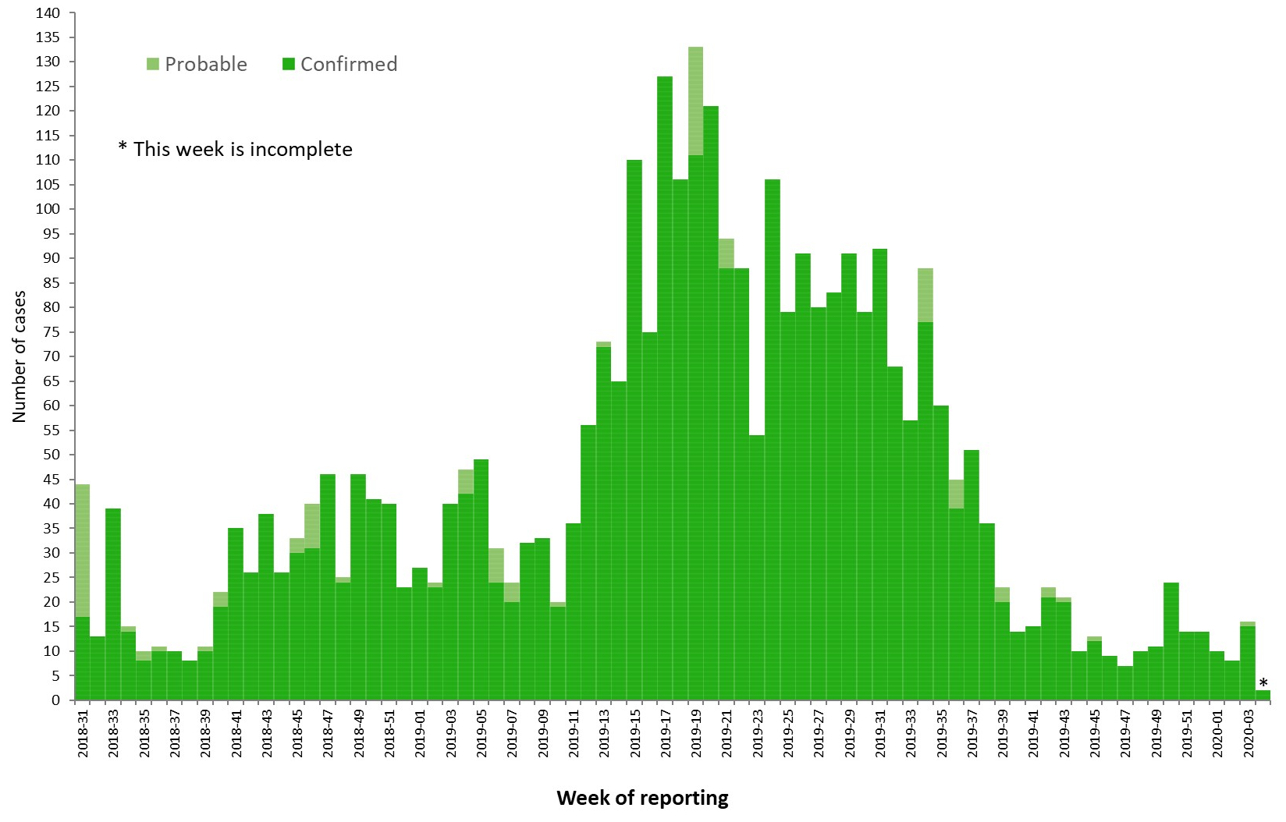
Distribution of confirmed and probable cases of Ebola virus disease by week of reporting, Democratic Republic of the Congo and Uganda, as of 22 January 2020

Slide 3
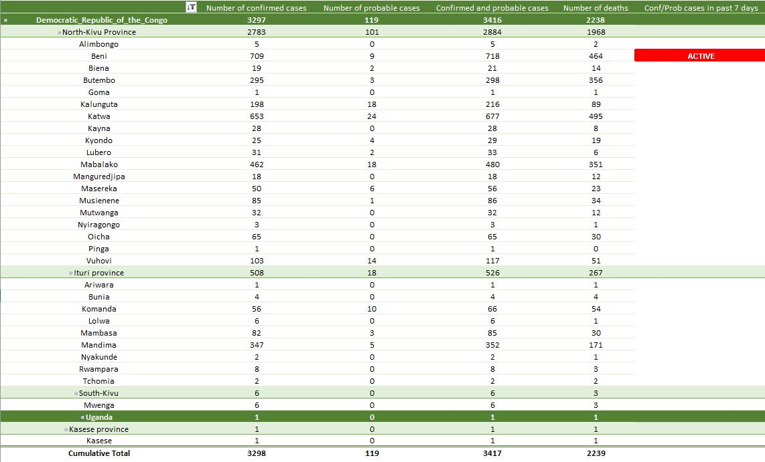
Ebola Virus Disease case distribution in DRC and Uganda as of 22 January 2020

Slide 4
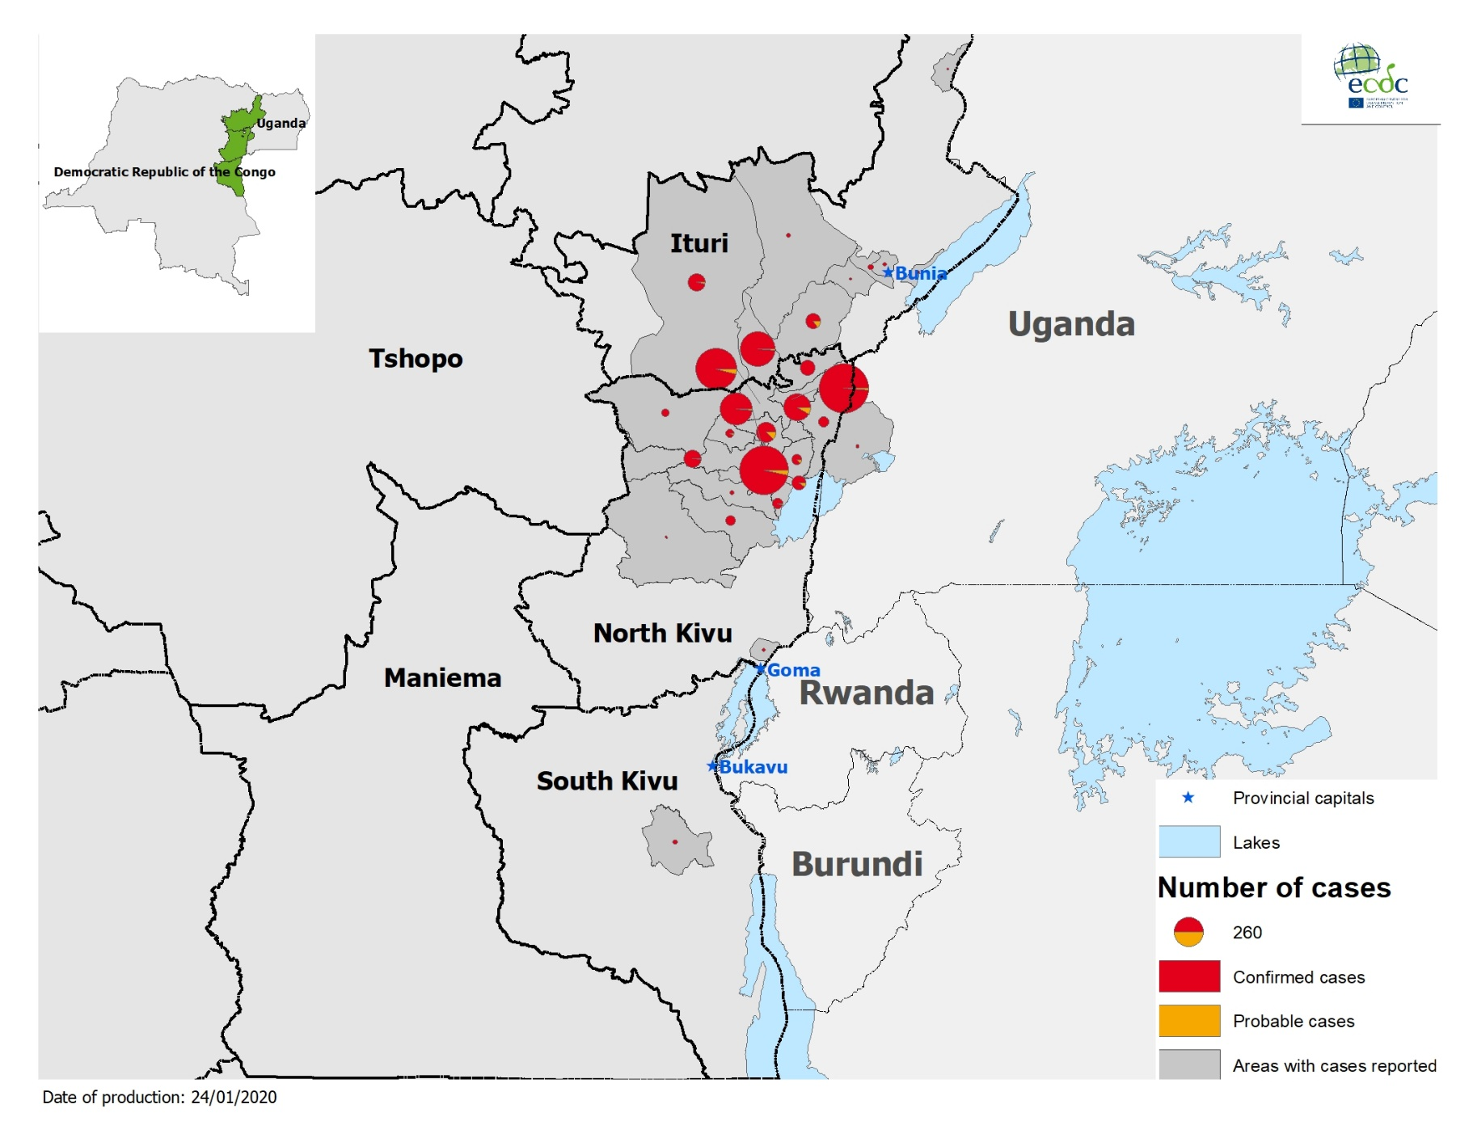
Geographical distribution of confirmed and probable cases of Ebola virus disease,
Democratic Republic of the Congo and Uganda as of 22 January 2020

Slide 5
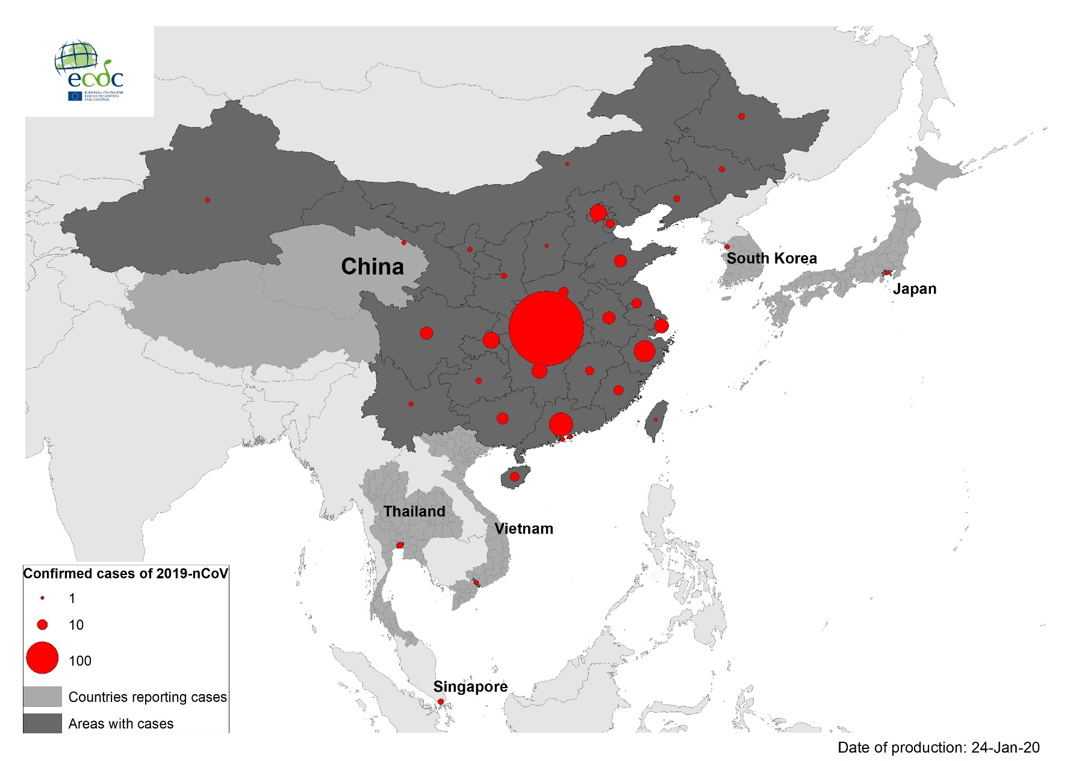
Geographical distribution of laboratory confirmed cases of 2019-nCoV in South-East Asia, as of 24 January 2020

Slide 6
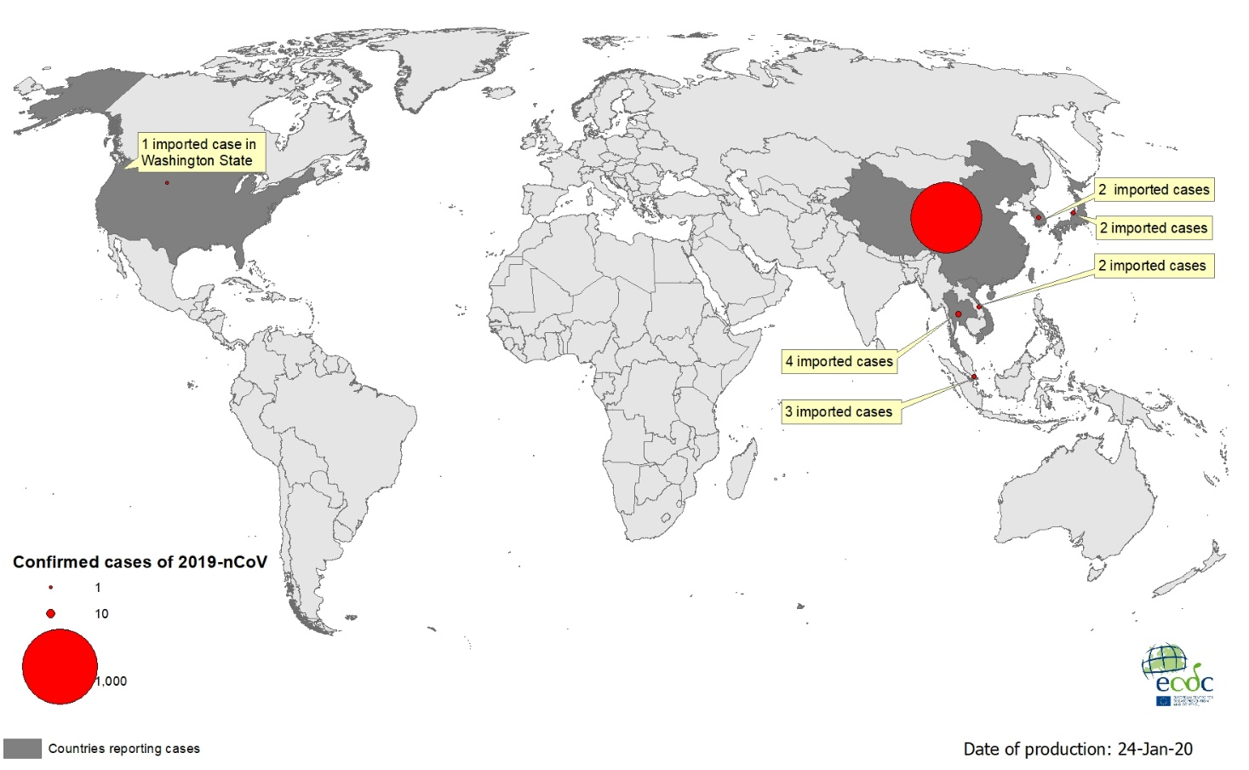
Geographical distribution of laboratory confirmed cases of 2019-nCoV, World, as of 24 January 2020

Slide 7
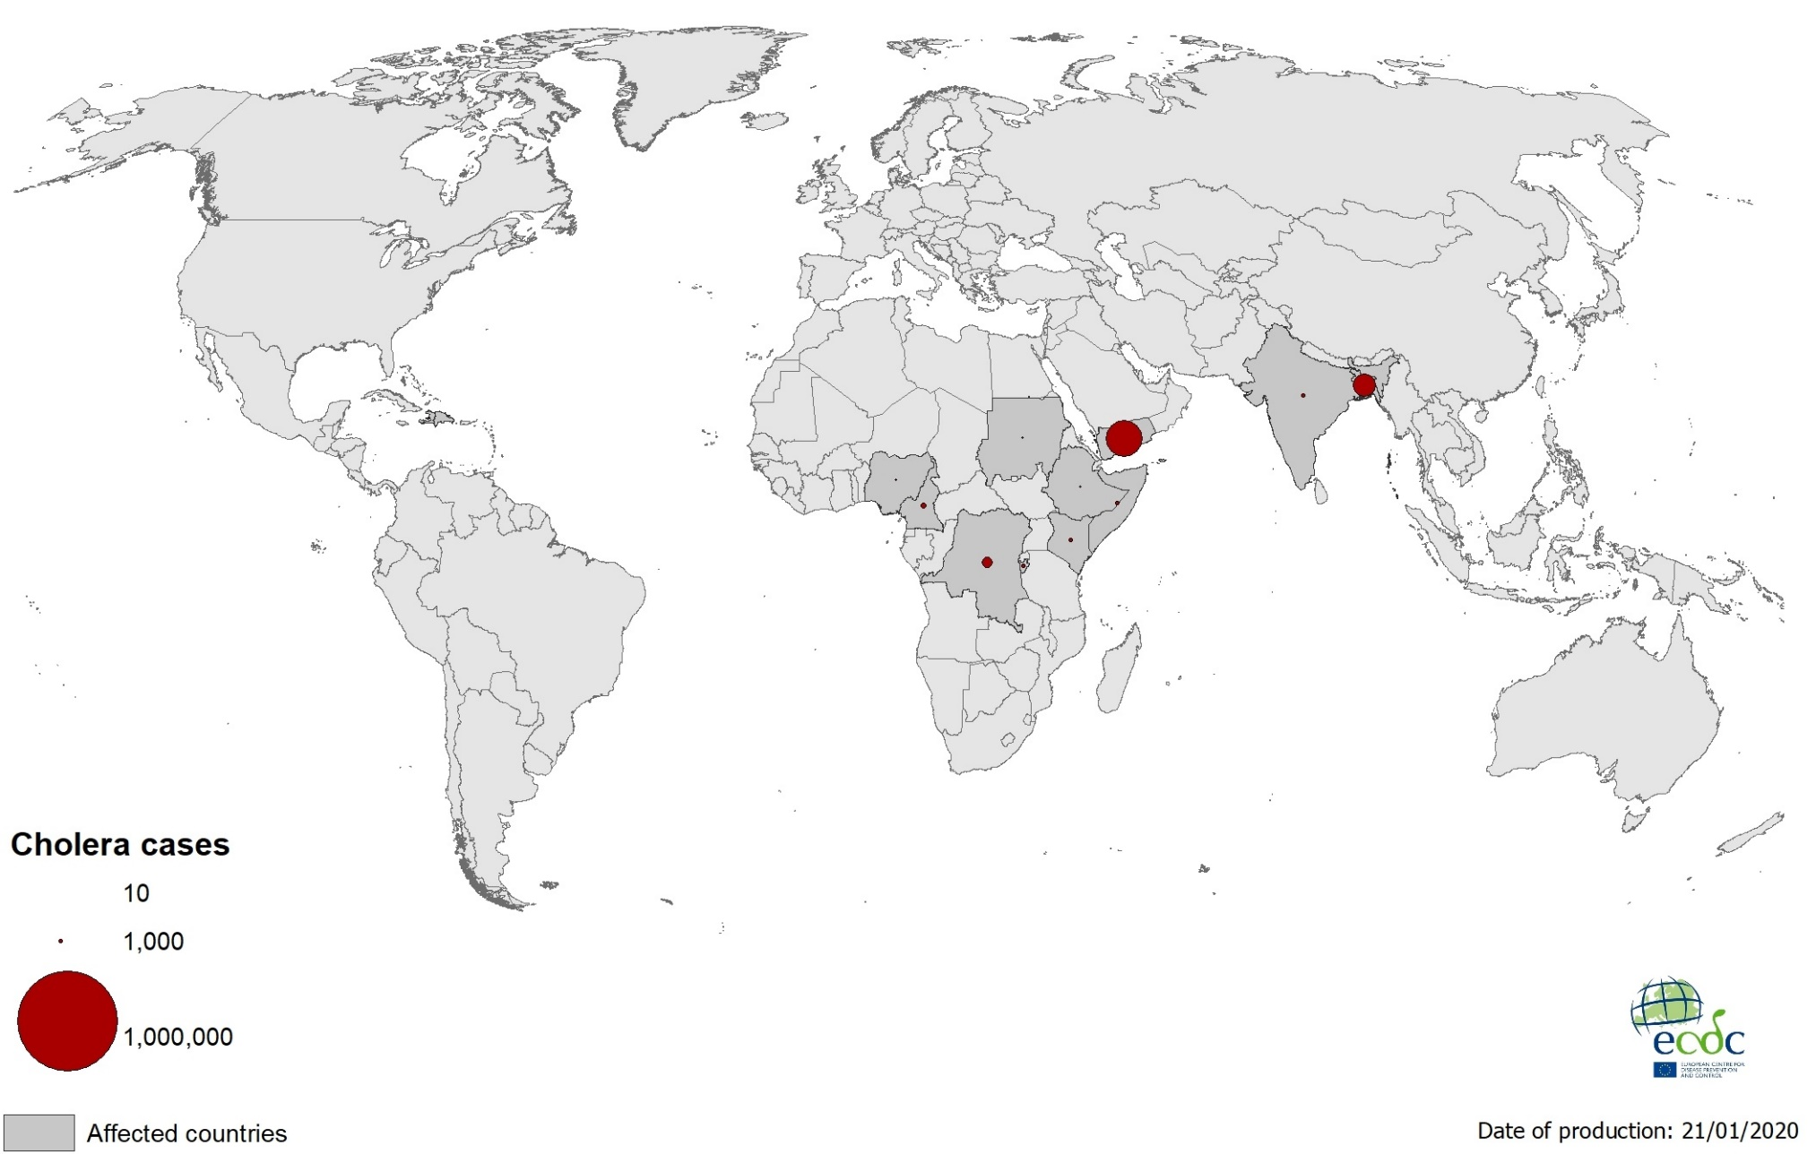
Geographical distribution of new cholera cases reported worldwide between November 2019 to January 2020

Slide 8
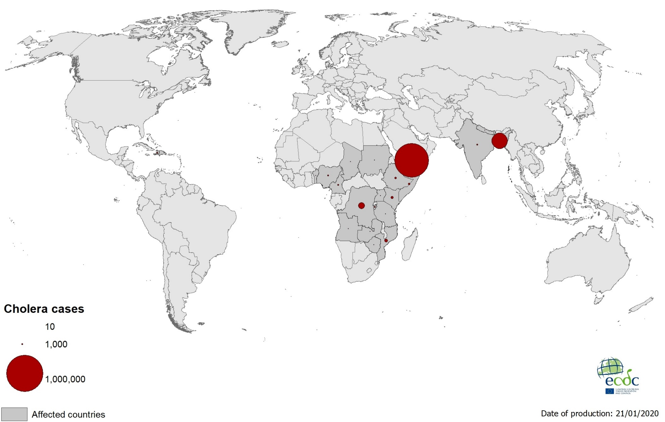
Geographical distribution of cholera cases reported worldwide in all 2019

Slide 9
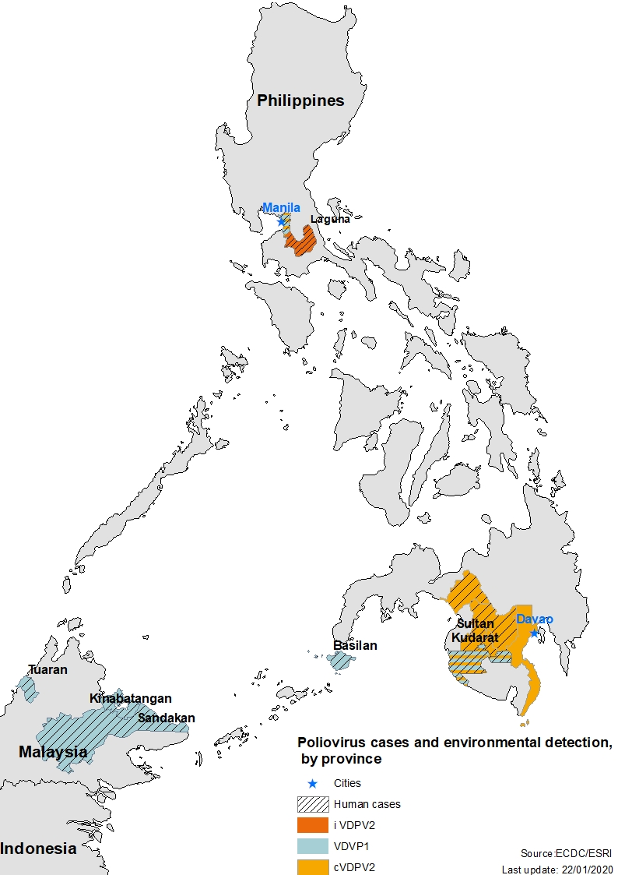
Geographic distribution of poliovirus cases and environmental detection in the Philippines and Malaysia, July 2019 to January 2020

