Slide 1
Reusable maps and graphs from ECDC Communicable Disease Threats Report Week 48, 2022
You are encouraged to reuse our maps and graphs for your own purposes and are free to translate them, provided the content is not altered and the source is acknowledged.

Slide 2
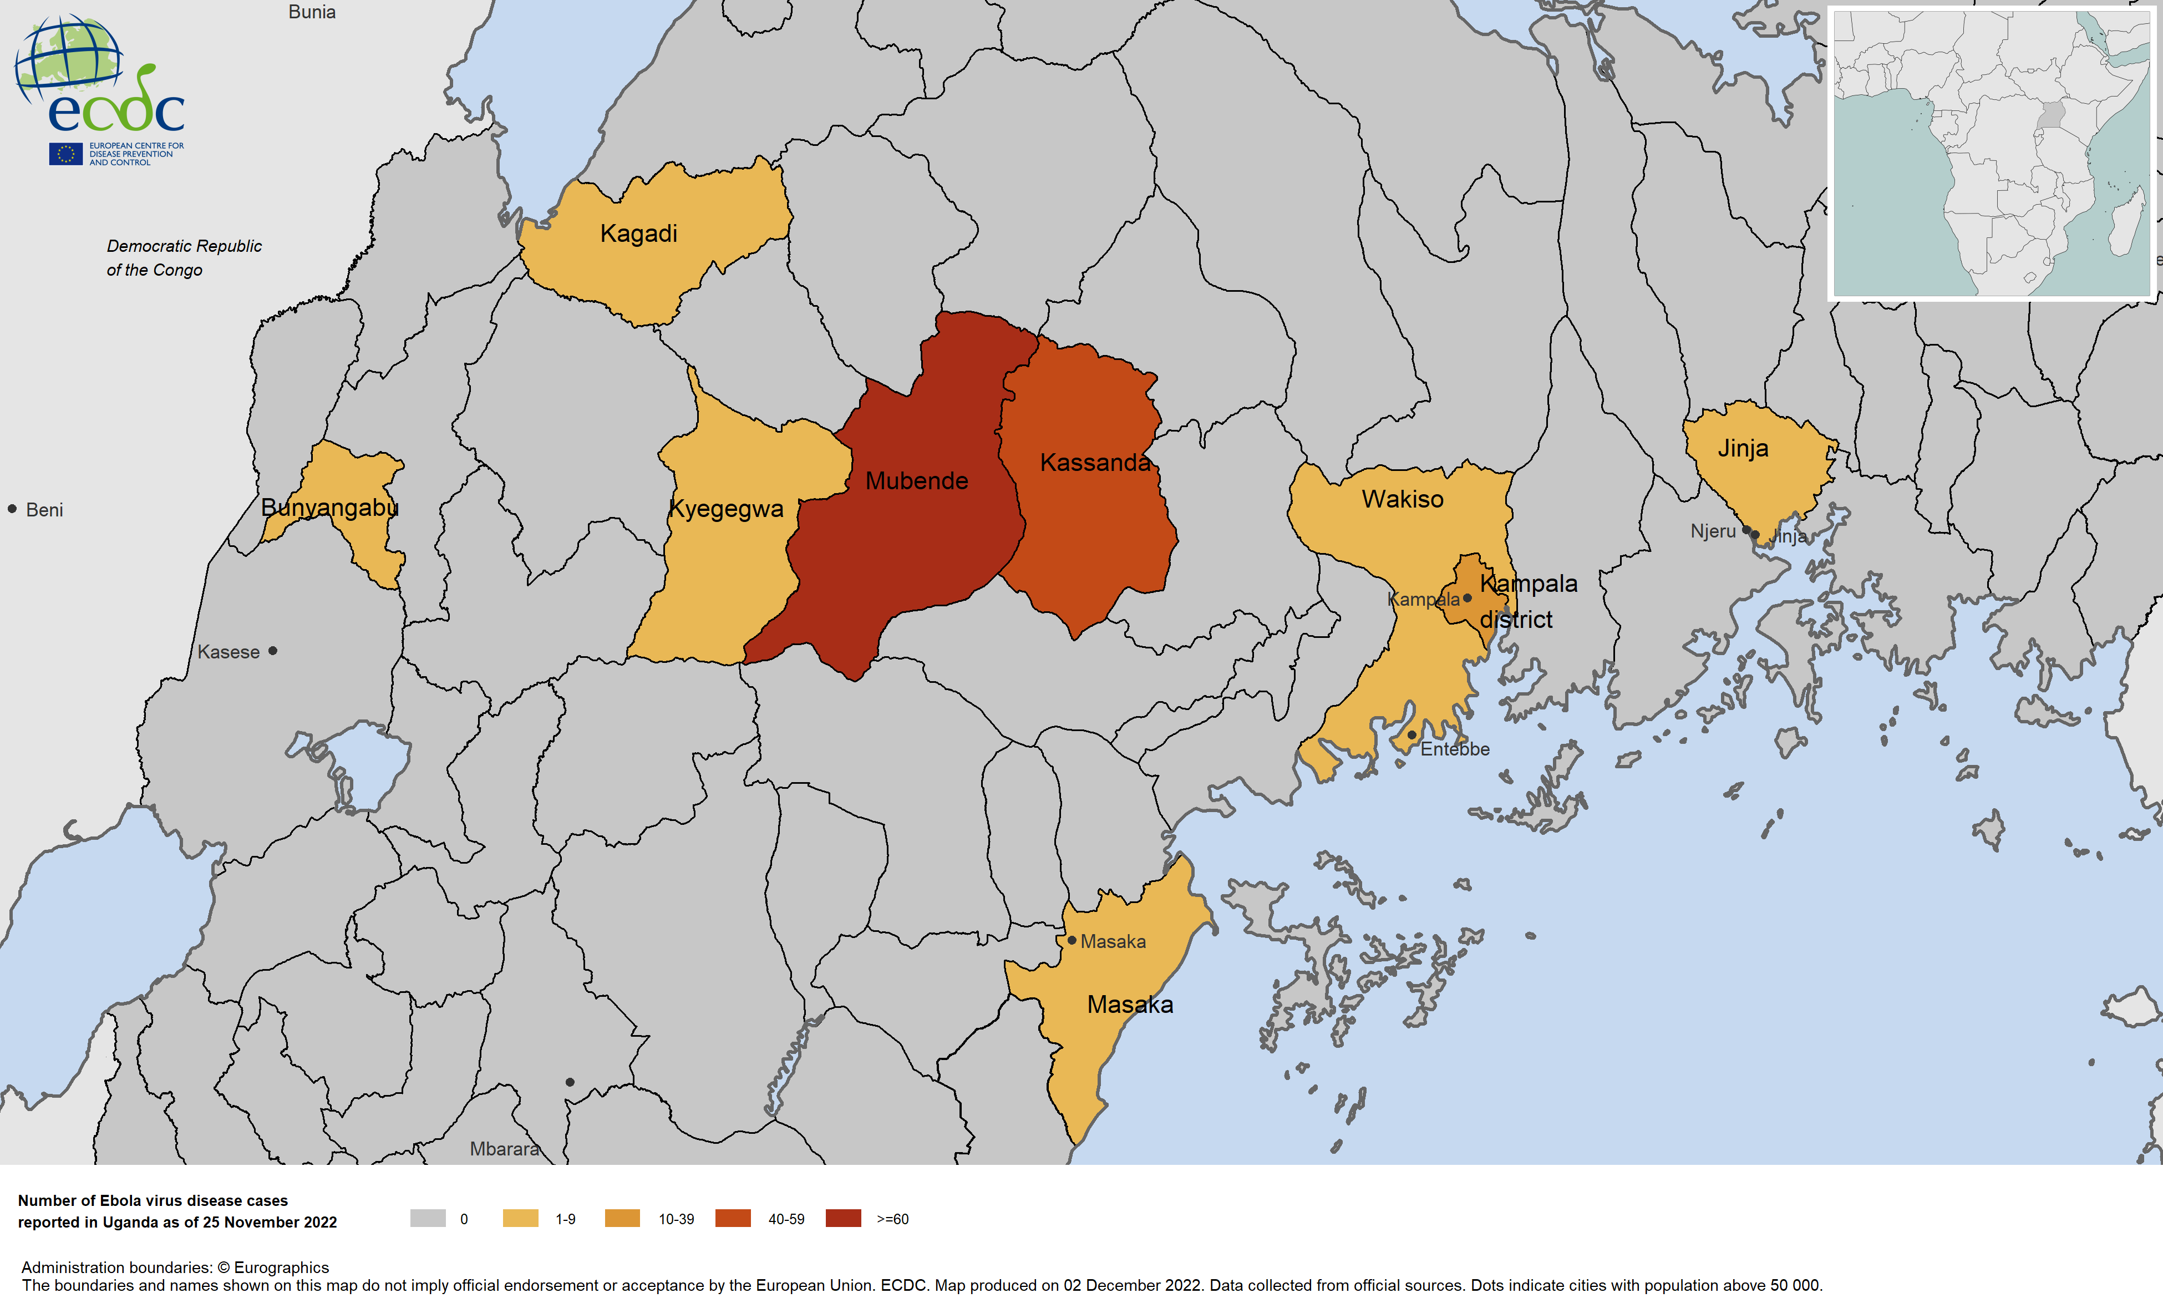
Geographic distribution of EVD cases, Uganda, 2022

Slide 3
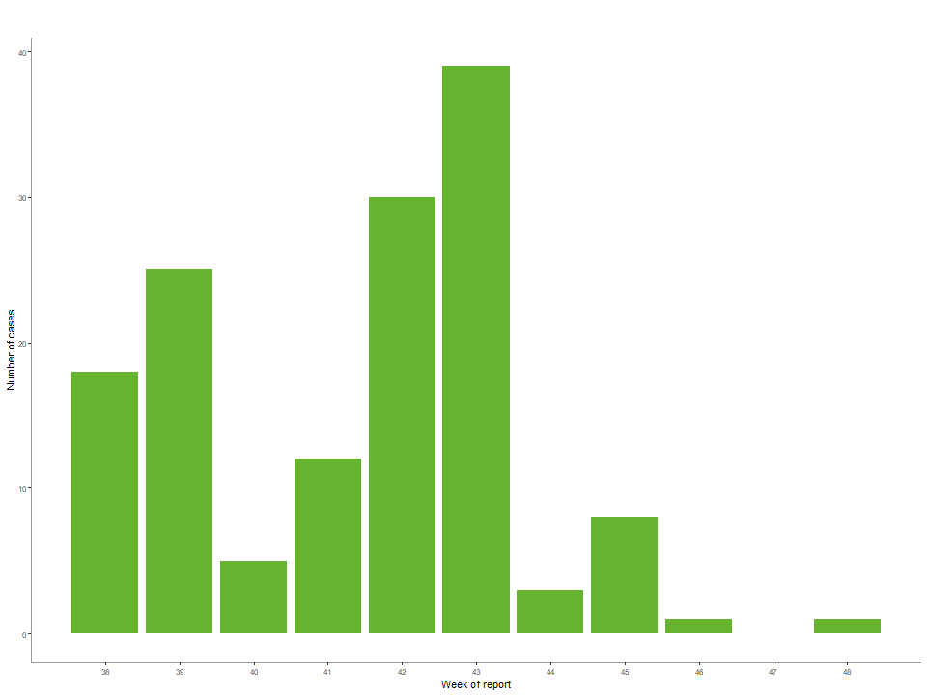
Ebola disease cases reported in Uganda in 2022, by week of reporting

Slide 4
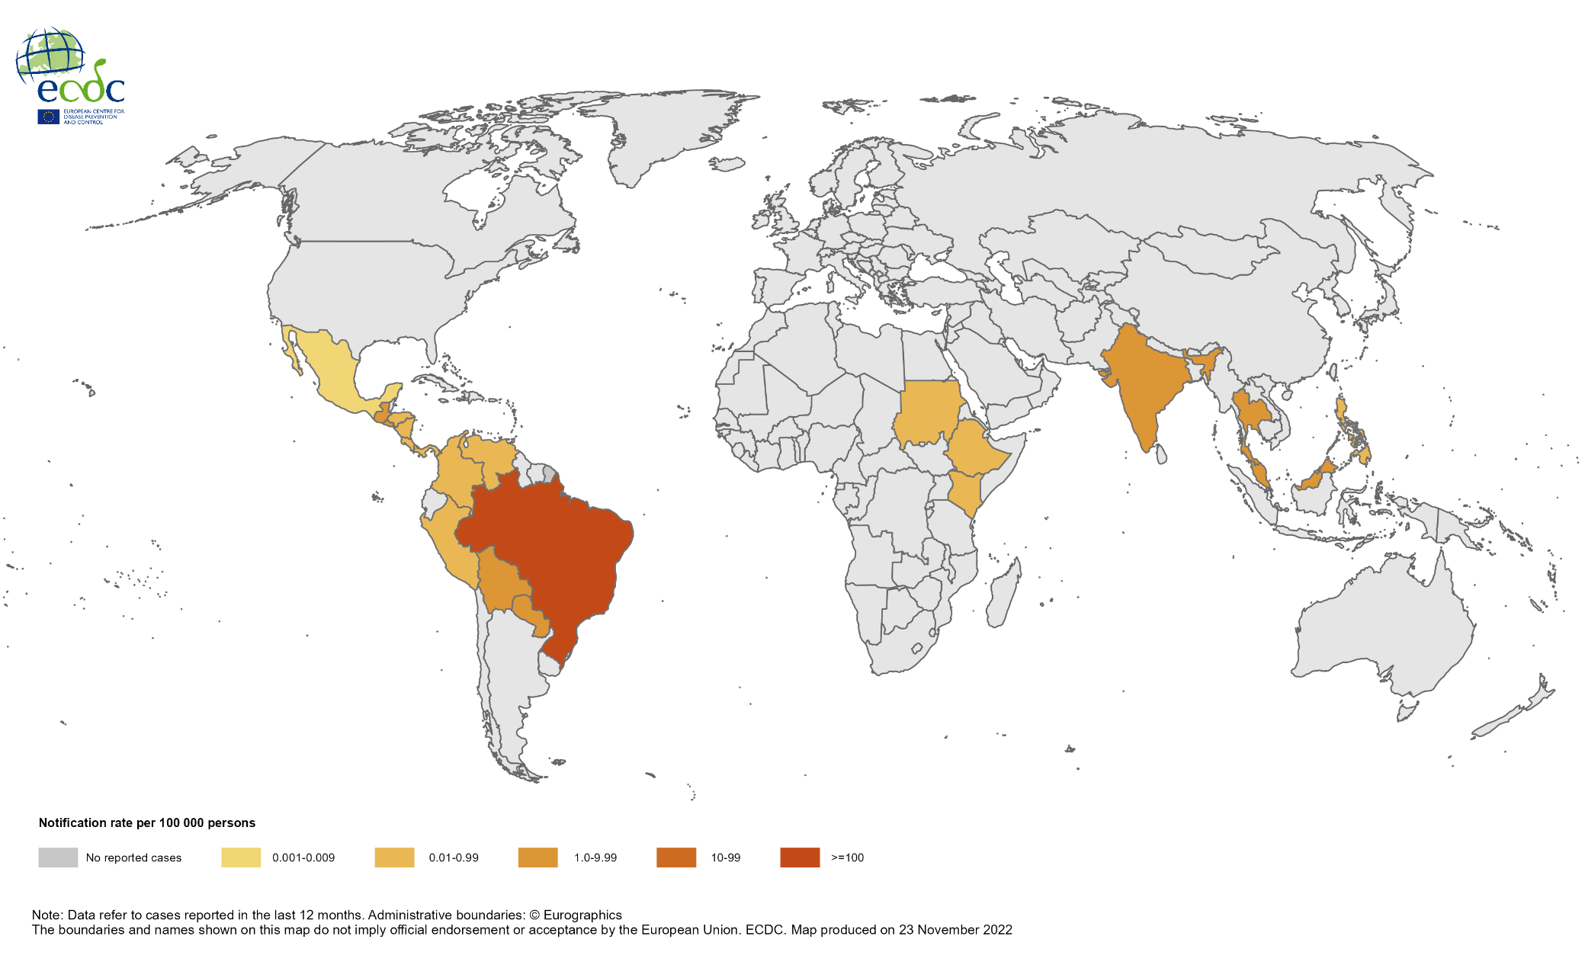
Notification rate of chikungunya cases reported worldwide, December 2021 to November 2022

Slide 5
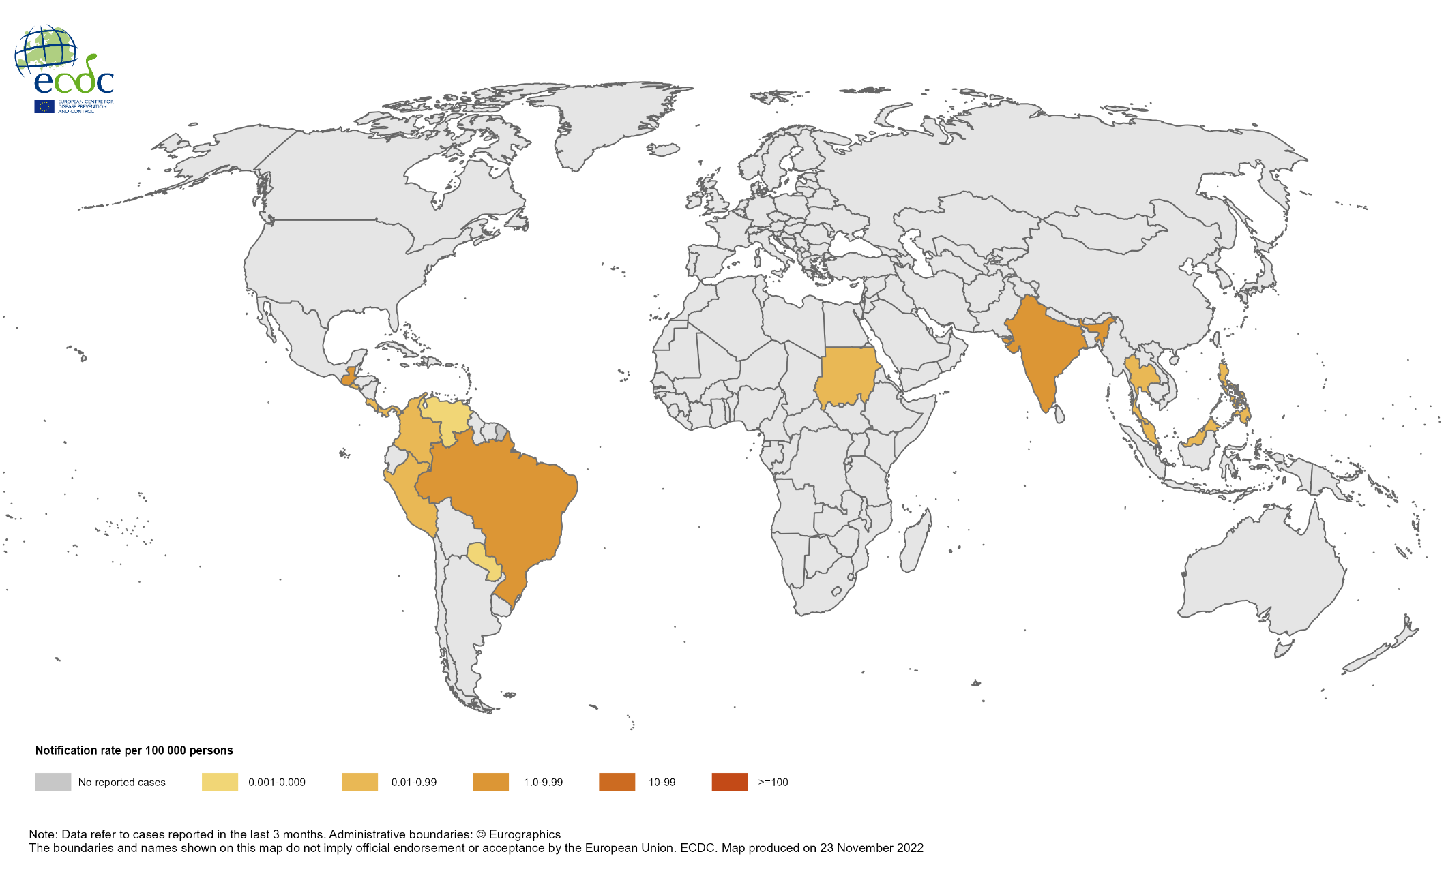
Notification rate of chikungunya cases reported worldwide, September to November 2022

Slide 6
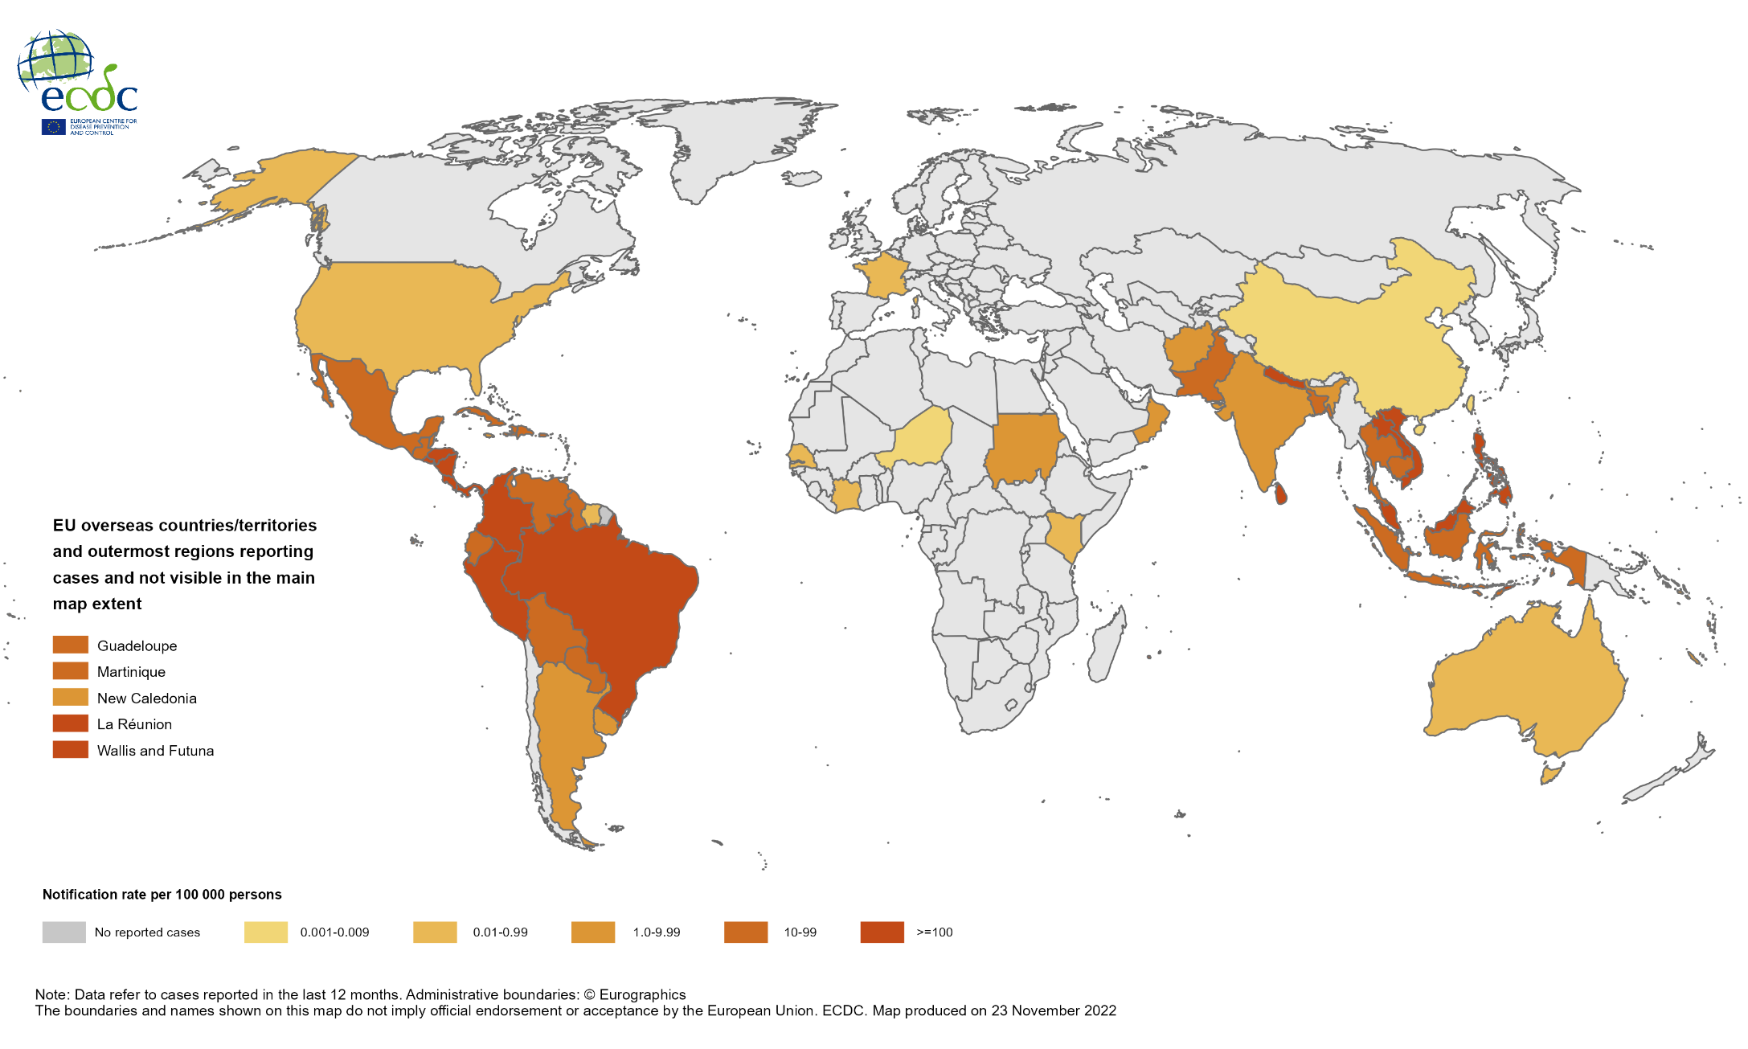
Notification rate of dengue cases reported worldwide, December 2021 to November 2022

Slide 7
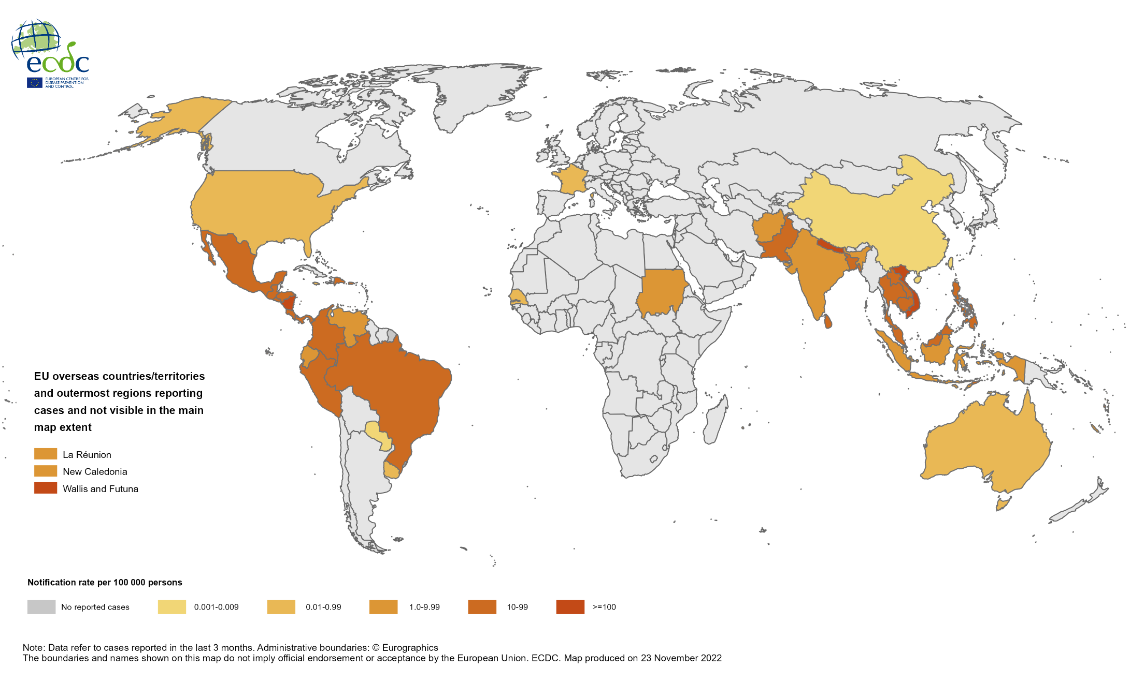
Notification rate of dengue cases reported worldwide, September to November 2022

