Slide 1
Reusable maps and graphs from ECDC Communicable Disease Threats Report
Week 48, 2019
You are encouraged to reuse our maps and graphs for your own purposes and free to translate, provided the content is not altered and the source is acknowledged.

Slide 2
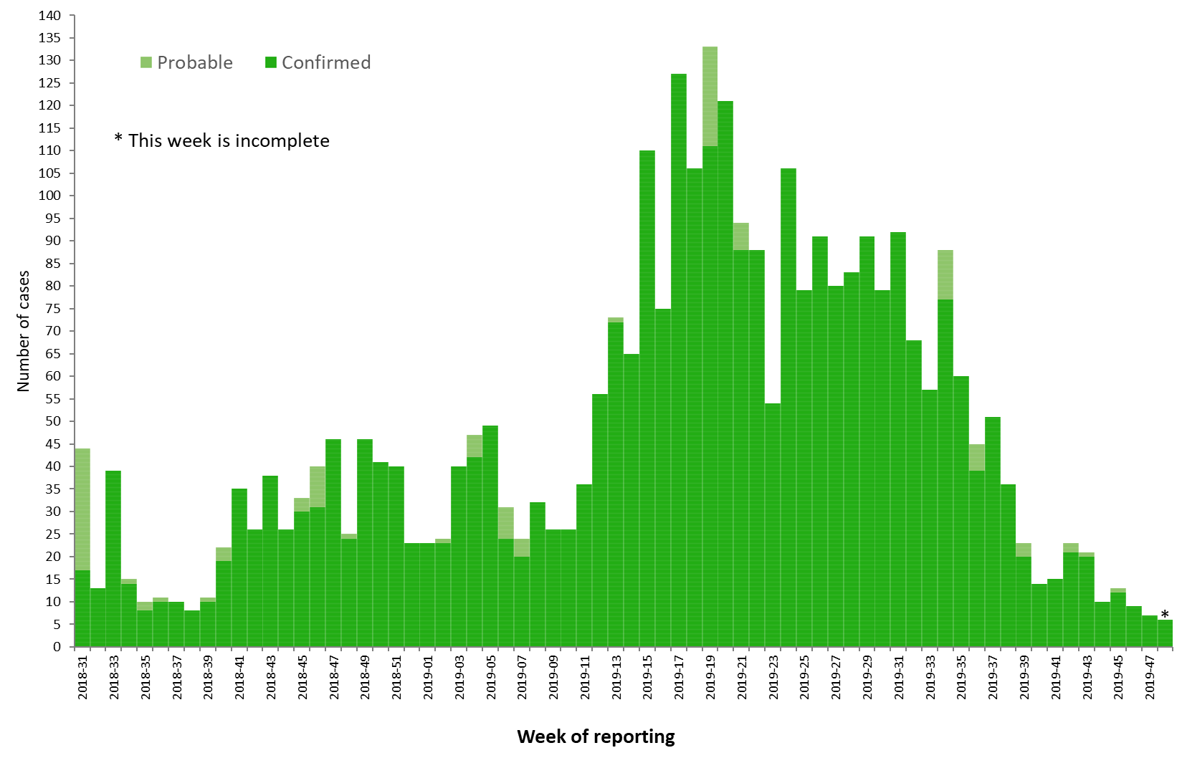
Distribution of confirmed and probable cases of Ebola virus disease by week of reporting, Democratic Republic of the Congo and Uganda, as of 27 November 2019

Slide 3
Ebola Virus Disease case distribution in DRC and Uganda as of 27 November 2019

Slide 4
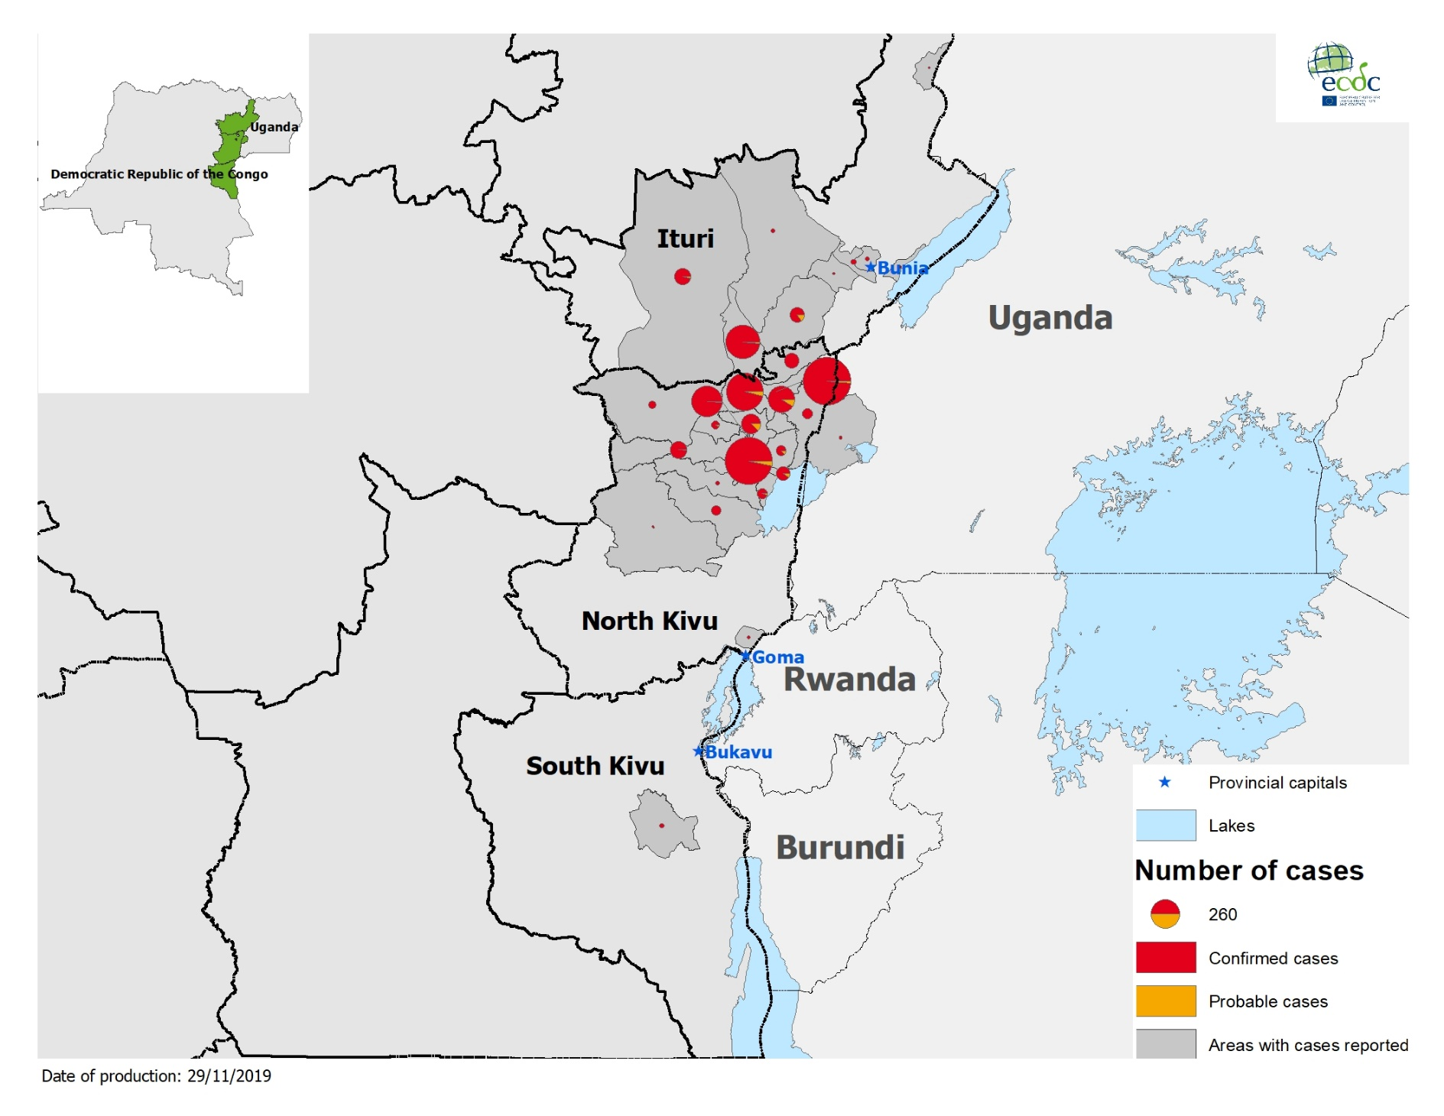
Geographical distribution of confirmed and probable cases of Ebola virus disease,
Democratic Republic of the Congo and Uganda as of 27 November 2019

Slide 5
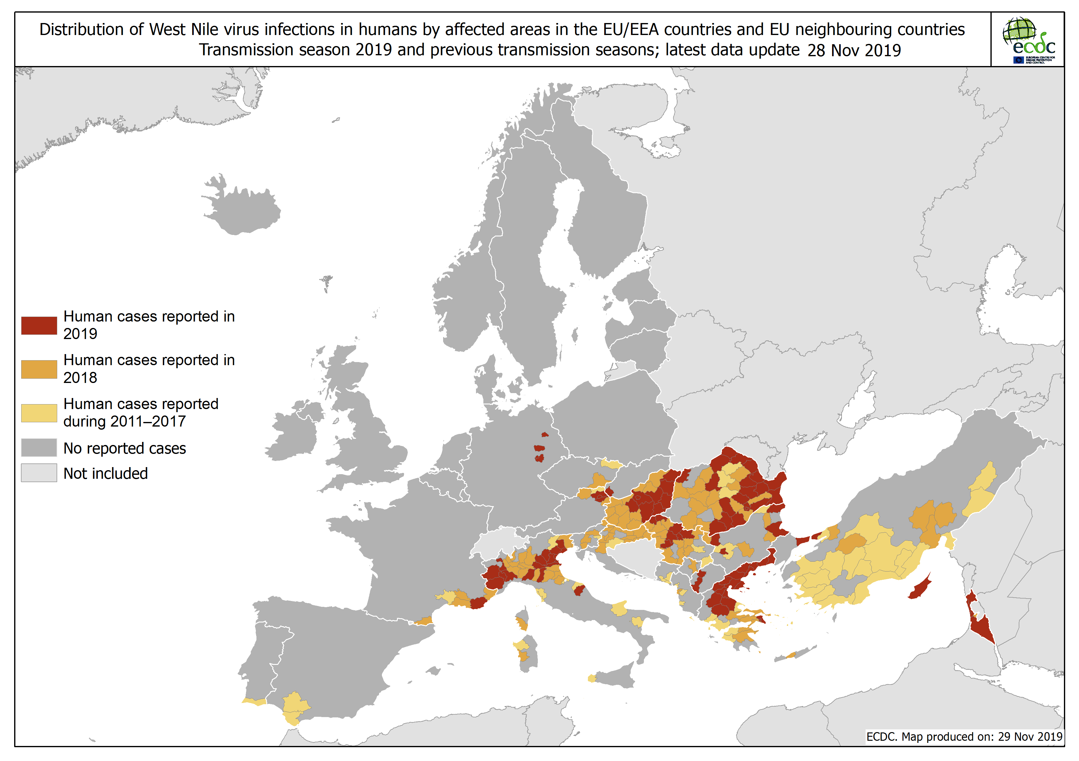

Slide 6
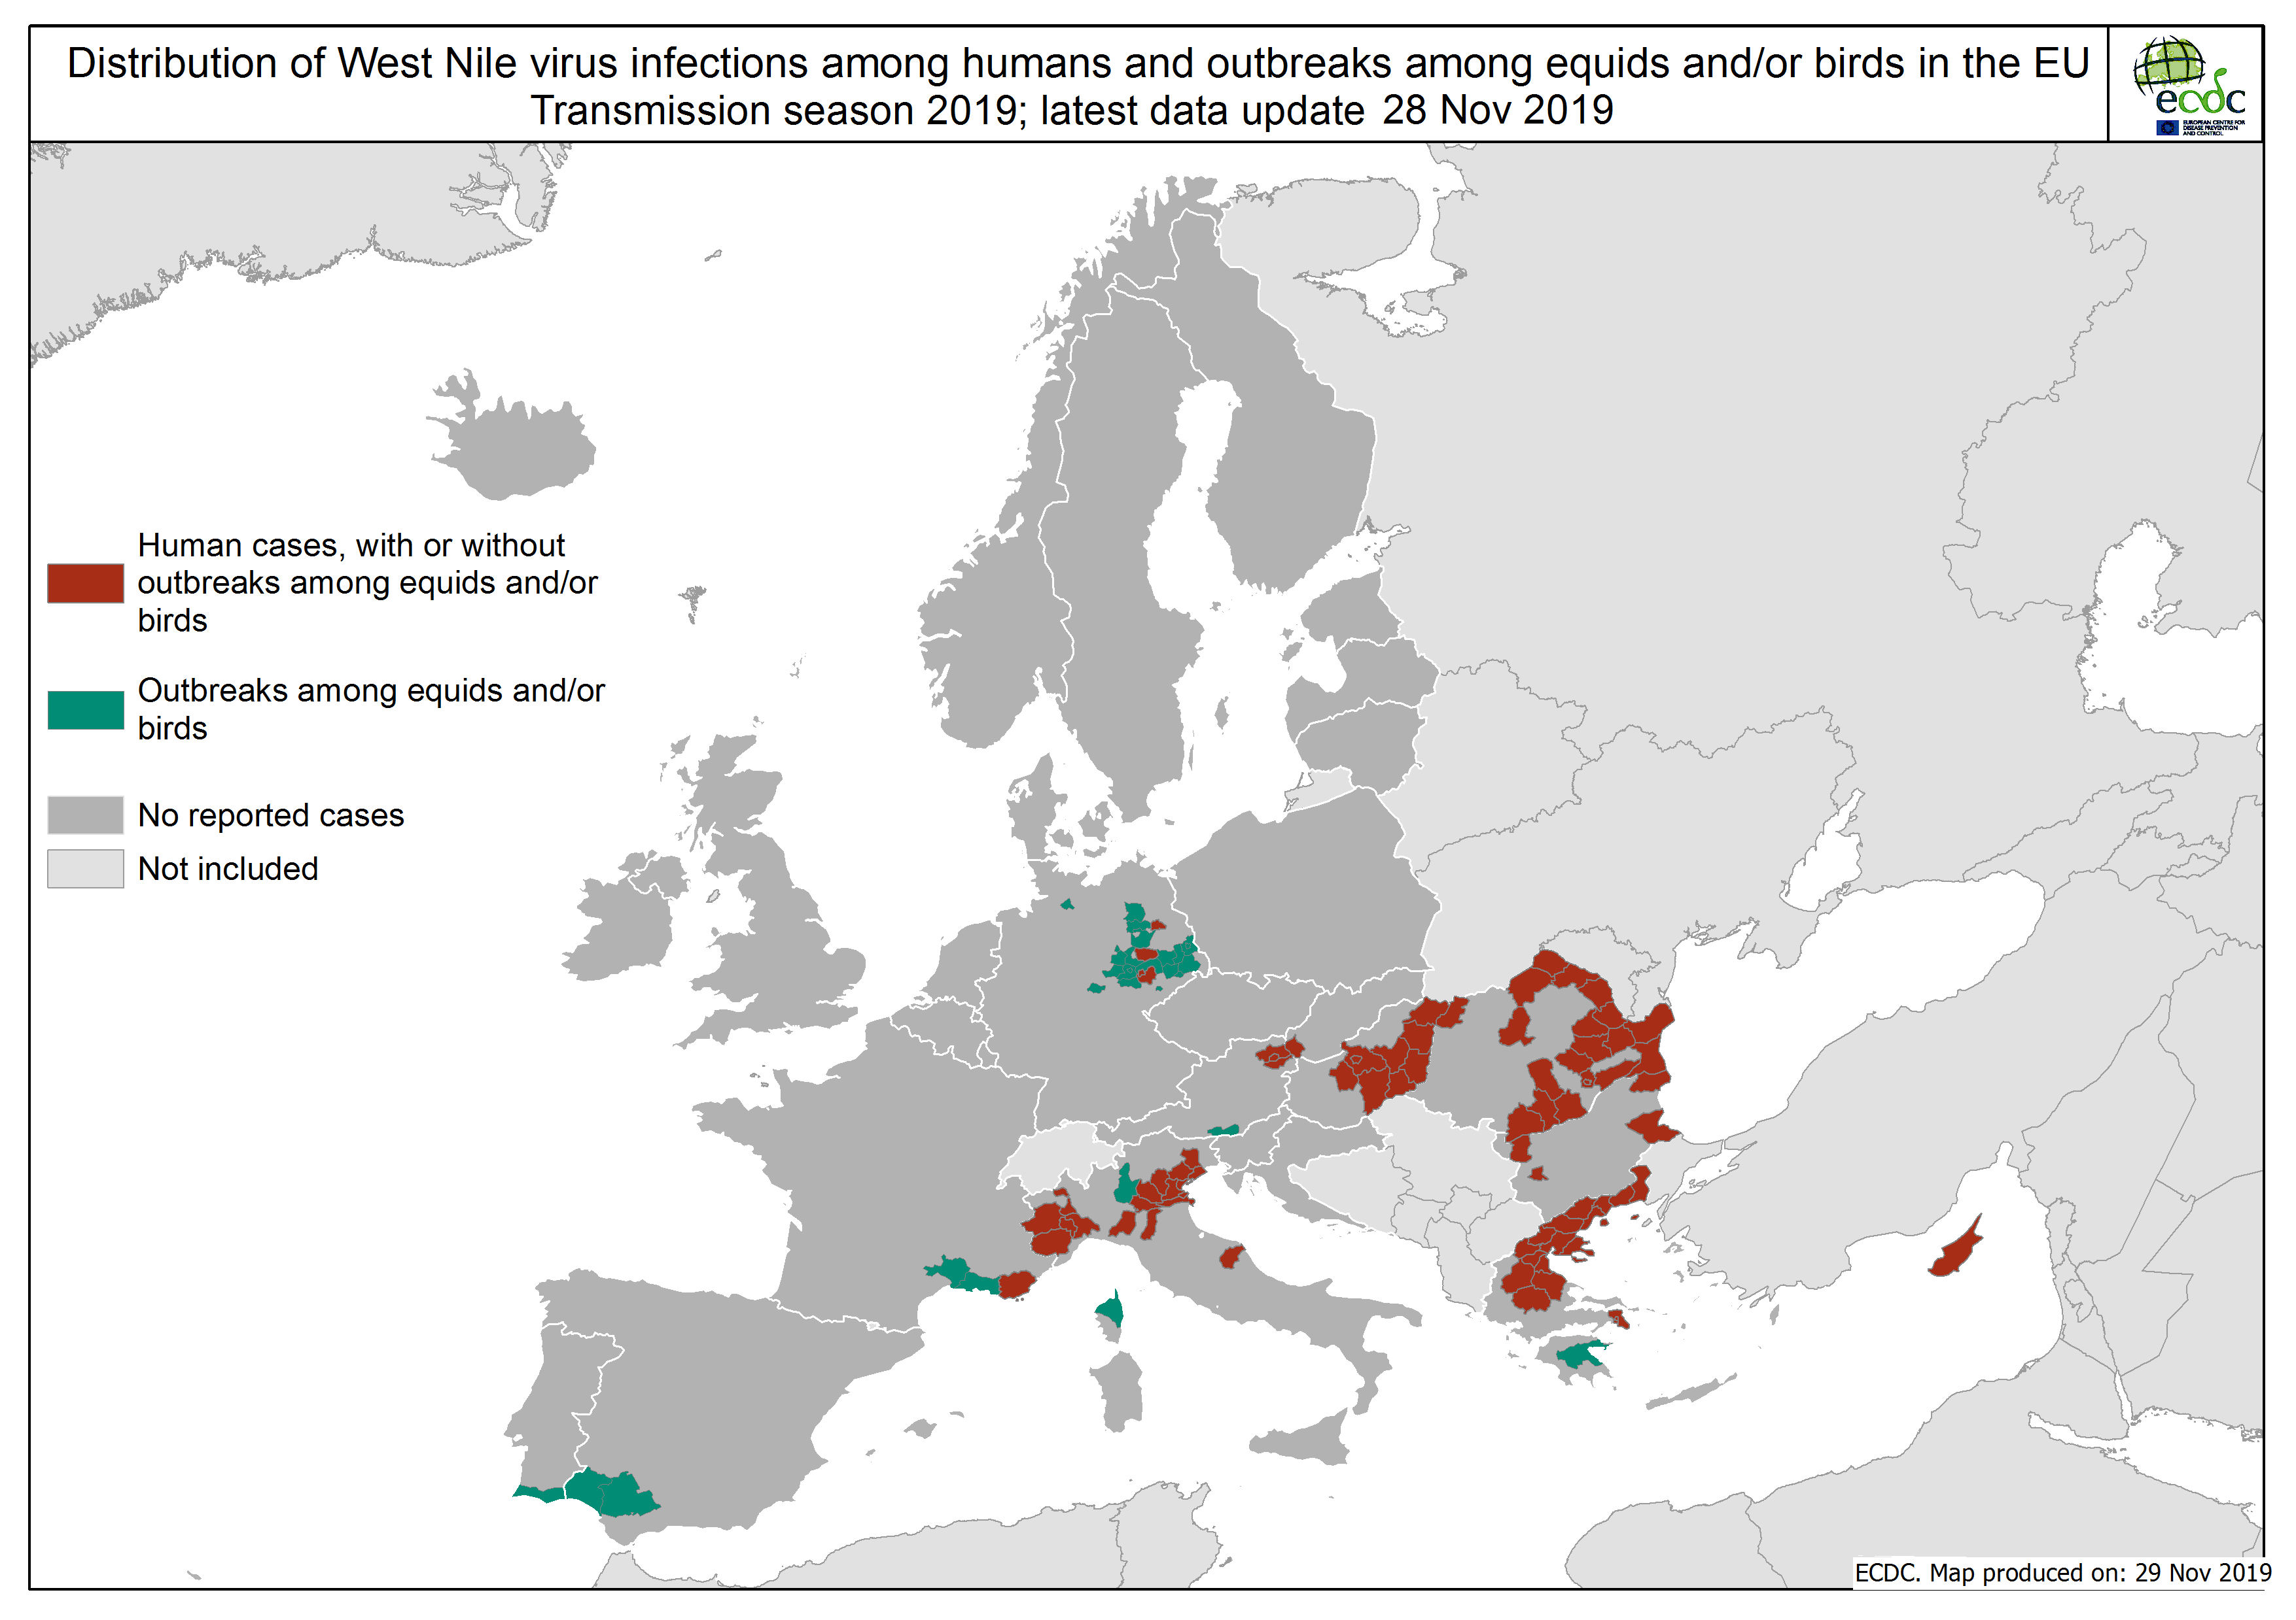

Slide 7
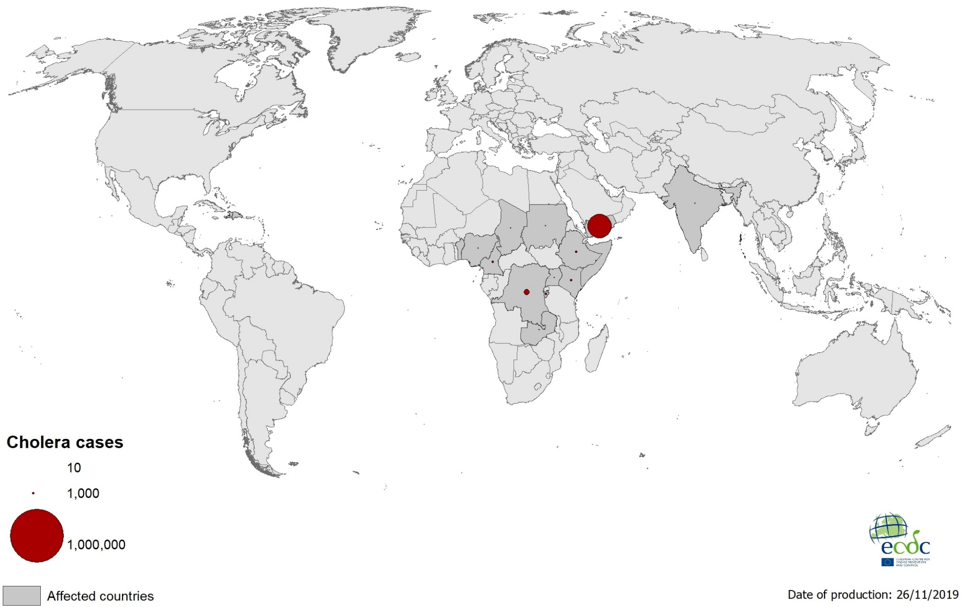
Geographical distribution of new cholera cases reported worldwide between September to November 2019

Slide 8
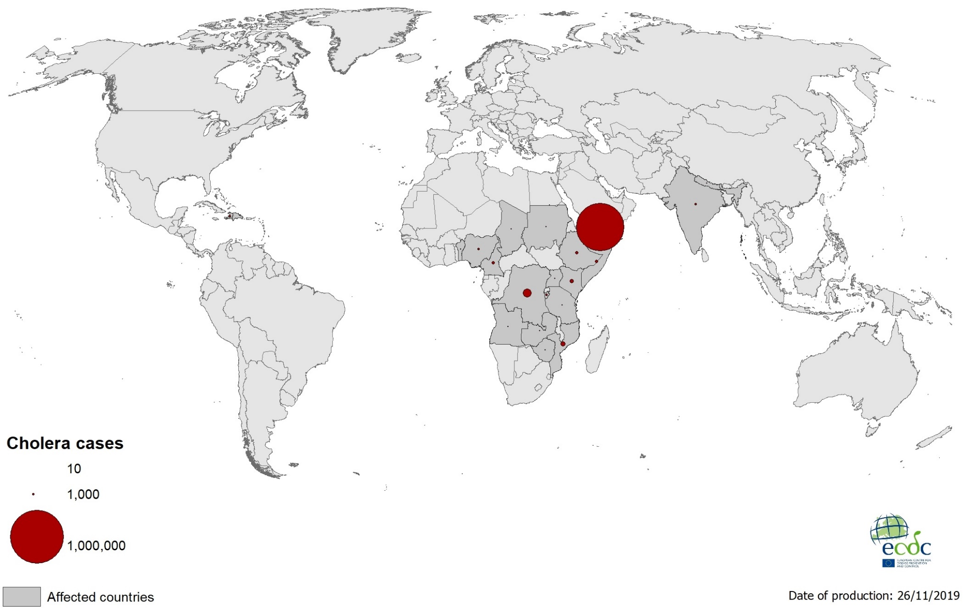
Geographical distribution of cholera cases reported worldwide in 2019

Slide 9
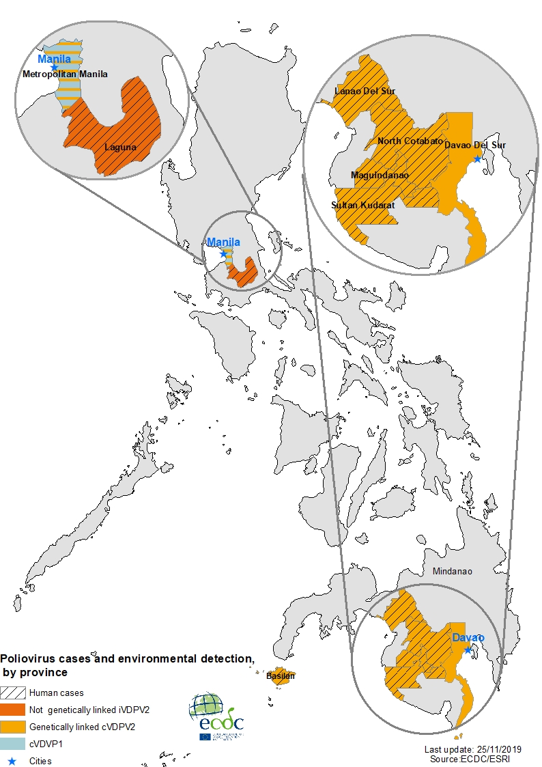
Poliovirus cases and environmental detection, by province, Philippines, July - November 2019

Slide 10
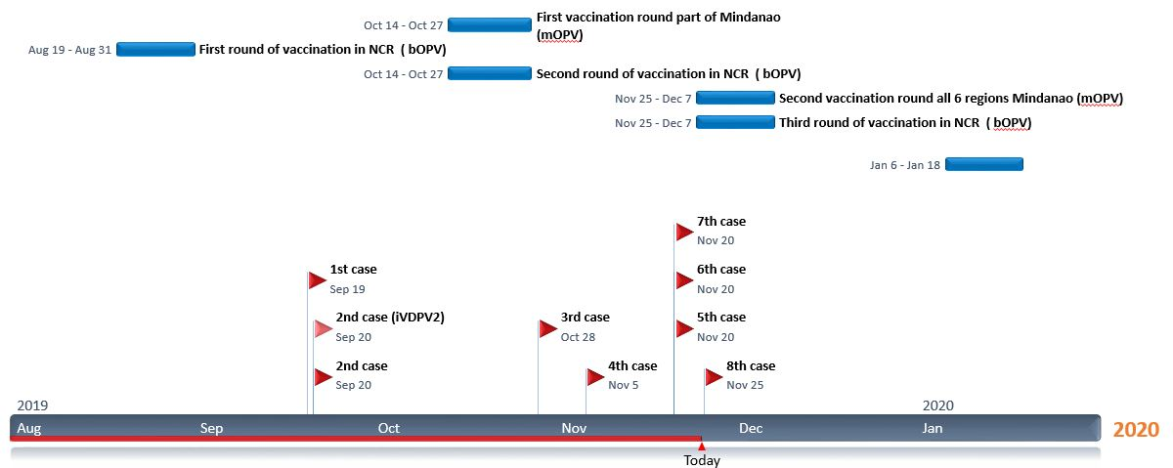
Timeline of poliomyelitis cases and response measures implemented in the Philippines outbreak

