Slide 1
Reusable maps and graphs from ECDC Communicable Disease Threats Report
Week 48, 2018
You are encouraged to reuse our maps and graphs for your own purposes and free to translate, provided the content is not altered and the source is acknowledged.

Slide 2
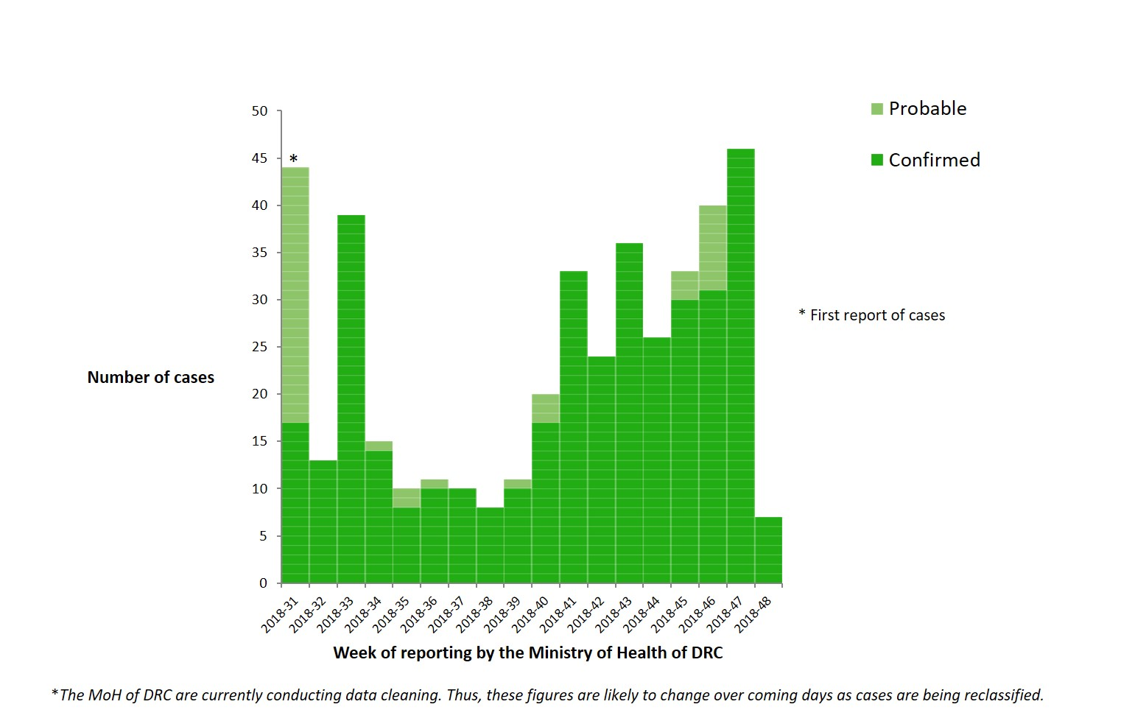
Distribution of confirmed and probable cases of Ebola virus disease, North Kivu and Ituri Provinces, Democratic Republic of the Congo, as of 28 November 2018

Slide 3
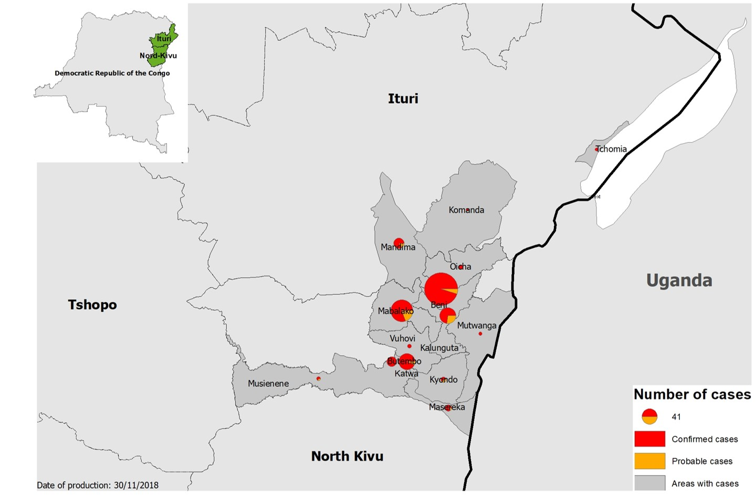
Geographical distribution of confirmed and probable cases of Ebola virus disease, North Kivu and Ituri Provinces, Democratic Republic of the Congo, as of week 48, 2018

Slide 4
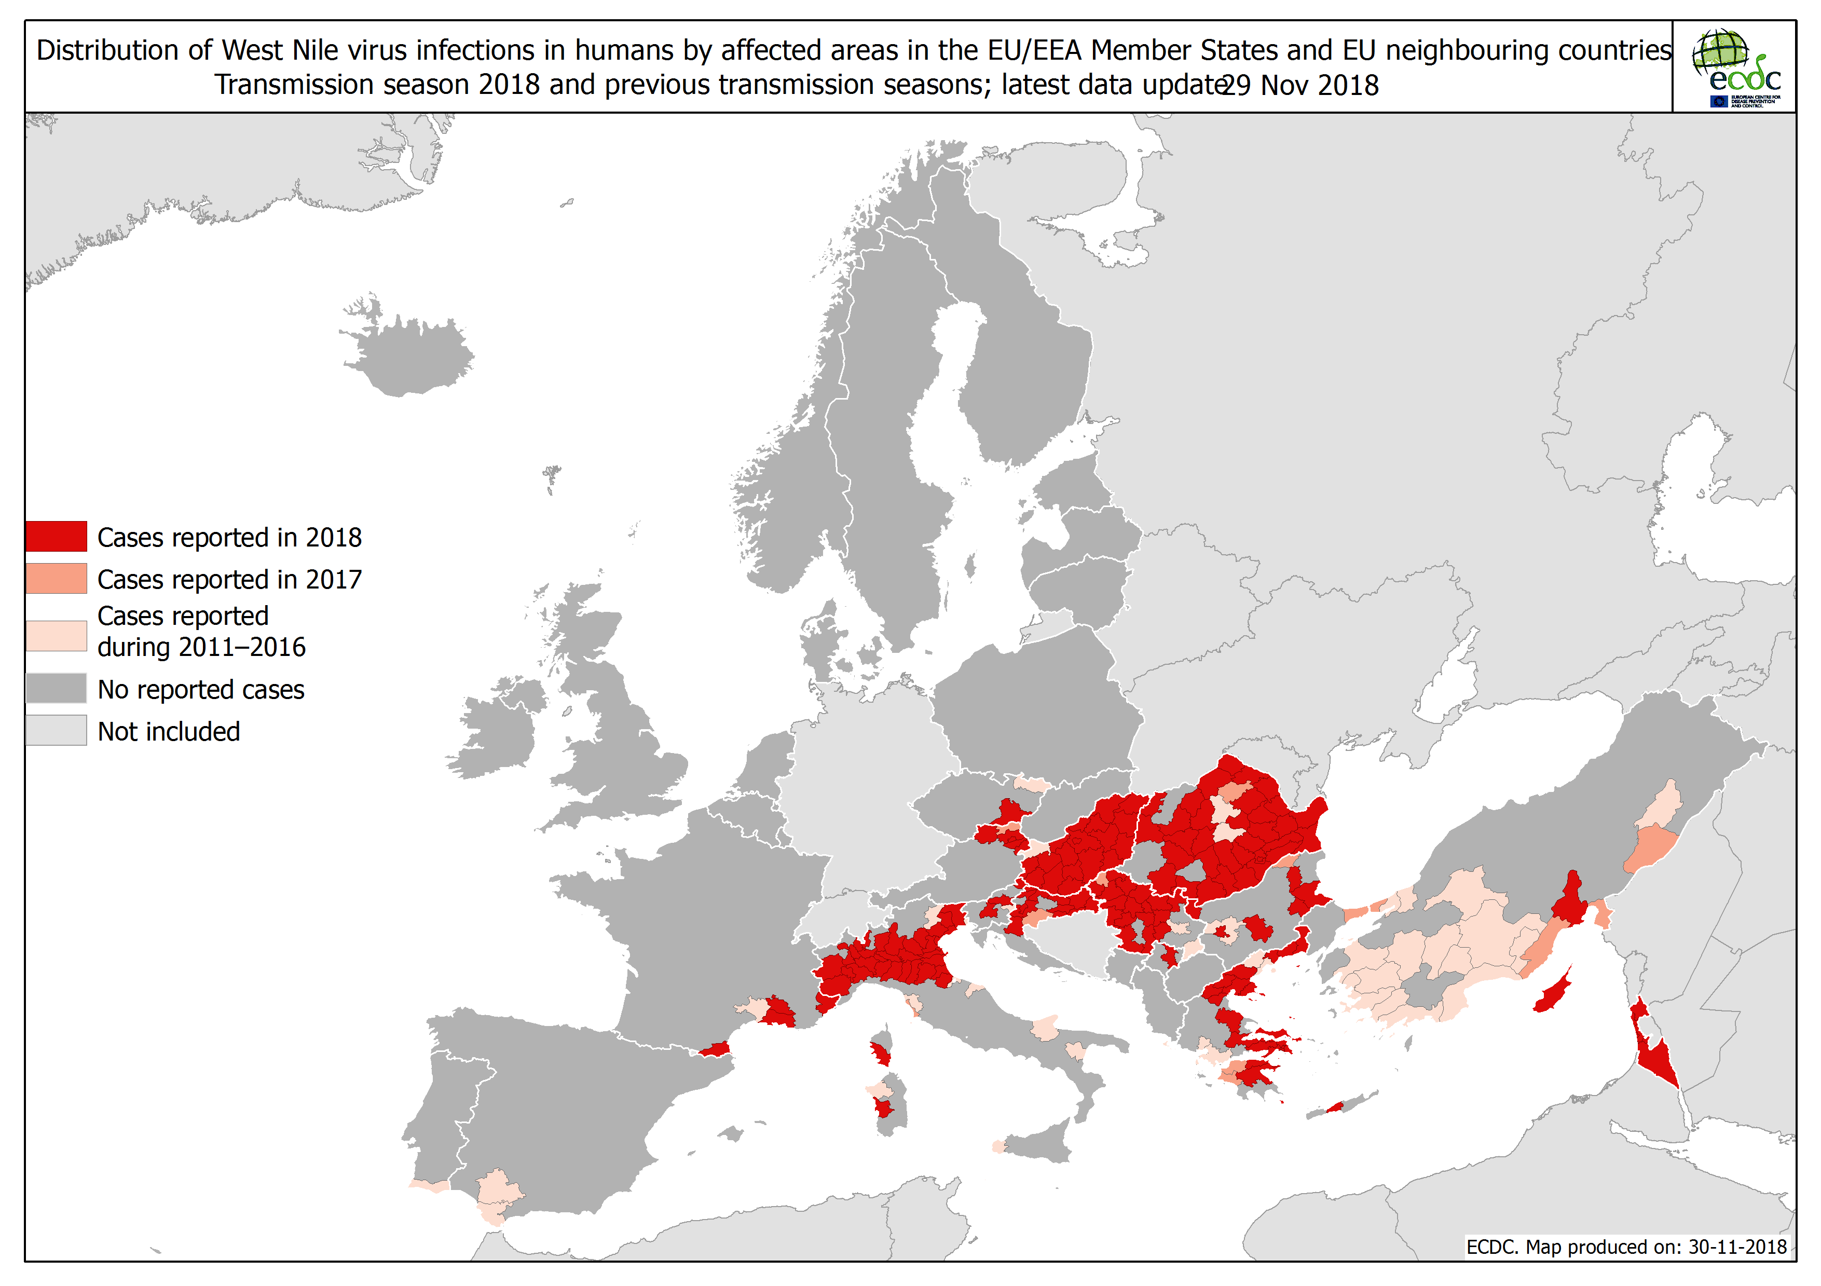

Slide 5
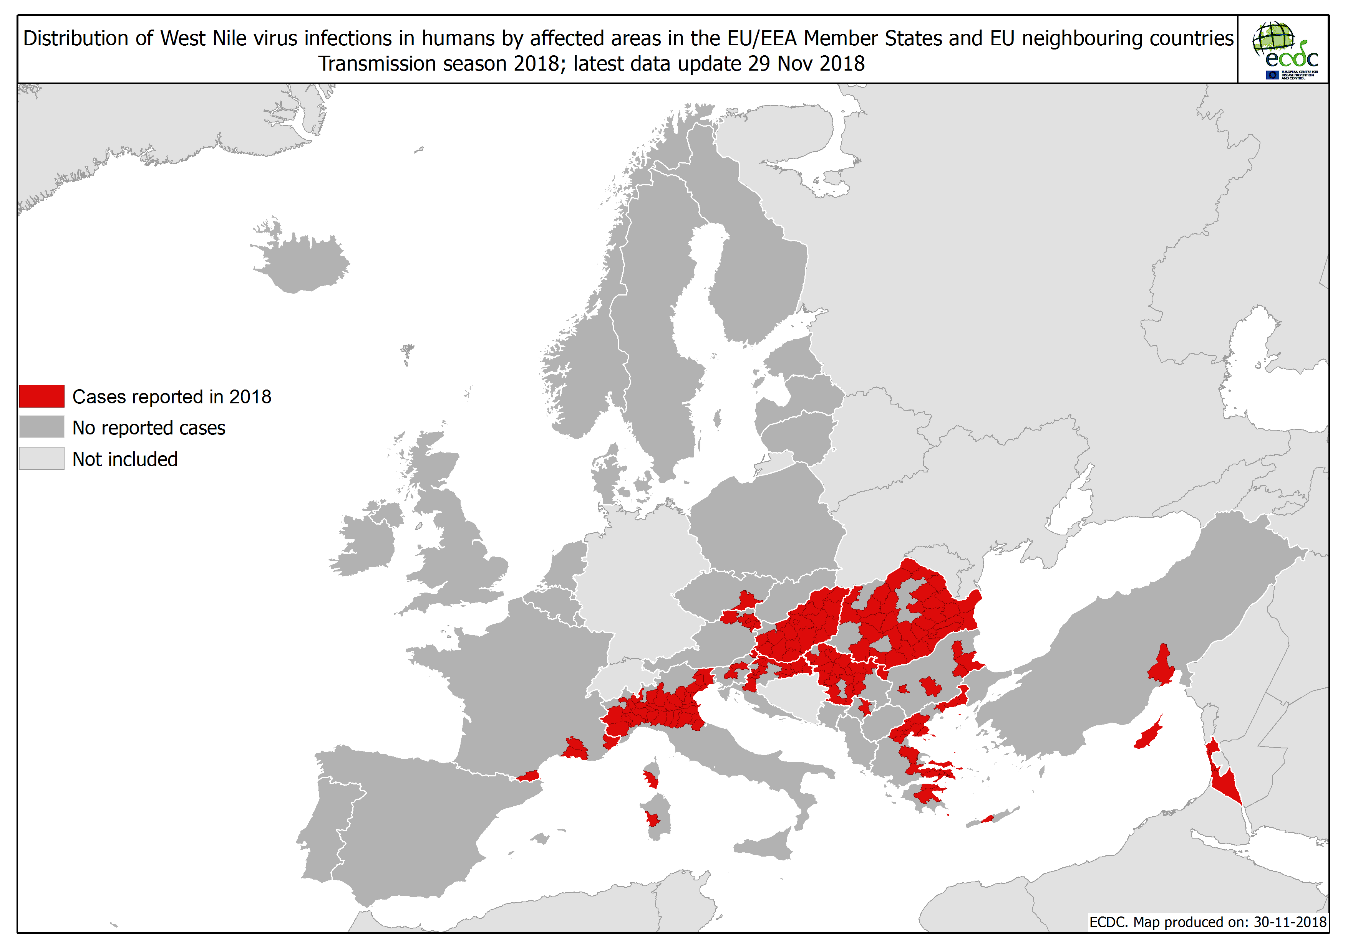

Slide 6
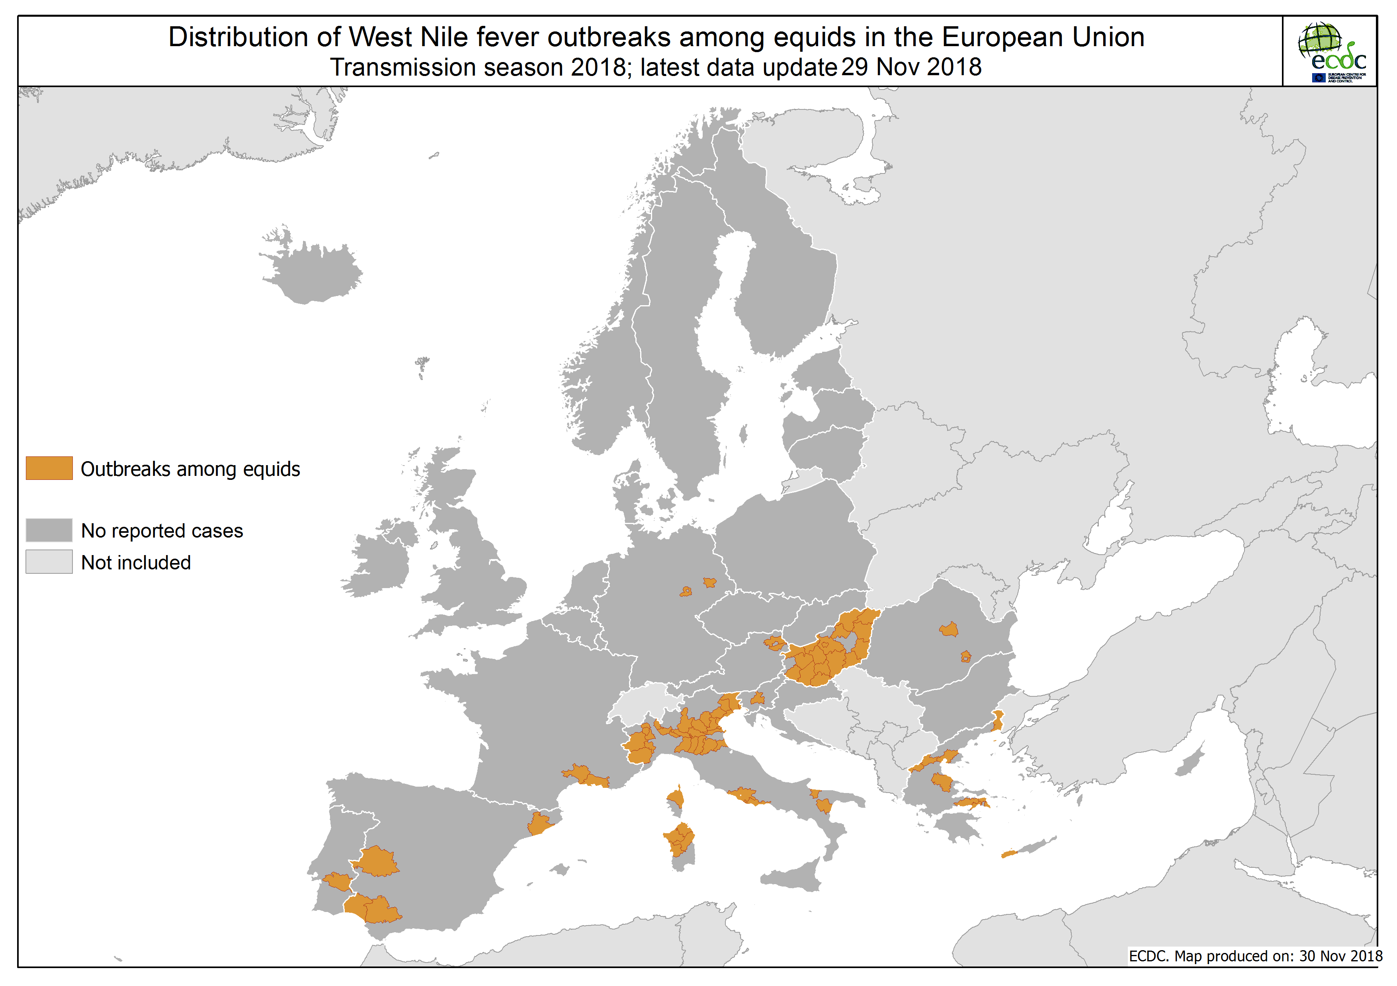

Slide 7
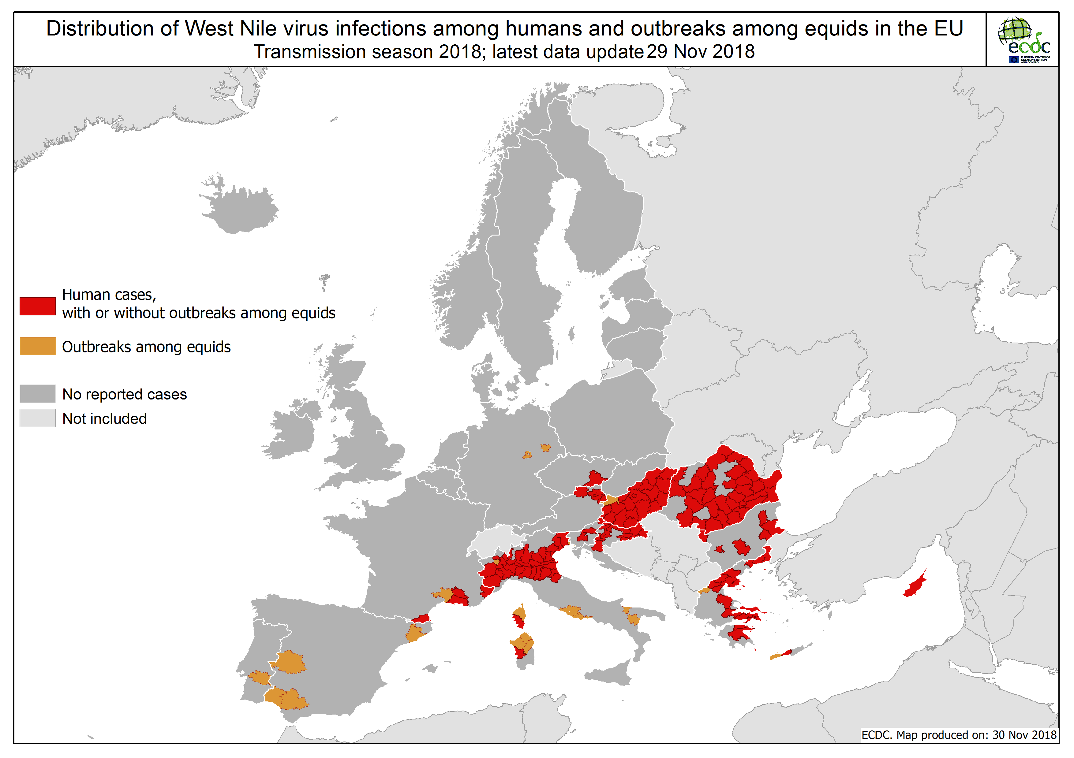

Slide 8
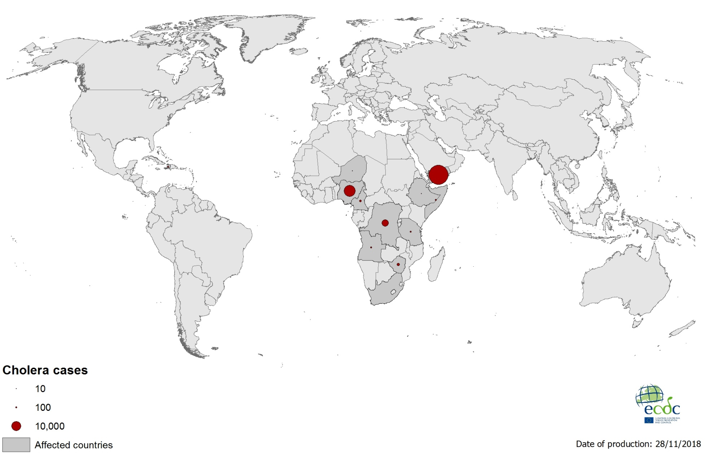
Geographical distribution of new cholera cases reported worldwide between October to November 2018

Slide 9
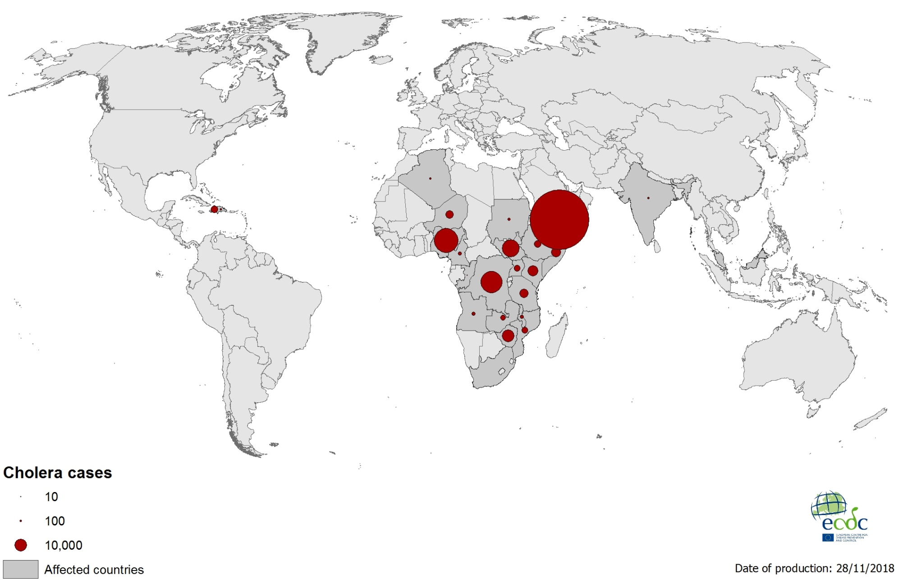
Geographical distribution of cholera cases reported worldwide between January to November 2018

Slide 10
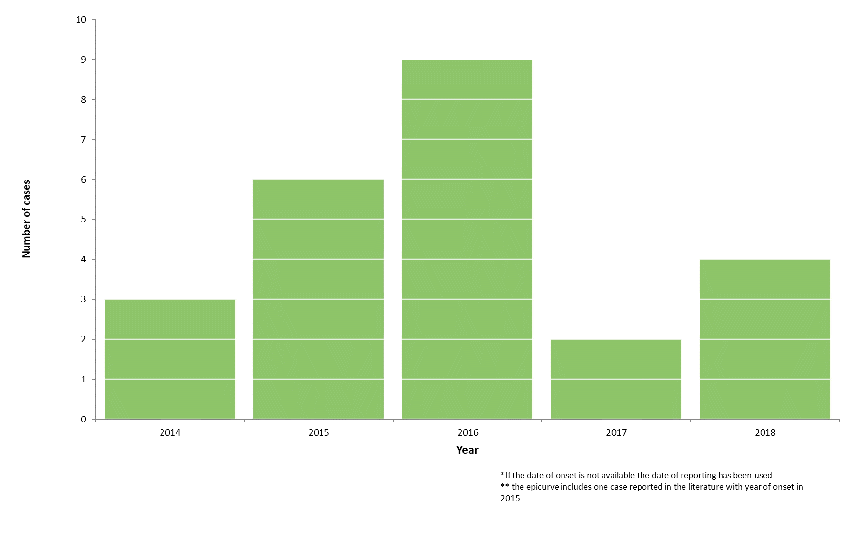
Distribution of confirmed cases of A(H5N6) by year of onset,
2014–2018 (n=24)

Slide 11
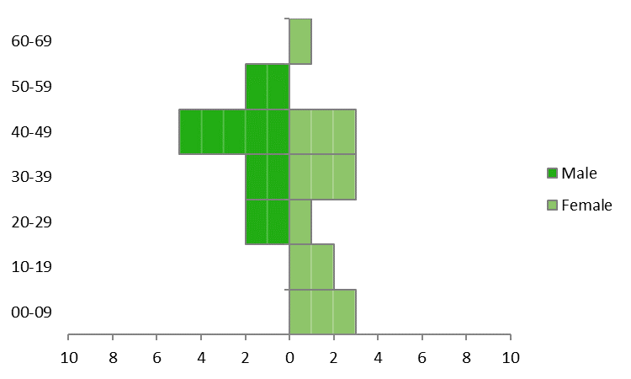
Distribution of confirmed cases of A(H5N6) by age and gender,
2014–2018 (n=24)

Slide 12
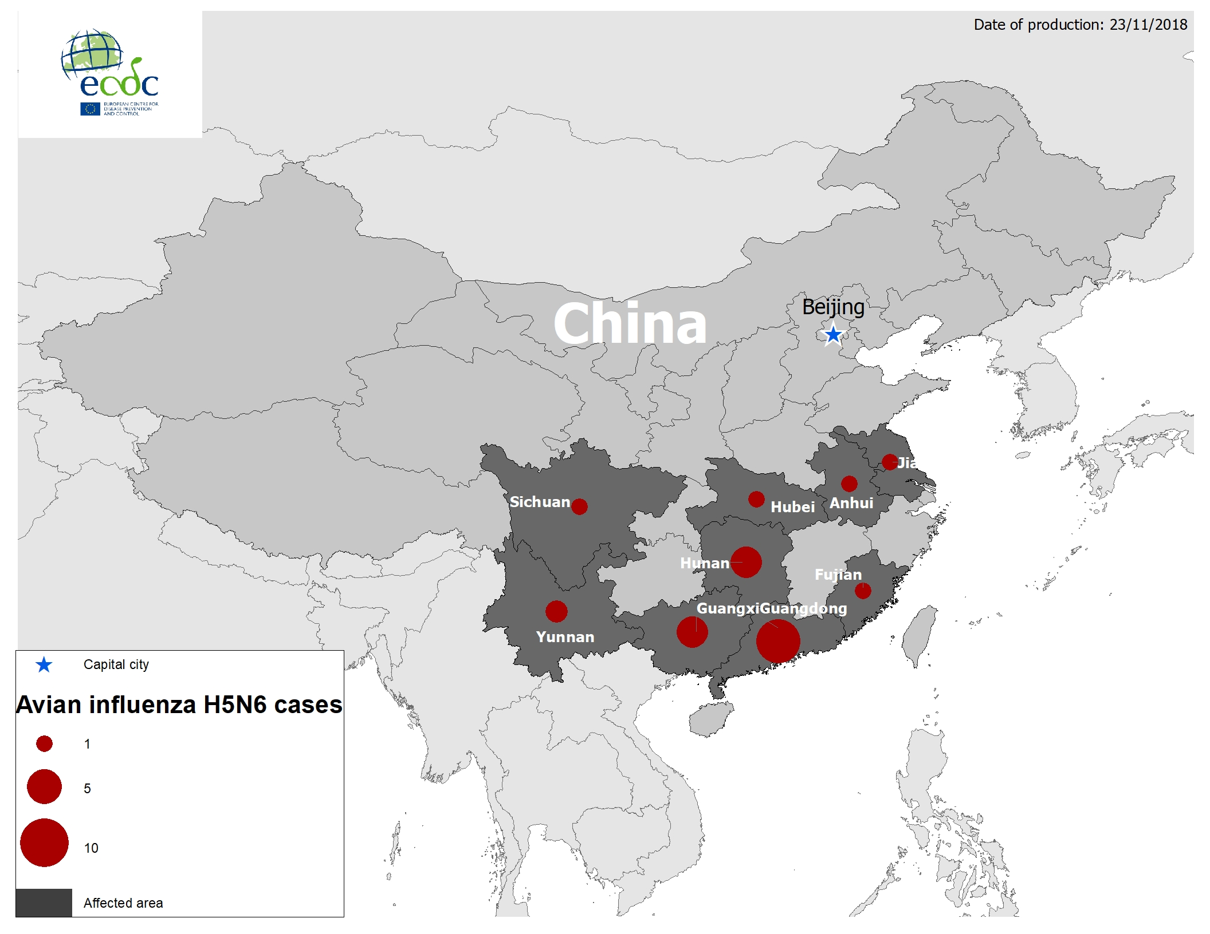
Geographical distribution of confirmed cases of A(H5N6), China, 2014–2018

