Slide 1
Reusable maps and graphs from ECDC Communicable Disease Threats Report
Week 47, 2023
You are encouraged to reuse our maps and graphs for your own purposes and are free to translate them, provided the content is not altered and the source is acknowledged.

Slide 2
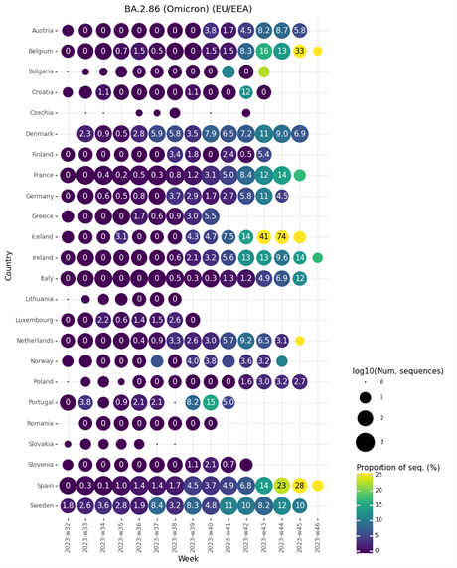
Figure 1. Proportion of sequences belonging to BA.2.86 lineages per sample collection week, EU/EEA, as of 20 November 2023 (GISAID EpiCoV)

Slide 3
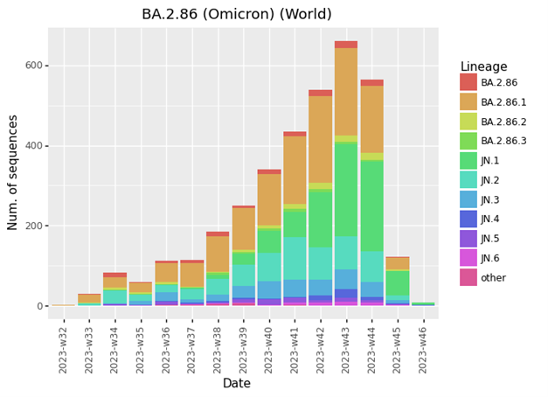
Figure 2. Distribution of BA.2.86 lineages per sample collection week, worldwide, as of 20 November 2023 (GISAID EpiCoV)

Slide 4
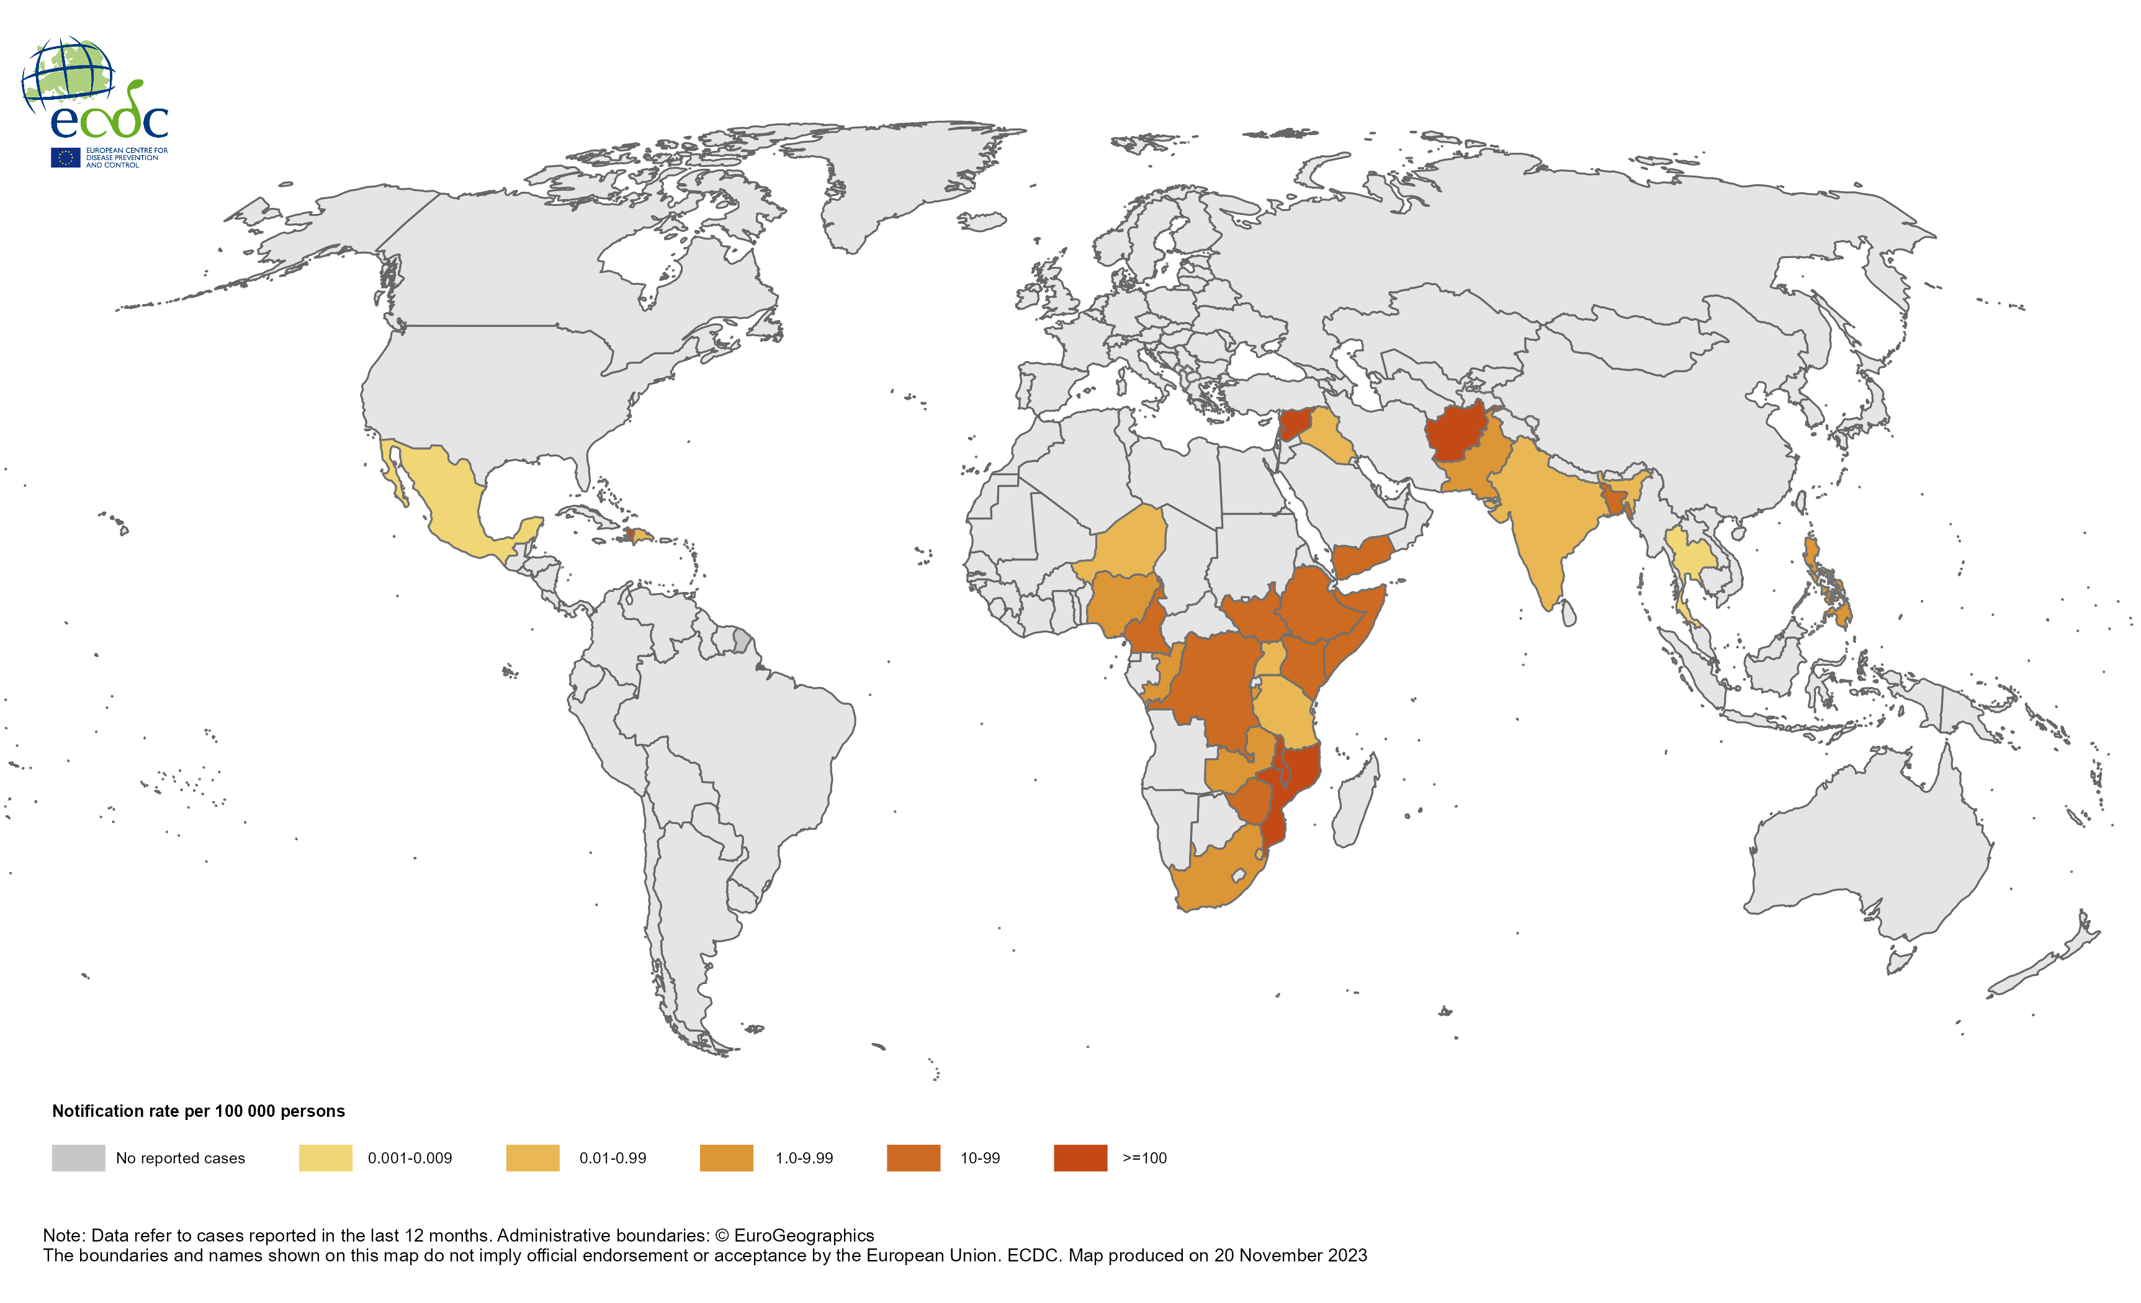
Geographical distribution of cholera cases reported worldwide, November 2022 to October 2023

Slide 5
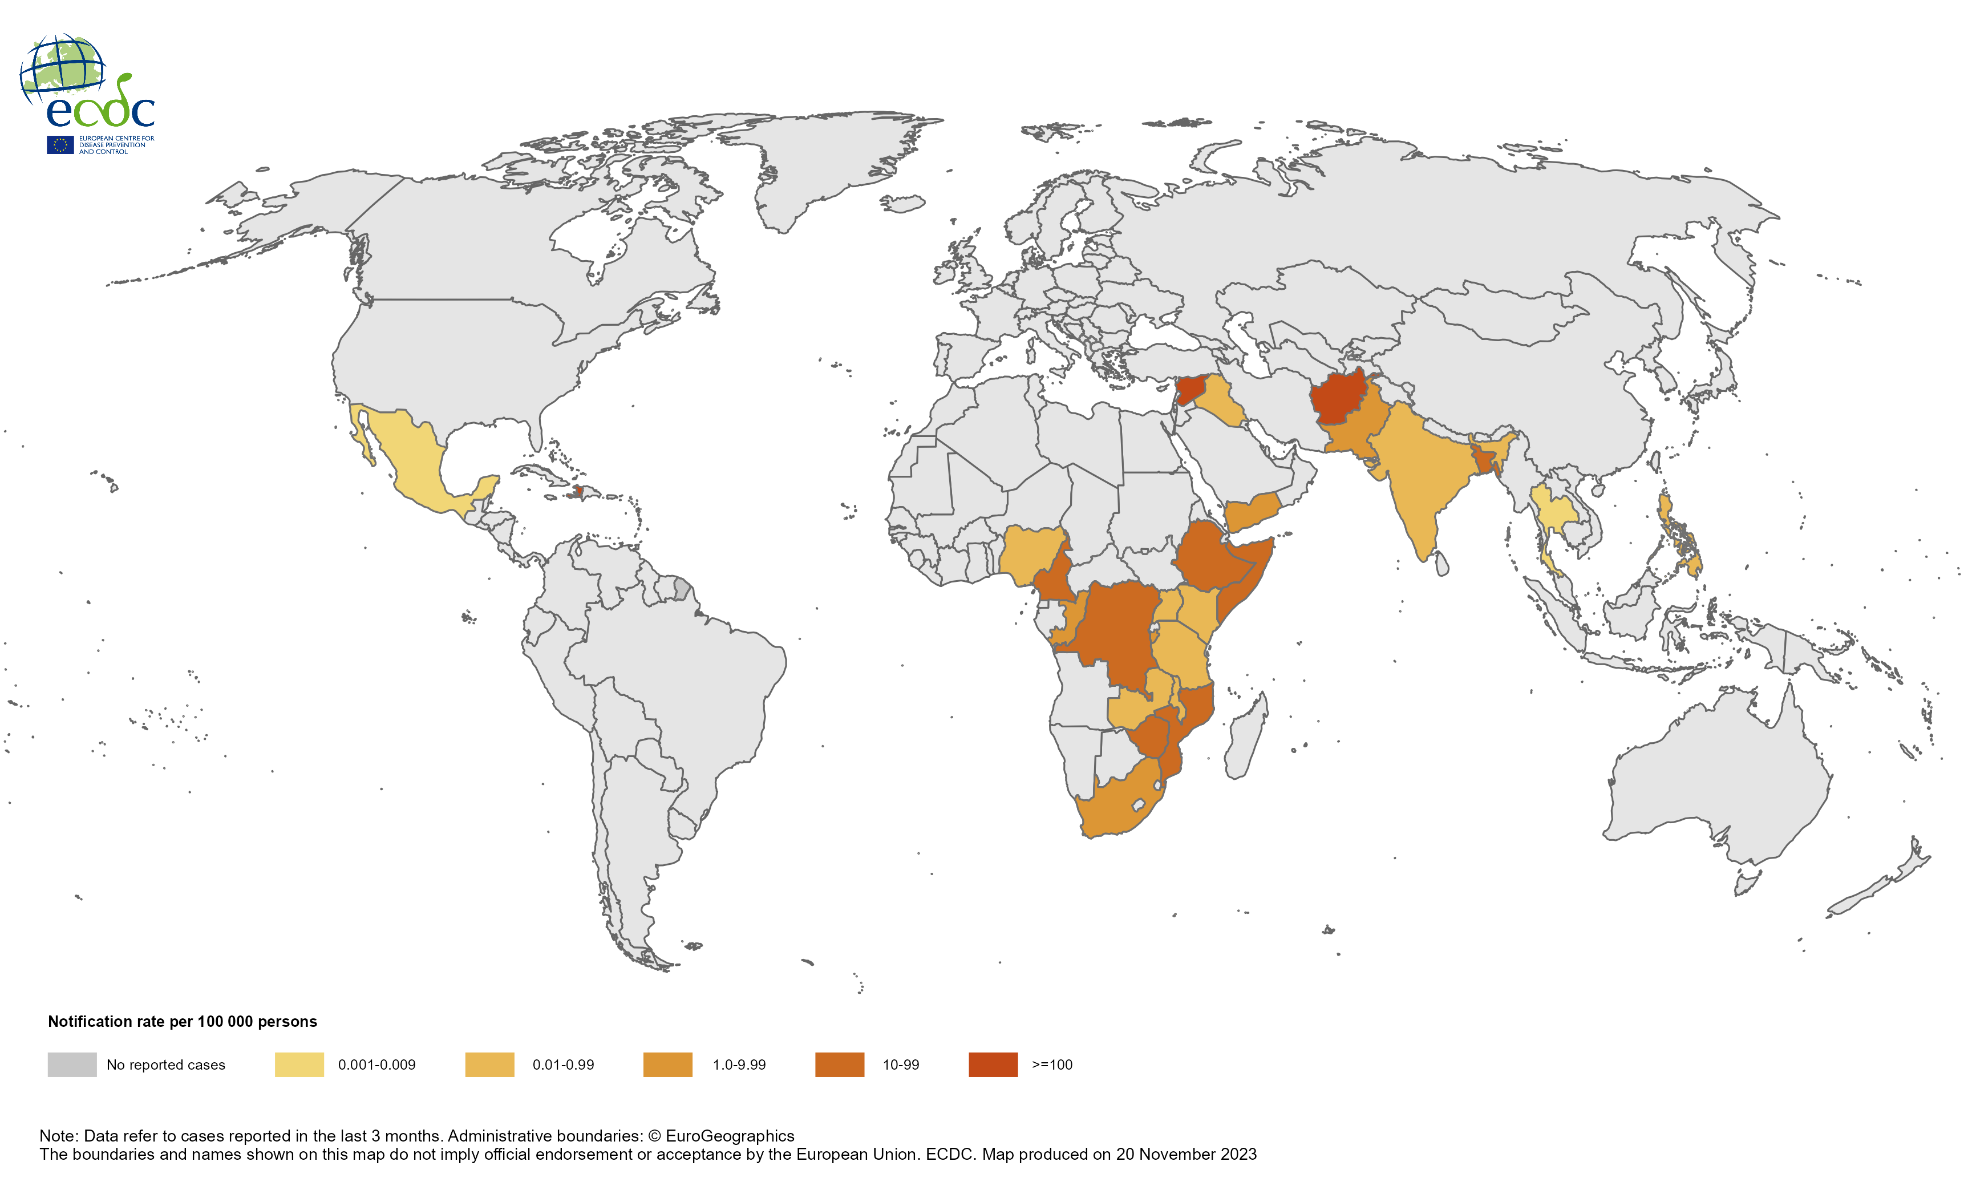
Geographical distribution of cholera cases reported worldwide, August to October 2023

