Slide 1
Reusable maps and graphs from ECDC Communicable Disease Threats Report Week 46, 2022
You are encouraged to reuse our maps and graphs for your own purposes and are free to translate them, provided the content is not altered and the source is acknowledged.

Slide 2
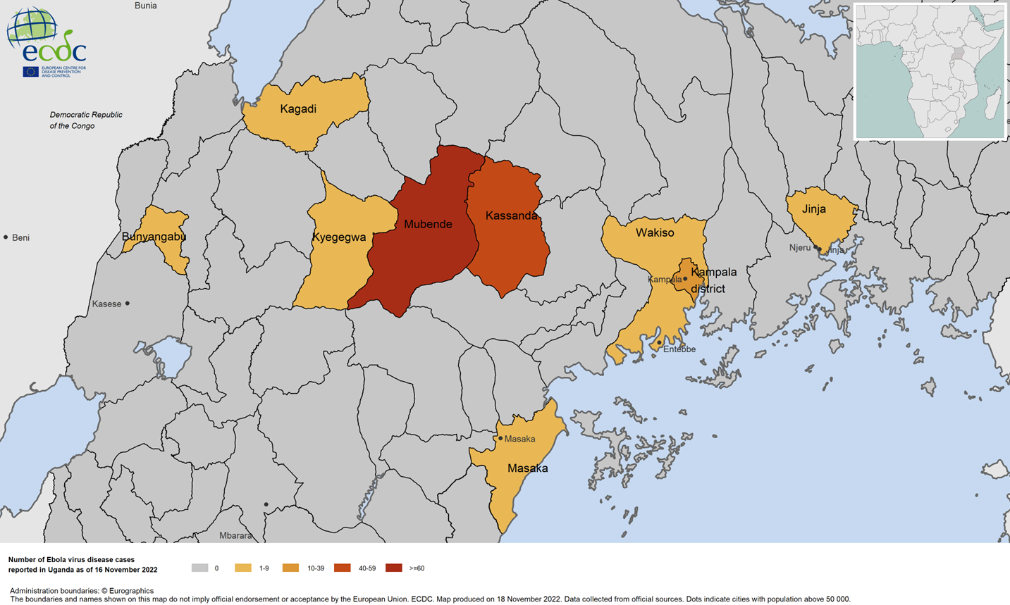
Geographic distribution of EVD cases, Uganda, 2022

