Slide 1
Reusable maps and graphs from ECDC Communicable Disease Threats Report Week 45, 2022
You are encouraged to reuse our maps and graphs for your own purposes and are free to translate them, provided the content is not altered and the source is acknowledged.

Slide 2
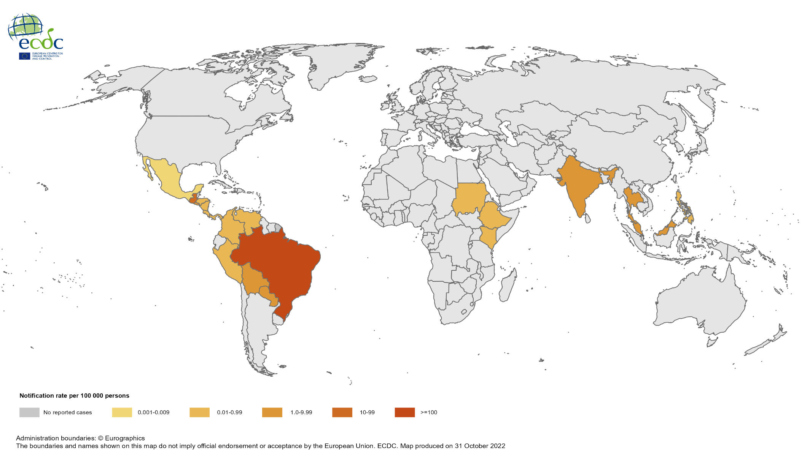
Notification rate of chikungunya cases reported worldwide, November 2021 to October 2022

Slide 3
Notification rate of chikungunya cases reported worldwide, August to October 2022

Slide 4
Notification rate of dengue cases reported worldwide, November 2021 to October 2022

Slide 5
Notification rate of dengue cases reported worldwide, August 2022 to October 2022

Slide 6
Geographic distribution of EVD cases, Uganda, 2022

Slide 7
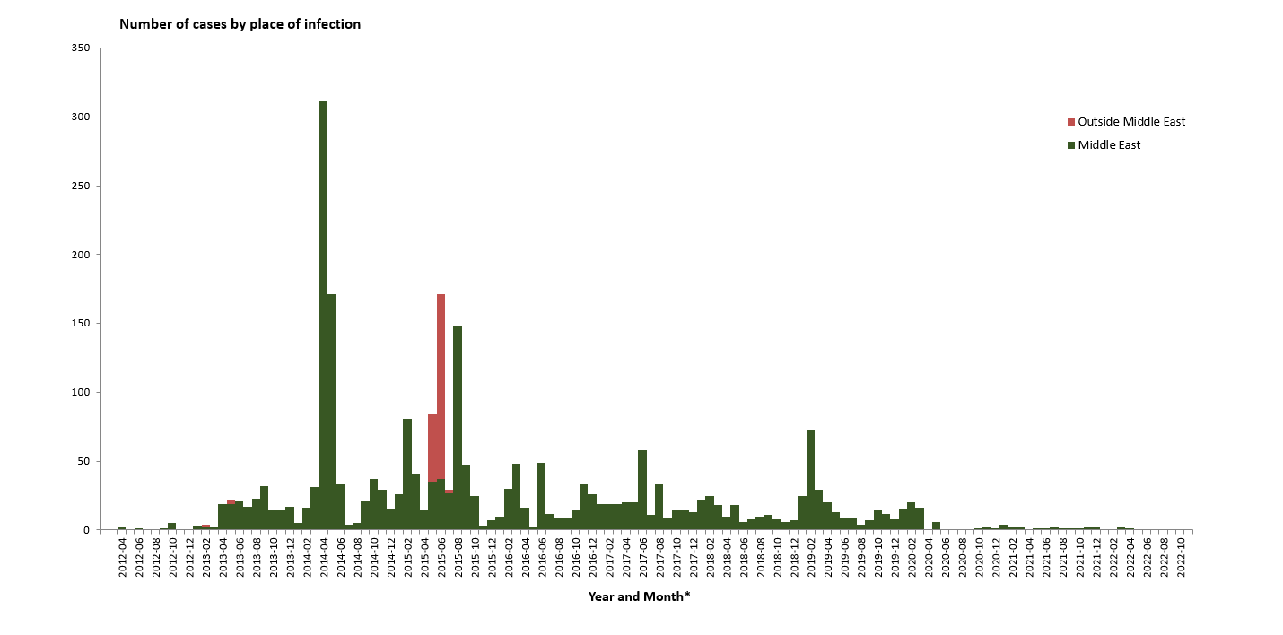
Distribution of confirmed cases of MERS-CoV by place of infection and month of onset, March 2012– November 2022

Slide 8
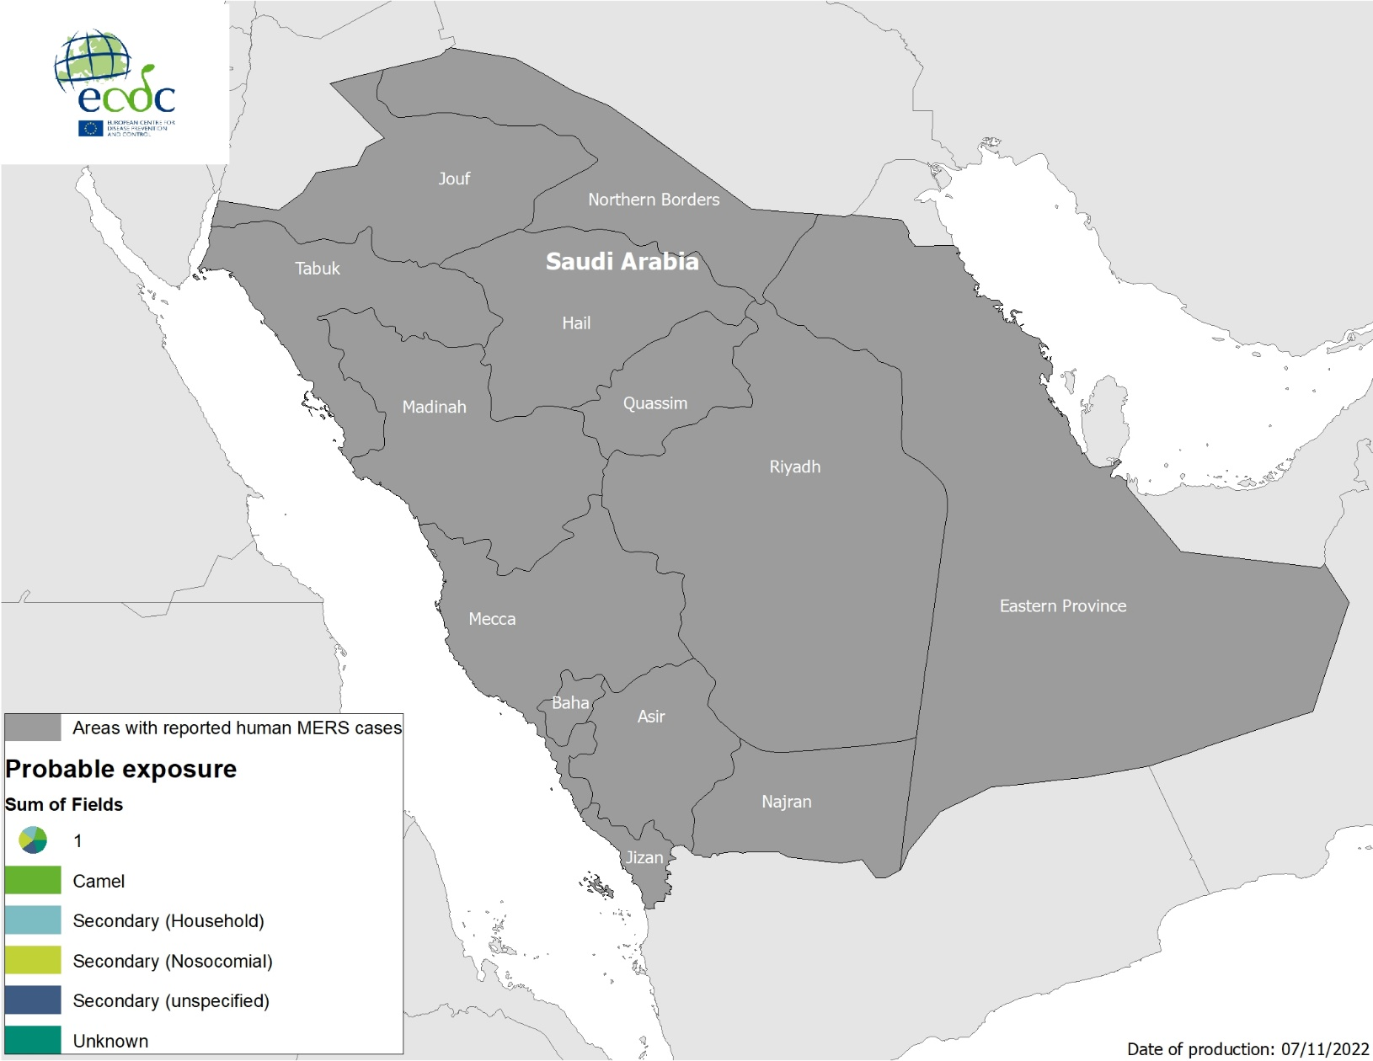
Geographical distribution of confirmed cases of MERS-CoV by probable region of infection and exposure, 1 January 2022 – 7 November 2022

Slide 9
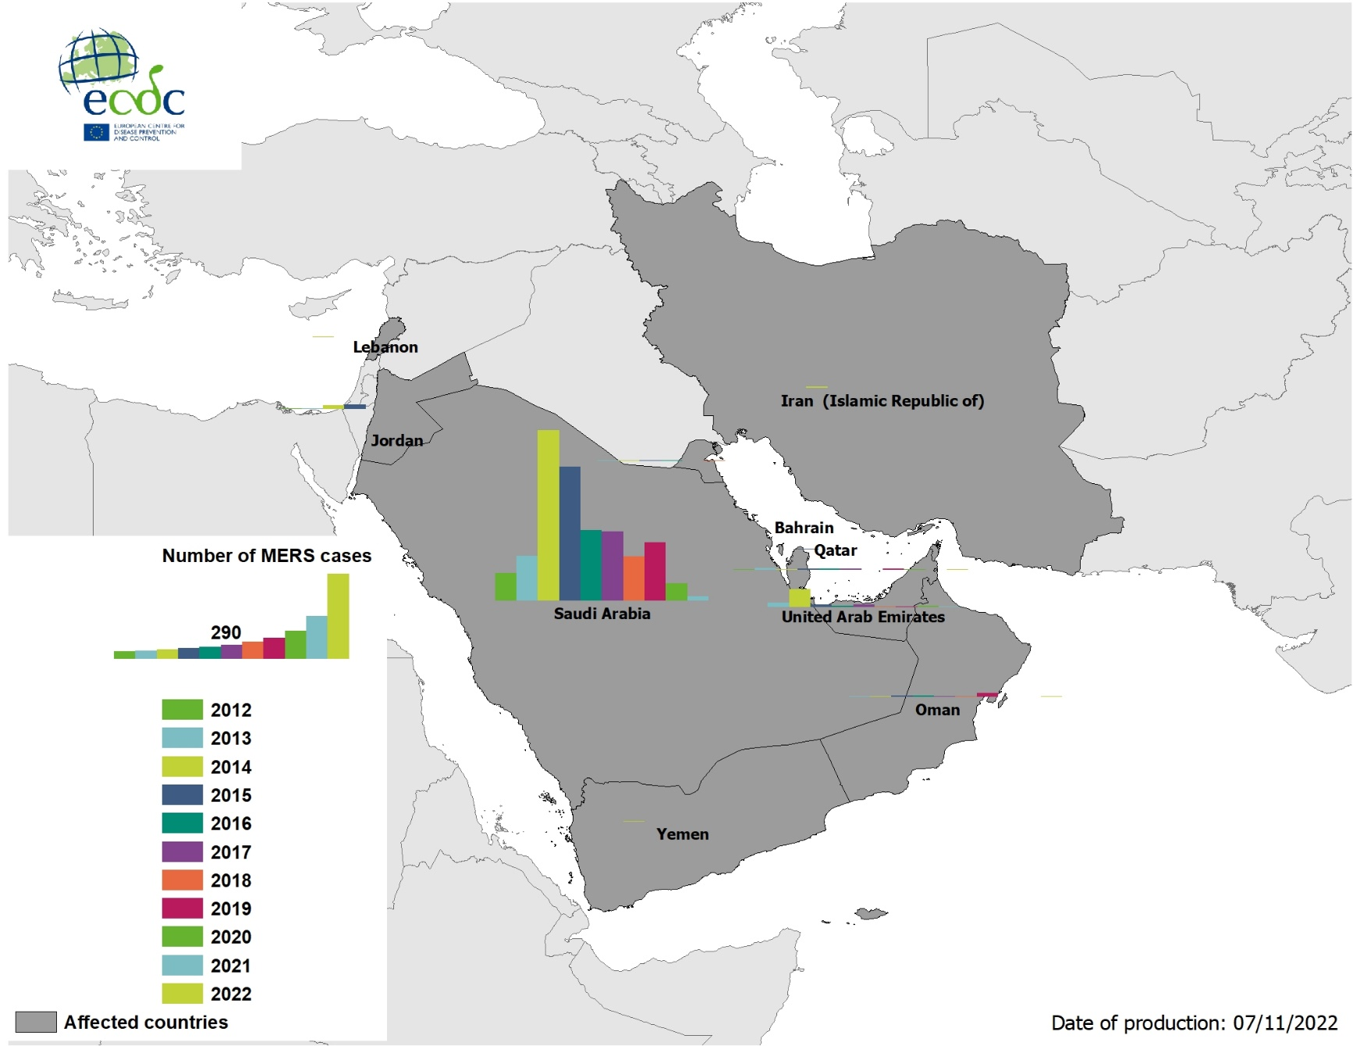
Geographical distribution of confirmed cases of MERS-CoV by country of infection and year, April 2012– 7 November 2022

Slide 10
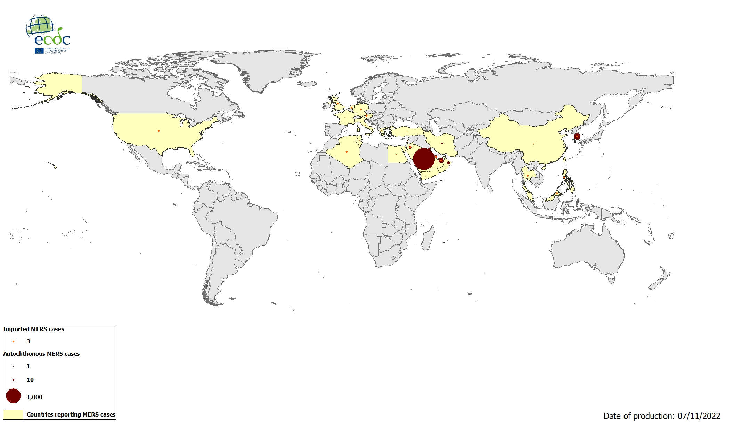
Geographical distribution of confirmed cases of MERS-CoV by reporting country, April 2012 - November 2022

