Slide 1
Reusable maps and graphs from ECDC Communicable Disease Threats Report Week 44, 2022
You are encouraged to reuse our maps and graphs for your own purposes and are free to translate them, provided the content is not altered and the source is acknowledged.

Slide 2
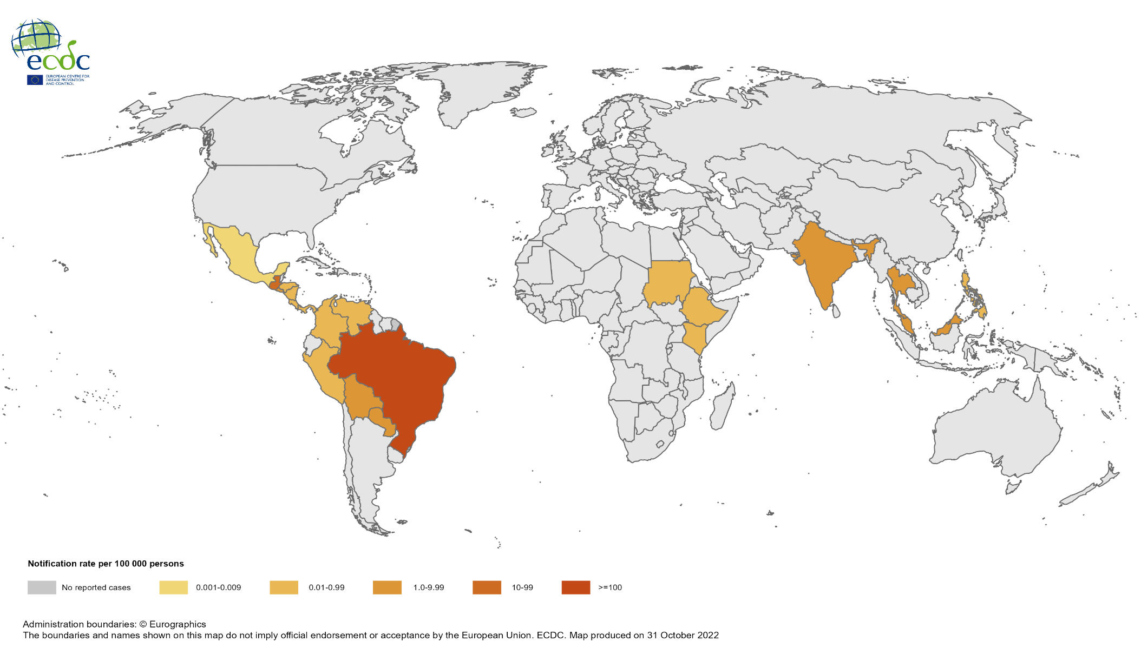
Notification rate of chikungunya cases reported worldwide, November 2021 to October 2022

Slide 3
Notification rate of chikungunya cases reported worldwide, August to October 2022

Slide 4
Notification rate of dengue cases reported worldwide, November 2021 to October 2022

Slide 5
Notification rate of dengue cases reported worldwide, August 2022 to October 2022

Slide 6
Geographic distribution of EVD cases, Uganda, 2022

