Slide 1
Reusable maps and graphs from ECDC Communicable Disease Threats Report
Week 44, 2019
You are encouraged to reuse our maps and graphs for your own purposes and free to translate, provided the content is not altered and the source is acknowledged.

Slide 2
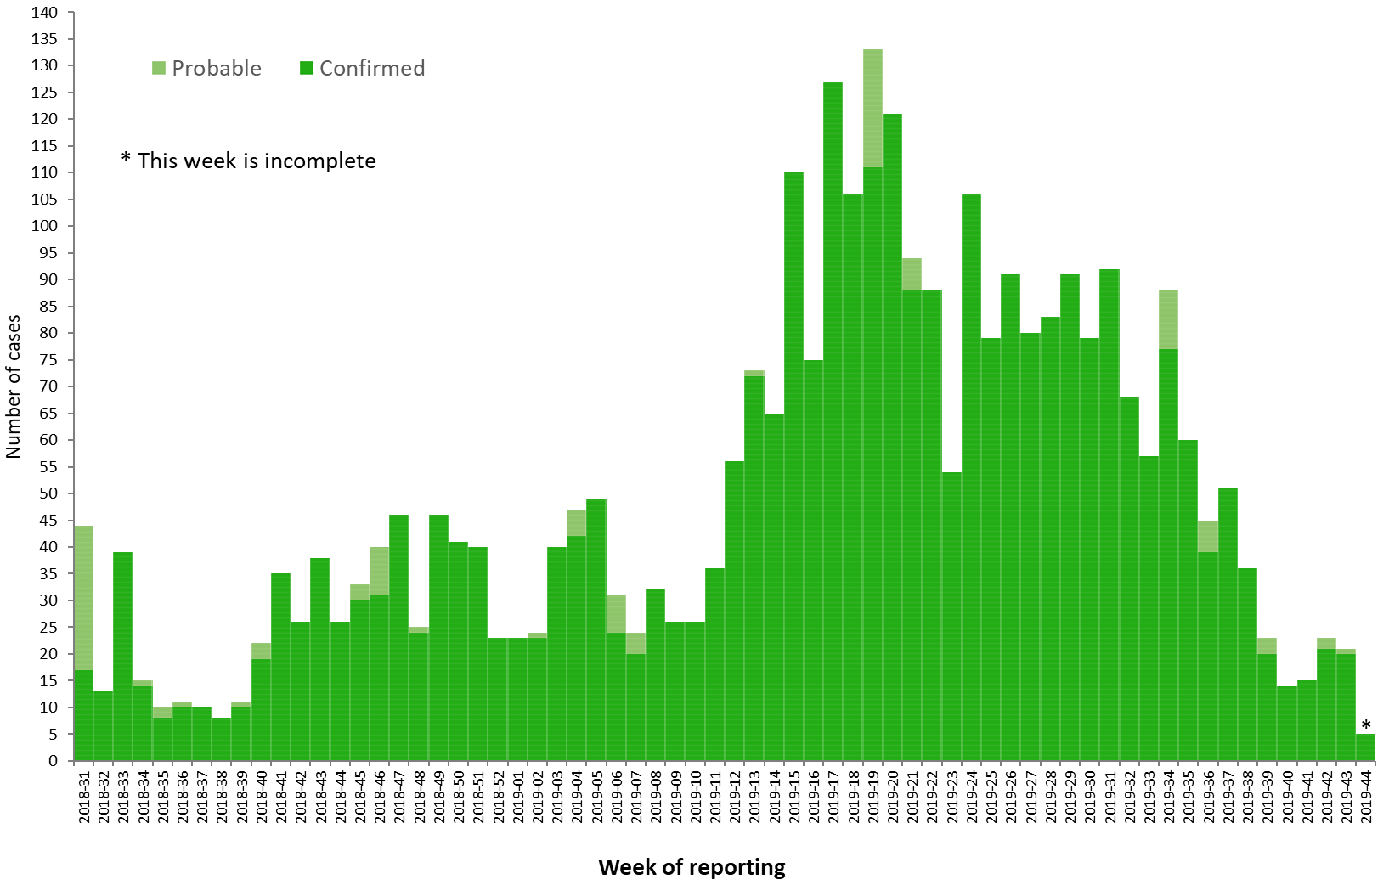
Distribution of confirmed and probable cases of Ebola virus disease by week of reporting, Democratic Republic of the Congo and Uganda, as of 29 October 2019

Slide 3
Ebola Virus Disease case distribution in DRC and Uganda as of 29 October 2019

Slide 4
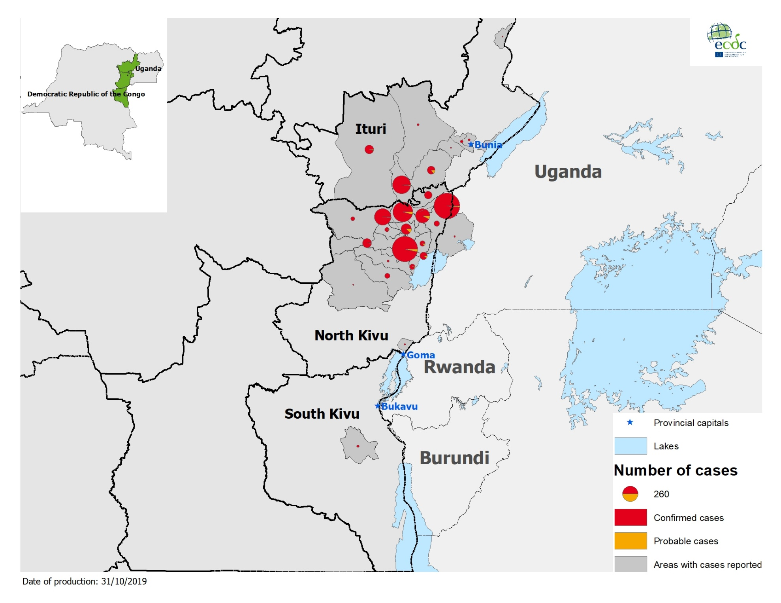
Geographical distribution of confirmed and probable cases of Ebola virus disease,
Democratic Republic of the Congo and Uganda as of 29 October 2019

Slide 5
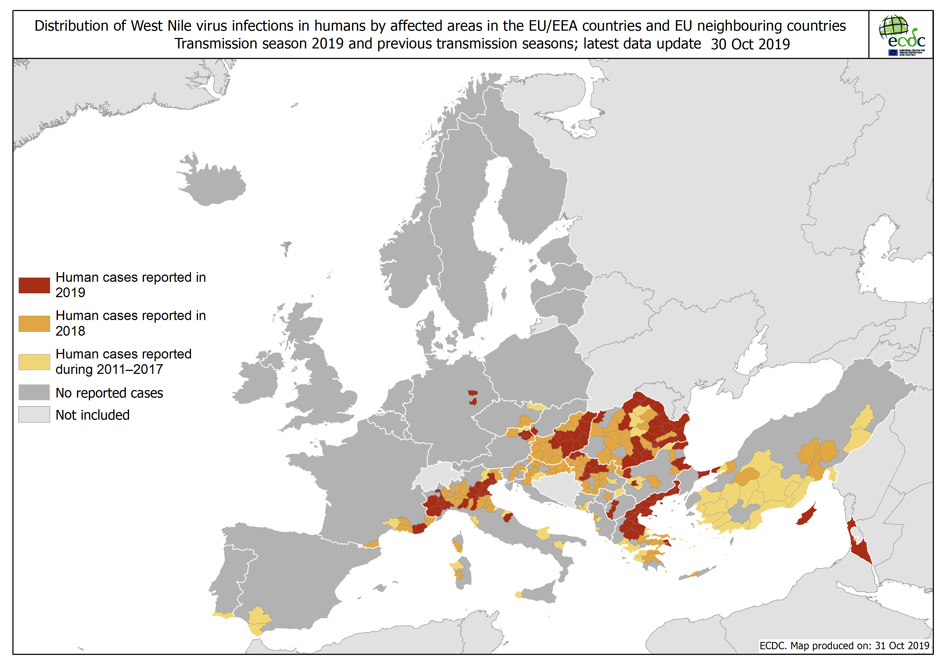

Slide 6
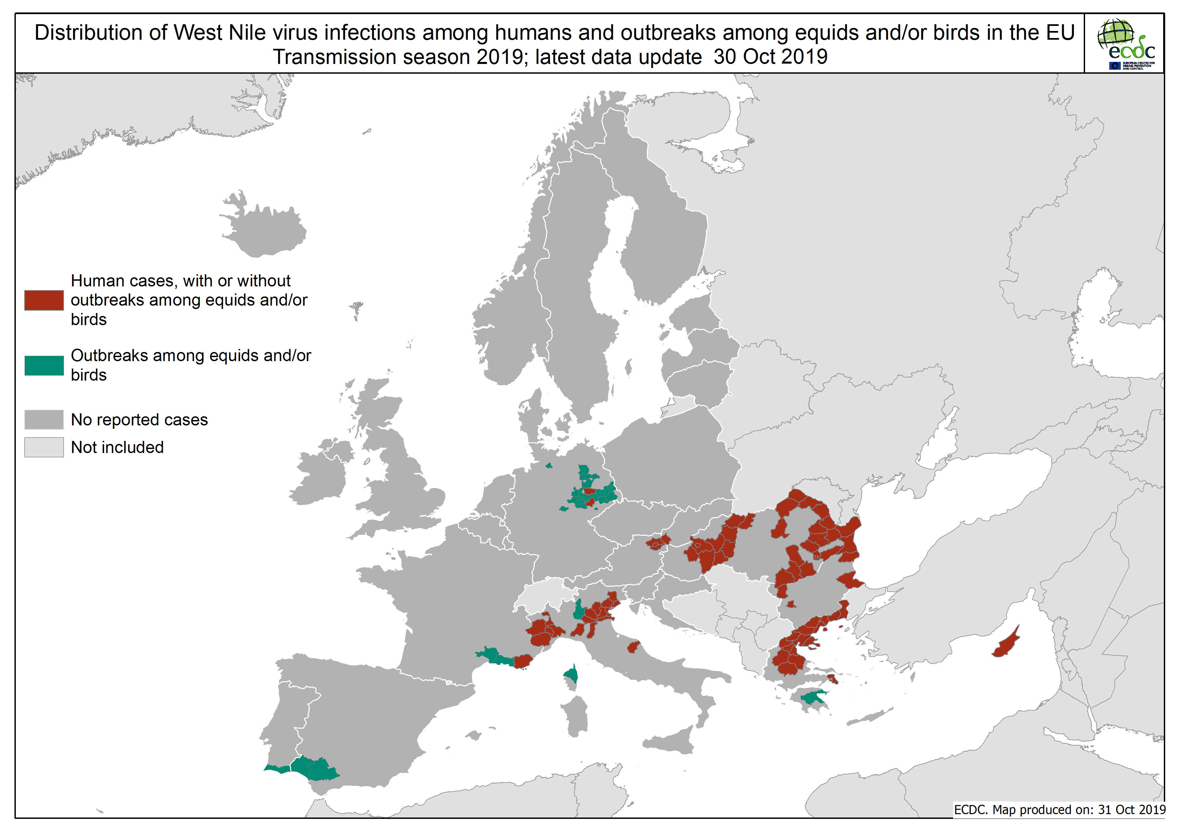

Slide 7
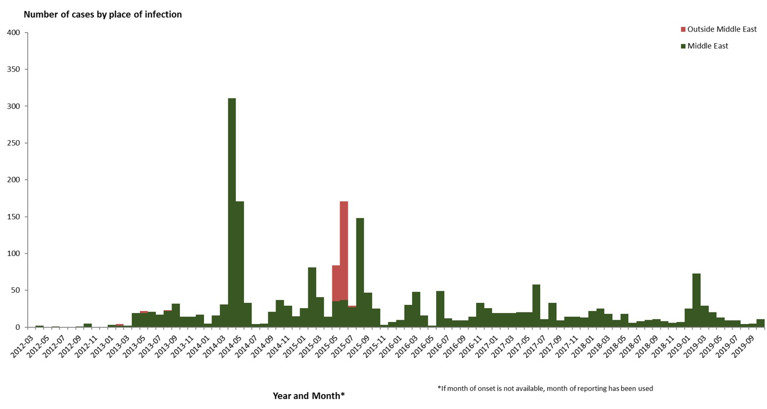
Distribution of confirmed cases of MERS-CoV by place of infection and month of onset,
March 2012–30 October 2019

Slide 8
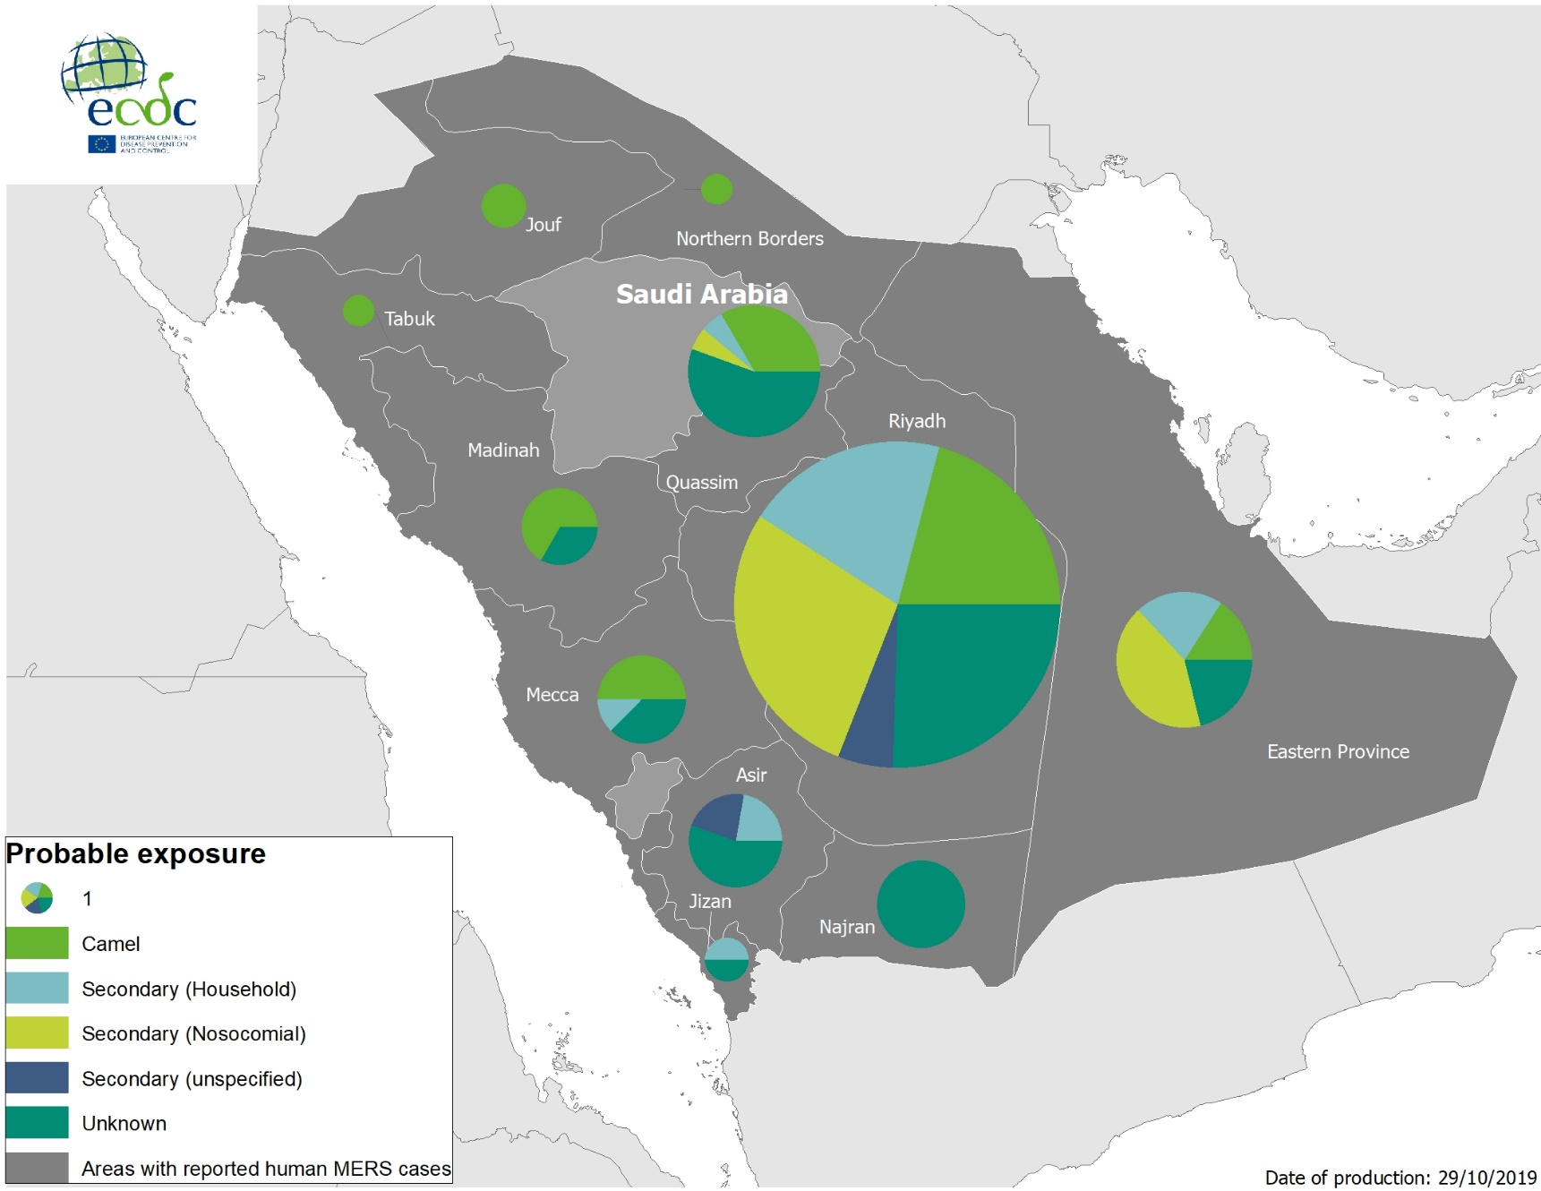
Geographical distribution of confirmed MERS-CoV cases by probable region of infection and exposure, April 2012–30 October 2019

Slide 9
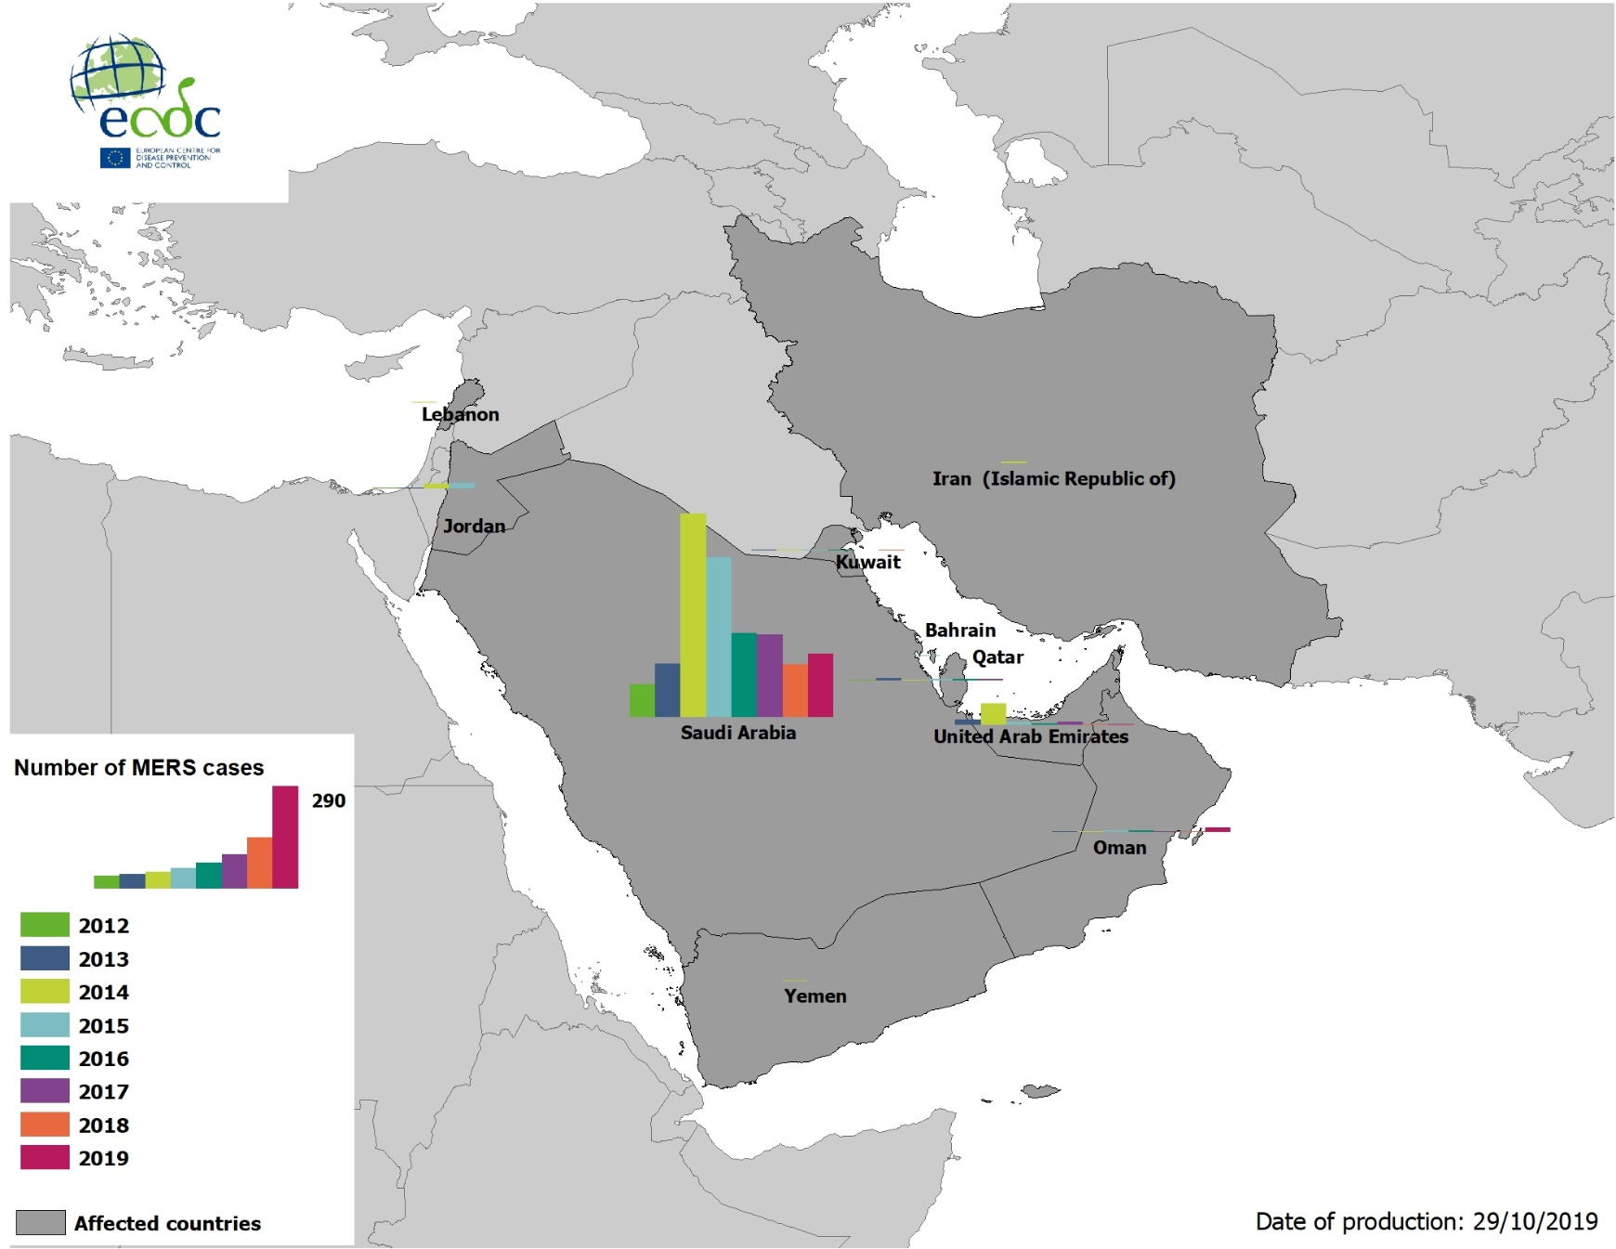
Geographical distribution of confirmed MERS-CoV cases by country of infection and year, April 2012–30 October 2019

Slide 10
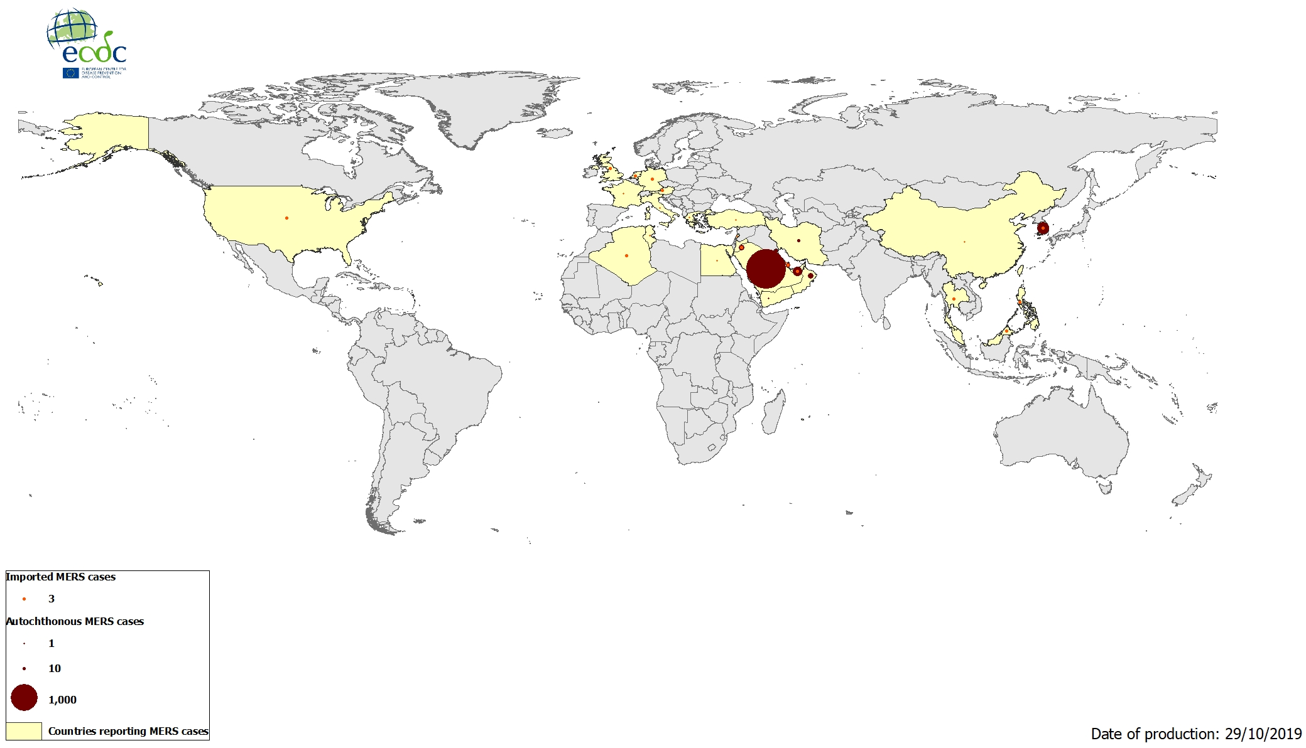
Geographical distribution of confirmed MERS-CoV cases by reporting country,
April 2012–30 October 2019

