Slide 1
Reusable maps and graphs from ECDC Communicable Disease Threats Report
Week 42, 2022
You are encouraged to reuse our maps and graphs for your own purposes and are free to translate them, provided the content is not altered and the source is acknowledged.

Slide 2
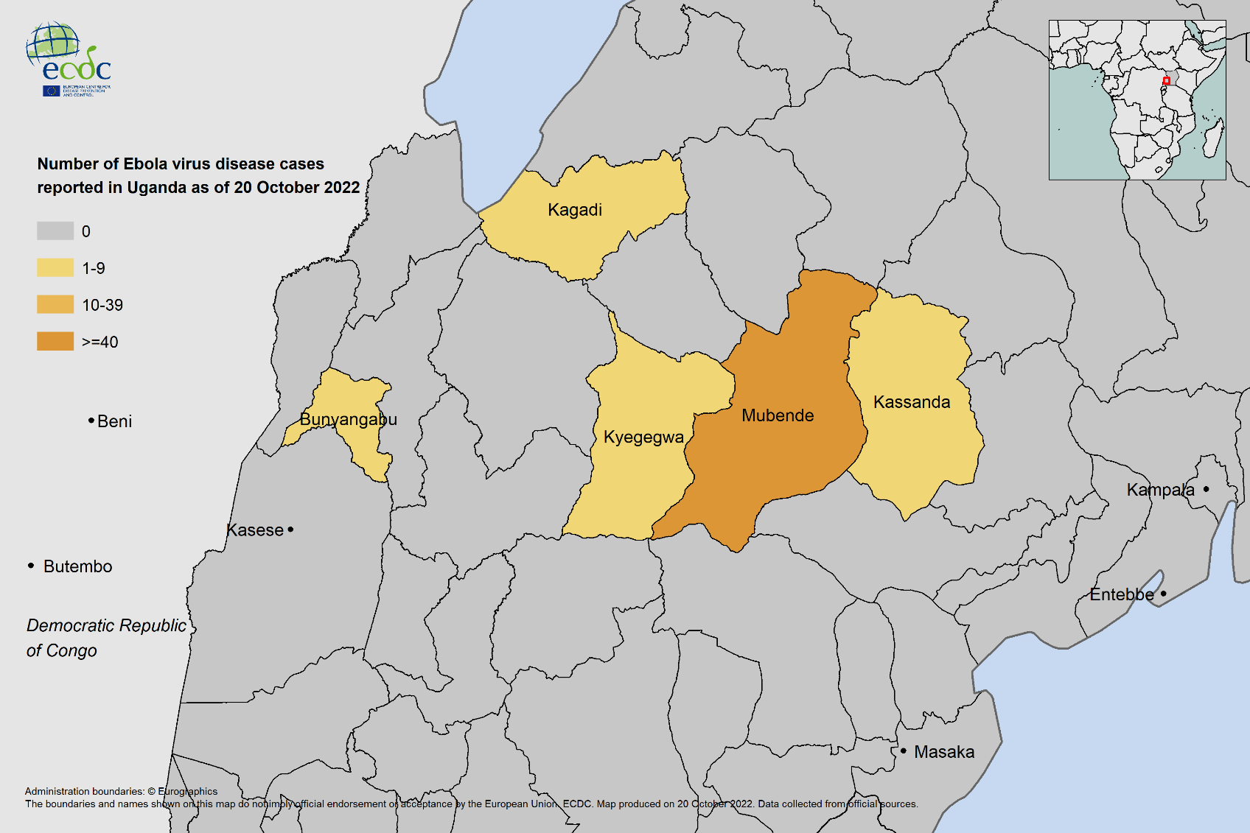
Geographic distribution of Ebola Virus Disease (EVD) cases, Uganda, 2022

Slide 3
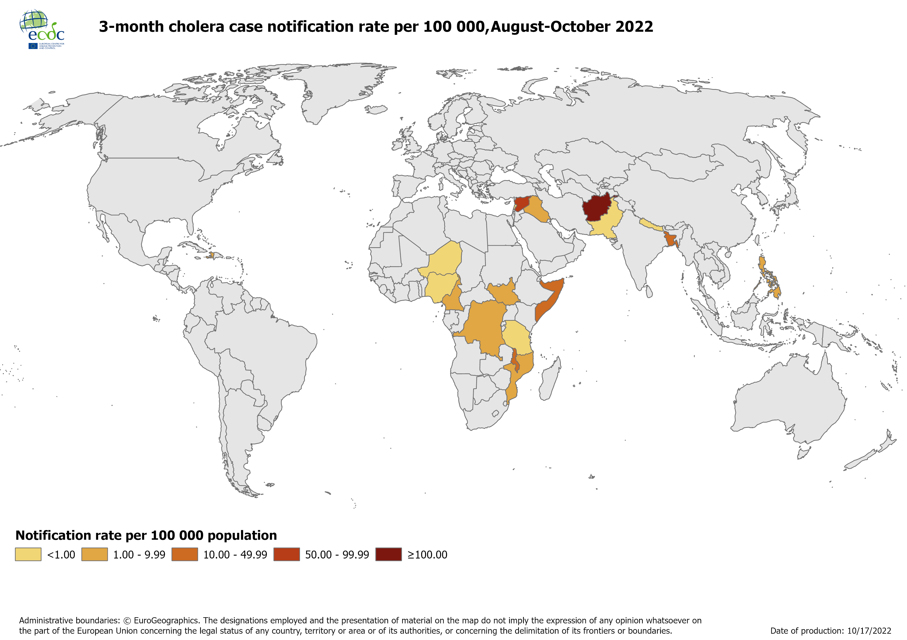
Three-month cholera case notification rate per 100 000, August-October 2022

Slide 4
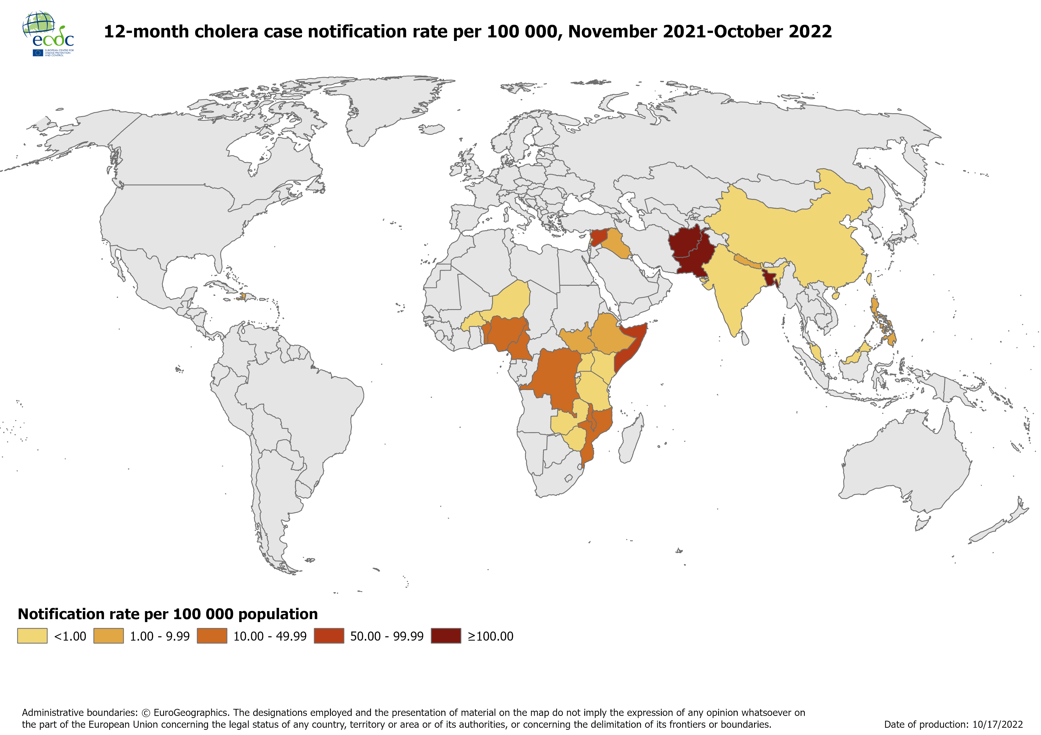
Twelve-month cholera case notification rate per 100 000, November 2021-October 2022

Slide 5
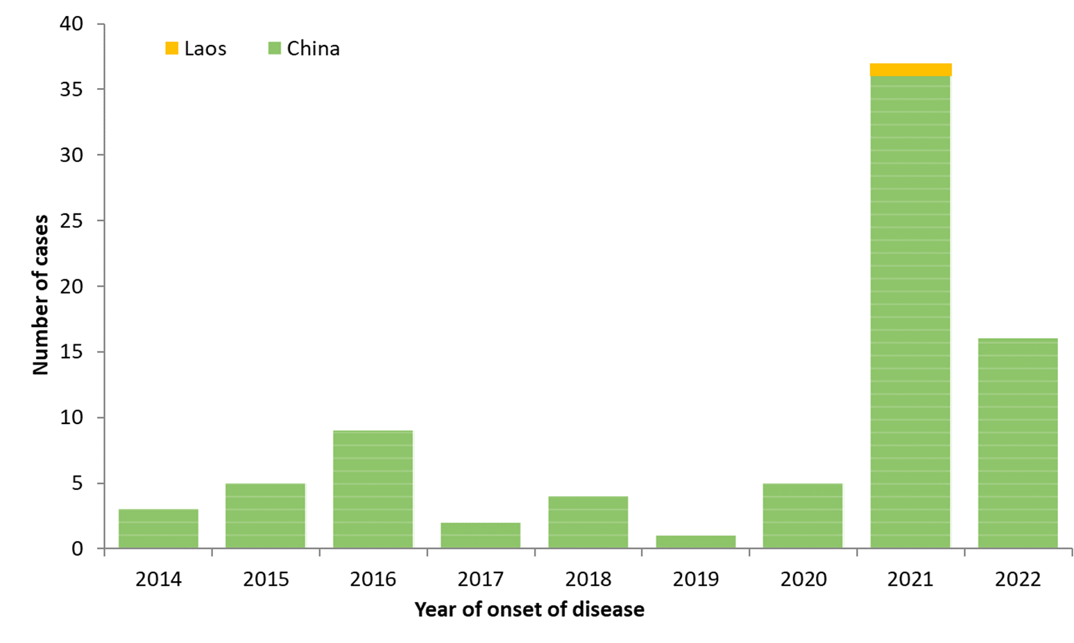
Distribution of confirmed human cases of avian influenza A(H5N6) virus infection by year of onset and country,
2014–20 October 2022 (n=82)

Slide 6
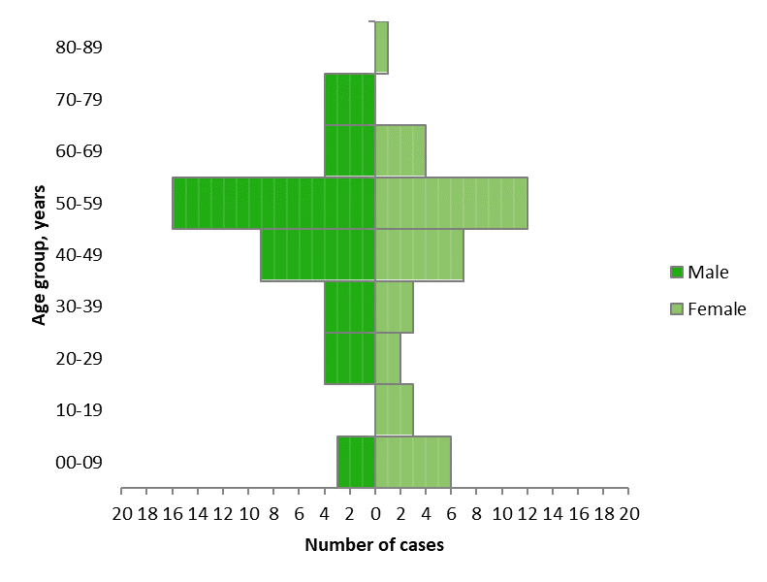
Distribution of confirmed human cases of avian influenza A(H5N6) virus infection by age and sex, 2014–20 October 2022 (n=82)

