Slide 1
You are encouraged to reuse our maps and graphs for your own purposes and free to translate, provided the content is not altered and the source is acknowledged. Either copy the images from the following slides or download directly from: ecdc.europa.eu/en/publications/surveillance_reports/Communicable-Disease-Threats-Report/Pages/cdtr.aspx
European Centre for Disease Prevention and Control
Reusable maps and graphs from ECDC Communicable Disease Threats Report, week 42, 2017

Slide 2
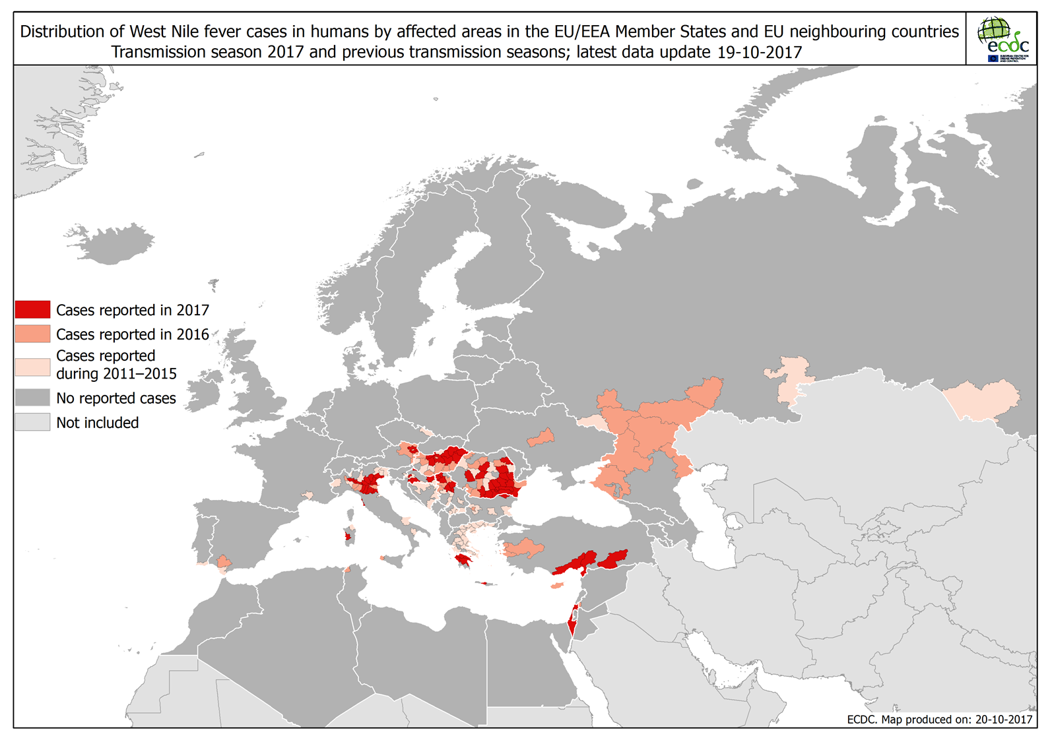

Slide 3
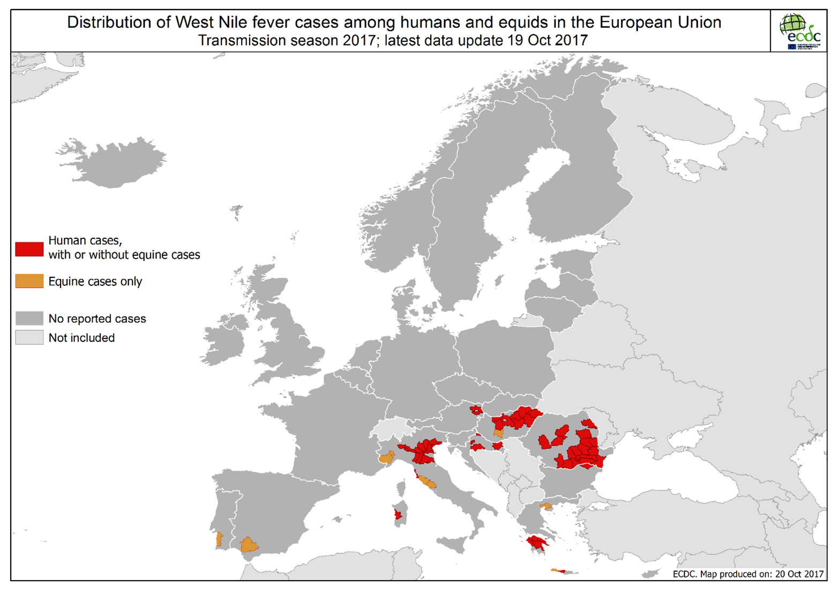

Slide 4
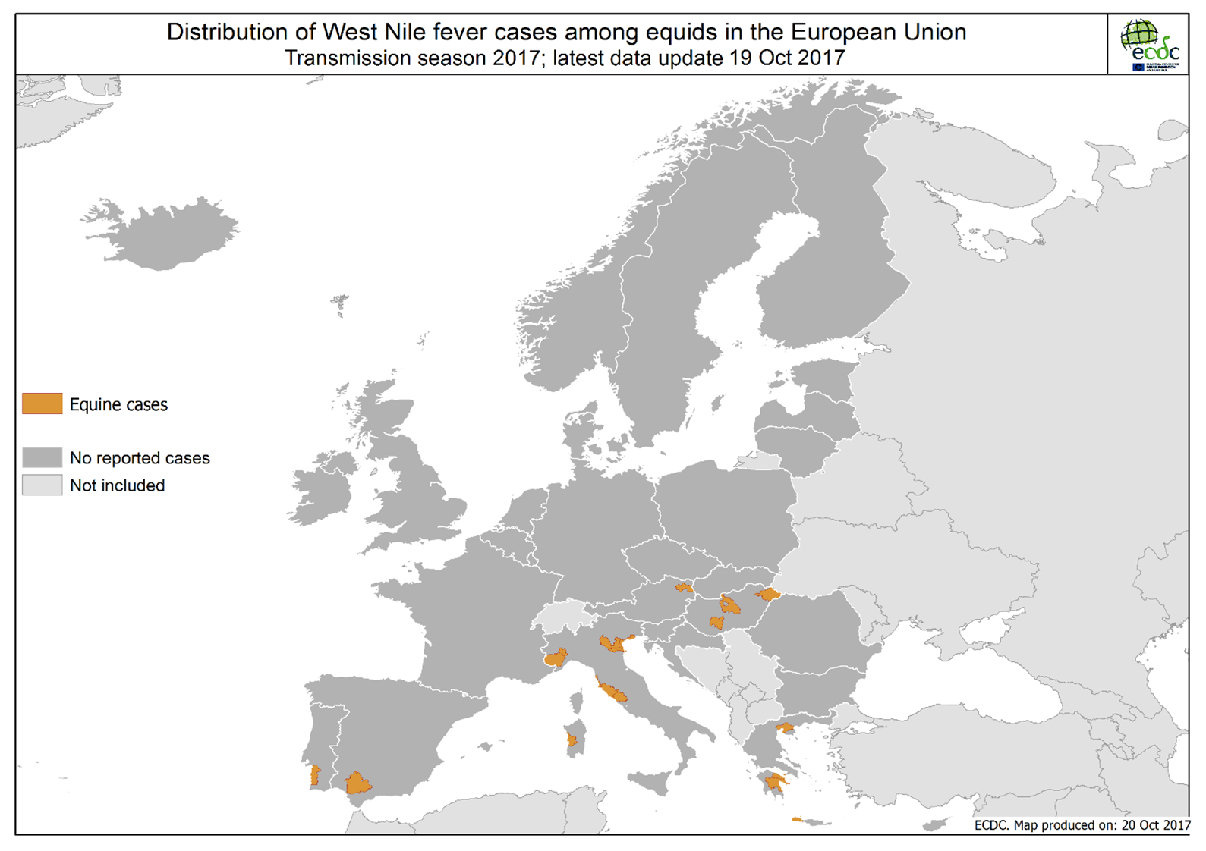

Slide 5
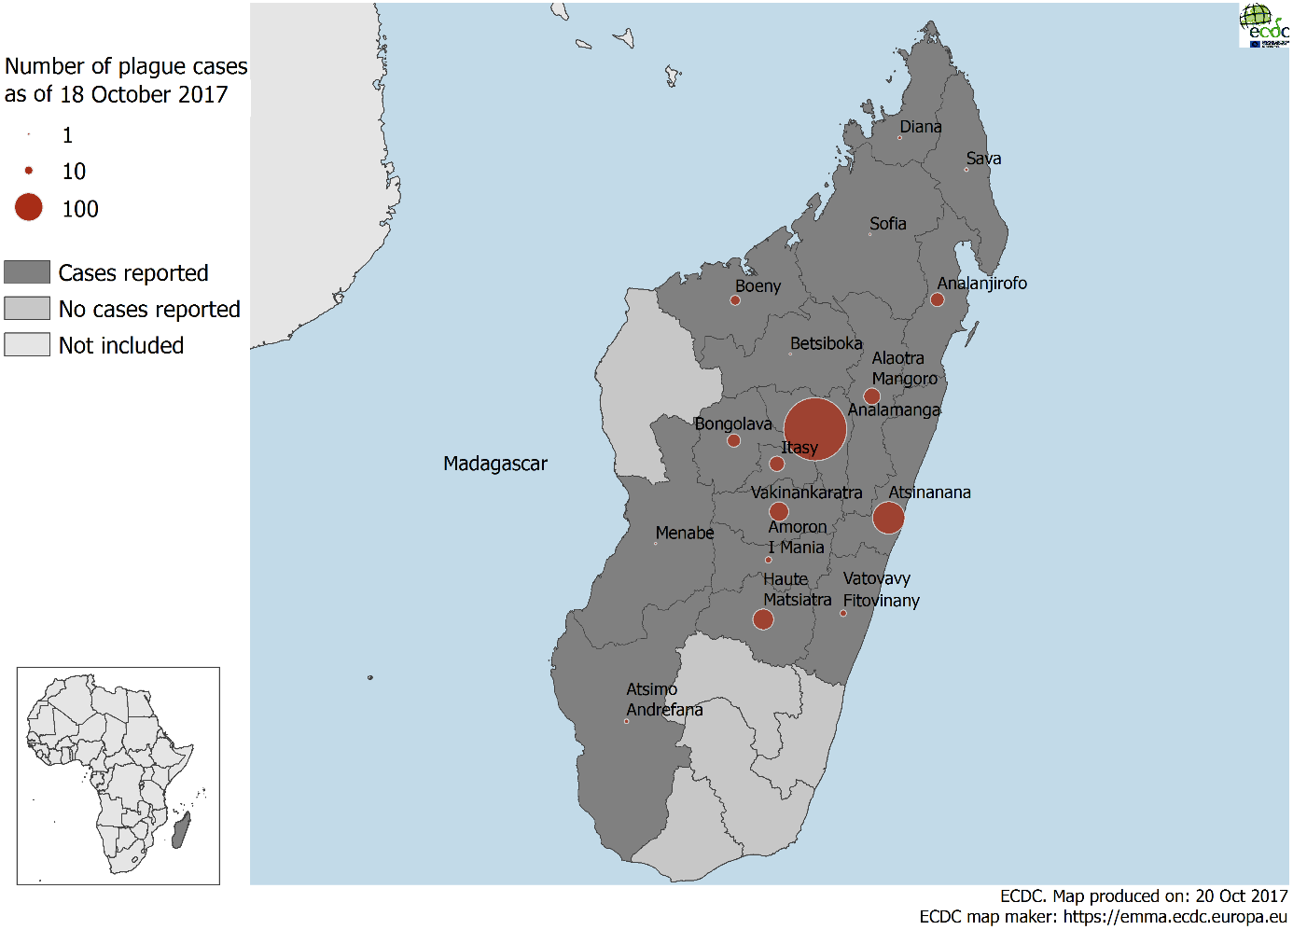
Plague cases from 1 August 2017 to 18 October 2017 in Madagascar

Slide 6
Plague cases by week of report, week 2017-37 to 2017- 42, Madagascar
*
Please note that there is still uncertainty on the correct numbers due to case reclassification and reporting delays

Slide 7
Pneumonic plague cases by week of report, week 2017-37 to 2017- 42, Madagascar
*
Please note that there is still uncertainty on the correct numbers due to case reclassification and reporting delays

