Slide 1
Reusable maps and graphs from ECDC Communicable Disease Threats Report
Week 41, 2020
You are encouraged to reuse our maps and graphs for your own purposes and free to translate, provided the content is not altered and the source is acknowledged.

Slide 2
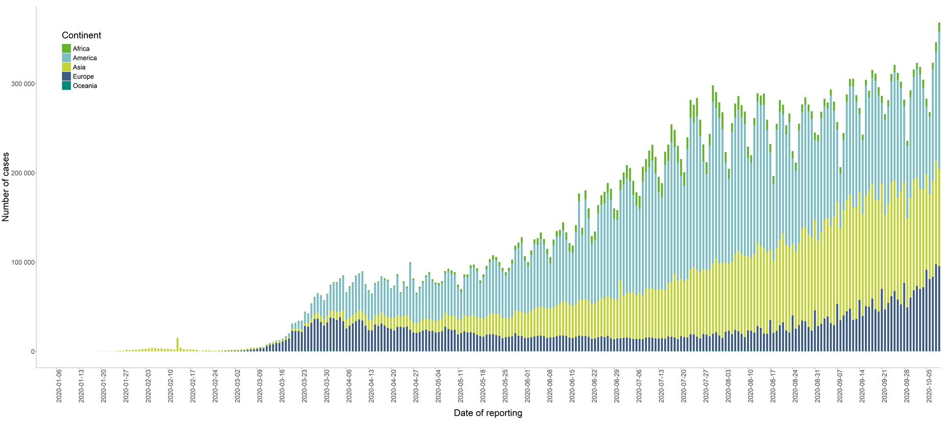
Distribution of COVID-19 cases* in accordance with the applied case definitions in the affected countries, as of 09 October 2020
*Spain: Since 11 May, the frequency of reporting from regional level to national level has changed. This may lead to possible discrepancies in cases and death numbers due to data validation. This discrepancy could persist for several days. The cases reported in this table for Spain include cases from the previous seven days with available data at the time of data collection.
*Sweden: from end of August 2020, Swedish authorities are performing daily data consolidation leading to data retro-corrections. From week 38, the Swedish Public Health Agency will update COVID-19 daily data four times per week on Tuesday–Friday. This can result in a decrease of cumulative figures (cases or deaths) and related outputs.

Slide 3
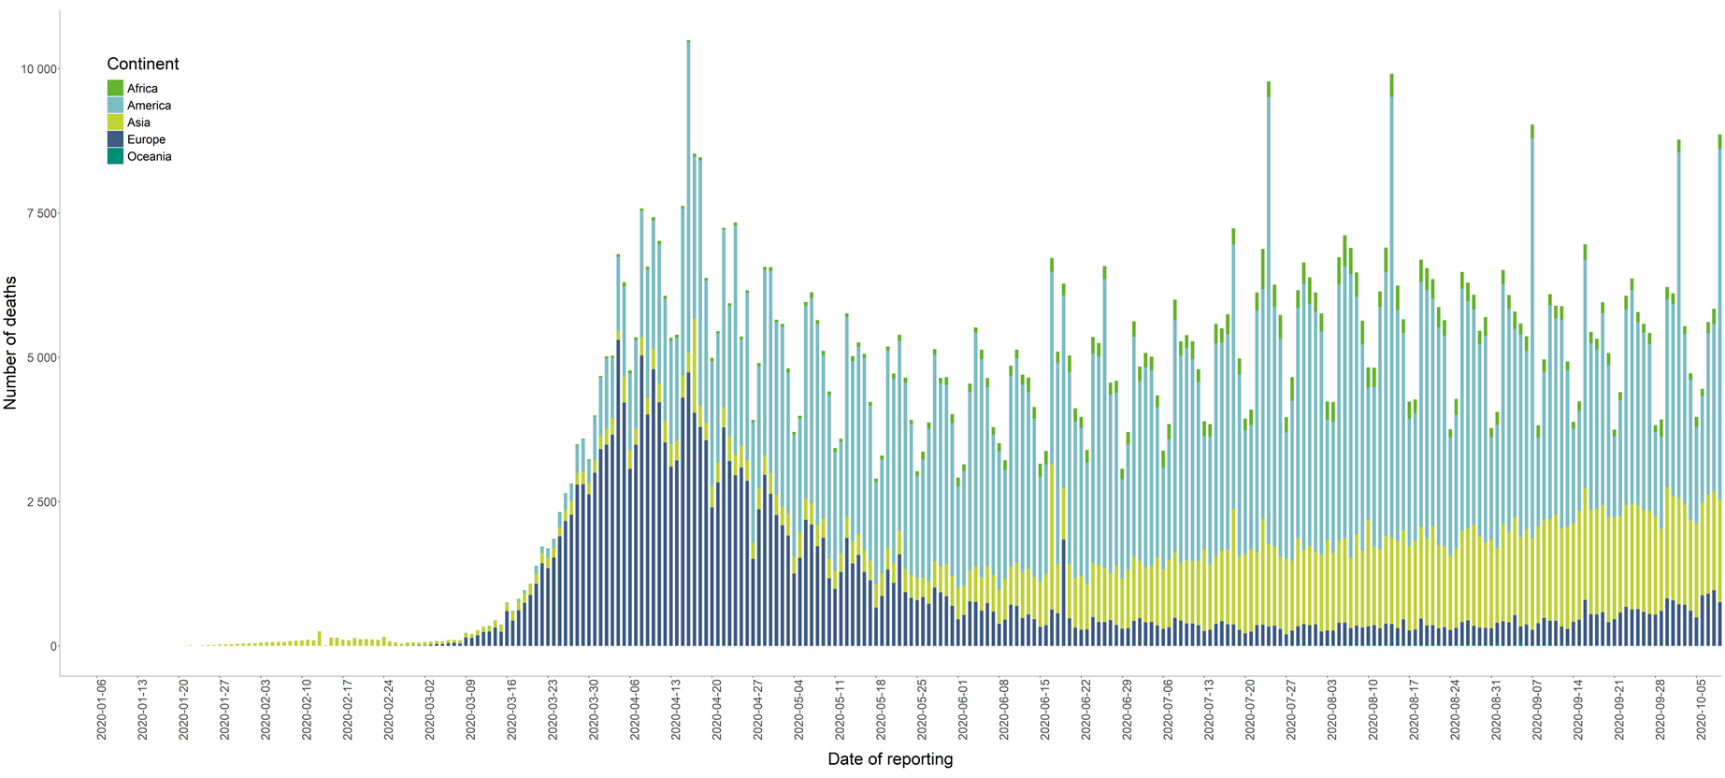
Distribution of COVID-19 deaths* worldwide, as of 9 October 2020
*According to media, the increase in deaths in Asia on 17 June is attributable to an increase in India as a result of a data reconciliation process in several states. https://timesofindia.indiatimes.com/india/2k-more-covid-deaths-cases-rise-to-3-5-lakh/articleshow/76415524.cms
Spain: Since 11 May, the frequency of reporting from regional level to national level has changed. This may lead to possible discrepancies in cases and death numbers due to data validation. This discrepancy could persist for several days. The cases reported in this table for Spain include cases from the previous 7 days with available data at the time of data collection. On 12 August 2020, Spain retro corrected the cumulative number of deaths leading to a negative increase of deaths.
*Sweden: from end of August 2020, Swedish authorities are performing daily data consolidation leading to data retro-corrections. From week 38, the Swedish Public Health Agency will update COVID-19 daily data four times per week on Tuesday–Friday. This can result in a decrease of cumulative figures (cases or deaths) and related outputs.
On 18 July, the increase in deaths is partly attributable to changes in the reporting system for Chile and Kyrgyzstan.
On 24 July, the increase in deaths is partly attributable to the inclusion of deaths by Peru (from March to the end of June) which were previously not reported.

Slide 4
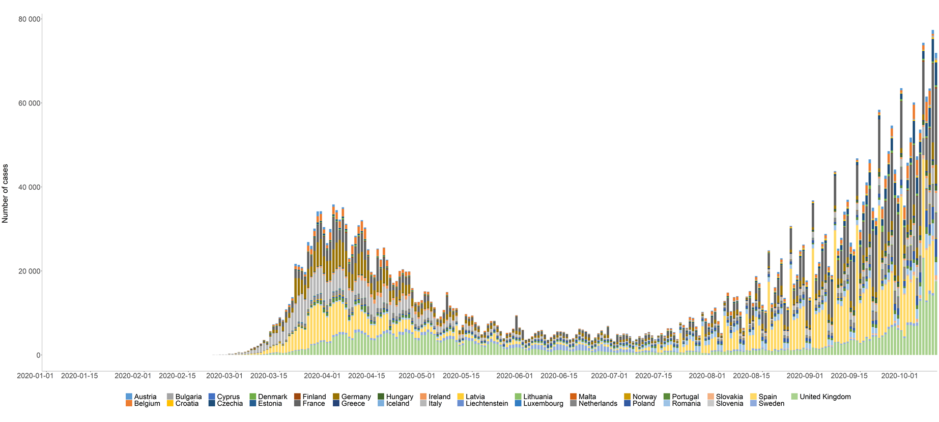
Distribution of laboratory-confirmed cases* of COVID-19 in EU/EEA and the UK, as of 9 October 2020
*Spain: Since 11 May, the frequency of reporting from regional level to national level has changed. This may lead to possible discrepancies in cases and death numbers due to data validation. This discrepancy could persist for several days. The cases reported in this table for Spain include cases from the previous 7 days with available data at the time of data collection. On 12 August 2020, Spain retro corrected the cumulative number of deaths leading to a negative increase of deaths.
*Sweden: from end of August 2020, Swedish authorities are performing daily data consolidation leading to data retro-corrections. From week 38, the Swedish Public Health Agency will update COVID-19 daily data four times per week on Tuesday–Friday. This can result in a decrease of cumulative figures (cases or deaths) and related outputs.

Slide 5
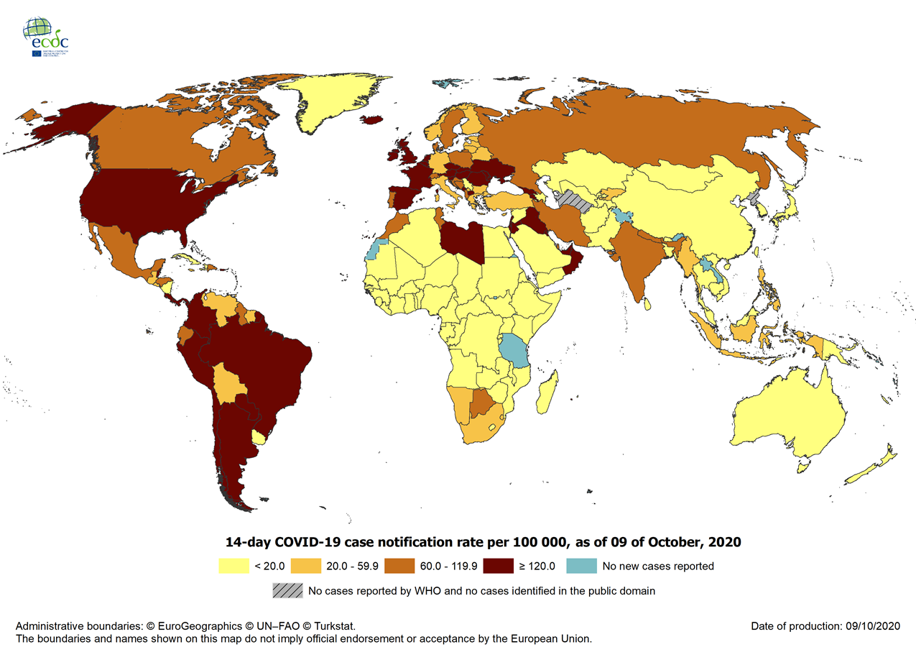
Geographic distribution of 14-day cumulative number of reported COVID-19 cases per 100 000 population, worldwide, as of 9 October 2020
14-day notification rates and trends are collected using epidemic intelligence from various sources and are affected by the testing strategy, laboratory capacity and the effectiveness of surveillance systems. As all of these factors can differ greatly between countries, ECDC does not recommend using notification rates to directly compare countries. Particular caution is needed when interpreting reported rates from areas with small populations where small changes in numbers of reported cases can have a big impact on the notification rate. In addition, retrospective adjustment of data by reporting authorities is possible. Negative counts of new cases can arise if countries or subnational areas report cumulative totals that are lower than those reported previously, which can affect the presentation of data in maps and time-series plots.

Slide 6
Ebola virus disease case distribution in Equateur Province,
Democratic Republic of the Congo, as of 6 October 2020

Slide 7
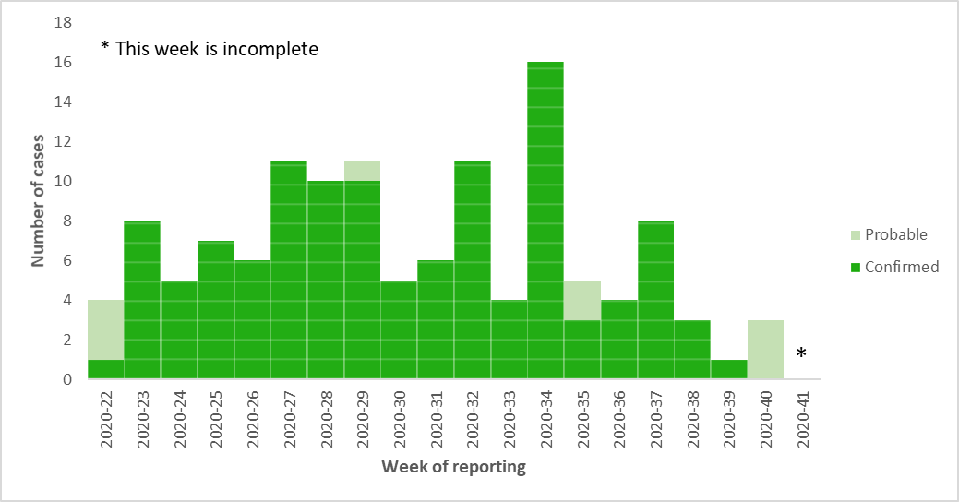
Distribution of confirmed and probable cases of Ebola virus disease by week of reporting in Equateur Province, Democratic Republic of the Congo, as of 6 October 2020

Slide 8
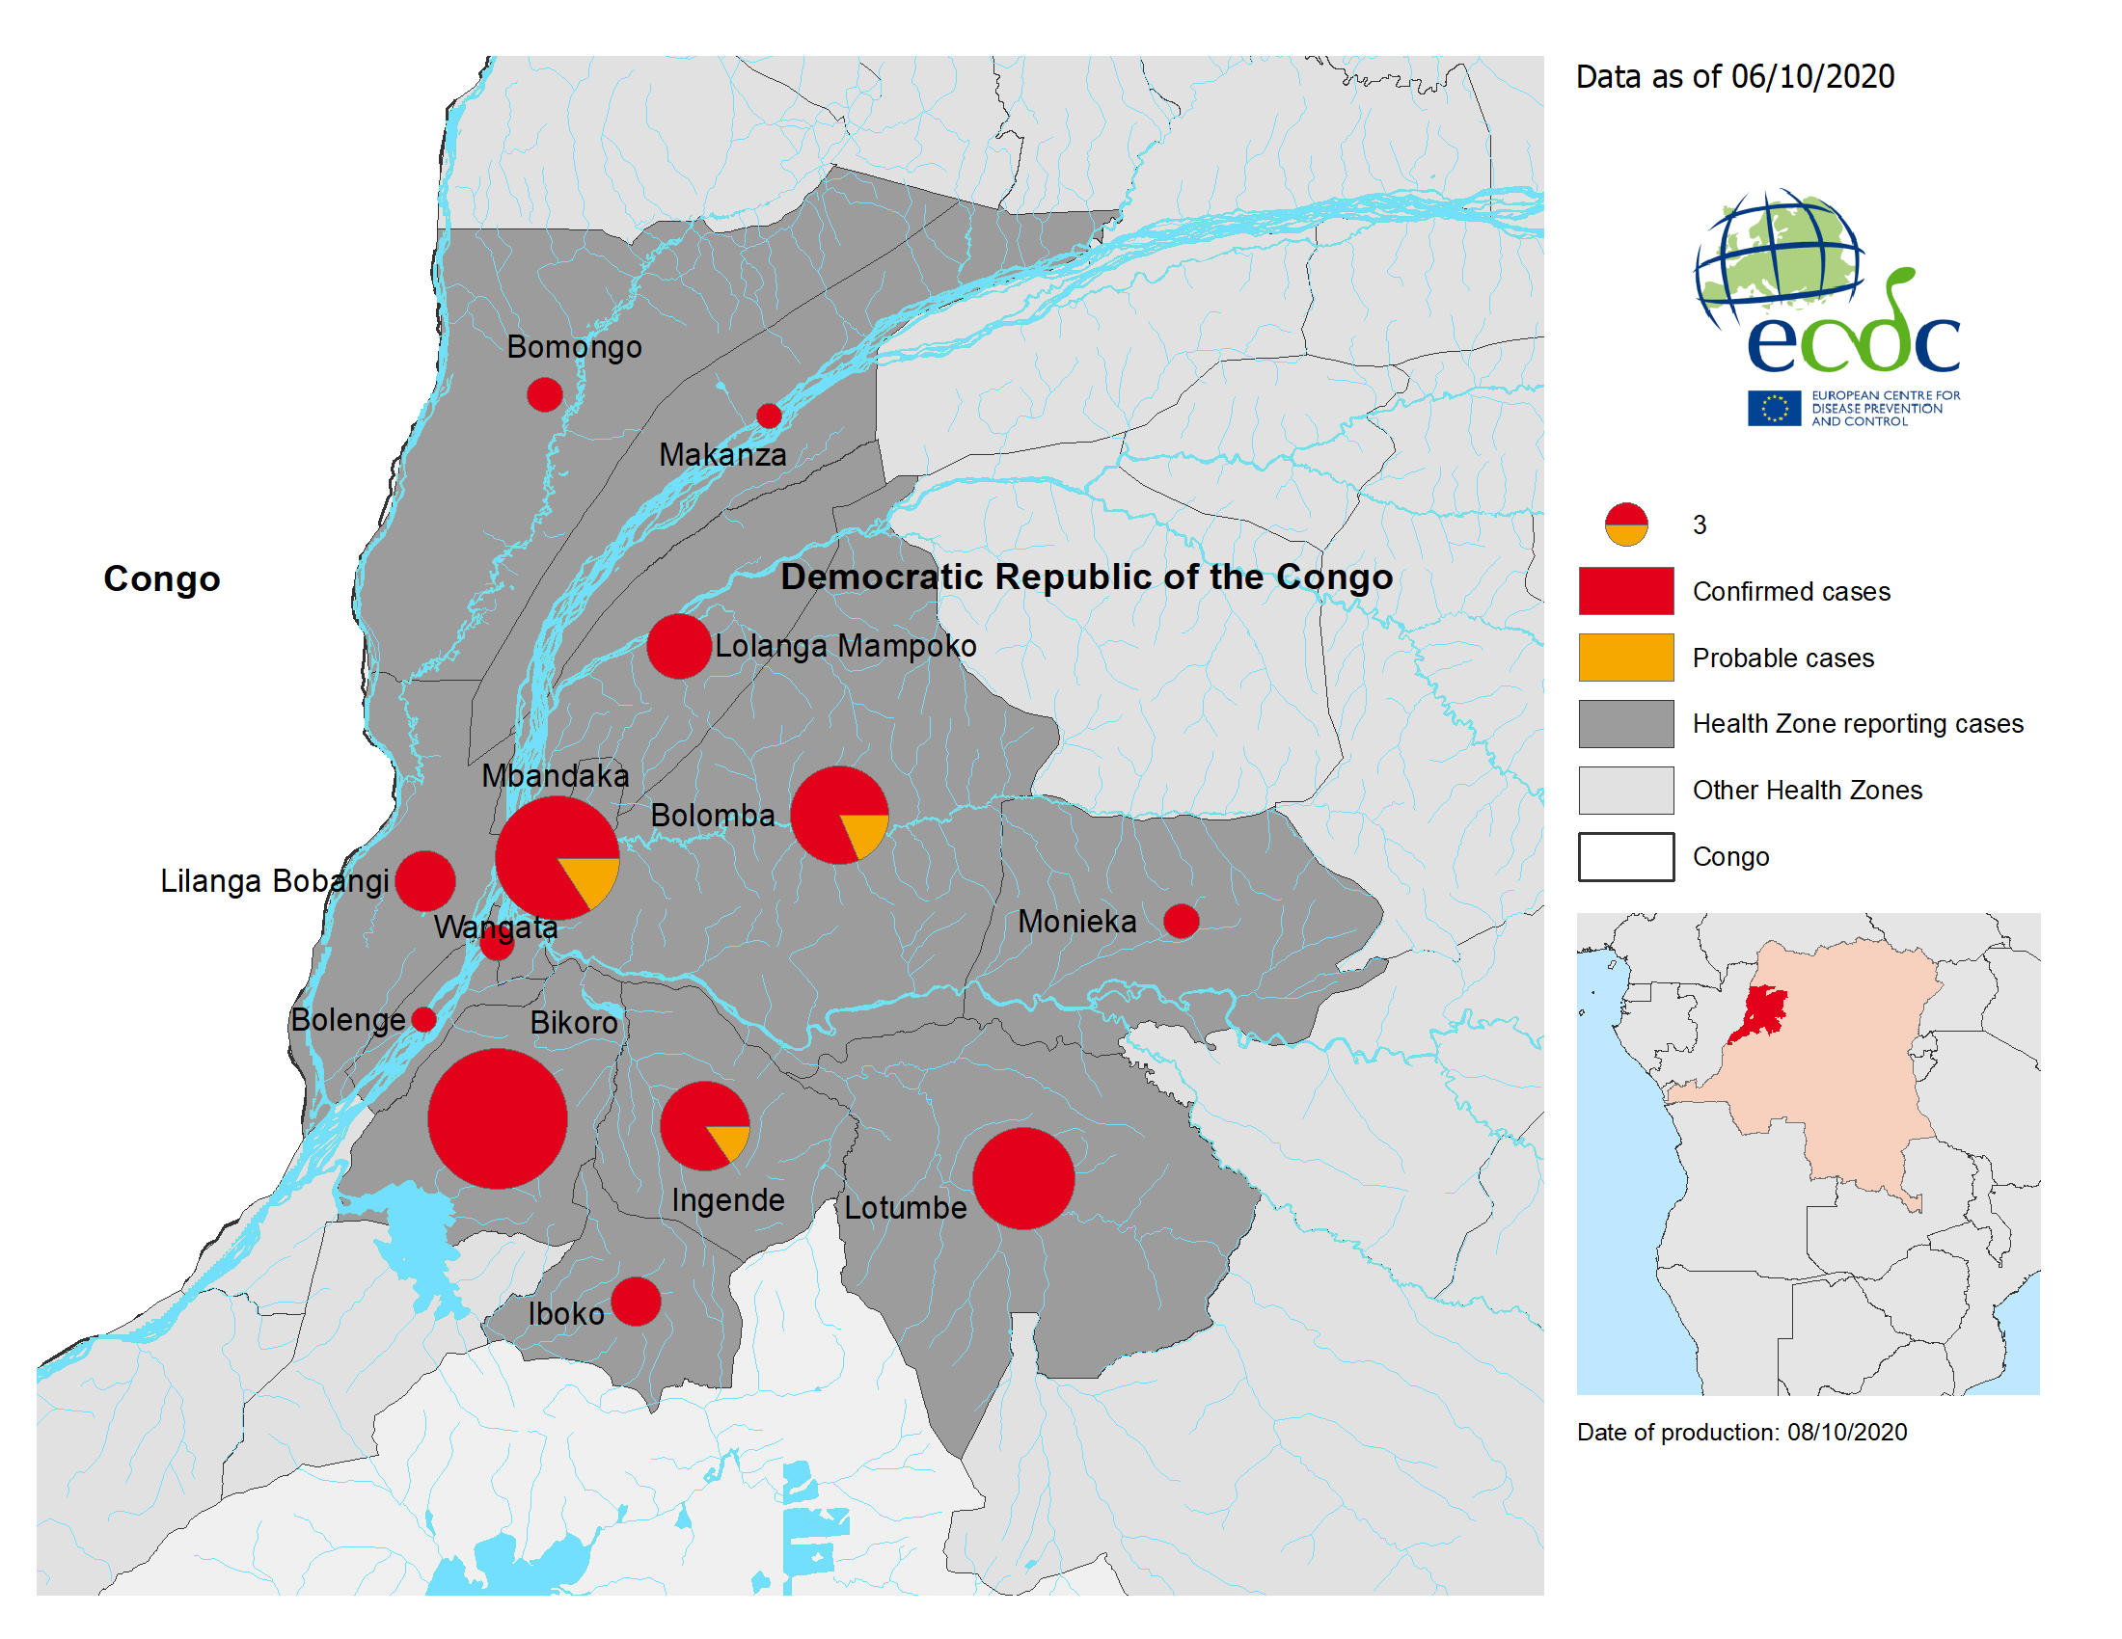
Geographical distribution of confirmed and probable cases of Ebola virus disease, Equateur Province, Democratic Republic of the Congo,
as of 6 October 2020

Slide 9
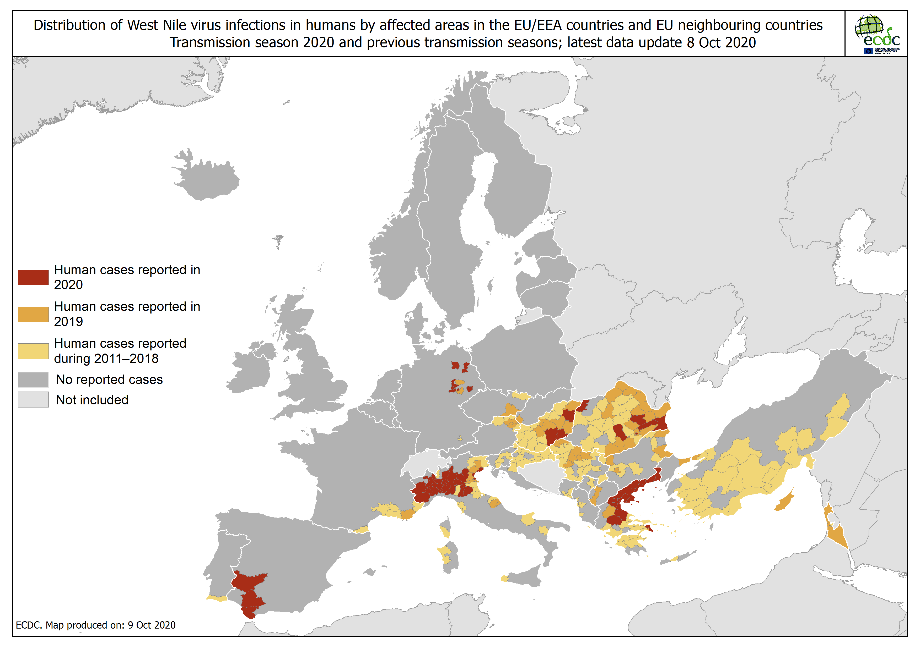

Slide 10
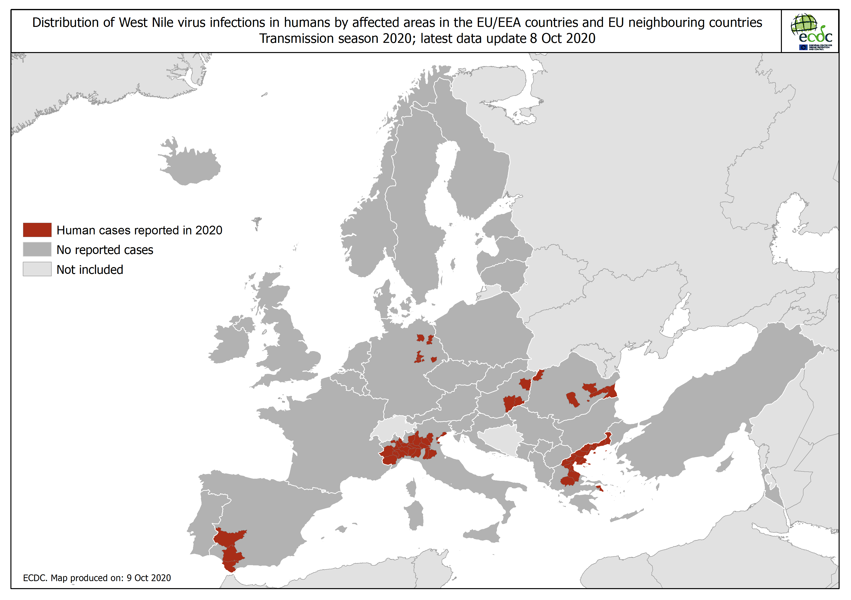

Slide 11
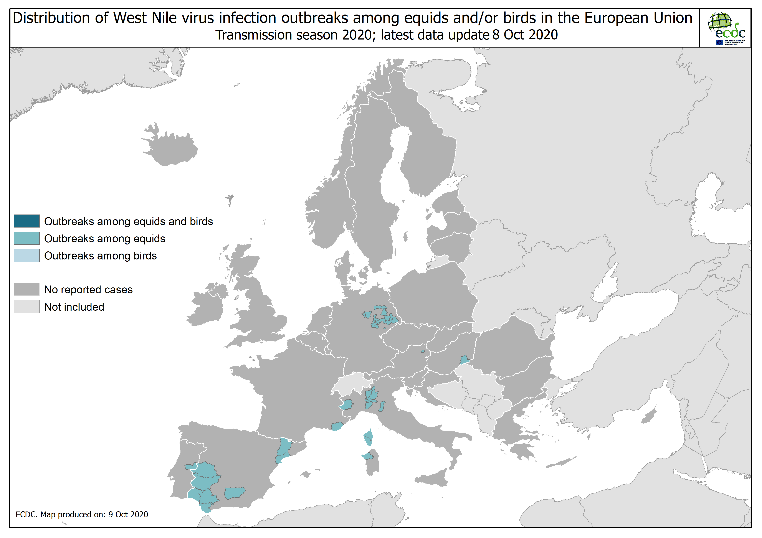

Slide 12
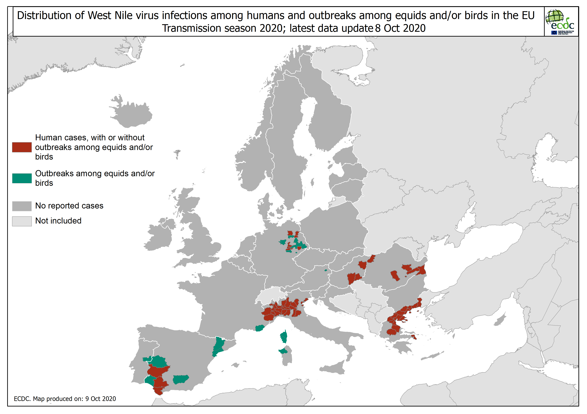

Slide 13
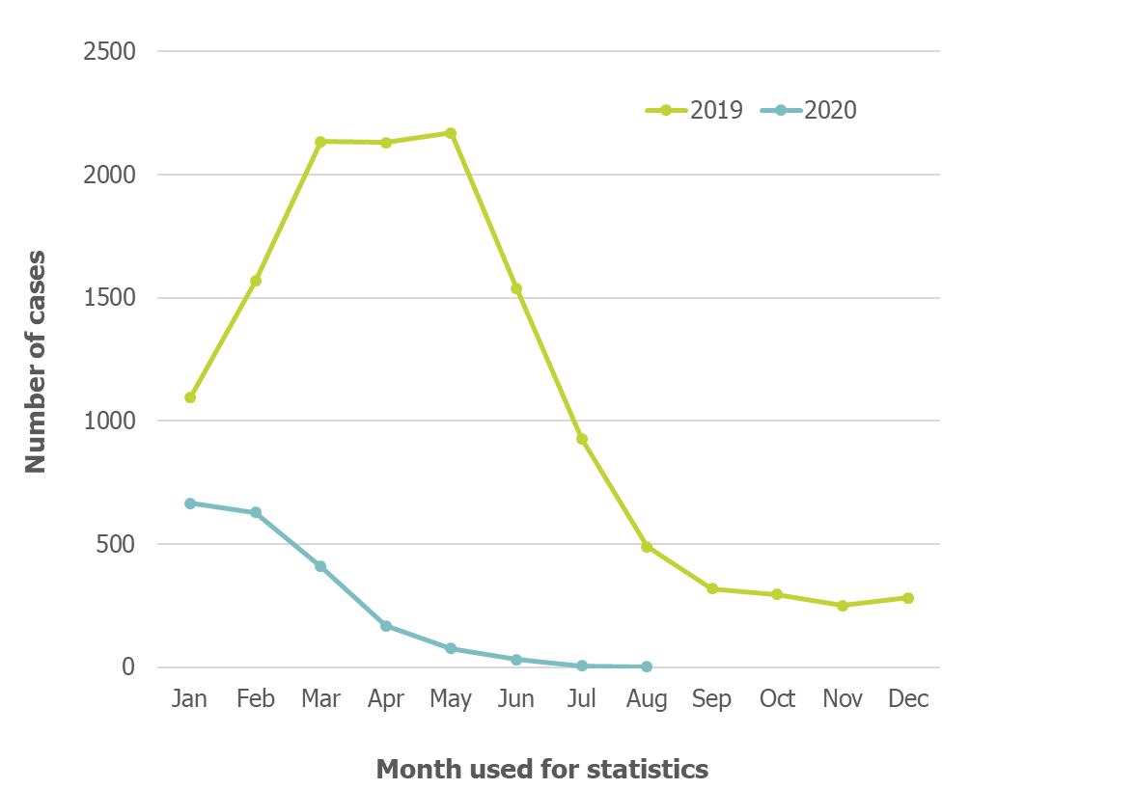
Distribution of confirmed measles cases reported by month and year January 2019–August 2020, EU/EEA and the UK

Slide 14
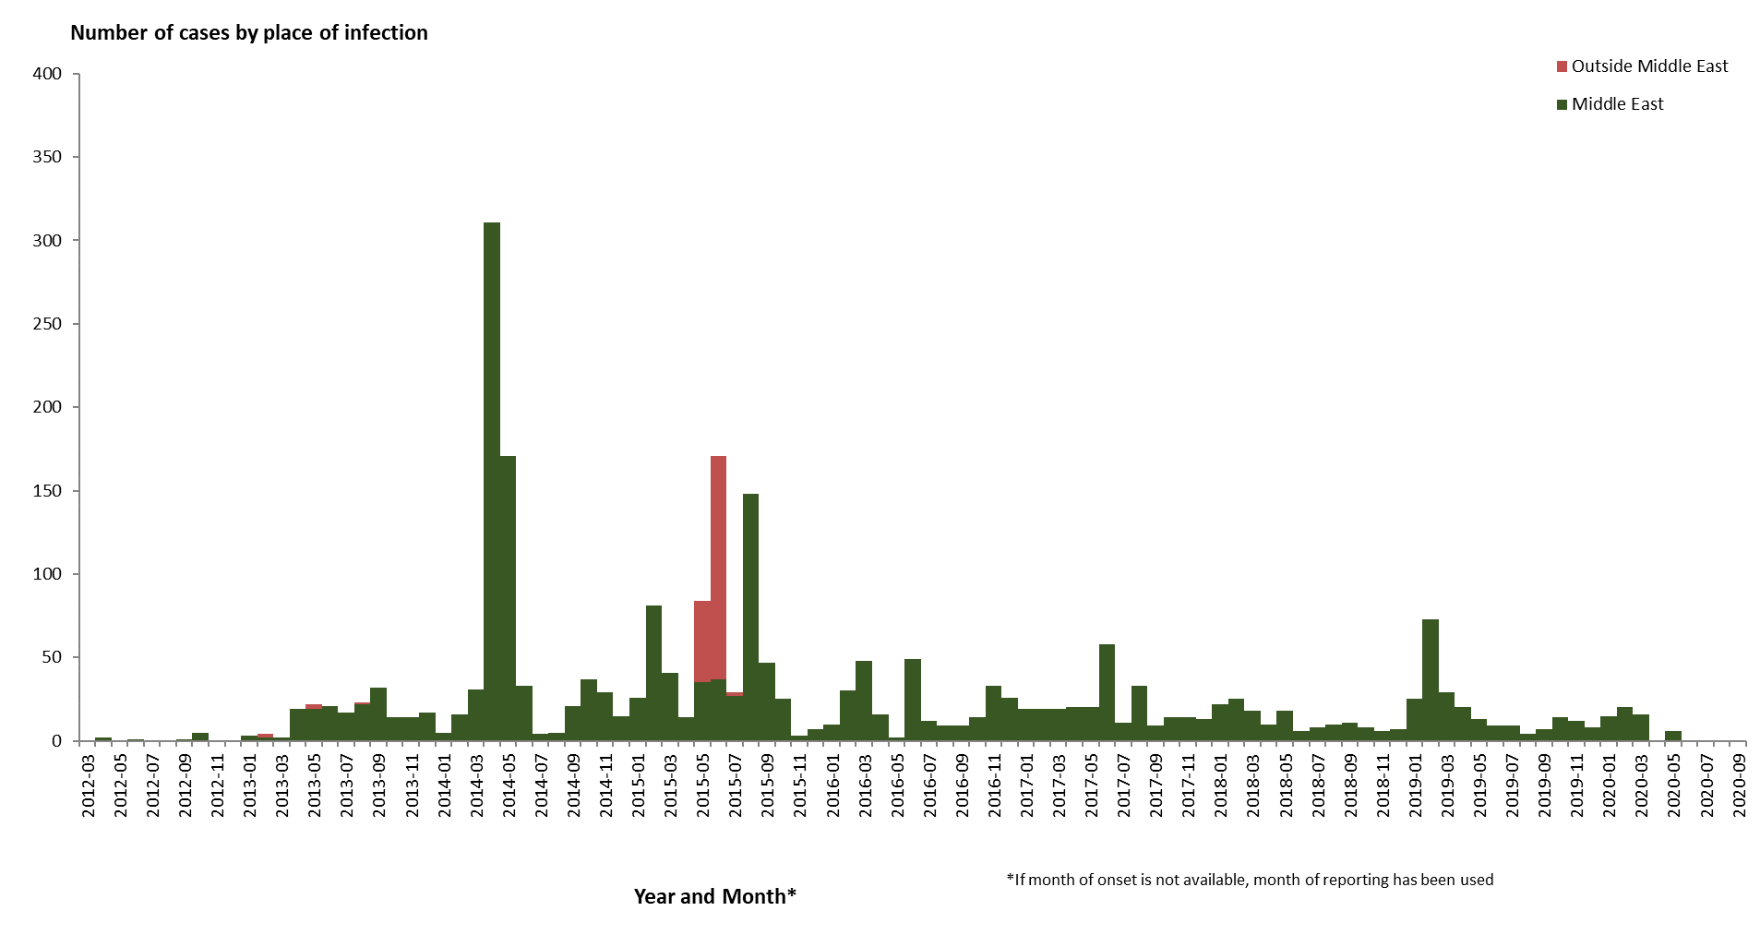
Distribution of confirmed cases of MERS-CoV by place of infection and month of onset, March 2012 – 6 October 2020

Slide 15
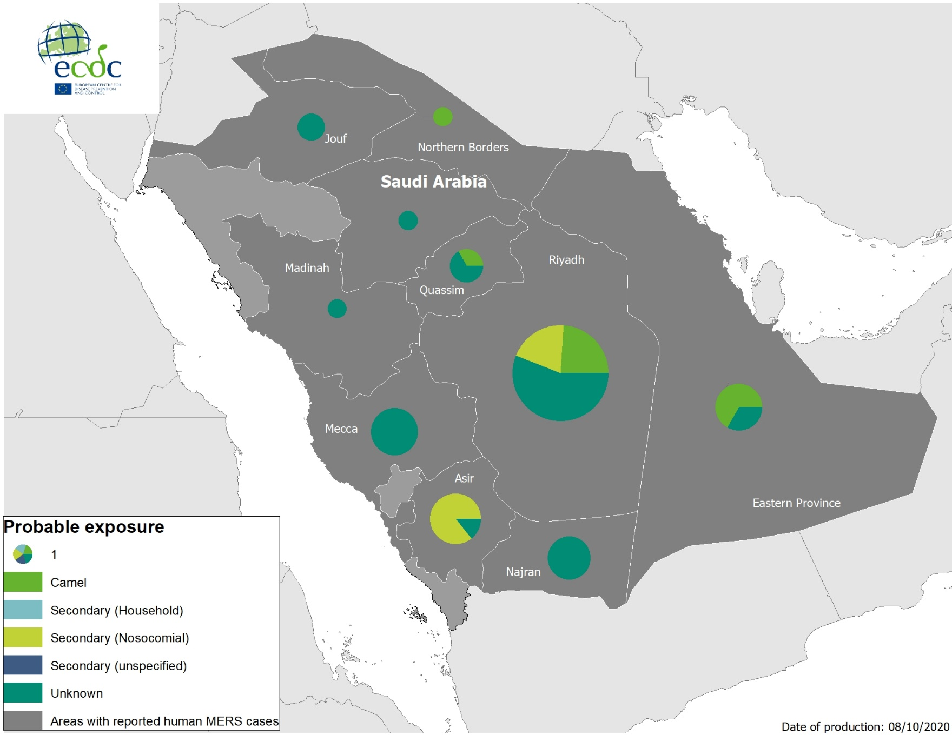
Geographical distribution of confirmed MERS-CoV cases by probable region of infection and exposure, from 1 January 2020 to 6 October 2020

Slide 16
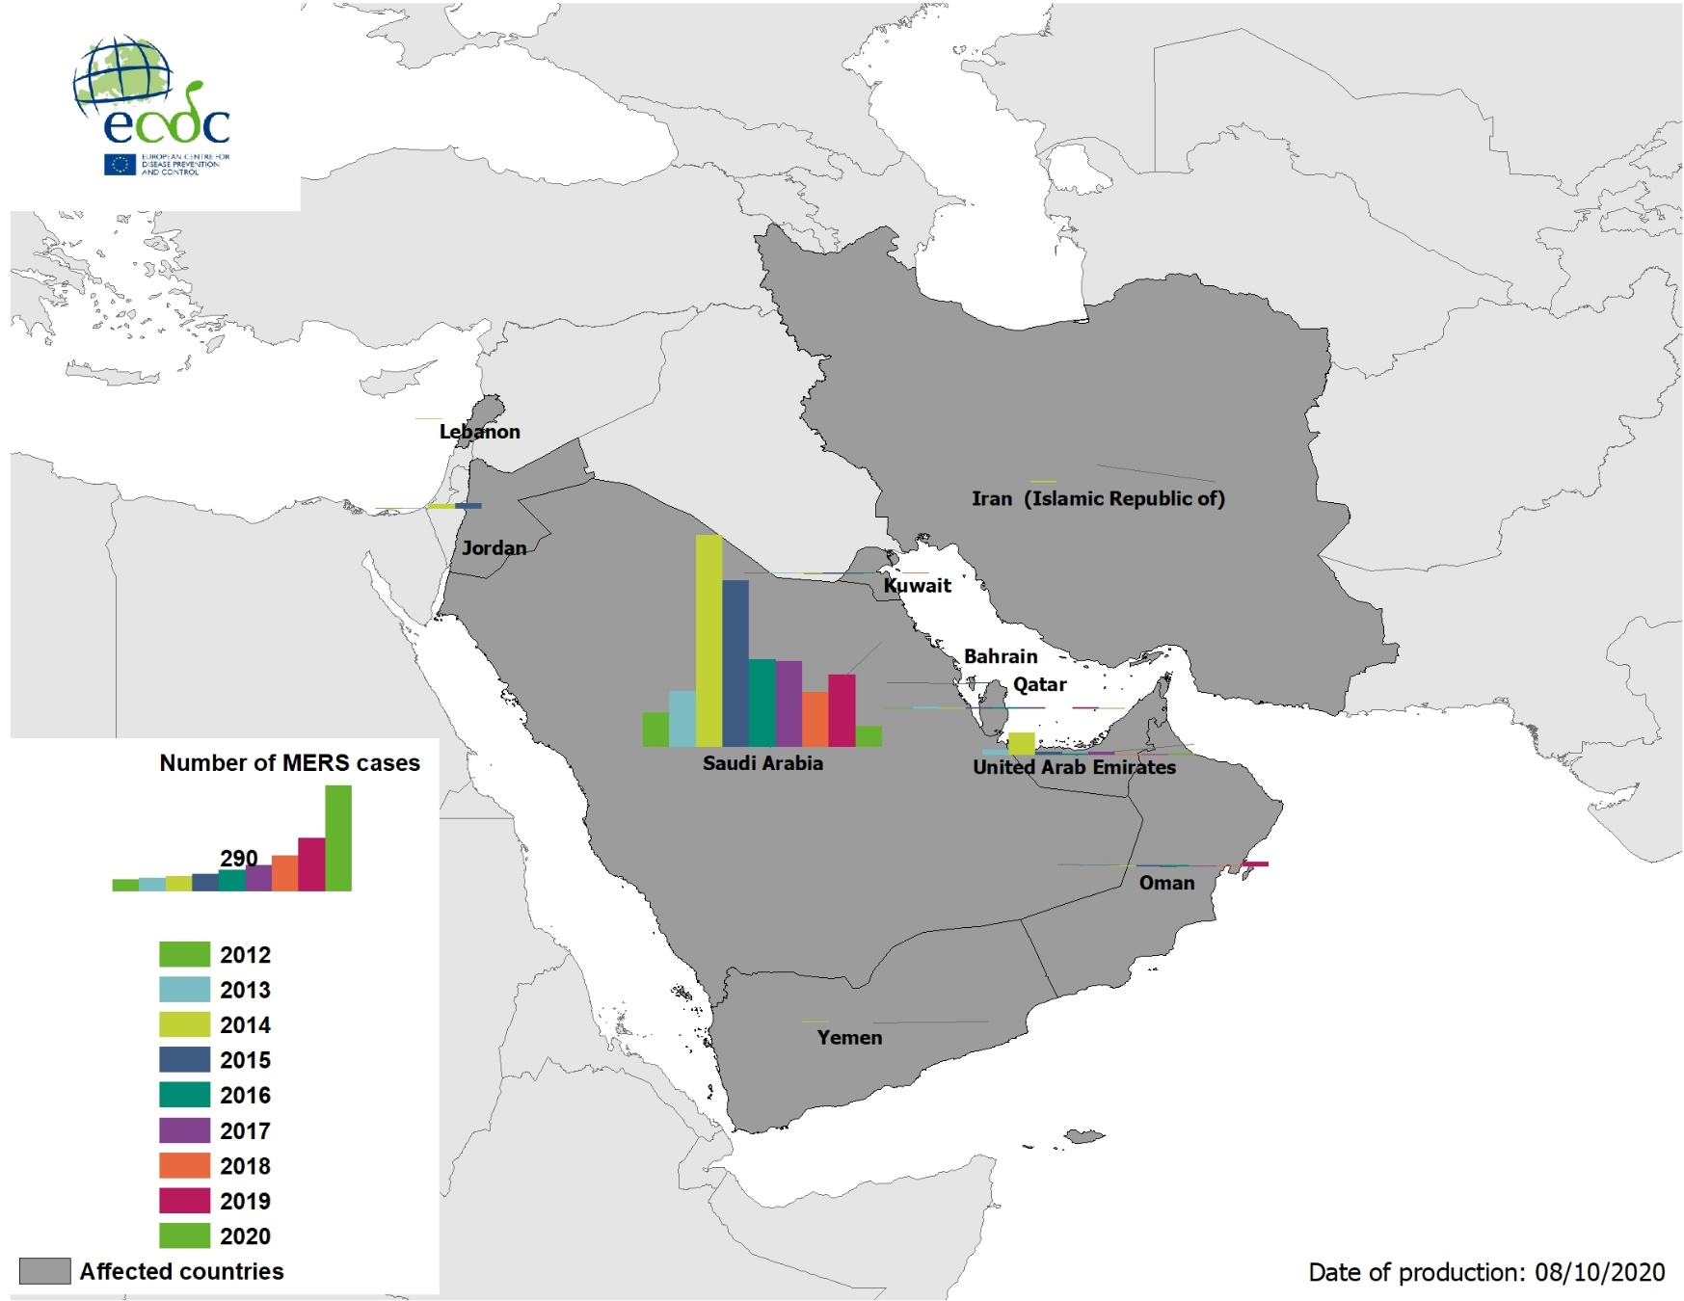
Geographical distribution of confirmed MERS-CoV cases by country of infection and year, from April 2012 to 6 October 2020

Slide 17
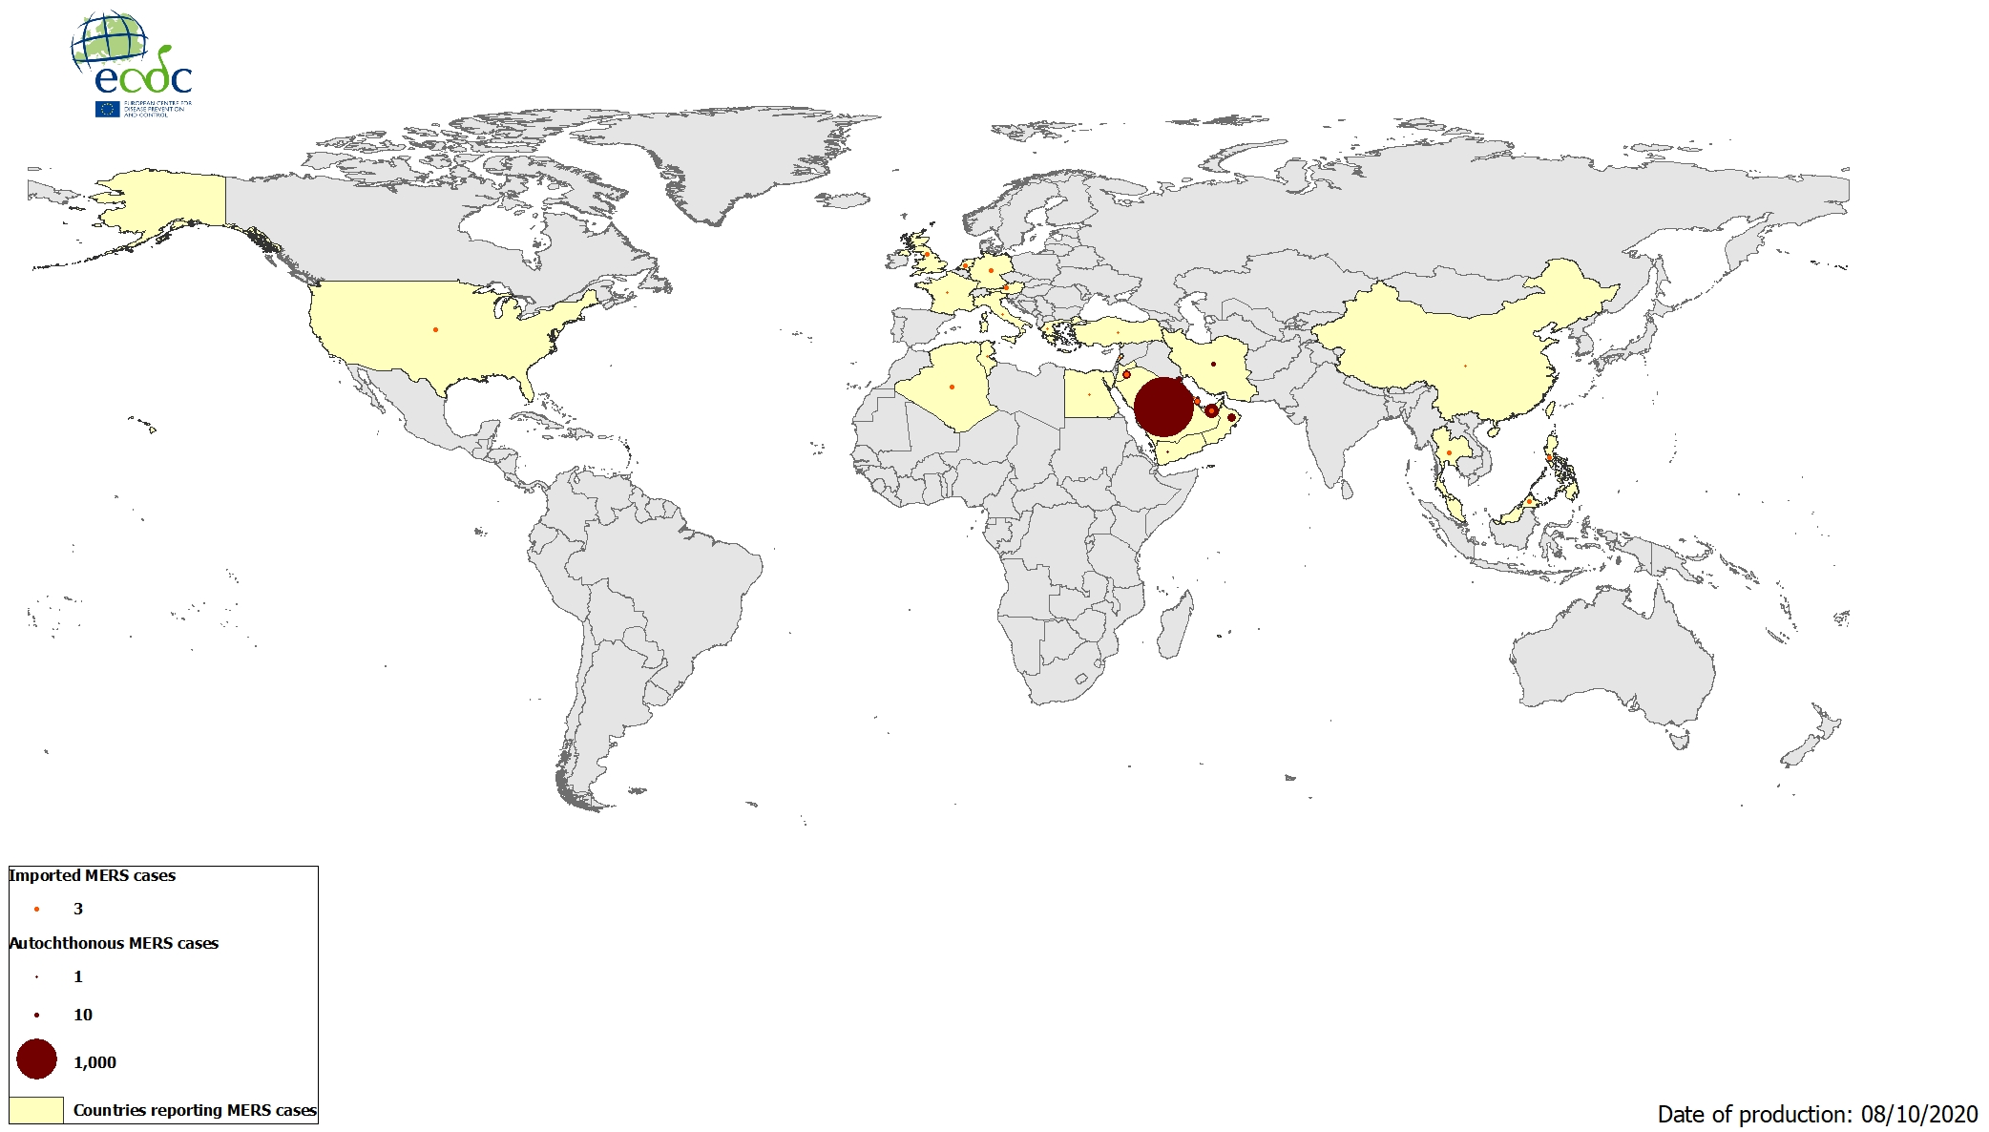
Geographical distribution of confirmed MERS-CoV cases by reporting country from April 2012 to 6 October 2020

