Slide 1
Reusable maps and graphs from ECDC Communicable Disease Threats Report
Week 41, 2023
You are encouraged to reuse our maps and graphs for your own purposes and are free to translate them, provided the content is not altered and the source is acknowledged.

Slide 2
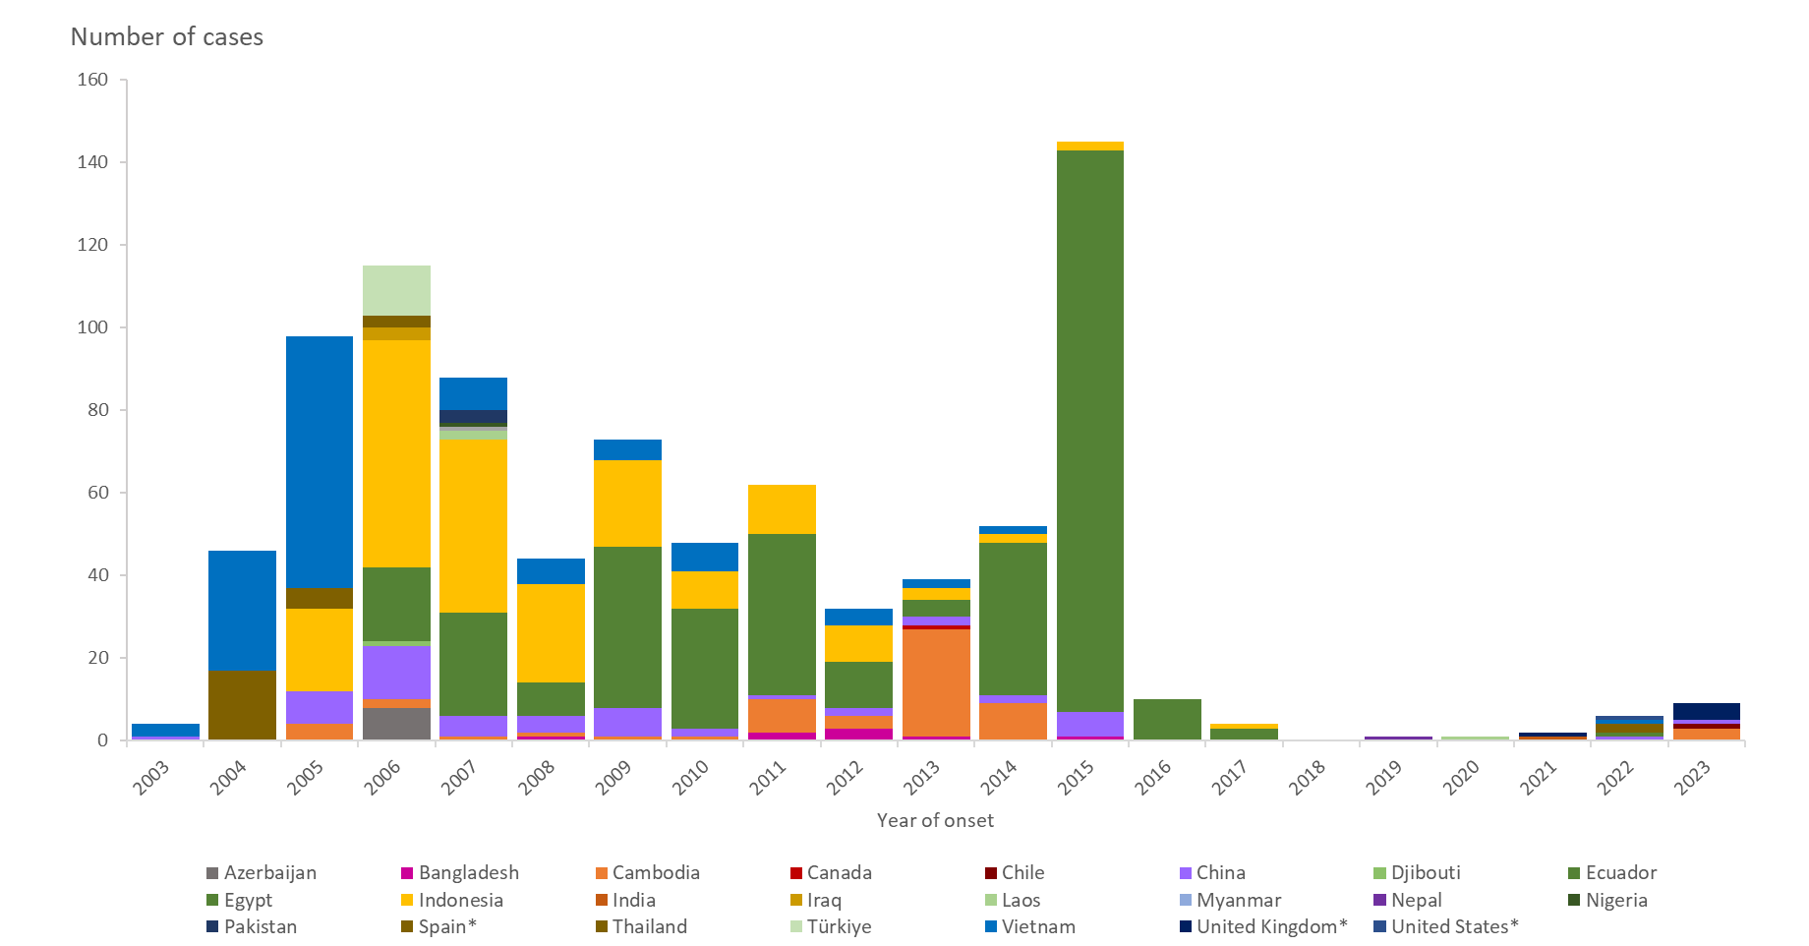
Distribution of confirmed human cases of avian influenza A(H5N1) virus infection by year of onset and country, 2003–2023 (updated on 10 October 2023, n=880)
*includes six detections due to suspected environmental contamination and no evidence of infection reported in 2022 from Spain (2) and the United States (1) and in 2023 from the United Kingdom (3).

