Slide 1
Reusable maps and graphs from ECDC Communicable Disease Threats Report Week 40, 2023
You are encouraged to reuse our maps and graphs for your own purposes and are free to translate them, provided the content is not altered and the source is acknowledged.

Slide 2
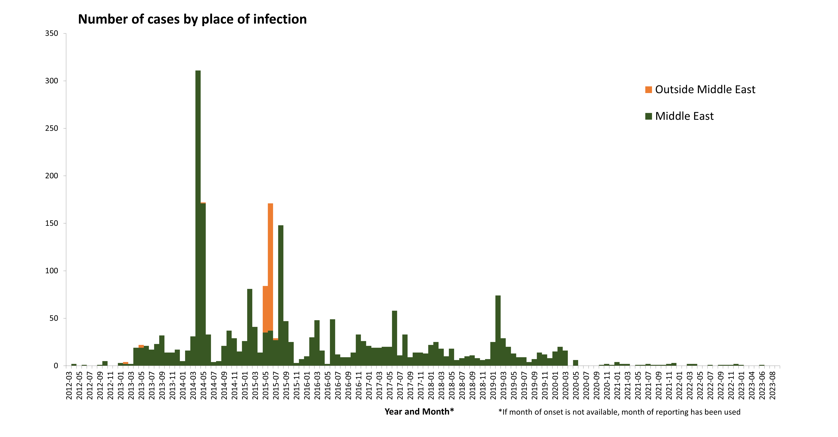
Distribution of confirmed MERS-CoV cases, by place of infection and month of onset, March 2012 – September 2023

Slide 3
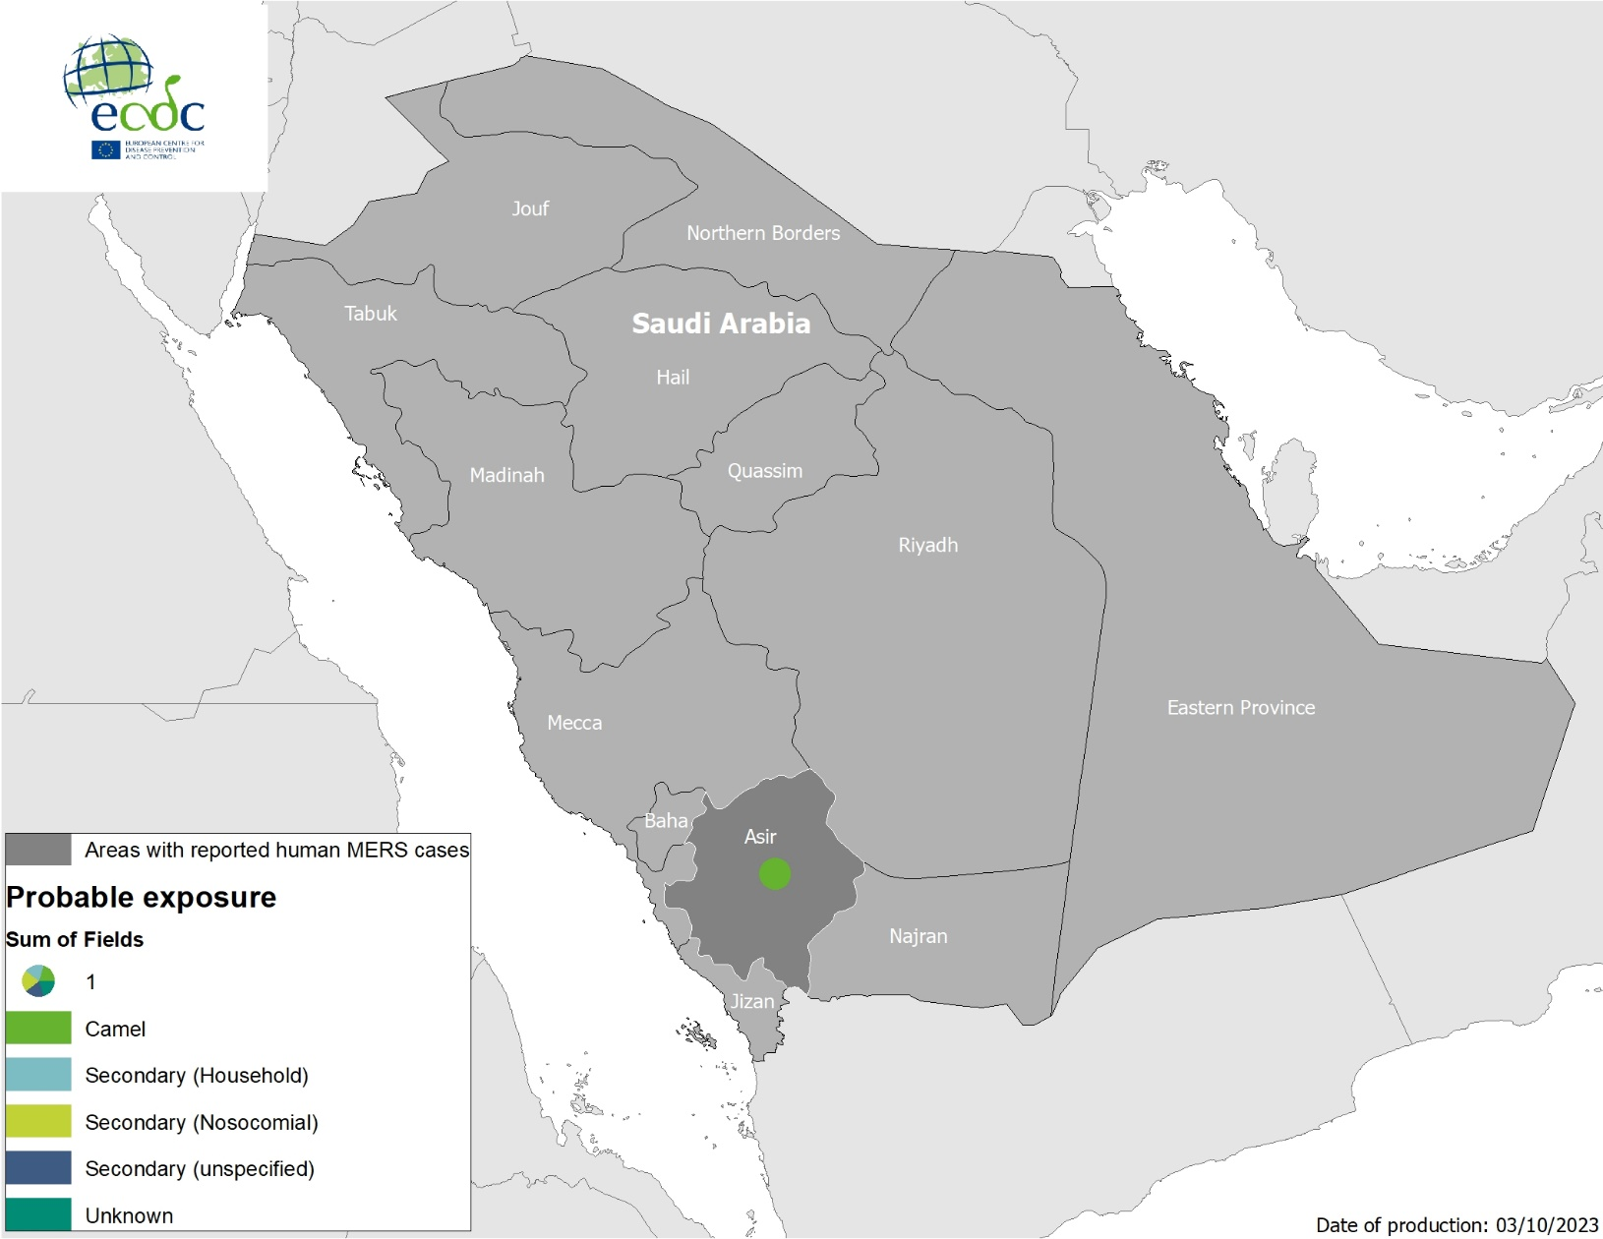
Geographical distribution of confirmed cases of MERS-CoV by probable region of infection and exposure, 1 January – 2 October 2023

Slide 4
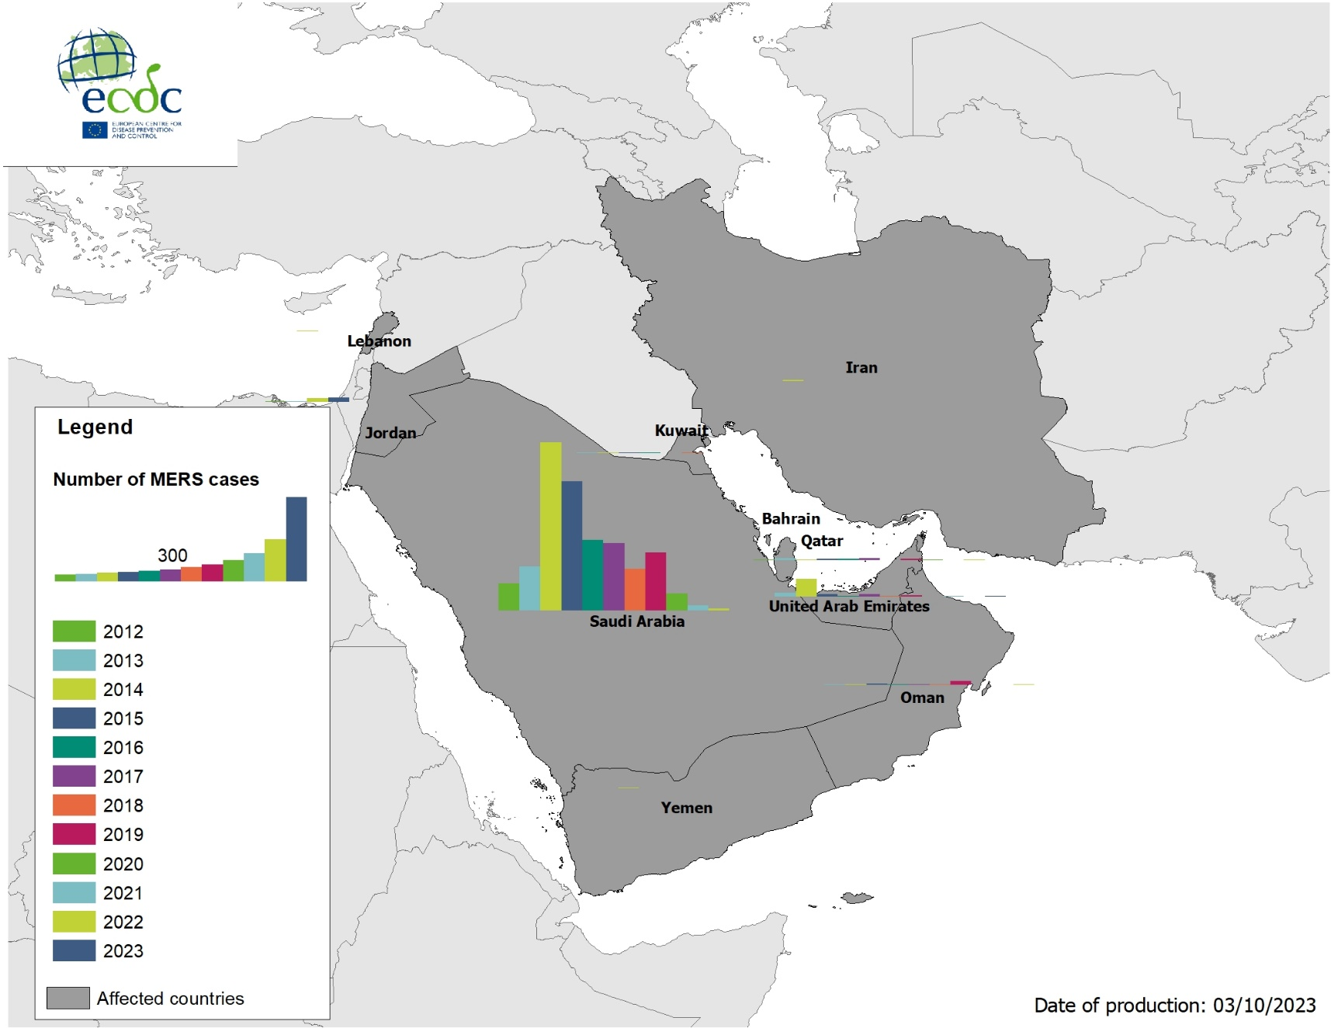
Geographical distribution of confirmed cases of MERS-CoV, by country of infection and year, from April 2012 to August 2023

Slide 5
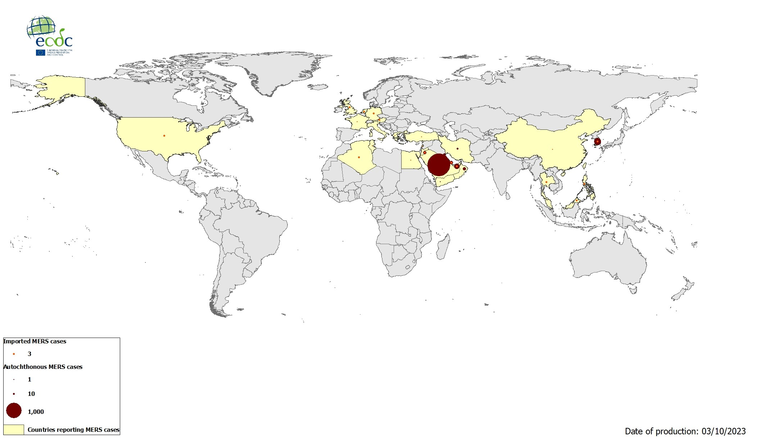
Geographical distribution of confirmed MERS-CoV cases, by reporting country, April 2012 – August 2023

Slide 6
Three-month Chikungunya virus disease case notification rate per 100 000 population, July-September 2023

Slide 7
12-month Chikungunya virus disease case notification rate per 100 000 population, October 2022 - September 2023

Slide 8
Countries/territories reporting Chikungunya cases since the beginning of 2023 and as of September 2023

Slide 9
Three-month dengue virus disease case notification rate per 100 000 population, August - October 2023

Slide 10
12-month dengue virus disease case notification rate per 100 000 population, November 2022 – October 2023

Slide 11
Countries/territories reporting dengue cases since the beginning of 2023 and as of October 2023

