Slide 1
Reusable maps and graphs from ECDC Communicable Disease Threats Report Week 4, 2023
You are encouraged to reuse our maps and graphs for your own purposes and are free to translate them, provided the content is not altered and the source is acknowledged.

Slide 2
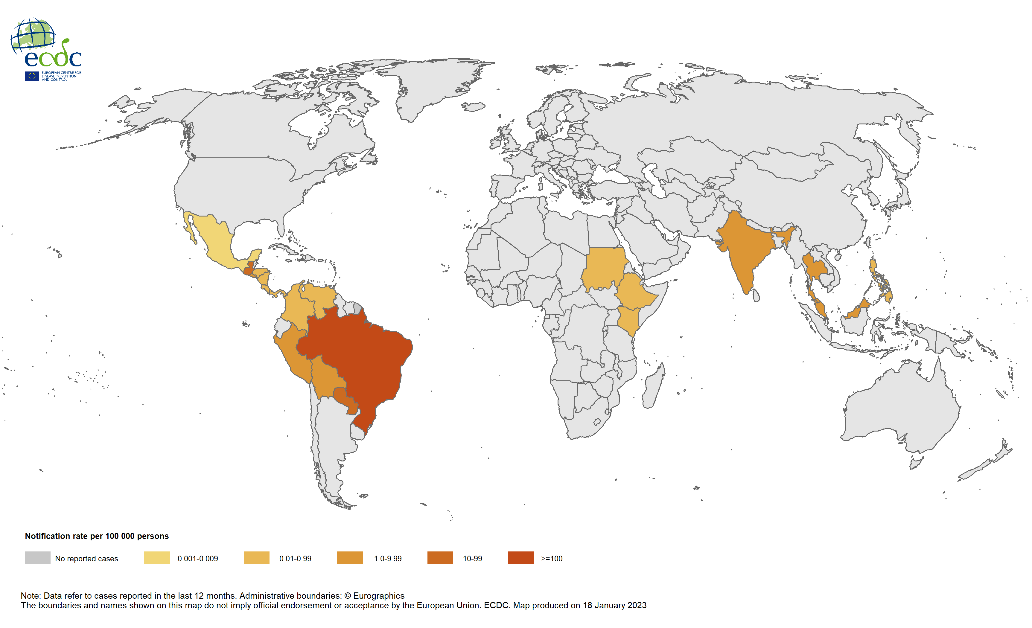
12-month chikungunya virus disease case notification rate per 100 000 population, January–December 2022

Slide 3
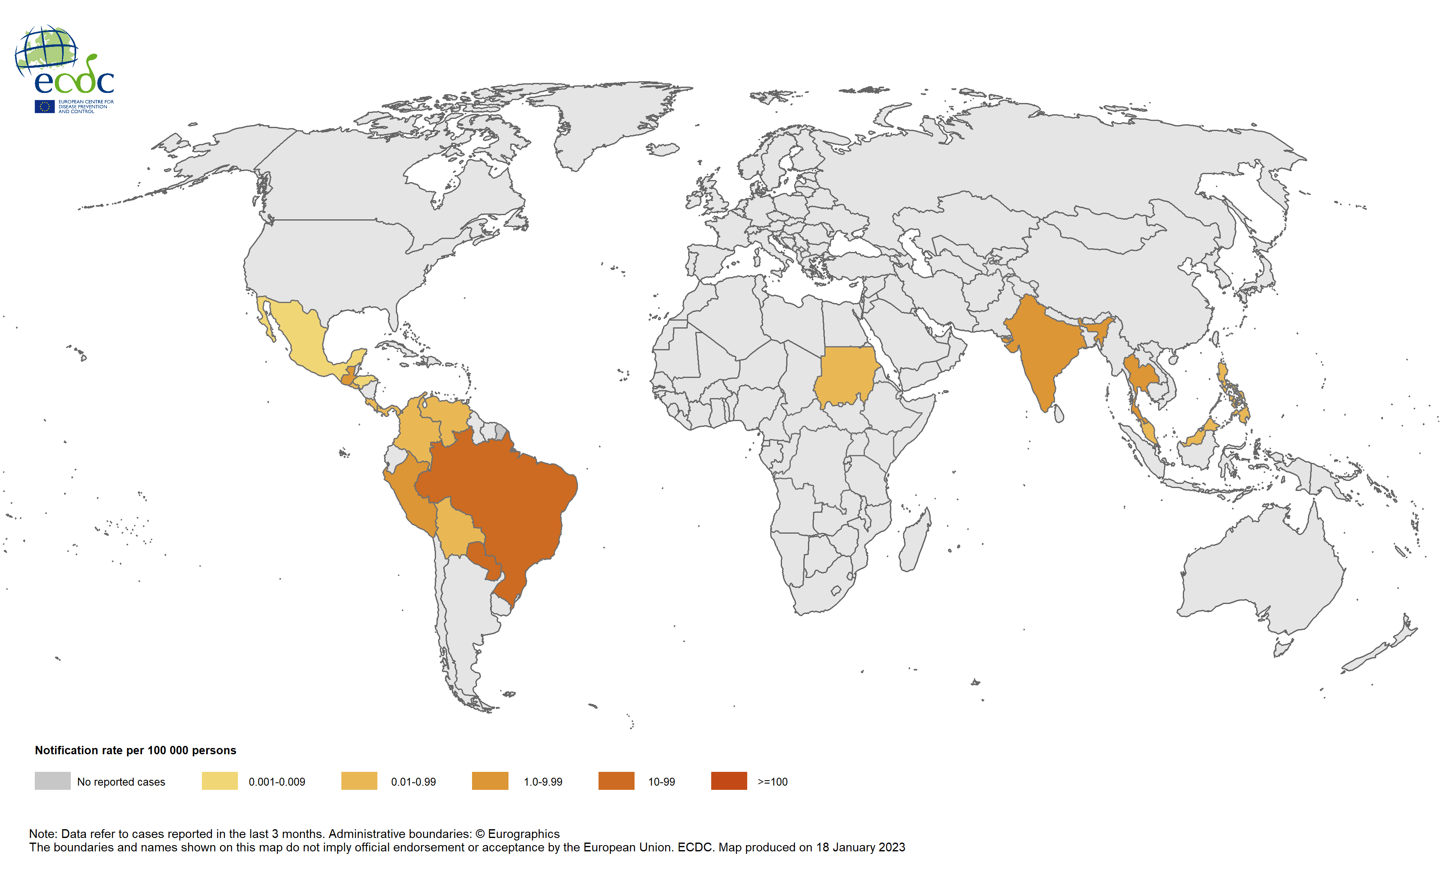
Three-month chikungunya virus disease case notification rate per 100 000 population, October–December 2022

Slide 4
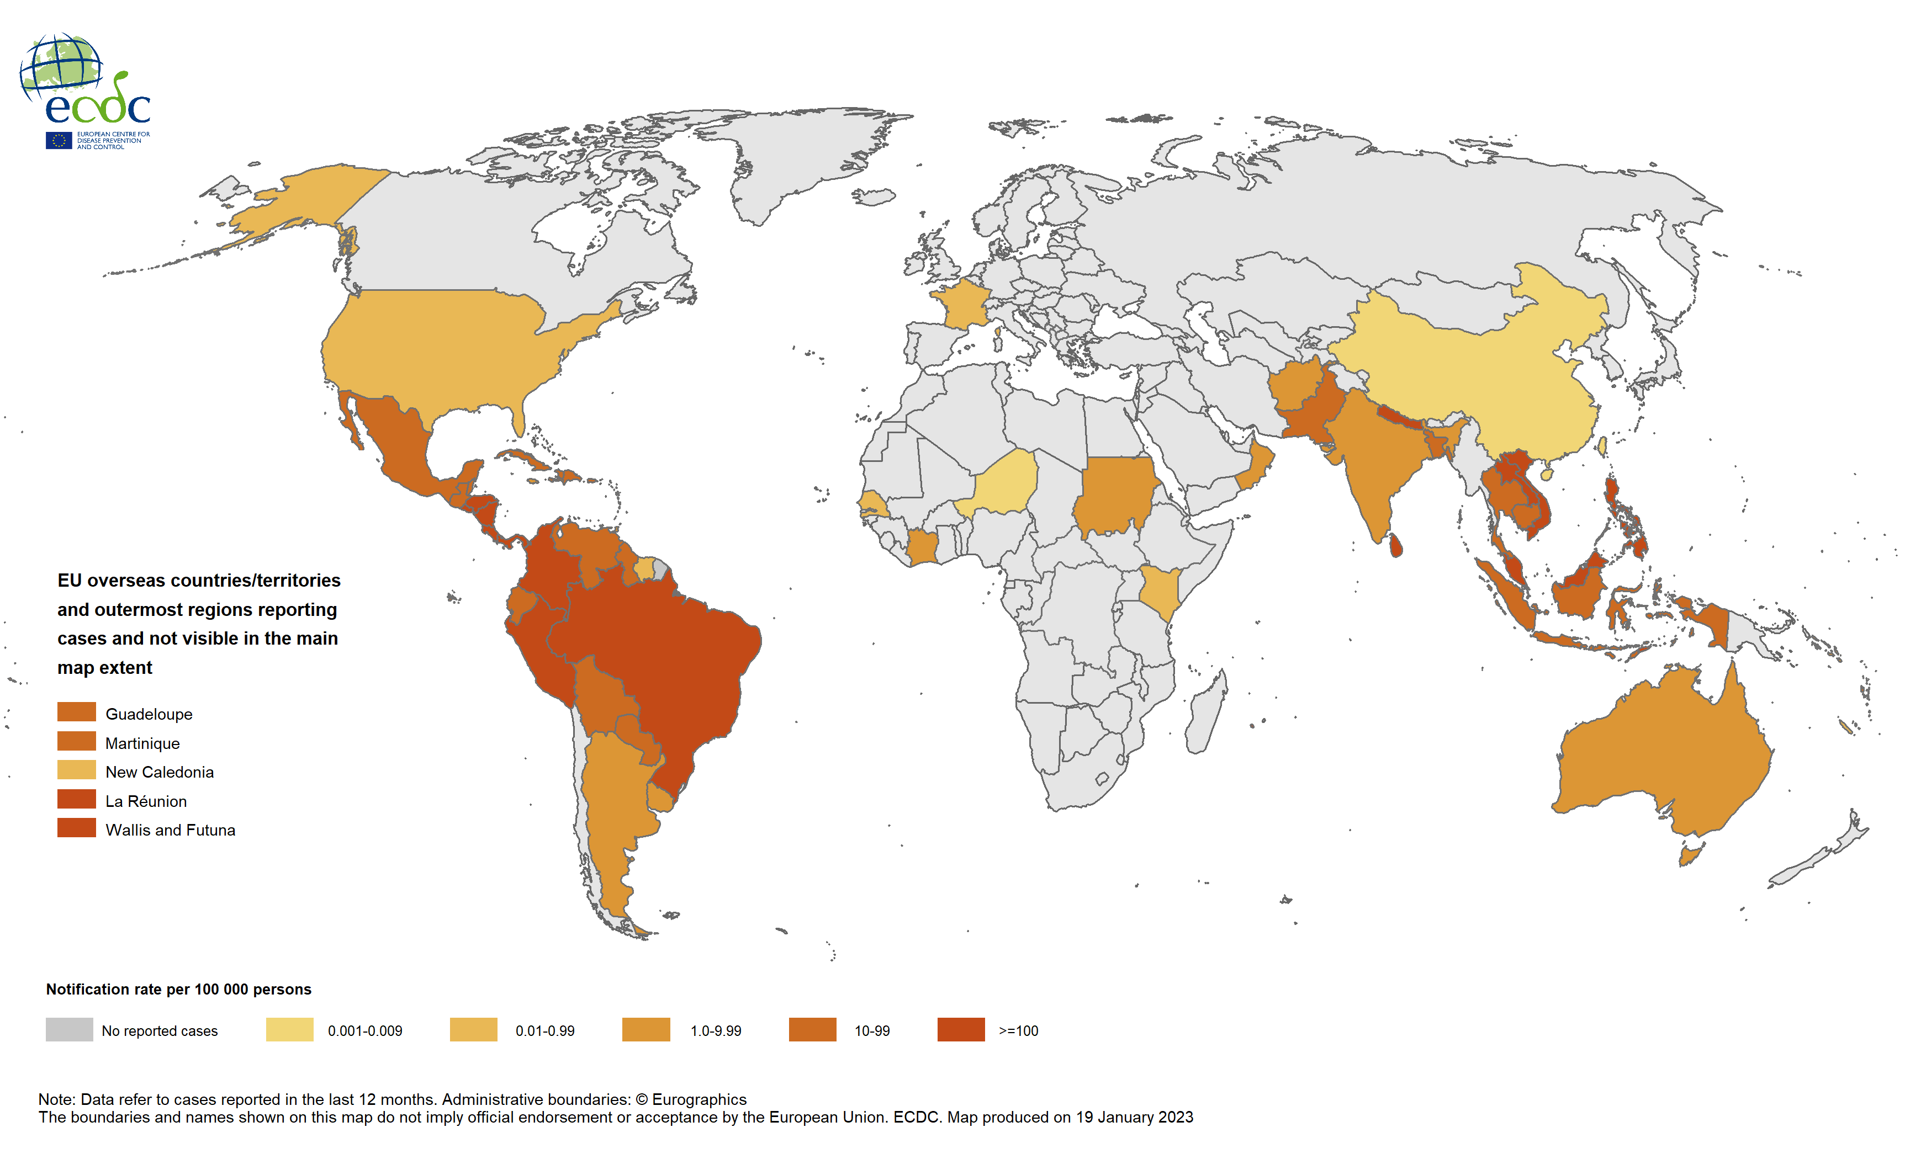
12-month dengue virus disease case notification rate per 100 000 population, January–December 2022

Slide 5
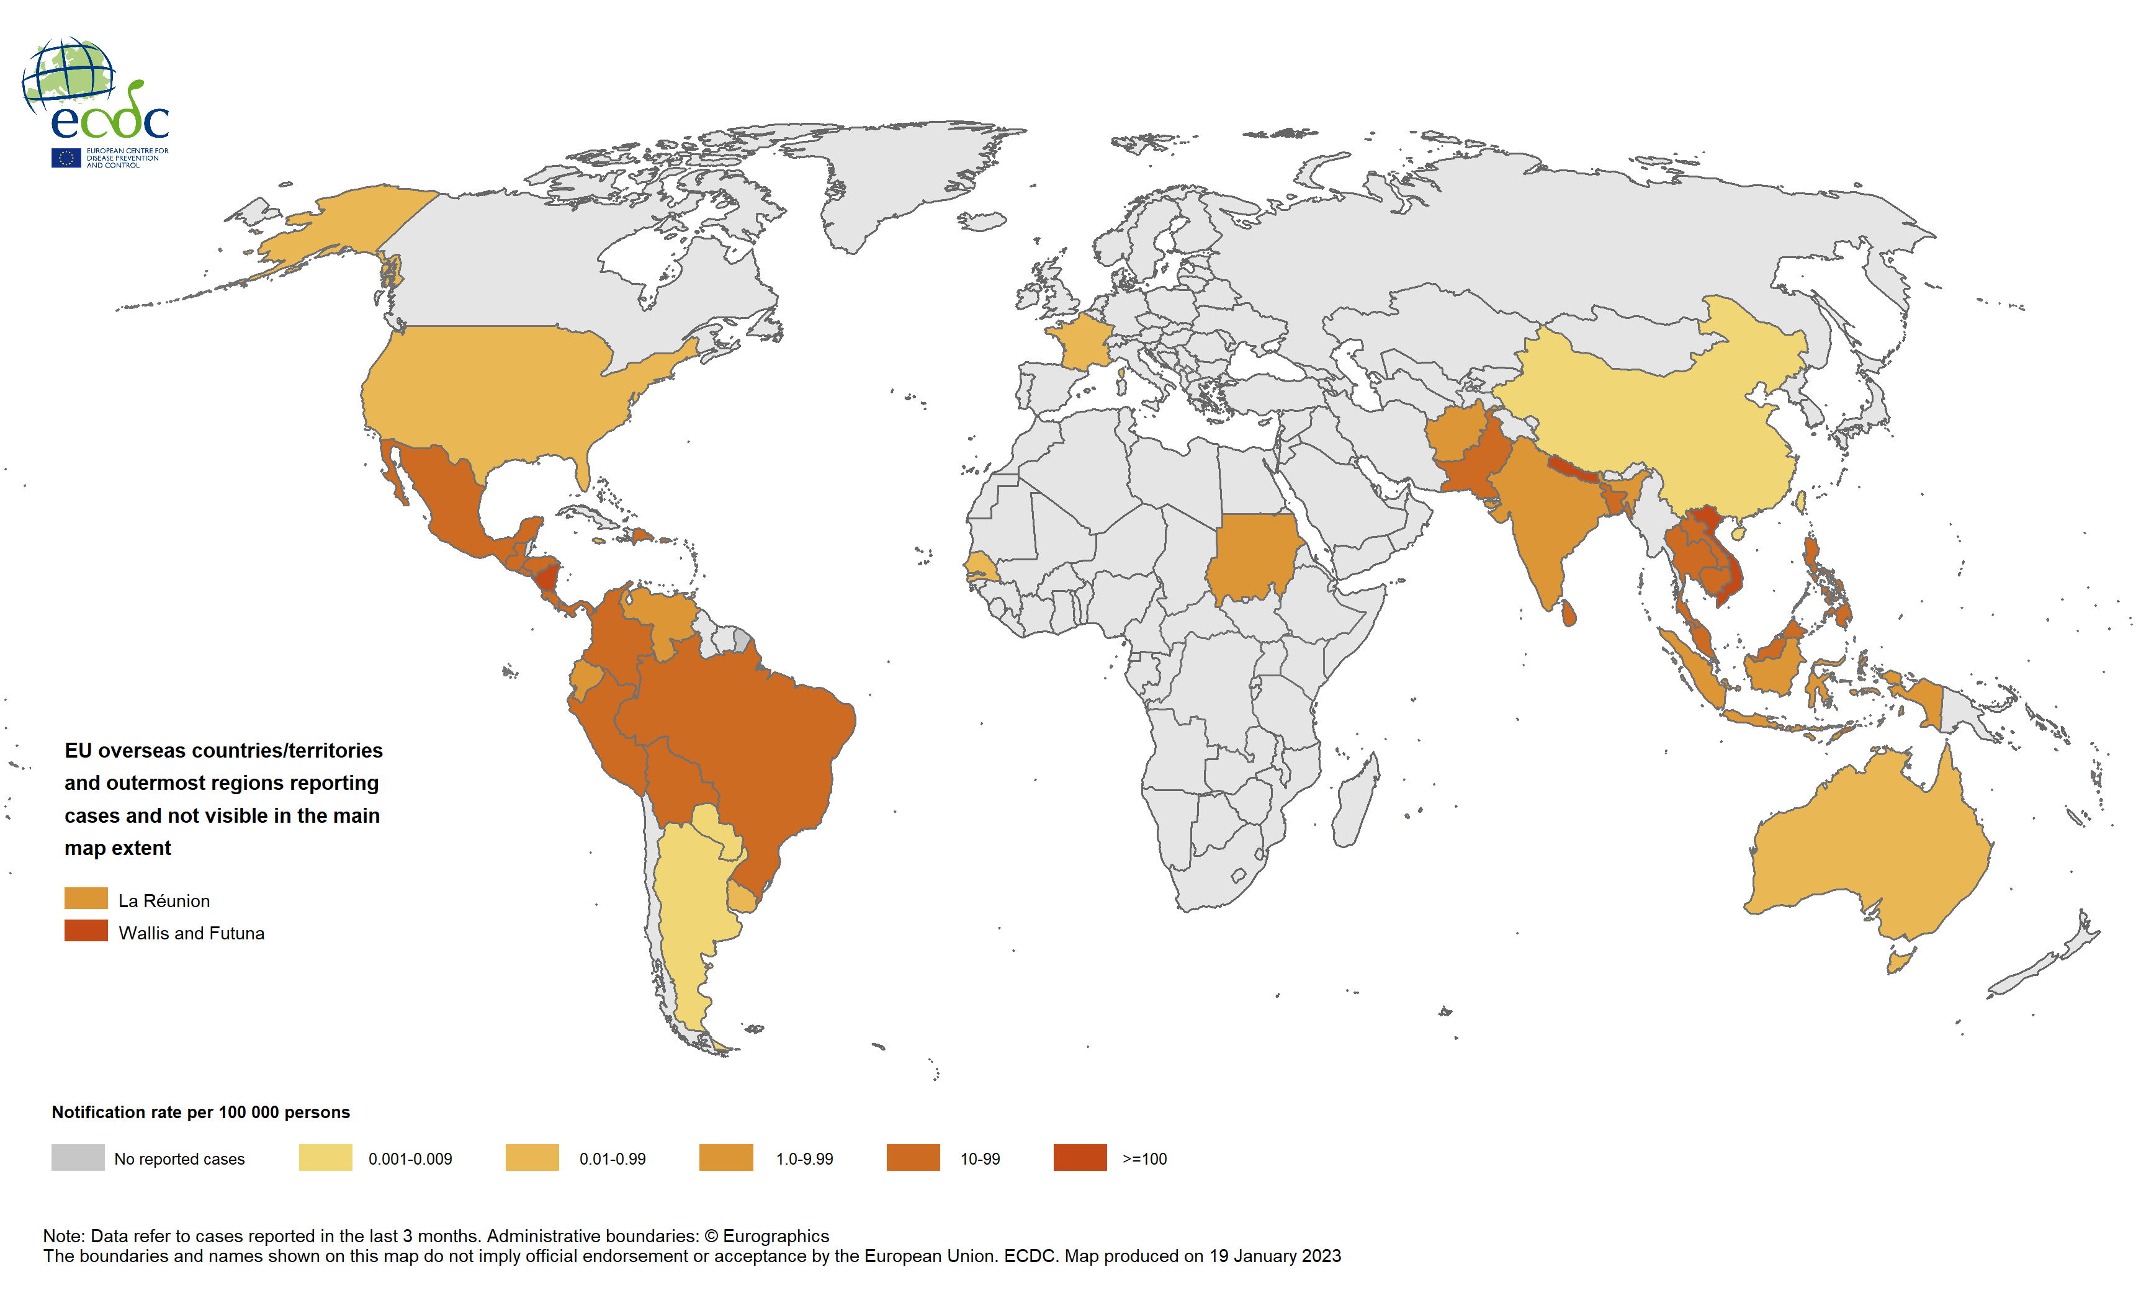
Three-month dengue virus disease case notification rate per 100 000 population, October–December 2022

