Slide 1
Reusable maps and graphs from ECDC Communicable Disease Threats Report
Week 3, 2019
You are encouraged to reuse our maps and graphs for your own purposes and free to translate, provided the content is not altered and the source is acknowledged.

Slide 2
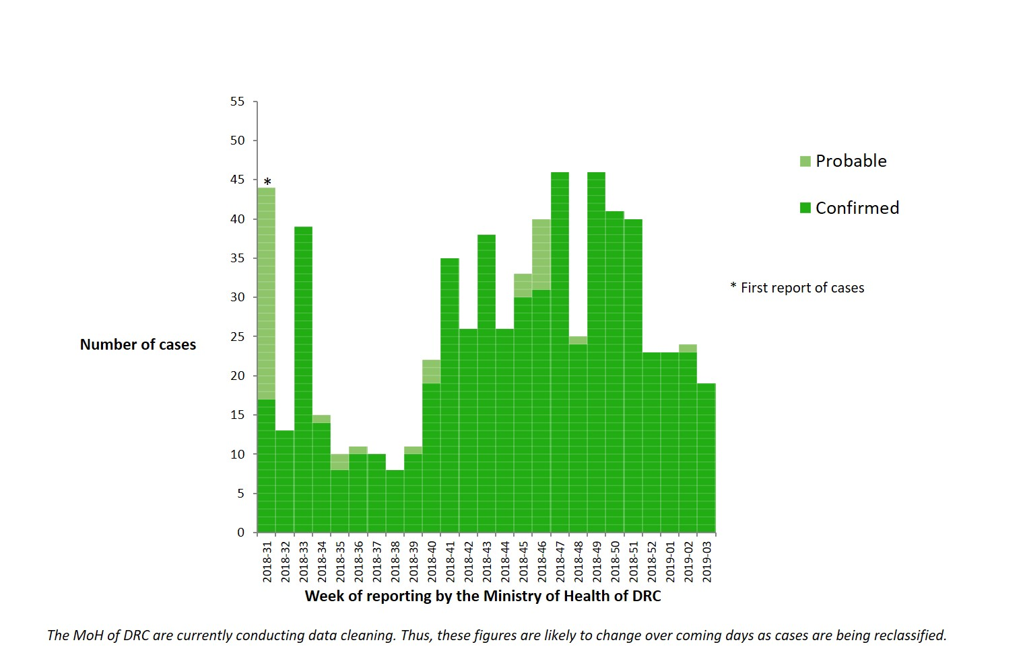
Distribution of confirmed and probable cases of Ebola virus disease, North Kivu and Ituri Provinces, Democratic Republic of the Congo, as of 16 January 2019

Slide 3
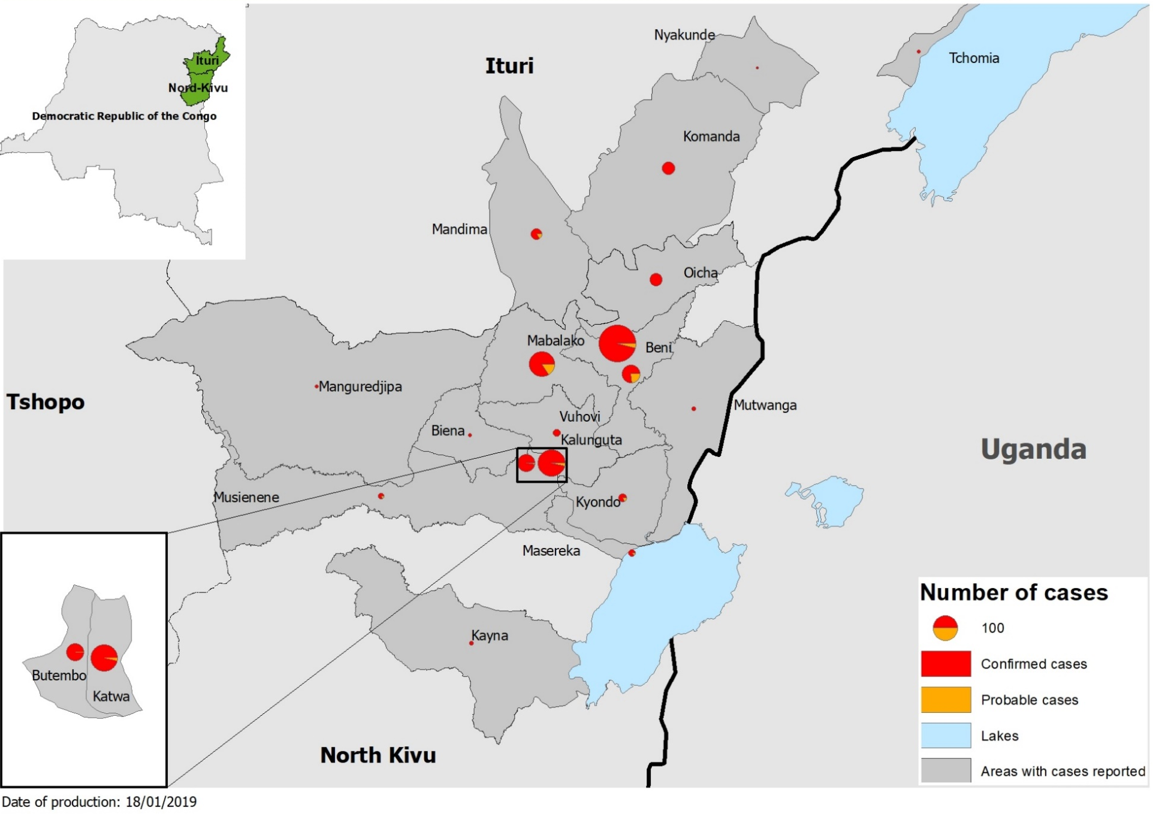
Geographical distribution of confirmed and probable cases of Ebola virus disease, North Kivu and Ituri Provinces, Democratic Republic of the Congo, as of week 3, 2019

Slide 4
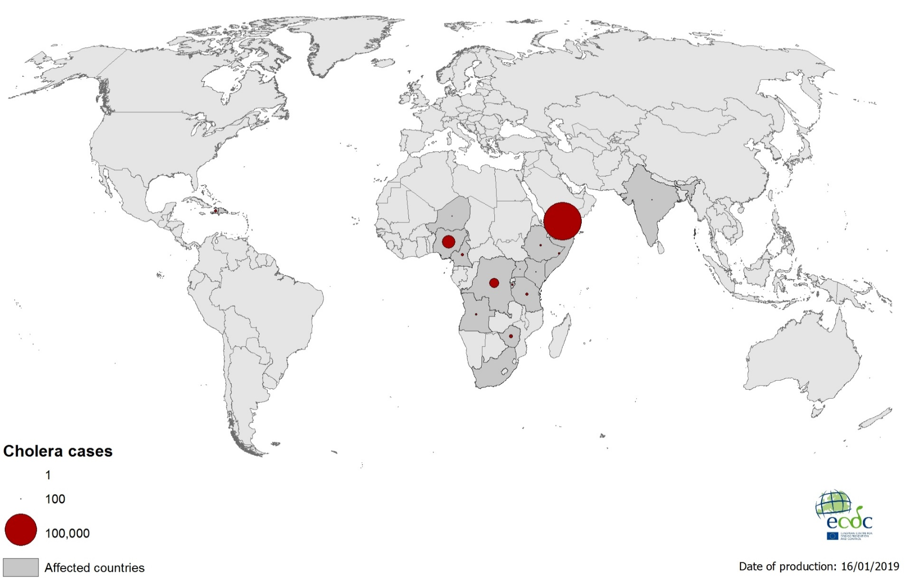
Geographical distribution of new cholera cases reported worldwide between November 2018 and January 2019

Slide 5
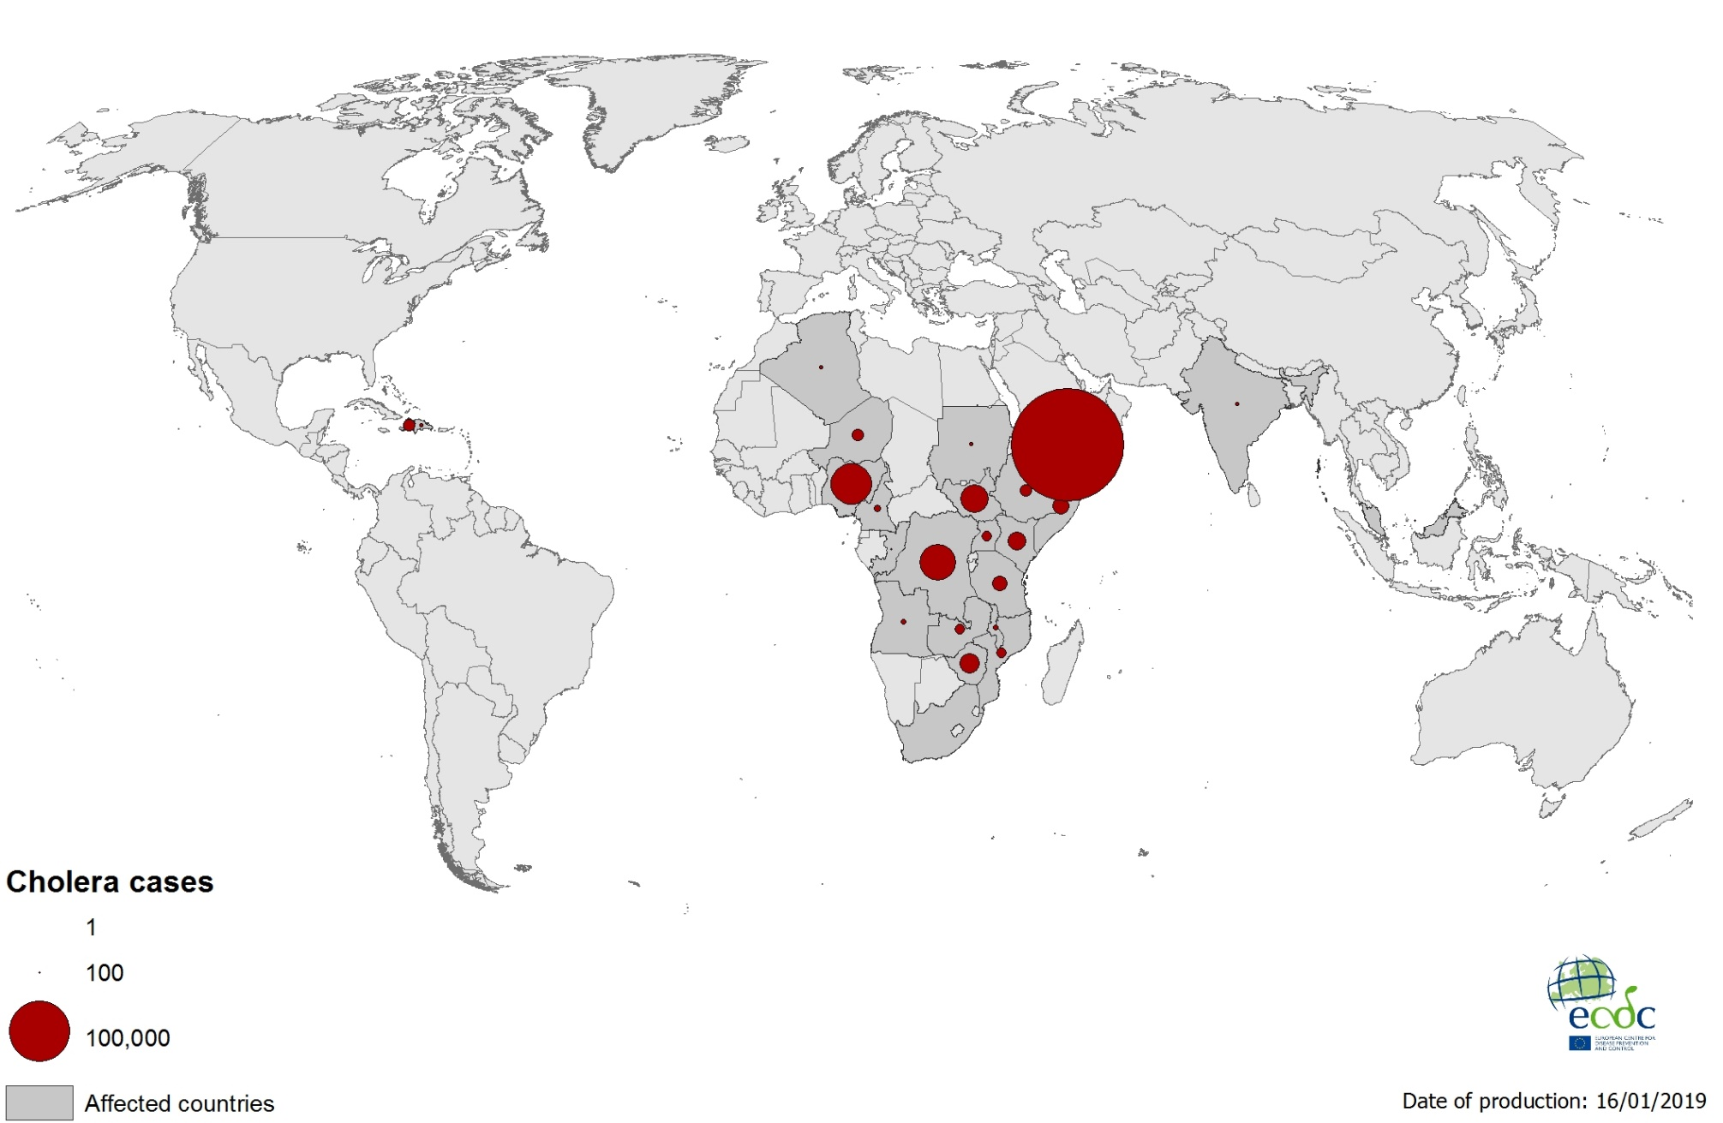
Geographical distribution of cholera cases reported worldwide in 2018

