Slide 1
Reusable maps and graphs from ECDC Communicable Disease Threats Report Week 38, 2022
You are encouraged to reuse our maps and graphs for your own purposes and are free to translate them, provided the content is not altered and the source is acknowledged.

Slide 2
Distribution of human West Nile virus infections in NUTS 3 or GAUL 1 regions in the EU/EEA and neighbouring countries during 2012-2022, as of 21 September 2022

Slide 3
Distribution of human and animal West Nile virus infections in NUTS 3 or GAUL 1 regions of the EU/EEA and neighbouring countries during 2022 season, as of 21 September 2022

Slide 4
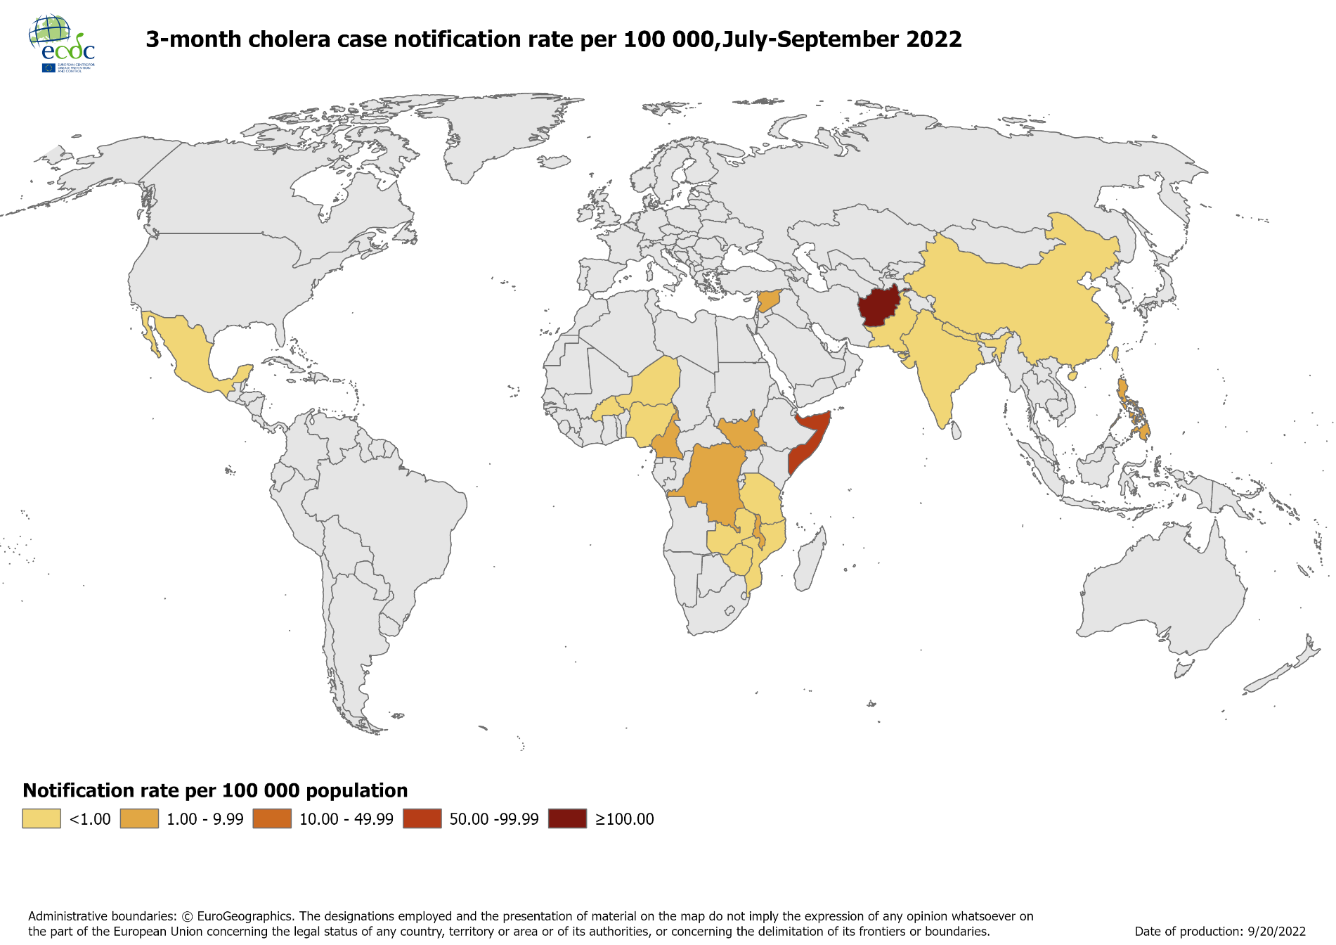
Geographical distribution of 3-month cholera case notification rate per 100 000 population reported worldwide, July-September 2022

Slide 5
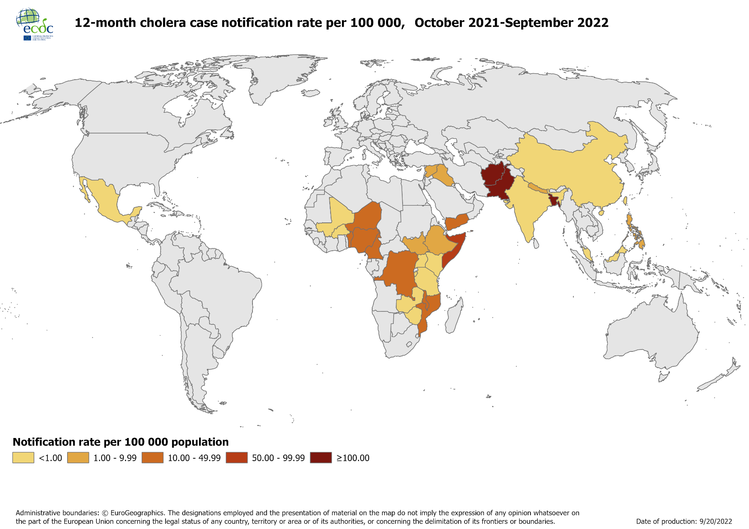
Geographical distribution of 12-month cholera case notification rate per 100 000 population reported worldwide, October 2021-September 2022

