Slide 1
Reusable maps and graphs from ECDC Communicable Disease Threats Report
Week 37 2022
You are encouraged to reuse our maps and graphs for your own purposes and are free to translate them, provided the content is not altered and the source is acknowledged.

Slide 2
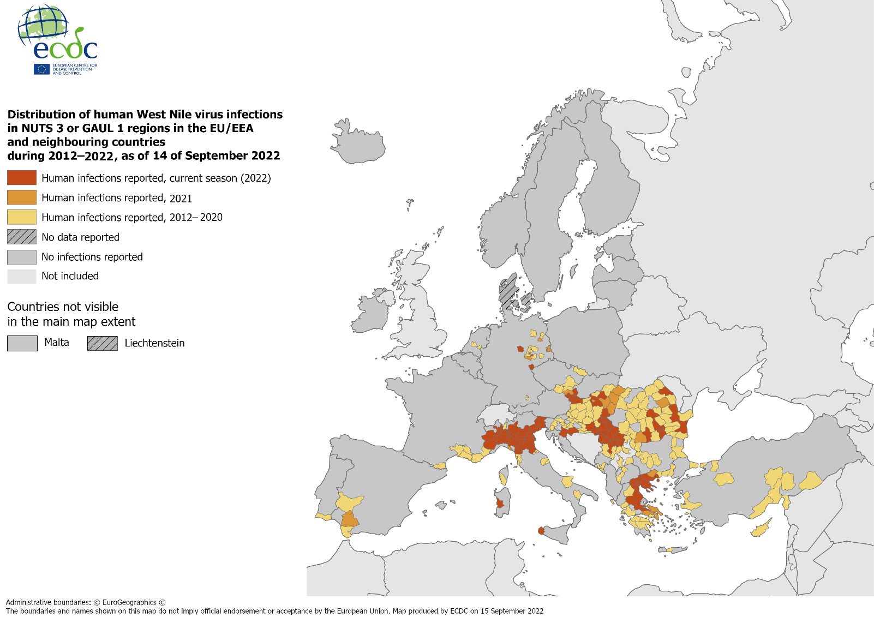
Distribution of human West Nile virus infections in NUTS 3 or GAUL 1 regions in the EU/EEA and neighbouring countries during 2012−2022, as of 14 September 2022

Slide 3
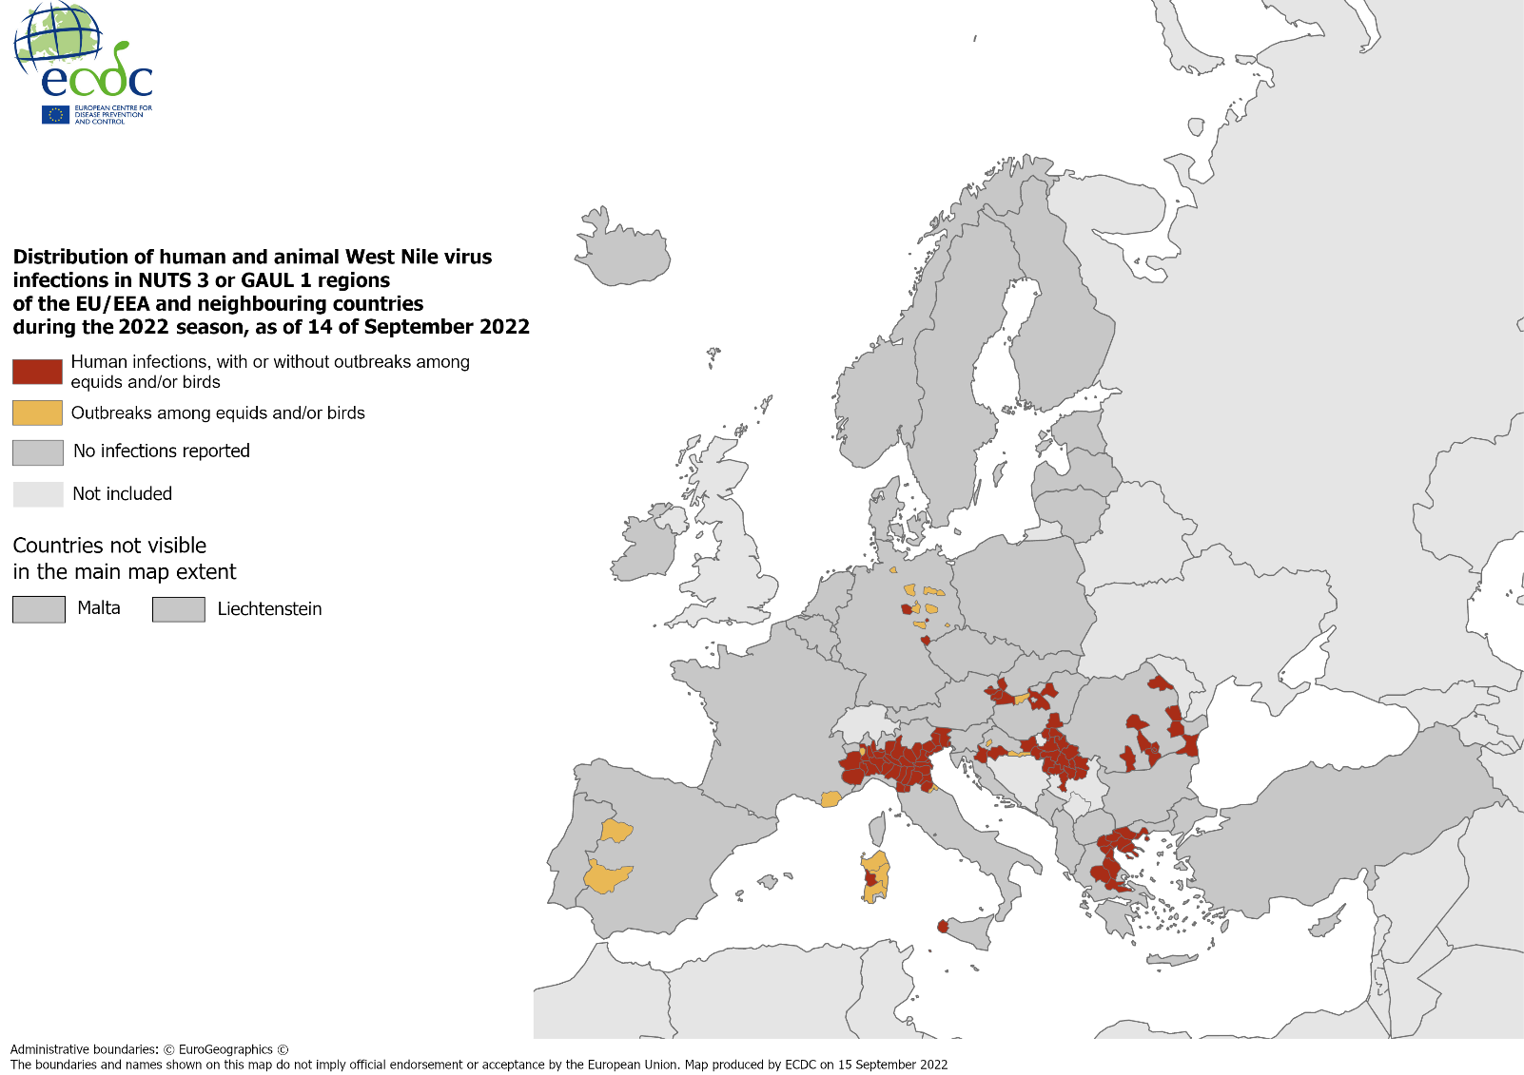
Distribution of human and animal West Nile virus infections in NUTS 3 or GAUL 1 regions of the EU/EEA and neighbouring countries during 2022 season, as of 14 September 2022

