Slide 1
You are encouraged to reuse our maps and graphs for your own purposes and free to translate, provided the content is not altered and the source is acknowledged.
Reusable maps and graphs from ECDC Communicable Disease Threats Report
Week 36, 2018

Slide 2
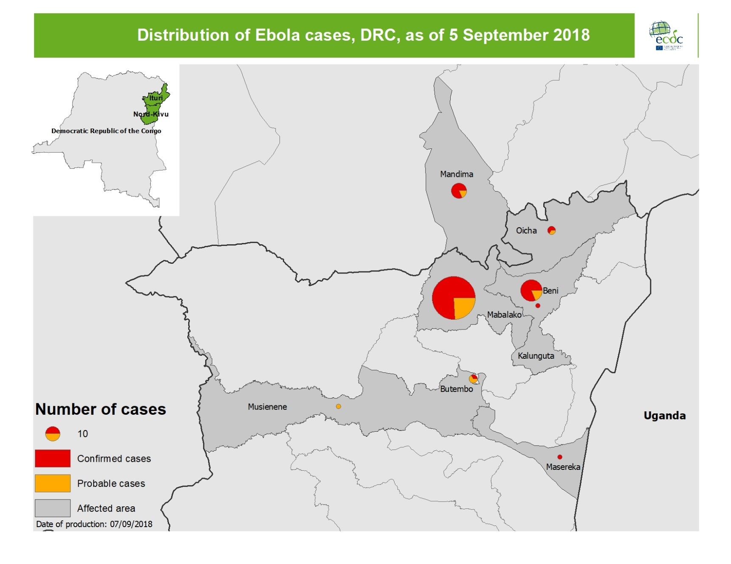
Geographical distribution of confirmed and probable cases of Ebola virus disease, North Kivu and Ituri Provinces, Democratic Republic of the Congo, as of 5 September 2018

Slide 3
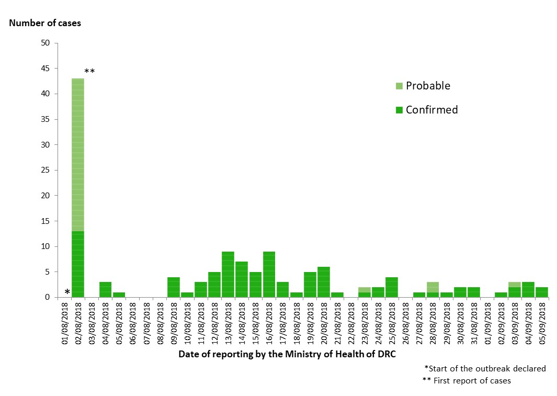
Distribution of confirmed and probable cases of Ebola virus disease, North Kivu and Ituri Provinces, Democratic Republic of the Congo, as of 5 September 2018

Slide 4
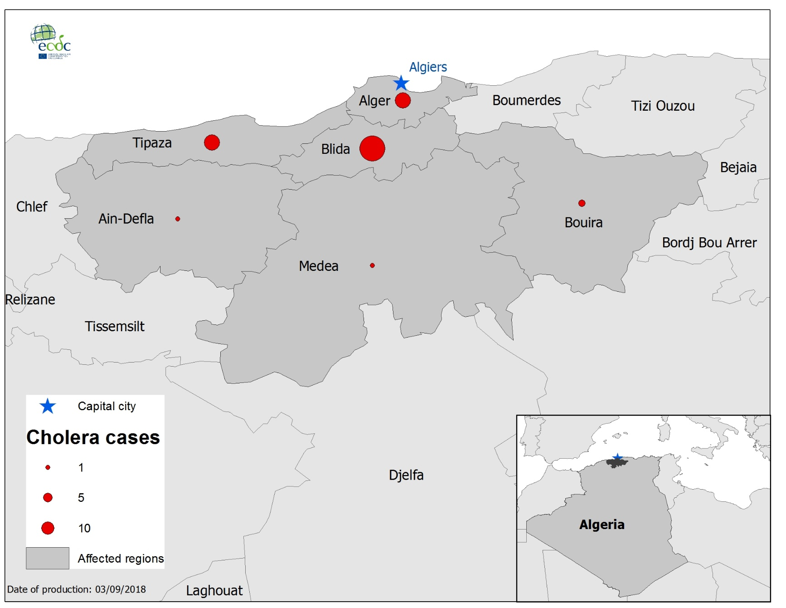
Geographical distribution of cholera cases, Algeria,
as of 3 September 2018

Slide 5
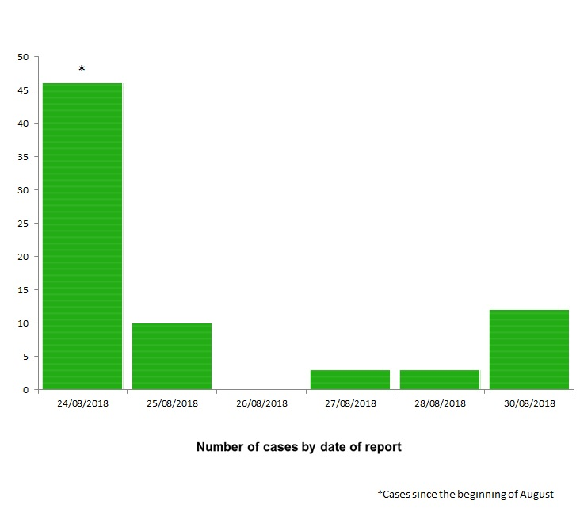
Distribution of confirmed cholera cases, Algeria, as of 30 August 2018

Slide 6
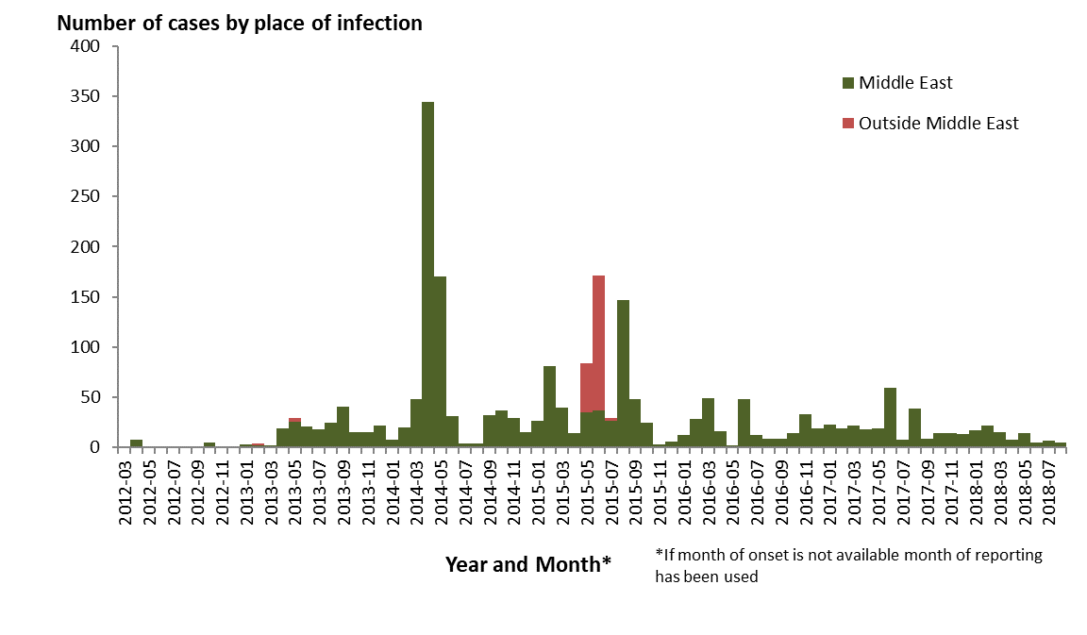
Distribution of confirmed cases of MERS-CoV by place of infection and month of onset, March 2012 – 31 August 2018

Slide 7
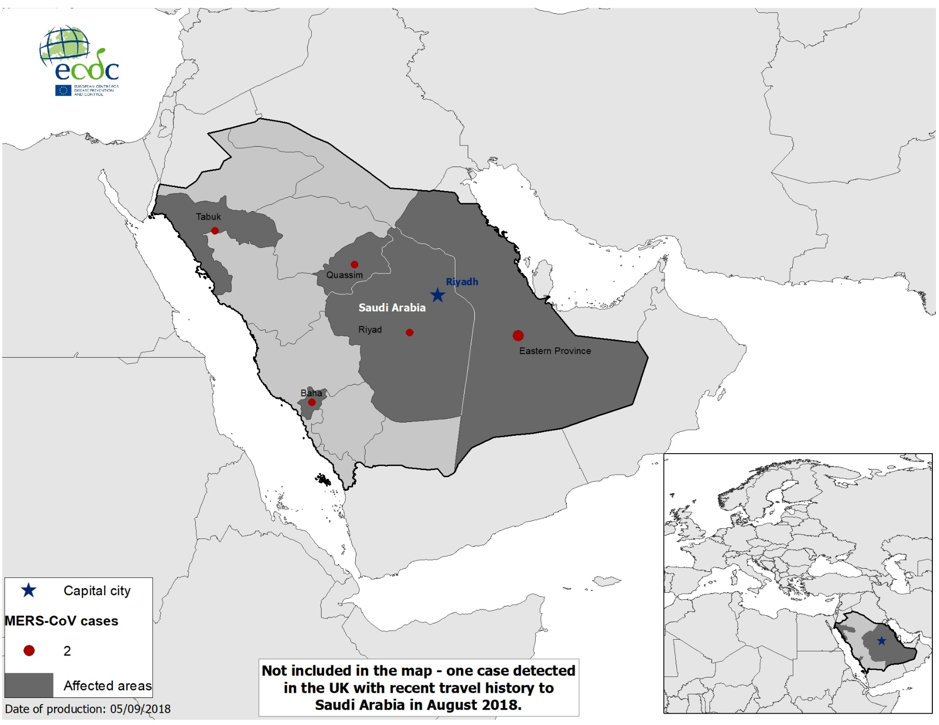
Geographical distribution of confirmed cases of MERS-CoV by probable region of infection in August 2018

Slide 8
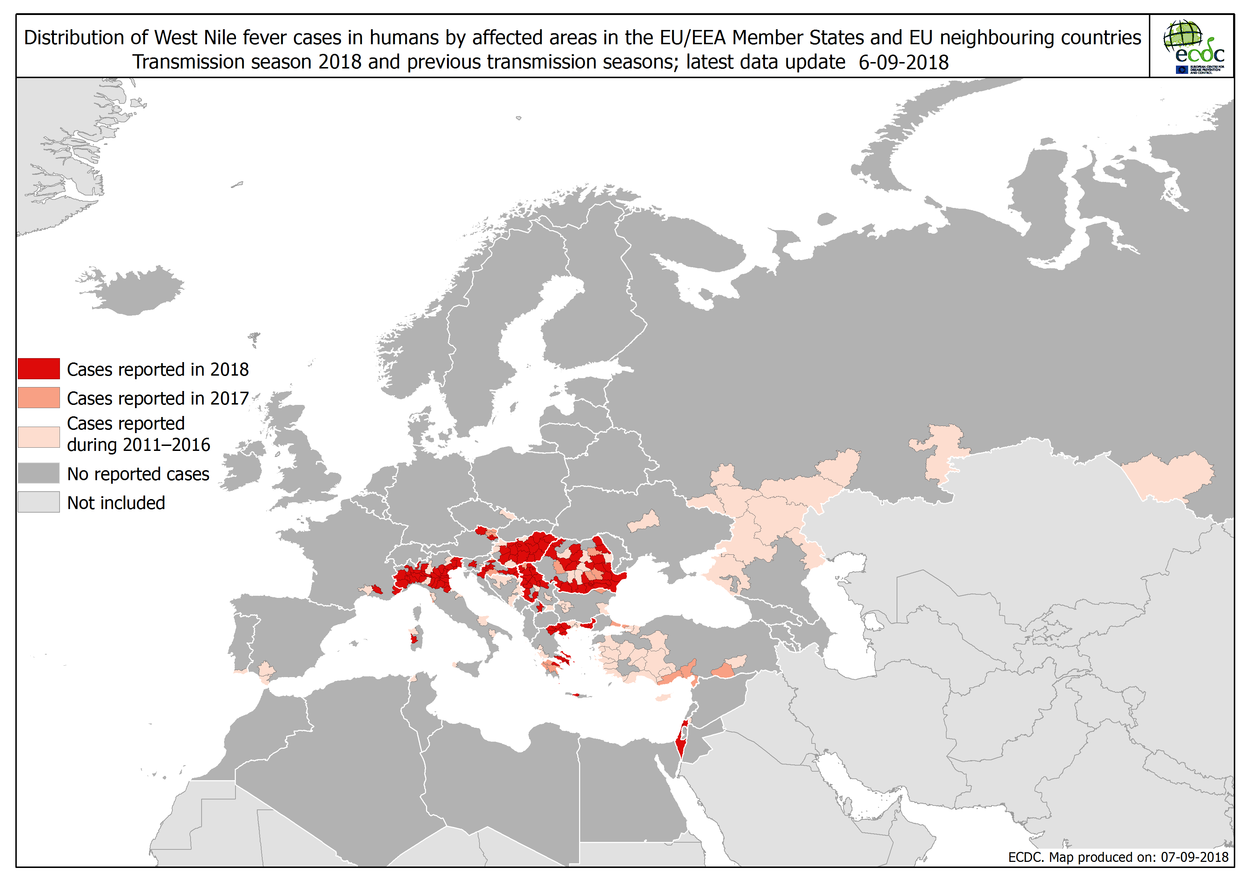

Slide 9
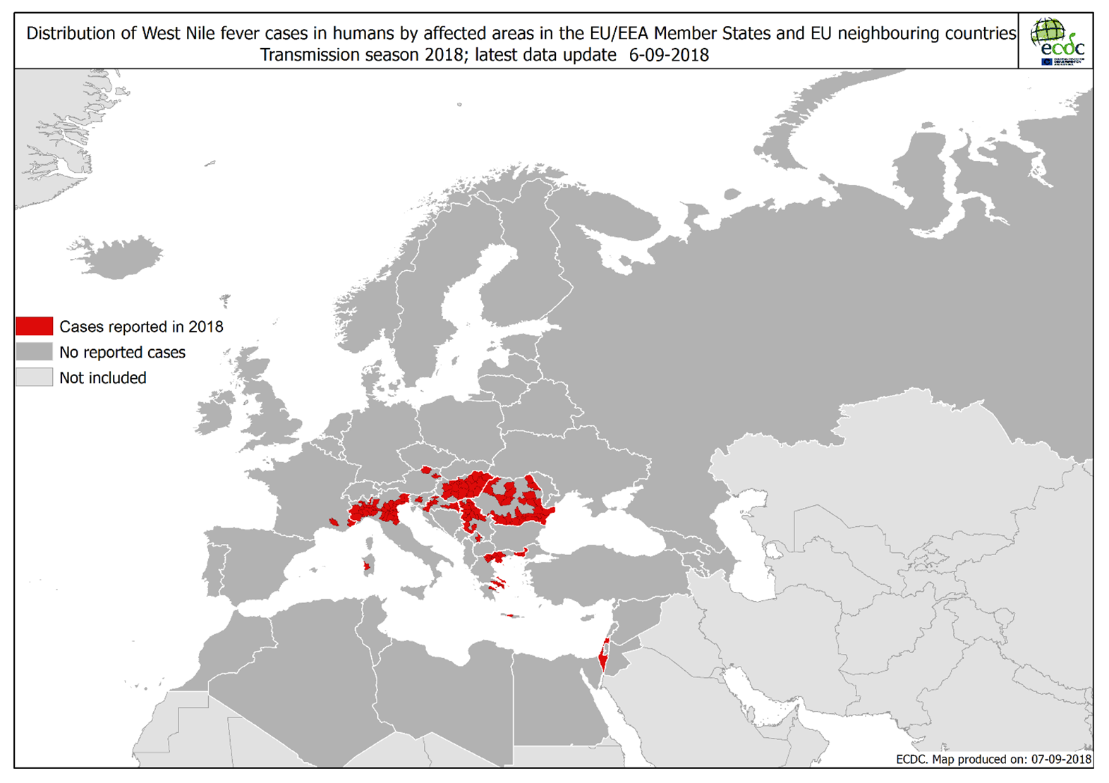

Slide 10
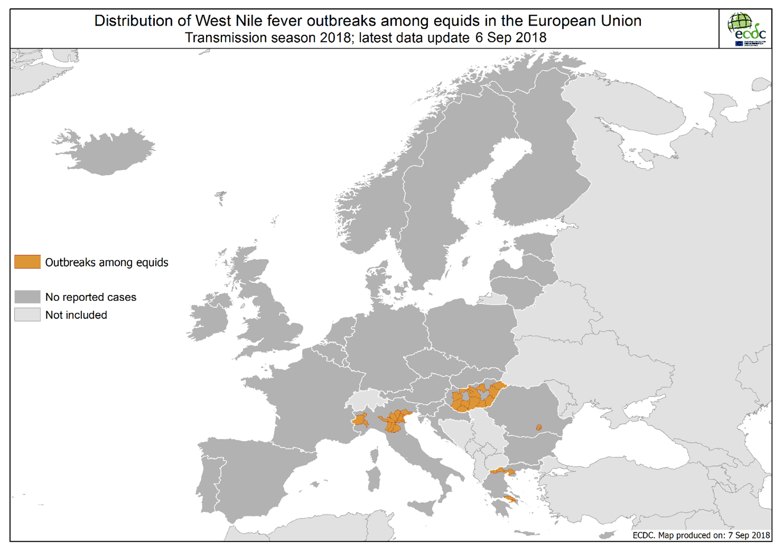

Slide 11
