Slide 1
Reusable maps and graphs from ECDC Communicable Disease Threats Report
Week 35, 2022
You are encouraged to reuse our maps and graphs for your own purposes and are free to translate them, provided the content is not altered and the source is acknowledged.

Slide 2
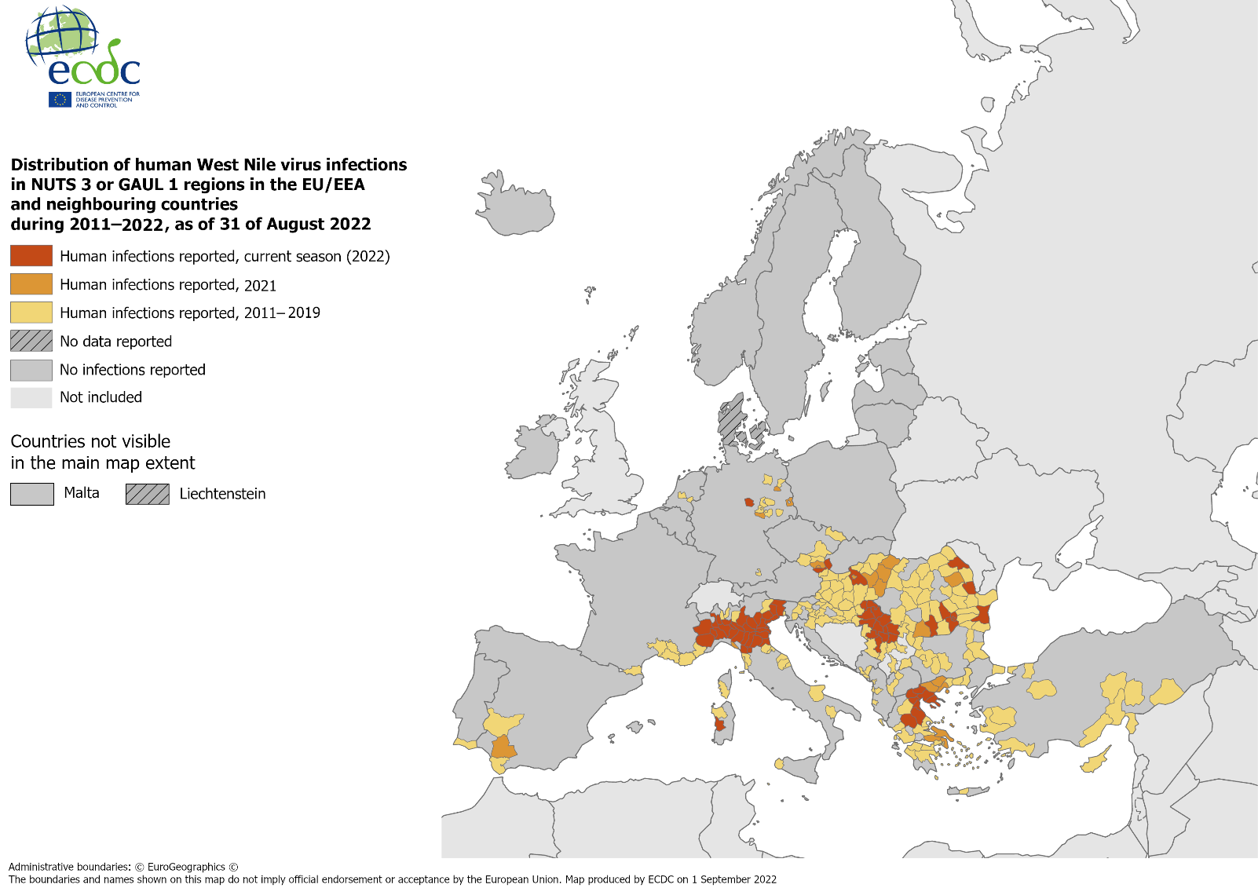
Distribution of human West Nile virus infections in NUTS-3 or GAUL-1 regions in the EU/EEA and neighbouring countries during 2011–2022, as of 31 August 2022

Slide 3
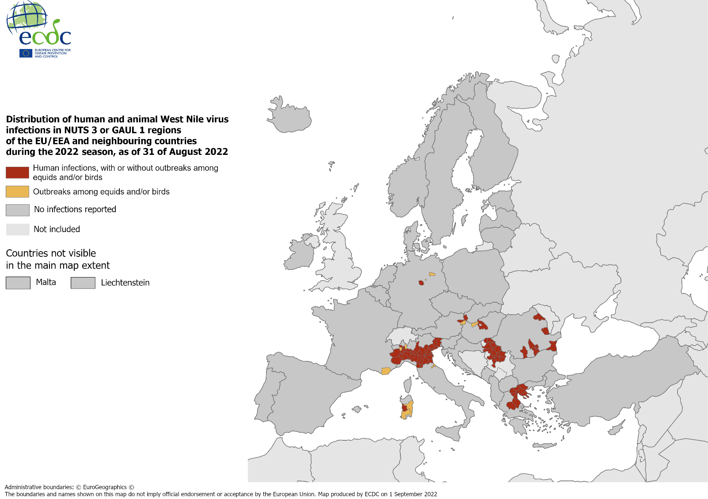
Distribution of human and animal West Nile virus infections in NUTS-3 or GAUL-1 regions of the EU/EEA and neighbouring countries during 2022 season, as of 31 August 2022

Slide 4
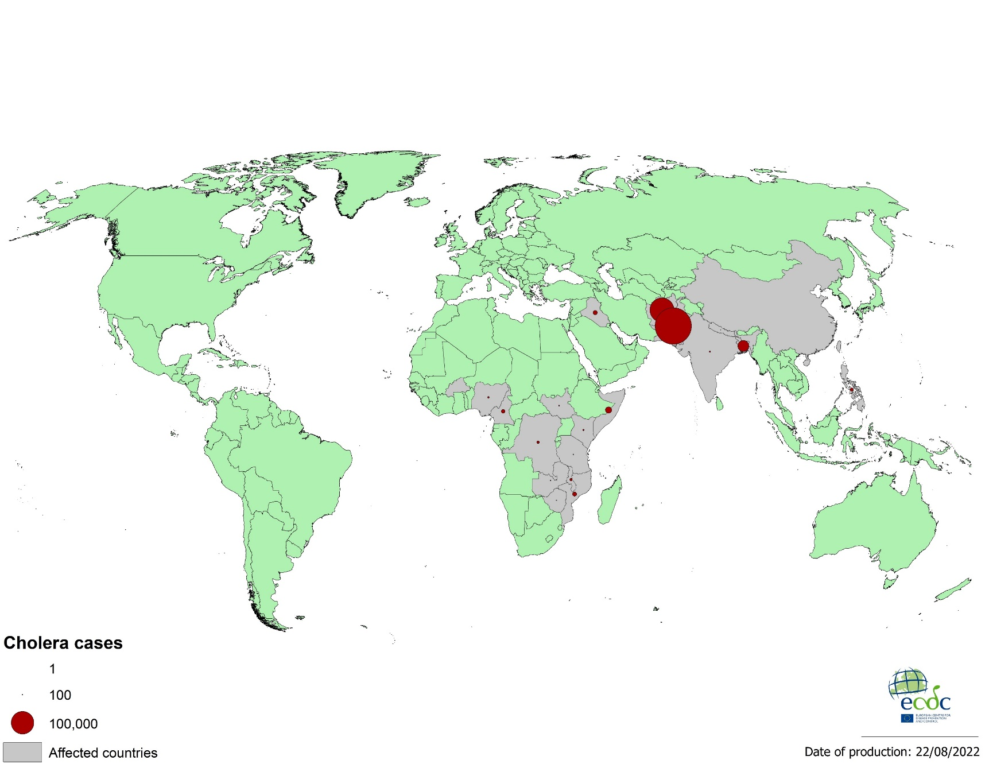
Geographical distribution of cholera cases reported worldwide, from June to August 2022

Slide 5
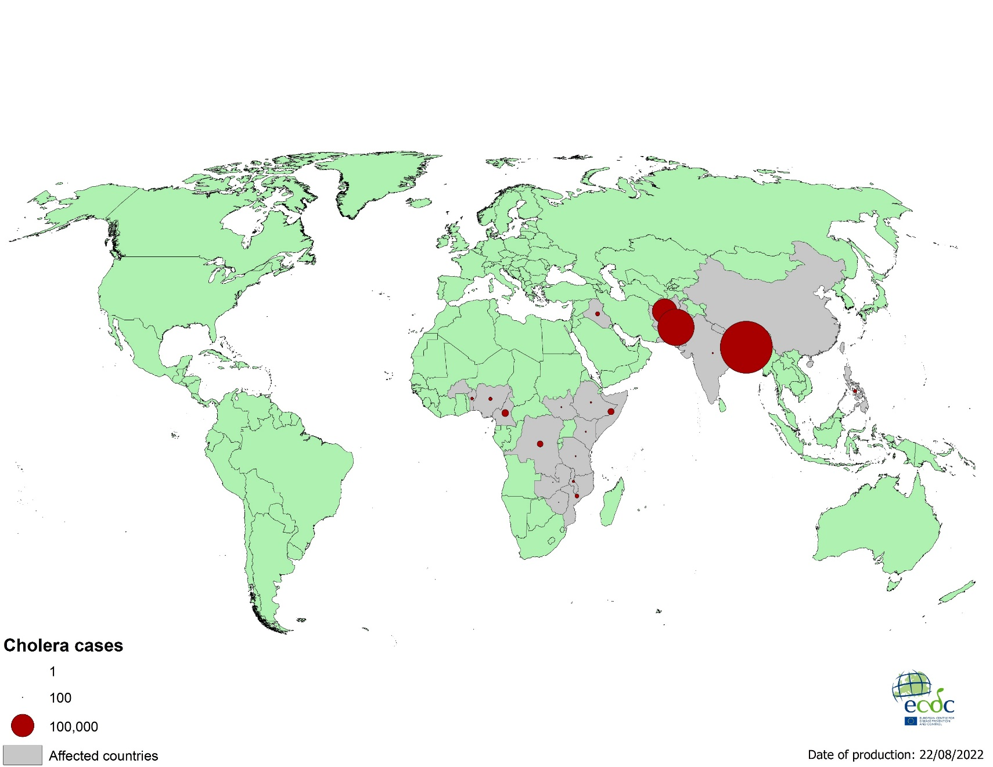
Geographical distribution of cholera cases reported worldwide, as of August 2022

Slide 6
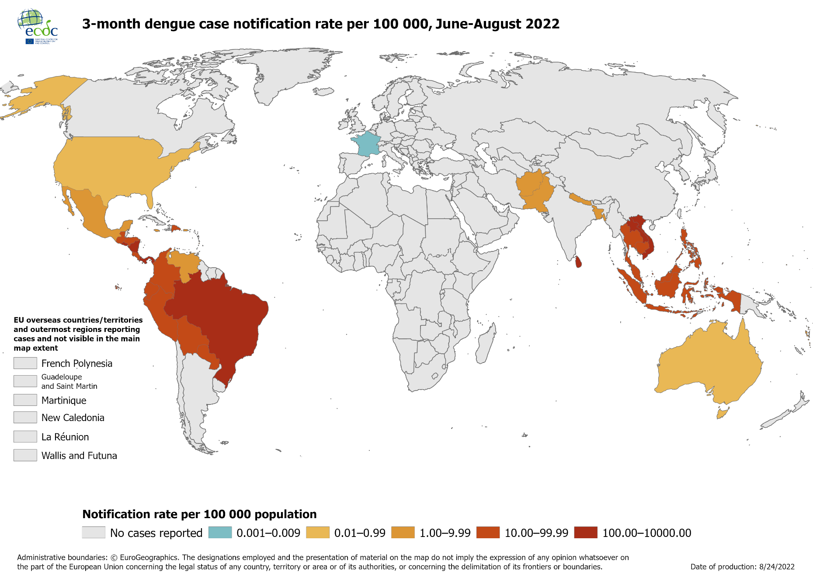
Notification rate of dengue cases reported worldwide, June–August 2022

Slide 7
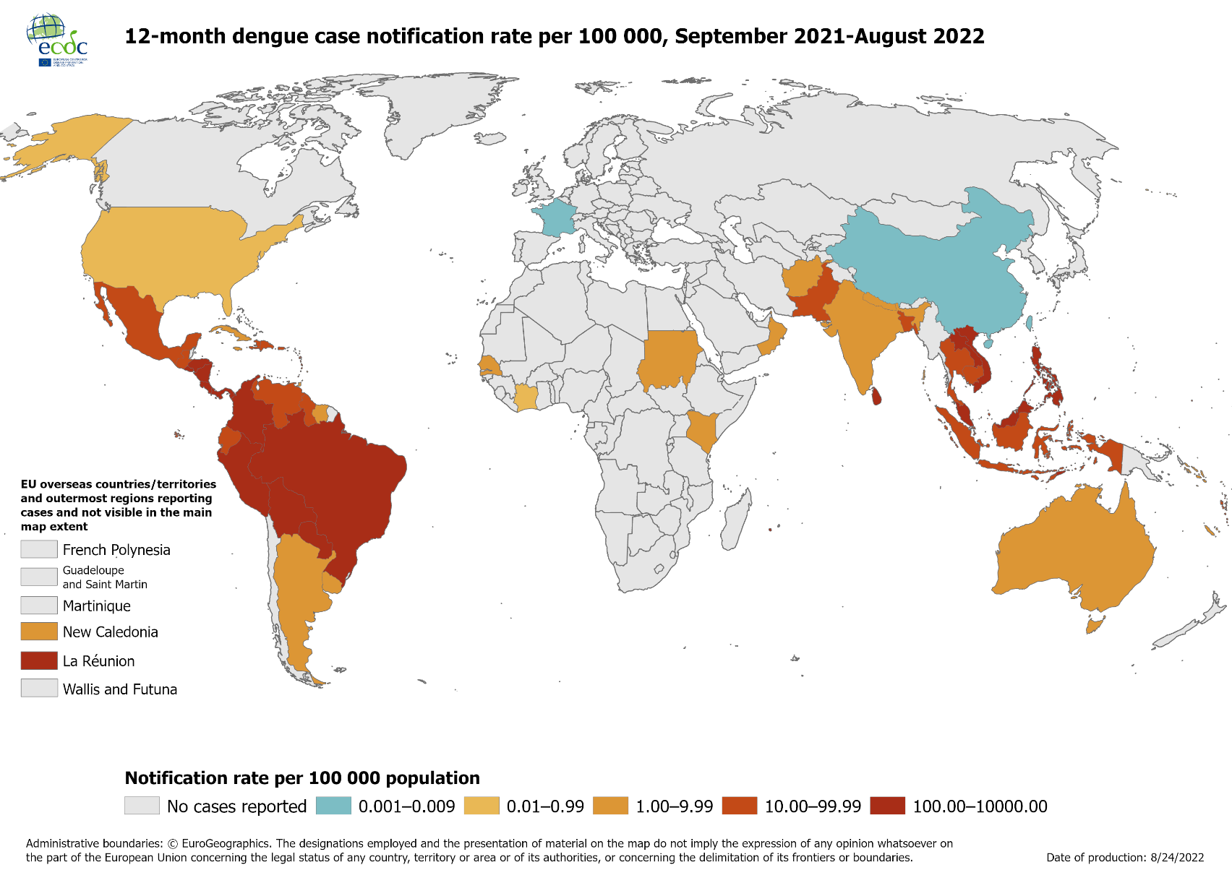
Notification rate of dengue cases reported worldwide, September 2021 –August 2022

Slide 8
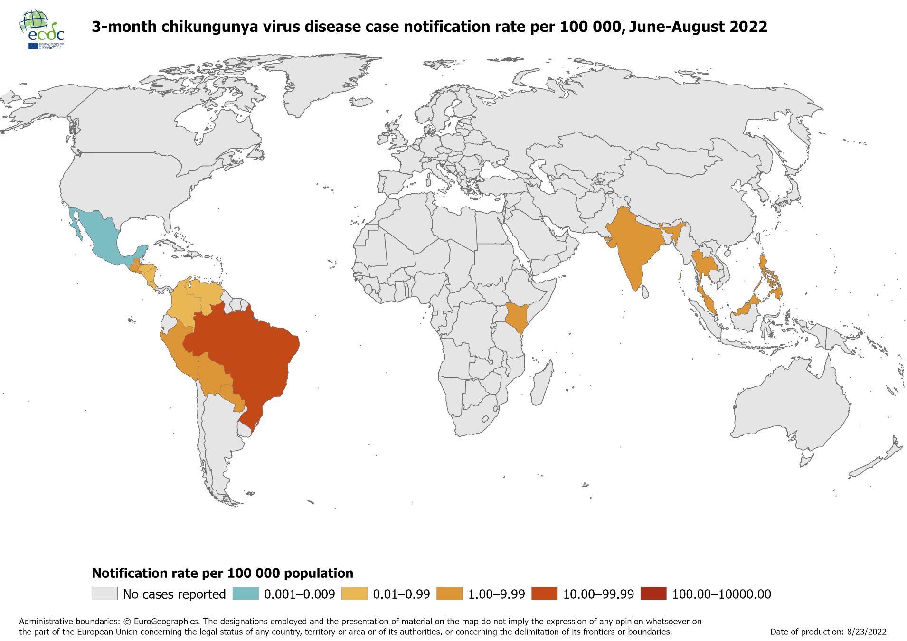
Notification rate of chikungunya cases reported worldwide, June–August 2022

Slide 9
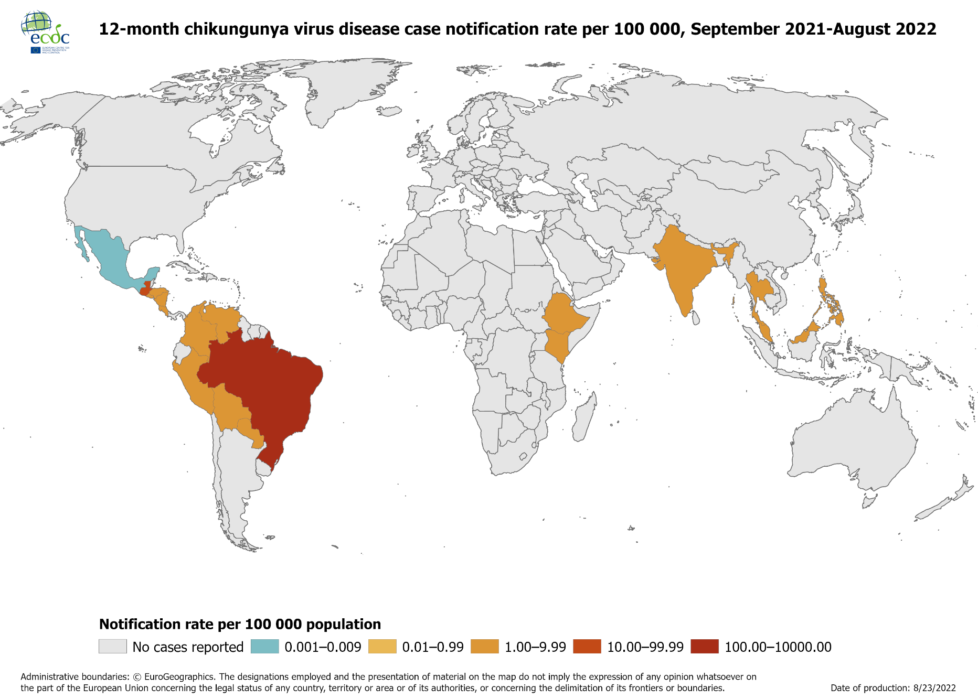
Notification rate of chikungunya cases reported worldwide, September 2021 –August 2022

