Slide 1
You are encouraged to reuse our maps and graphs for your own purposes and free to translate, provided the content is not altered and the source is acknowledged.
Reusable maps and graphs from ECDC Communicable Disease Threats Report
Week 35, 2018

Slide 2
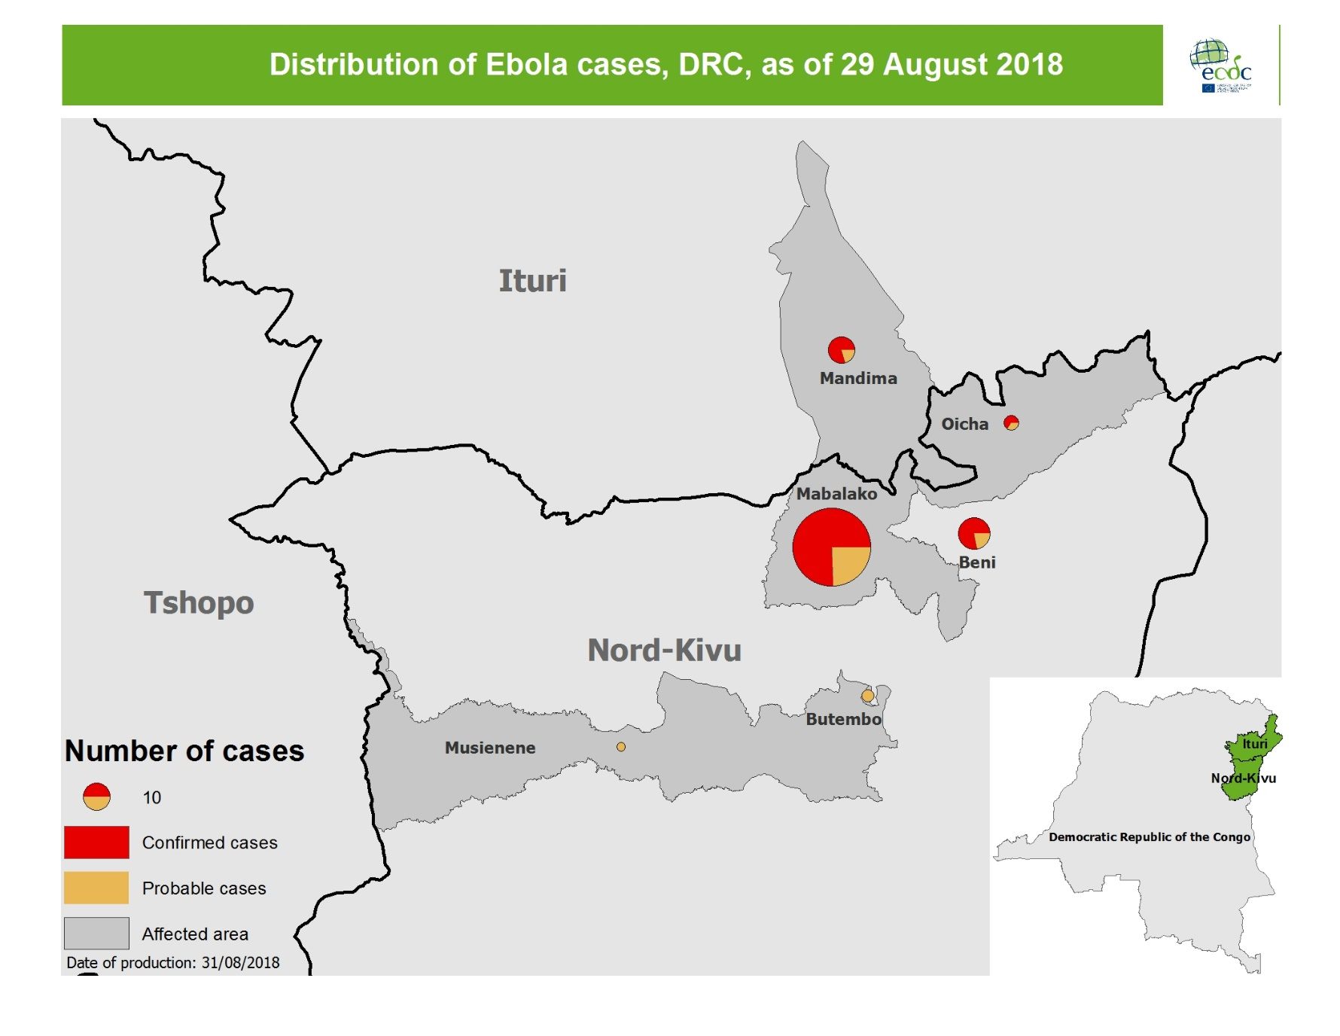
Geographical distribution of confirmed and probable cases of Ebola virus disease, North Kivu and Ituri Provinces, Democratic Republic of the Congo, as of 29 August 2018

Slide 3
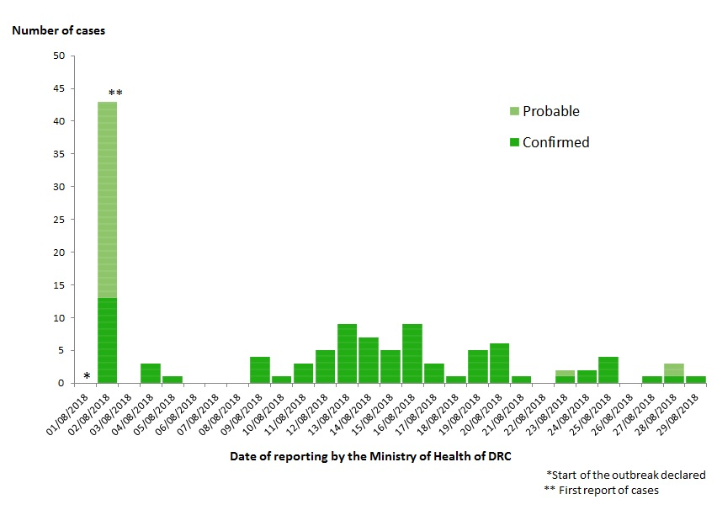
Distribution of confirmed and probable cases of Ebola virus disease, North Kivu and Ituri Provinces, Democratic Republic of the Congo, as of 29 August 2018

Slide 4
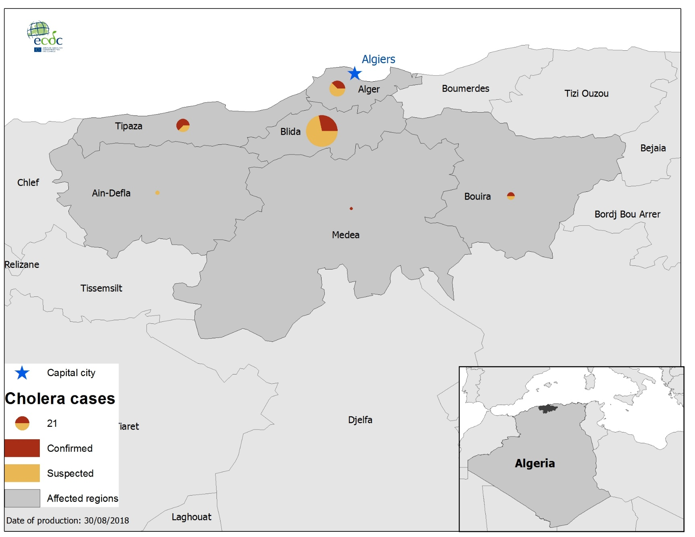
Geographical distribution of cholera cases, Algeria,
as of 26 August 2018

