Slide 1
Reusable maps and graphs from ECDC Communicable Disease Threats Report
Week 35, 2023
You are encouraged to reuse our maps and graphs for your own purposes and are free to translate them, provided the content is not altered and the source is acknowledged.

Slide 2
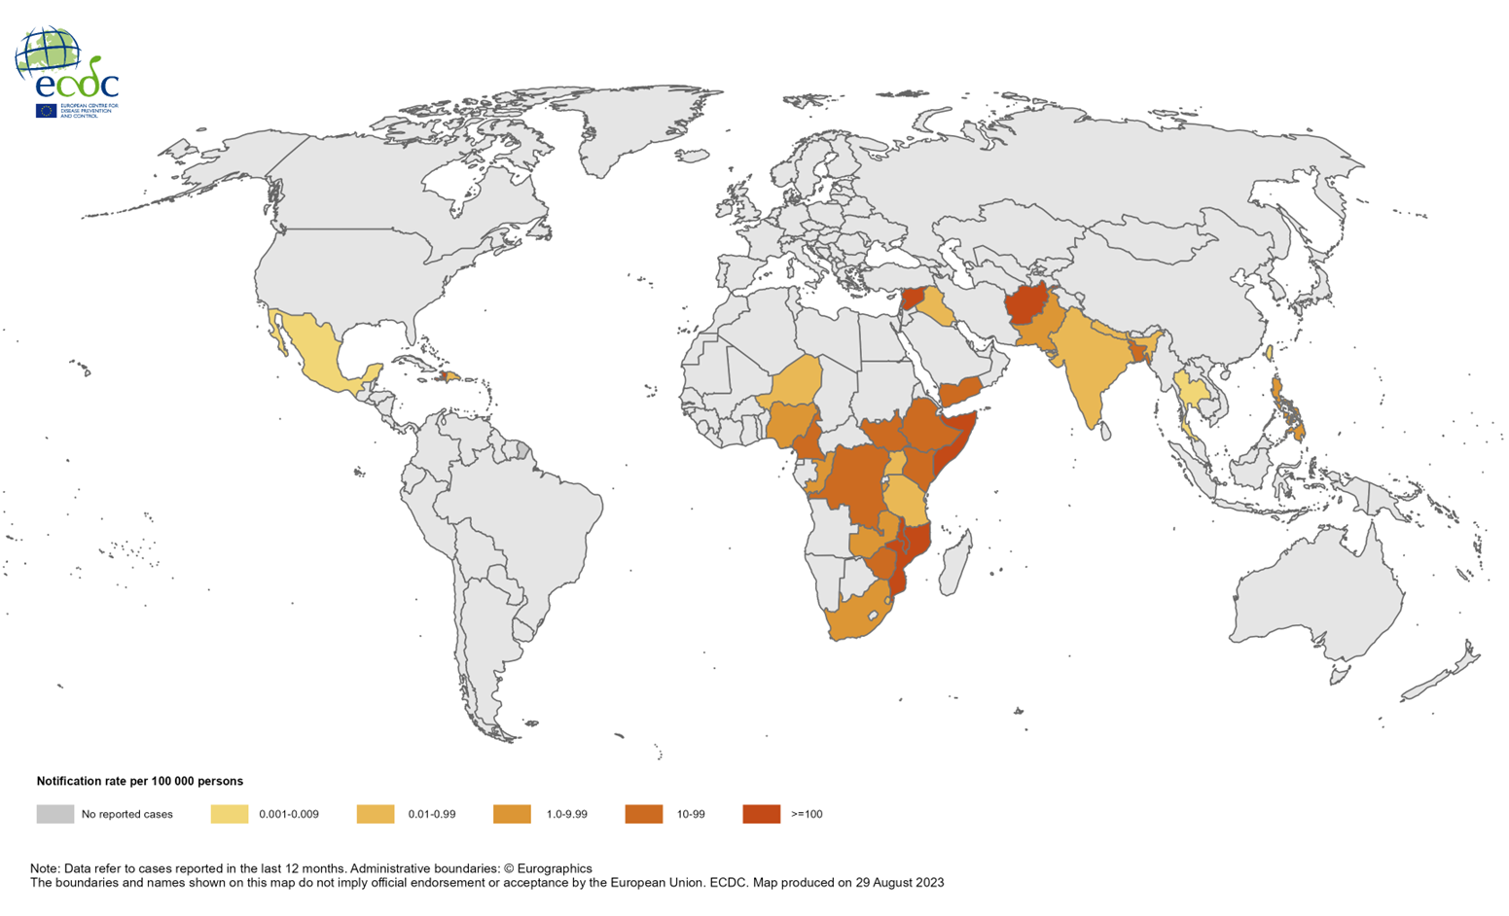
Geographical distribution of cholera cases reported worldwide,
September 2022–August 2023

Slide 3
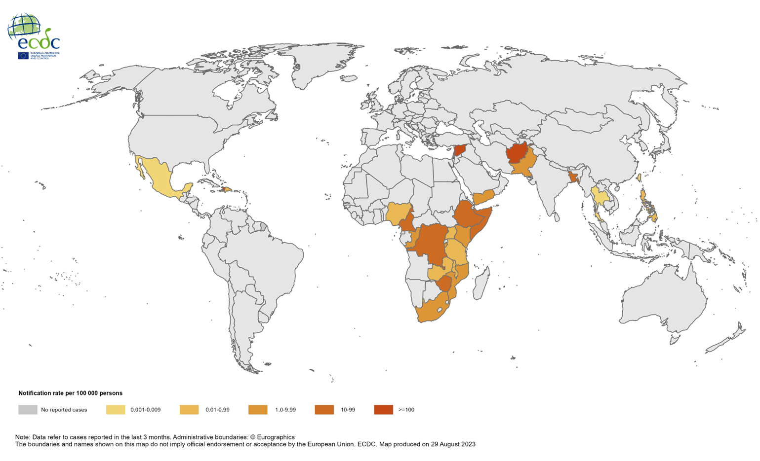
Geographical distribution of cholera cases reported worldwide,
June–August 2023

Slide 4
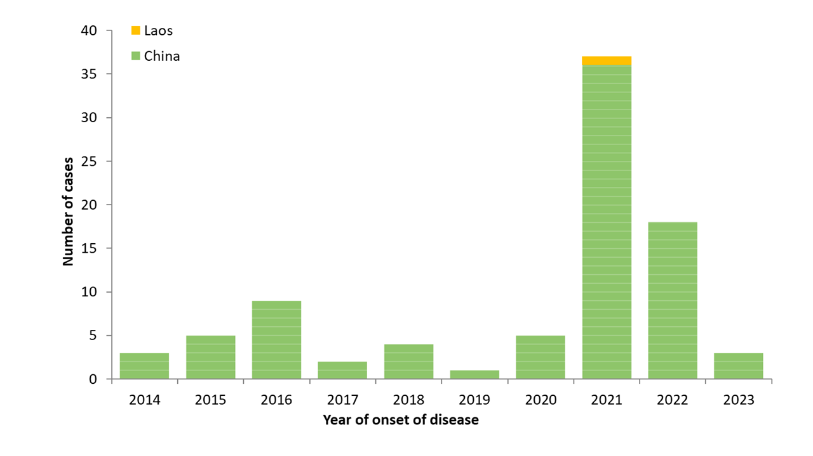
Distribution of confirmed human cases of avian influenza A(H5N6) virus infection by year of onset and country, 2014 to 24 August 2023

