Slide 1
Reusable maps and graphs from ECDC Communicable Disease Threats Report Week 31, 2022
You are encouraged to reuse our maps and graphs for your own purposes and are free to translate them, provided the content is not altered and the source is acknowledged.

Slide 2
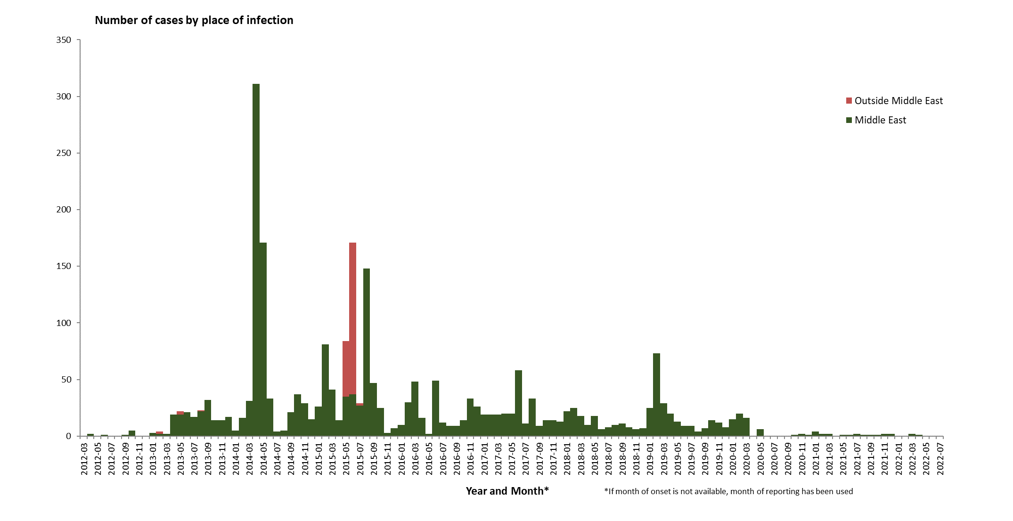
Distribution of confirmed cases of MERS-CoV by place of infection and month of onset, March 2012 – August 2022

Slide 3
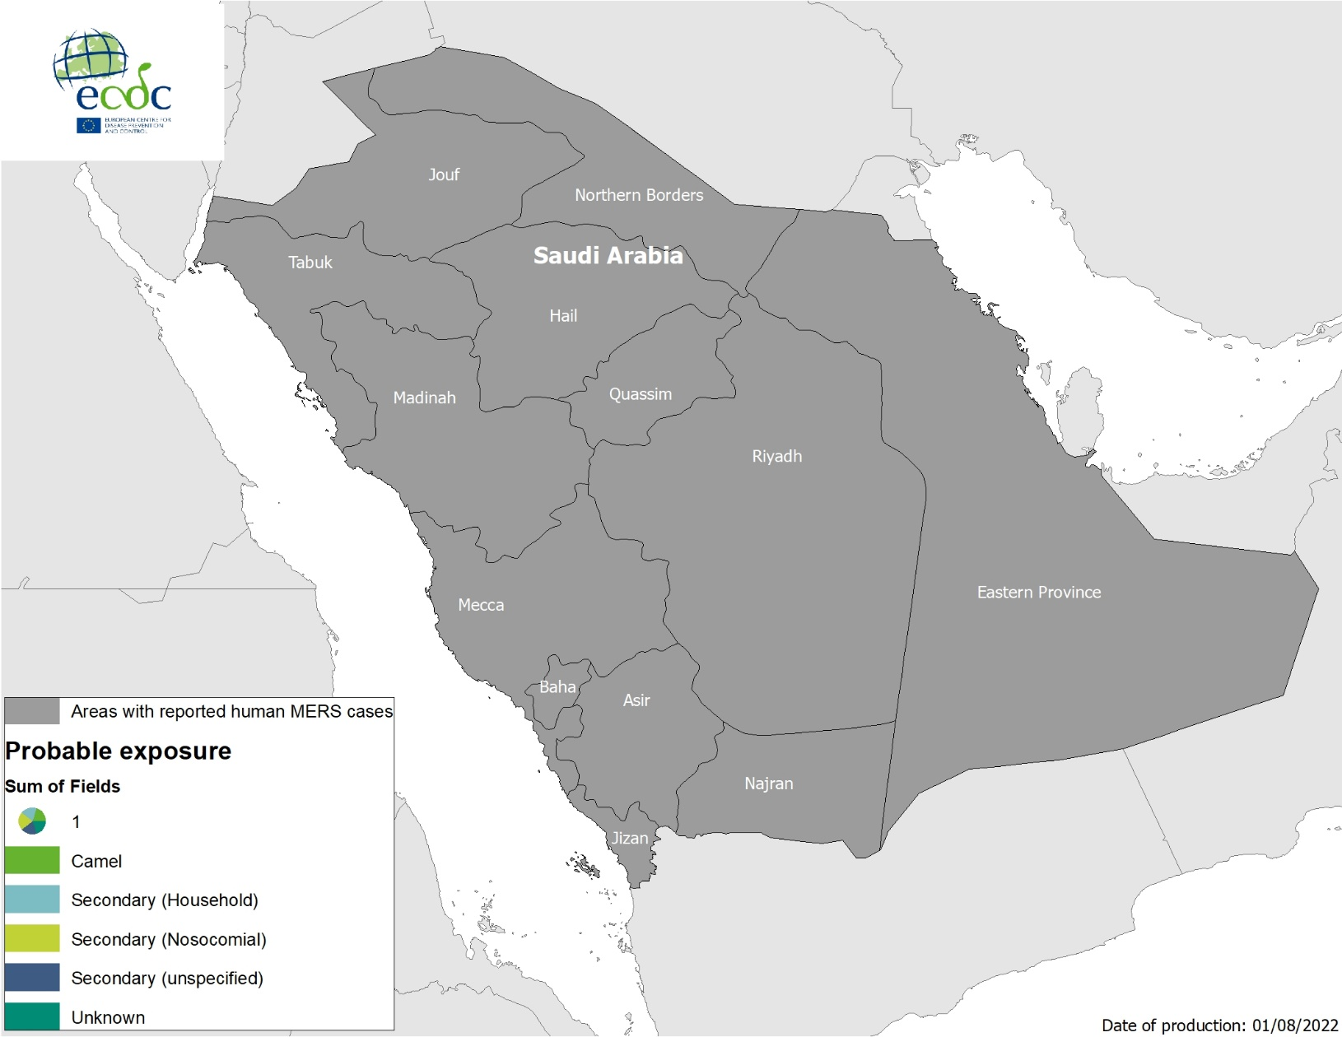
Geographical distribution of confirmed cases of MERS-CoV by probable region of infection and exposure, 1 January 2022 – 1 August 2022

Slide 4
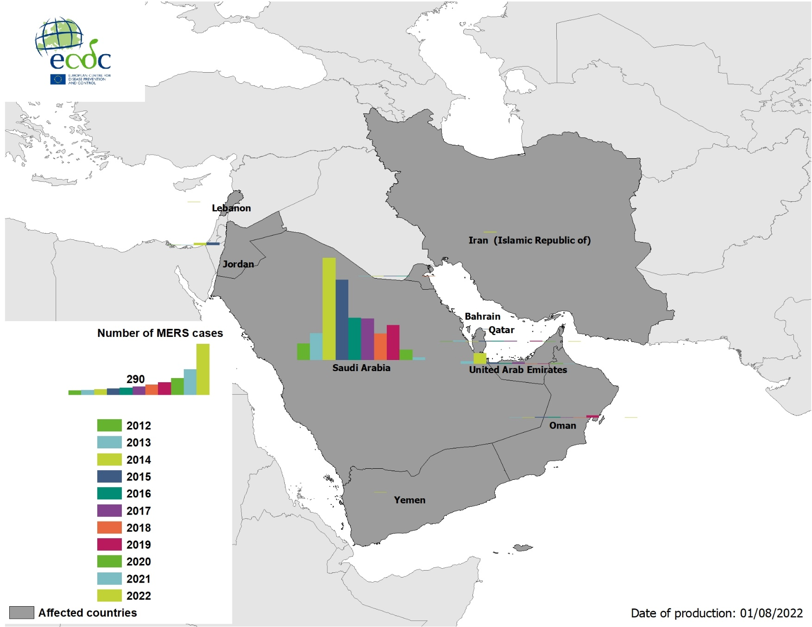
Geographical distribution of confirmed cases of MERS-CoV by country of infection and year, April 2012 – 1 August 2022

Slide 5
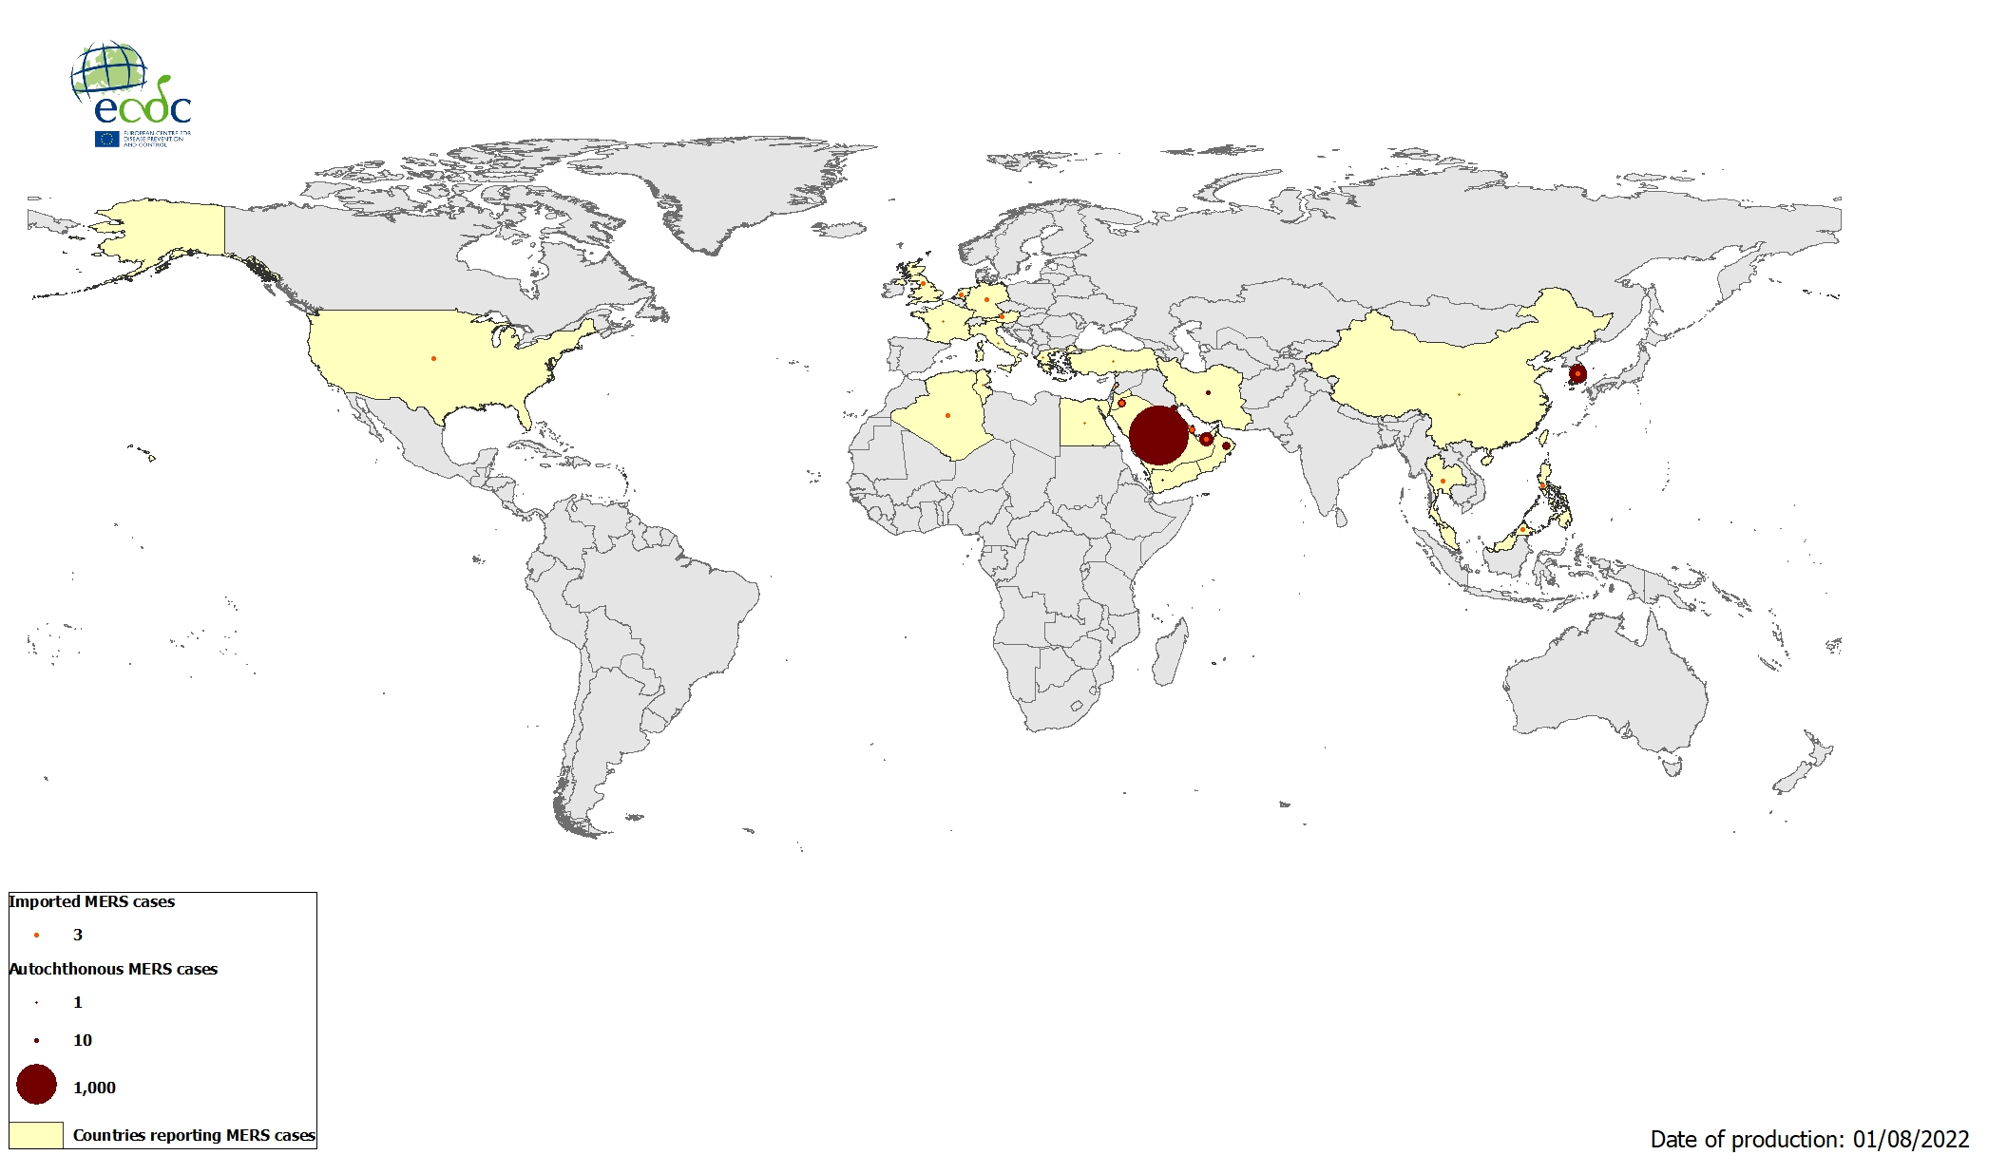
Geographical distribution of confirmed cases of MERS-CoV by reporting country, April 2012 – 1 August 2022

Slide 6
Distribution of human West Nile virus infections in NUTS 3 or GAUL 1 regions in the EU/EEA and neighbouring countries during 2011–2022, as of 3 August 2022

Slide 7
Distribution of human and animal West Nile virus infections in NUTS 3 or GAUL 1 regions of the EU/EEA and neighbouring countries during 2022 season, as of 3 August 2022

