Slide 1
Reusable maps and graphs from ECDC Communicable Disease Threats Report Week 31, 2020
You are encouraged to reuse our maps and graphs for your own purposes and free to translate, provided the content is not altered and the source is acknowledged.

Slide 2
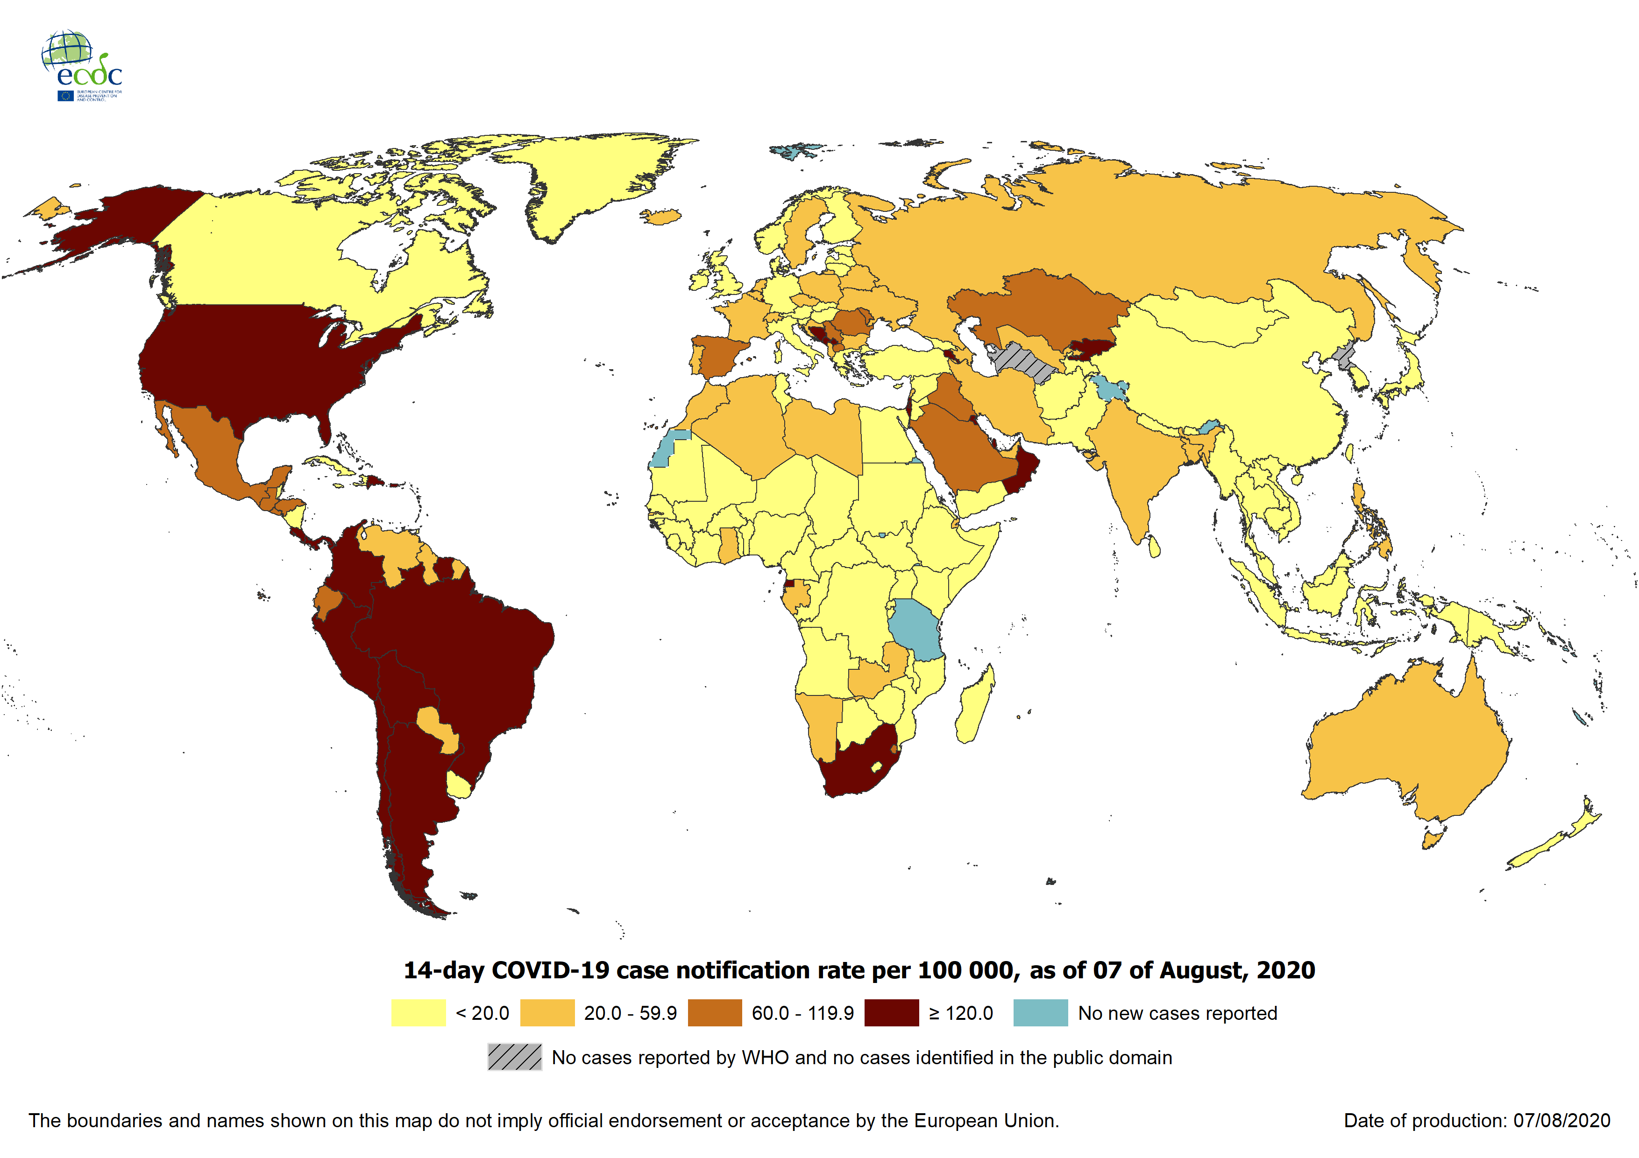
Geographic distribution of 14-day cumulative number of reported COVID-19 cases per 100 000 population, worldwide, as of 7 August 2020

Slide 3
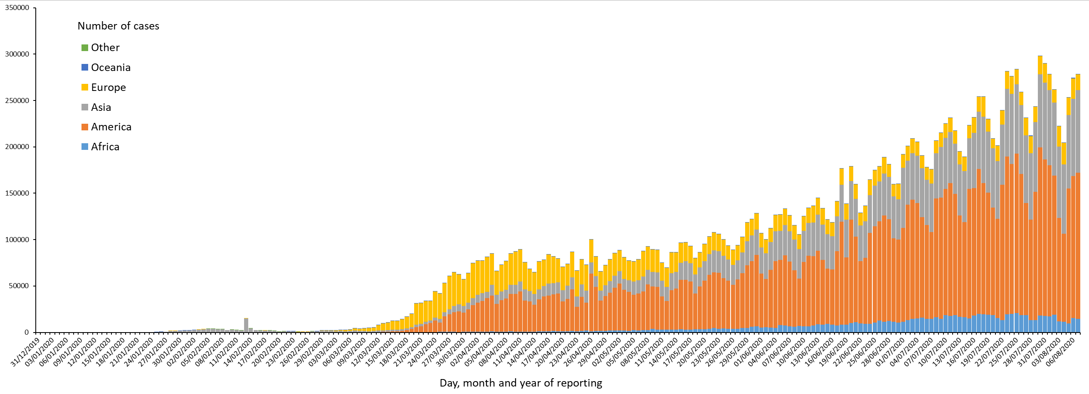
Distribution of COVID-19 cases*§ in accordance with the applied case definitions in the affected countries, by country and region, as of 7 August 2020
*Spain: Since 11 May 2020, the frequency of reporting from regional level to national level has changed. This may lead to possible discrepancies in cases and death numbers resulting from data validation. This discrepancy could persist for several days.
§UK: On 3 July 2020, the UK announced a revision of historical data that led to a negative number of new cases and an overall decrease in cases for the UK. In the displayed graph the revision of data is not considered as the change in reported cases would result in a negative number of cases for Europe overall.

Slide 4
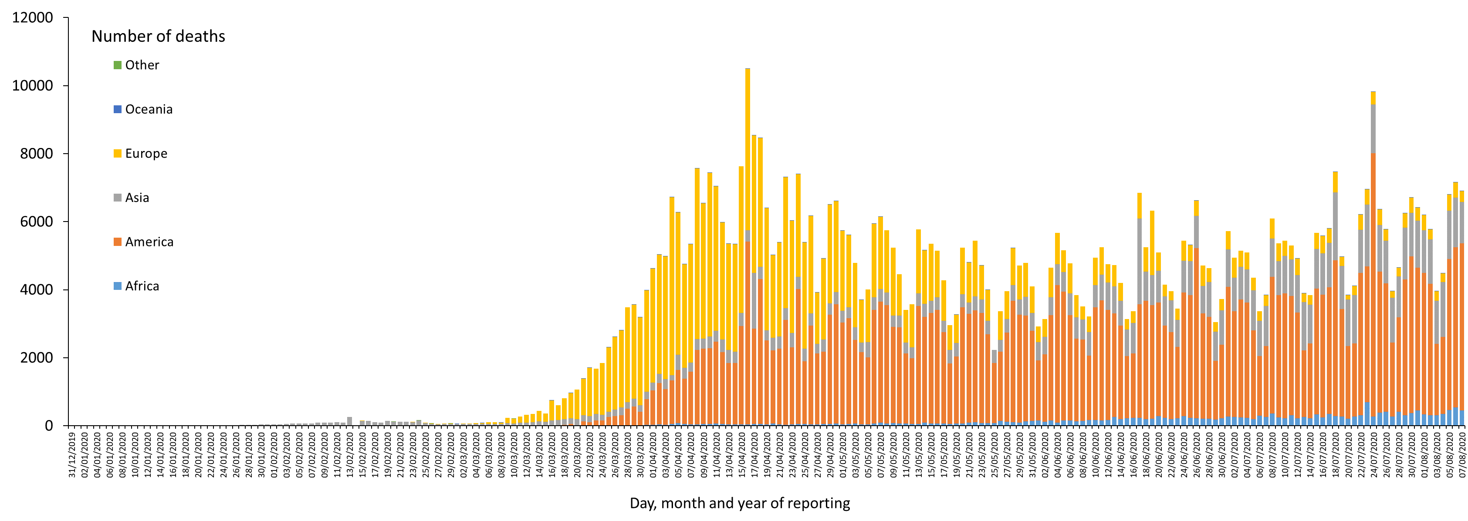
Distribution of COVID-19 deaths (in accordance with the applied case definition in the country) by country and region, as of 7 August 2020
* Increase of deaths in America is attributable to the US, which since 14 April 2020 includes confirmed and probable cases and deaths:
https://www.cdc.gov/coronavirus/2019-ncov/cases-updates/cases-in-us.html#2019coronavirus-summary
** Spain: Since 11 May 2020, the frequency of reporting from regional level to national level has changed. This may lead to possible discrepancies in cases and death numbers resulting from data validation. This discrepancy could persist for several days.
In the displayed graph no new deaths are reported for Spain from 25 May 2020 as the change in reported deaths would result in a negative number of deaths for Europe overall.

Slide 5
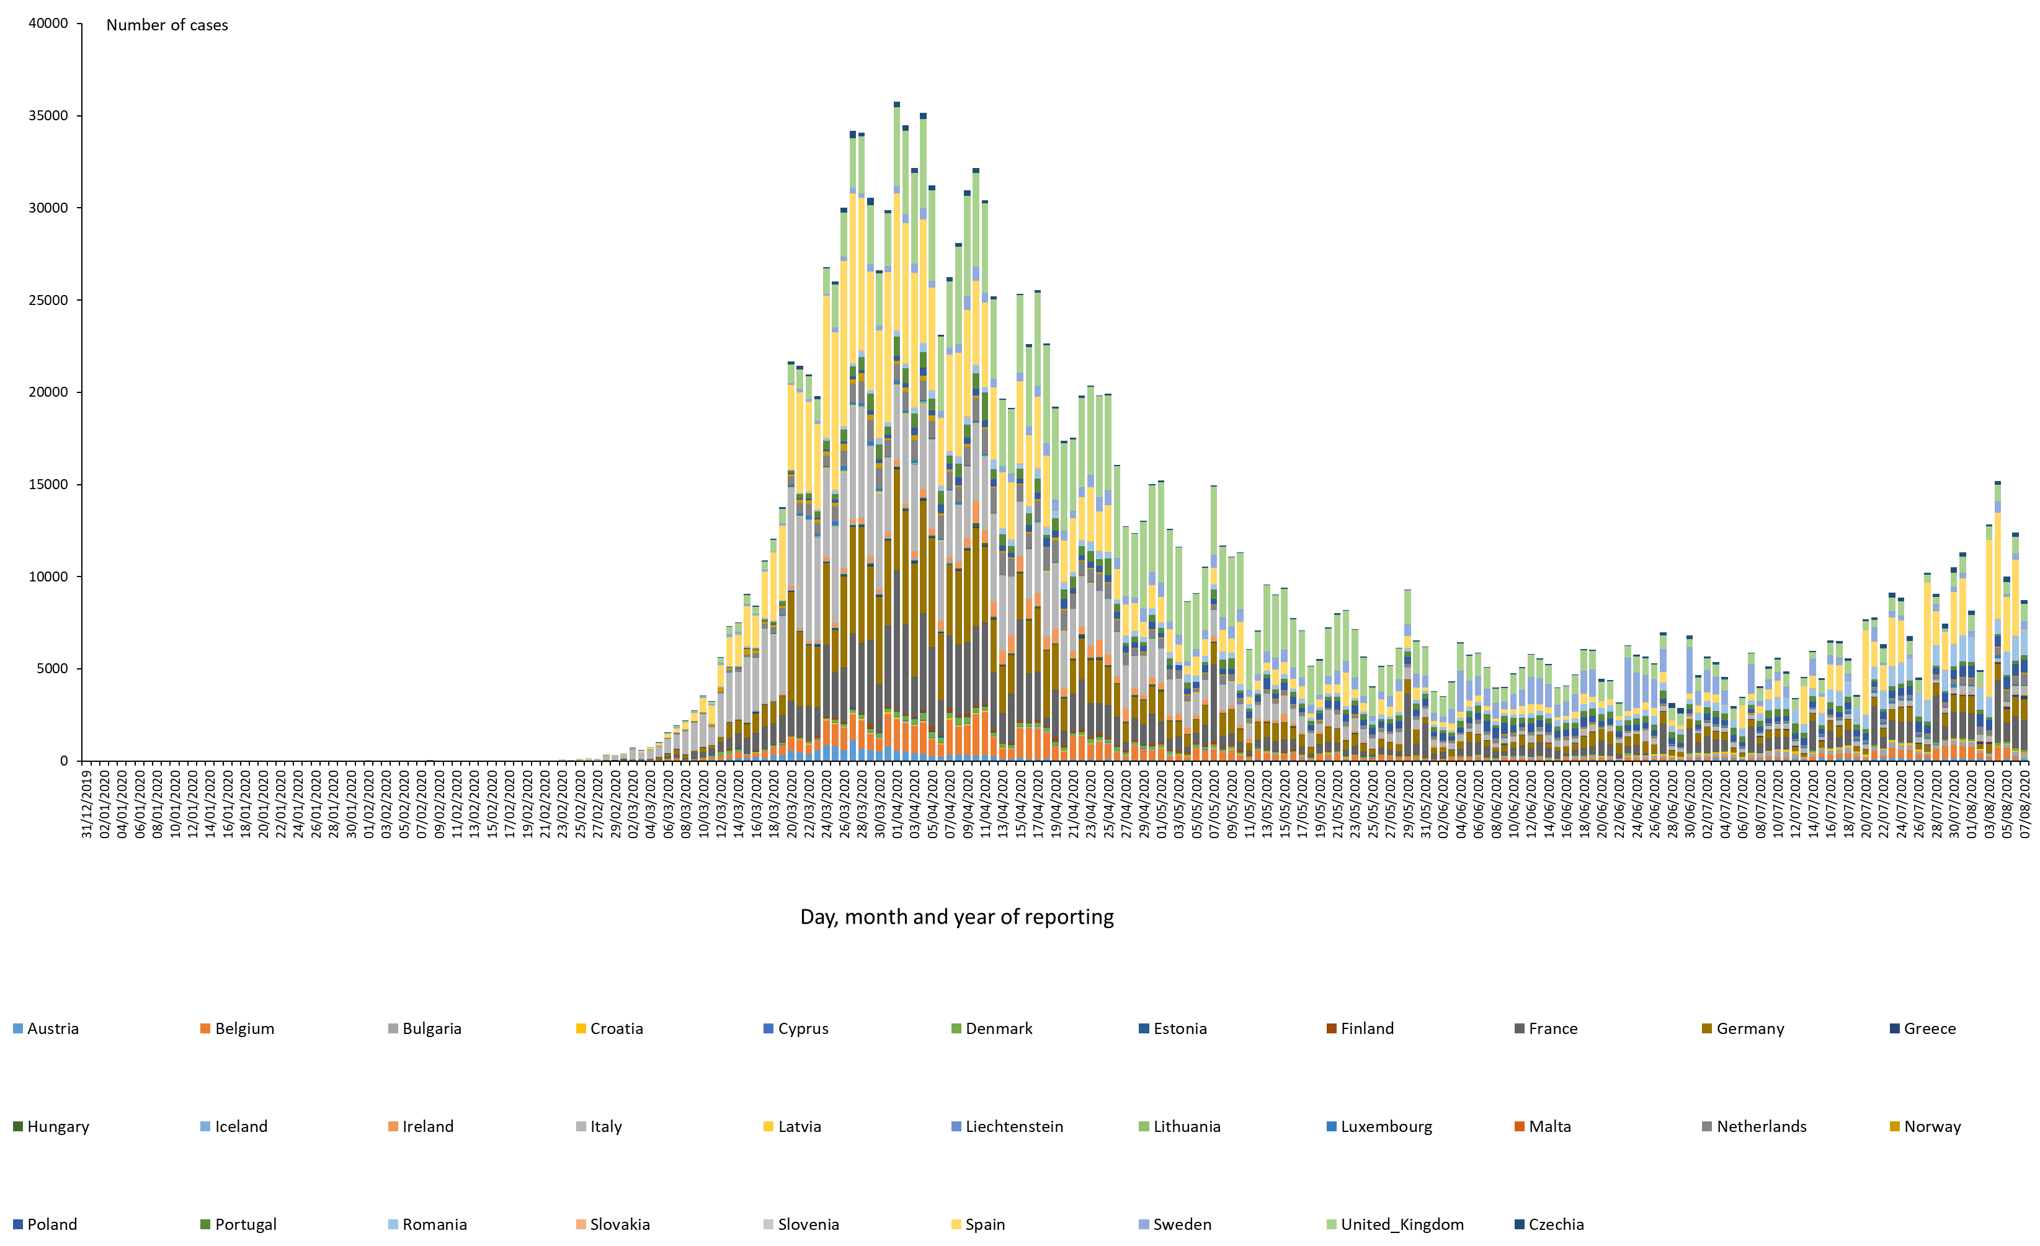
Distribution of COVID-19 cases*§ (according to the applied case definition in the country) in EU/EEA and the UK, as of 7 August 2020
*Spain: Since 11 May 2020, the frequency of reporting from regional level to national level has changed. This may lead to possible discrepancies in cases and death numbers due to data validation. This discrepancy could persist for several days.
§UK: On 3 July 2020, the UK announced an ongoing revision of historical data that may lead to a decreased number of cases. Data will be retro-corrected accordingly.

Slide 6
Eleventh outbreak: Ebola Virus Disease case distribution in Equateur Province, Democratic Republic of the Congo, as of 4 August 2020

Slide 7
Eleventh outbreak: distribution of confirmed and probable cases of Ebola virus disease by week of reporting in Equateur Province, Democratic Republic of the Congo, as of 4 August 2020

Slide 8
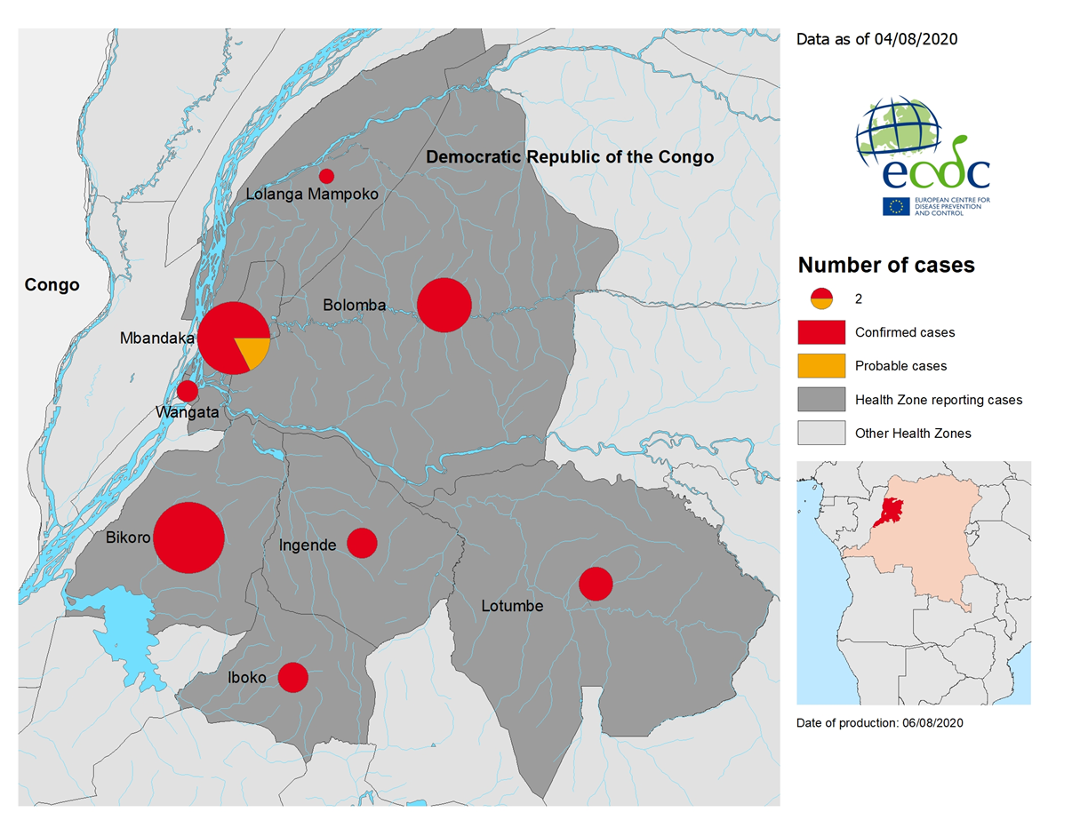
Eleventh outbreak: geographical distribution of confirmed and probable cases of Ebola virus disease, Equateur Province, Democratic Republic of the Congo,
as of 4 August 2020

Slide 9
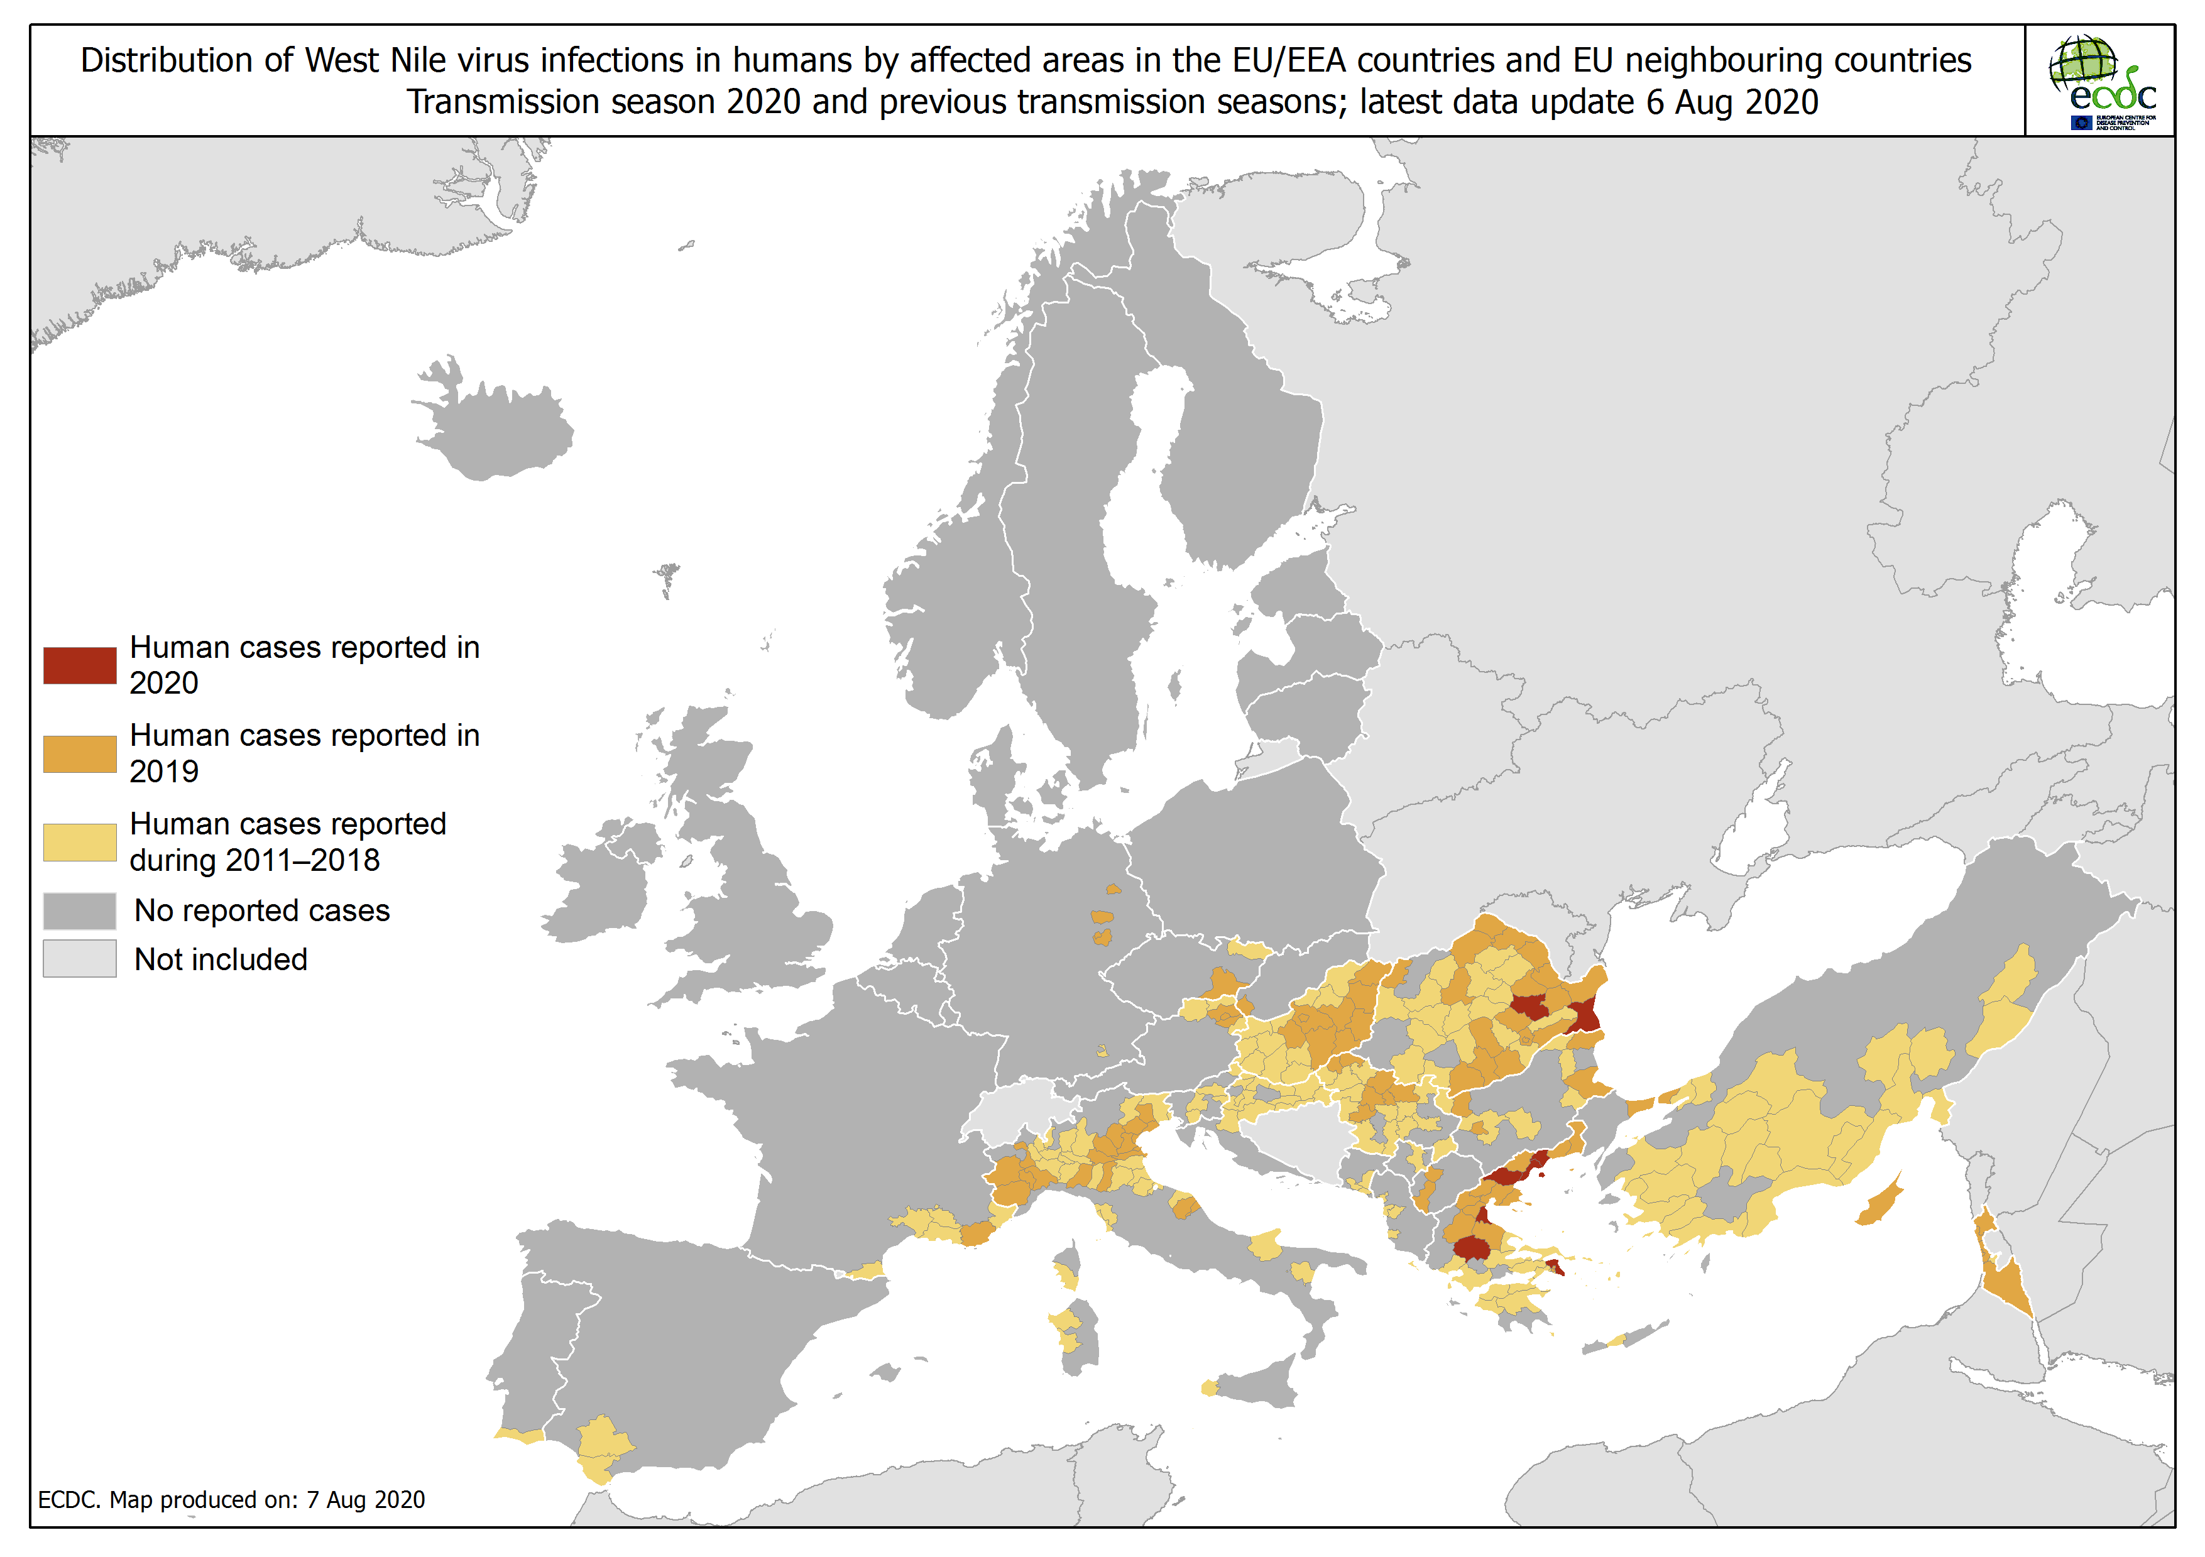
Distribution of West Nile virus infections in humans by affected areas in the EU/EEA countries and EU neighbouring countries, as of 6 August 2020

Slide 10
Distribution of West Nile virus infections in humans by affected areas in the EU/EEA countries and EU neighbouring countries, as of 6 August 2020

Slide 11
Distribution of West Nile virus infection outbreaks among equids and/or birds in the EU, as of 6 August 2020

Slide 12
Distribution of West Nile virus infections among humans and outbreaks among equids and/or birds in the EU, as of 6 August 2020

Slide 13
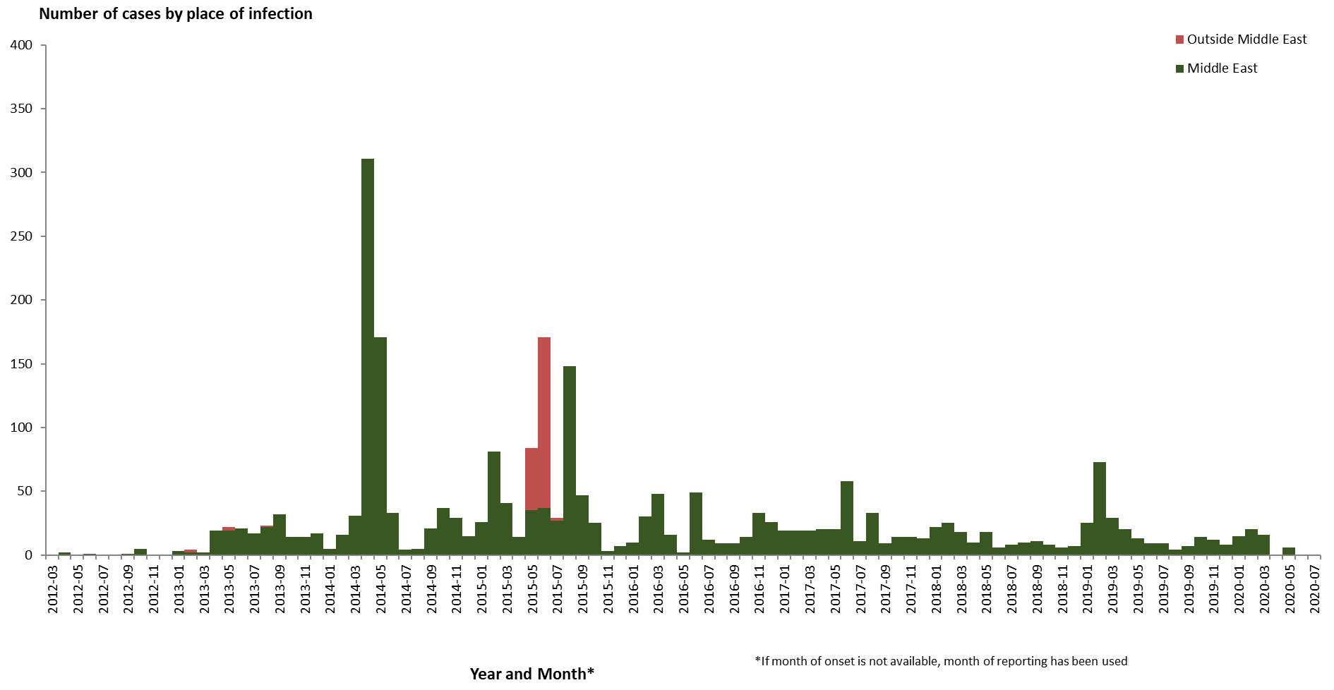
Distribution of confirmed cases of MERS-CoV by place of infection and month of onset, March 2012 – 4 August 2020

Slide 14
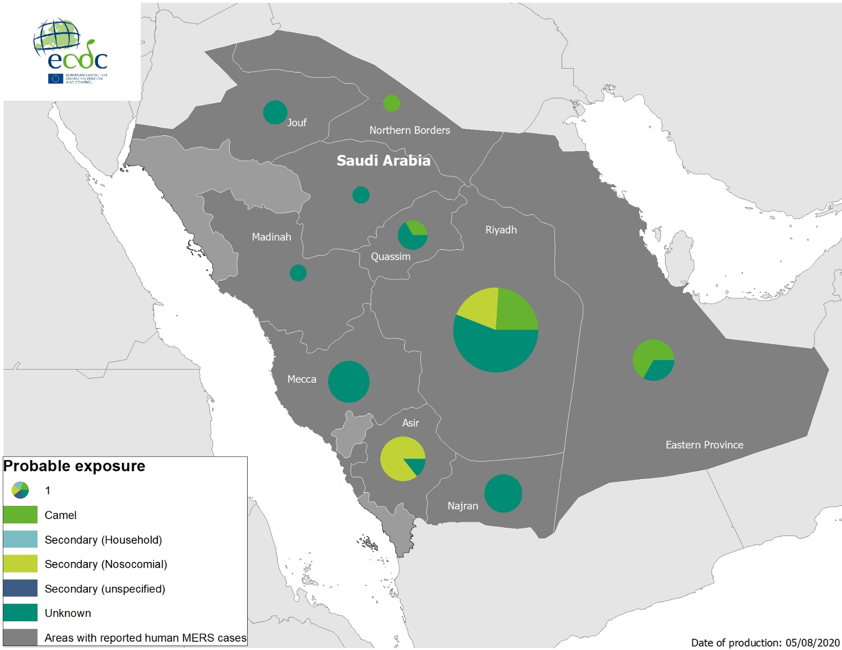
Geographical distribution of confirmed MERS-CoV cases by probable region of infection and exposure, from 1 January 2020 to 4 August 2020

Slide 15
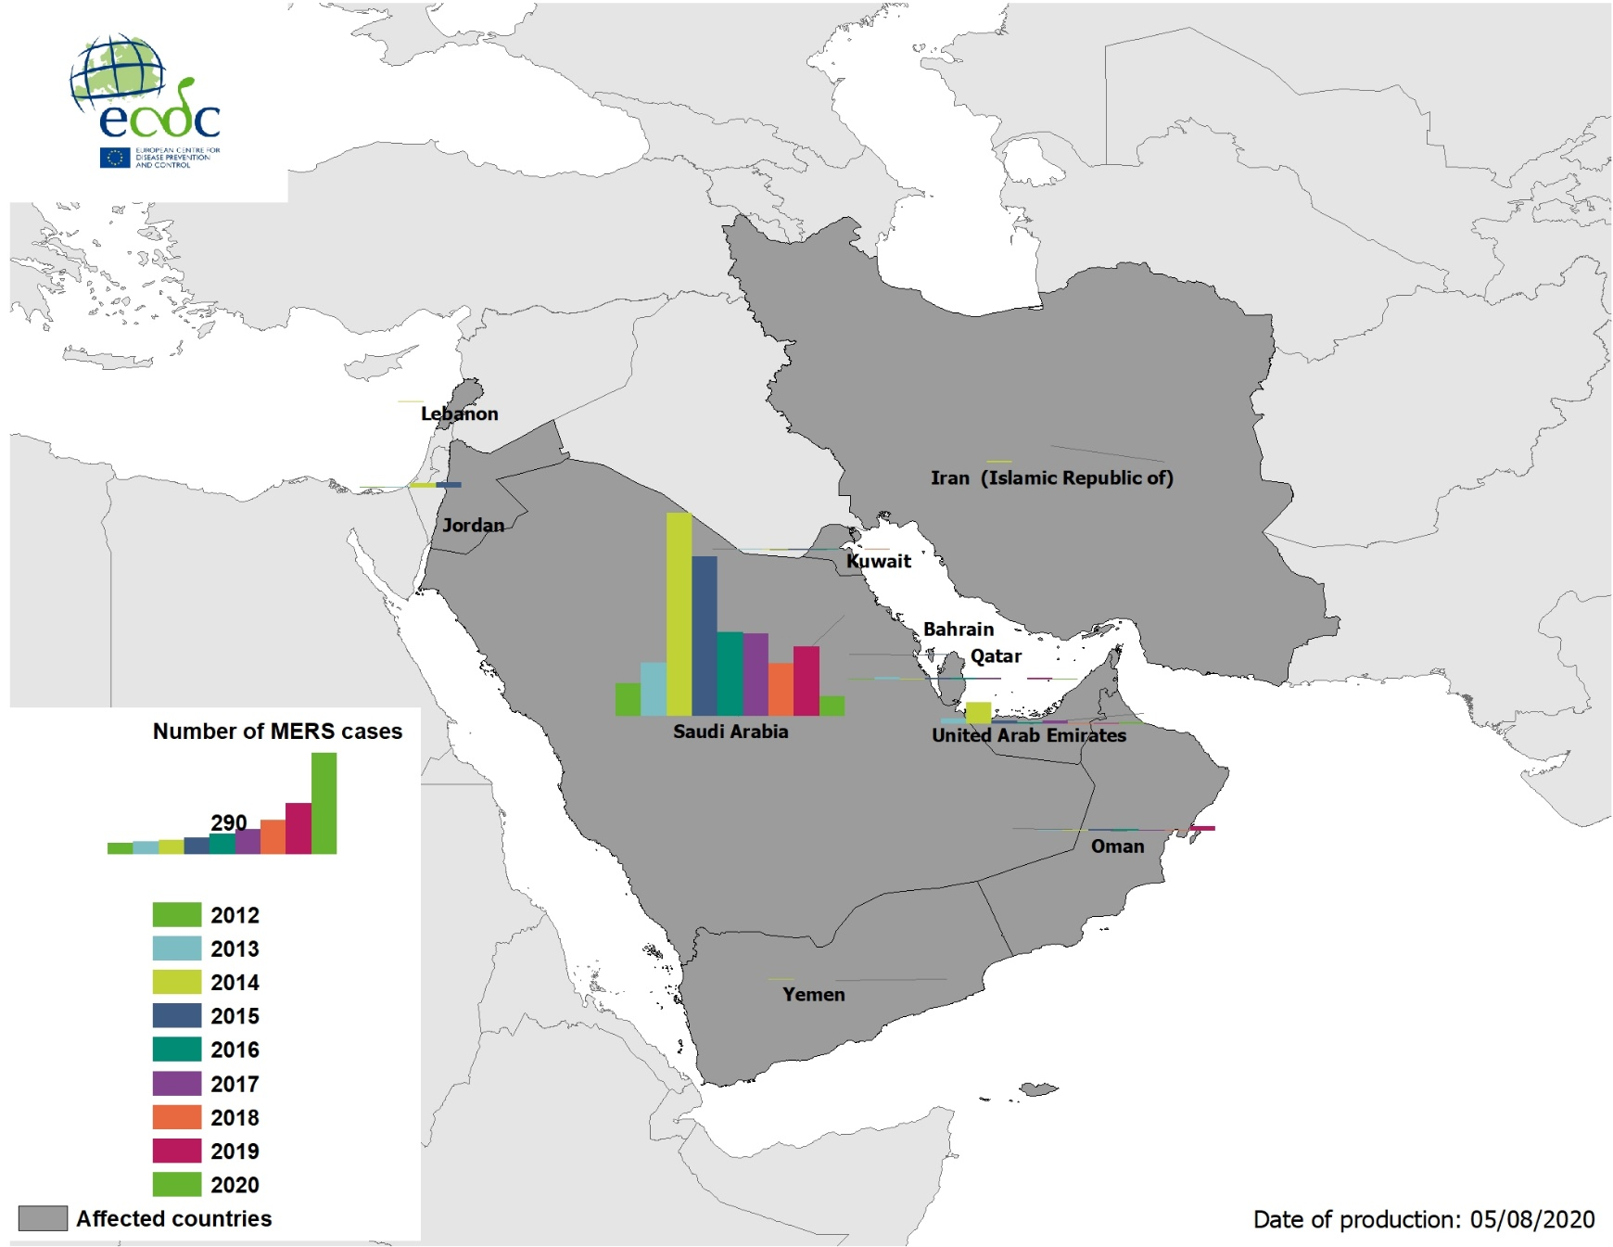
Geographical distribution of confirmed MERS-CoV cases by country of infection and year, from April 2012 to 4 August 2020

Slide 16
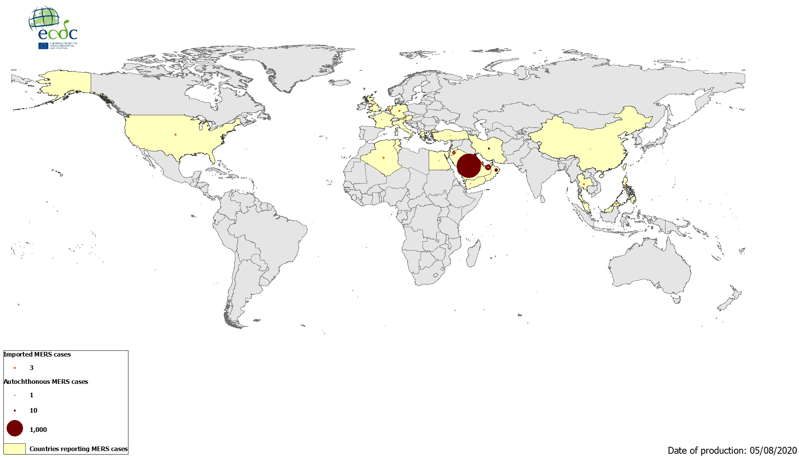
Geographical distribution of confirmed MERS-CoV cases by reporting country from April 2012 to 4 August 2020

