Slide 1
You are encouraged to reuse our maps and graphs for your own purposes and free to translate, provided the content is not altered and the source is acknowledged.
Reusable maps and graphs from ECDC Communicable Disease Threats Report
Week 31, 2018

Slide 2
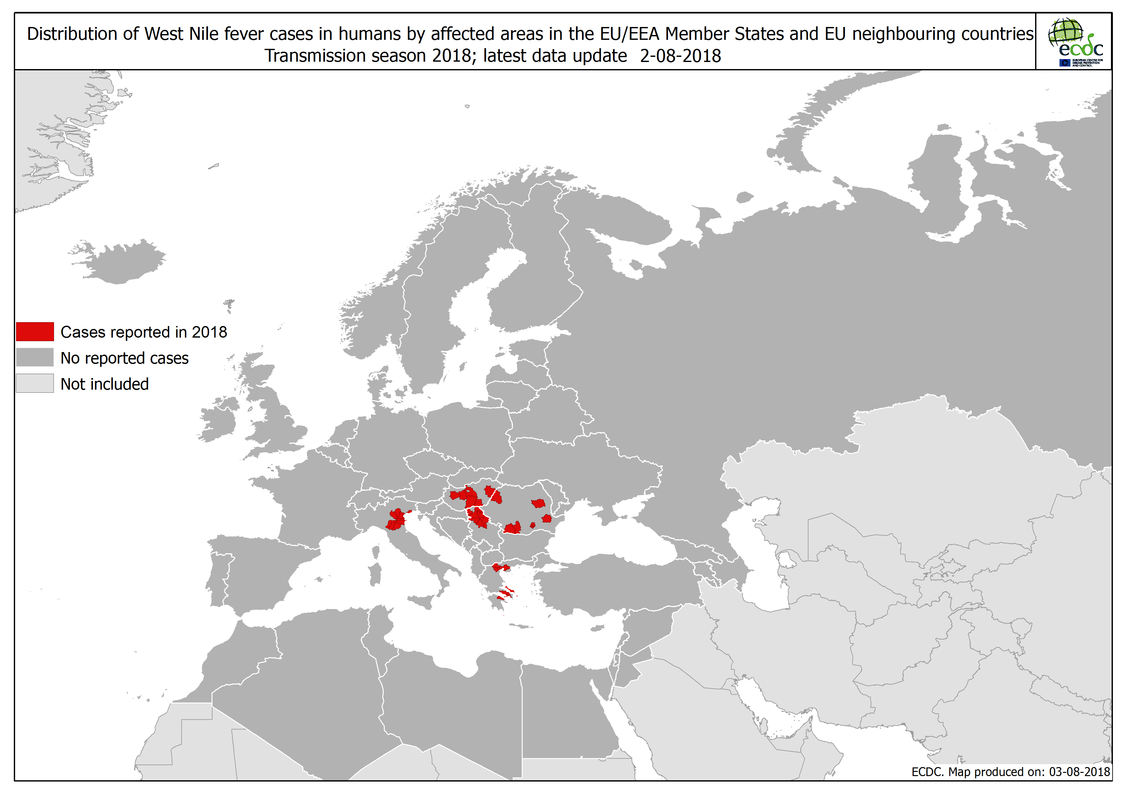

Slide 3
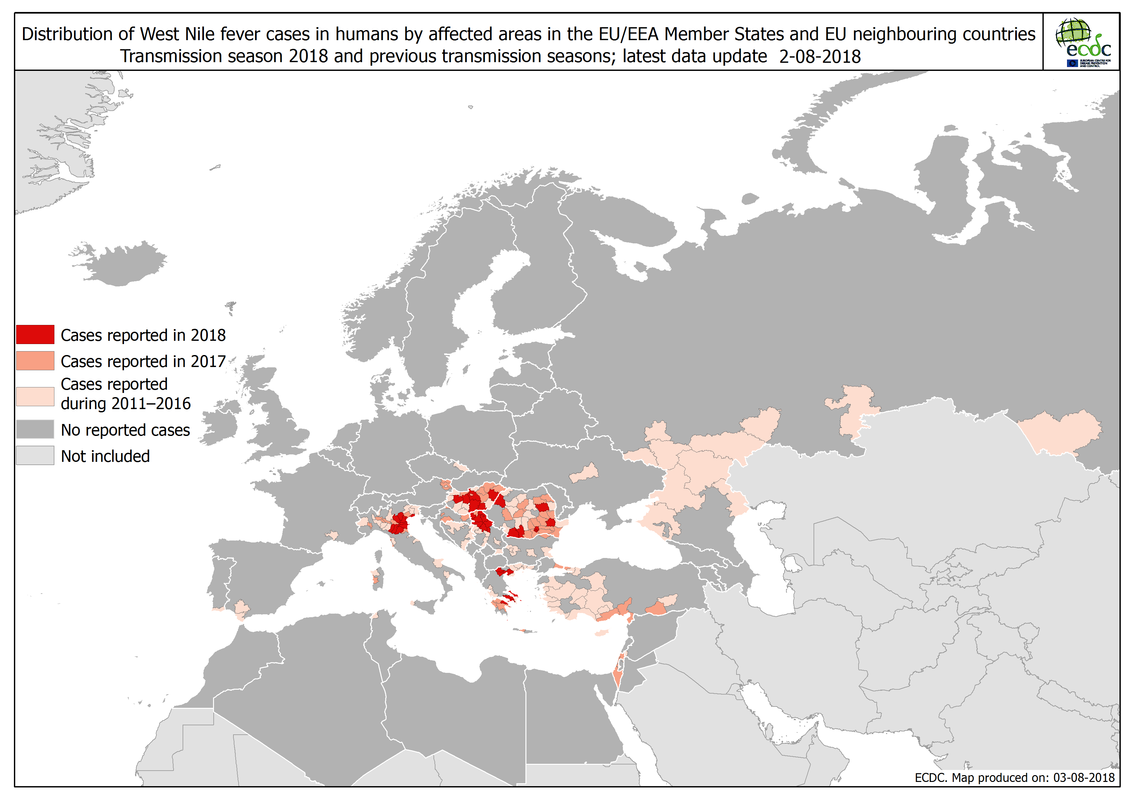

Slide 4
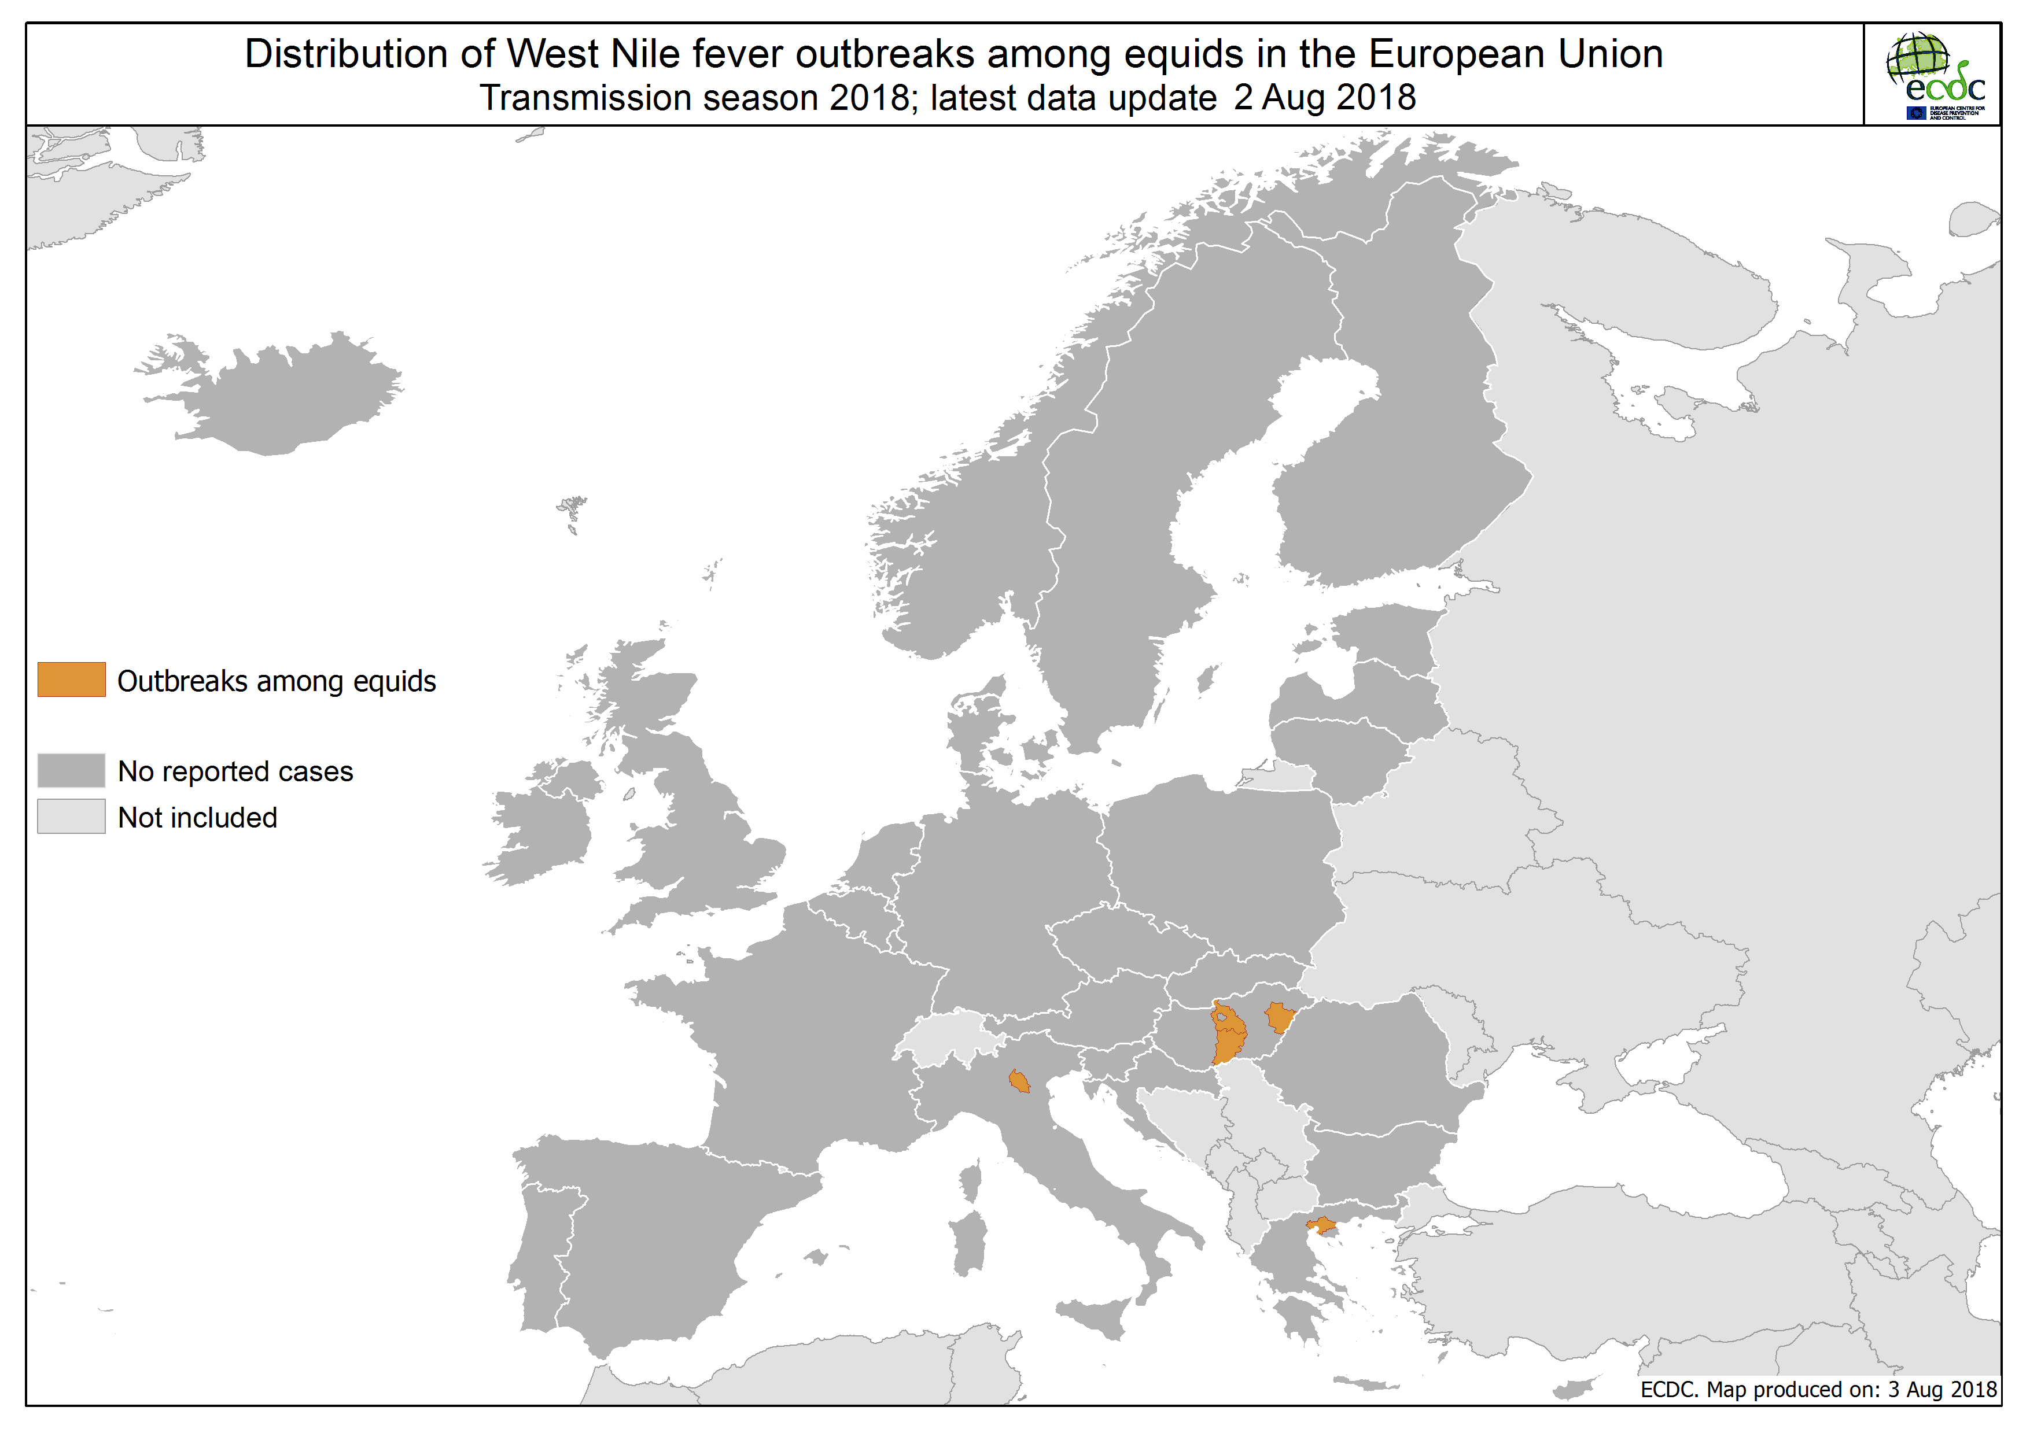

Slide 5
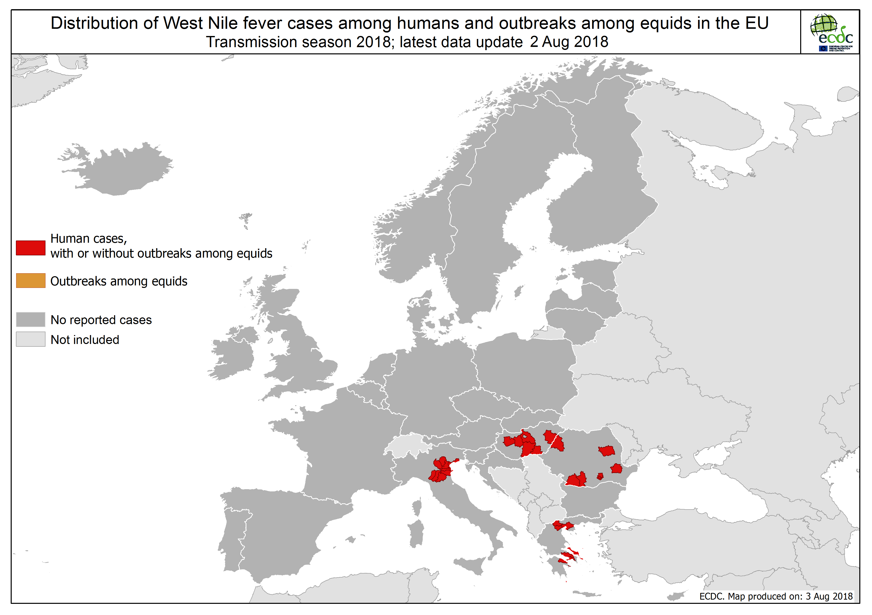

Slide 6
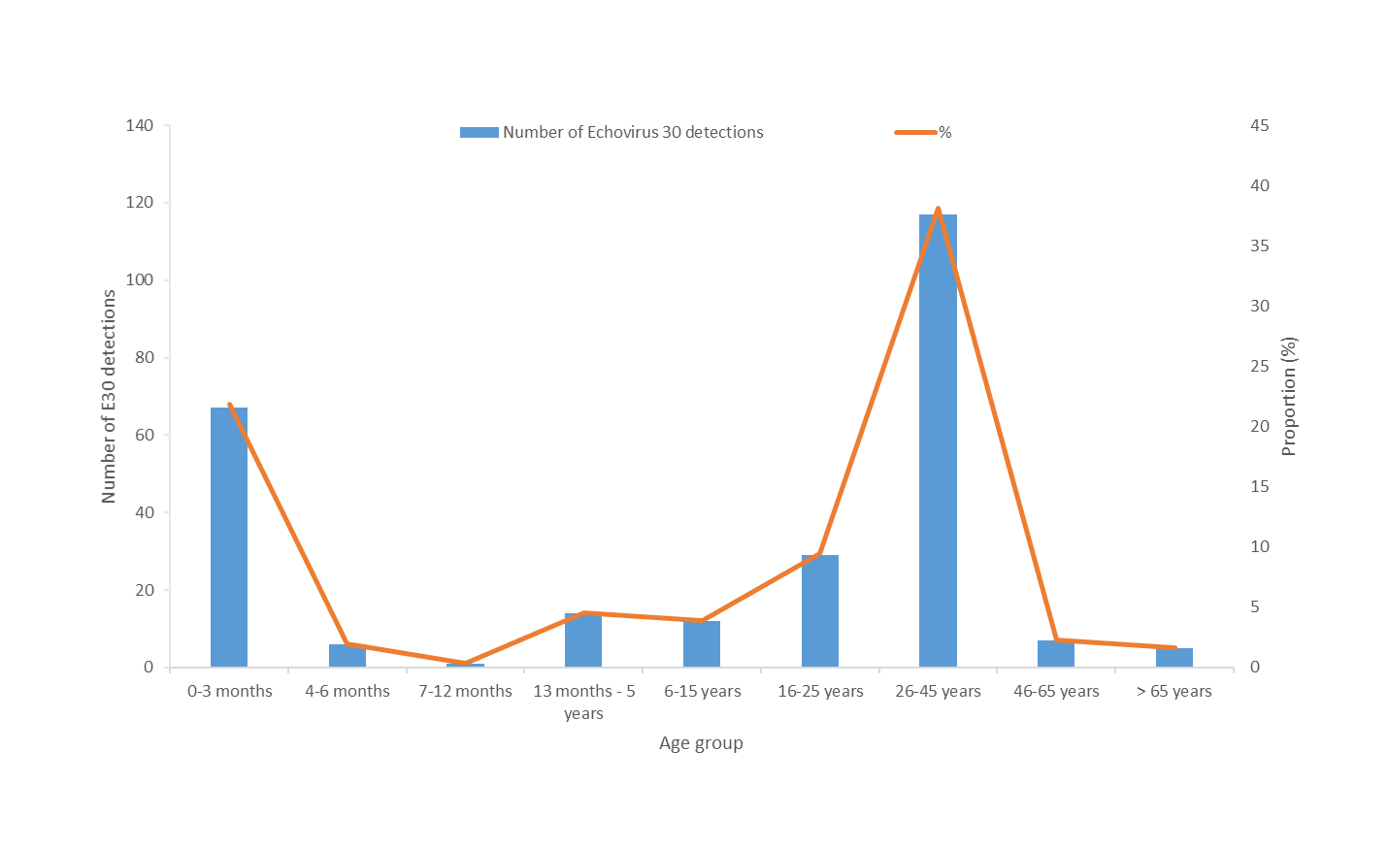
Distribution of Echovirus 30 detections by age group, reported by Denmark, the Netherlands, Norway, Sweden and the United Kingdom, 2018

Slide 7
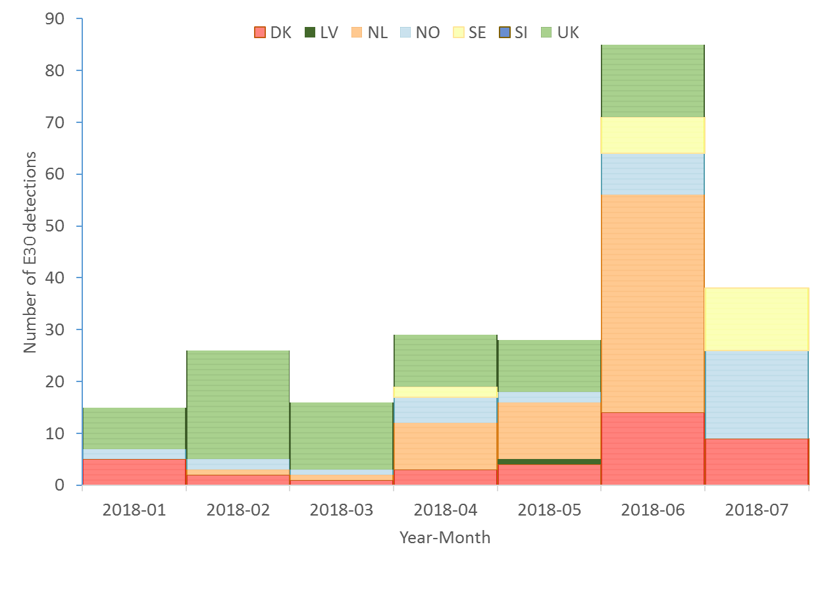
Distribution of Echovirus 30 detections by month, reported by Denmark, Latvia, the Netherlands, Norway, Sweden, Slovenia and the United Kingdom, 2018

