Slide 1
Reusable maps and graphs from ECDC Communicable Disease Threats Report Week 30 2022
You are encouraged to reuse our maps and graphs for your own purposes and are free to translate them, provided the content is not altered and the source is acknowledged.

Slide 2
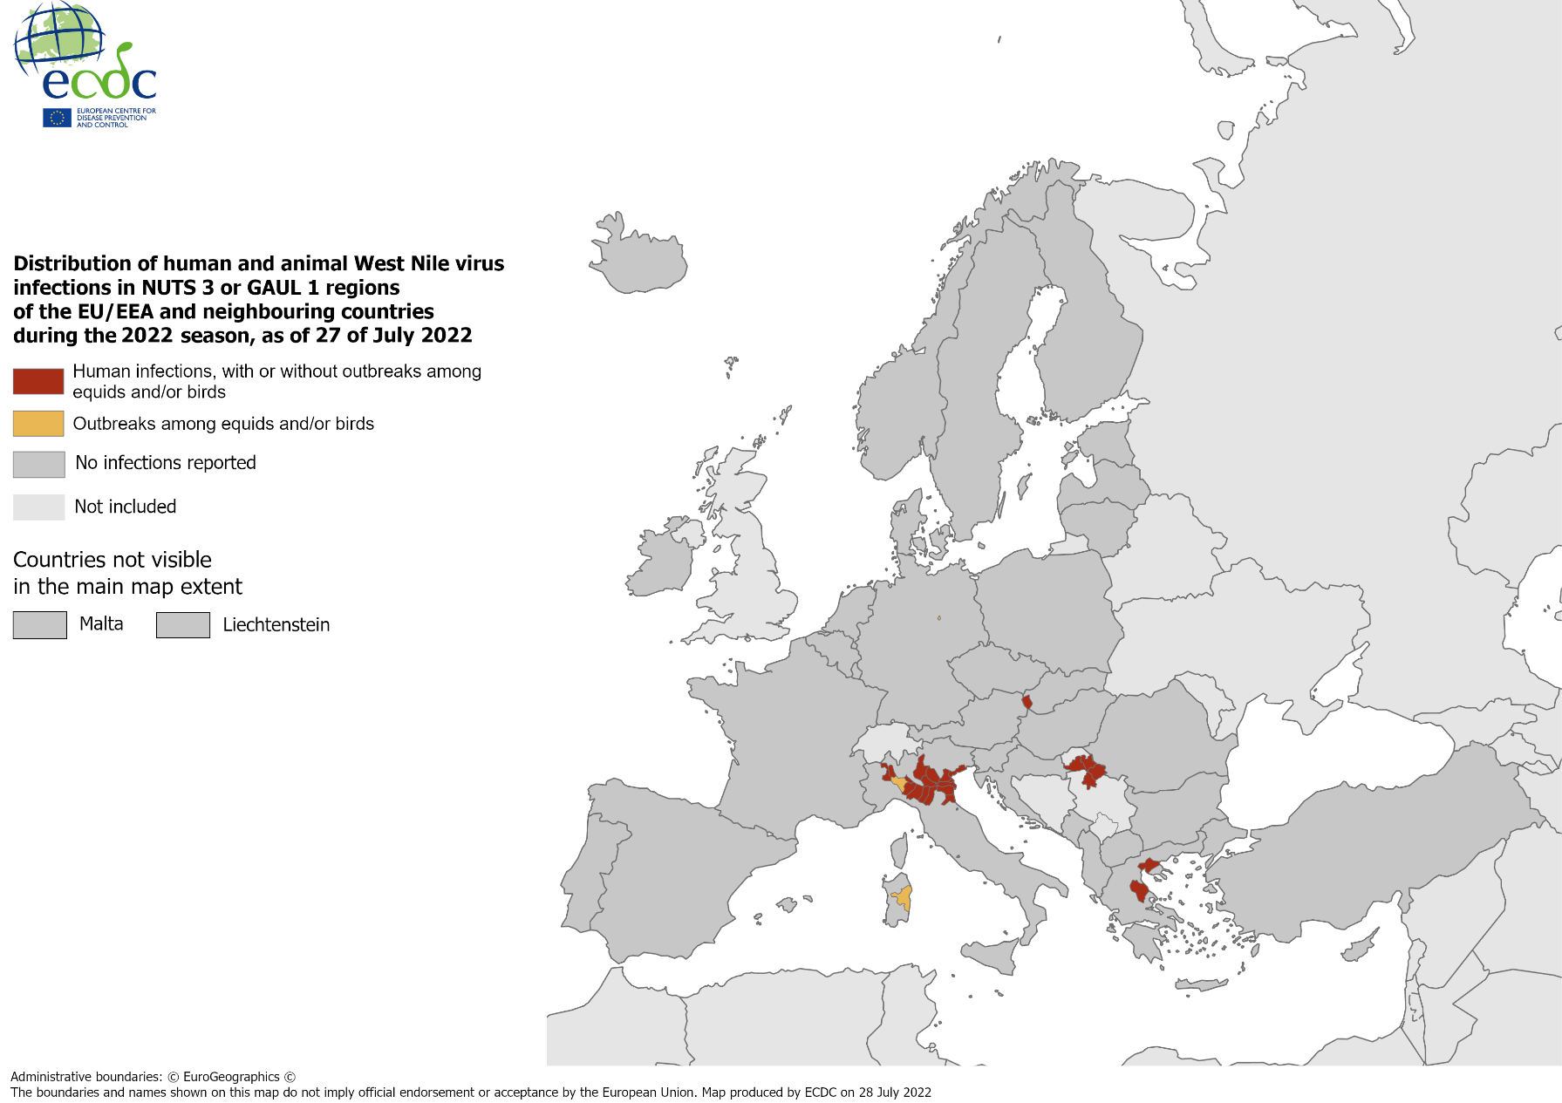
Distribution of human and animal West Nile virus infections in NUTS 3 or GAUL 1 regions of the EU/EEA and neighbouring countries during the 2022 season, as of 27 July 2022

Slide 3
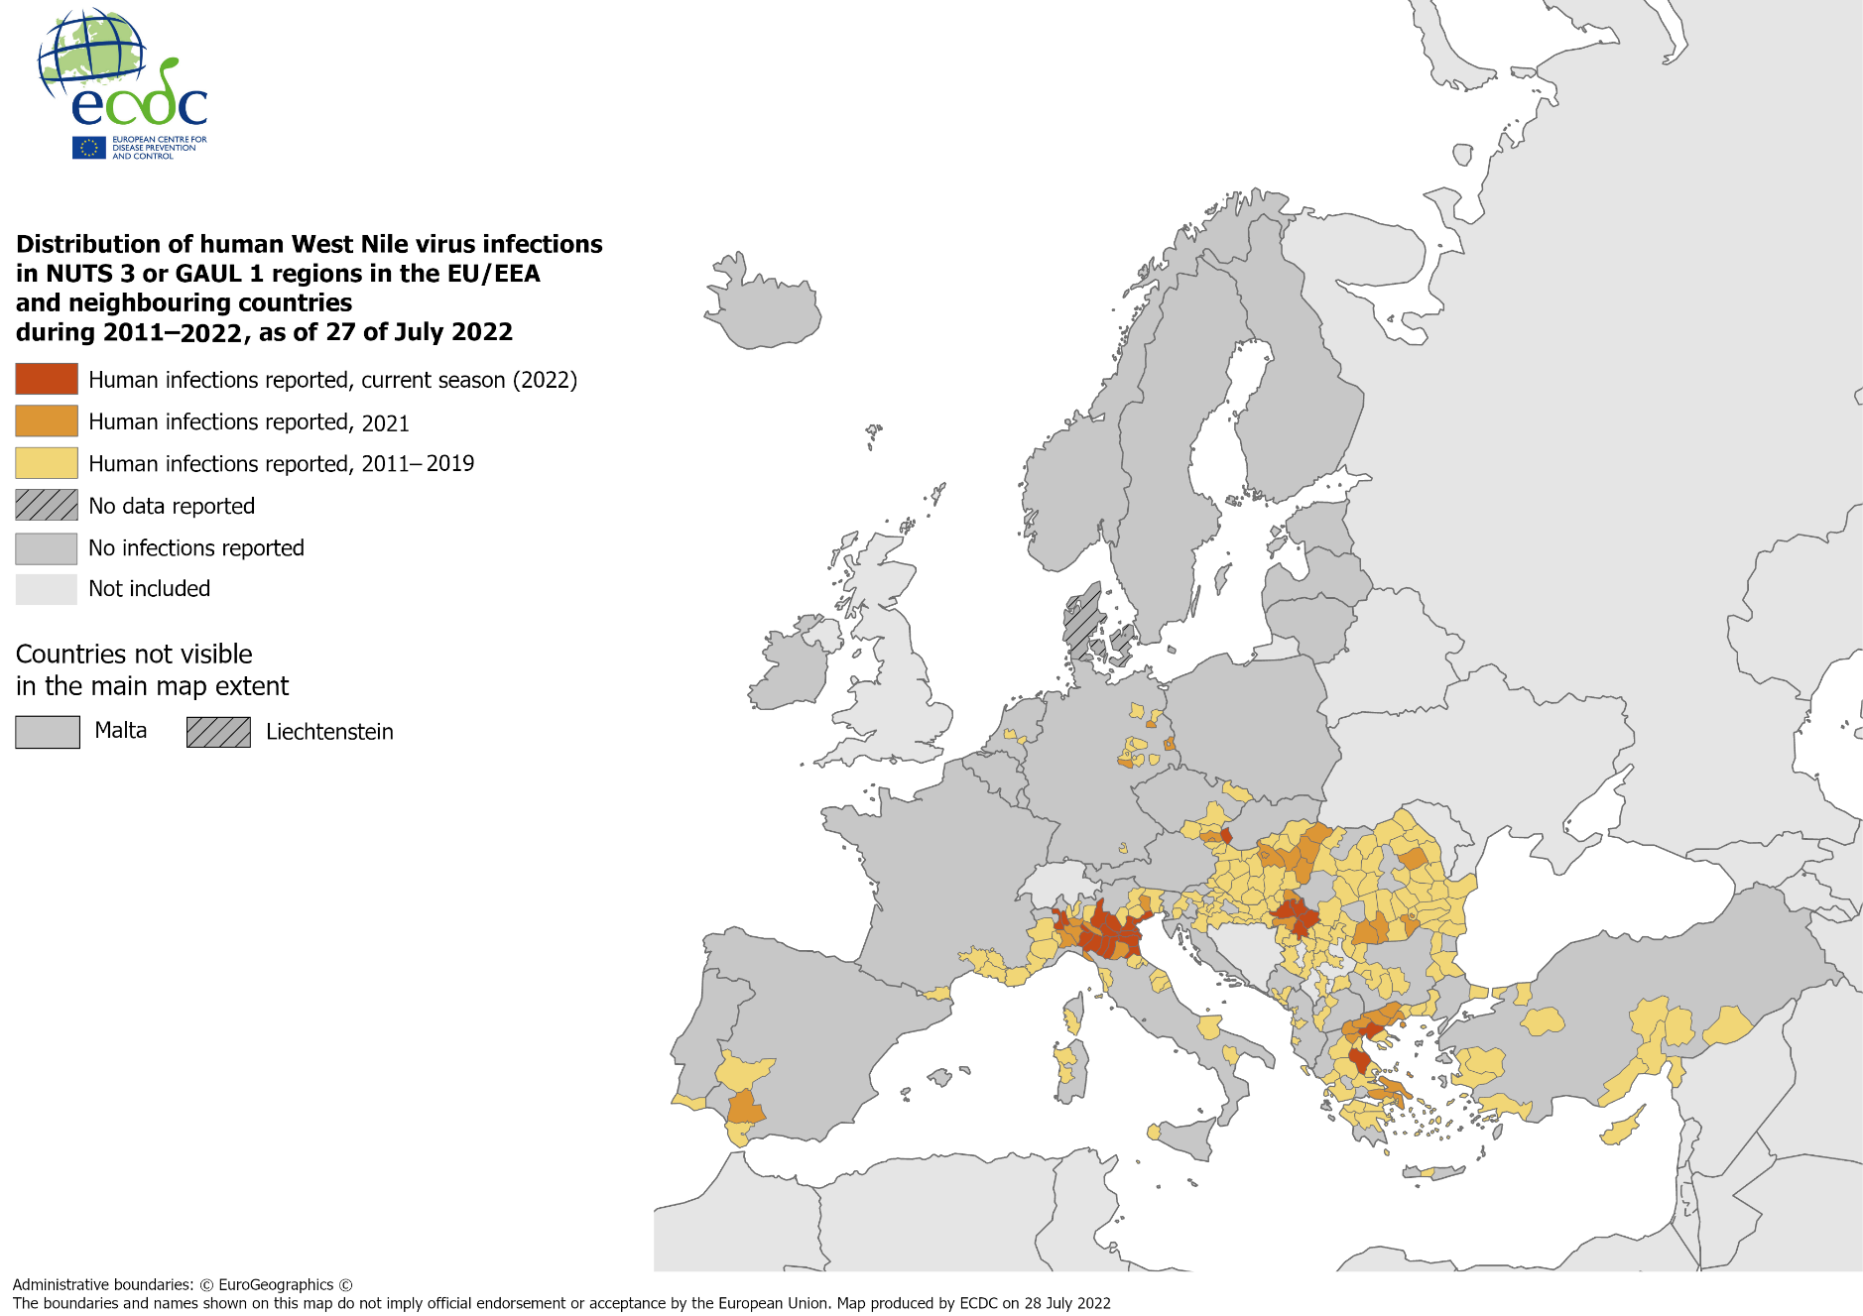
Distribution of human West Nile virus infections in NUTS 3 or GAUL 1 regions in the EU/EEA and neighbouring countries during the 2011-2022 season, as of 27 July 2022

Slide 4
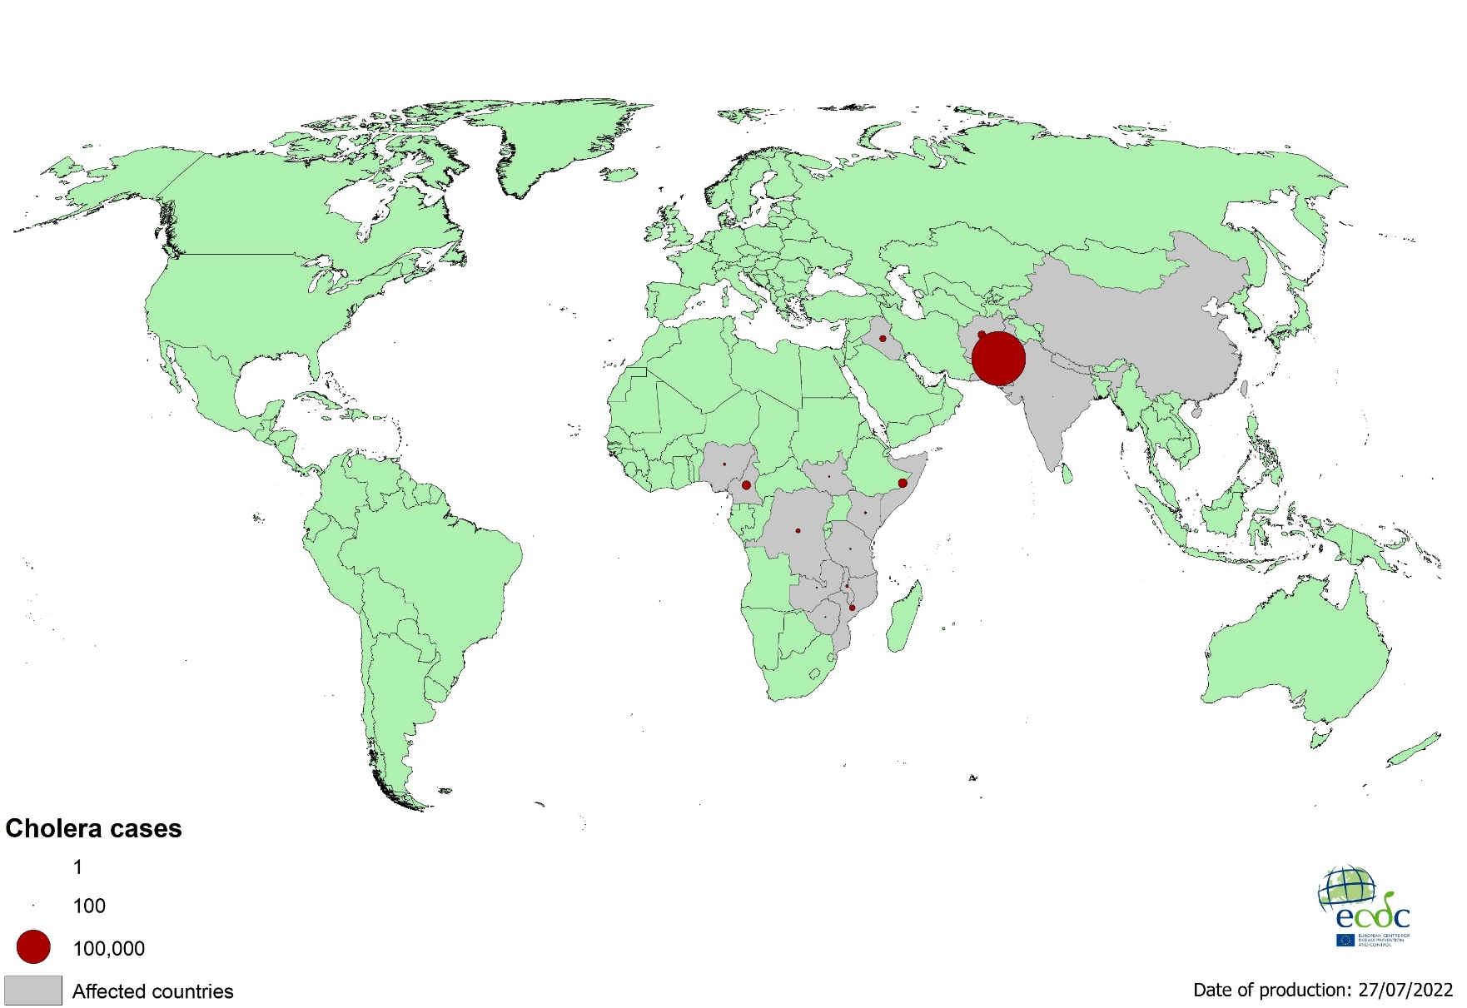
Geographical distribution of cholera cases reported worldwide from May to July 2022

Slide 5
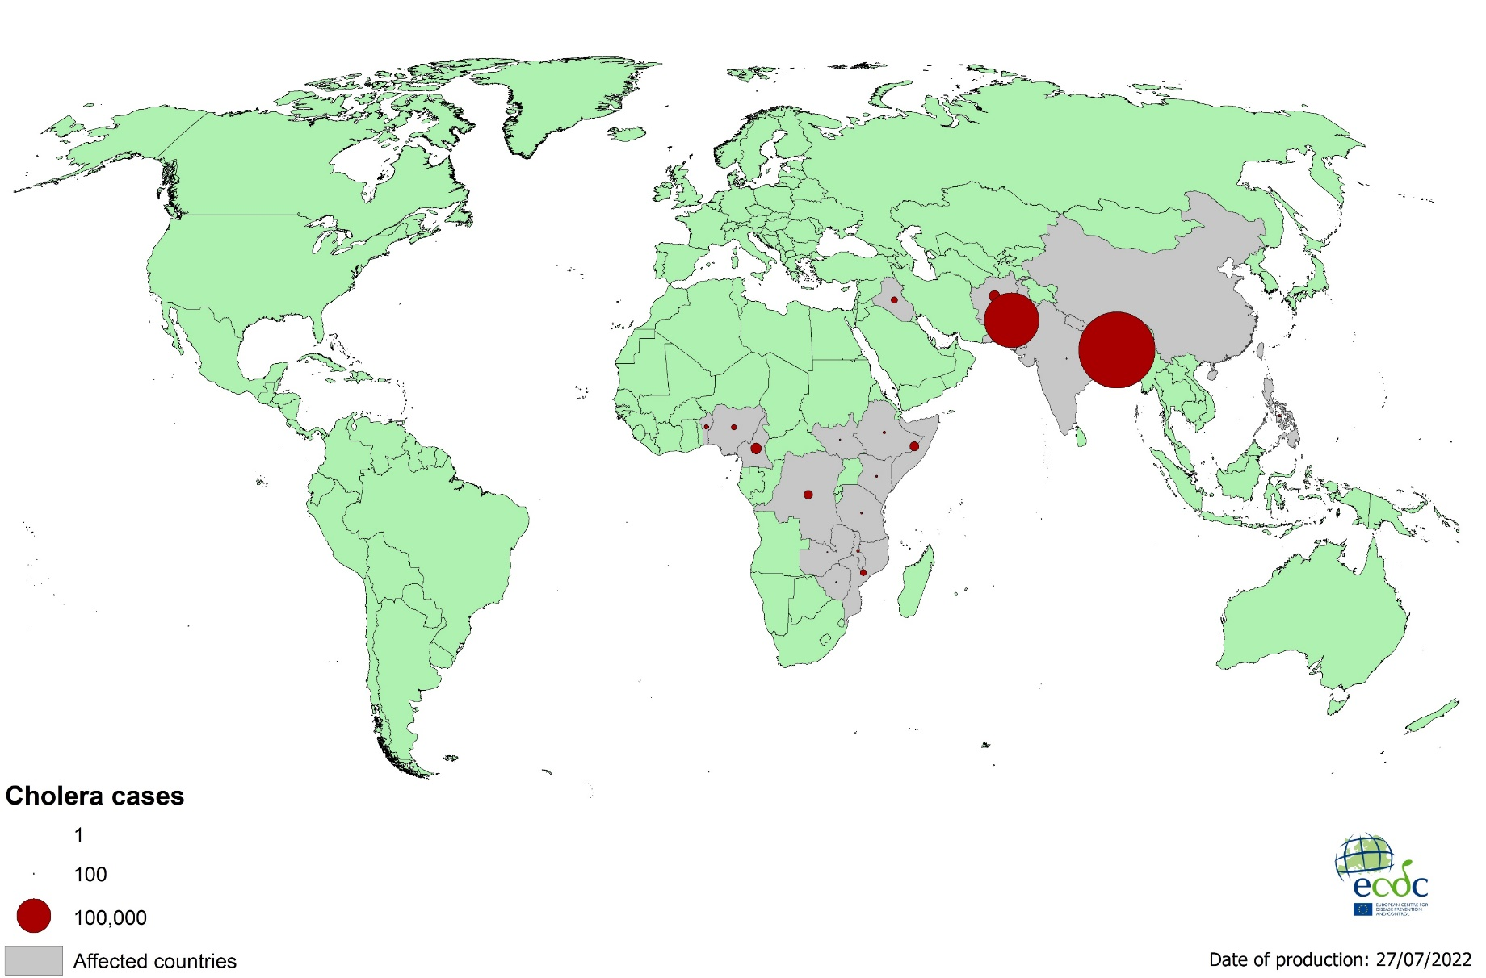
Geographical distribution of cholera cases reported worldwide, as of July 2022

Slide 6
Notification rate of dengue cases reported worldwide, May to July 2022

Slide 7
Notification rate of dengue cases reported worldwide, August 2021 to July 2022

Slide 8
Notification rate of chikungunya cases reported worldwide, May to July 2022

Slide 9
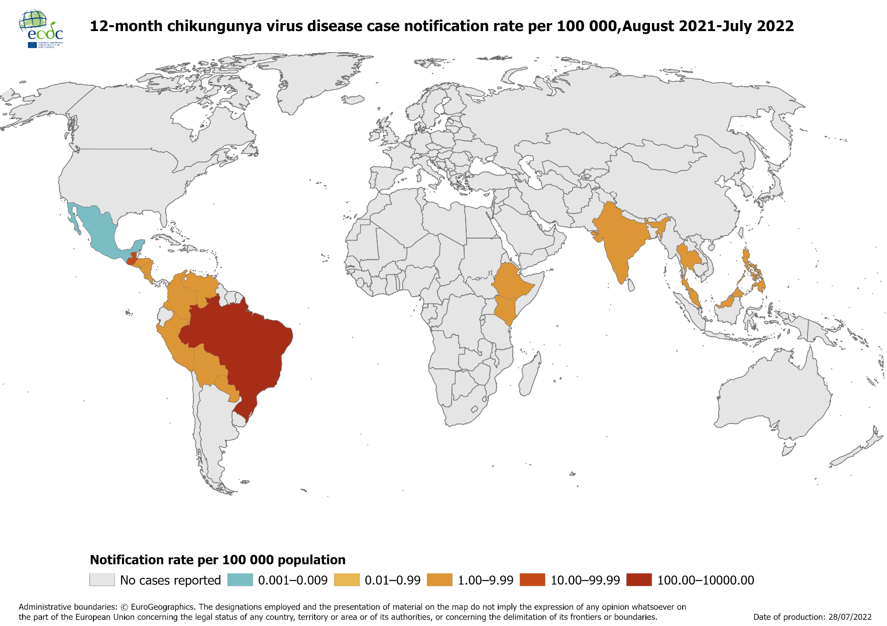
Notification rate of chikungunya cases reported worldwide, August 2021 to July 2022

