Slide 1
Reusable maps and graphs from ECDC Communicable Disease Threats Report
Week 30, 2020
You are encouraged to reuse our maps and graphs for your own purposes and free to translate, provided the content is not altered and the source is acknowledged.

Slide 2
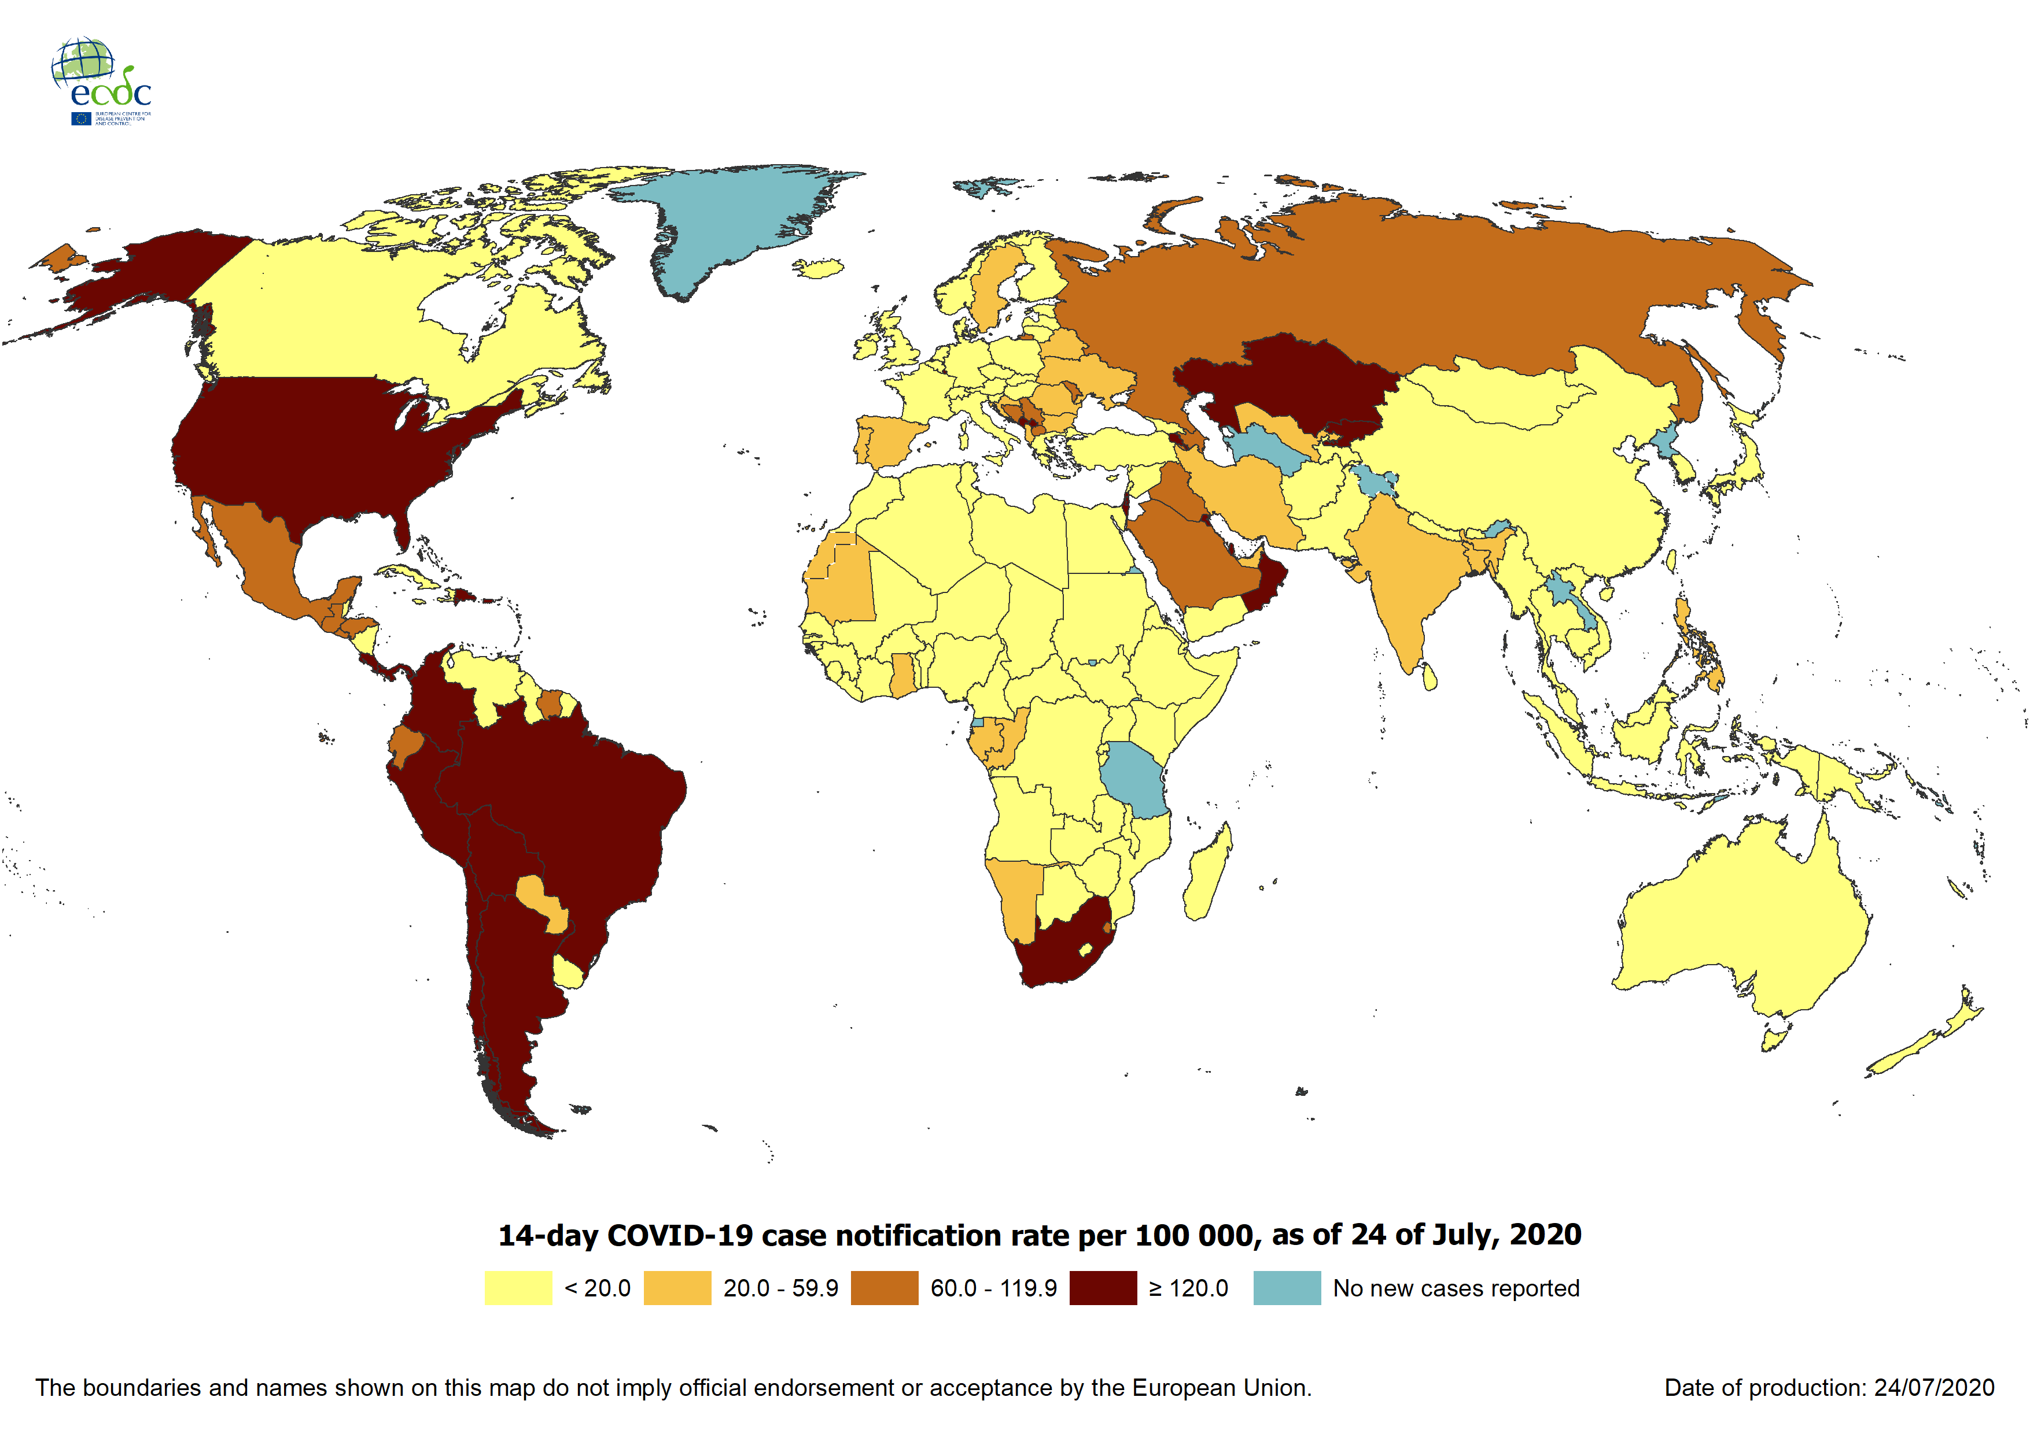
Geographic distribution of 14-day cumulative number of reported COVID-19 cases per 100 000 population, worldwide, as of 24 July 2020

Slide 3
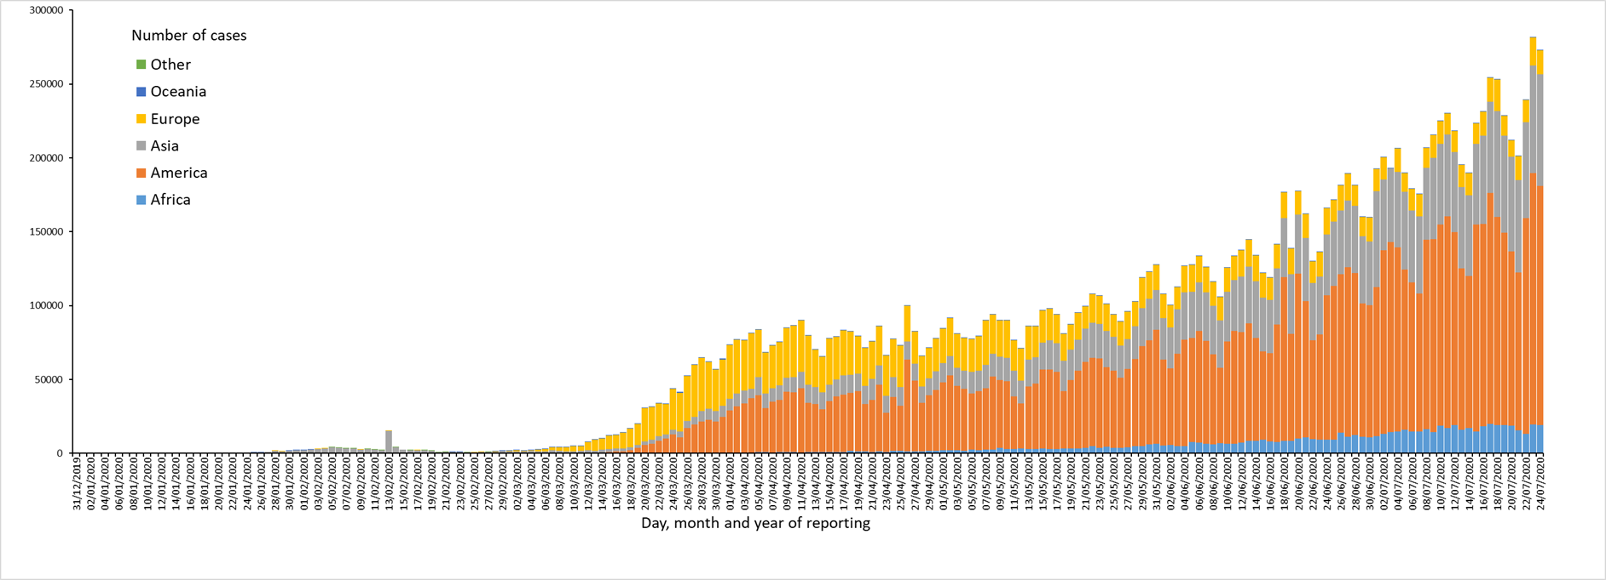
Distribution of COVID-19 cases*,** in accordance with the applied case definitions in the affected countries, by country and region, as of 24 July 2020
*Spain: Since 11 May, the frequency of reporting from regional level to national level has changed. This may lead to possible discrepancies in cases and death numbers due to data validation. This discrepancy could persist for several days.
**UK: On 3 July 2020 the UK announced a revision of historical data that lead to a negative number of new cases and an overall decrease in cases for the UK. In the displayed graph the revision of data is not considered as the change in reported cases would result in a negative number of cases for Europe overall.

Slide 4
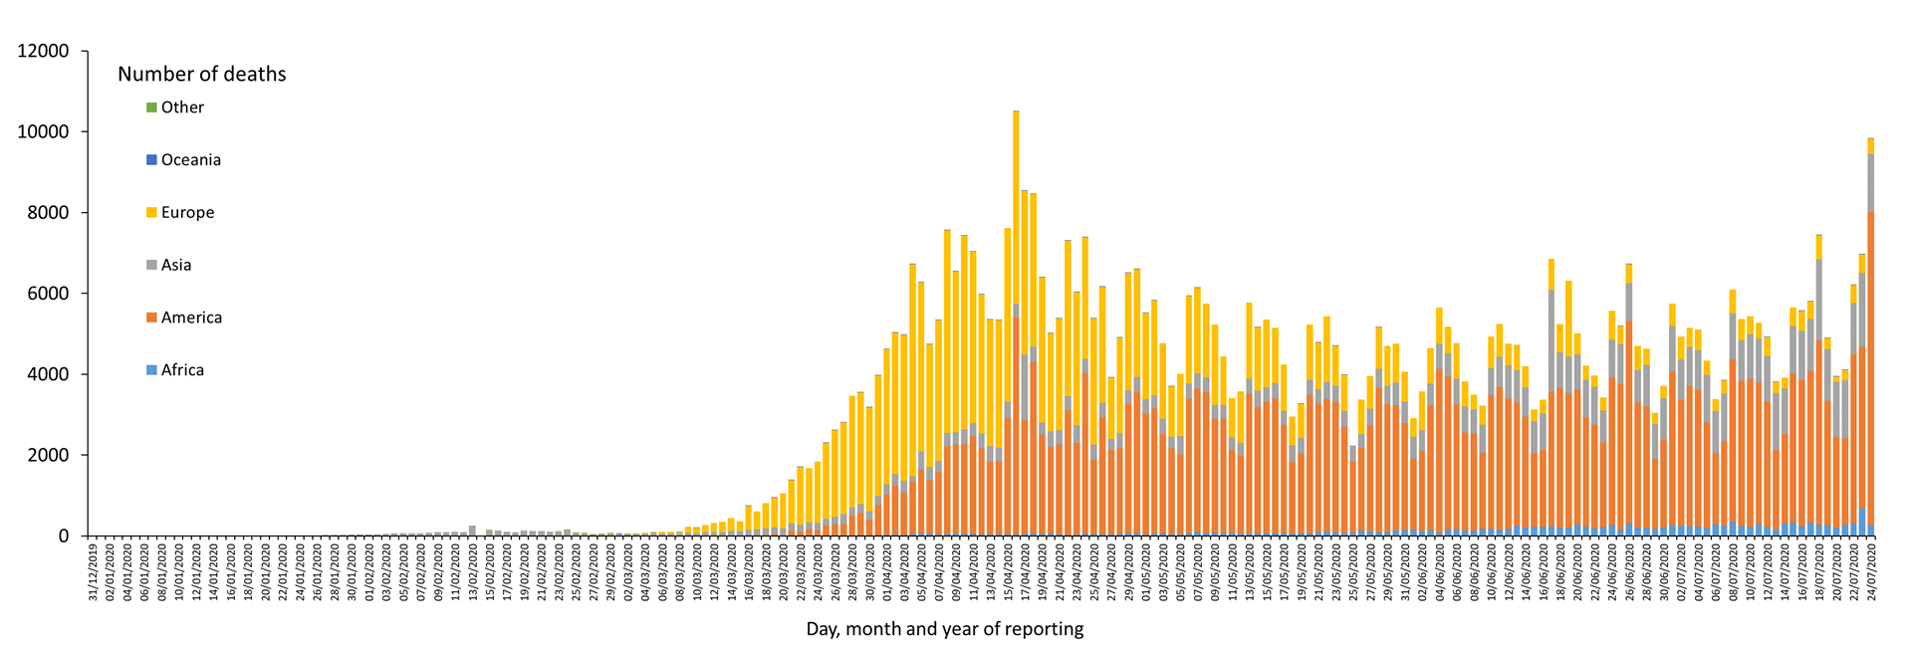
Distribution of COVID-19 deaths (in accordance with the applied case definition in the country) by country and region, as of 24 July 2020
*
* Increase of deaths in America is attributable to the US, which since 14 April 2020 includes confirmed and probable cases and deaths:
https://www.cdc.gov/coronavirus/2019-ncov/cases-updates/cases-in-us.html#2019coronavirus-summary
** Spain: Since 11 May, the frequency of reporting from regional level to national level has changed. This may lead to possible discrepancies in cases and death numbers due to data validation. This discrepancy could persist for several days.
In the displayed graph no new deaths are reported for Spain from 25 May 2020 as the change in reported deaths would result in a negative number of deaths for Europe overall.

Slide 5
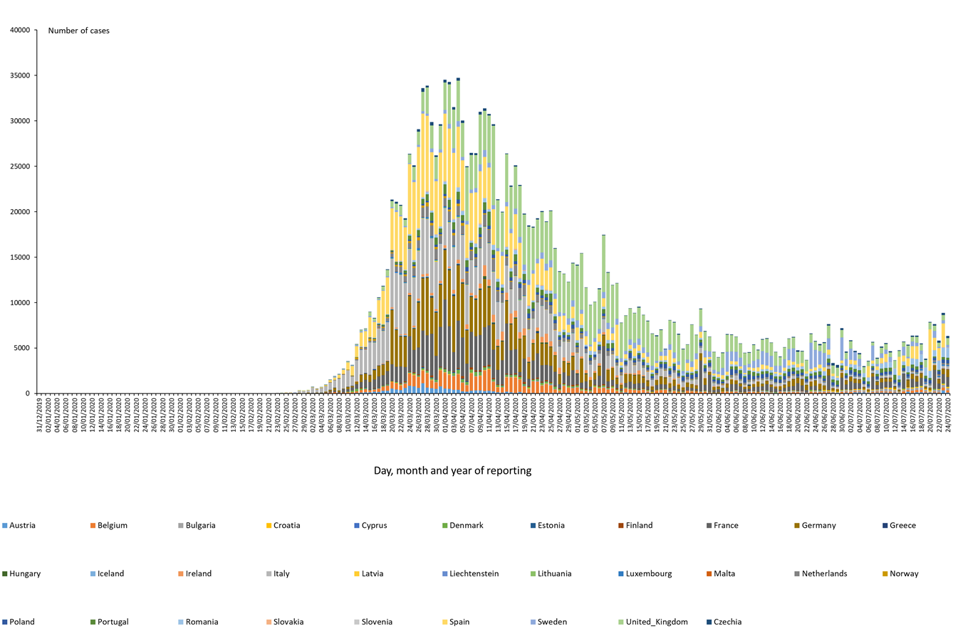
Distribution of COVID-19 cases* (according to the applied case definition in the country) in EU/EEA and the UK, as of 24 July 2020
*Spain: Since 11 May 2020, the frequency of reporting from regional level to national level has changed. This may lead to possible discrepancies in cases and death numbers due to data validation. This discrepancy could persist for several days.
**UK: On 3 July 2020, the UK announced an ongoing revision of historical data that may lead to a decreased number of cases. Data will be retro-corrected accordingly.

Slide 6
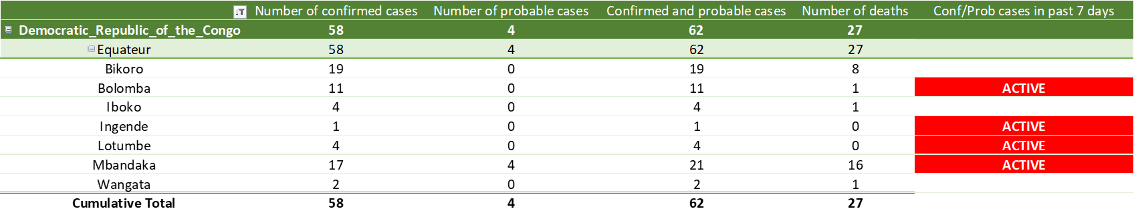
11th outbreak: Ebola Virus Disease cases distribution in Equateur Province, Democratic Republic of the Congo, as of 21 July 2020

Slide 7
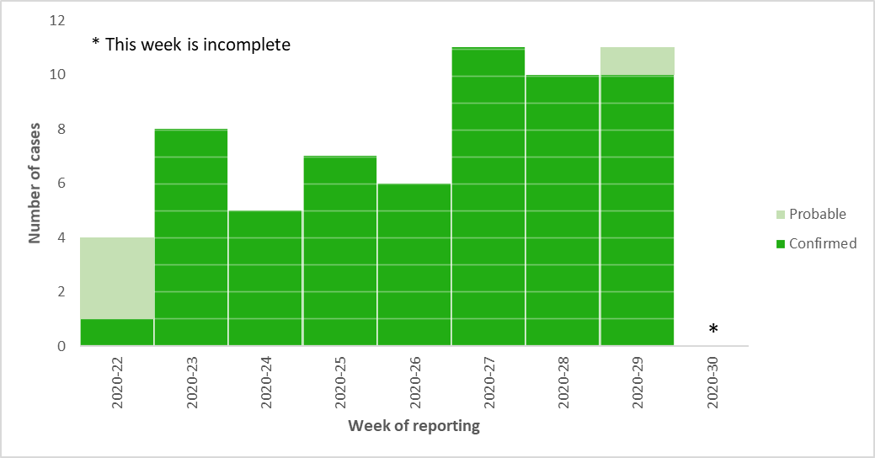
11th outbreak: distribution of confirmed and probable cases of Ebola virus disease by week of reporting in Equateur Province, Democratic Republic of the Congo as of 21 July 2020

Slide 8
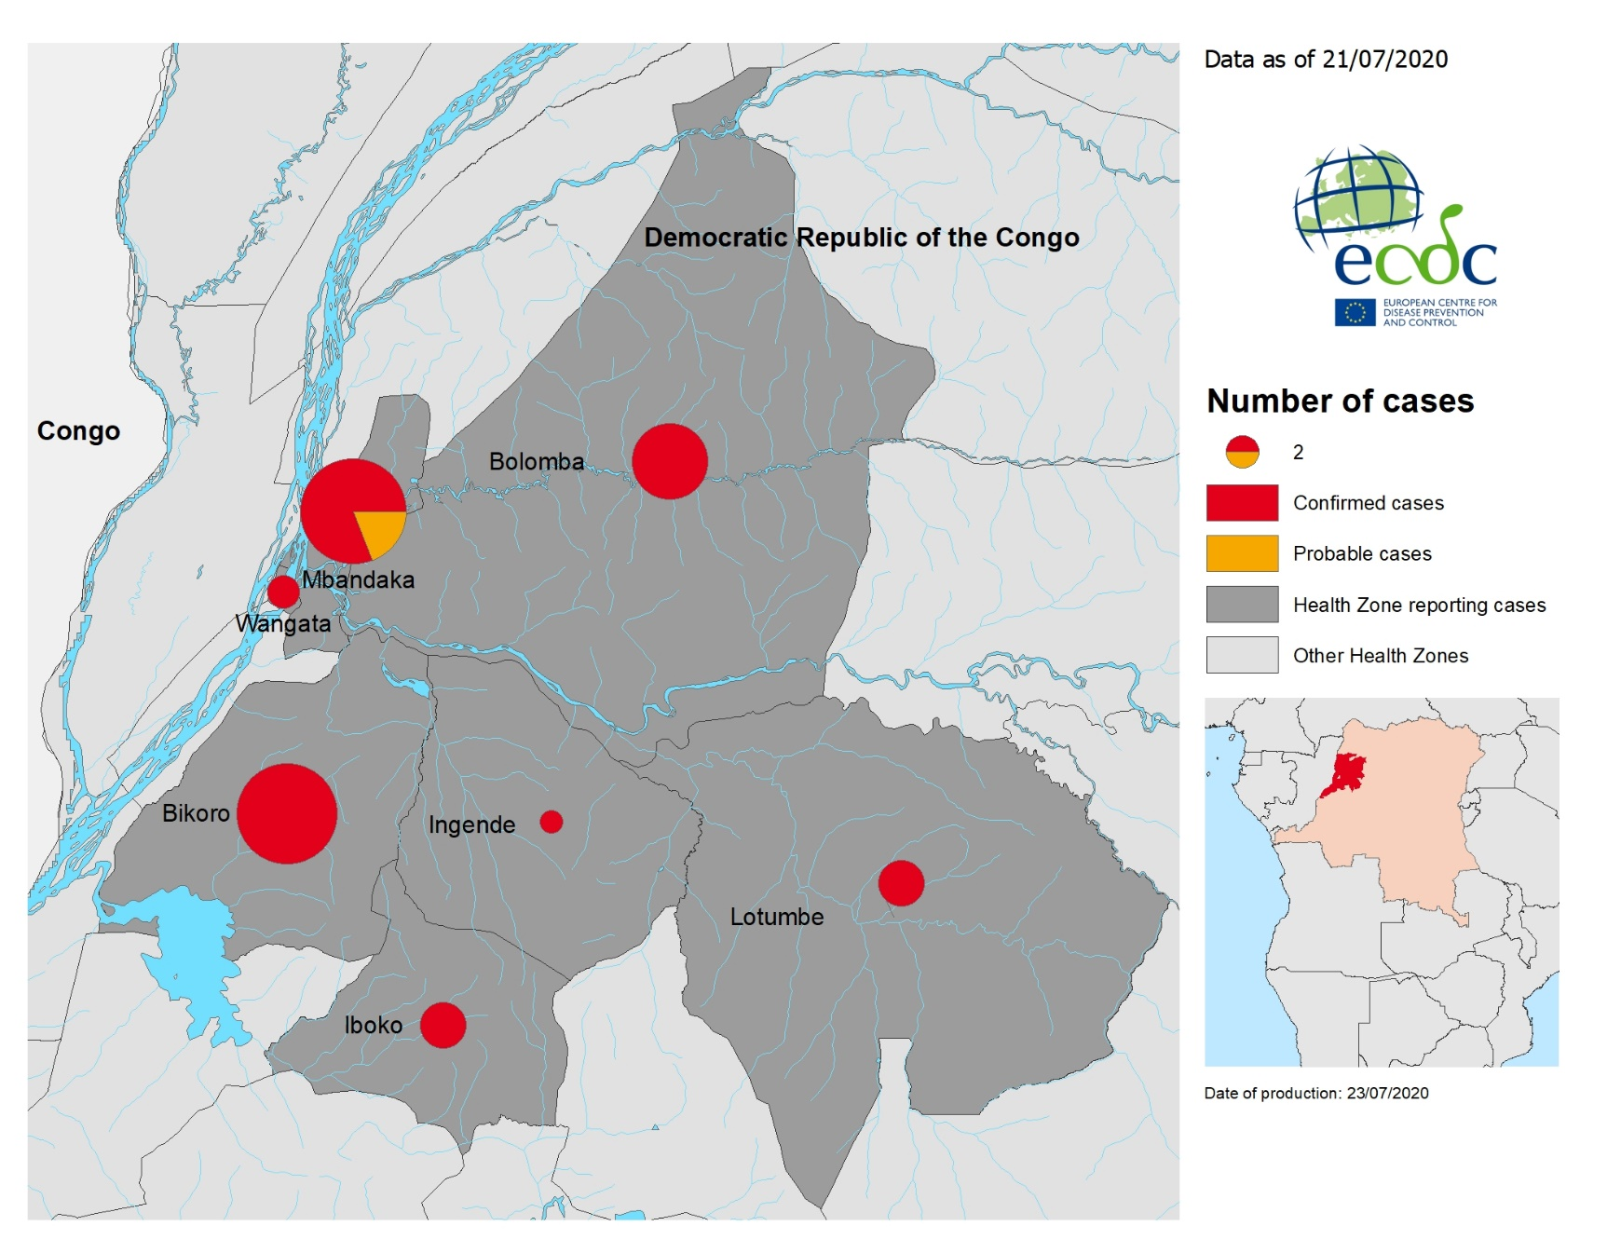
11th outbreak: geographical distribution of confirmed and probable cases of Ebola virus disease, Equateur Province, Democratic Republic of the Congo,
as of 21 July 2020

Slide 9
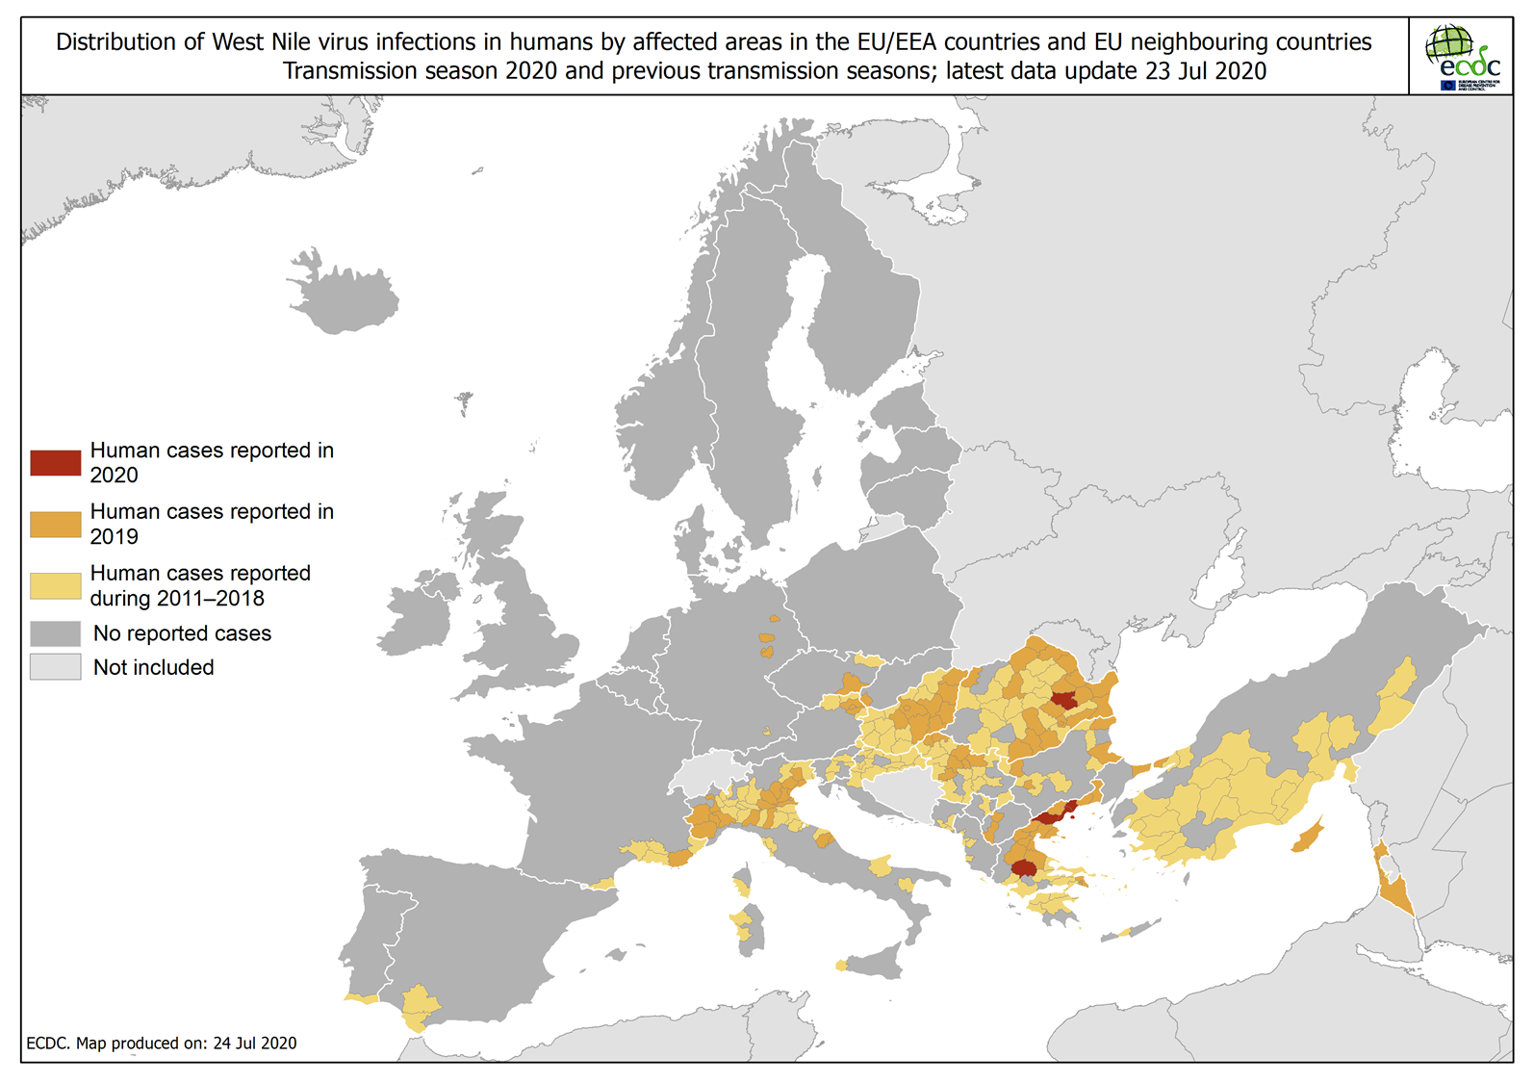
Distribution of West Nile virus infections in humans by affected areas in the EU/EEA countries and EU neighbouring countries, as of 23 July 2020

Slide 10
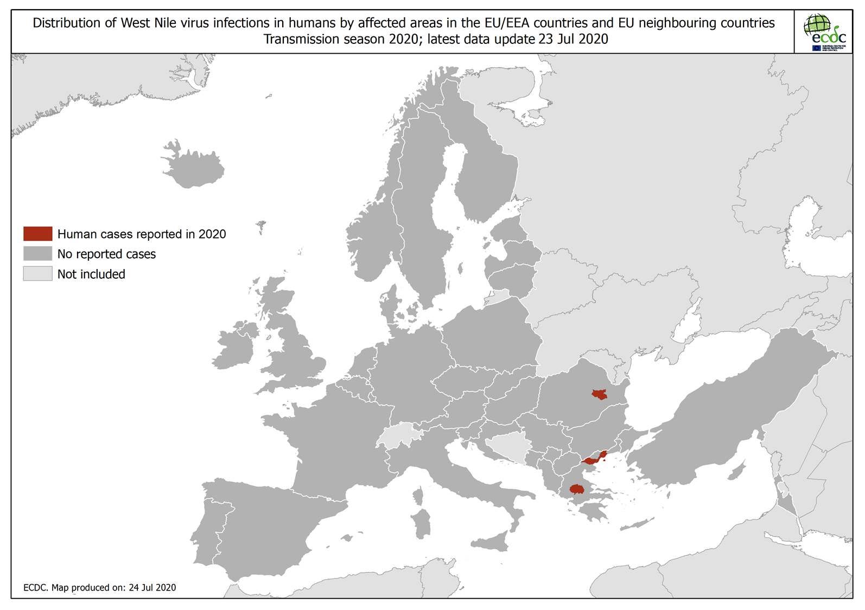
Distribution of West Nile virus infections in humans by affected areas in the EU/EEA countries and EU neighbouring countries, as of 23 July 2020

Slide 11
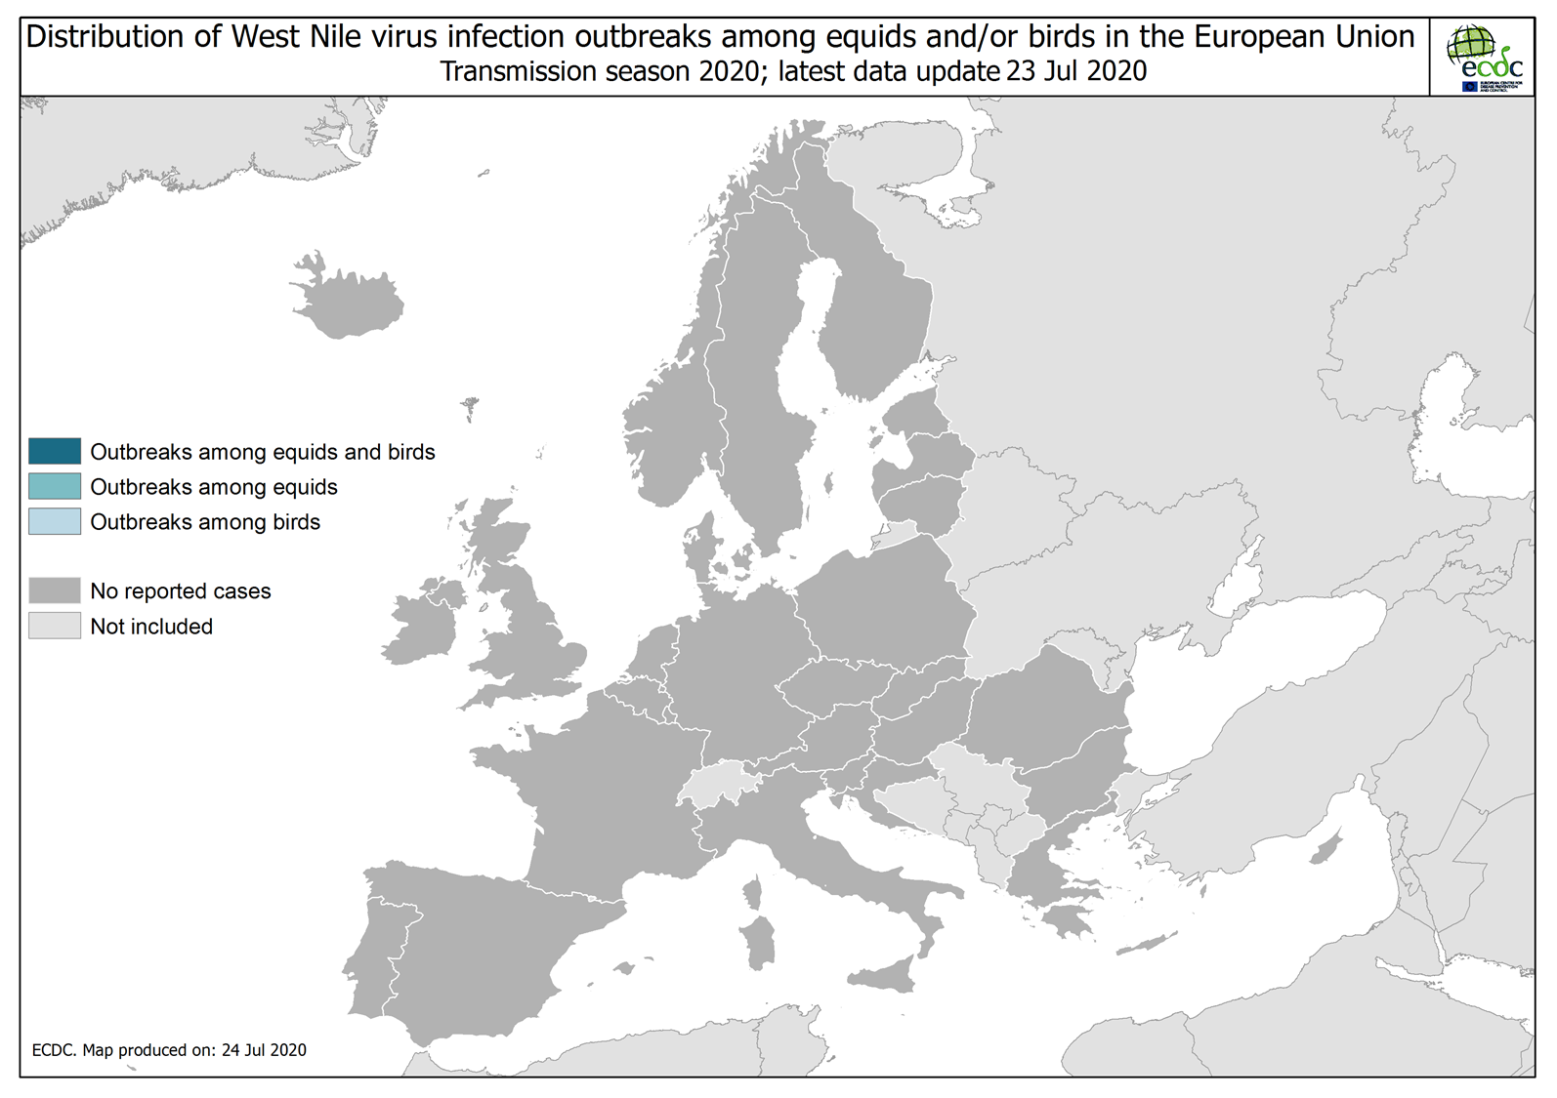
Distribution of West Nile virus infection outbreaks among equids and/or birds in the EU, as of 23 July 2020

Slide 12
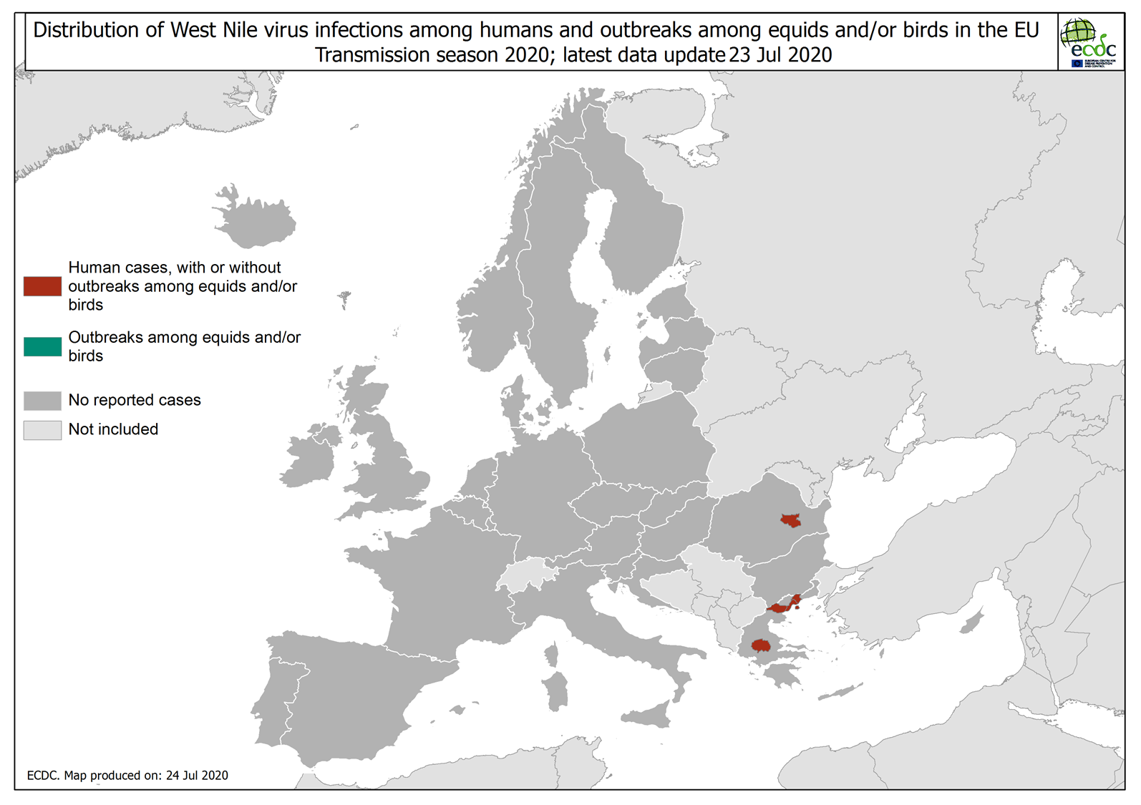
Distribution of West Nile virus infections among humans and outbreaks among equids and/or birds in the EU, as of 23 July 2020

Slide 13
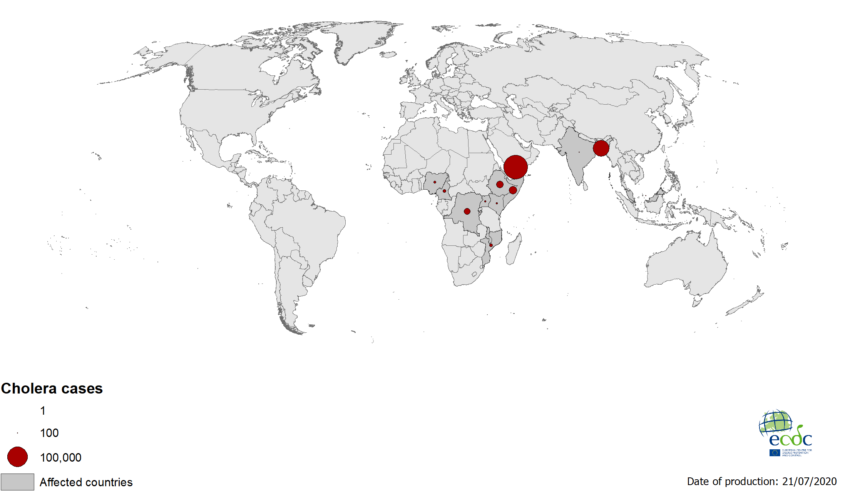
Geographical distribution of new cholera cases reported worldwide in 2020

