Slide 1
Reusable maps and graphs from ECDC Communicable Disease Threats Report
Week 30, 2019
You are encouraged to reuse our maps and graphs for your own purposes and free to translate, provided the content is not altered and the source is acknowledged.

Slide 2
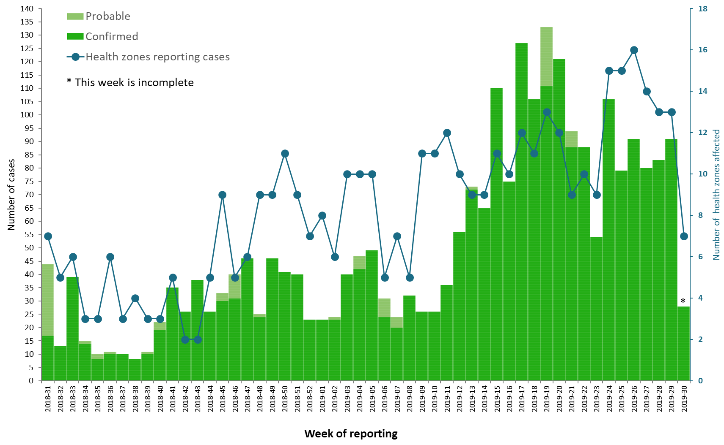
Distribution of confirmed and probable cases of Ebola virus disease
by week of reporting, Democratic Republic of the Congo, as of 24 July 2019

Slide 3
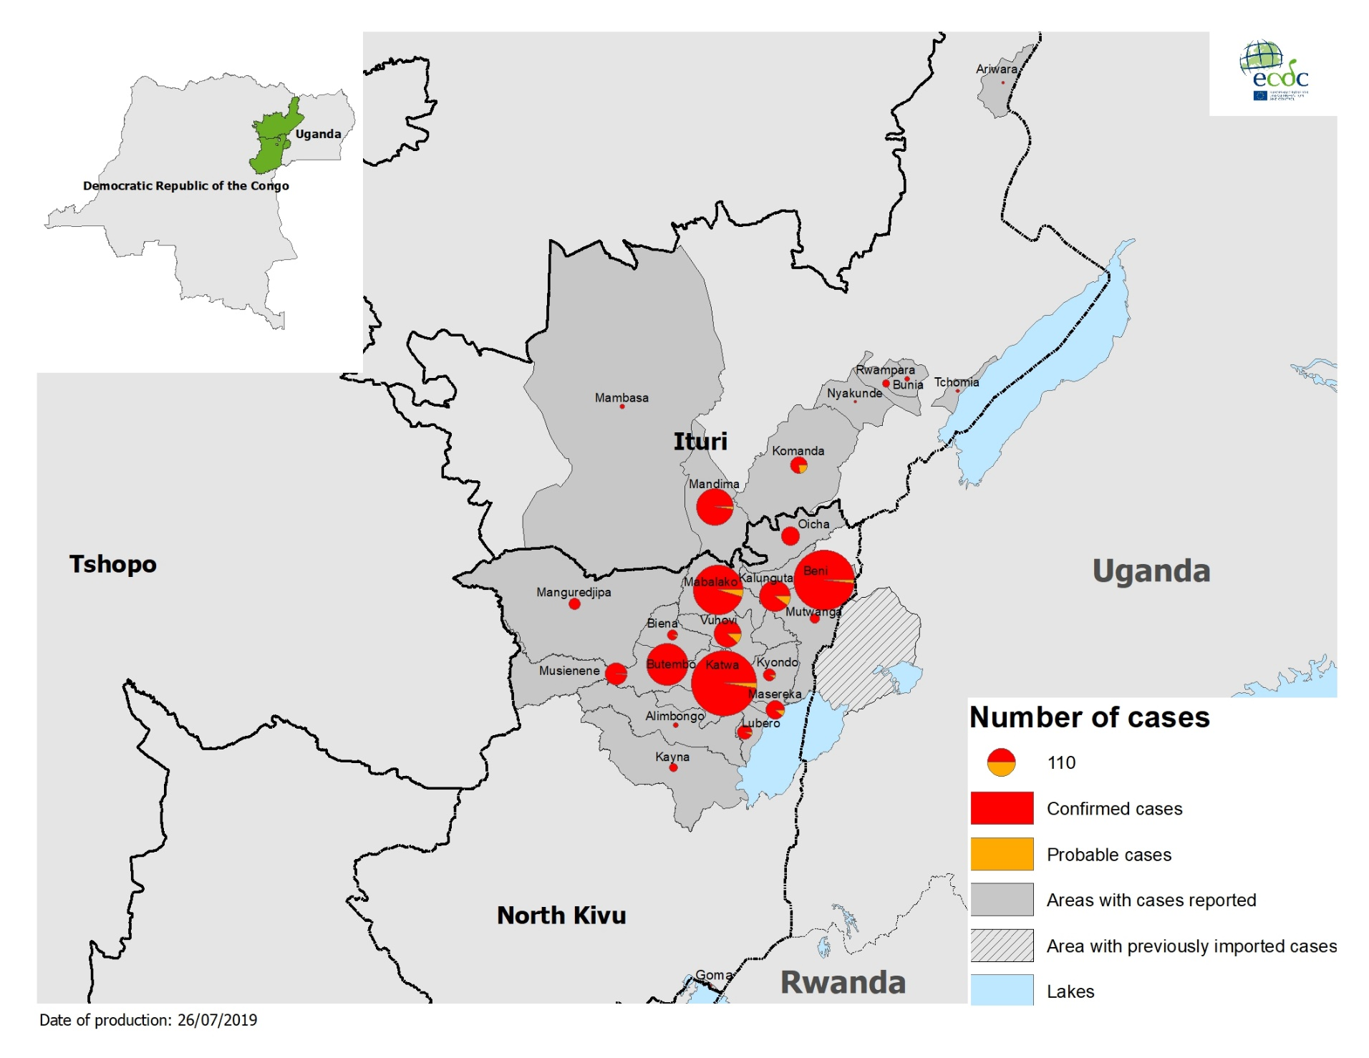
Geographical distribution of confirmed and probable cases of Ebola virus disease,
Democratic Republic of the Congo and Uganda, as of 24 July 2019

Slide 4
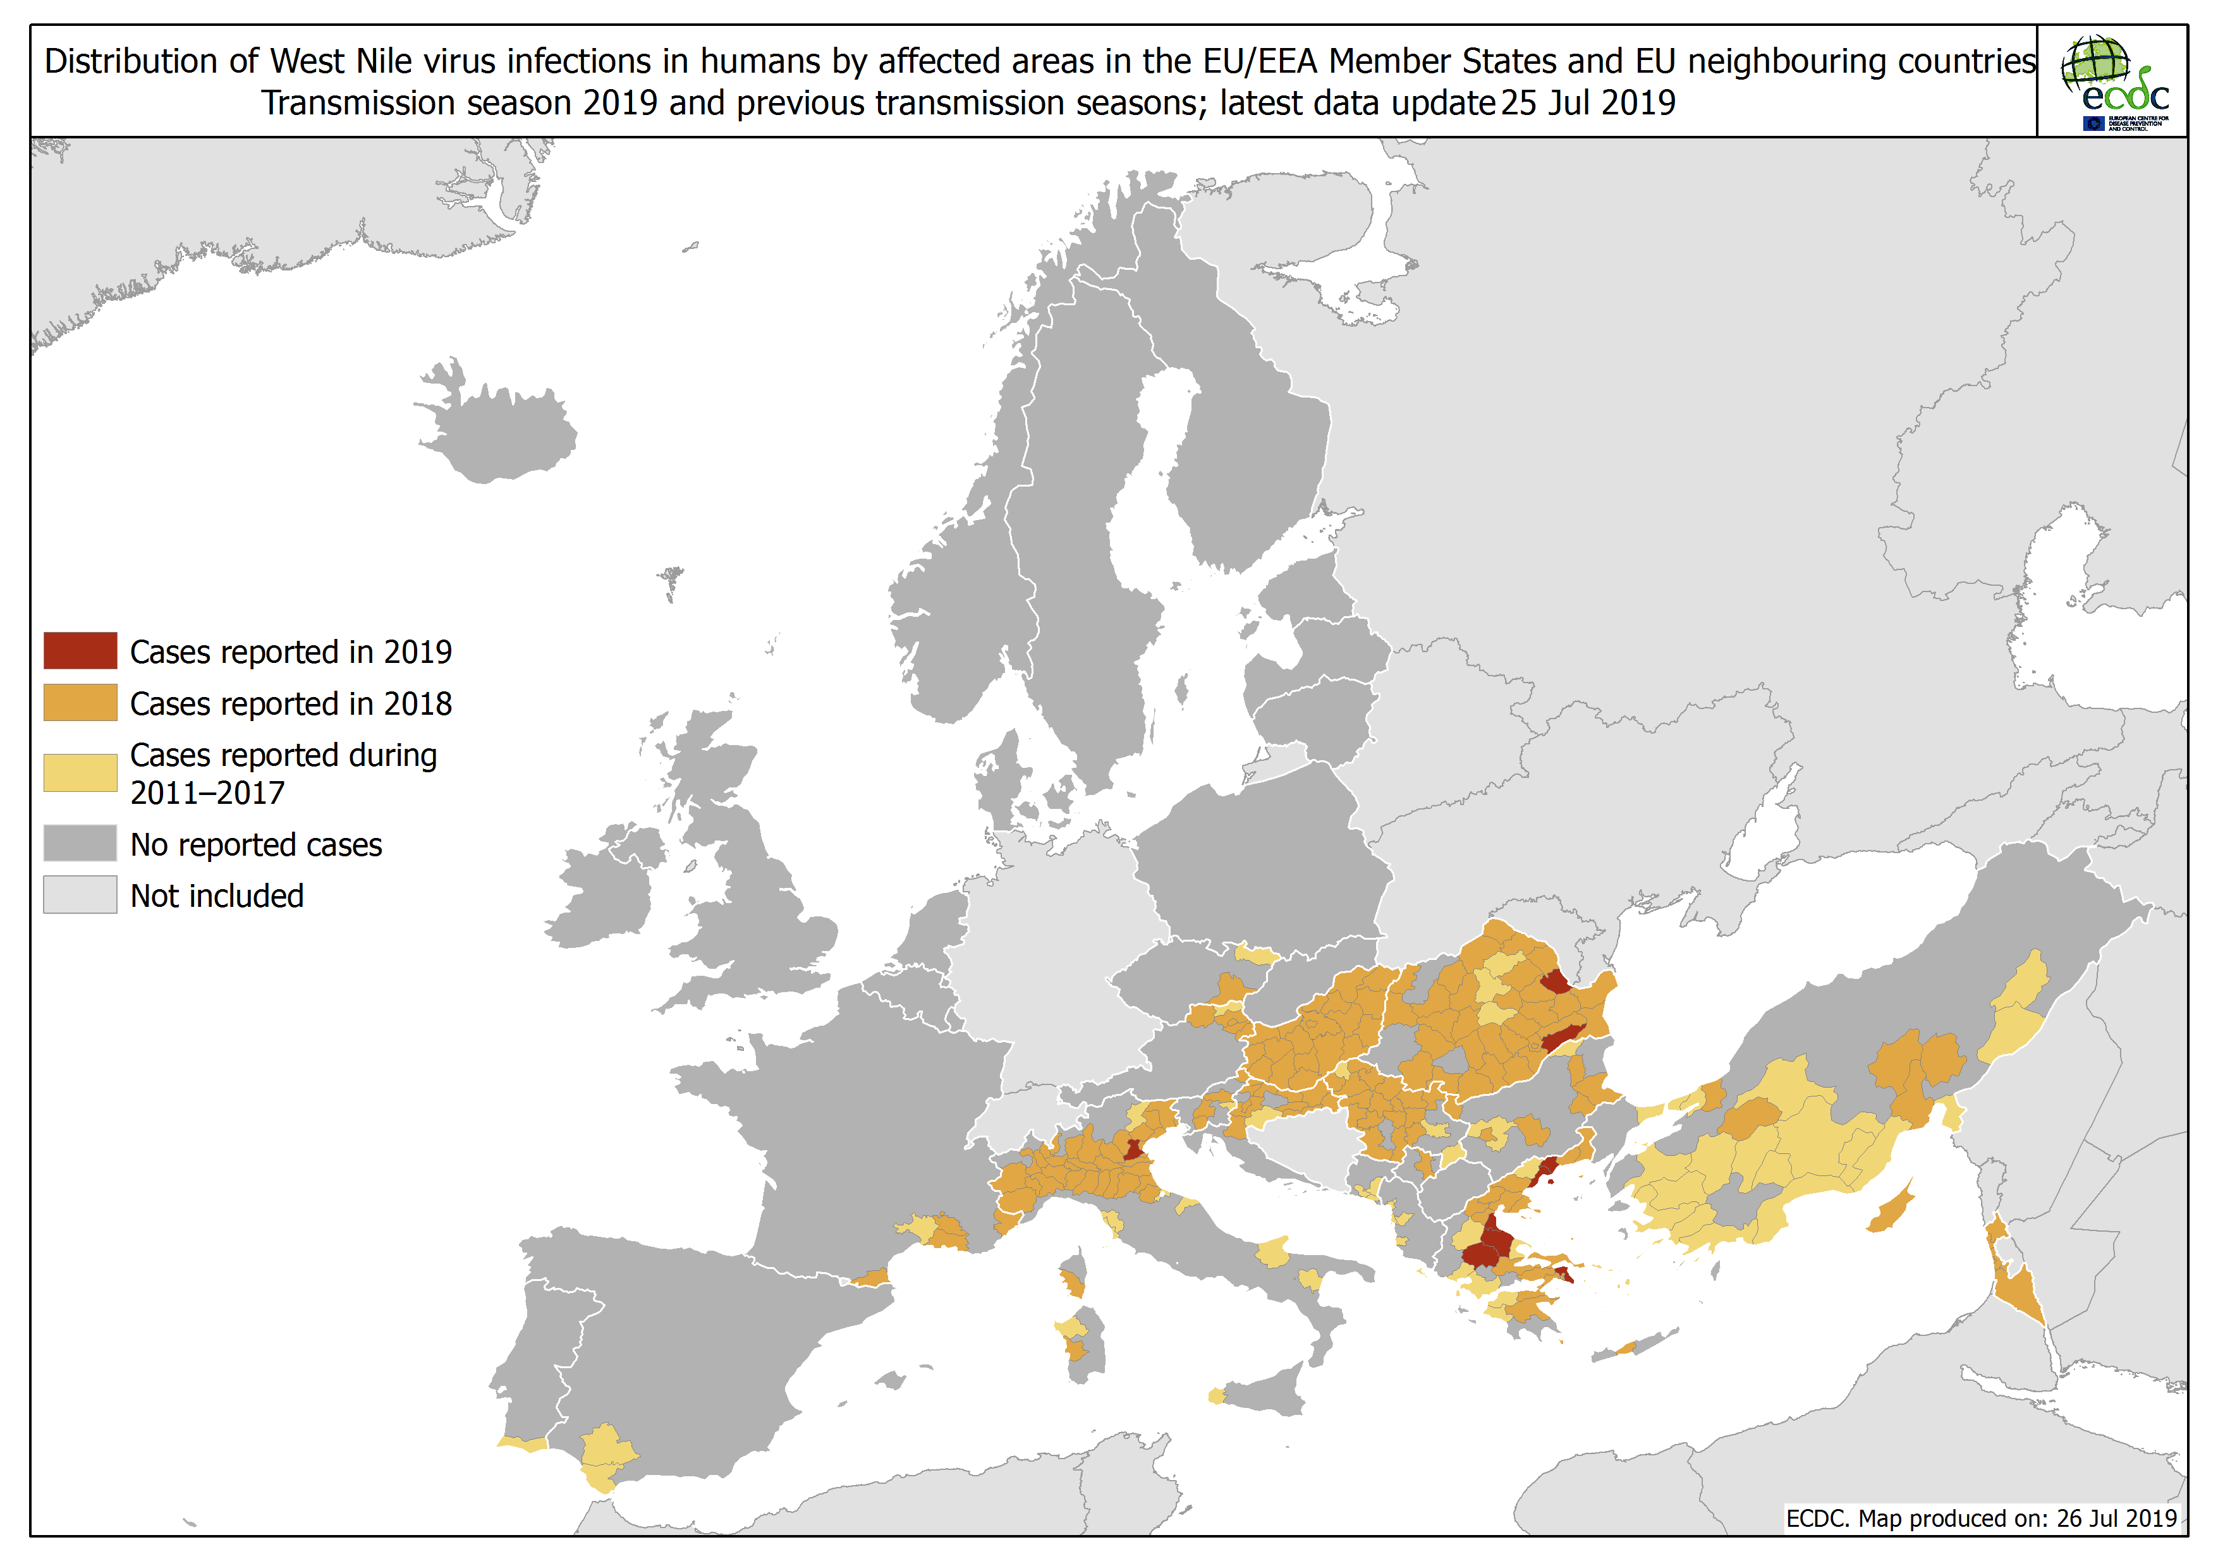

Slide 5
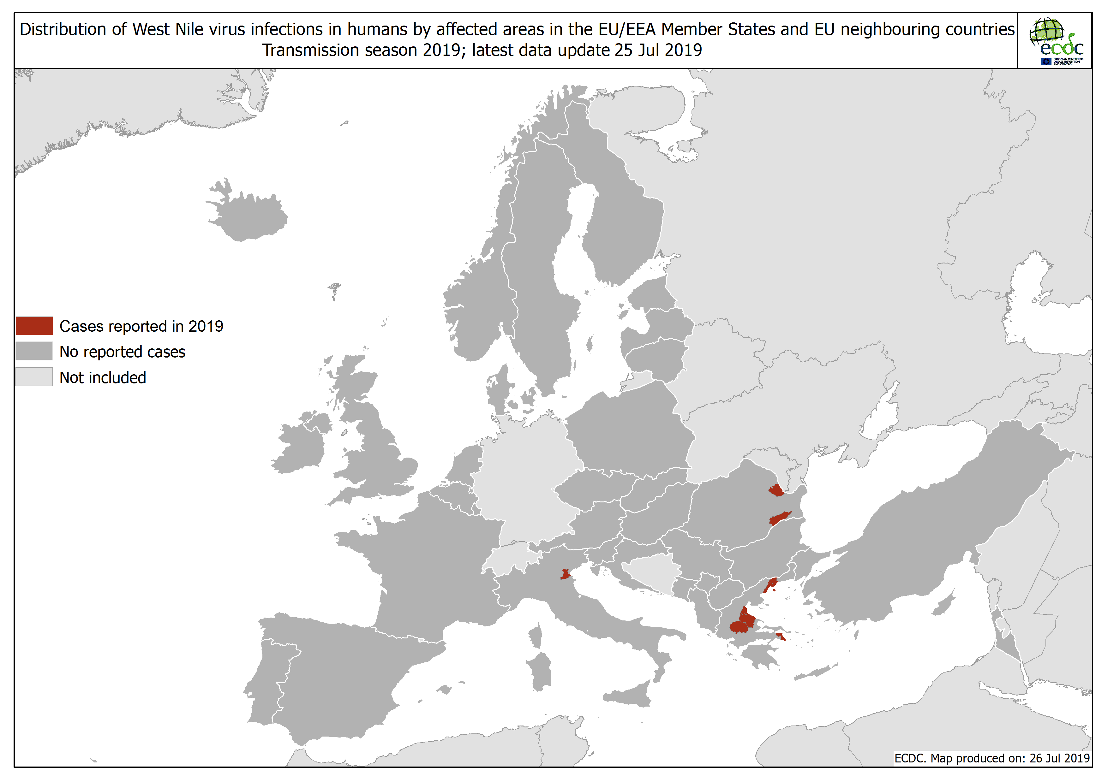

Slide 6
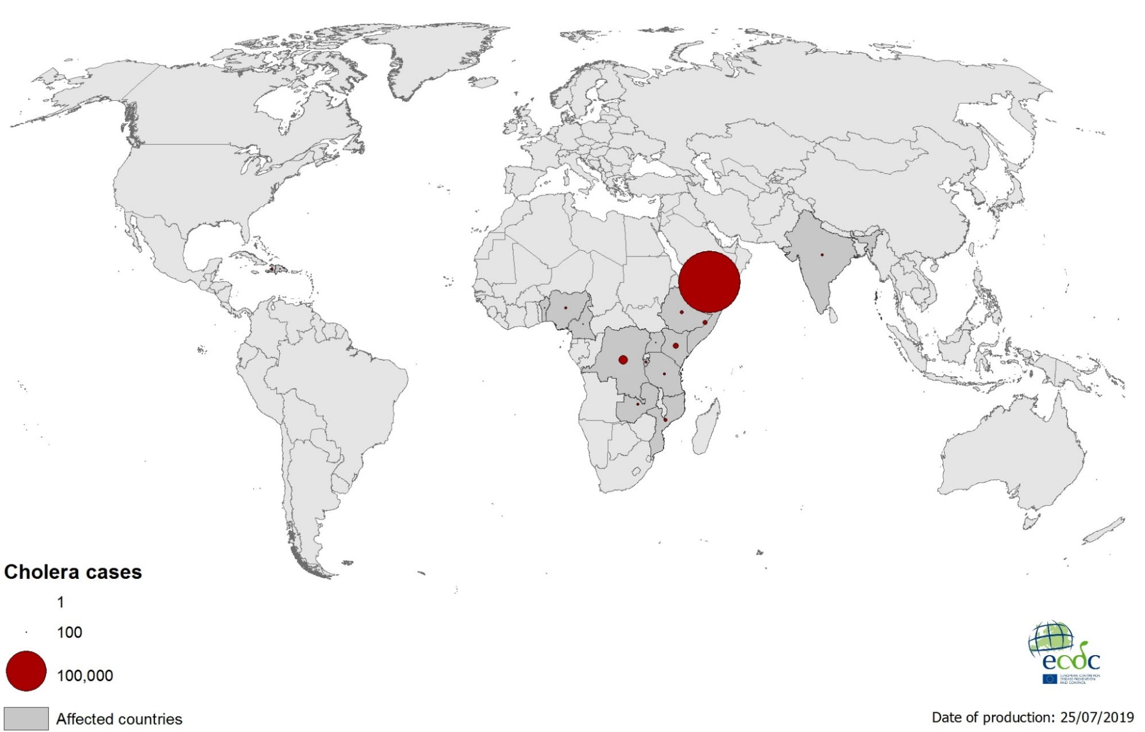
Geographical distribution of new cholera cases reported worldwide, May–July 2019

Slide 7
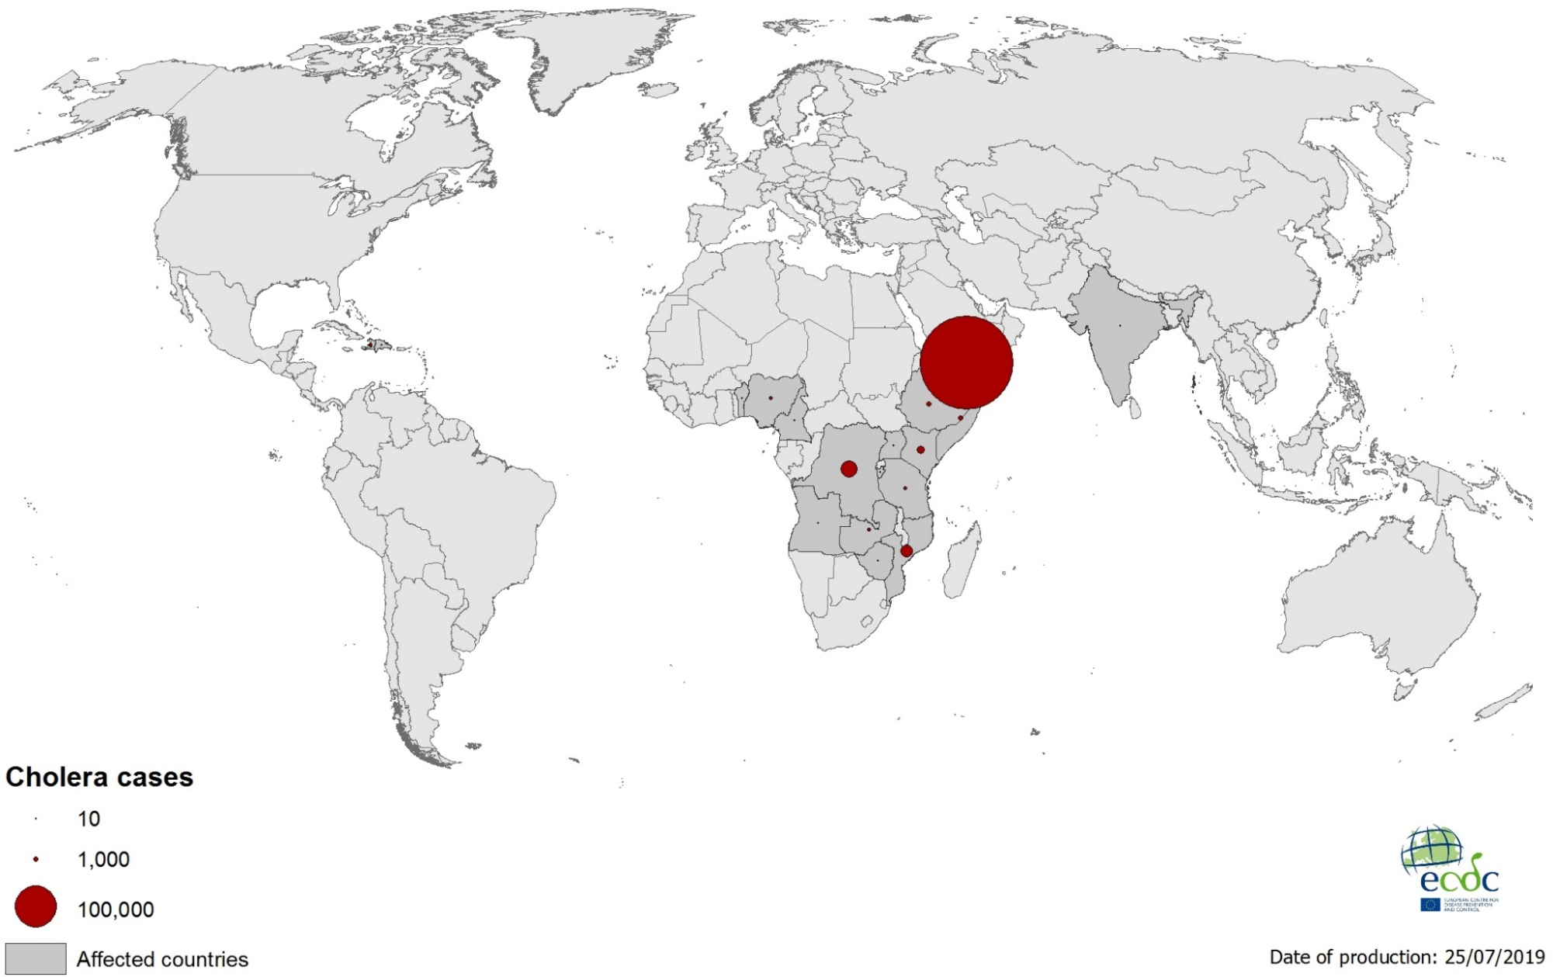
Geographical distribution of cholera cases reported worldwide in 2019

