Slide 1
Reusable maps and graphs from ECDC Communicable Disease Threats Report
Week 3, 2024
You are encouraged to reuse our maps and graphs for your own purposes and are free to translate them, provided the content is not altered and the source is acknowledged.

Slide 2
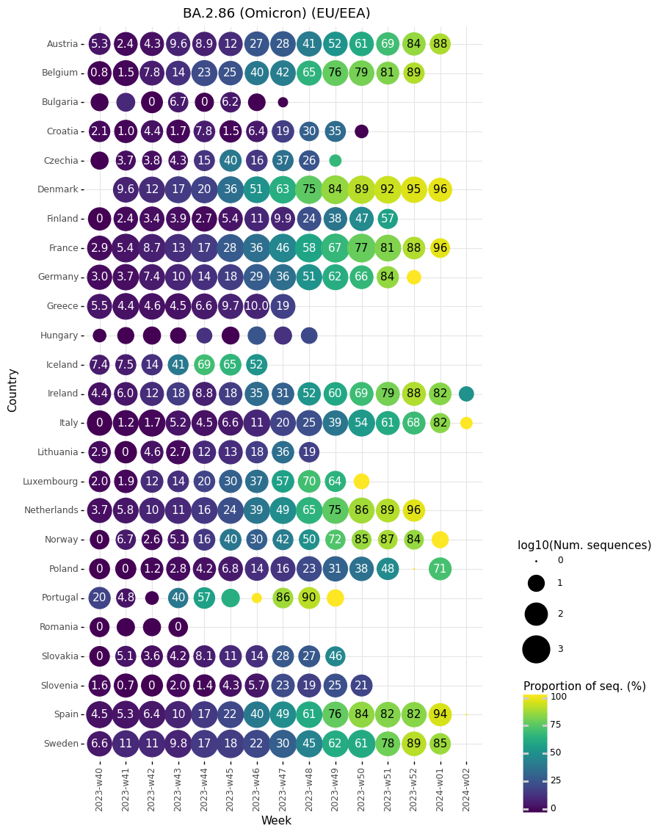
Proportion of sequences belonging to BA.2.86 lineages per sample collection week, reported by EU/EEA countries to GISAID EpiCoV as of 15 January 2024

Slide 3
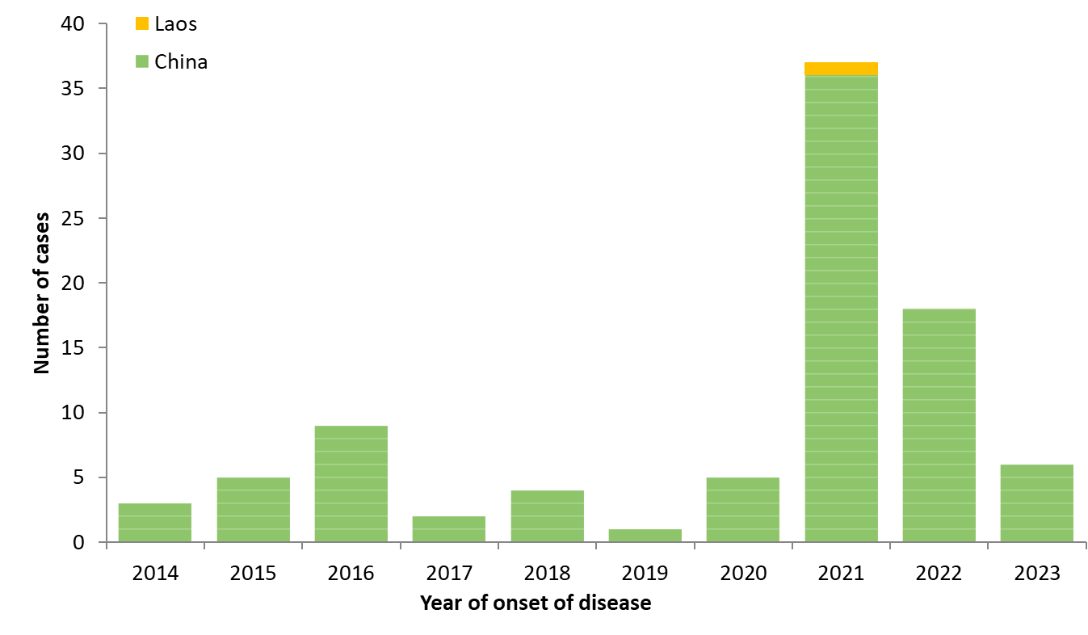
Distribution of confirmed human cases of avian influenza A(H5N6) virus infection by year of onset and country, 2014–17 Jan 2024 (n=90)

Slide 4
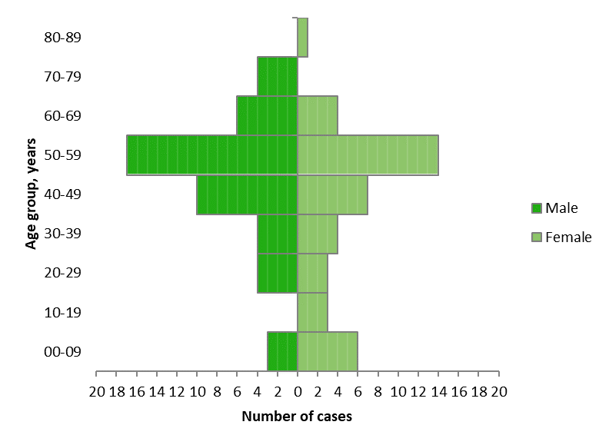
Distribution of confirmed human cases of avian influenza A(H5N6) virus infection by age group and gender, 2014–17 Jan 2024 (n=90)

