Slide 1
Reusable maps and graphs from ECDC Communicable Disease Threats Report Week 3, 2023
You are encouraged to reuse our maps and graphs for your own purposes and are free to translate them, provided the content is not altered and the source is acknowledged.

Slide 2
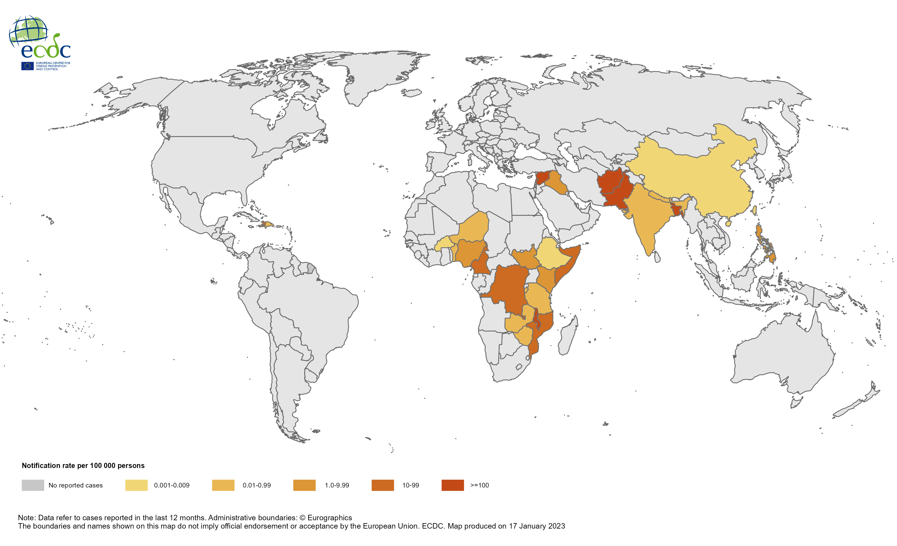
Geographical distribution of cholera cases reported worldwide from January 2022 to January 2023

Slide 3
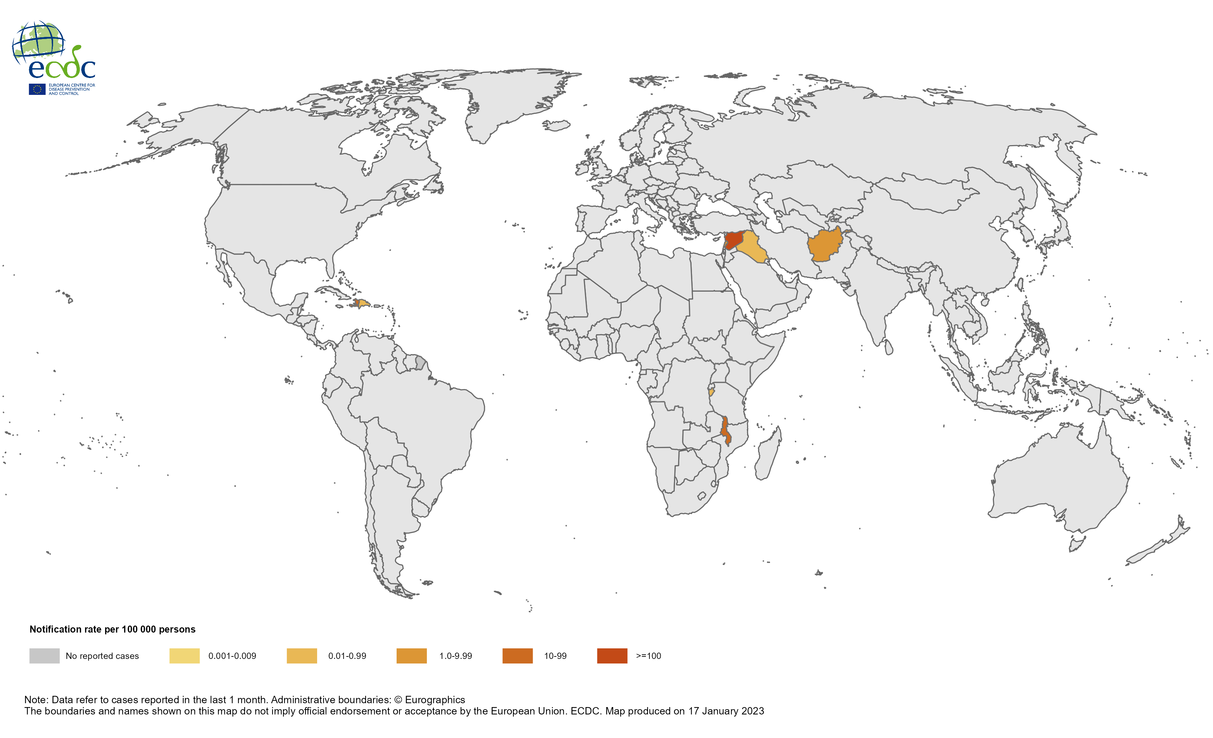
Geographical distribution of cholera cases reported worldwide in January 2023

