Slide 1
Reusable maps and graphs from ECDC Communicable Disease Threats Report
Week 2, 2022
You are encouraged to reuse our maps and graphs for your own purposes and are free to translate them, provided the content is not altered and the source is acknowledged.

Slide 2
Distribution of COVID-19 cases worldwide, in accordance with the applied case definitions in the affected countries, as of week 2 2022

Slide 3
Distribution of COVID-19 deaths worldwide, as of week 2 2022

Slide 4
Distribution of laboratory-confirmed cases of COVID-19 in the EU/EEA, as of week 2 2022

Slide 5
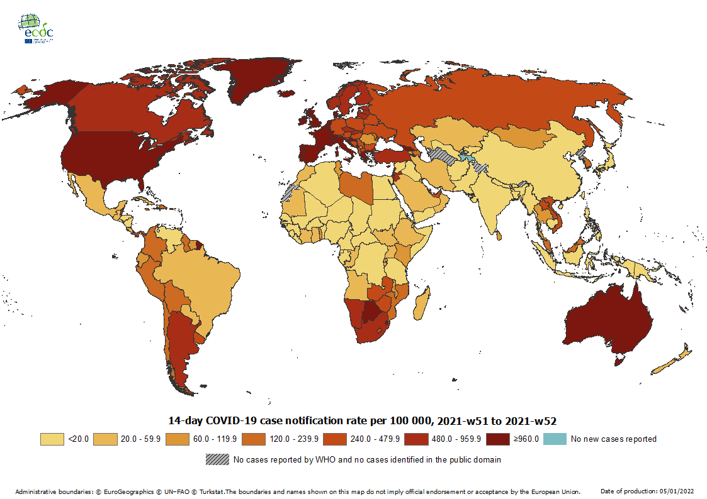
Geographical distribution of 14-day cumulative number of reported COVID-19 cases per 100 000 population, worldwide, week 51 to week 52 2021
Note: As the winter holidays affected epidemic intelligence routines, it has not been possible to produce the 14-day notification rate and map for week 1 2022. The map will be available again for week 2 2022
14-day notification rates and trends are collected using epidemic intelligence from various sources and are affected by the testing strategy, laboratory capacity and effectiveness of surveillance systems. As all of these factors can differ greatly between countries, ECDC does not recommend using notification rates to directly compare countries. Particular caution is needed when interpreting reported rates from areas with small populations, where small changes in the numbers of reported cases can have a large impact on the notification rate. In addition, the retrospective adjustment of data by reporting authorities is possible. Negative counts of new cases can arise if countries or subnational areas report cumulative totals that are lower than those reported previously, which can affect the presentation of data in maps and time-series plots.

Slide 6
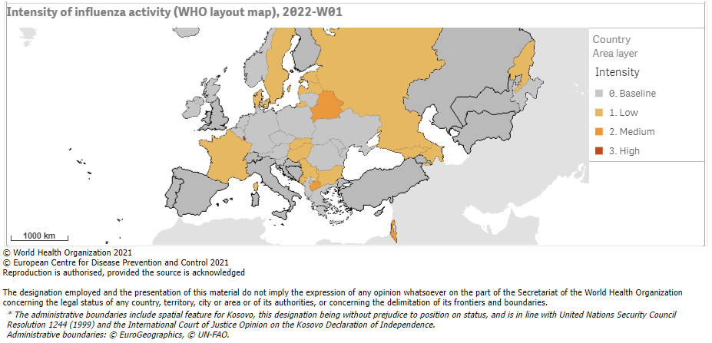
Intensity of influenza activity in the WHO European Region, week 2-2022

Slide 7
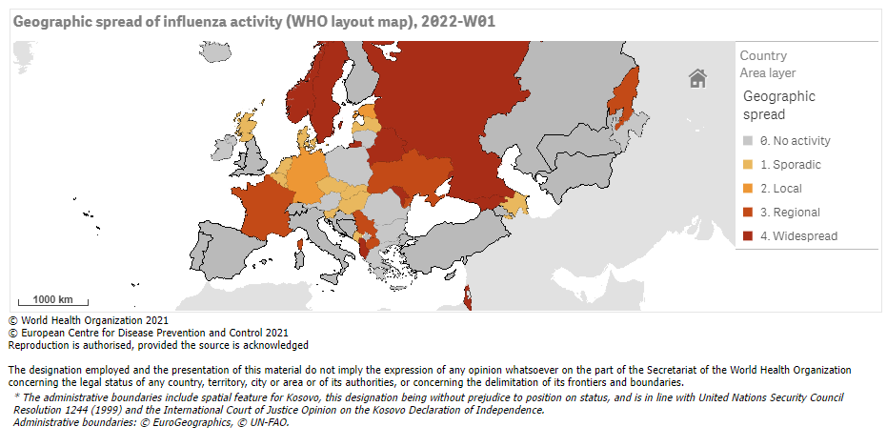
Geographic spread of influenza viruses in the WHO European Region, week 2-2022

Slide 8
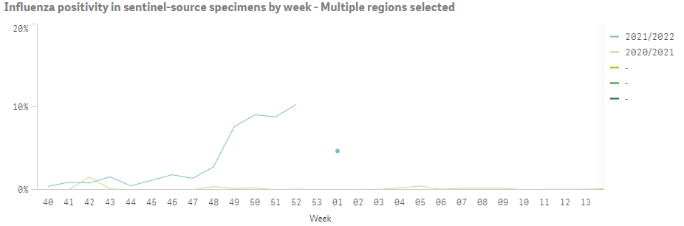
Influenza positivity in sentinel-source specimens by week, WHO European Region, seasons 2020/2021 and 2021/2022

Slide 9
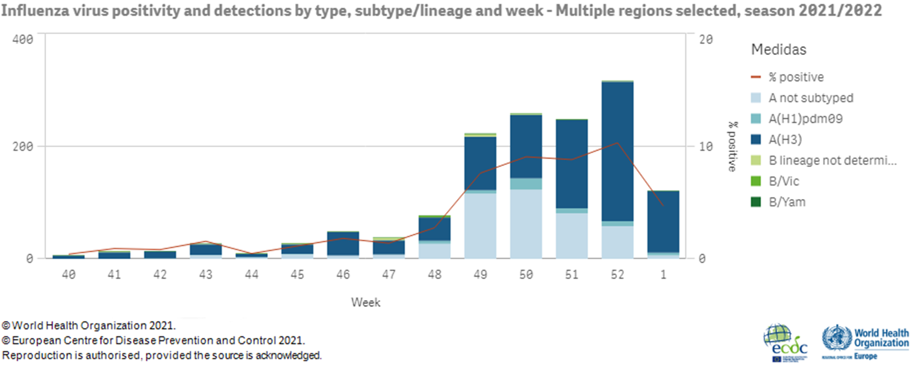
Influenza positivity and detections by type and subtype/lineage,
WHO European Region, season 2021/2022, weeks 40-2021 – 1-2022

Slide 10
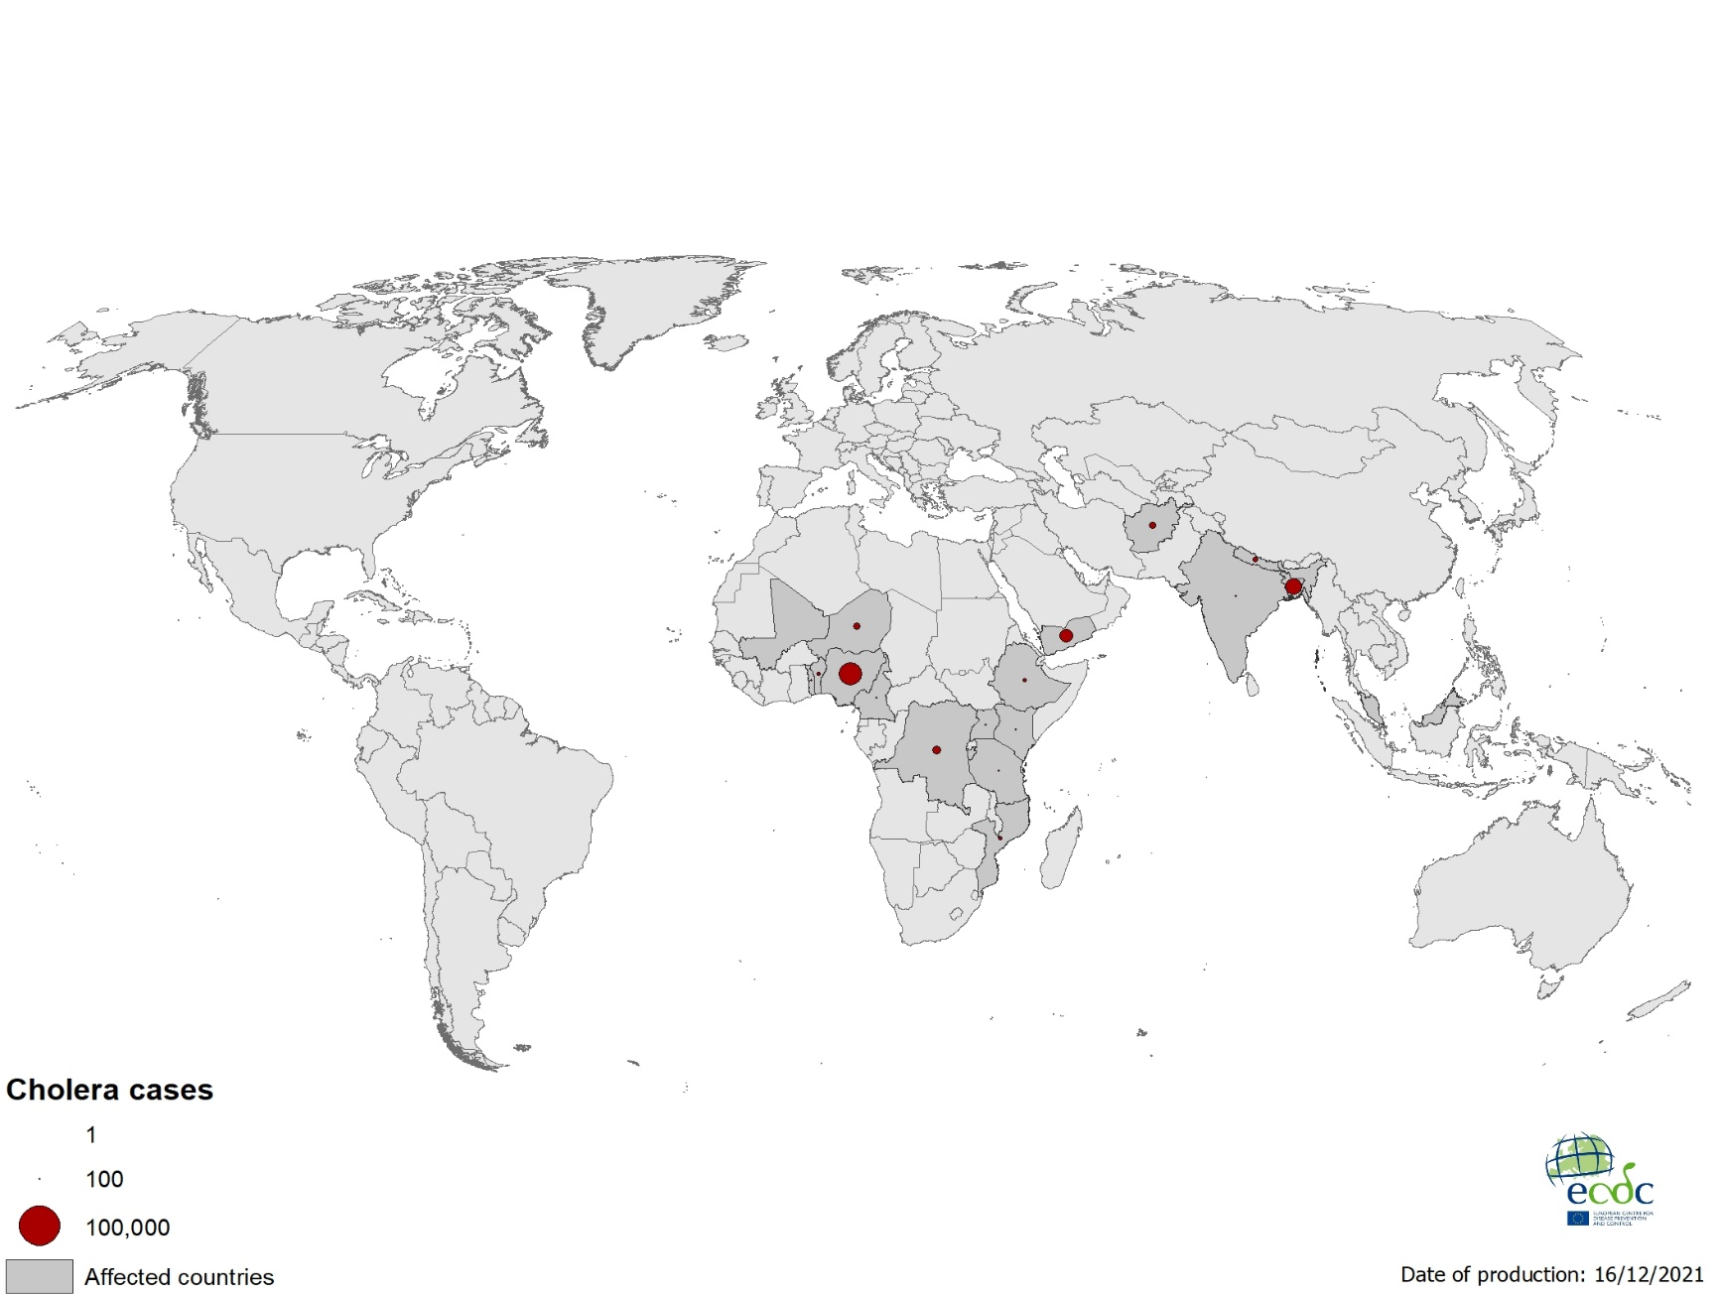
Geographical distribution of cholera cases reported worldwide from October to December 2021

Slide 11
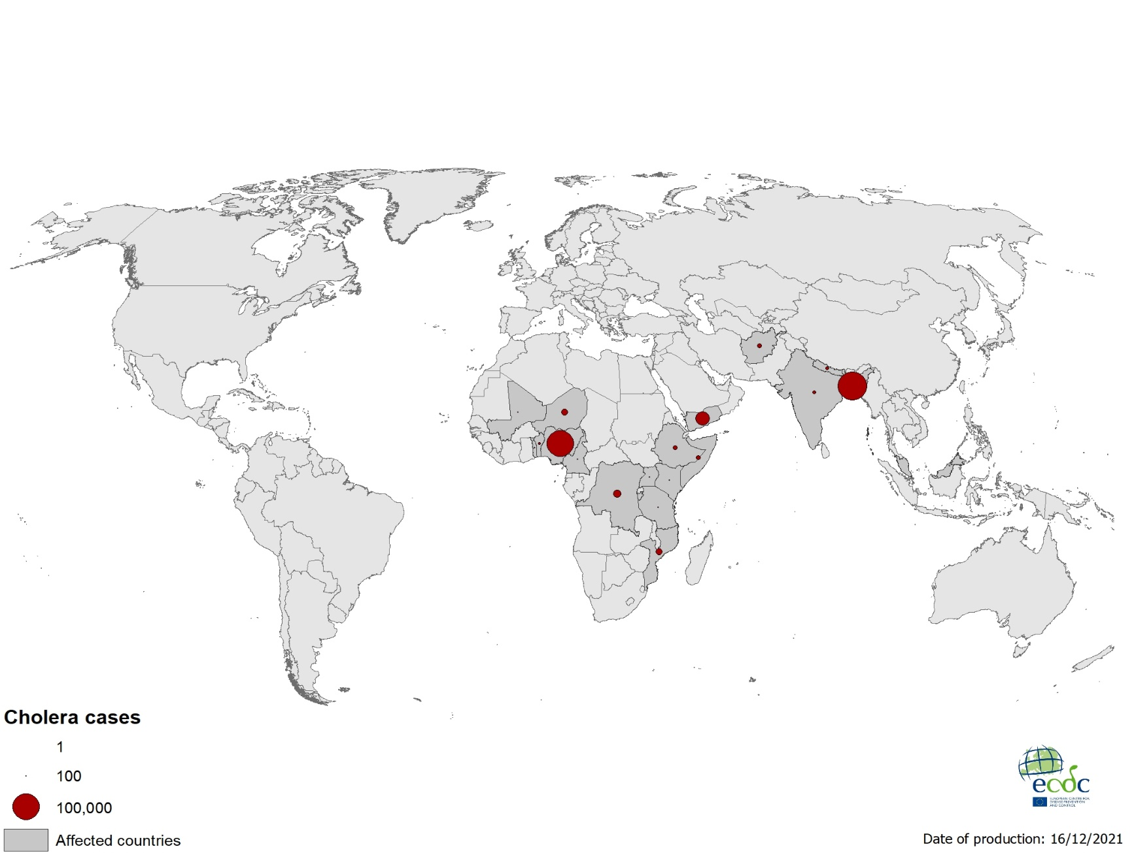
Geographical distribution of cholera cases reported worldwide as of December 2021

Slide 12
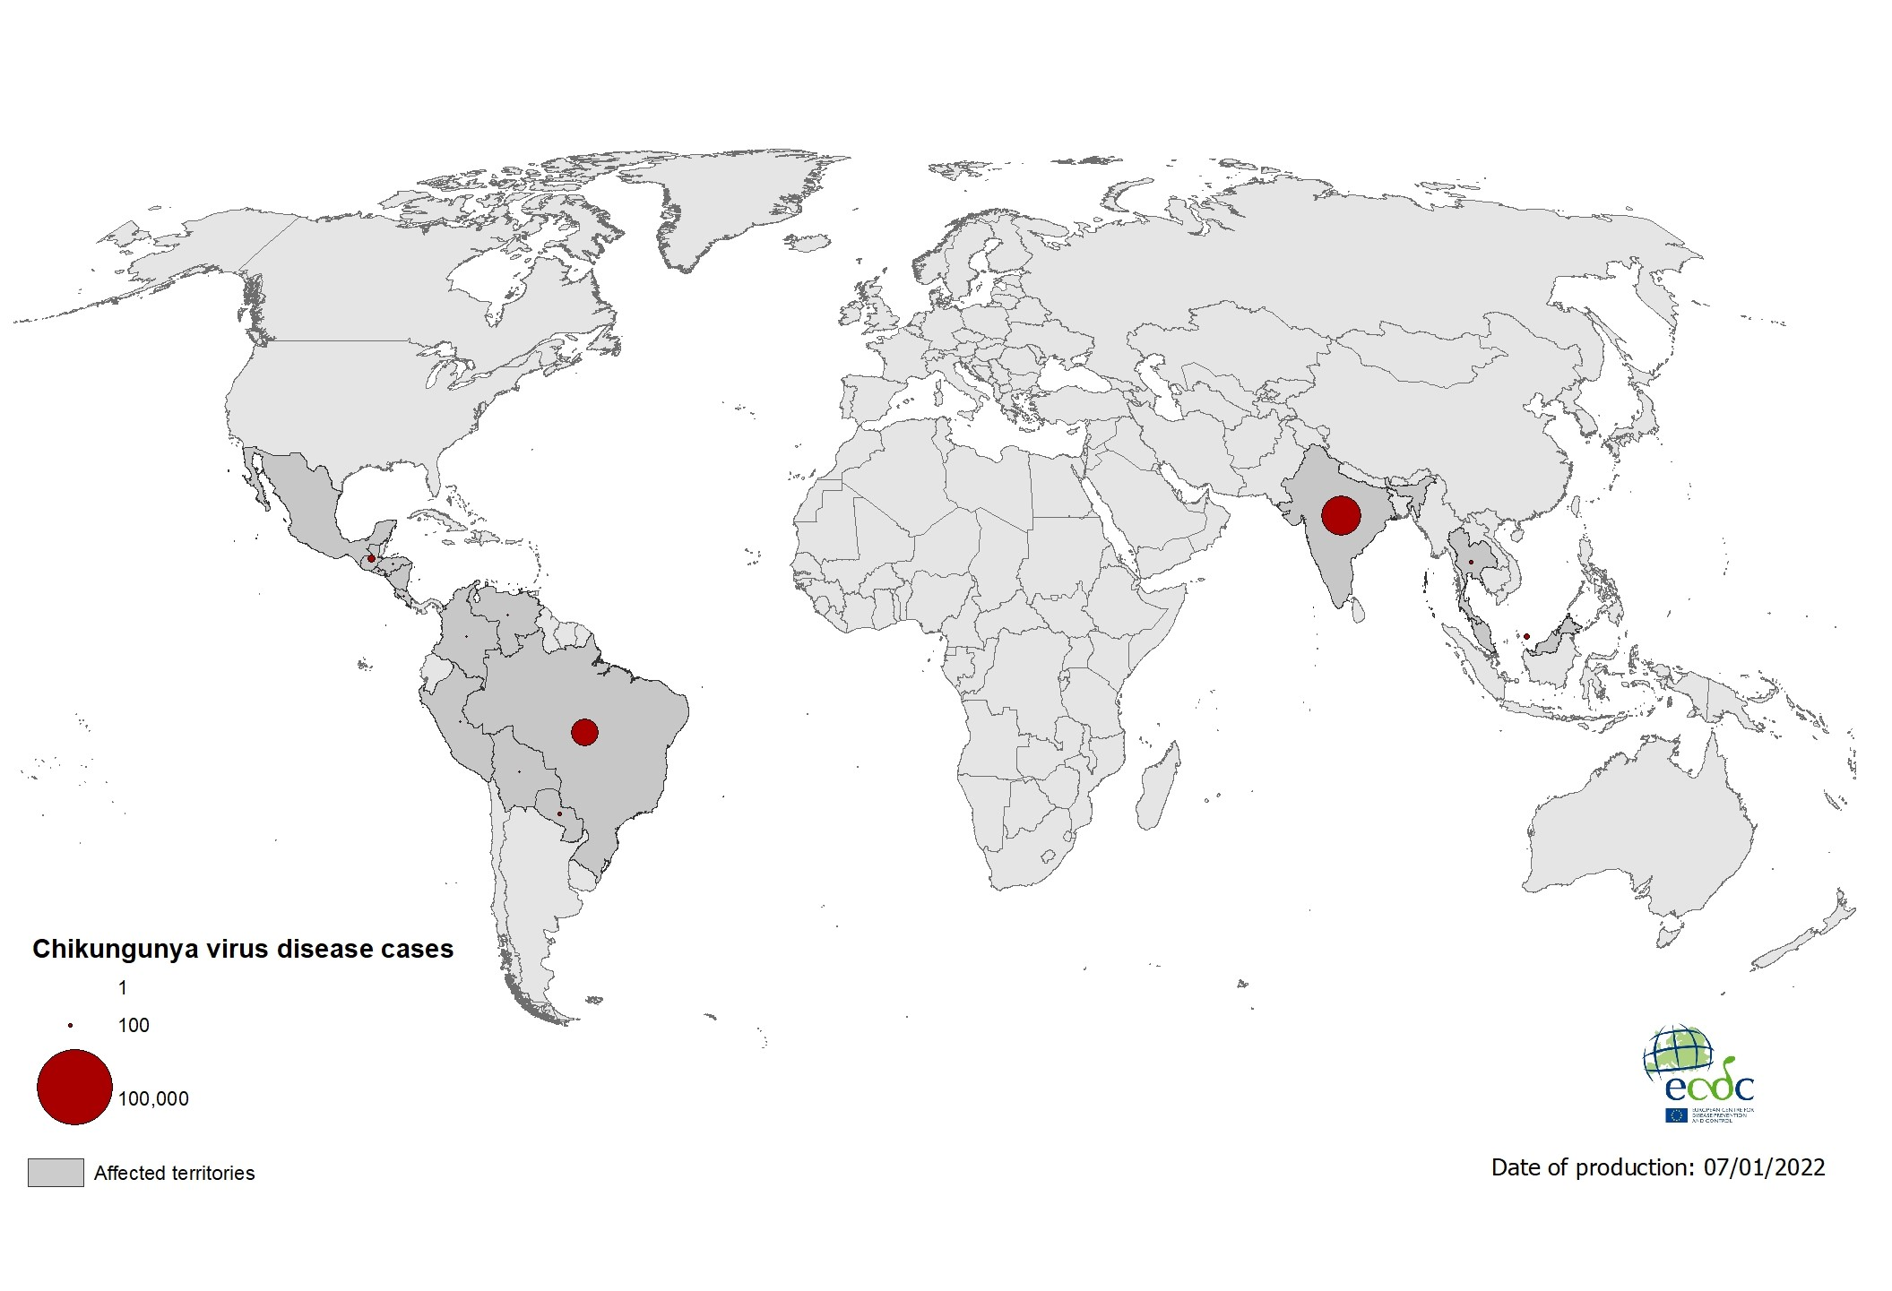
Geographical distribution of chikungunya cases reported worldwide, October to December 2021

Slide 13
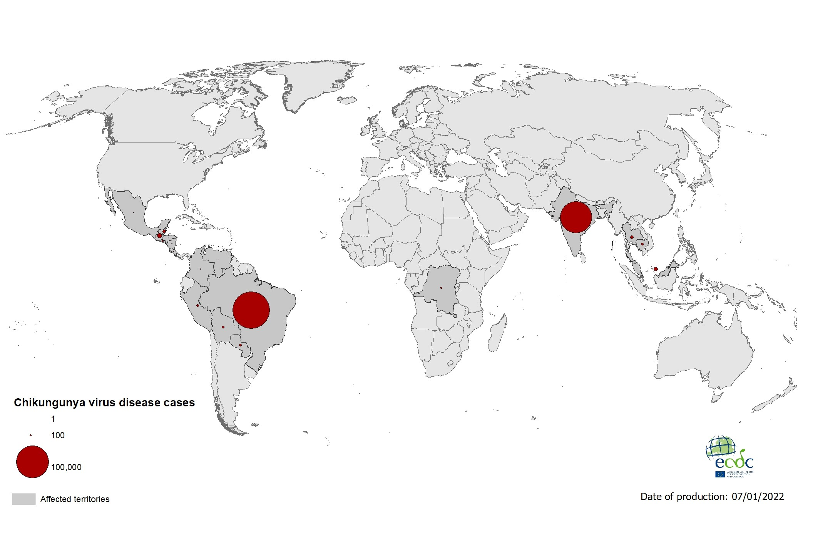
Geographical distribution of chikungunya cases reported worldwide, January to December 2021

Slide 14
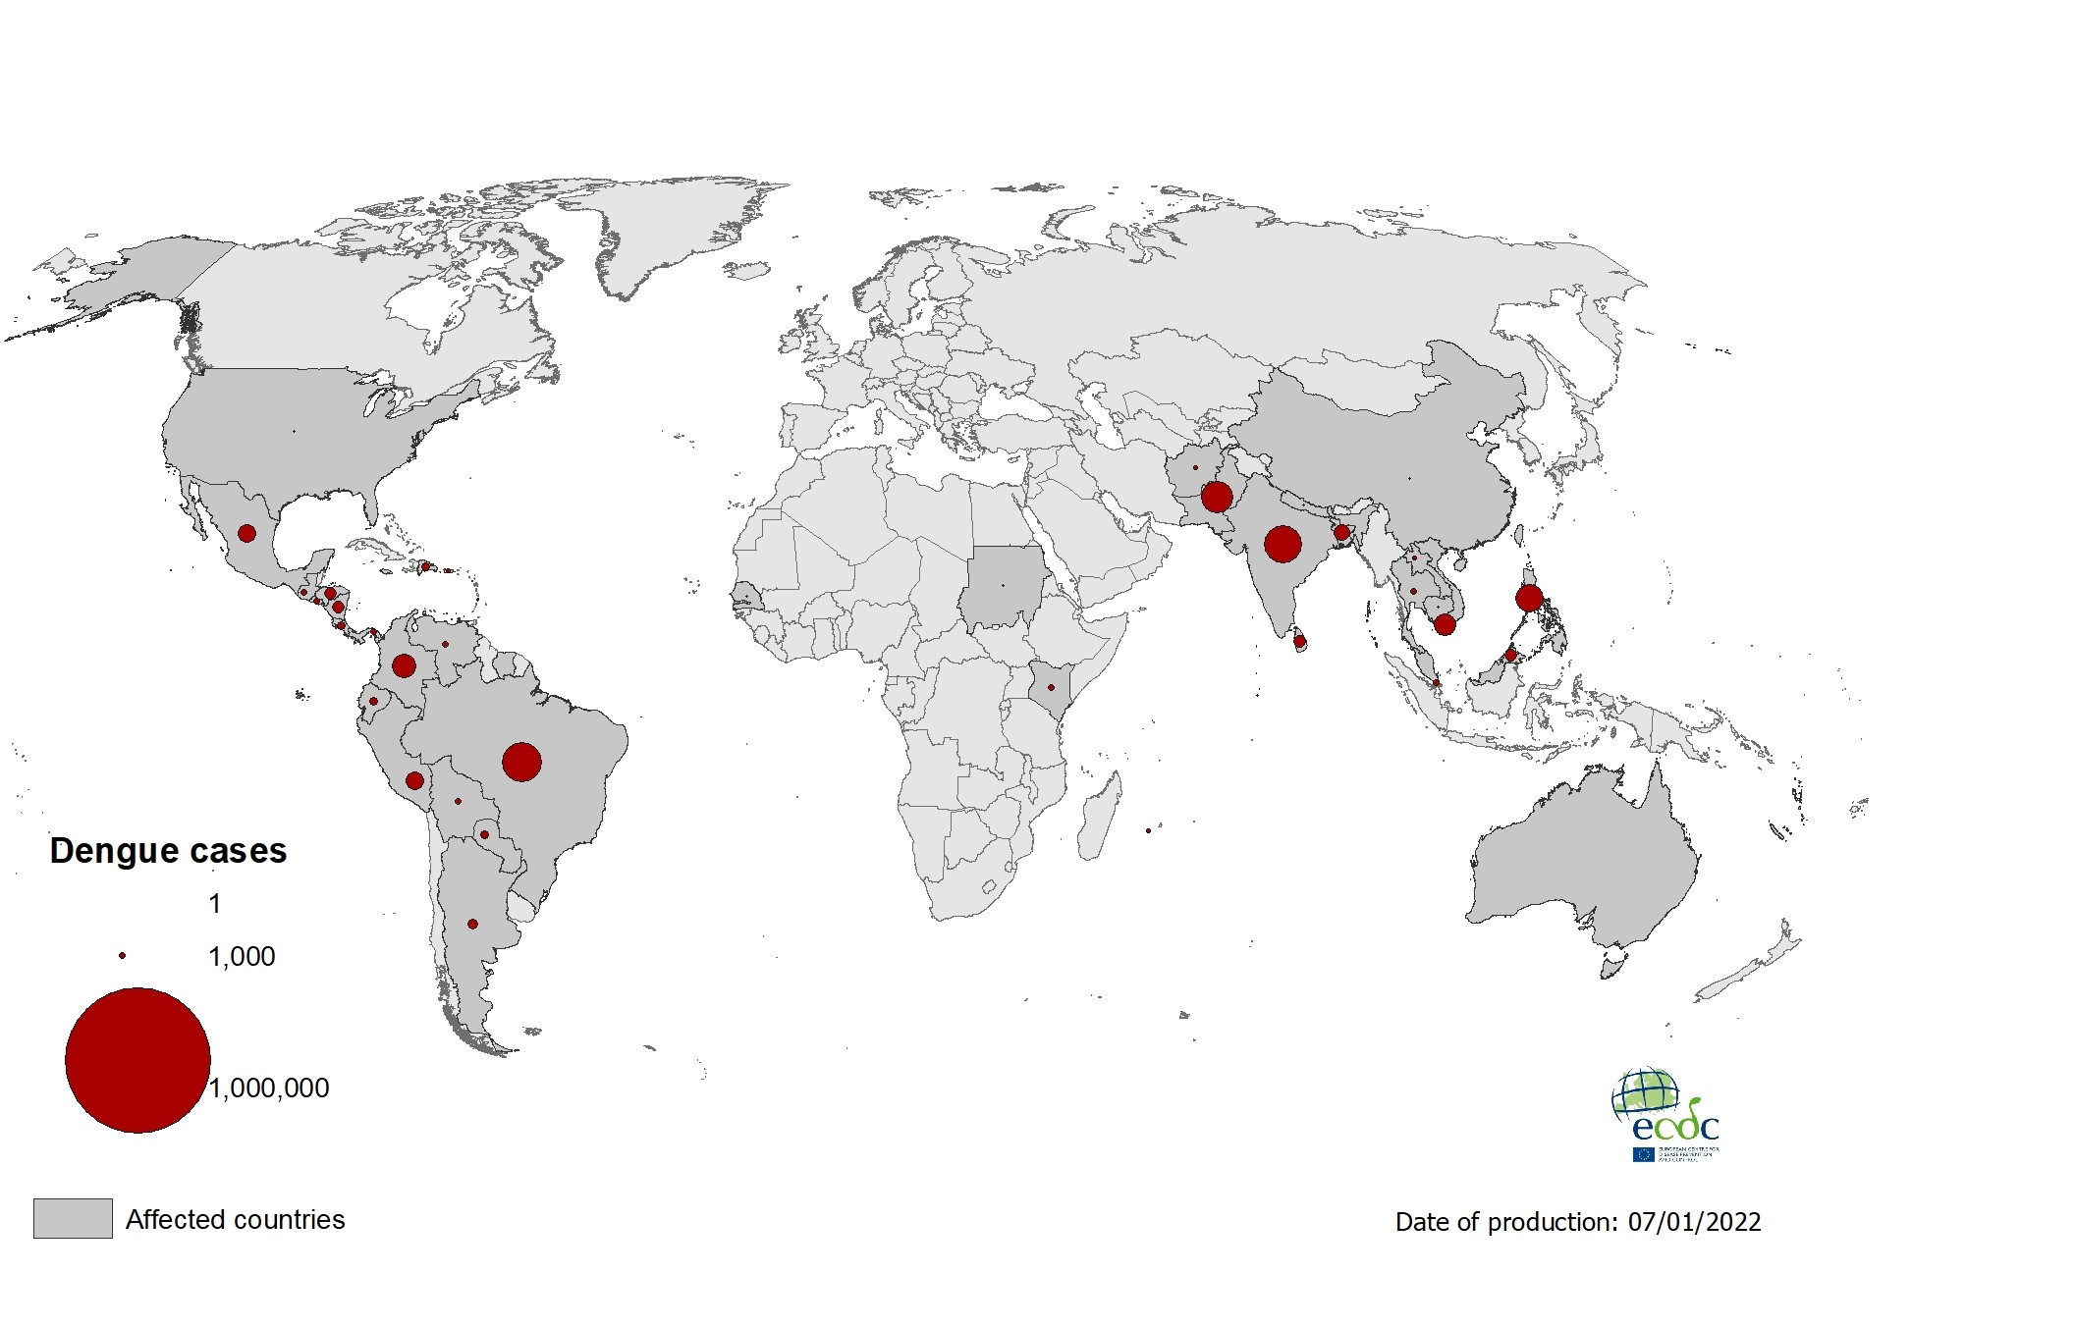
Geographical distribution of dengue cases reported worldwide, October to December 2021

Slide 15
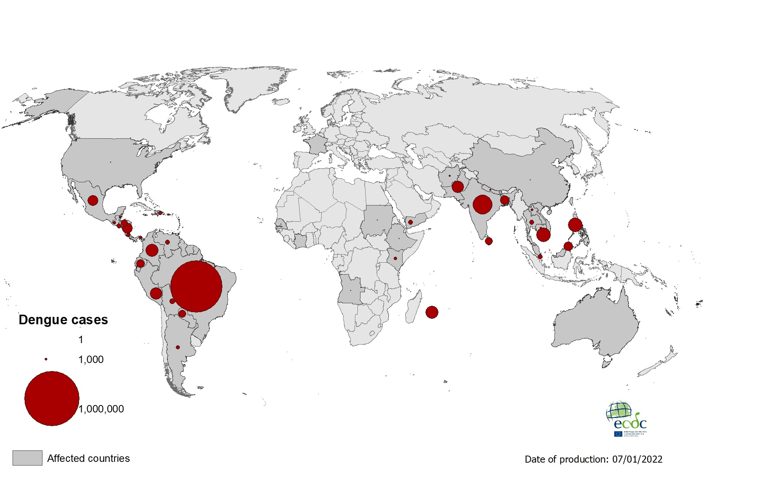
Geographical distribution of dengue cases
reported worldwide, January to December 2021

Slide 16

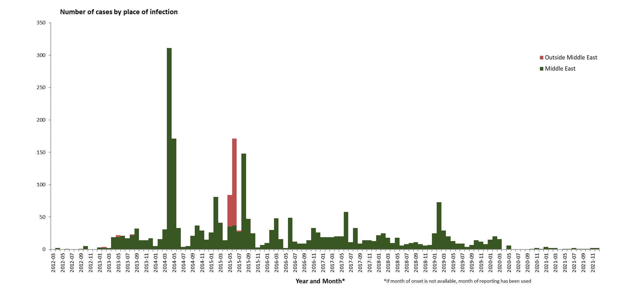
Distribution of confirmed cases of MERS-CoV by place of infection and month of onset,
March 2012 – December 2021
Notes:
Cases in 2020: 61
Cases in 2019: 223

Slide 17
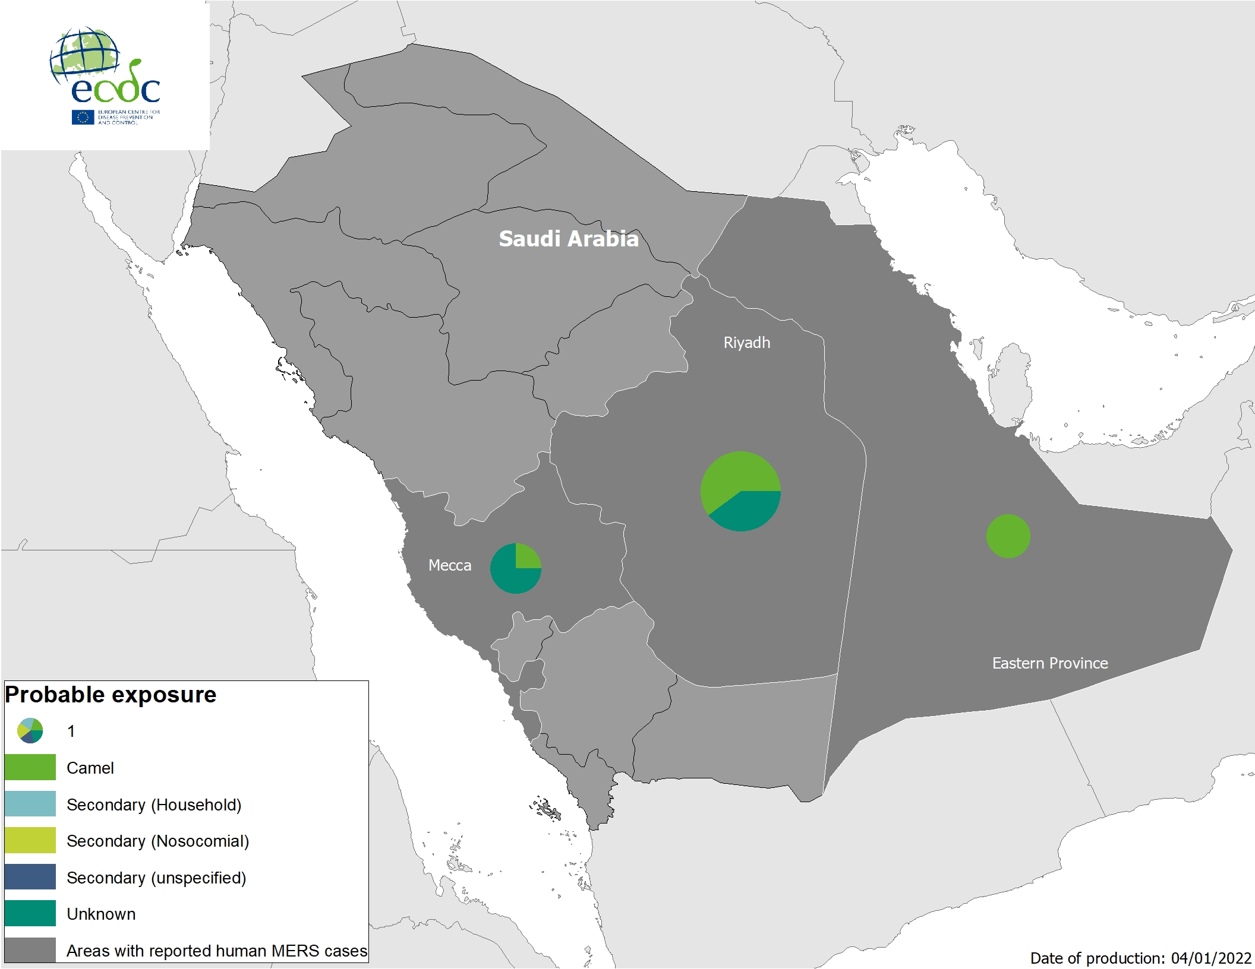
Geographical distribution of confirmed MERS-CoV cases by probable region of infection and exposure, from 1 January 2021 to 31 December 2021

Slide 18
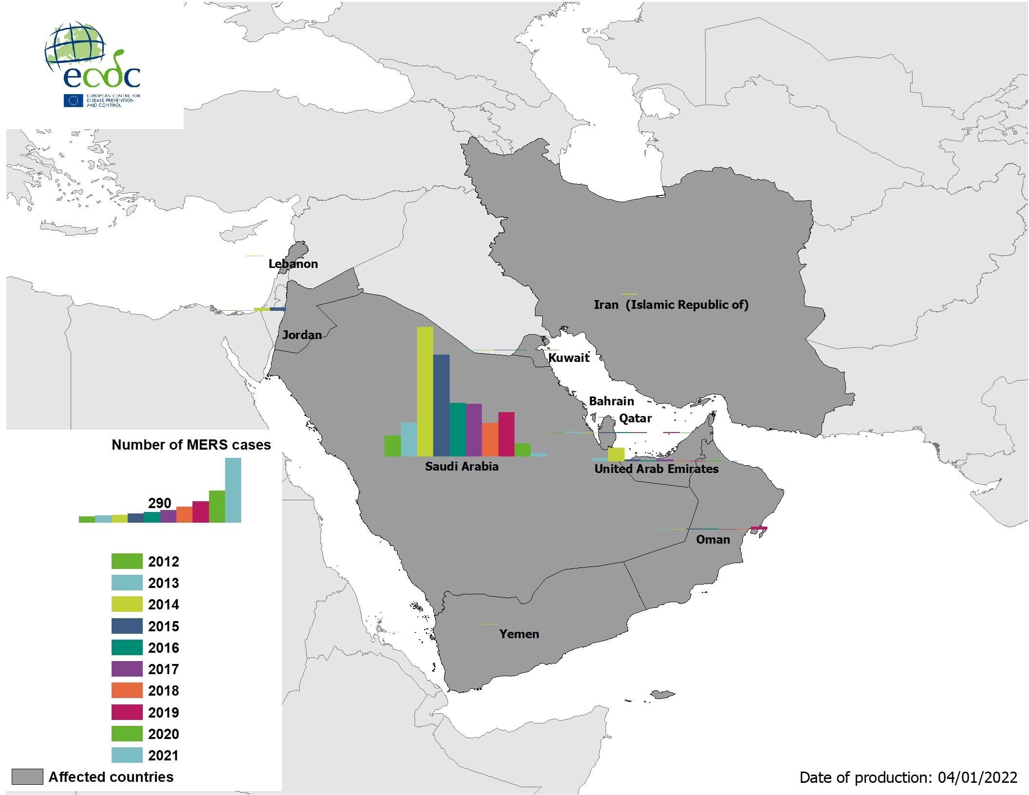
Geographical distribution of confirmed MERS-CoV cases by country of infection and year, from April 2012 to 31 December 2021
Notes:
Cases only in SA and UAE

Slide 19
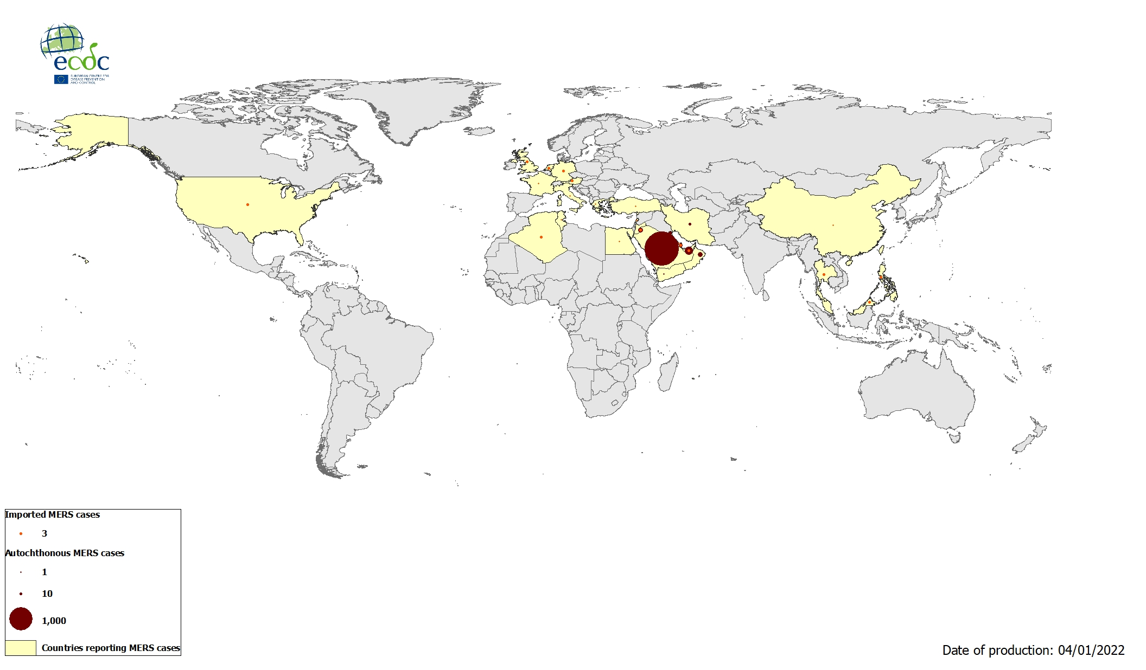
Geographical distribution of confirmed MERS-CoV cases by reporting country from April 2012 to 31 December 2021
Notes:
2600 total cases ww and 943 deaths

Slide 20
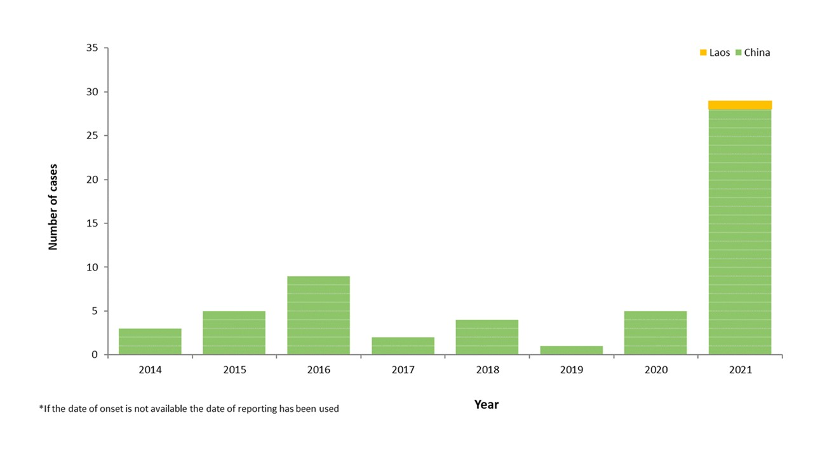
Distribution of confirmed human cases with avian influenza A(H5N6) virus infection by onset year and country, 2014 - 2021

Slide 21
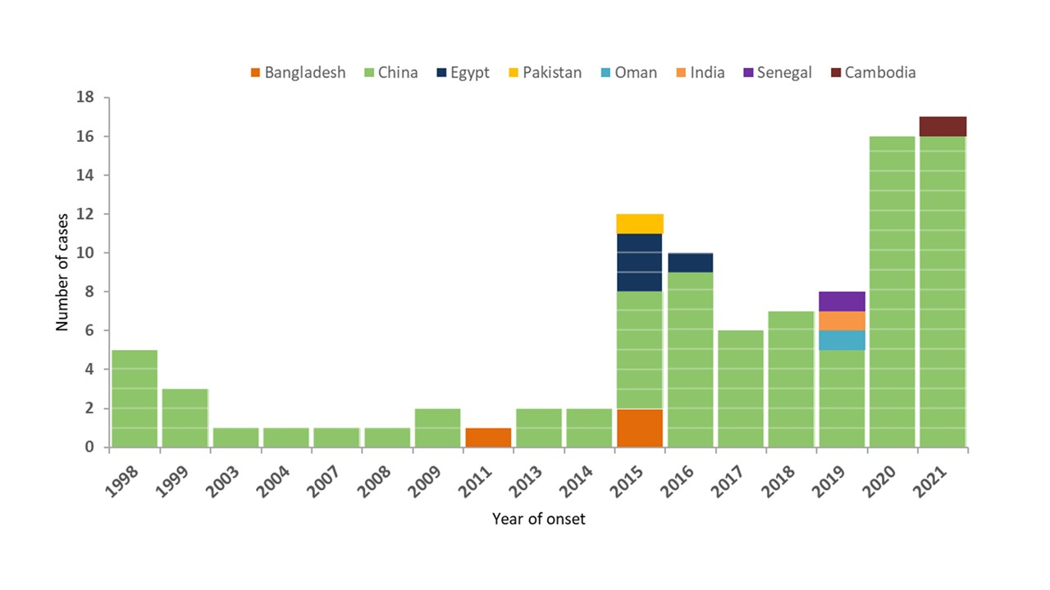
Distribution of confirmed human cases with avian influenza A(H9N2) virus infection by onset year and country, 1998 – 2021

