Slide 1
Reusable maps and graphs from ECDC Communicable Disease Threats Report Week 28 2022
You are encouraged to reuse our maps and graphs for your own purposes and are free to translate them, provided the content is not altered and the source is acknowledged.

Slide 2
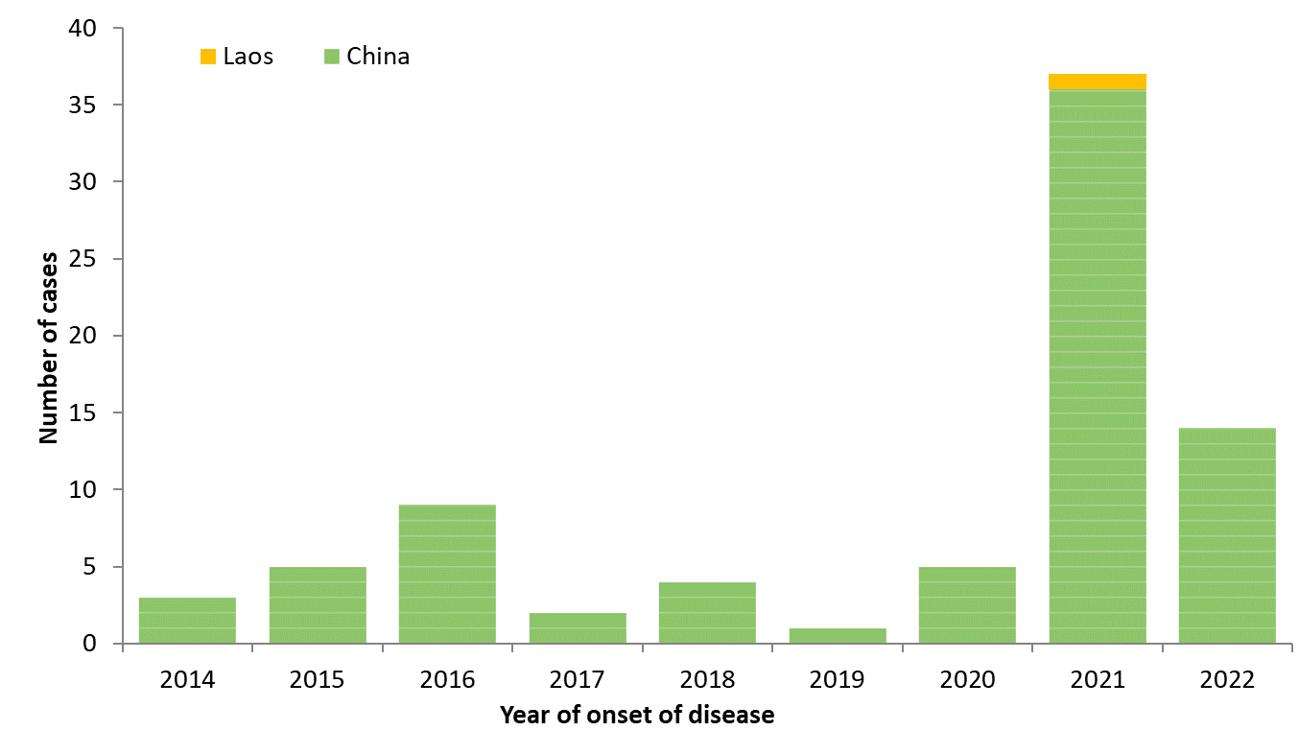
Distribution of confirmed human cases of avian influenza A(H5N6) virus infection by year of onset and country, 2014–2022 (n=80, updated 13 July 2022)

Slide 3
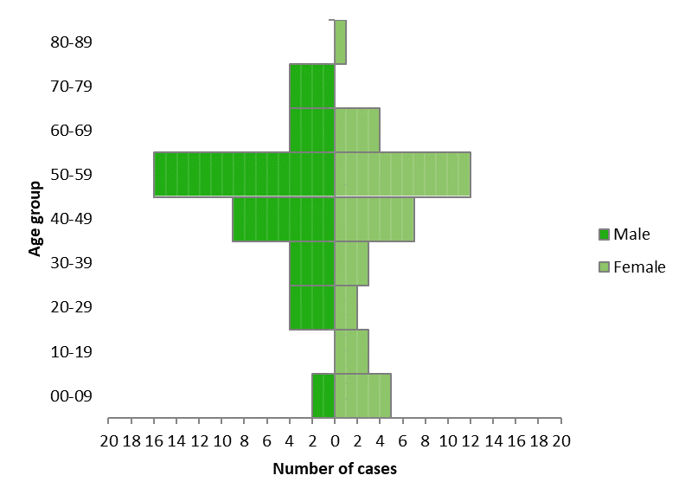
Age and sex distribution of confirmed human cases with influenza A(H5N6) virus infection, 2014–2022, China and Laos (n=80, updated 13 July 2022)
Notes:
Median age 38.5 years, average 36

Slide 4
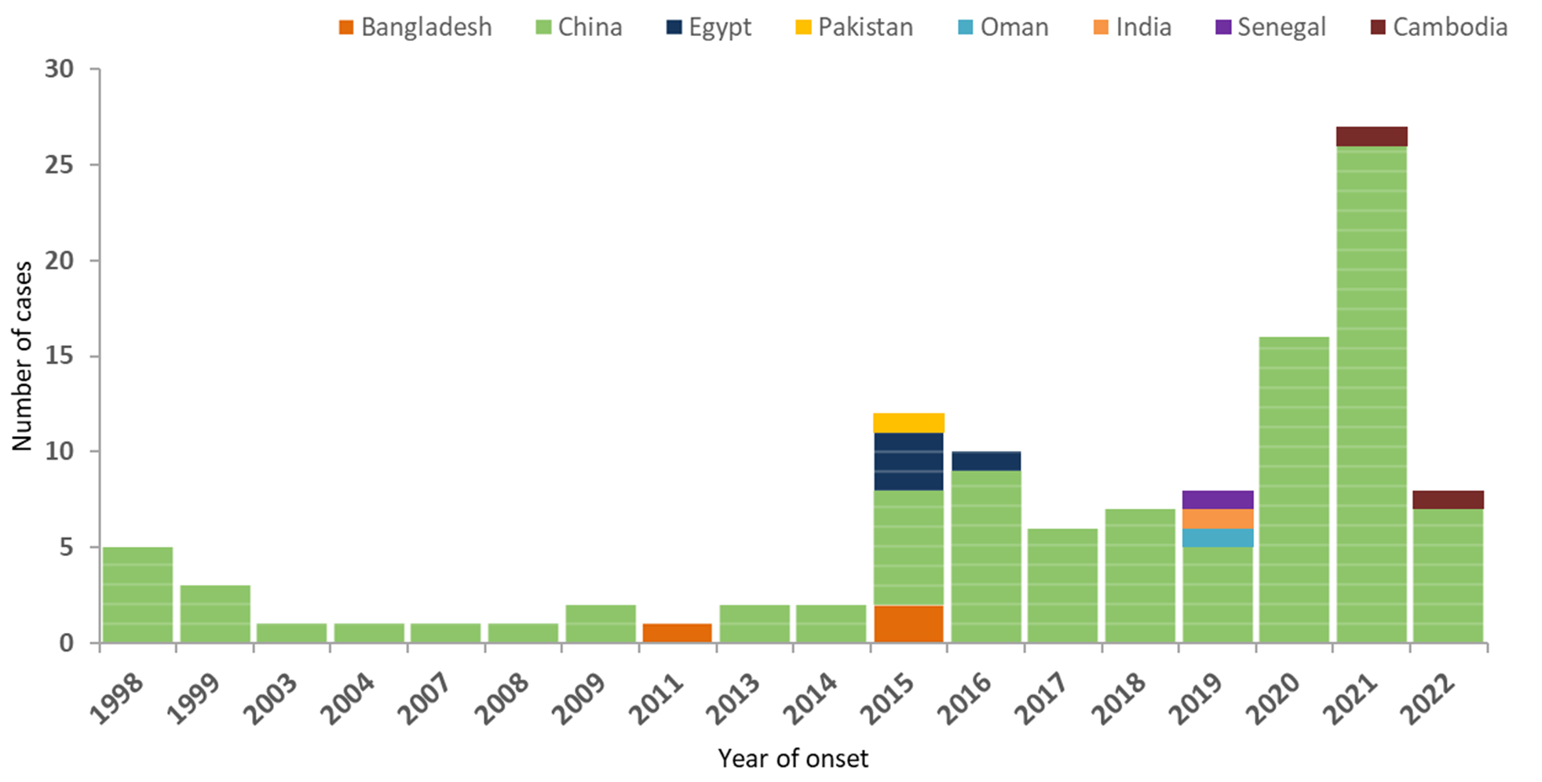
Distribution of confirmed human cases of avian influenza A(H9N2) virus infection by year of onset and country, 1998-2022 (updated on 13 July, n=113)

Slide 5
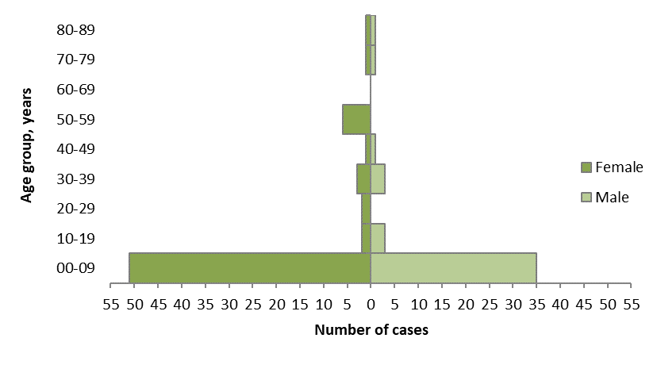
Age and sex distribution of confirmed human cases with influenza A(H9N2) virus infection, 1998–2022 (updated 13 July 2022, n = 113)
Notes:
Median age 38.5 years, average 36

