Slide 1
Reusable maps and graphs from ECDC Communicable Disease Threats Report Week 27, 2020
You are encouraged to reuse our maps and graphs for your own purposes and free to translate, provided the content is not altered and the source is acknowledged.

Slide 2
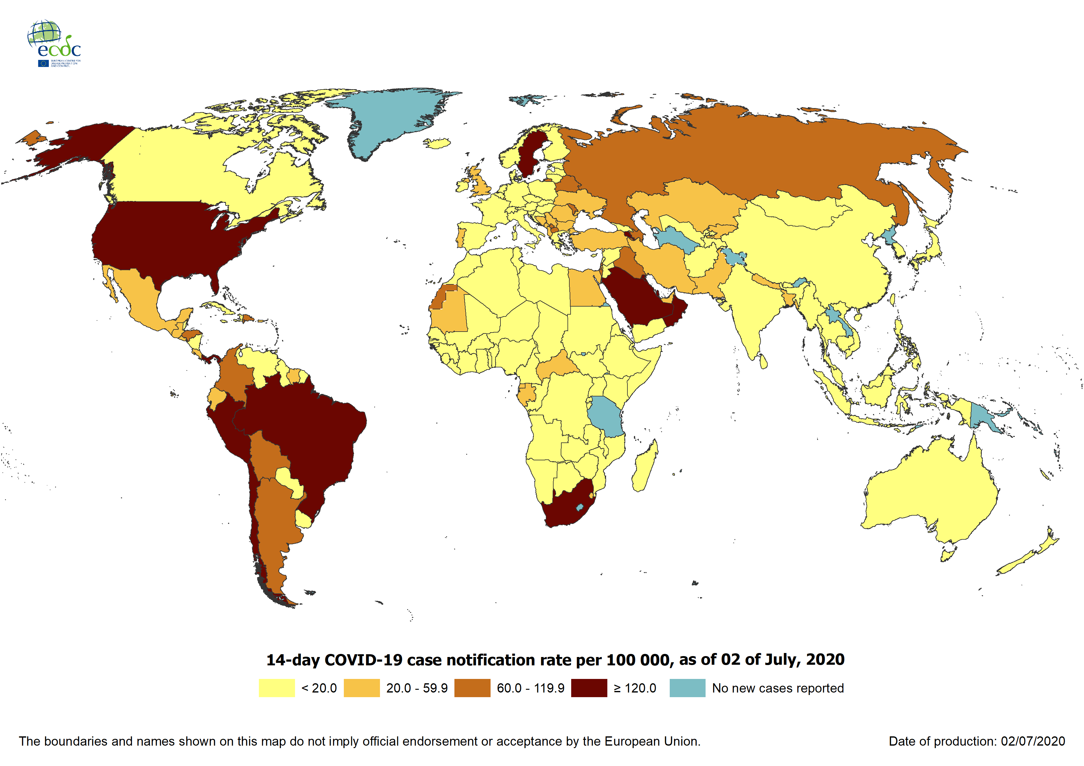
Geographic distribution of 14-day cumulative number of reported COVID-19 cases per 100 000 population, worldwide, as of 3 July 2020

Slide 3
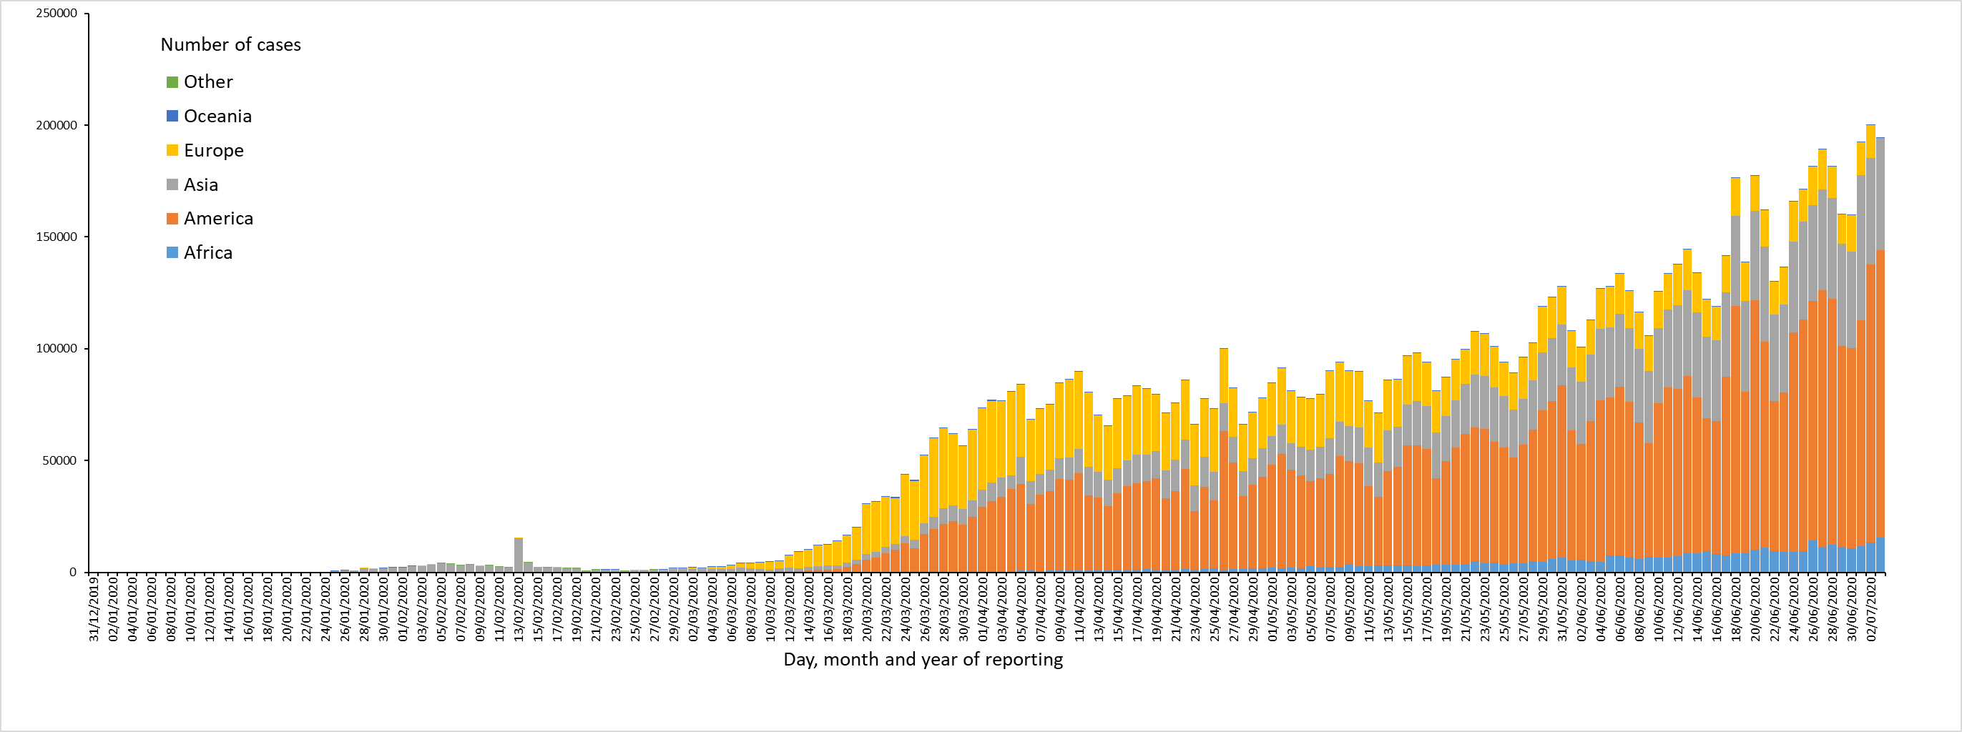
Distribution of COVID-19 cases* (in accordance with the applied case definition in the country) by country and region, as of 3 July 2020
*Spain: Since 11 May, the frequency of reporting from regional level to national level has changed. This may lead to possible discrepancies in cases and death numbers due to data validation. This discrepancy could persist for several days.

Slide 4
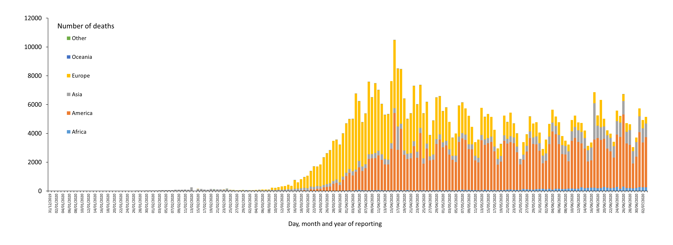
Distribution of COVID-19 deaths (in accordance with the applied case definition in the country) by country and region, as of 3 July 2020
*
* Increase of deaths in America is attributable to the US, which since 14 April 2020 includes confirmed and probable cases and deaths:
https://www.cdc.gov/coronavirus/2019-ncov/cases-updates/cases-in-us.html#2019coronavirus-summary
** Spain: Since 11 May, the frequency of reporting from regional level to national level has changed. This may lead to possible discrepancies in cases and death numbers due to data validation. This discrepancy could persist for several days.
In the displayed graph no new deaths are reported for Spain from the 25 of May as the change in reported deaths would result in a negative number of deaths for Europe overall.

Slide 5
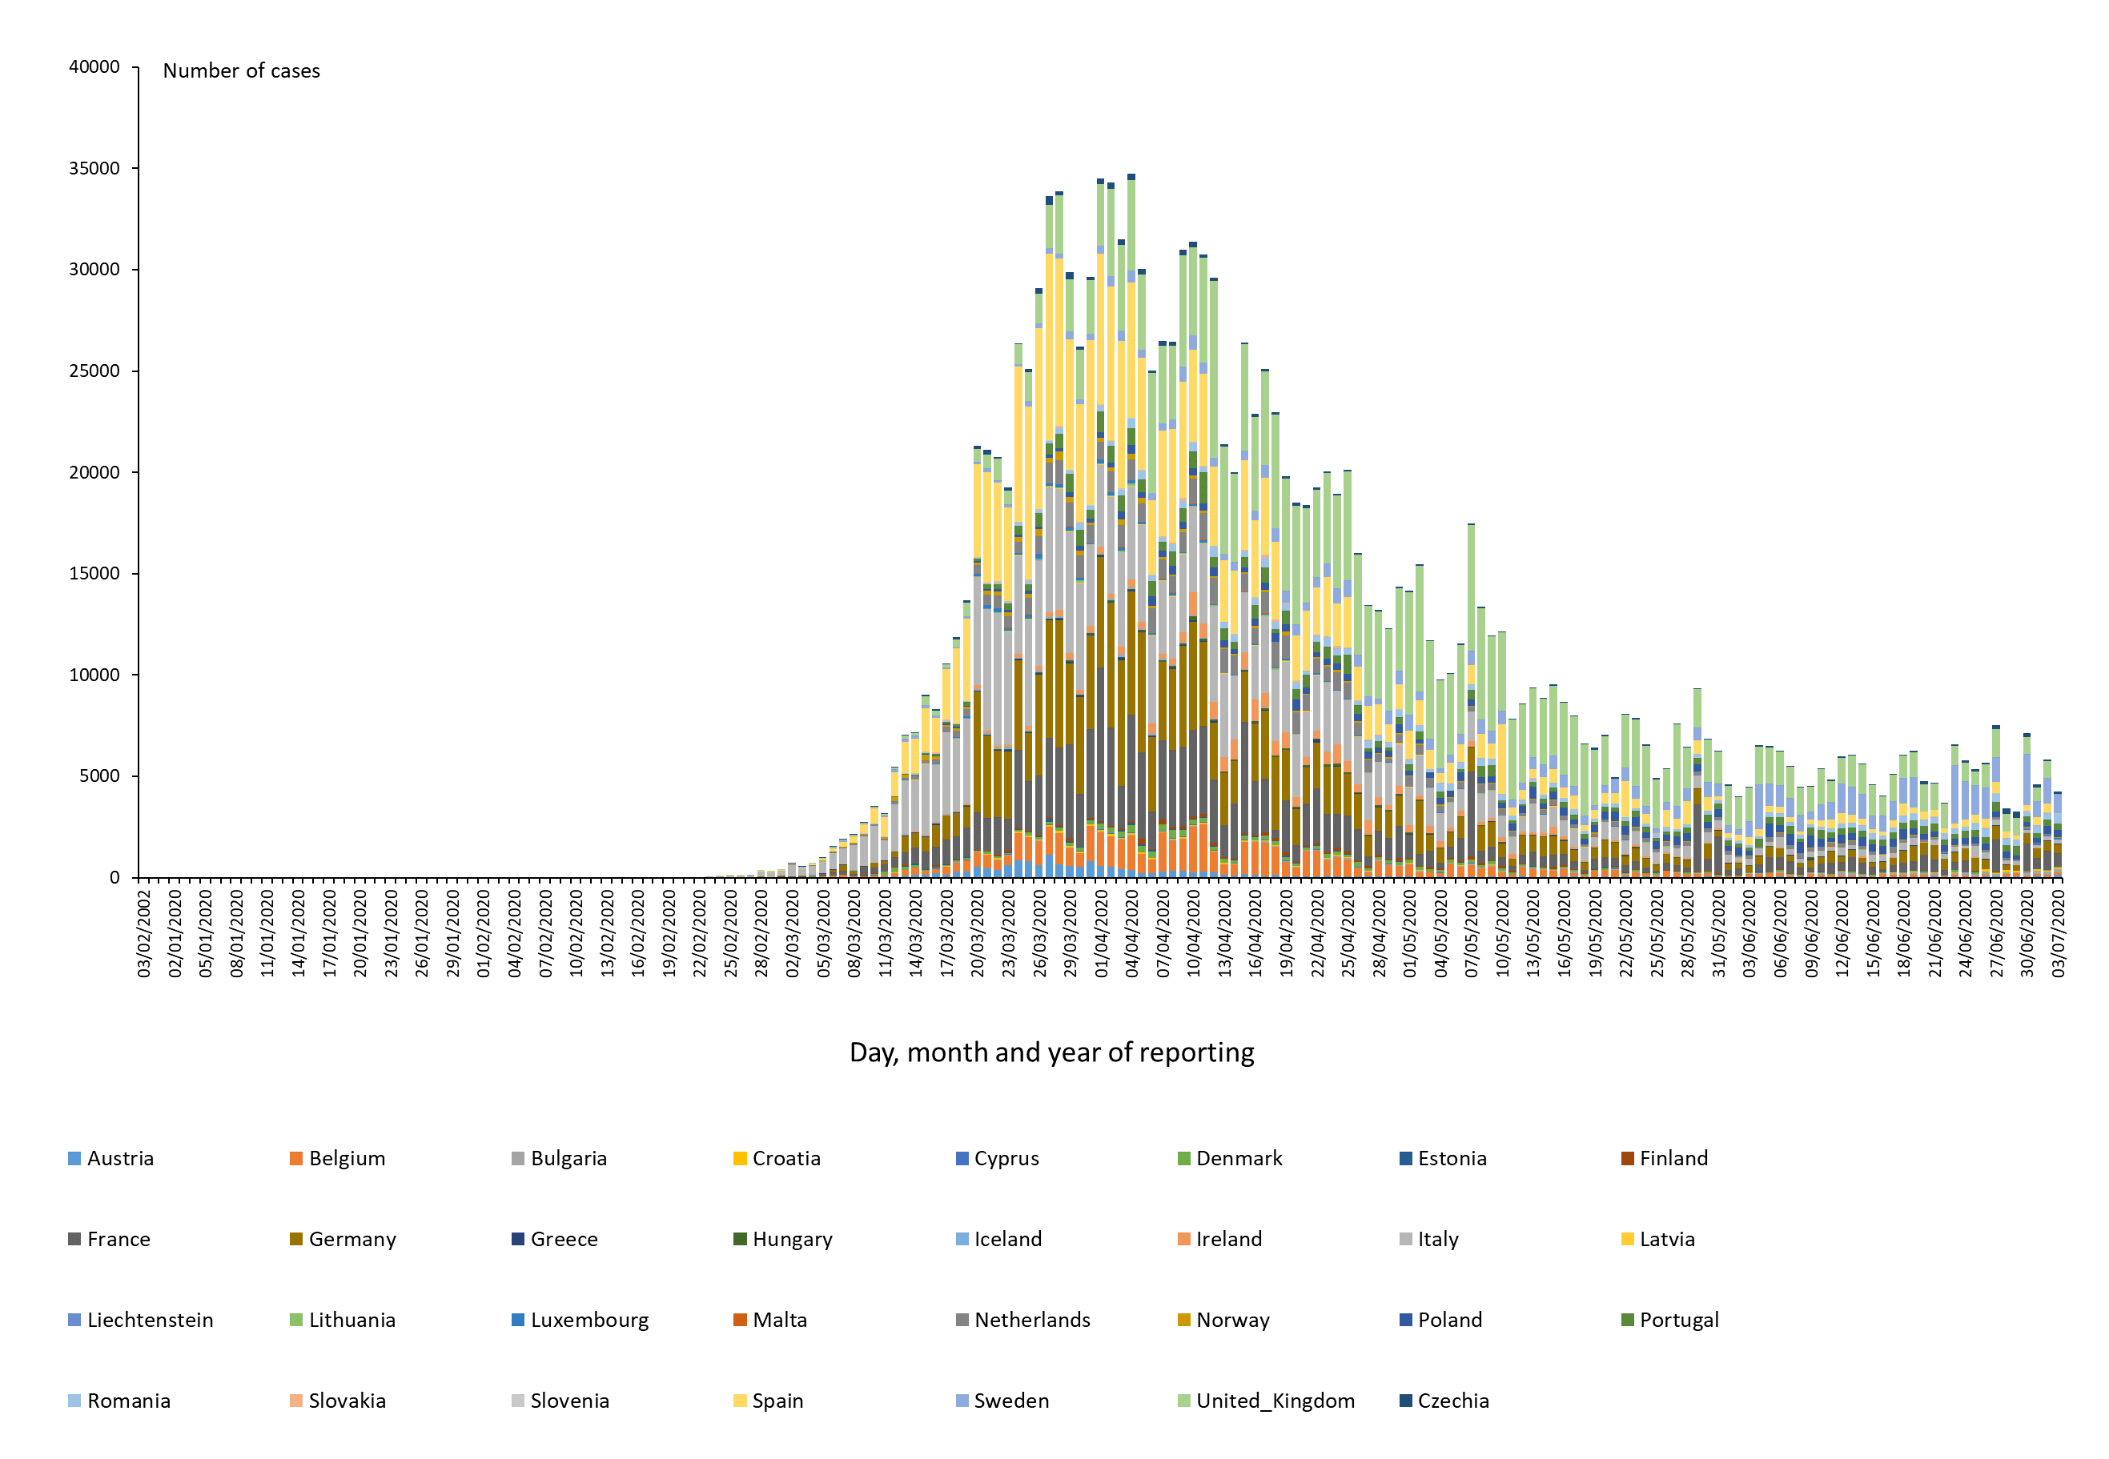
Distribution of COVID-19 cases* (according to the applied case definition in the country) in EU/EEA and the UK, as of 3 July 2020
*Spain: Since 11 May, the frequency of reporting from regional level to national level has changed. This may lead to possible discrepancies in cases and death numbers due to data validation. This discrepancy could persist for several days.

Slide 6
11th outbreak: Ebola Virus Disease cases distribution in Equateur Province, Democratic Republic of the Congo, as of 30 June 2020

Slide 7
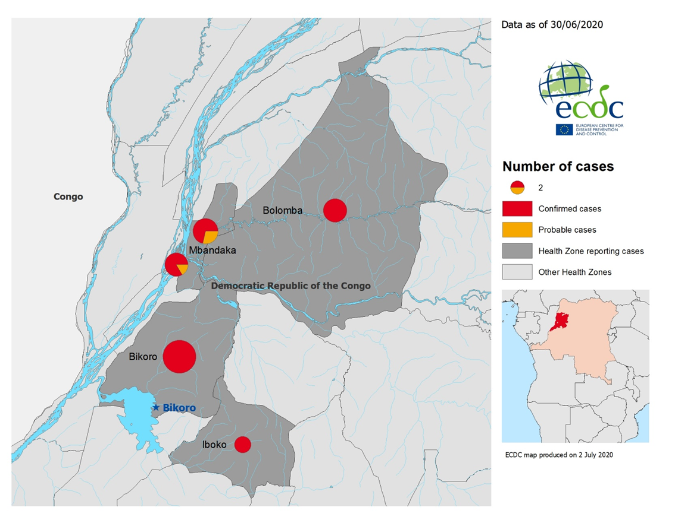
11th outbreak: Geographical distribution of confirmed and probable cases of Ebola virus disease, Equateur Province, Democratic Republic of the Congo,
as of 30 June 2020

Slide 8
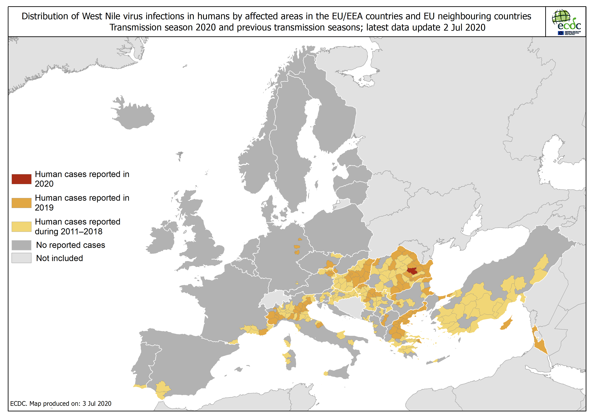
Distribution of West Nile virus infections in humans by affected areas in the EU/EEA countries and EU neighbouring countries, as of 2 July 2020

Slide 9
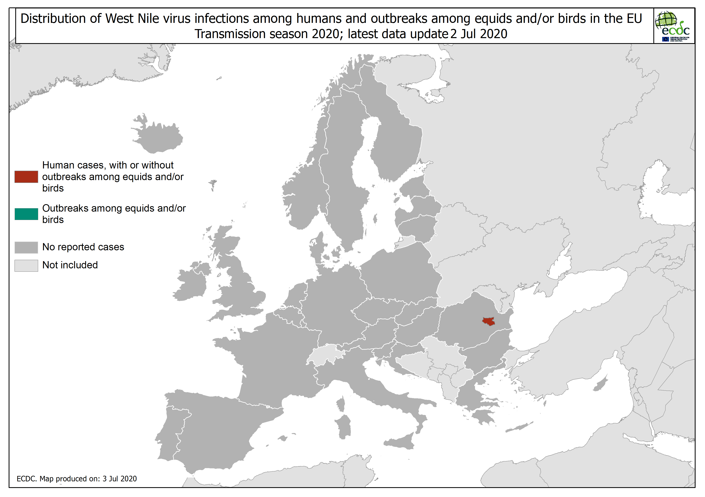
Distribution of West Nile virus infections among humans and outbreaks among equids and/or birds in the EU, as of 2 July 2020

Slide 10
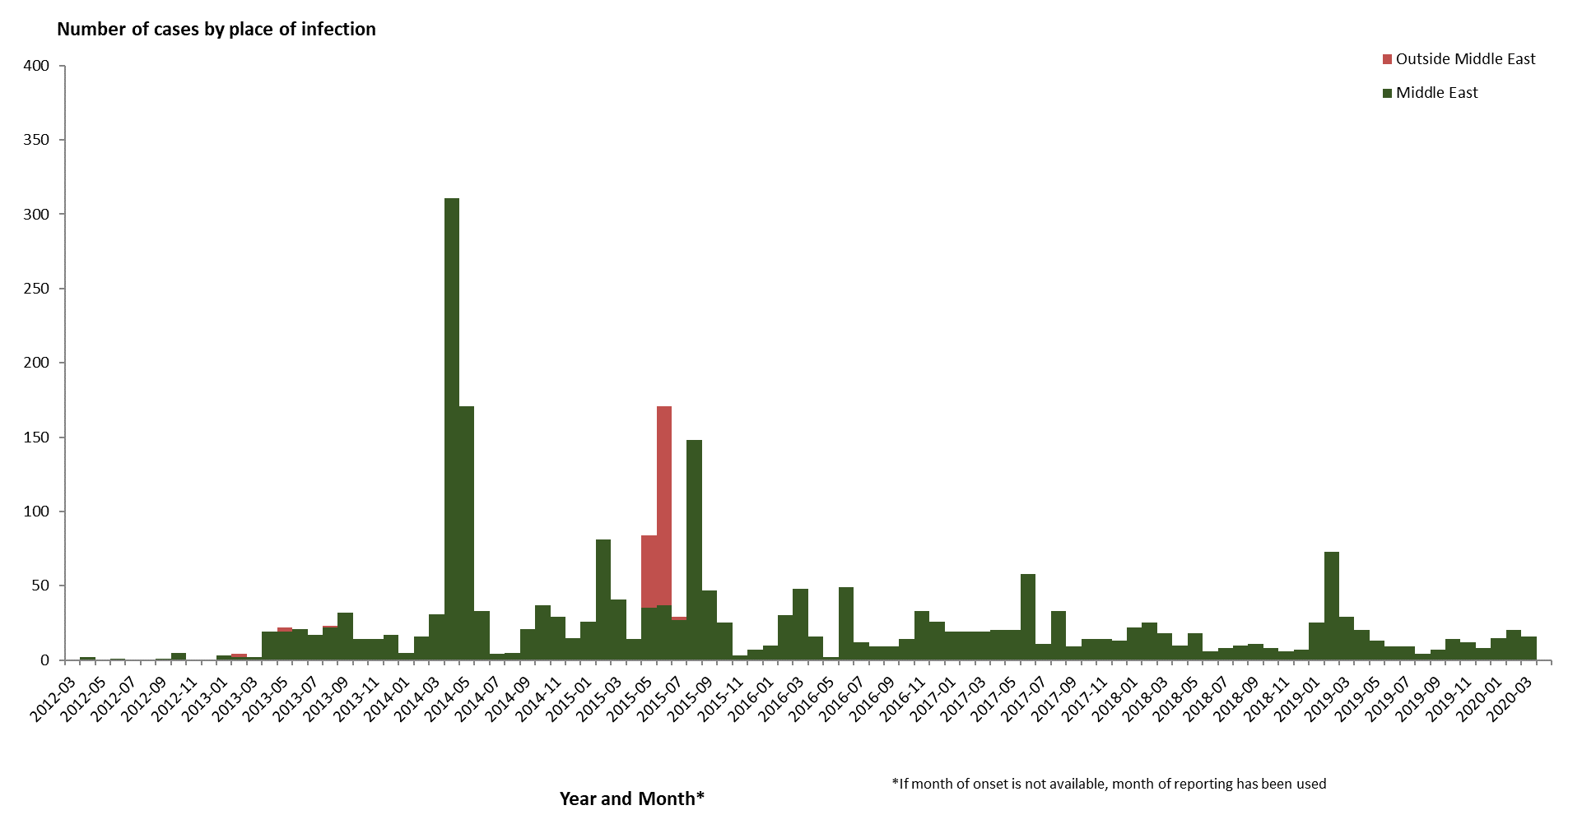
Distribution of confirmed cases of MERS-CoV by place of infection and month of onset, March 2012 – 9 April 2020

Slide 11
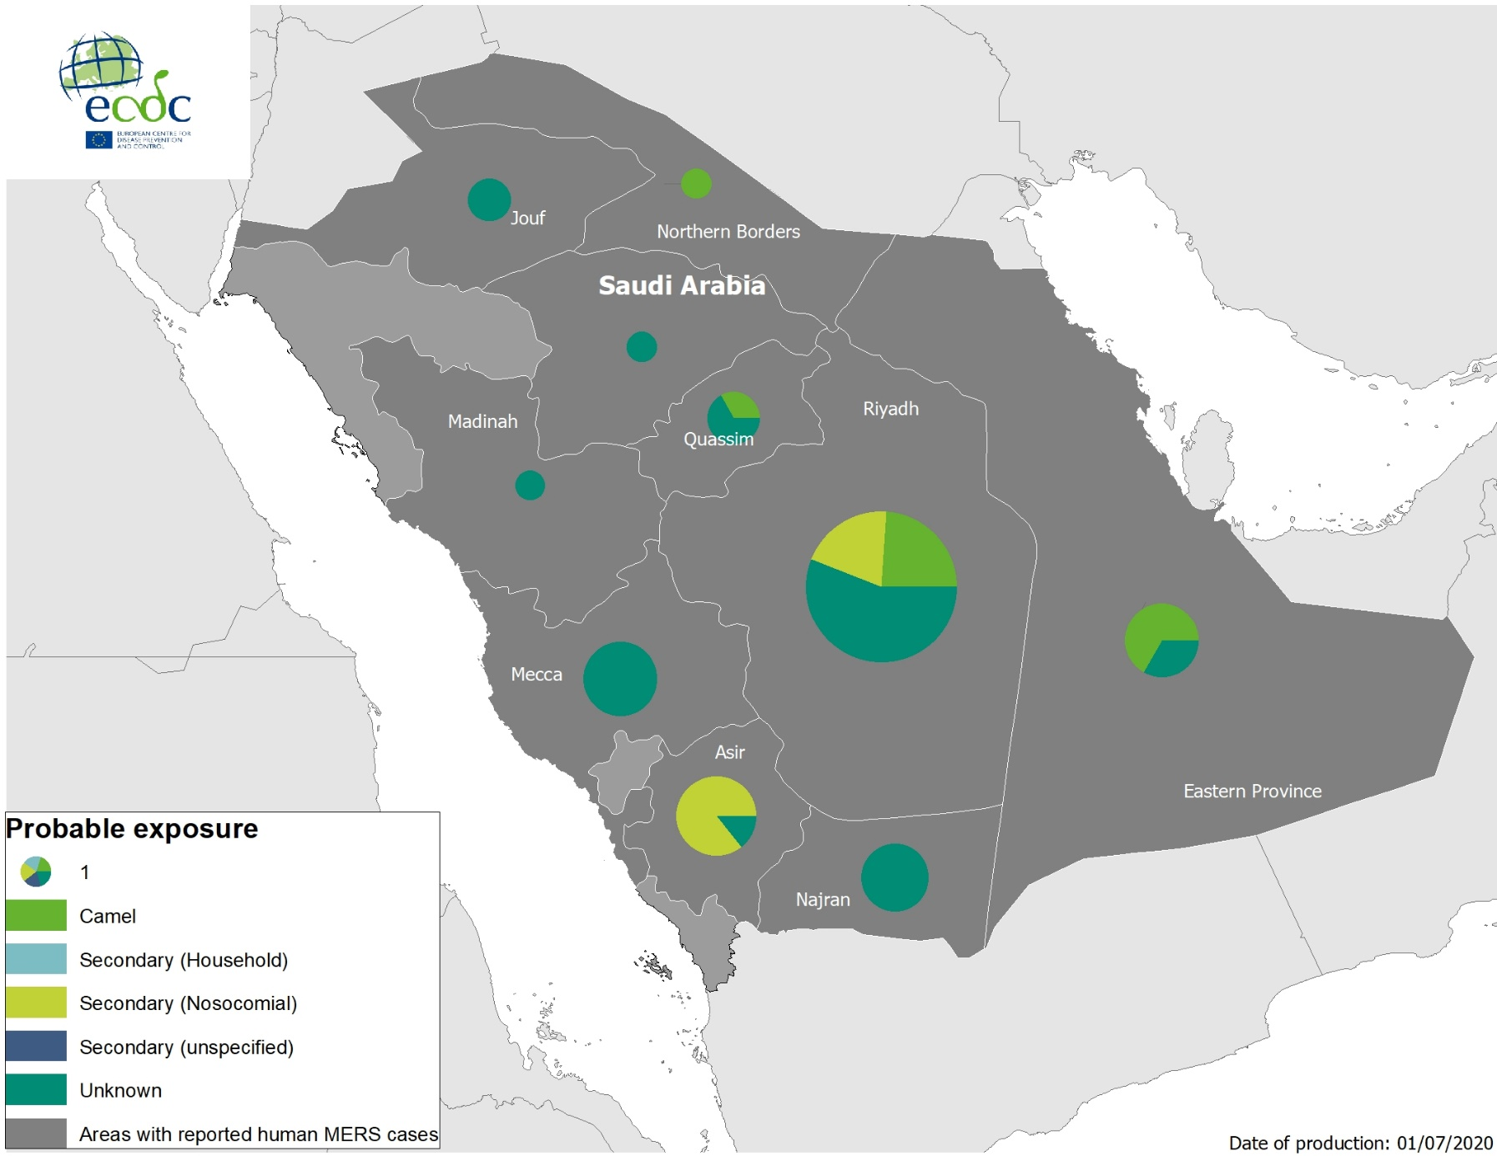
Geographical distribution of confirmed MERS-CoV cases by probable region of infection and exposure, from 1 January 2019 to 9 April 2020

Slide 12
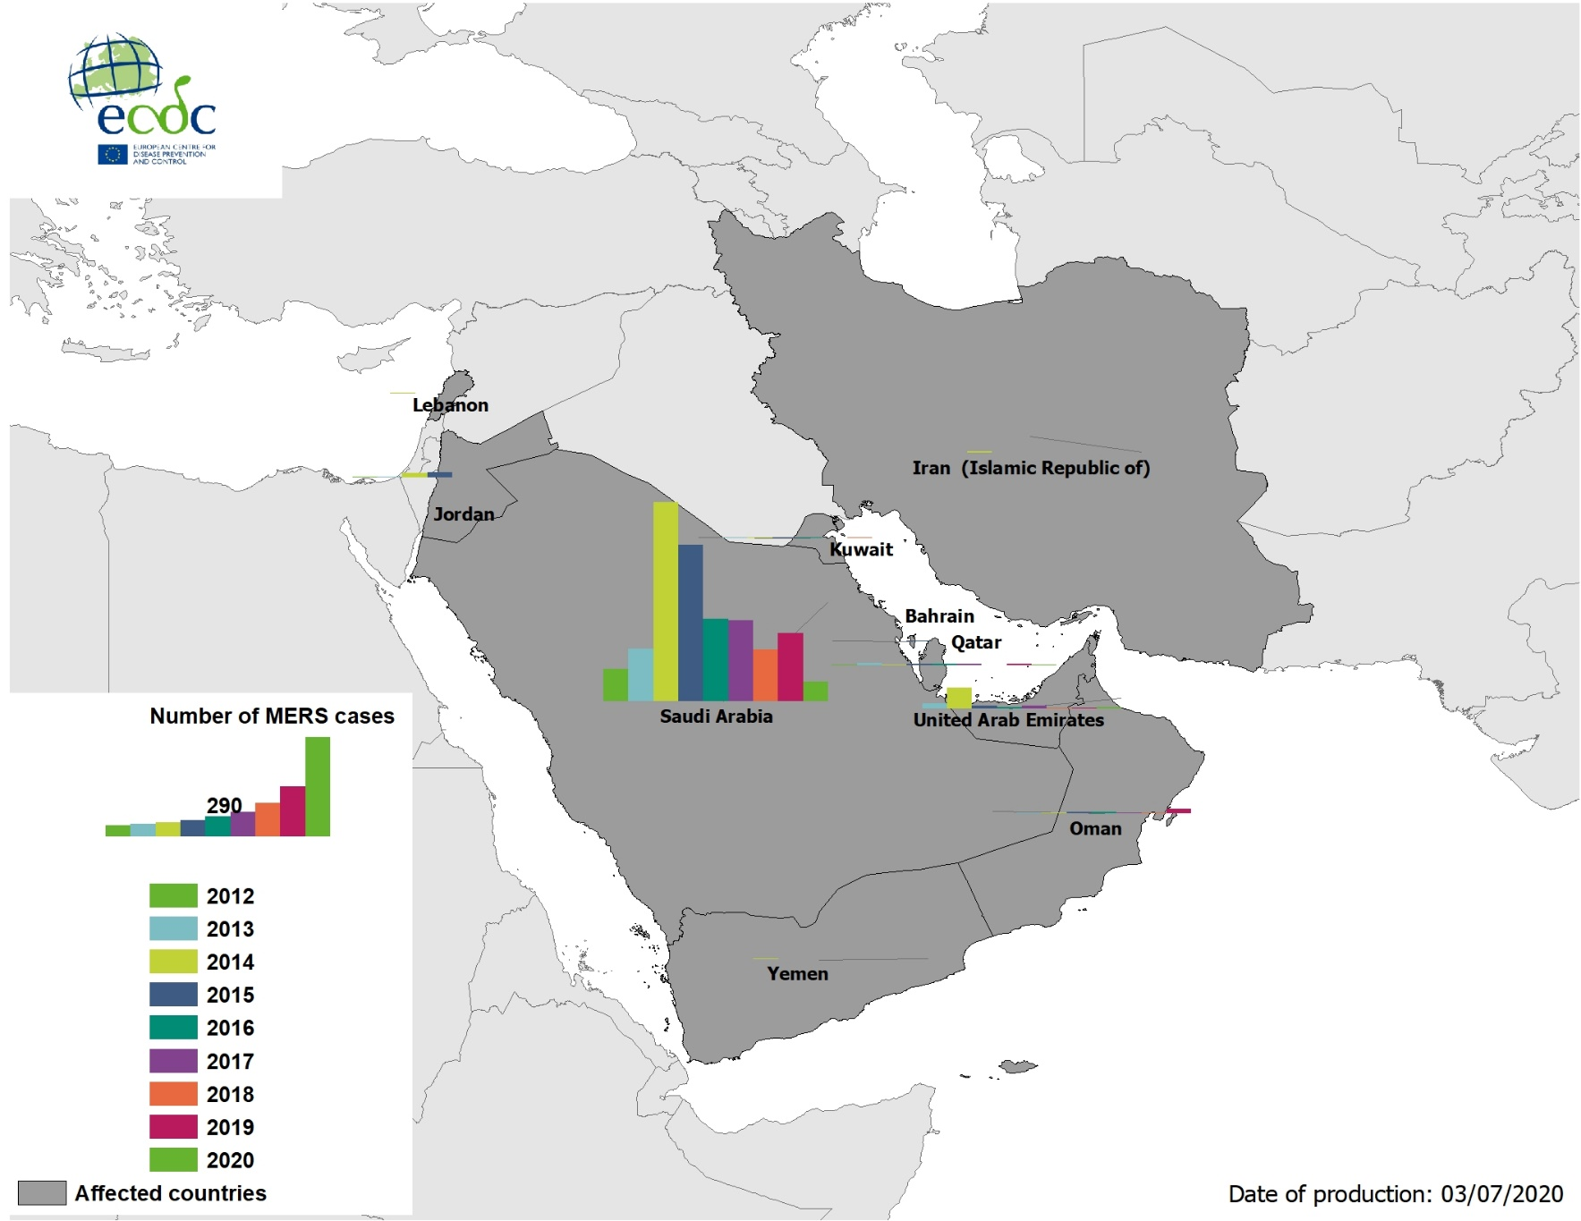
Geographical distribution of confirmed MERS-CoV cases by country of infection and year, from April 2012 to 9 April 2020

Slide 13
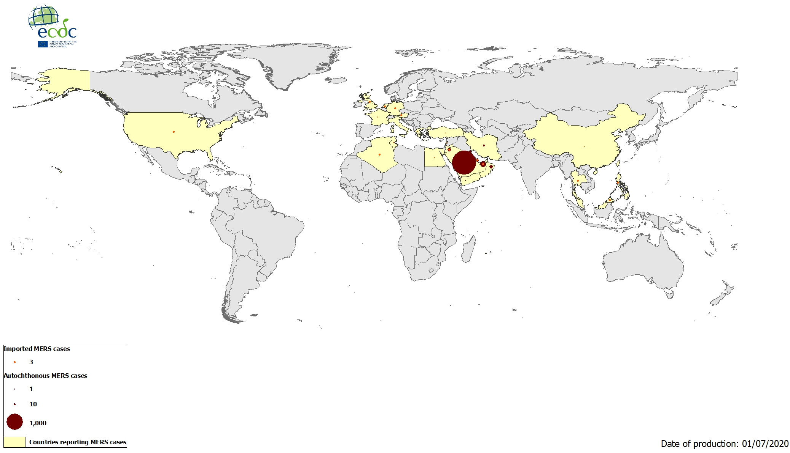
Geographical distribution of confirmed MERS-CoV cases by reporting country from April 2012 to 9 April 2020

