Slide 1
Reusable maps and graphs from ECDC Communicable Disease Threats Report
Week 26 2022
You are encouraged to reuse our maps and graphs for your own purposes and are free to translate them, provided the content is not altered and the source is acknowledged.

Slide 2
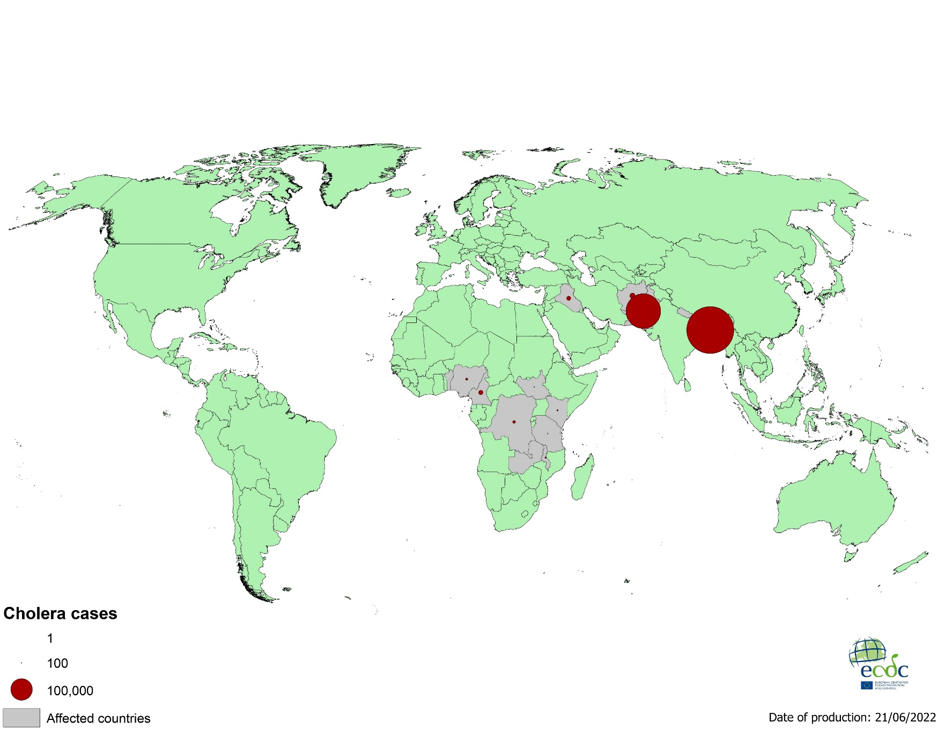
Geographical distribution of cholera cases reported worldwide from April to June 2022

Slide 3
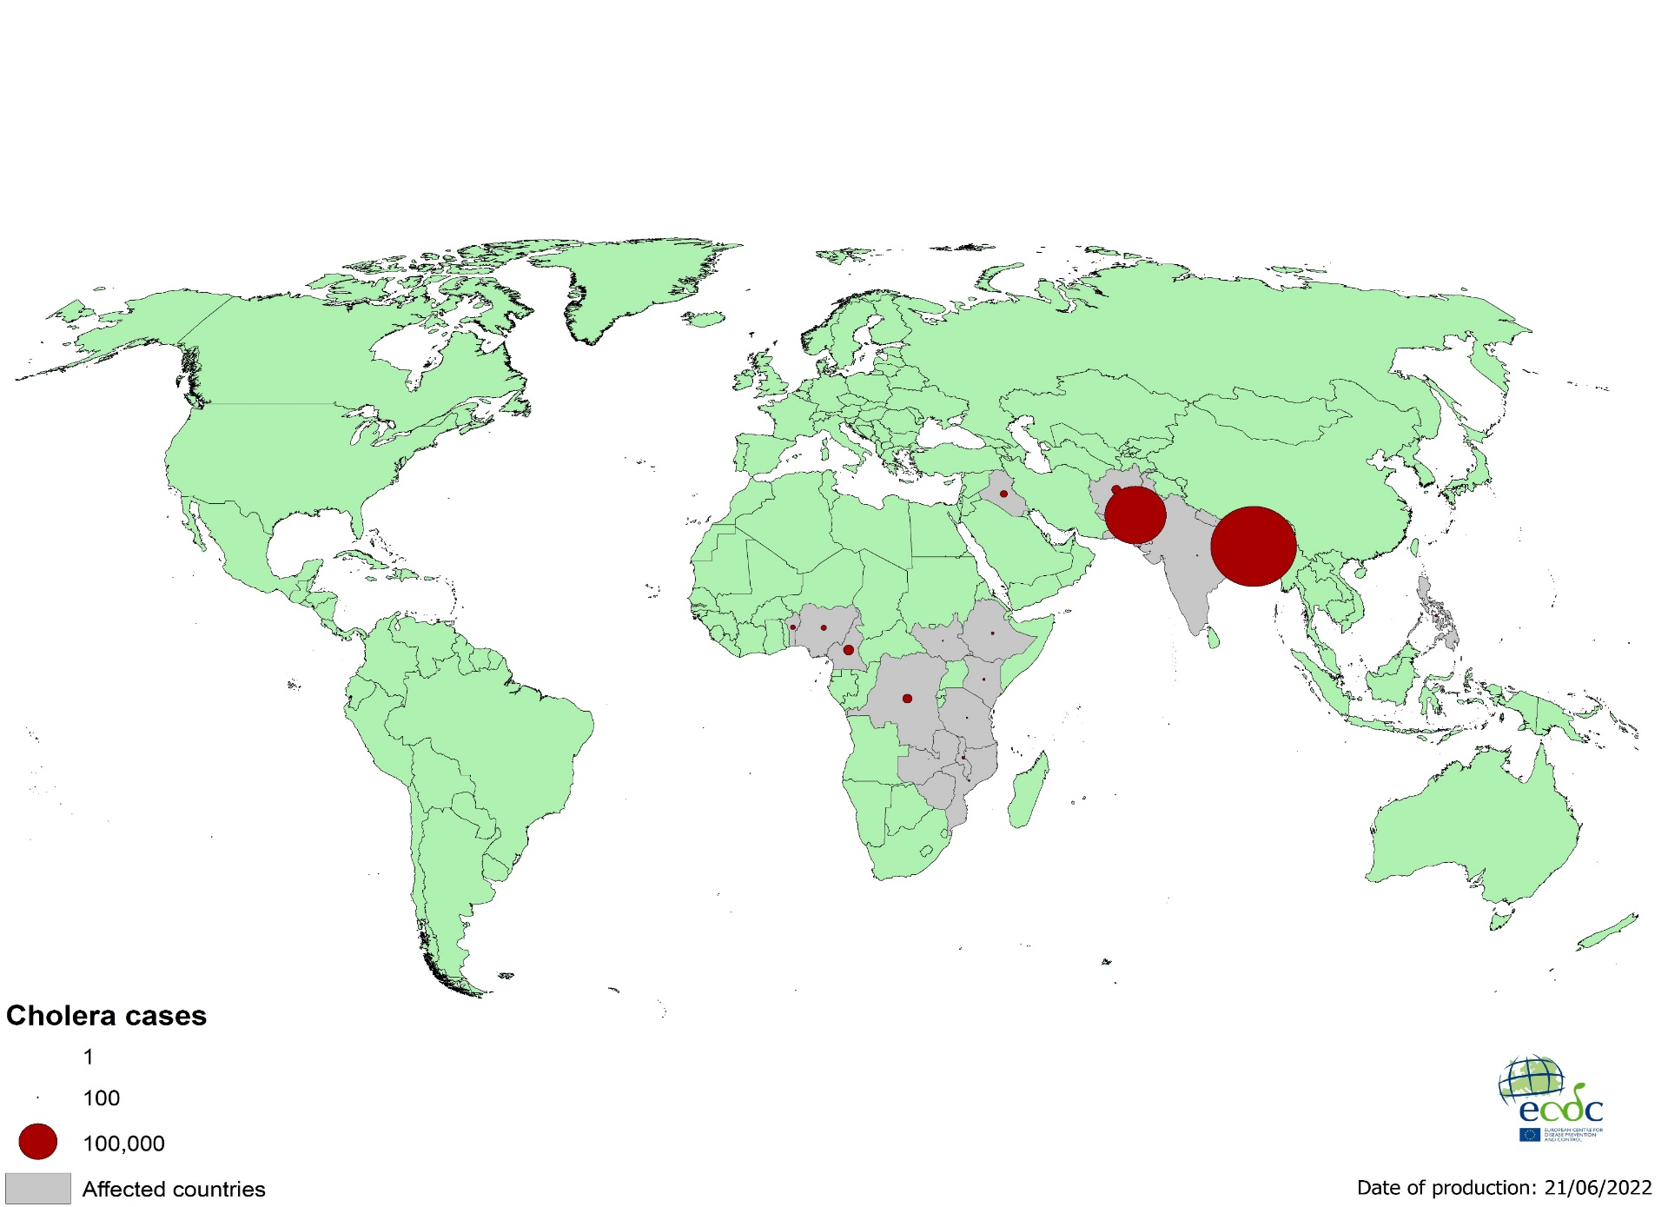
Geographical distribution of cholera cases reported worldwide as of June 2022

Slide 4
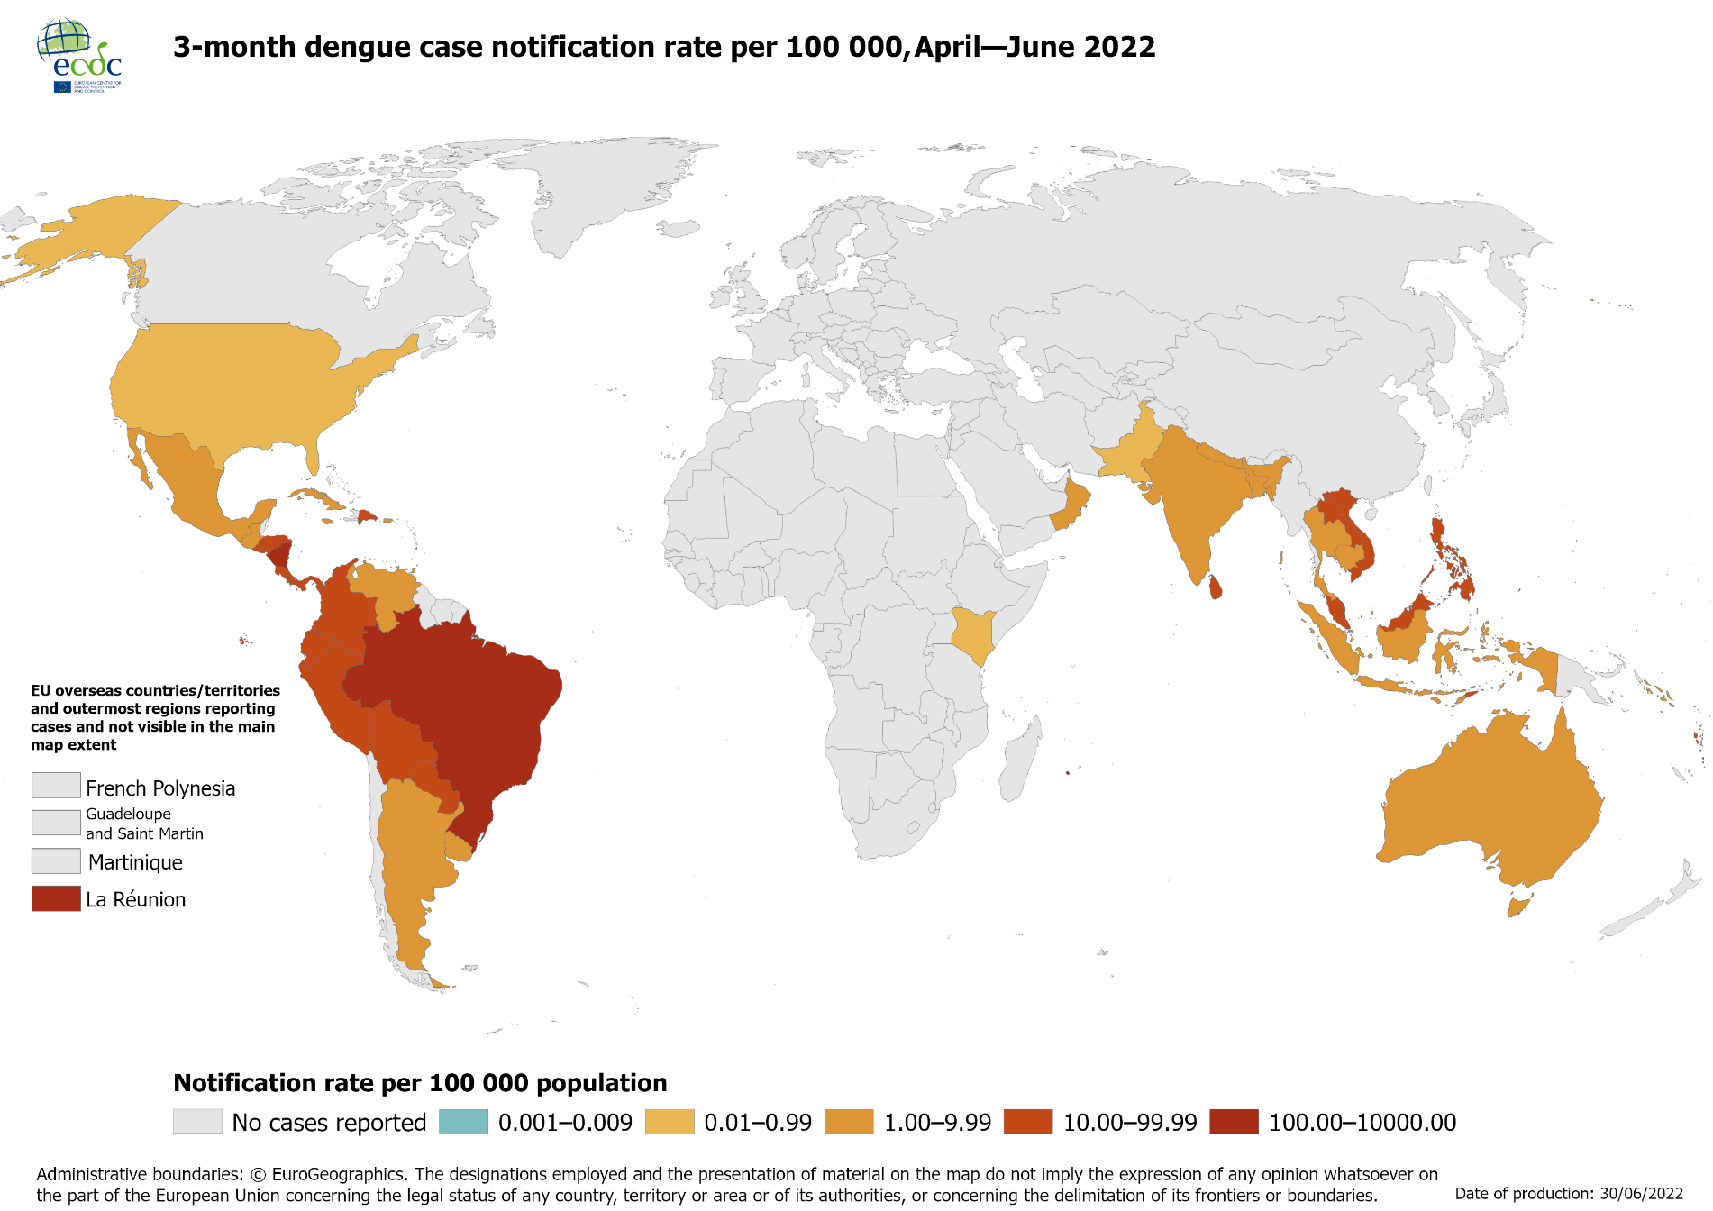
Notification rate of dengue cases reported worldwide, April to June 2022

Slide 5
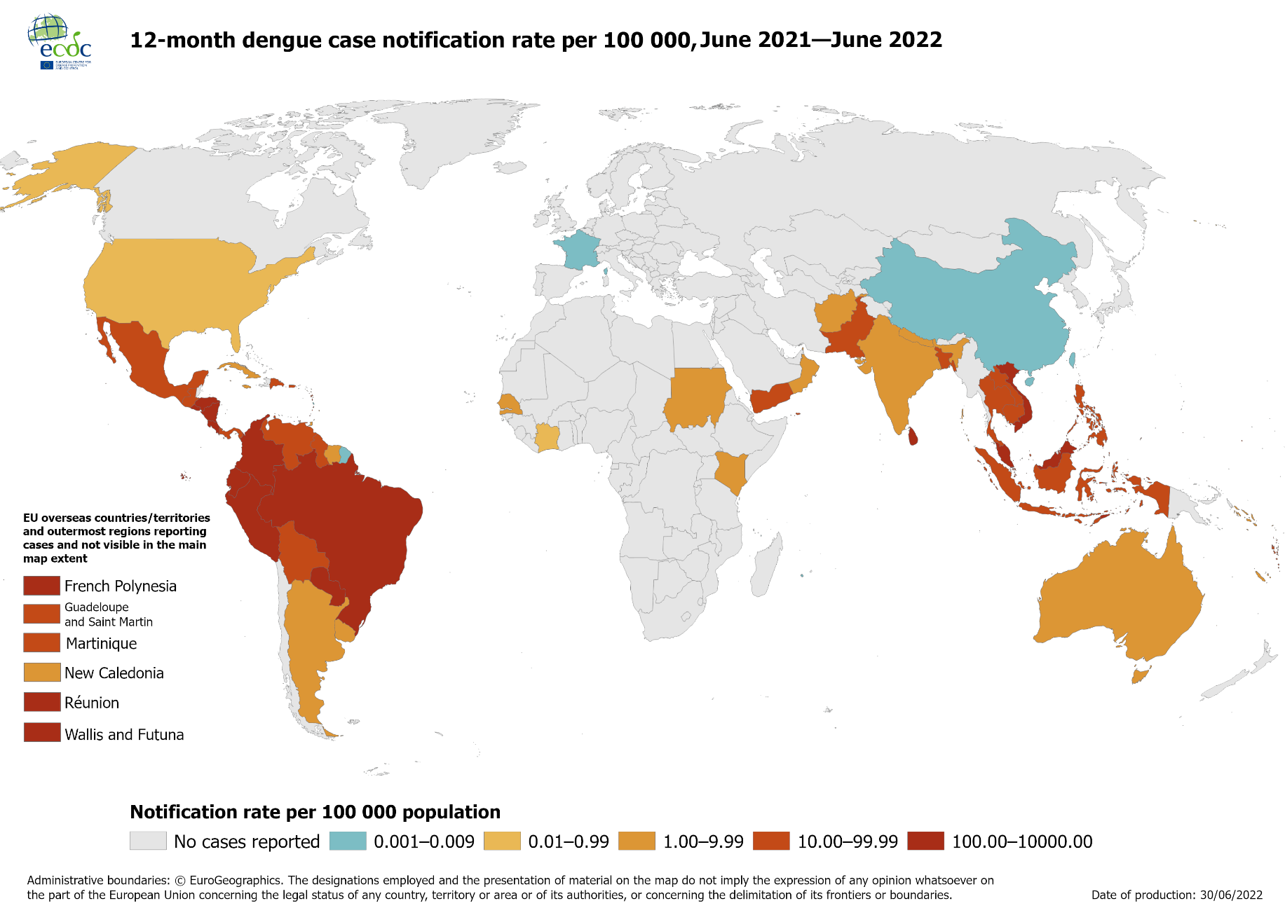
Notification rate of dengue cases reported worldwide, June 2021 to June 2022

Slide 6
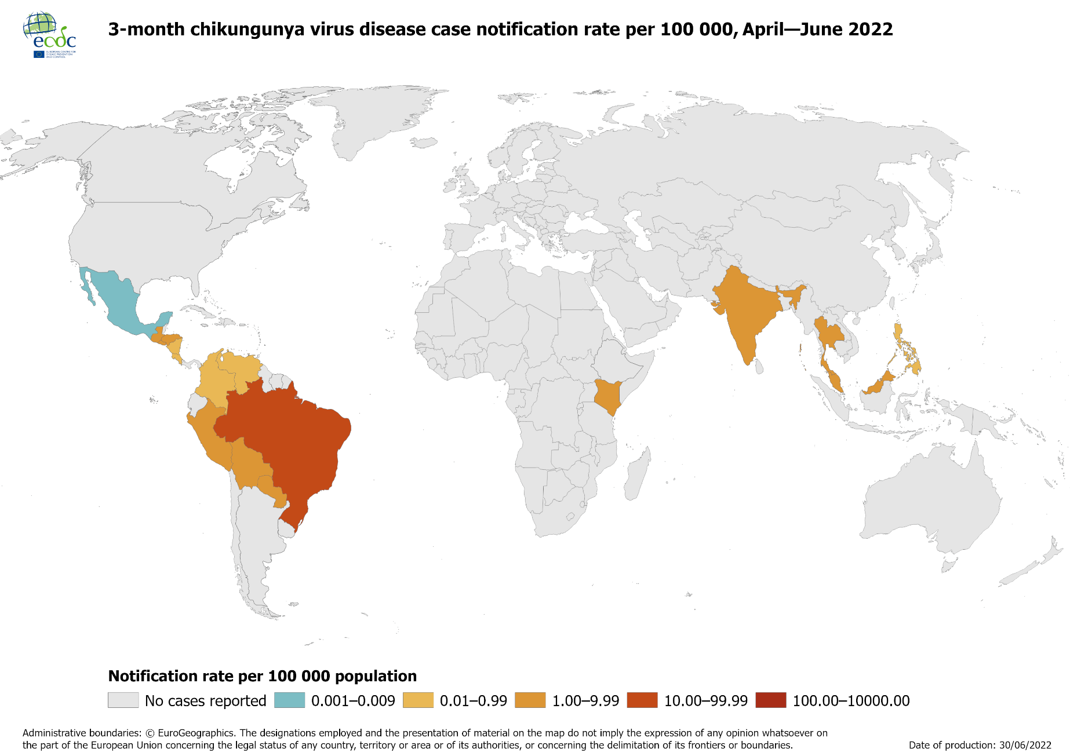
Notification rate of chikungunya cases reported worldwide, April to June 2022

Slide 7
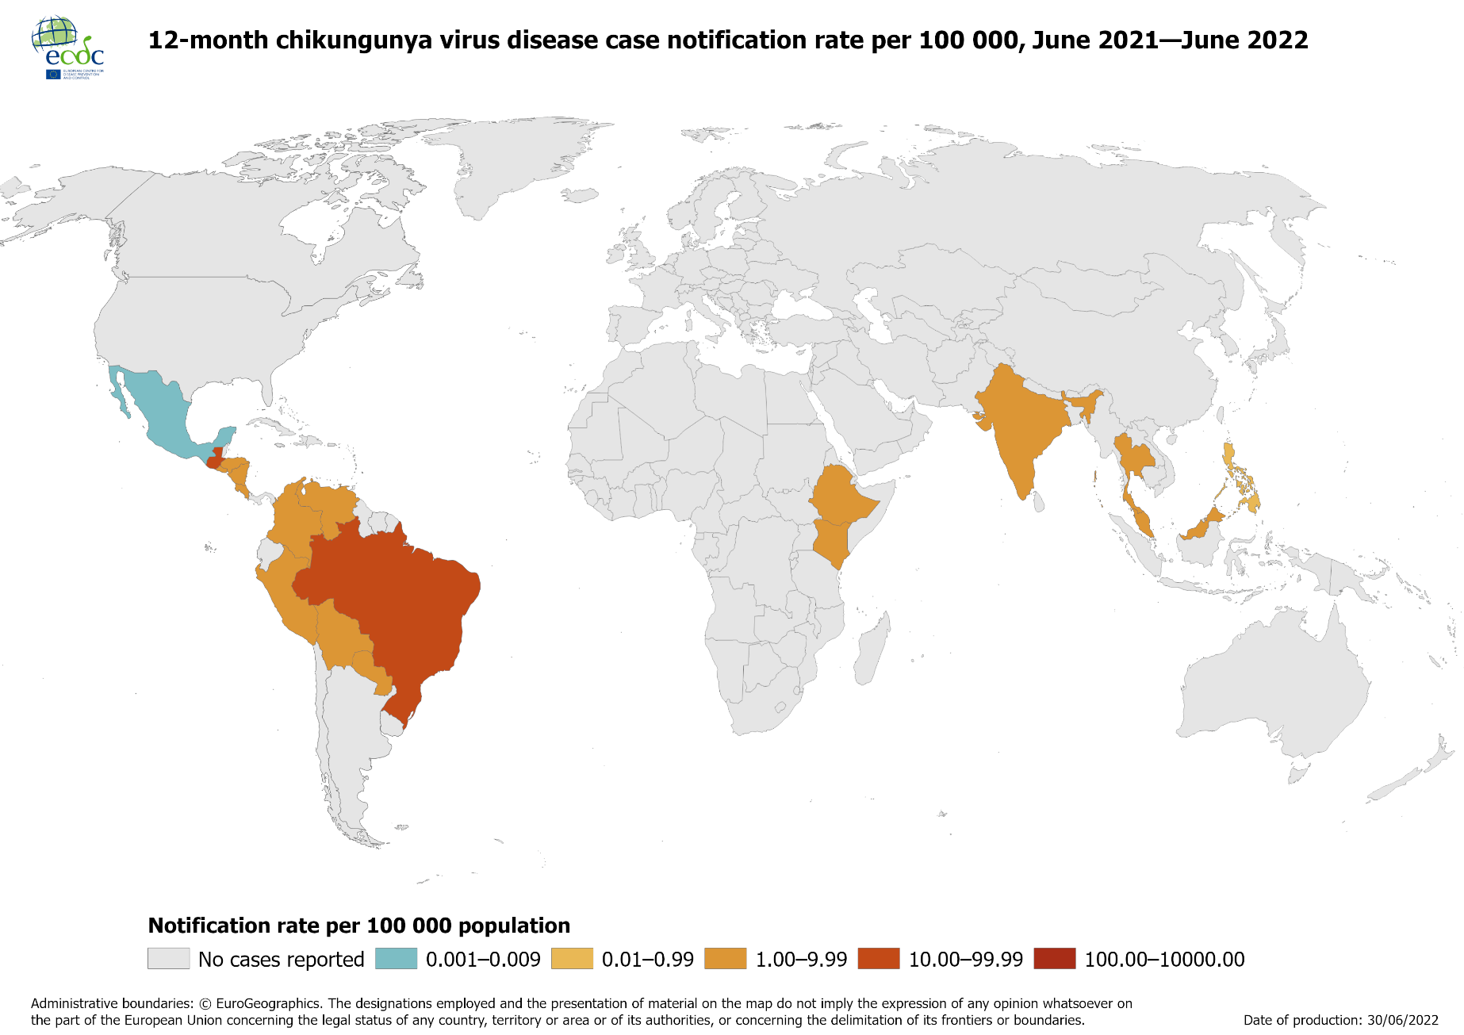
Notification rate of chikungunya cases reported worldwide, June 2021 to June 2022

