Slide 1
You are encouraged to reuse our maps and graphs for your own purposes and free to translate, provided the content is not altered and the source is acknowledged. Either copy the images from the following slides or download directly from: ecdc.europa.eu/en/publications/surveillance_reports/Communicable-Disease-Threats-Report/Pages/cdtr.aspx
European Centre for Disease Prevention and Control
Reusable maps and graphs from ECDC Communicable Disease Threats Report, week 26, 2018

Slide 2
Distribution of autochthonous dengue cases by week of onset, week 1-2017 to week 24-2018, Réunion
Source: Adapted from the MoH bulletin "Surveillance de la dengue à la Réunion. Point épidémiologique au 26 juin 2018”

Slide 3
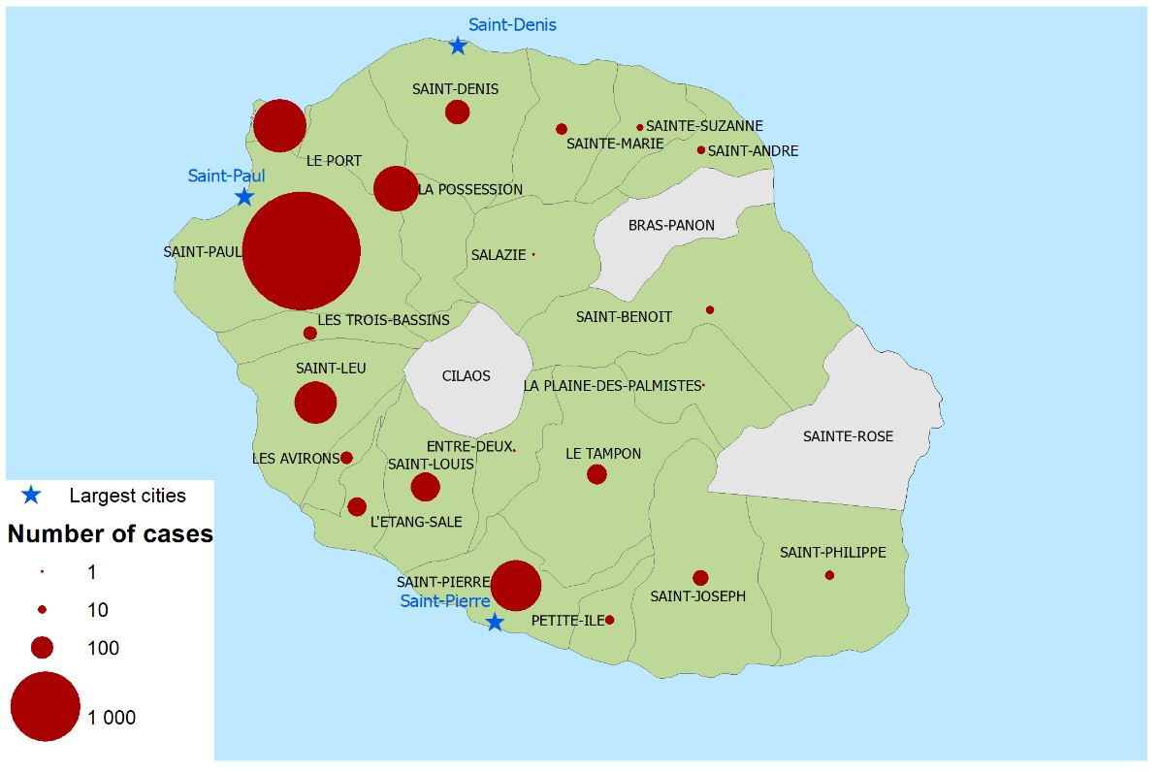
Geographical distribution of autochthonous dengue cases, Réunion, data as of 17 June 2018
Source: Adapted from the MoH bulletin "Surveillance de la dengue à la Réunion. Point épidémiologique au 26 juin 2018”

Slide 4
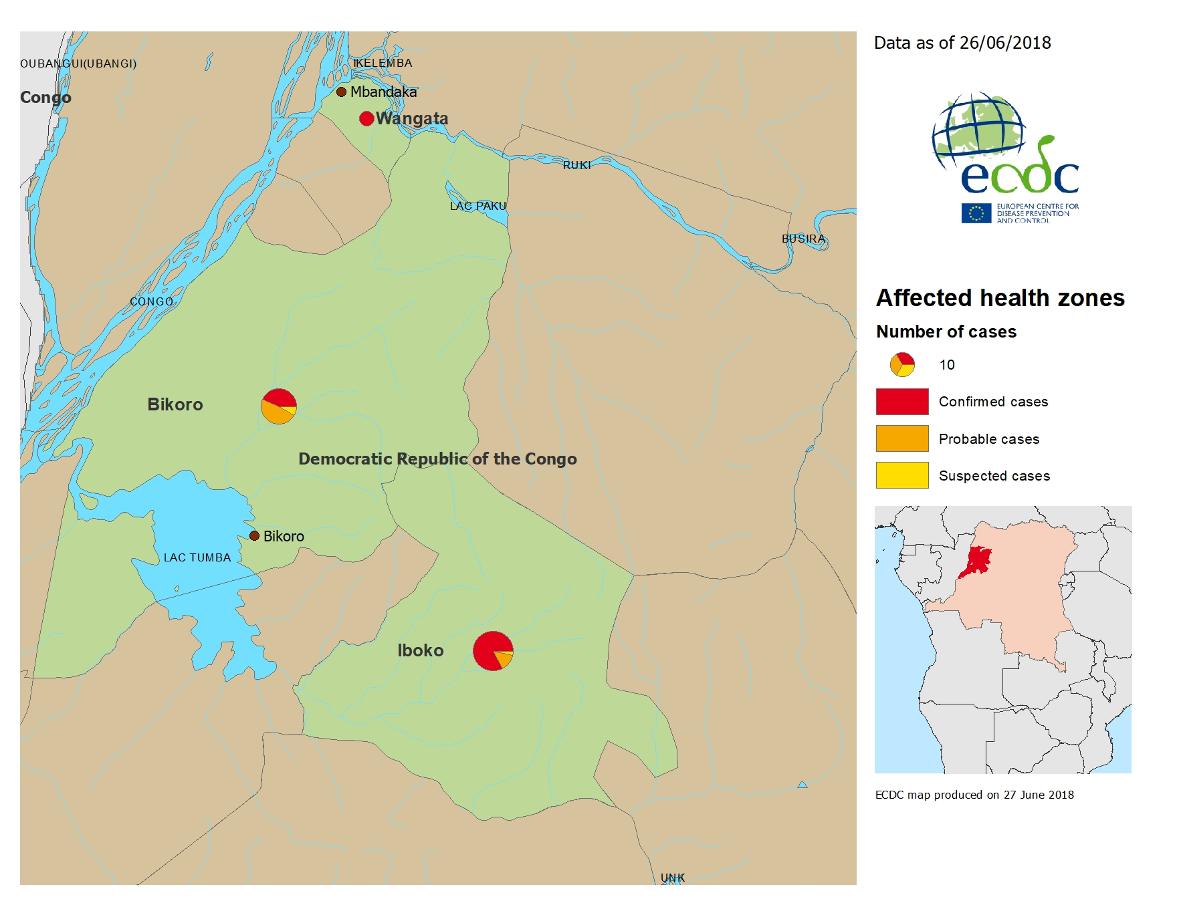
Geographical distribution of confirmed, probable and suspected cases of Ebola virus disease, Equateur Province, The Republic Democratic of Congo, as of 27 June 2018

Slide 5
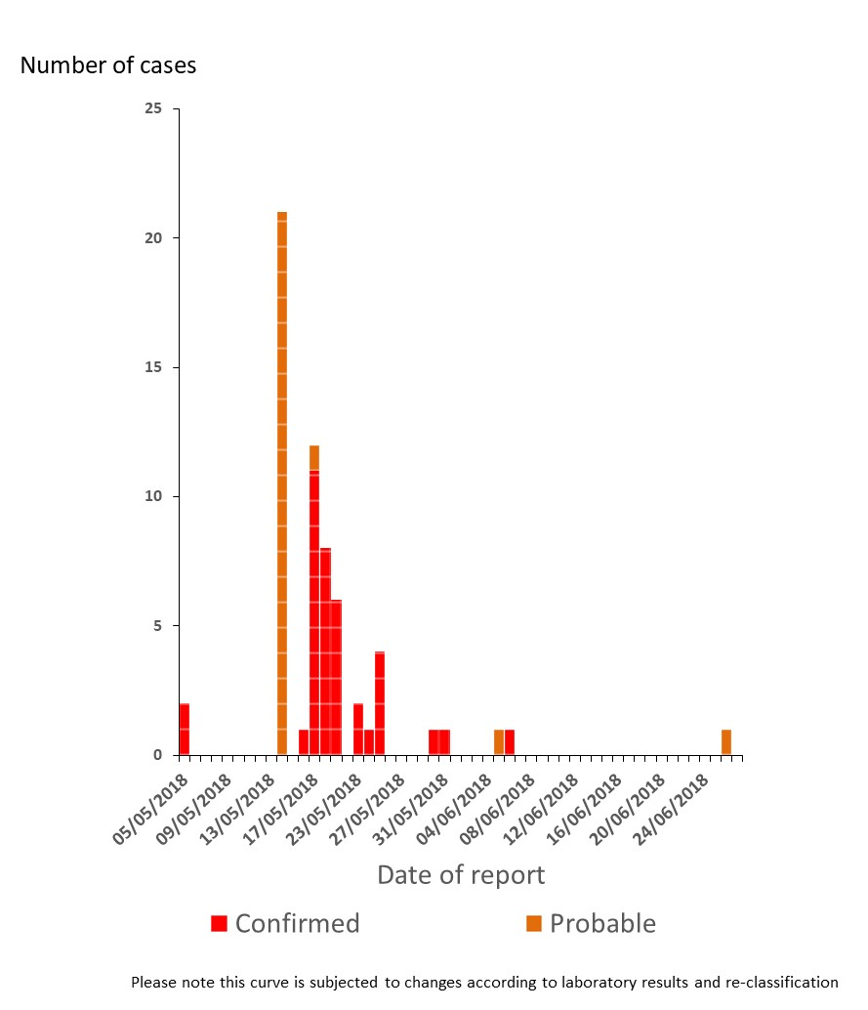
Distribution of confirmed and probable cases of Ebola virus disease, Equateur Province, The Republic Democratic of Congo, as of 27 June 2018

Slide 6
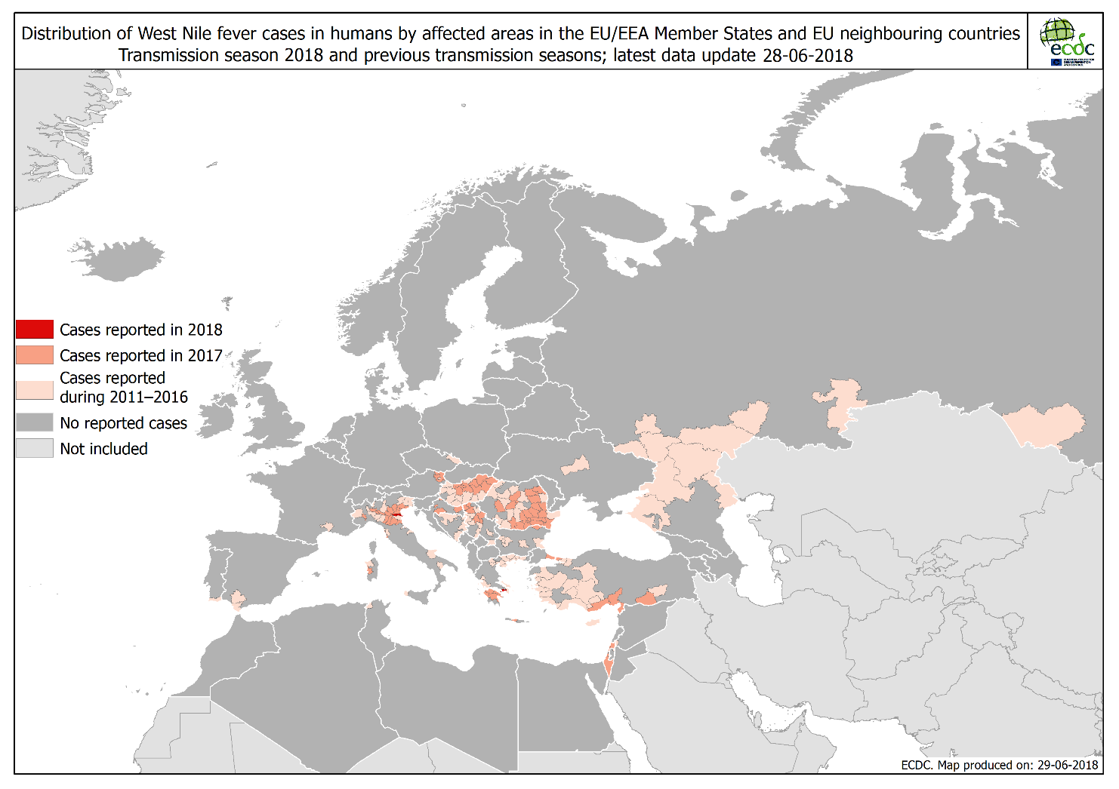

Slide 7
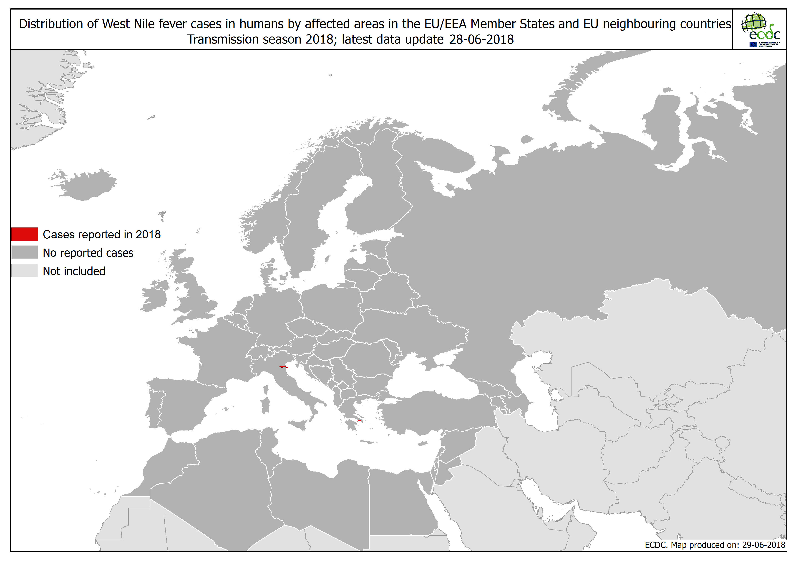

Slide 8
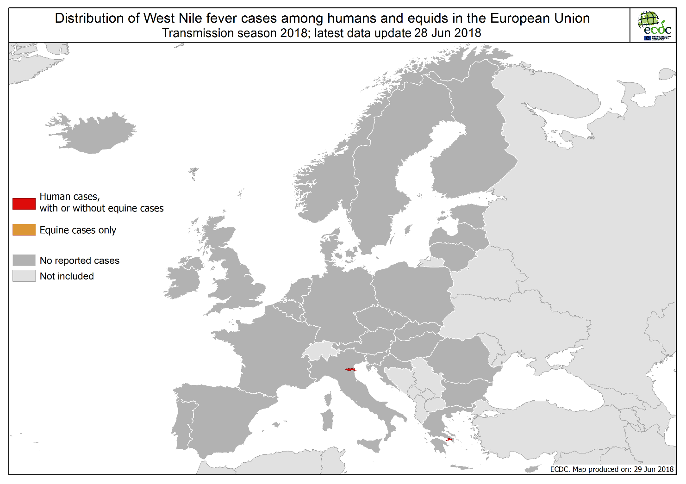

Slide 9
