Slide 1
Reusable maps and graphs from ECDC Communicable Disease Threats Report Week 25, 2019
You are encouraged to reuse our maps and graphs for your own purposes and free to translate, provided the content is not altered and the source is acknowledged.

Slide 2
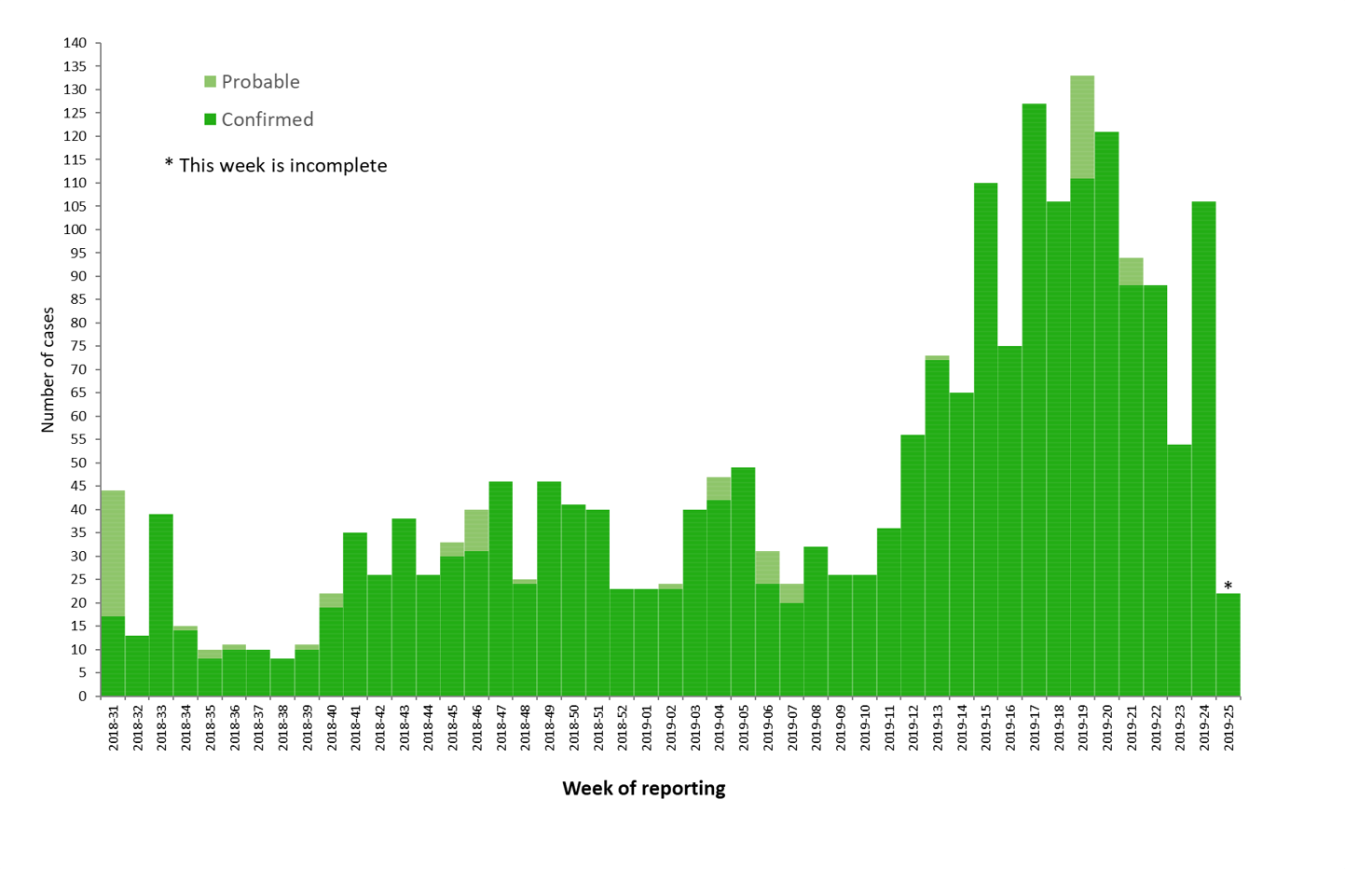
Distribution of confirmed and probable cases of Ebola virus disease and trend line by week of reporting, Democratic Republic of the Congo, as of 18 June 2019

Slide 3
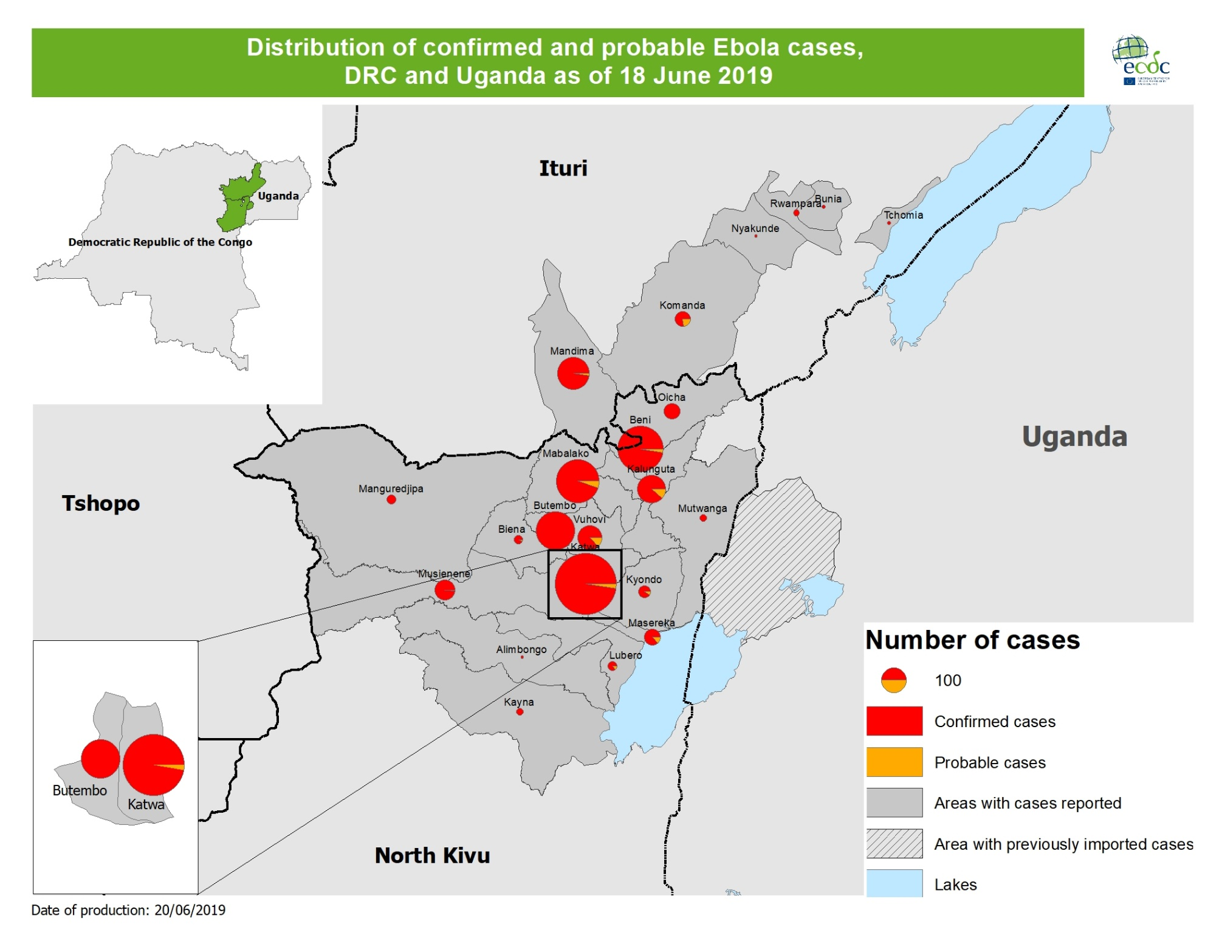

Slide 4
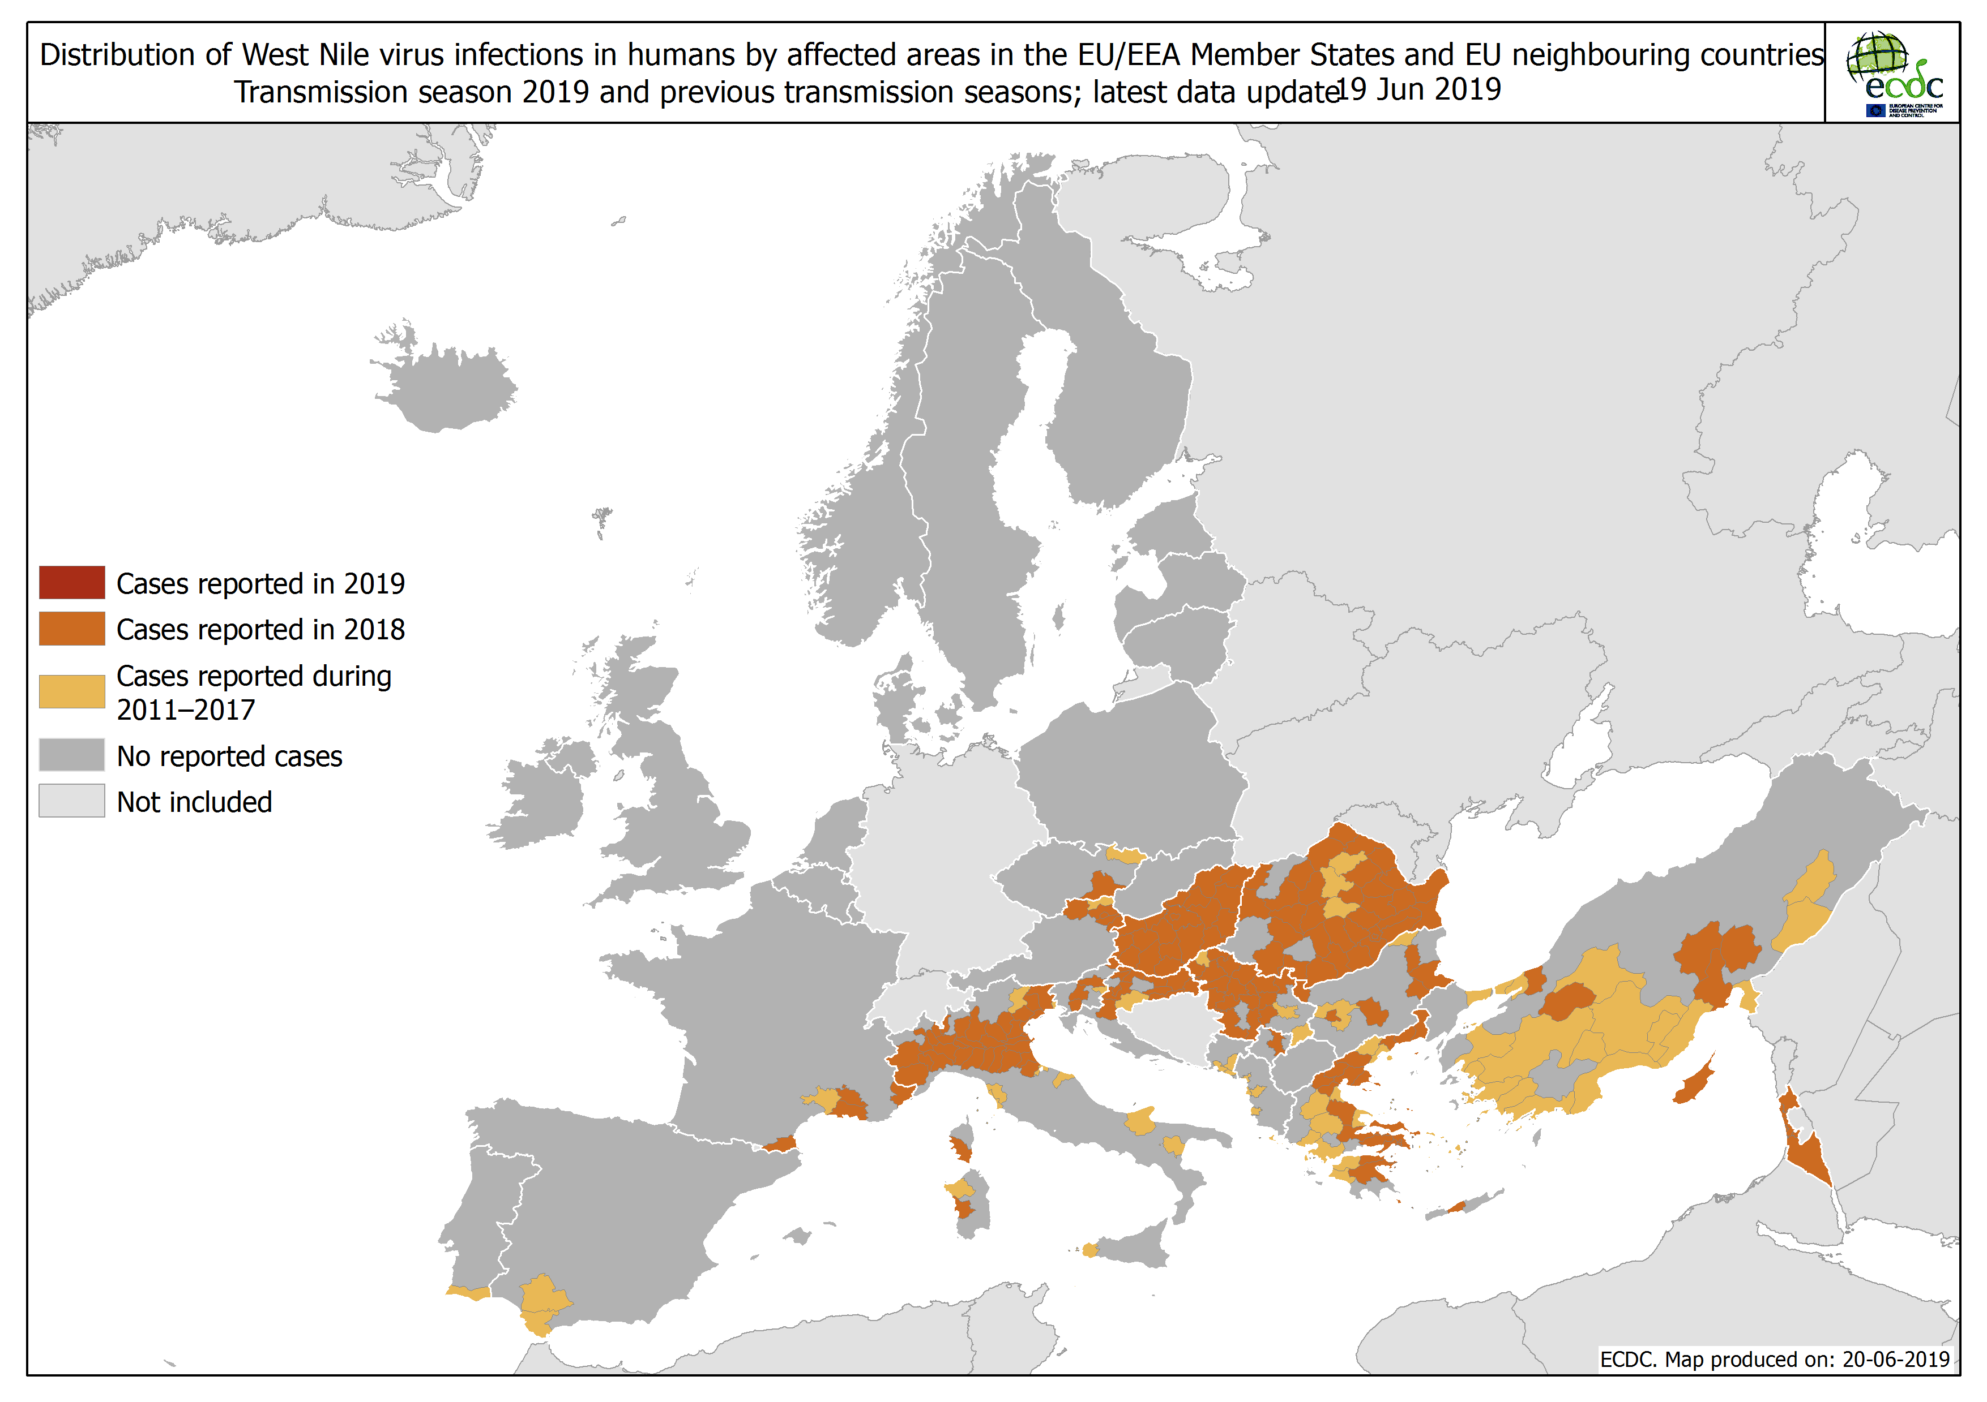

Slide 5
