Slide 1
Reusable maps and graphs from ECDC Communicable Disease Threats Report Week 24, 2019
You are encouraged to reuse our maps and graphs for your own purposes and free to translate, provided the content is not altered and the source is acknowledged.

Slide 2
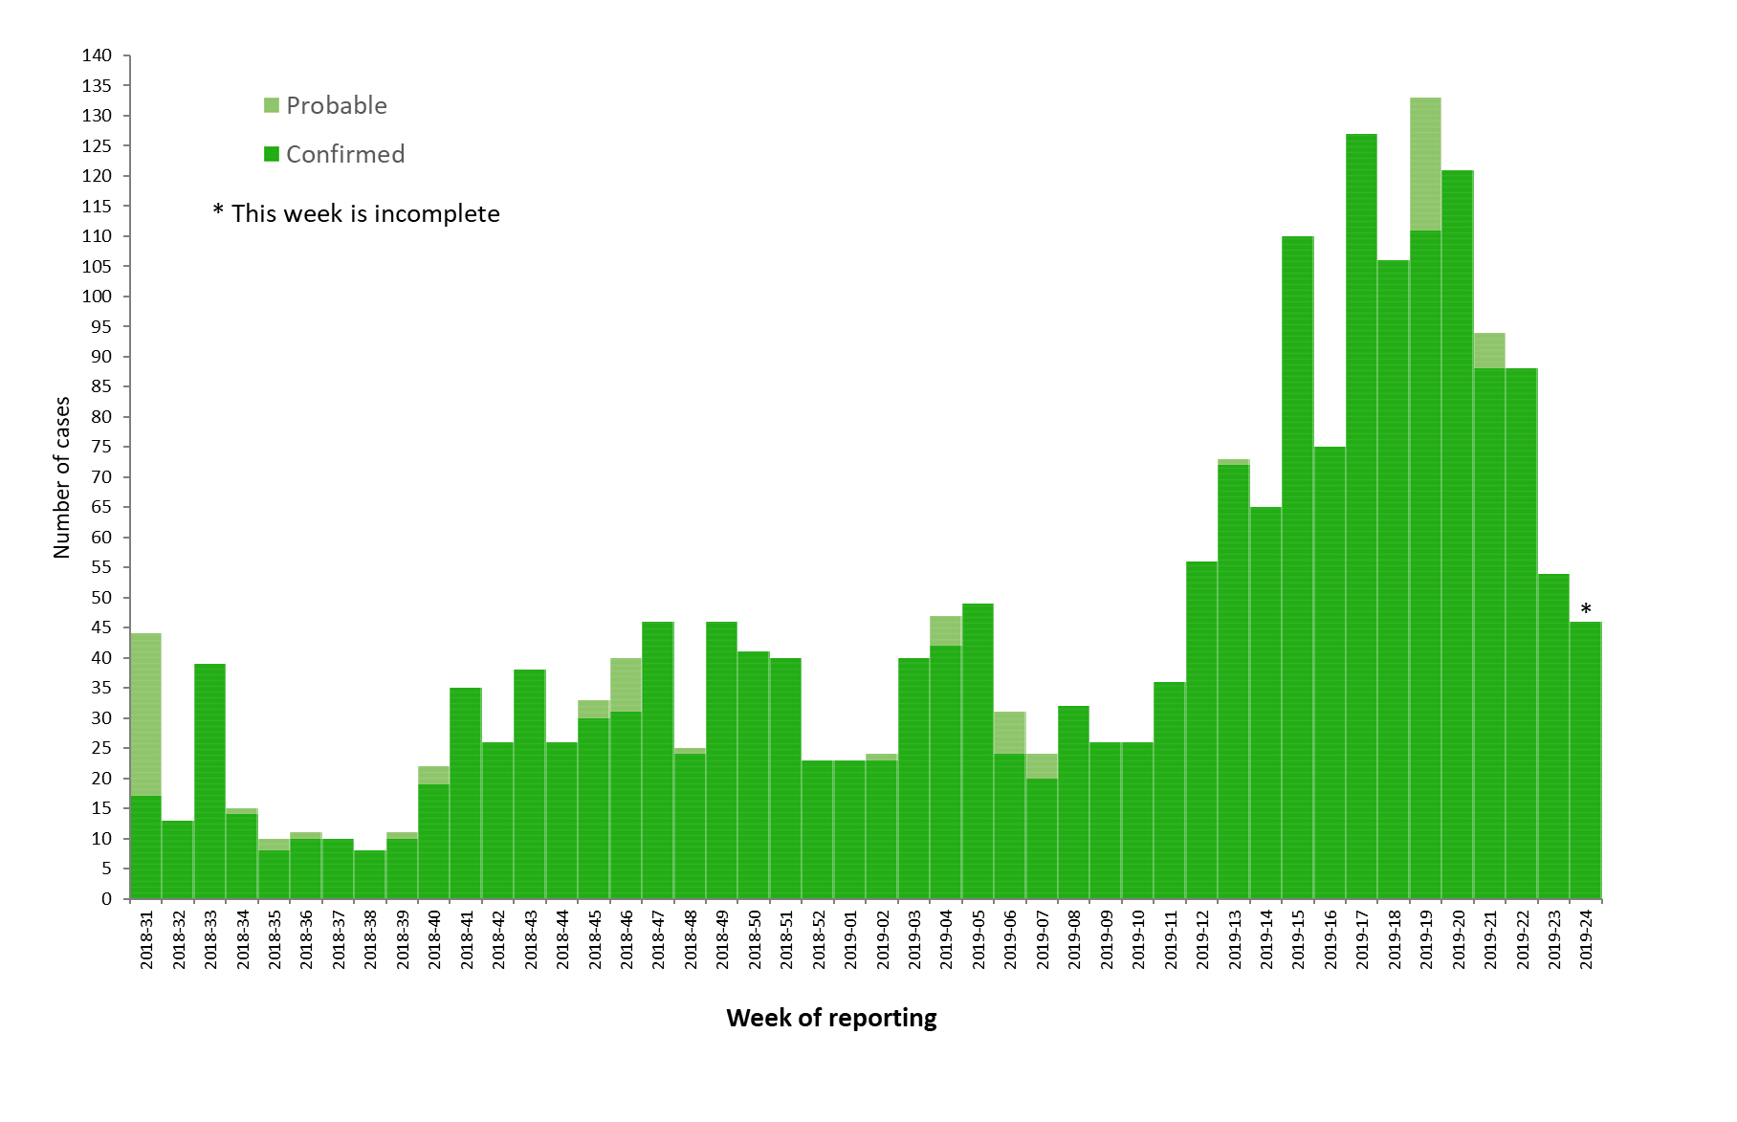
Distribution of confirmed and probable cases of Ebola virus disease and trend line by week of reporting, Democratic Republic of the Congo, as of 12 June 2019

Slide 3
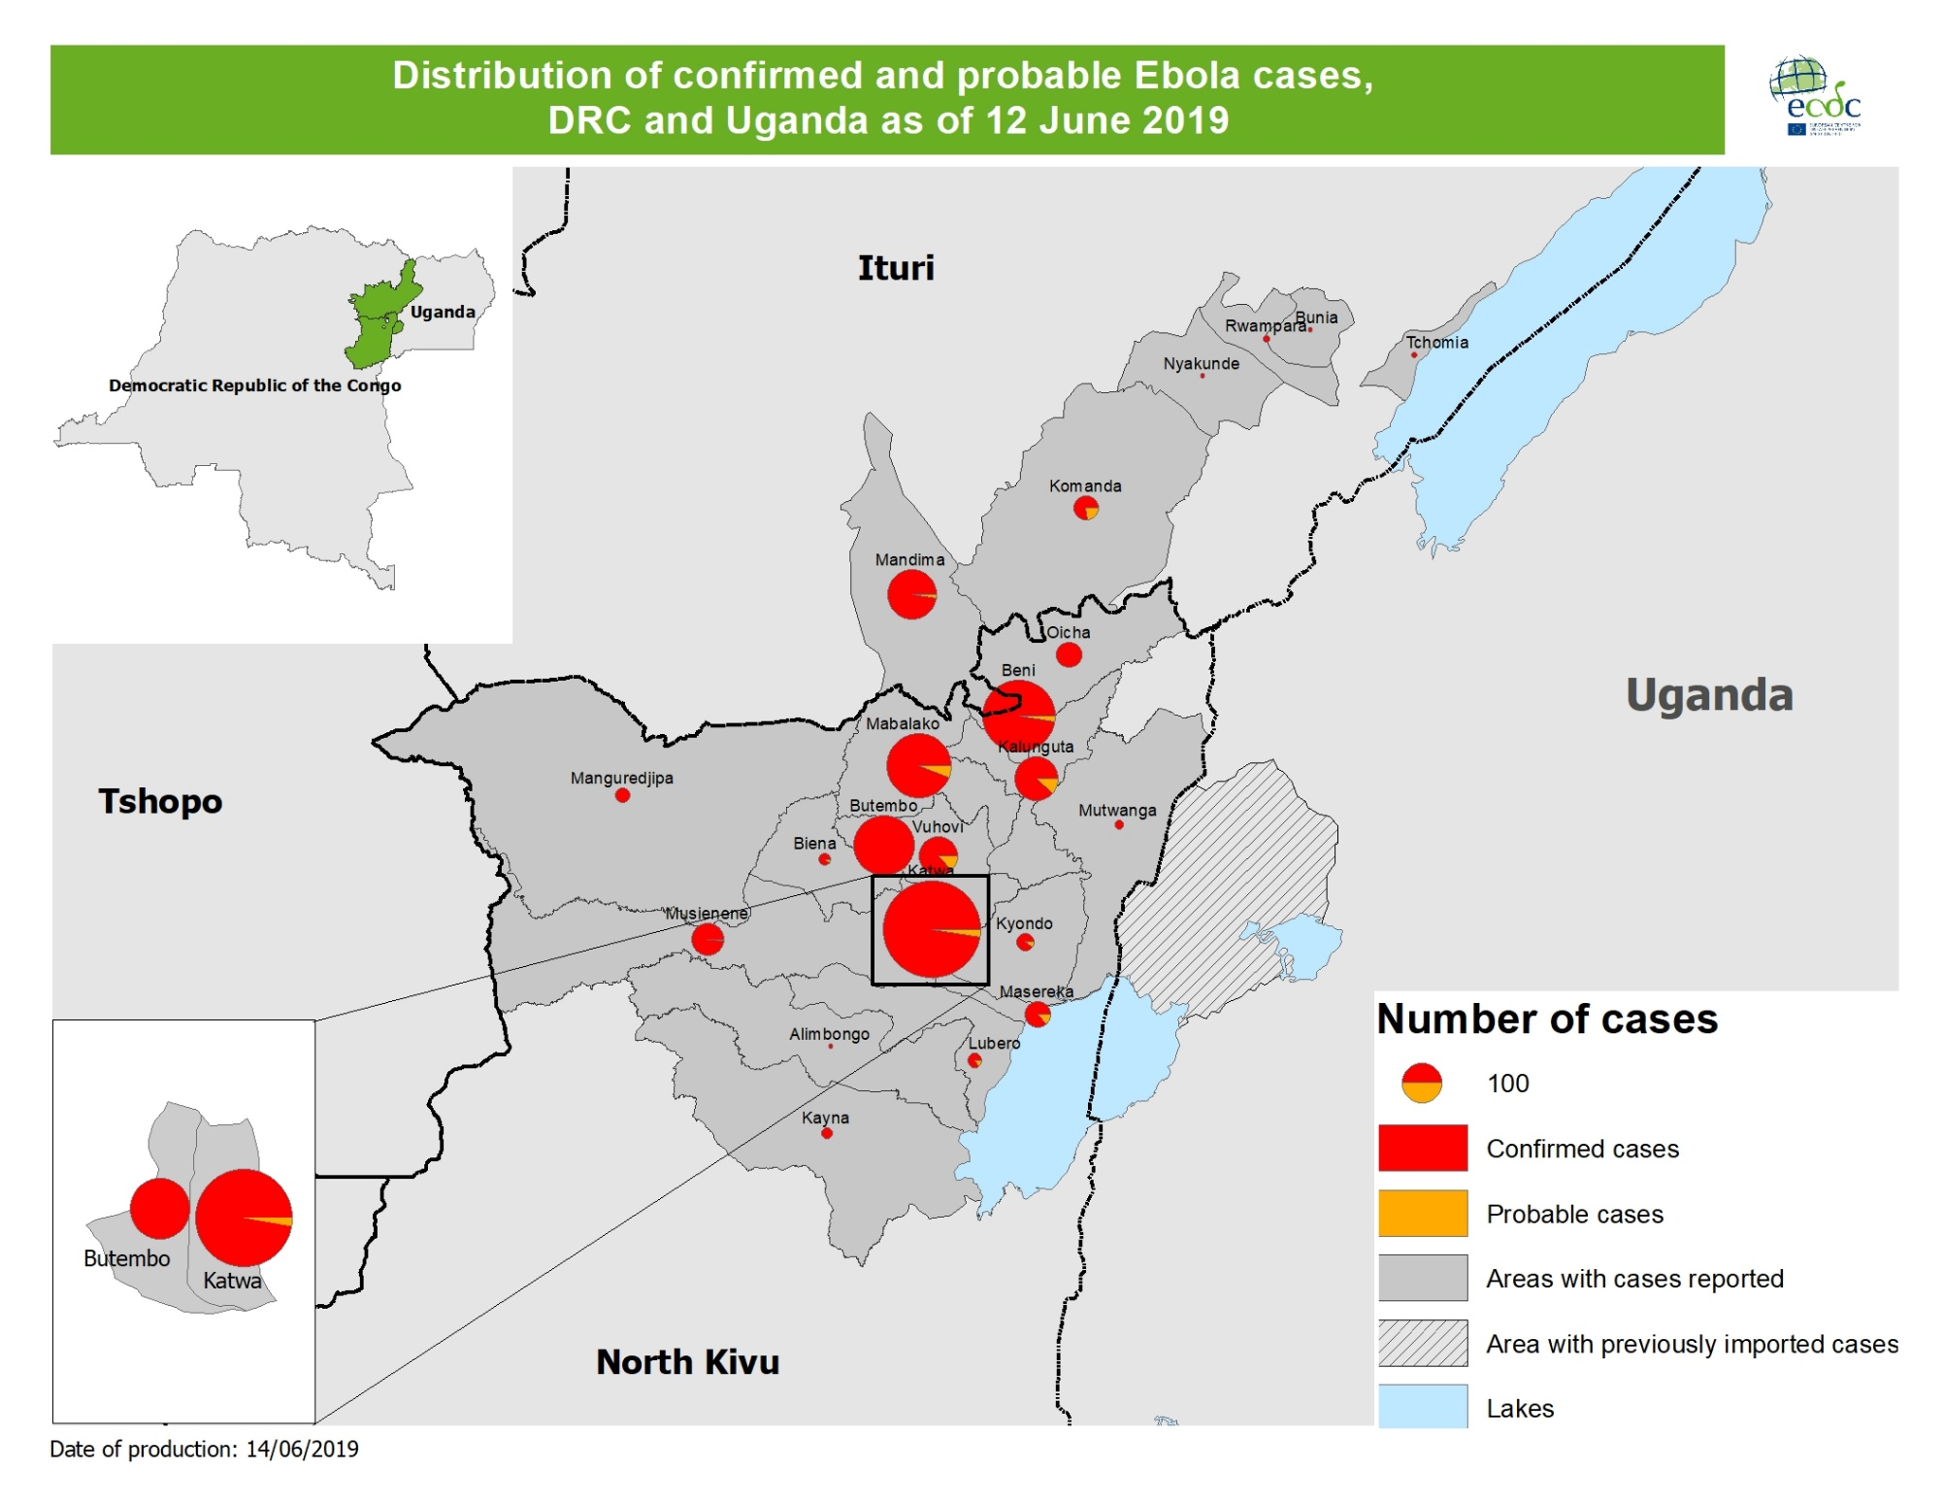

Slide 4
Geographical distribution of new cholera cases reported worldwide, April–June 2019

Slide 5
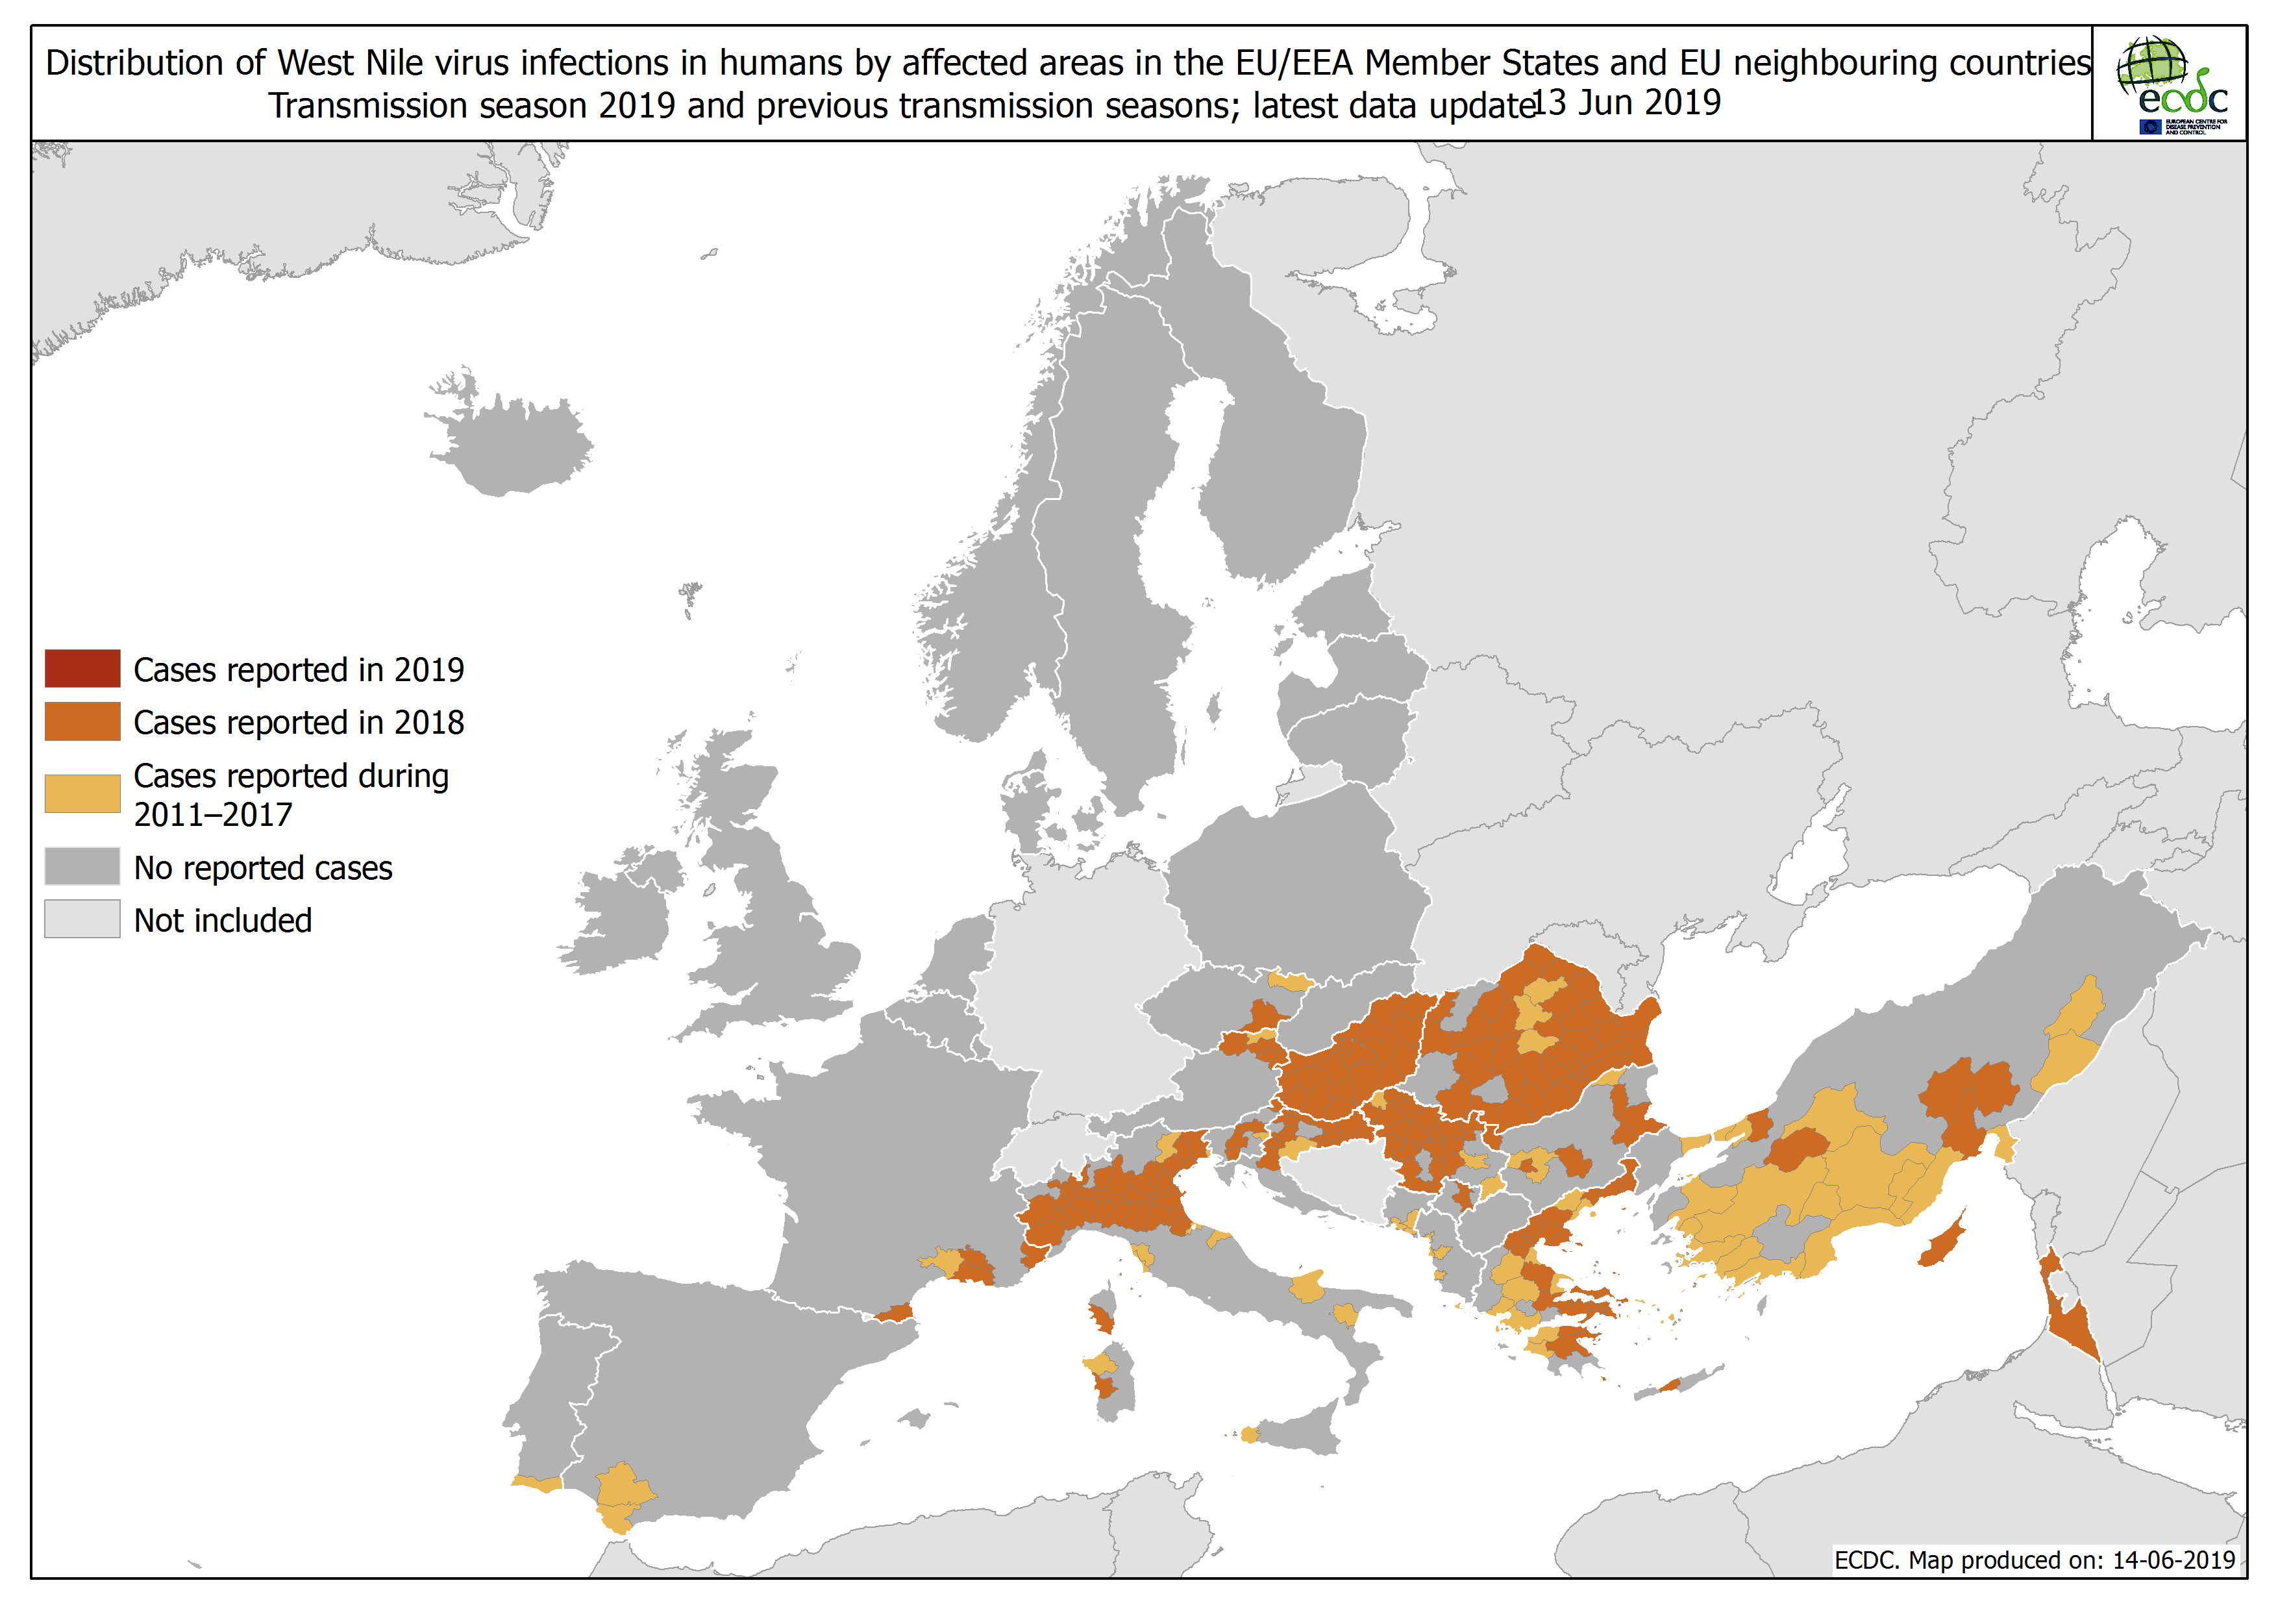

Slide 7
Distribution of measles cases in EU/EEA, January 2017–April 2019

Slide 8
Seasonality and annual cumulative cases of measles in EU/EEA, January 2017–April 2019

Slide 9
Measles associated deaths by country, EU/EEA, January 2017–April 2019
Country | 2017 | 2018 | 2019 | Total
Romania | 24 | 22 | 1 | 47
Italy | 5 | 9 | 1 | 15
France | 1 | 3 |  | 4
Greece | 2 | 2 |  | 4
Bulgaria | 1 |  |  | 1
Germany | 1 |  |  | 1
Portugal | 1 |  |  | 1
EU/EEA | 35 | 36 | 2 | 73
Table shows data from TESSy. In 2019 (EI), 7 deaths were reported in the EU in Romania (5), Italy (1) and France (1).

