Slide 1
Reusable maps and graphs from ECDC Communicable Disease Threats Report Week 23 2022
You are encouraged to reuse our maps and graphs for your own purposes and are free to translate them, provided the content is not altered and the source is acknowledged.

Slide 2
Distribution of COVID-19 cases worldwide, in accordance with the applied case definitions in the affected countries, as of week 22 2022

Slide 3
Distribution of COVID-19 deaths worldwide, as of week 22 2022

Slide 4
Distribution of laboratory-confirmed cases of COVID-19 in the EU/EEA, as of week 22 2022

Slide 5
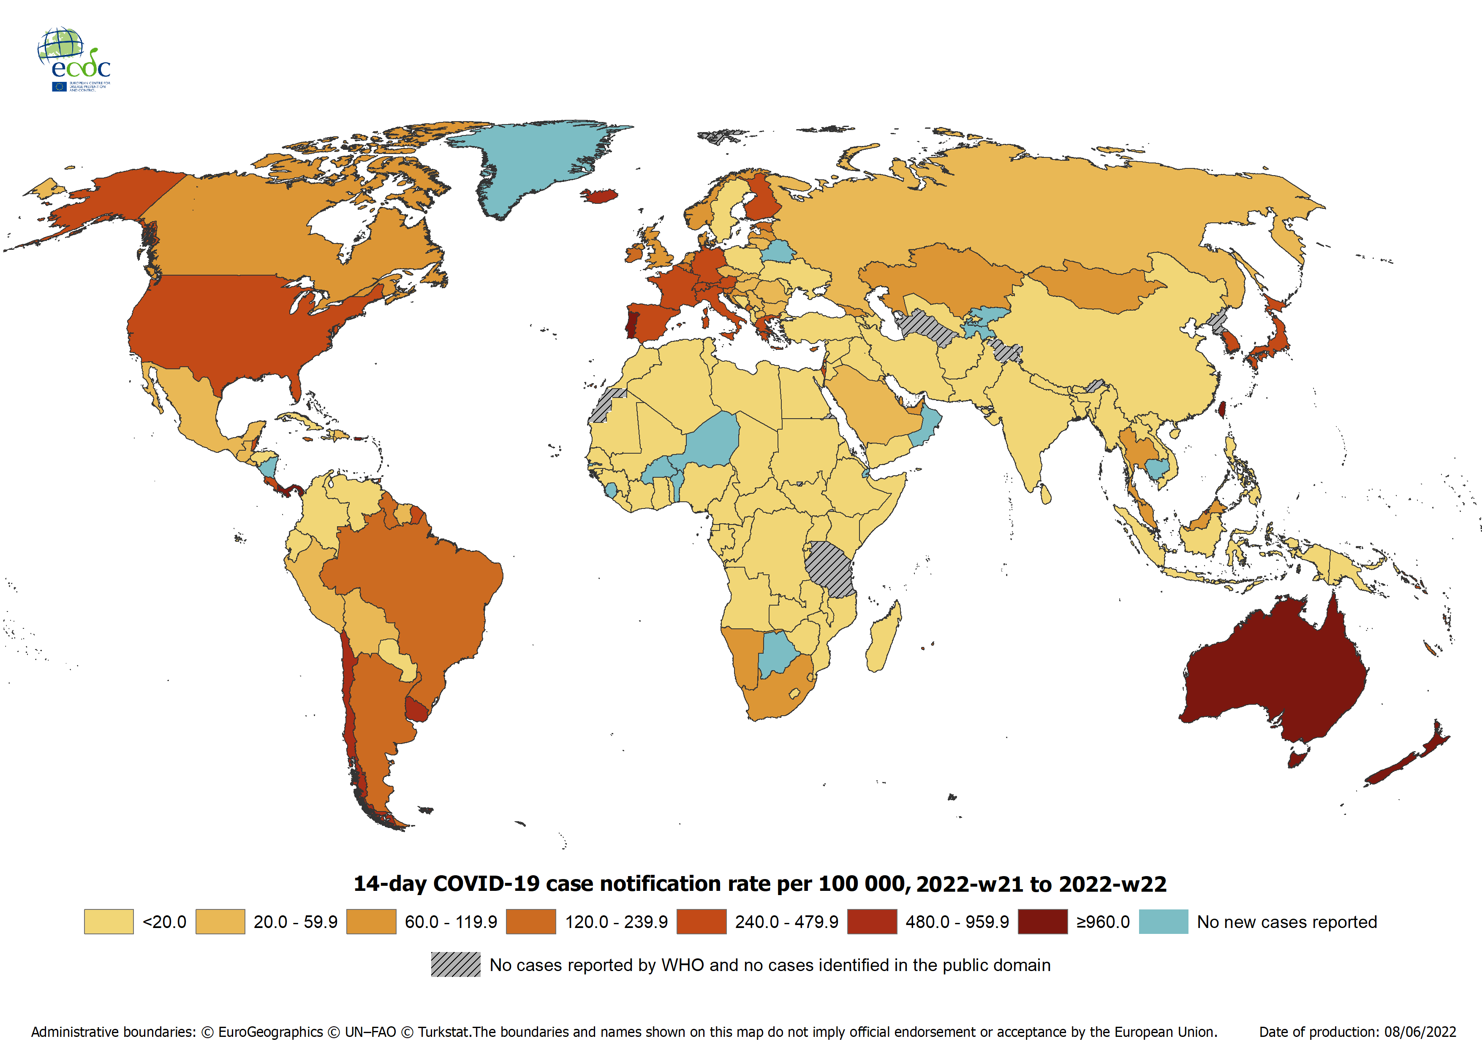
Geographic distribution of 14-day cumulative number of reported COVID-19 cases per 100 000 population, worldwide, as of week 22 2022

Slide 6
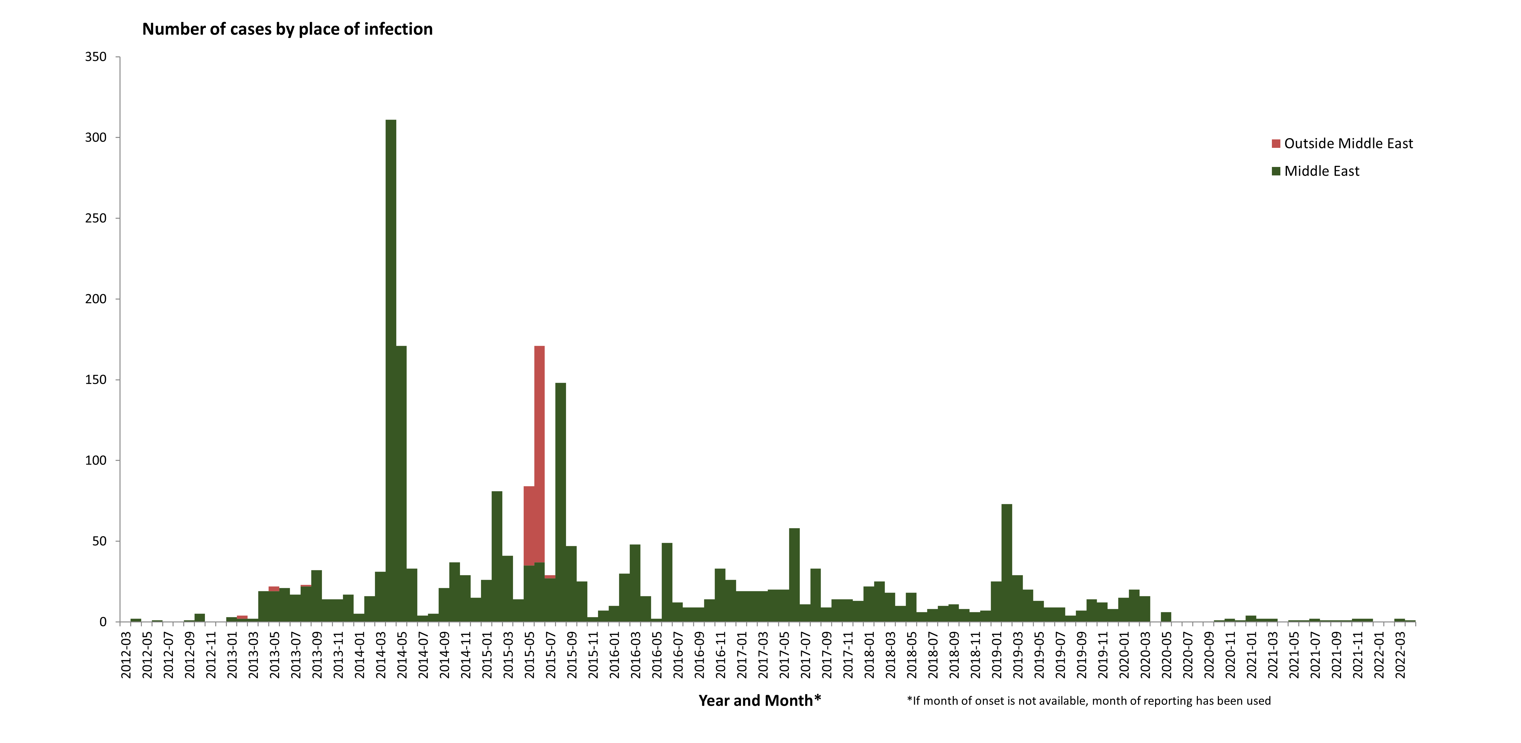
Distribution of confirmed cases of MERS-CoV by place of infection and month of onset,
March 2012 – May 2022
Notes:
Cases in 2020: 61
Cases in 2019: 223

Slide 7
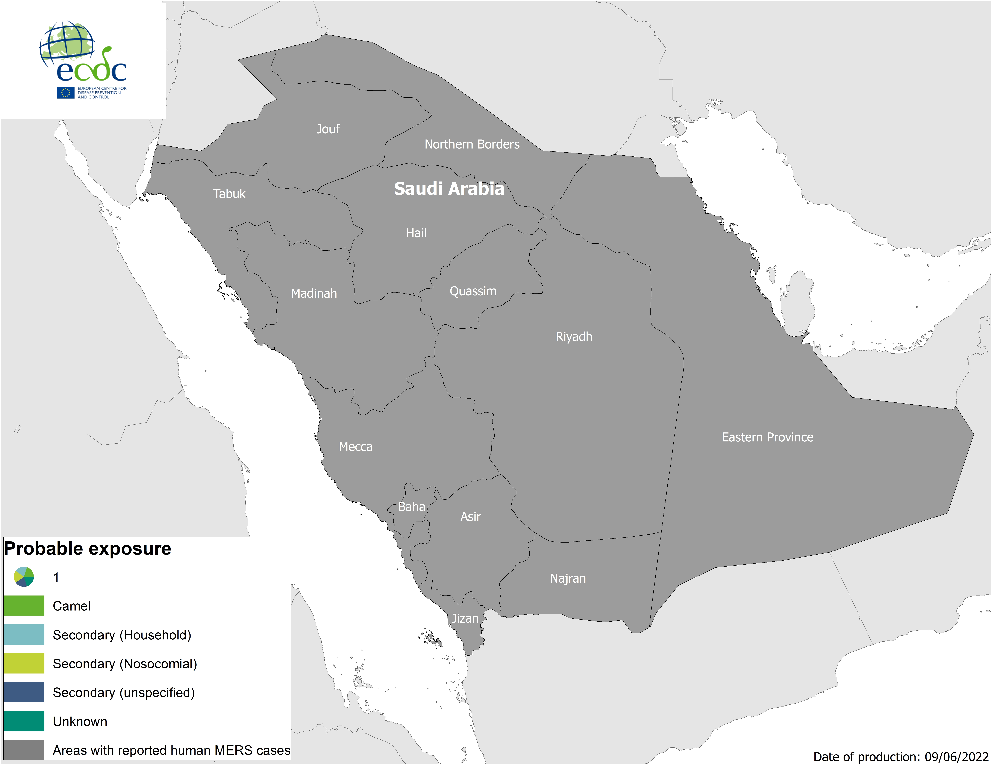
Geographical distribution of confirmed MERS-CoV cases by probable region of infection and exposure, from 1 January 2022 to 8 June 2022

Slide 8
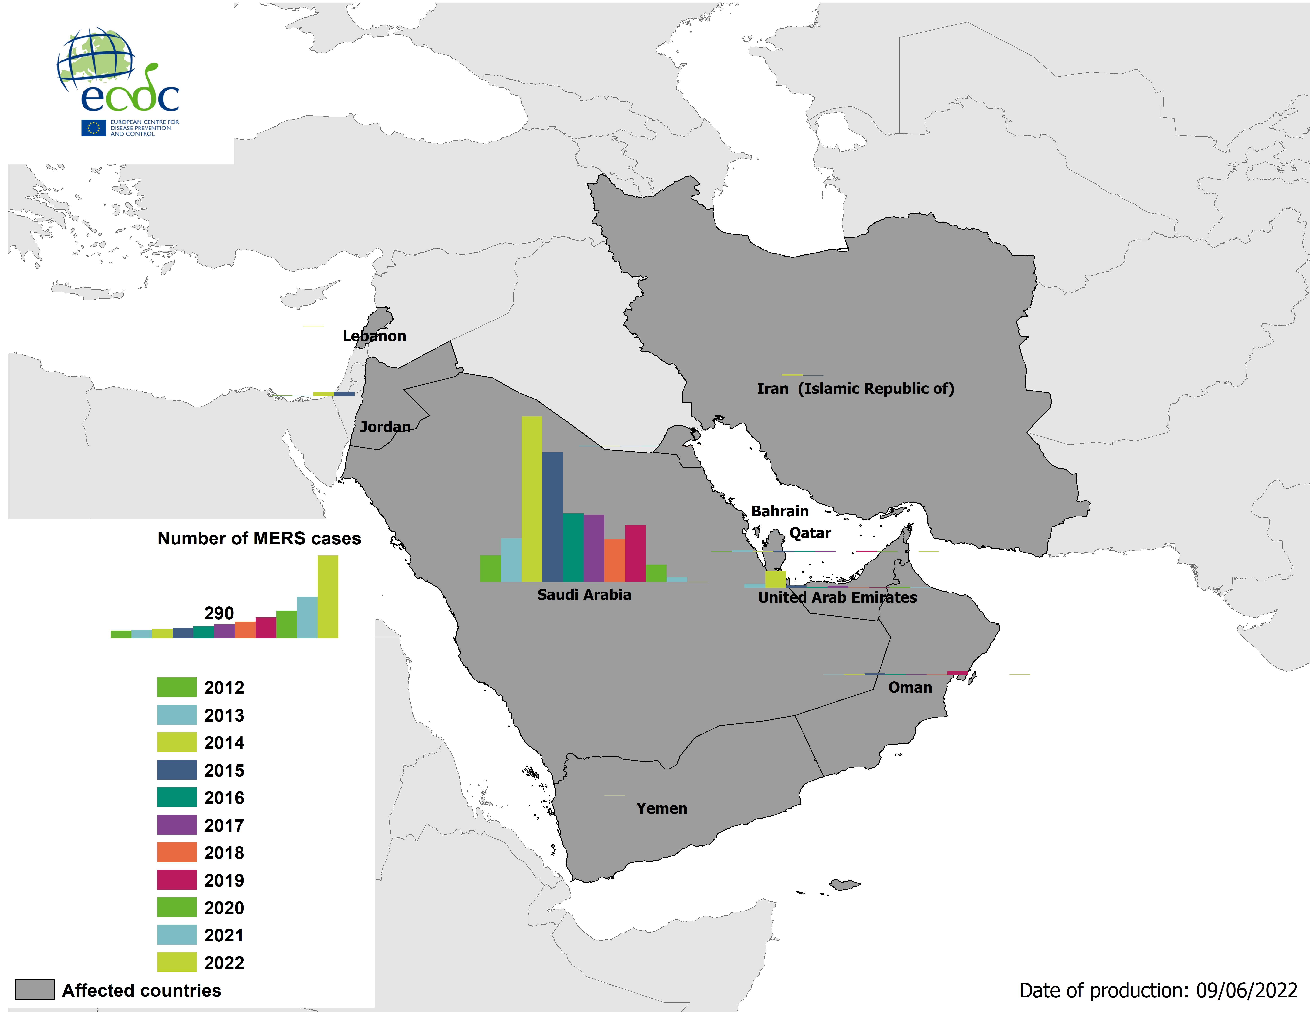
Geographical distribution of confirmed MERS-CoV cases by country of infection and year, from April 2012 to 8 June 2022
Notes:
Cases only in SA and UAE

Slide 9
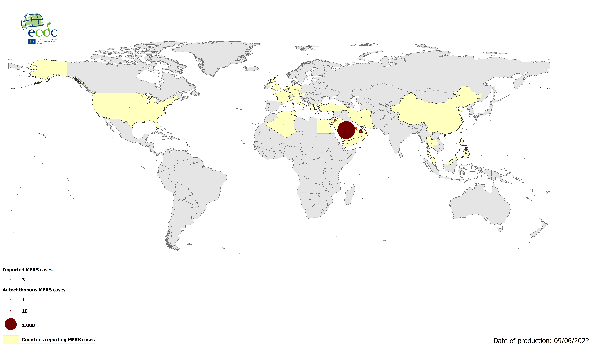
Geographical distribution of confirmed MERS-CoV cases by reporting country from April 2012 to 8 June 2022
Notes:
2600 total cases ww and 943 deaths

