Slide 1
Reusable maps and graphs from ECDC Communicable Disease Threats Report
Week 22, 2023
You are encouraged to reuse our maps and graphs for your own purposes and are free to translate them, provided the content is not altered and the source is acknowledged.

Slide 2
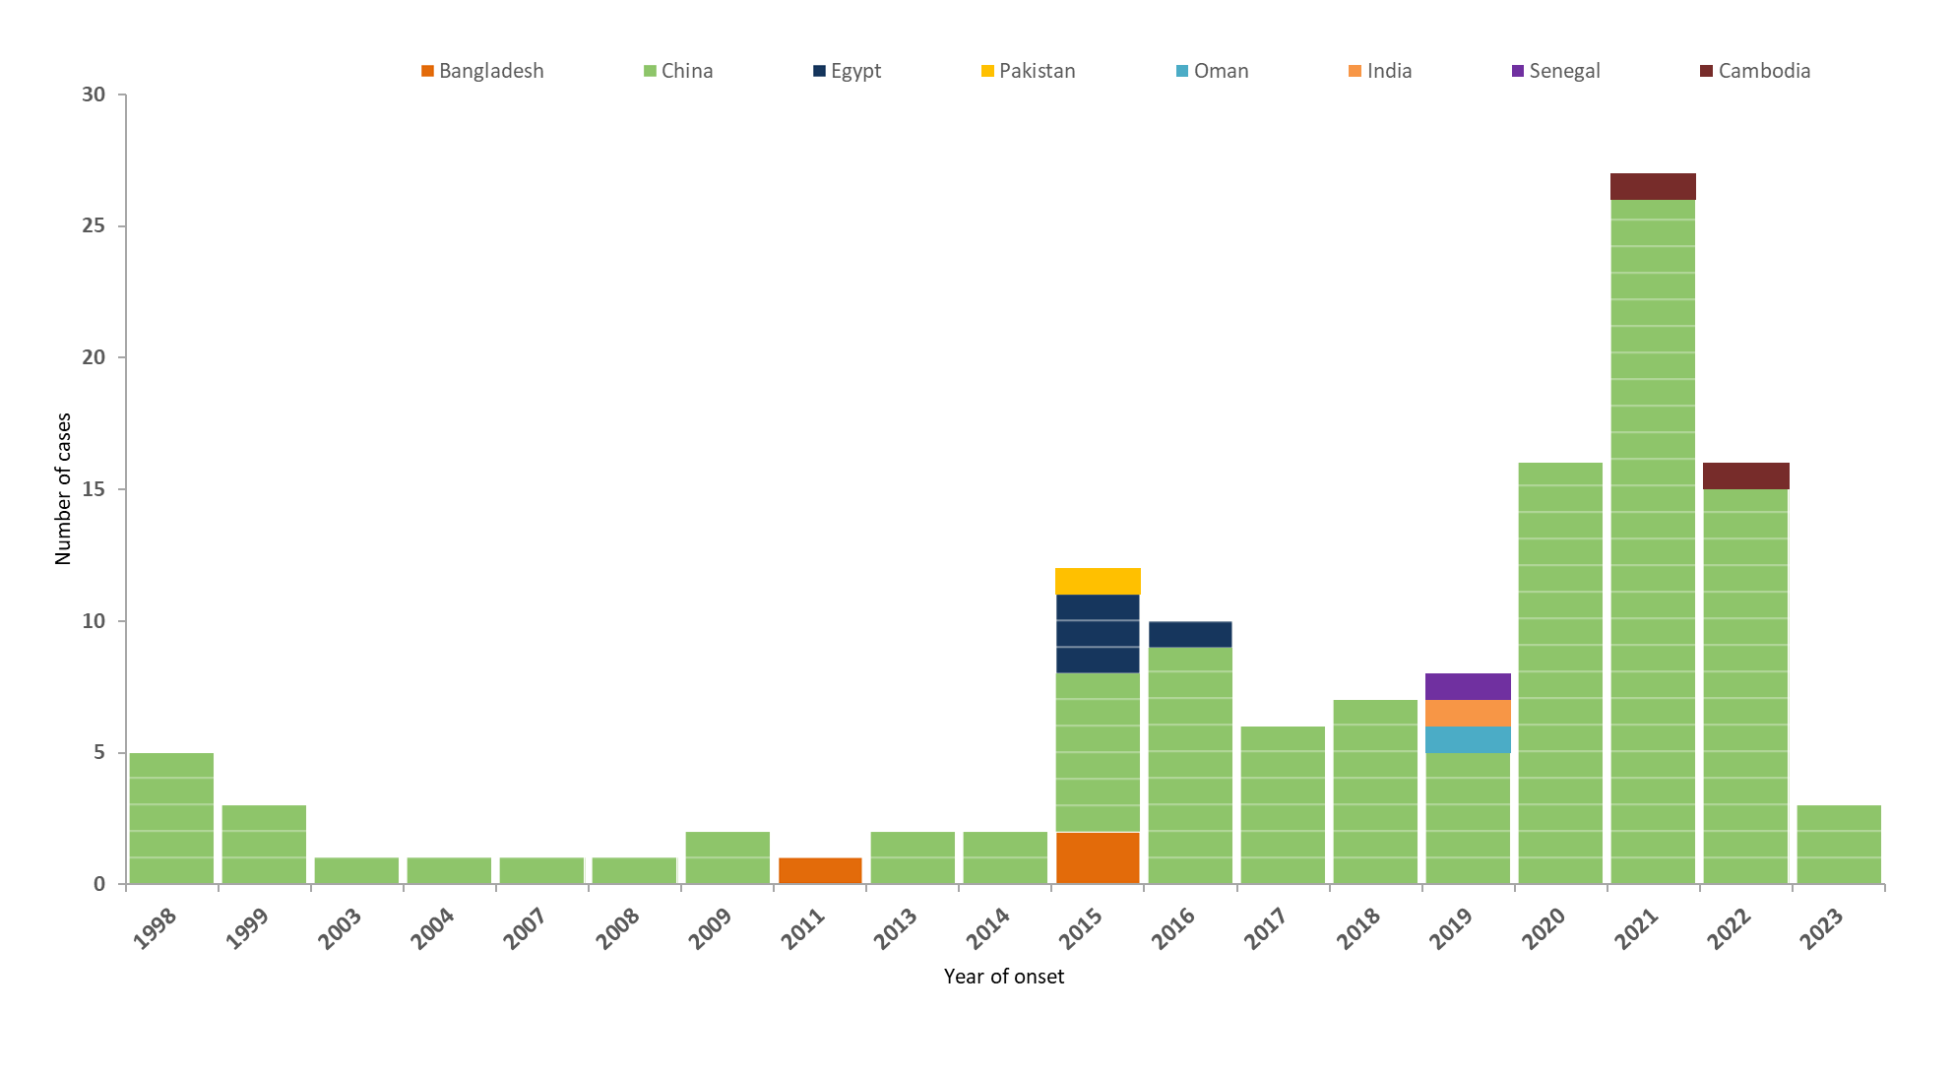
Distribution of confirmed human cases of avian influenza A(H9N2) virus infection by year of onset and country, 1998–2023 (n=124, updated on 29 May 2023)

Slide 3
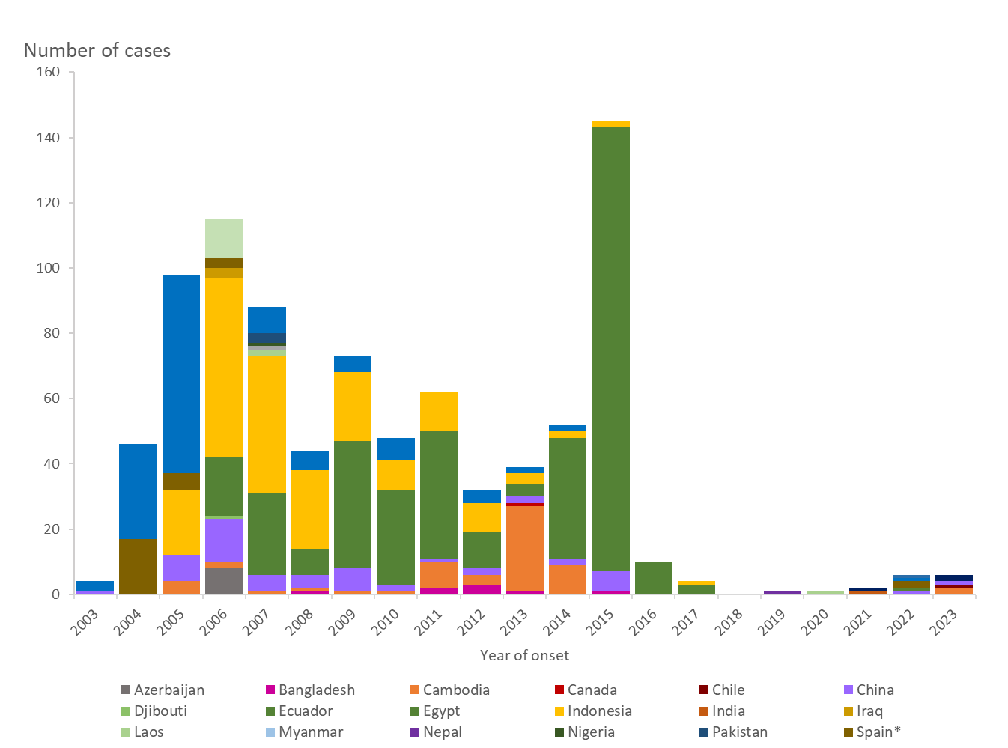
Distribution of confirmed human cases of avian influenza A(H5N1) virus infection by year of onset and country, 2003–2023 (updated on 02 June 2023, n=876*)
*Note: includes two detections reported in 2022 from Spain and one from the United States due to suspected environmental contamination and no evidence of infection.

Slide 4
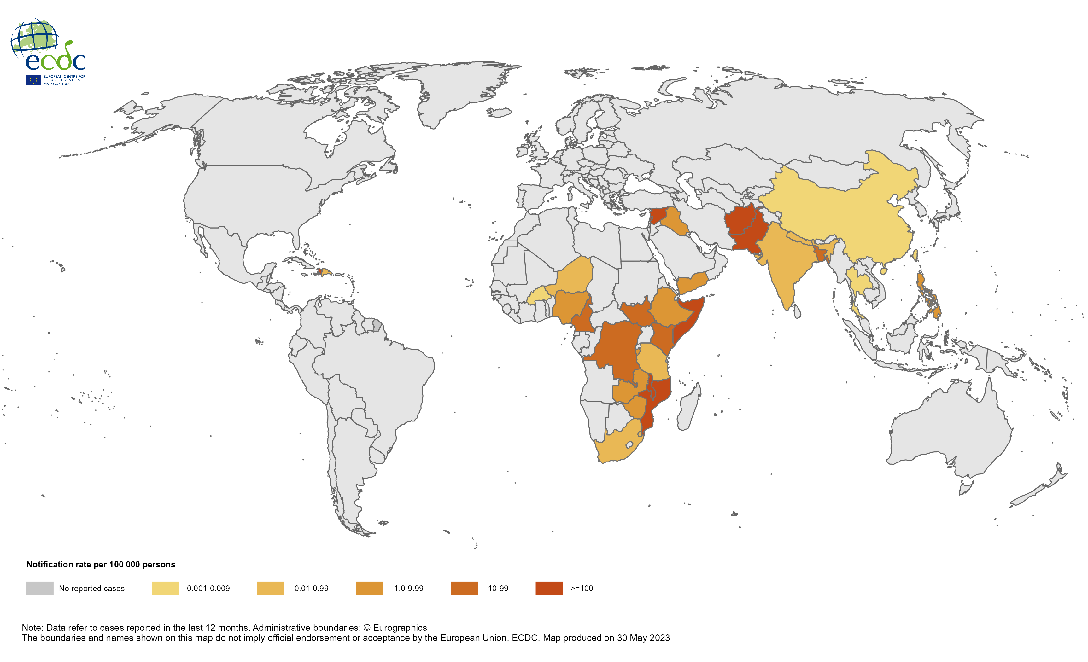
Geographical distribution of cholera cases reported worldwide from June 2022 to May 2023

Slide 5
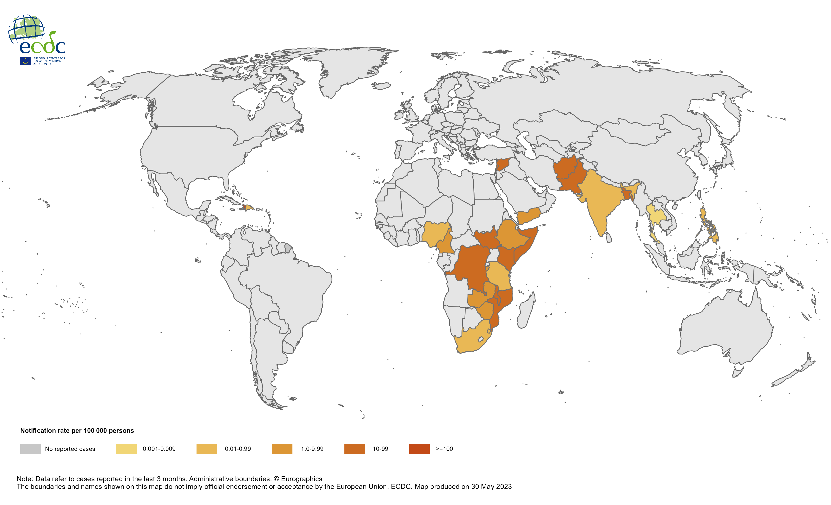
Geographical distribution of cholera cases reported worldwide from March 2023 to May 2023

