Slide 1
Reusable maps and graphs from ECDC Communicable Disease Threats Report Week 22, 2021
You are encouraged to reuse our maps and graphs for your own purposes and free to translate, provided the content is not altered and the source is acknowledged.

Slide 2
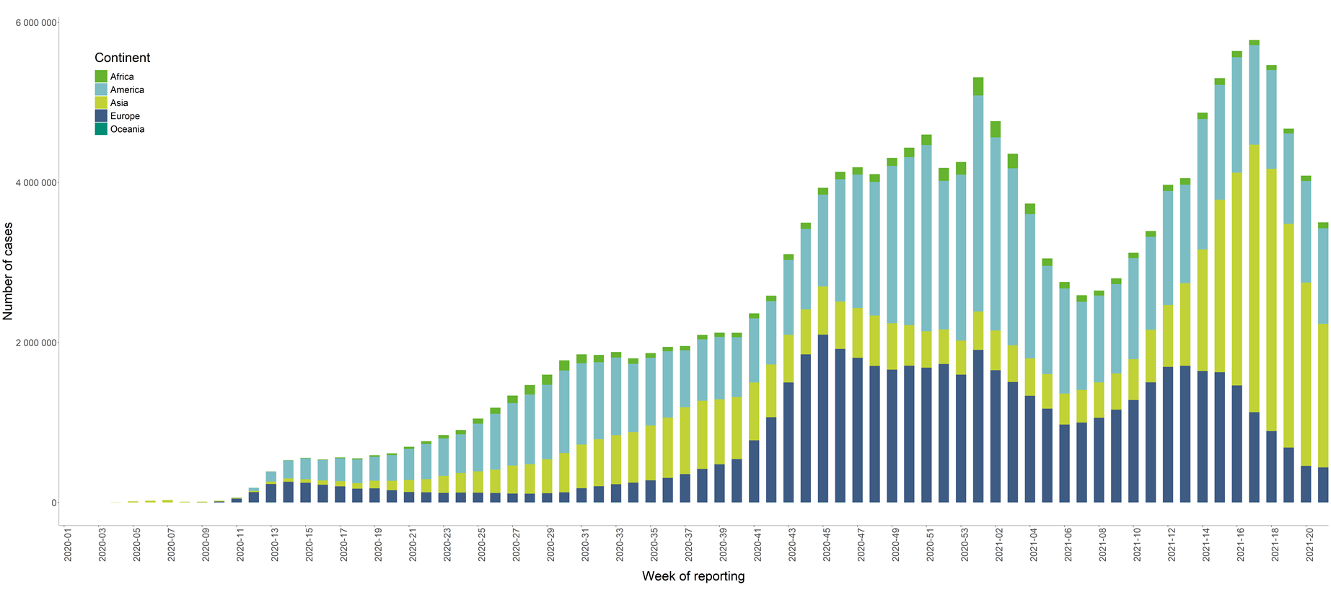
Distribution of COVID-19 cases worldwide in accordance with the applied case definitions in the affected countries, as of week 21, 2021

Slide 3
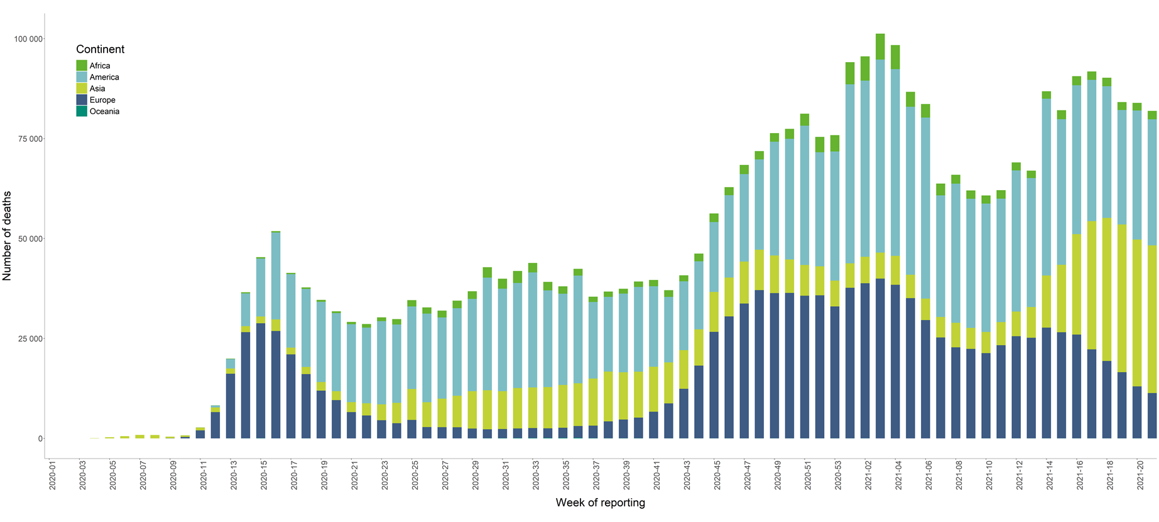
Distribution of COVID-19 deaths worldwide, as of Week 21, 2021

Slide 4
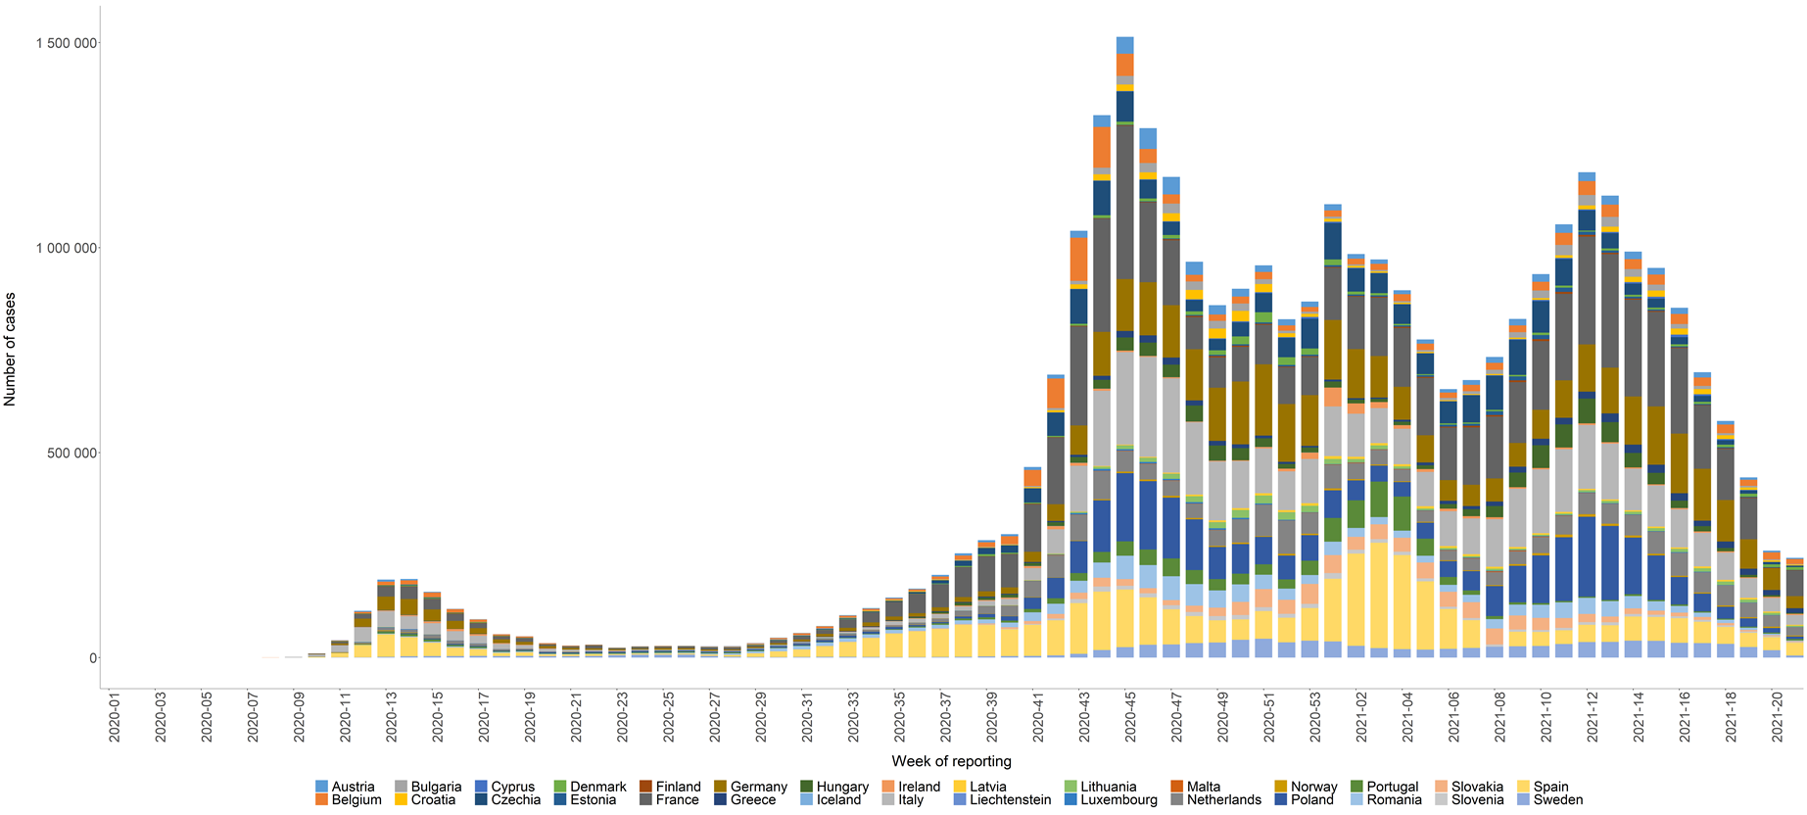
Distribution of laboratory-confirmed cases of COVID-19 in the EU/EEA, as of Week 21, 2021

Slide 5
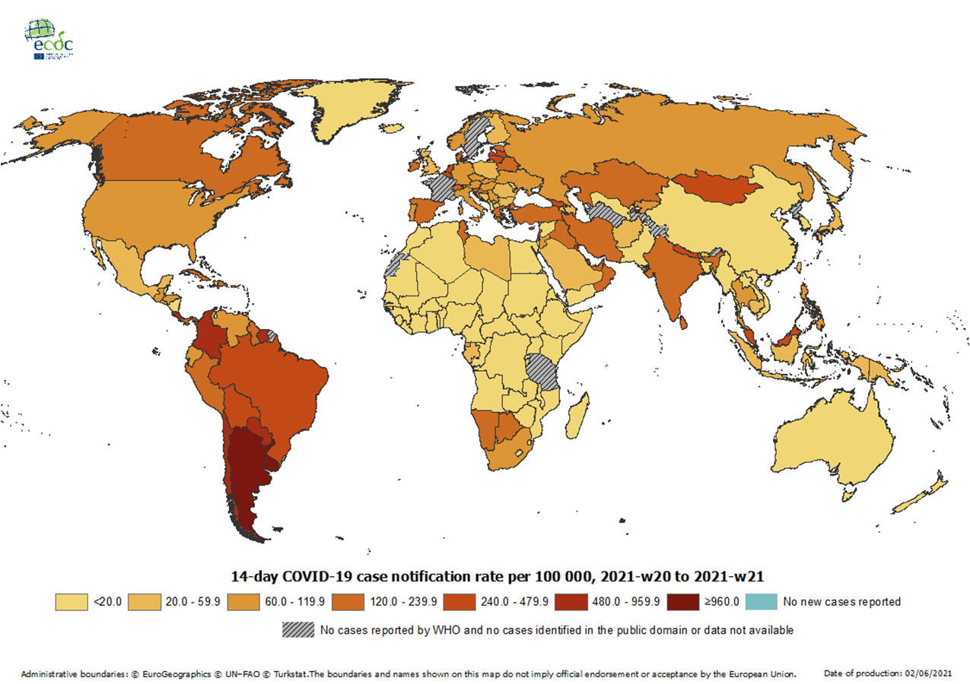
Geographic distribution of 14-day cumulative number of reported COVID-19 cases per 100 000 population, worldwide, from 2021-w20 to 2021-w21
On week 19 -2021, France performed data cleaning and retro-correction, therefore the data are not display in this map.
Data for Sweden is not available for week 2021-21 due to a disruption to of the national database on notifiable diseases (SmiNet), therefore the data are not displayed in the map.
14-day notification rates and trends are collected using epidemic intelligence from various sources and are affected by the testing strategy, laboratory capacity and the effectiveness of surveillance systems. As all of these factors can differ greatly between countries, ECDC does not recommend using notification rates to directly compare countries. Particular caution is needed when interpreting reported rates from areas with small populations, where small changes in the numbers of reported cases can have a large impact on the notification rate. In addition, the retrospective adjustment of data by reporting authorities is possible. Negative counts of new cases can arise if countries or subnational areas report cumulative totals that are lower than those reported previously, which can affect the presentation of data in maps and time-series plots.

Slide 8
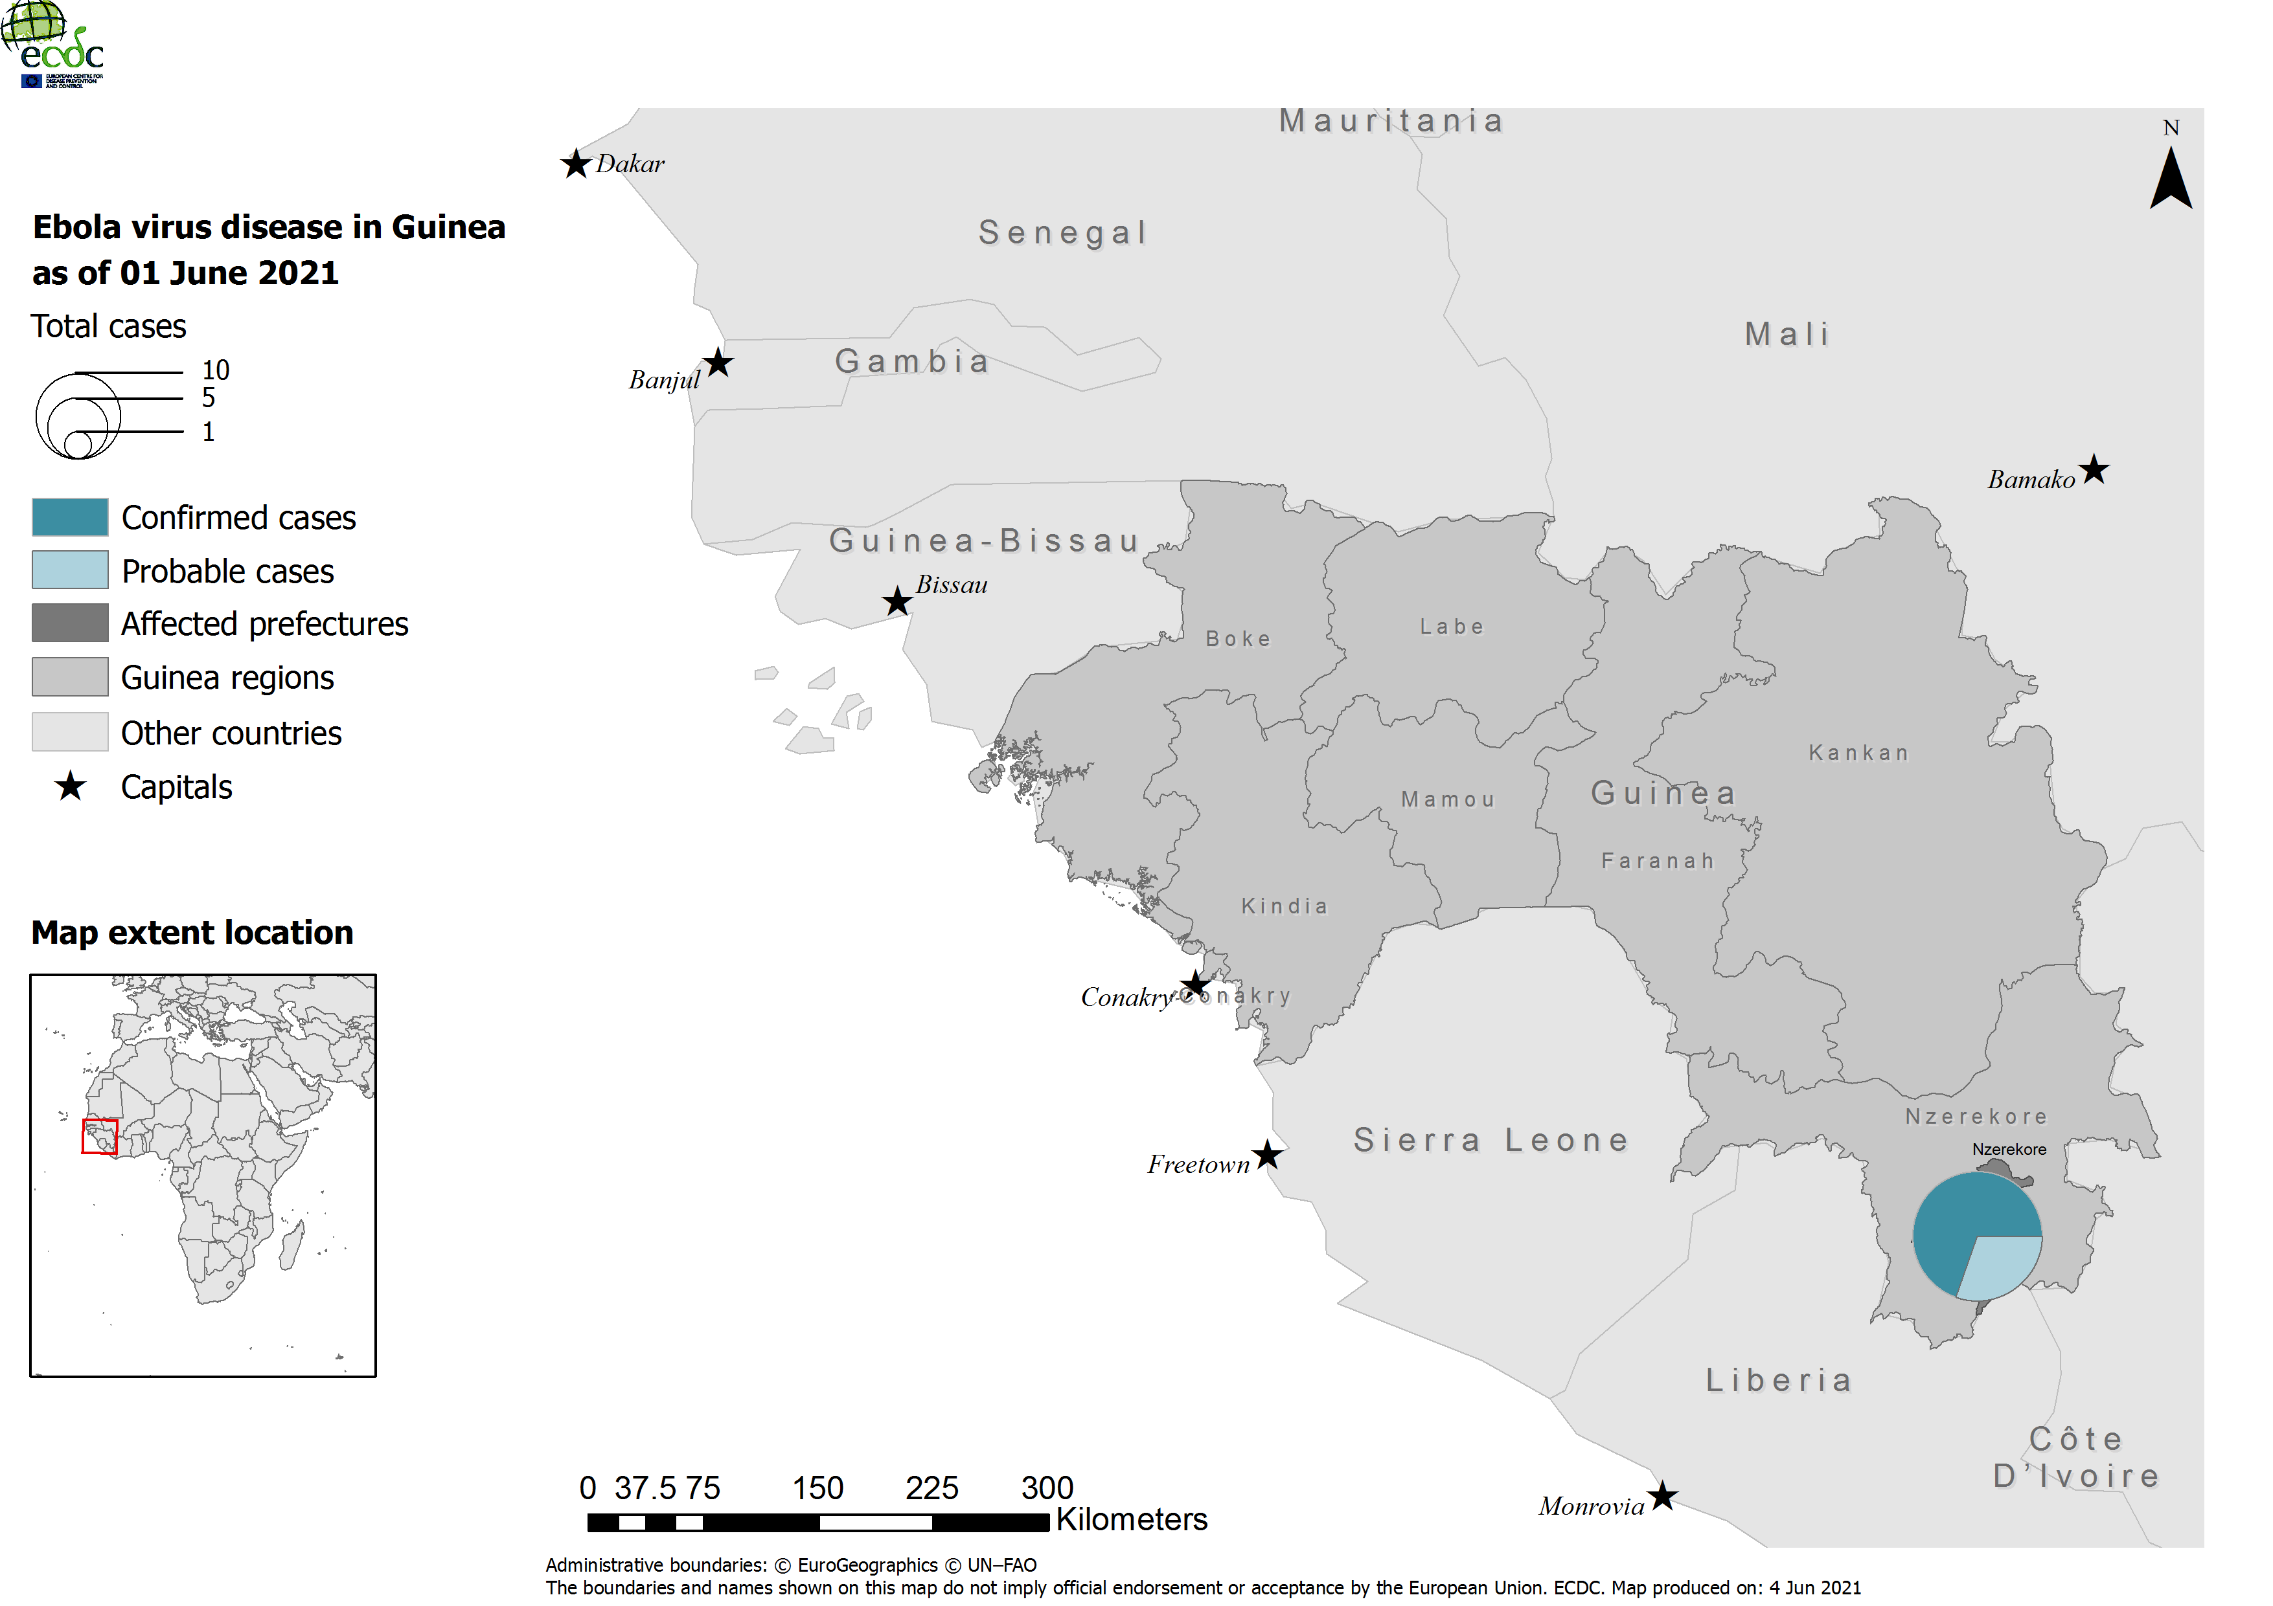
Geographical distribution of EVD cases in Guinea, as of 1 June 2021

Slide 9
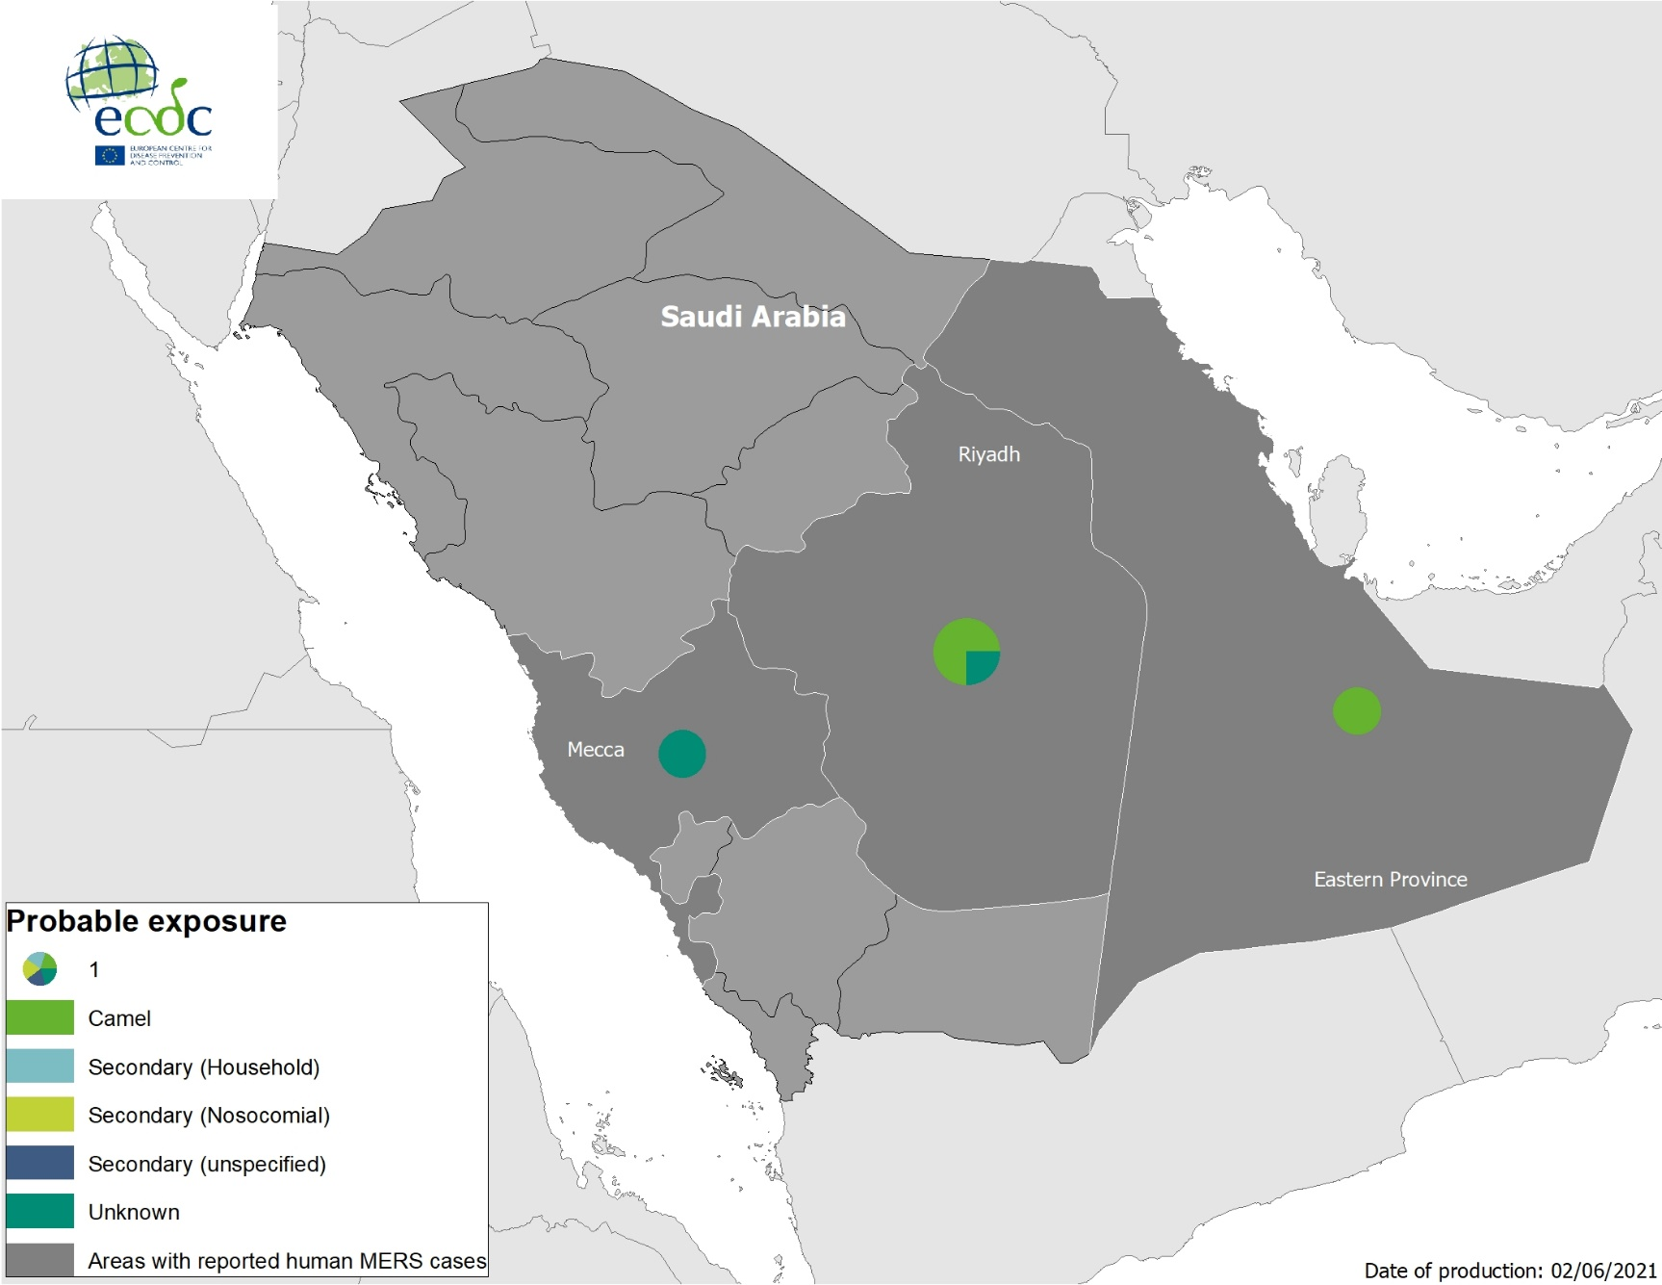
Geographical distribution of confirmed MERS-CoV cases by probable region of infection and exposure, from 1 January 2021 to 31 May 2021

Slide 10
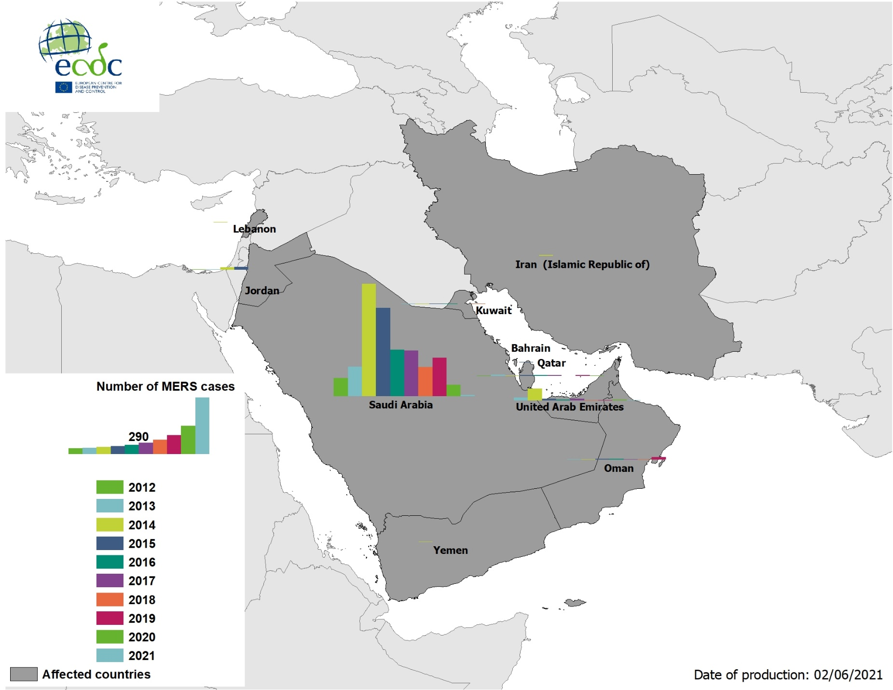
Geographical distribution of confirmed MERS-CoV cases by country of infection and year, from April 2012 to 31 May 2021

