Slide 1
Reusable maps and graphs from ECDC Communicable Disease Threats Report
Week 20, 2019
You are encouraged to reuse our maps and graphs for your own purposes and free to translate, provided the content is not altered and the source is acknowledged.

Slide 2
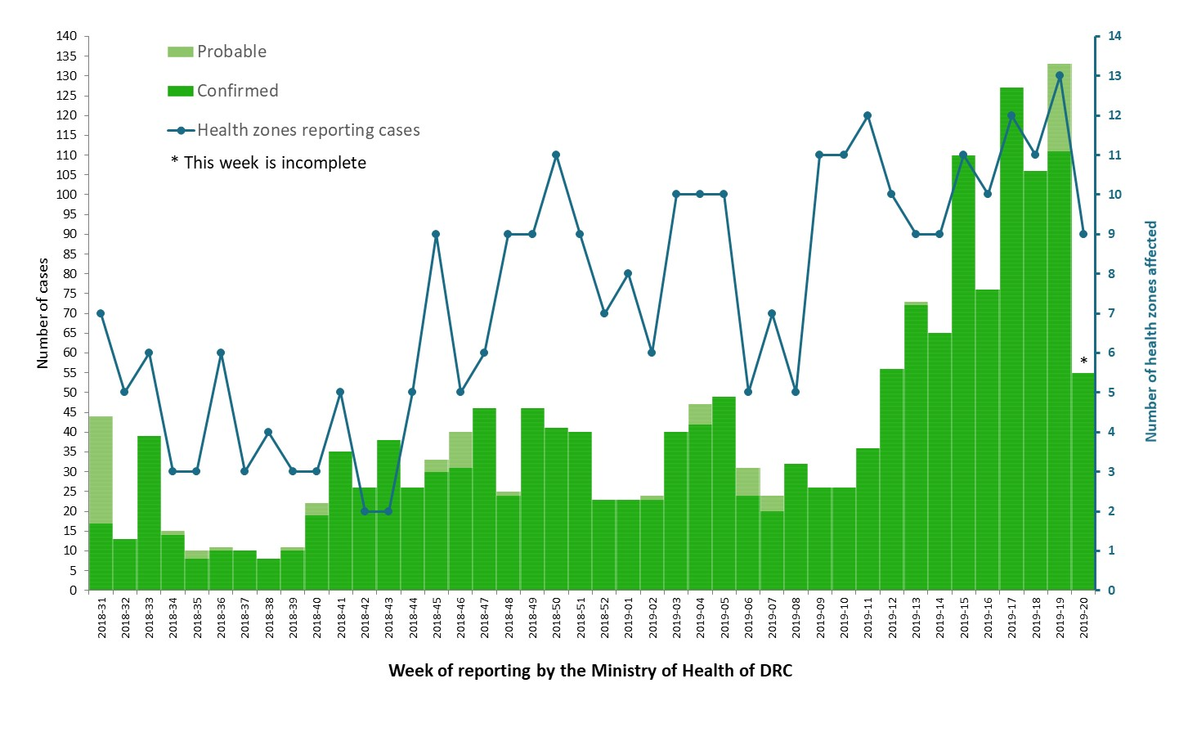
Distribution of confirmed and probable cases of Ebola virus disease and health zones reporting cases, North Kivu and Ituri Provinces, Democratic Republic of the Congo, as of 15 May 2019

Slide 3
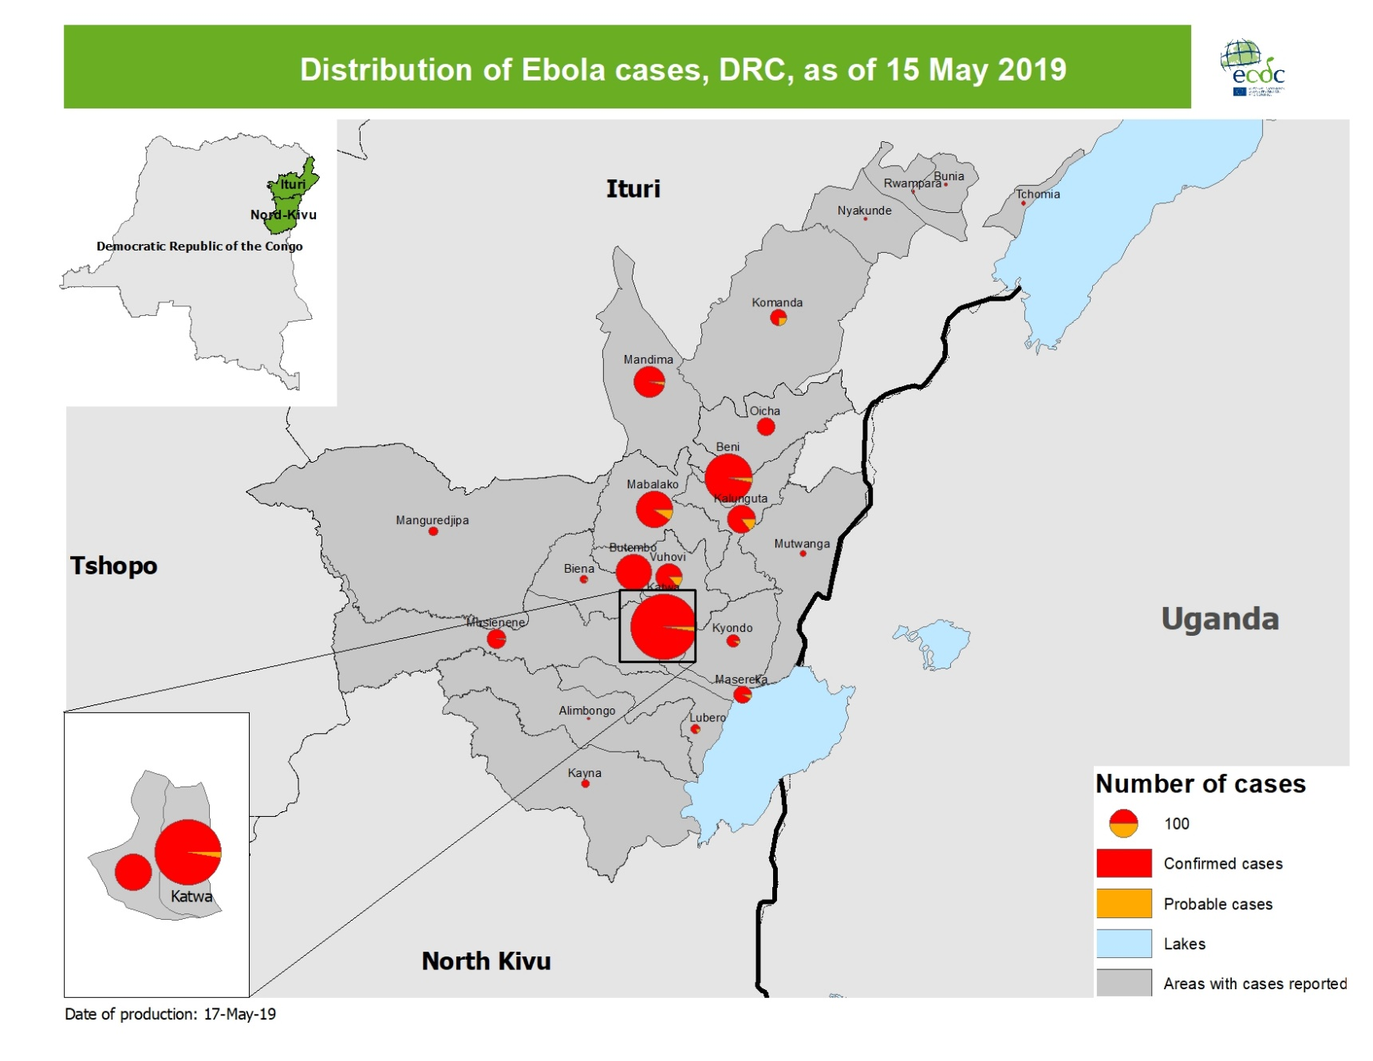
Geographical distribution of confirmed and probable cases of Ebola virus disease, North Kivu and Ituri Provinces, Democratic Republic of the Congo, as of 15 May 2019

Slide 4
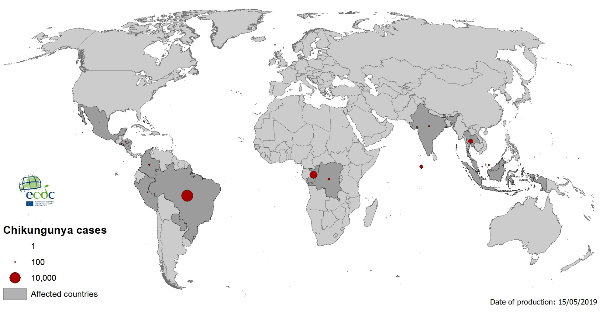
Geographical distribution of chikungunya cases reported worldwide, March–May 2019

Slide 5
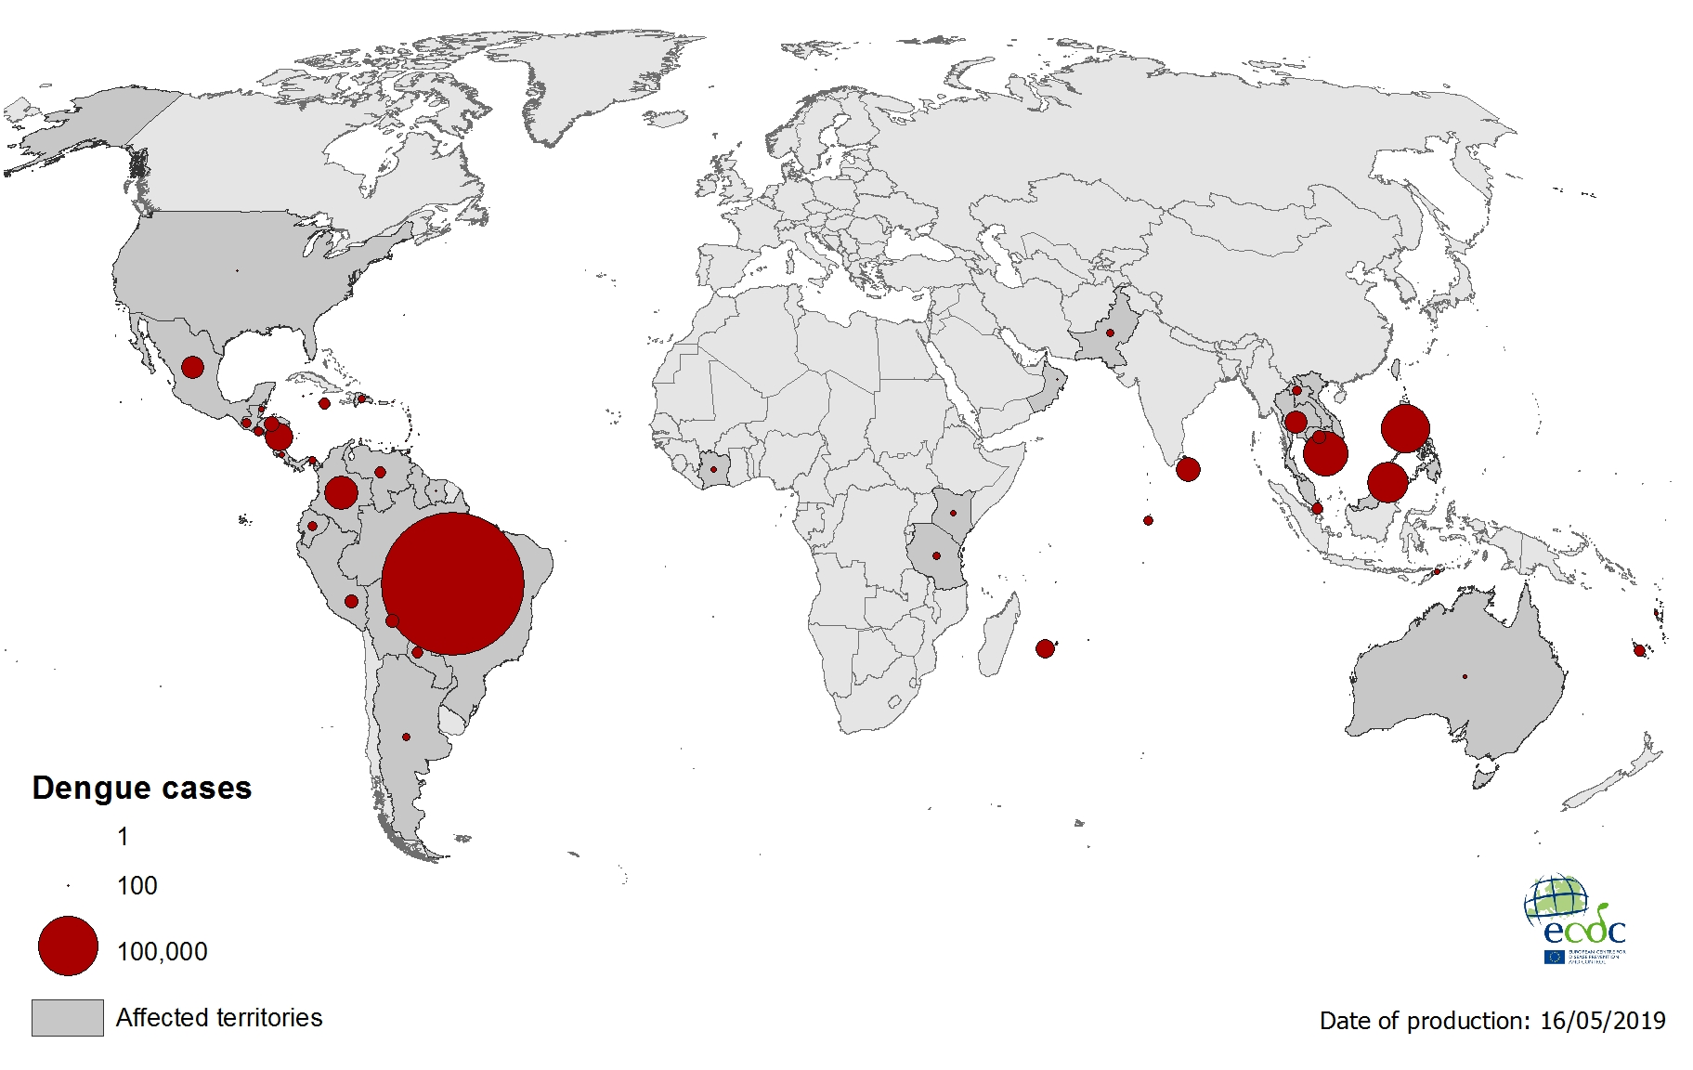
Geographical distribution of dengue cases reported worldwide, March–May 2019

Slide 6
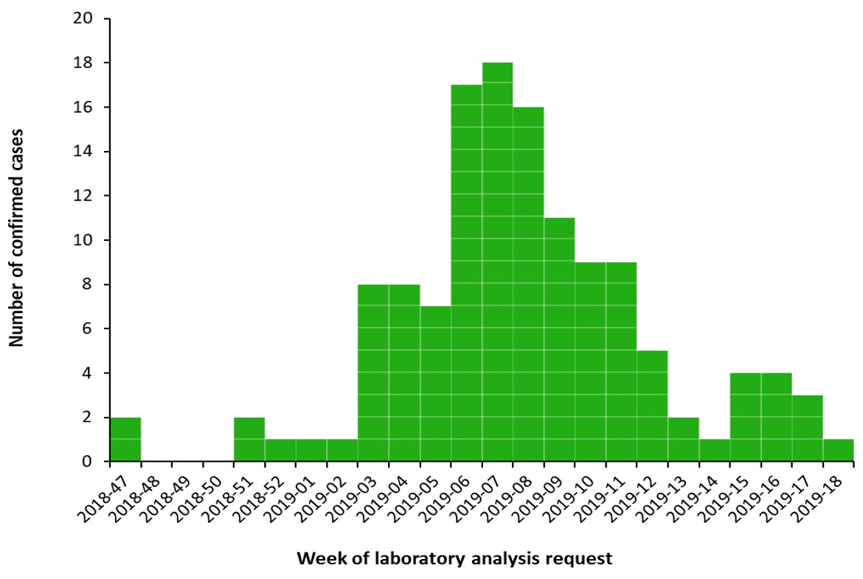
Distribution of confirmed human cases of Rift Valley fever in Mayotte by week of laboratory analysis request,
22 November 2018–3 May 2019

Slide 7
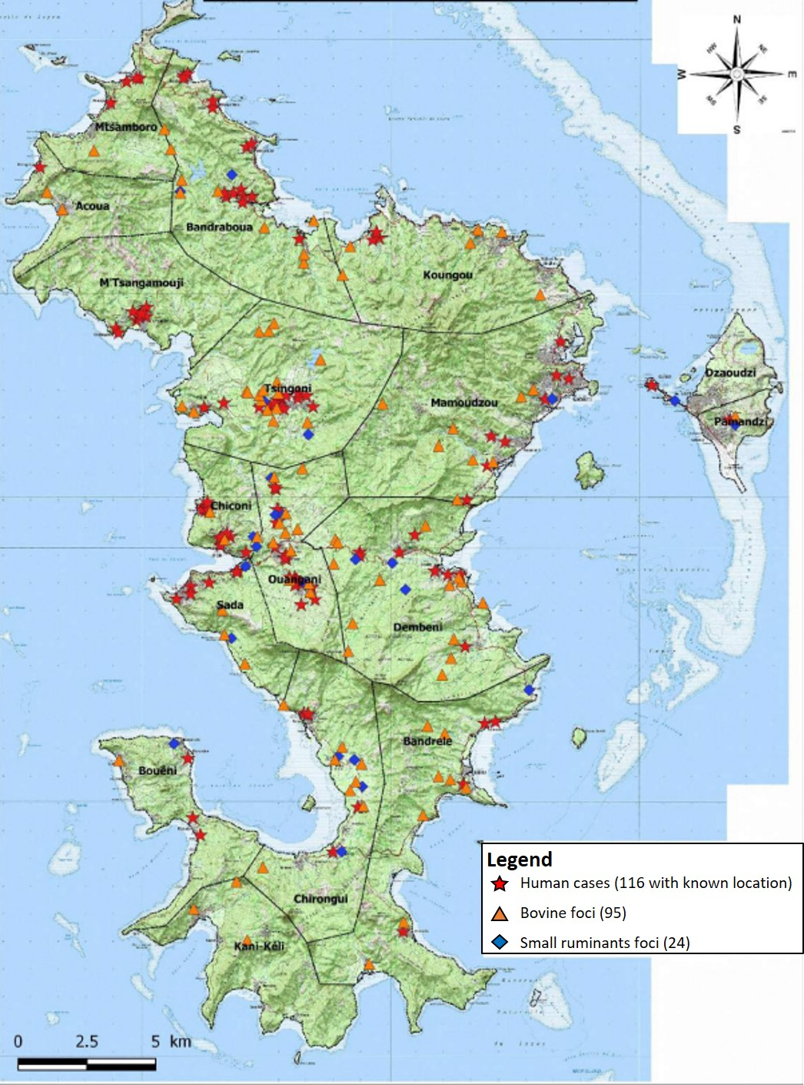
Geographic distribution of human cases (red star), bovine foci (orange triangle) and small ruminant foci (blue diamond) from 22 November 2018–10 May 2019

