Slide 1
Reusable maps and graphs from ECDC Communicable Disease Threats Report
Week 19, 2020
You are encouraged to reuse our maps and graphs for your own purposes and free to translate, provided the content is not altered and the source is acknowledged.

Slide 2
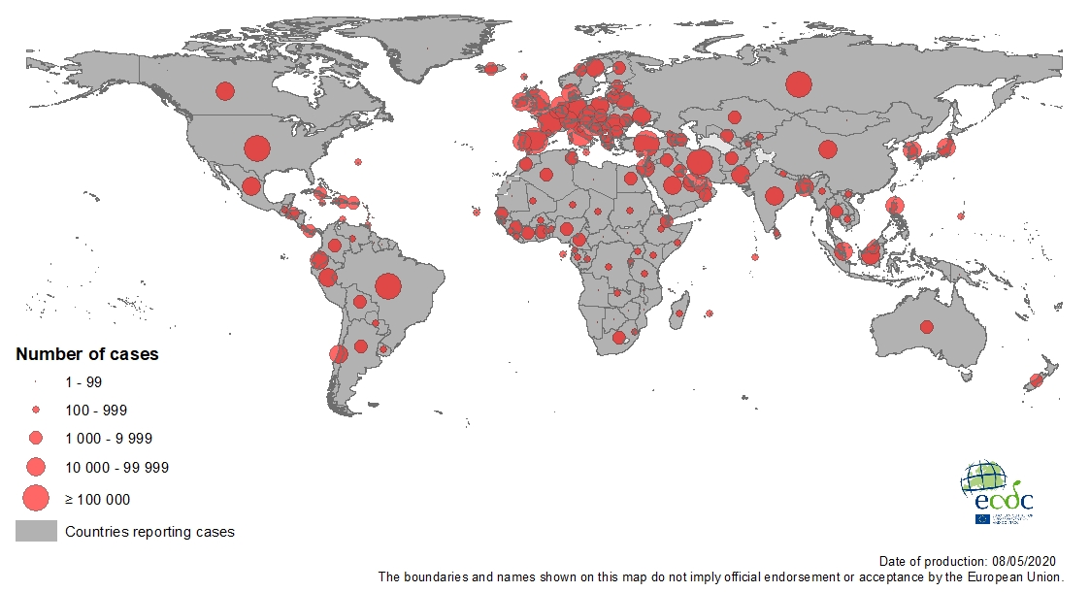
Geographical distribution of COVID-19 cases (in accordance with the applied case definition in the country), as of 8 May 2020

Slide 3
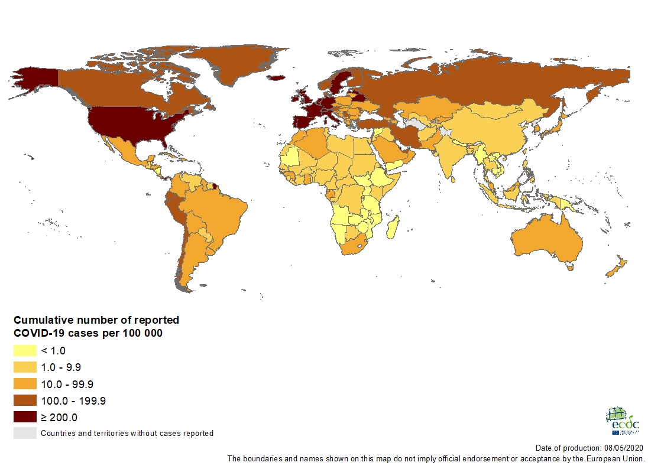
Geographic distribution of cumulative number of reported COVID-19 cases per 100 000 population, worldwide, as of 8 May 2020

Slide 4
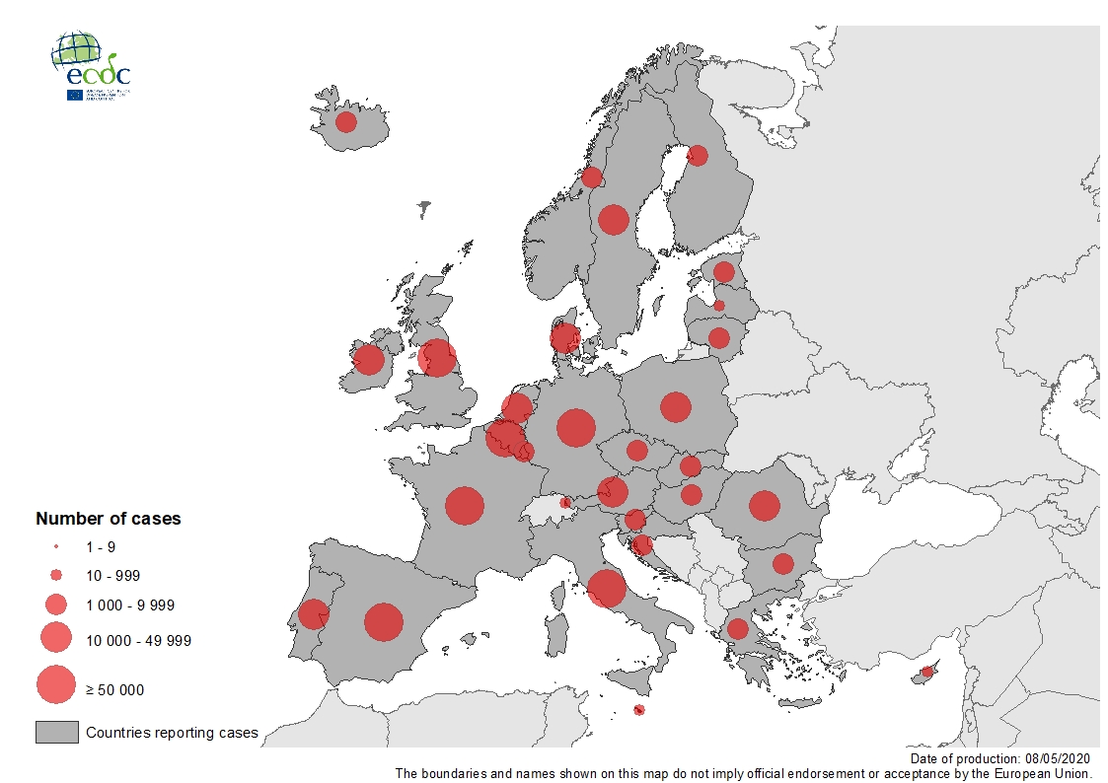
Geographic distribution of laboratory confirmed COVID-19 cases in the EU/EEA and the UK, as of 8 May 2020

Slide 5
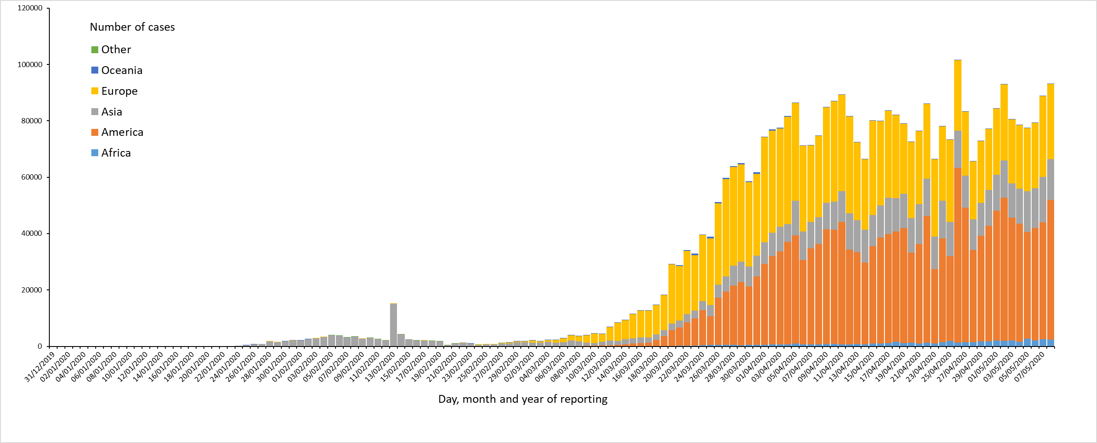
Distribution of COVID-19 cases (in accordance with the applied case definition in the country) by country and region, as of 8 May 2020

Slide 6
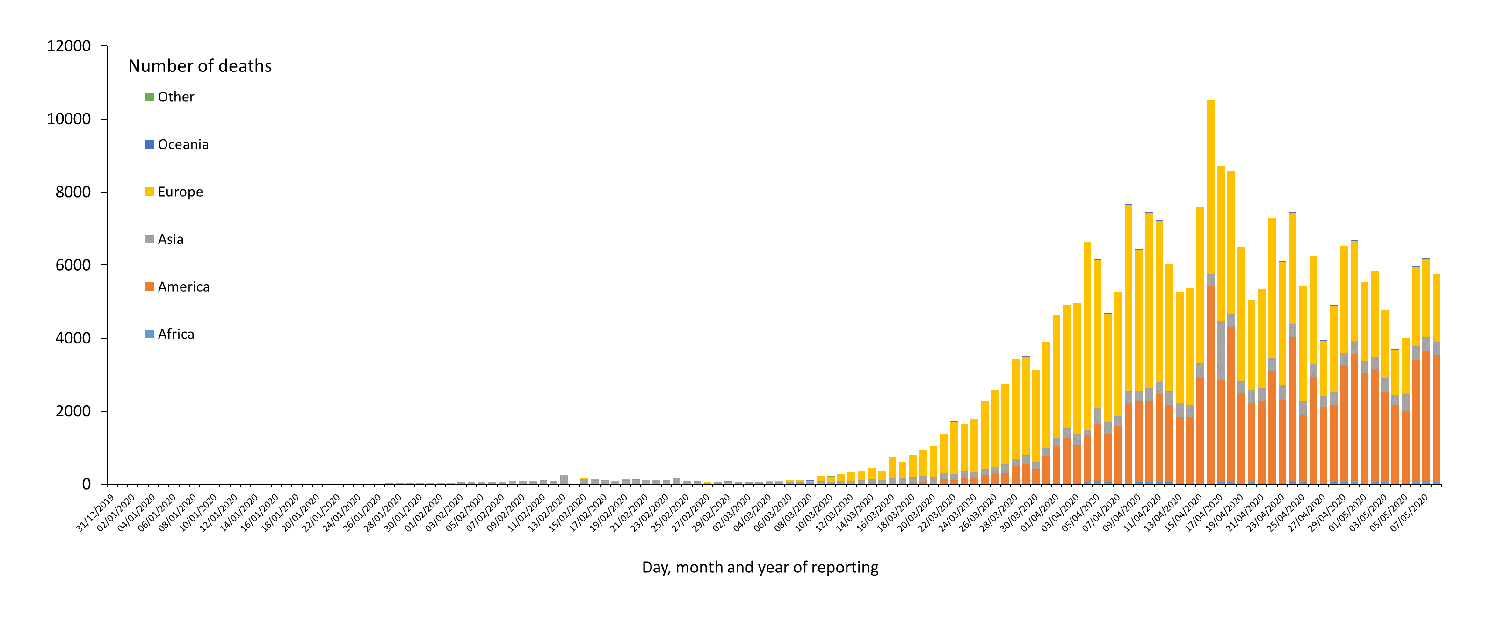
Distribution of COVID-19 deaths (in accordance with the applied case definition in the country) by country and region, as of 8 May 2020
*
* Increase of deaths in America is attributable to the US, which since 14 April 2020 includes confirmed and probable cases and deaths:
https://www.cdc.gov/coronavirus/2019-ncov/cases-updates/cases-in-us.html#2019coronavirus-summary

Slide 7
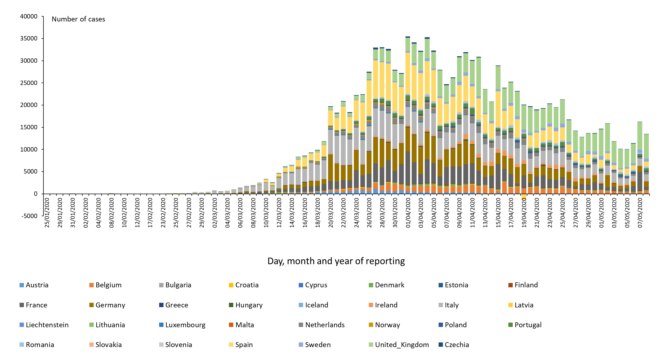
Distribution of COVID-19 cases (according to the applied case definition in the country) in EU/EEA and the UK, as of 8 May 2020

Slide 8
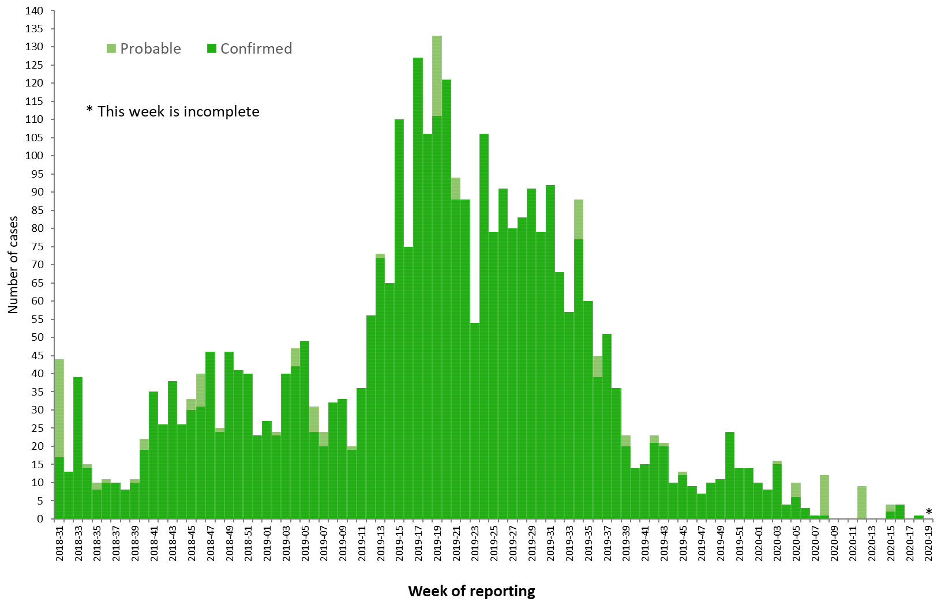
Distribution of confirmed and probable cases of Ebola virus disease by week of reporting, Democratic Republic of the Congo and Uganda, as of 5 May 2020

Slide 9
Ebola Virus Disease case distribution in DRC and Uganda as of 5 May 2020

Slide 10
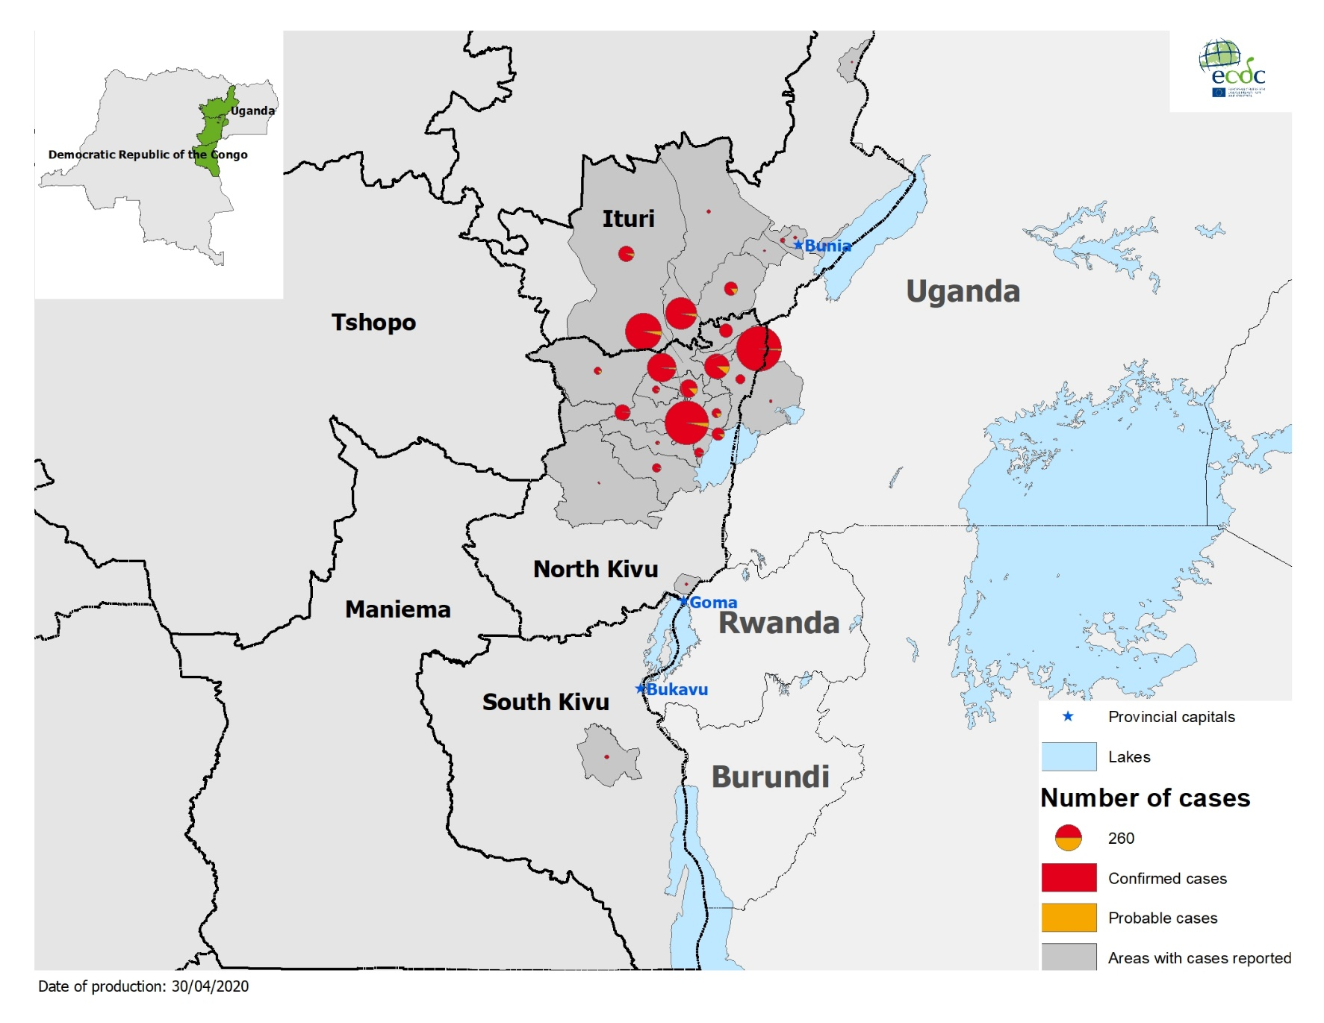
Geographical distribution of confirmed and probable cases of Ebola virus disease, Democratic Republic of the Congo and Uganda as of 5 May 2020

