Slide 1
Reusable maps and graphs from ECDC Communicable Disease Threats Report
Week 18, 2024
You are encouraged to reuse our maps and graphs for your own purposes and are free to translate them, provided the content is not altered and the source is acknowledged.

Slide 2
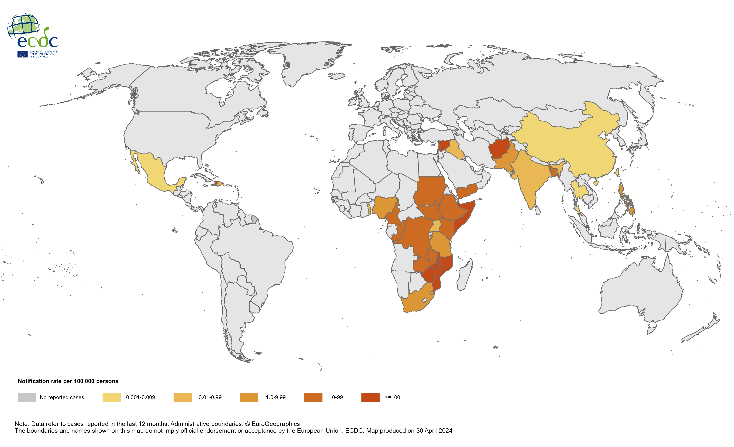
Geographical distribution of cholera cases reported worldwide from April 2023 to March 2024

Slide 3
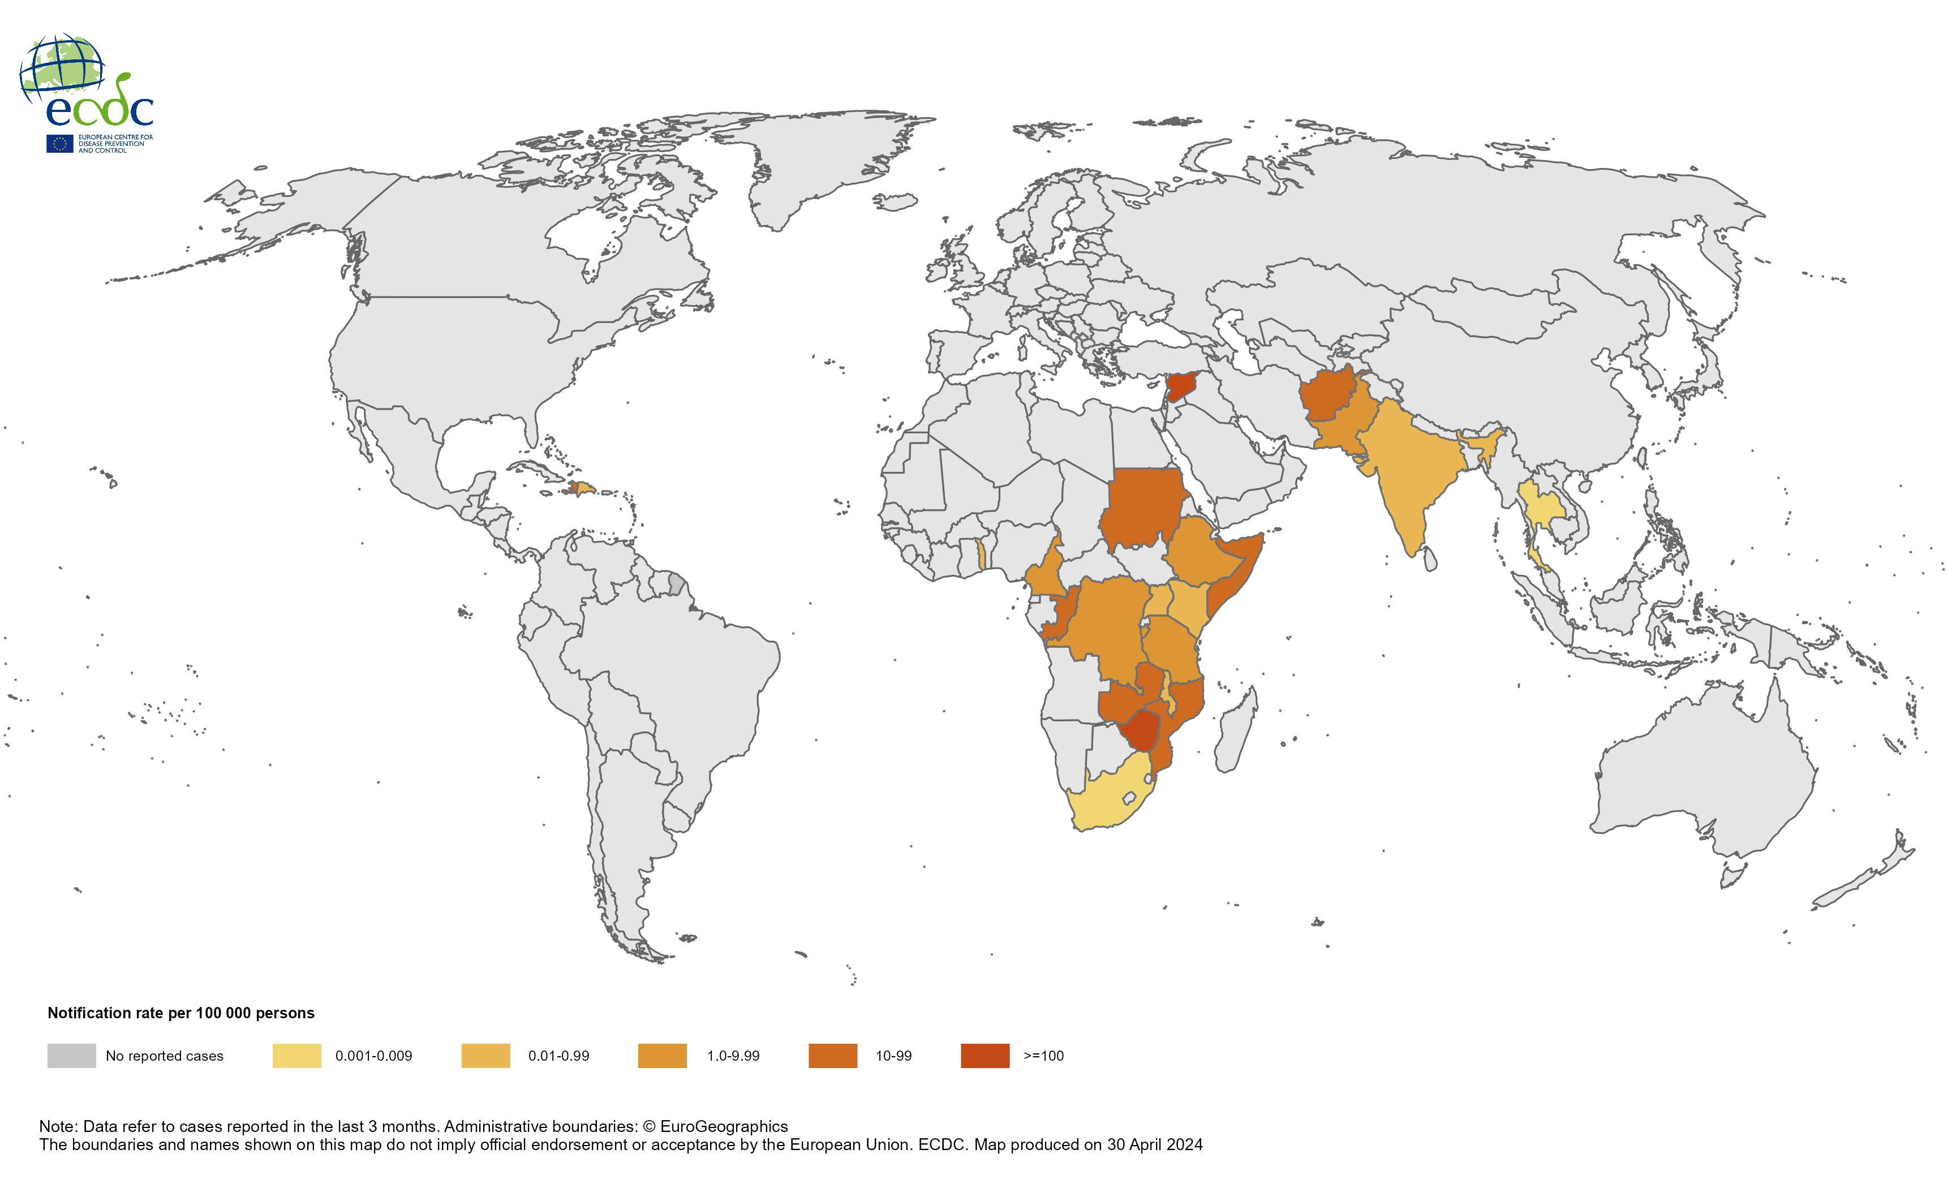
Geographical distribution of cholera cases reported worldwide from January to March 2024

Slide 4
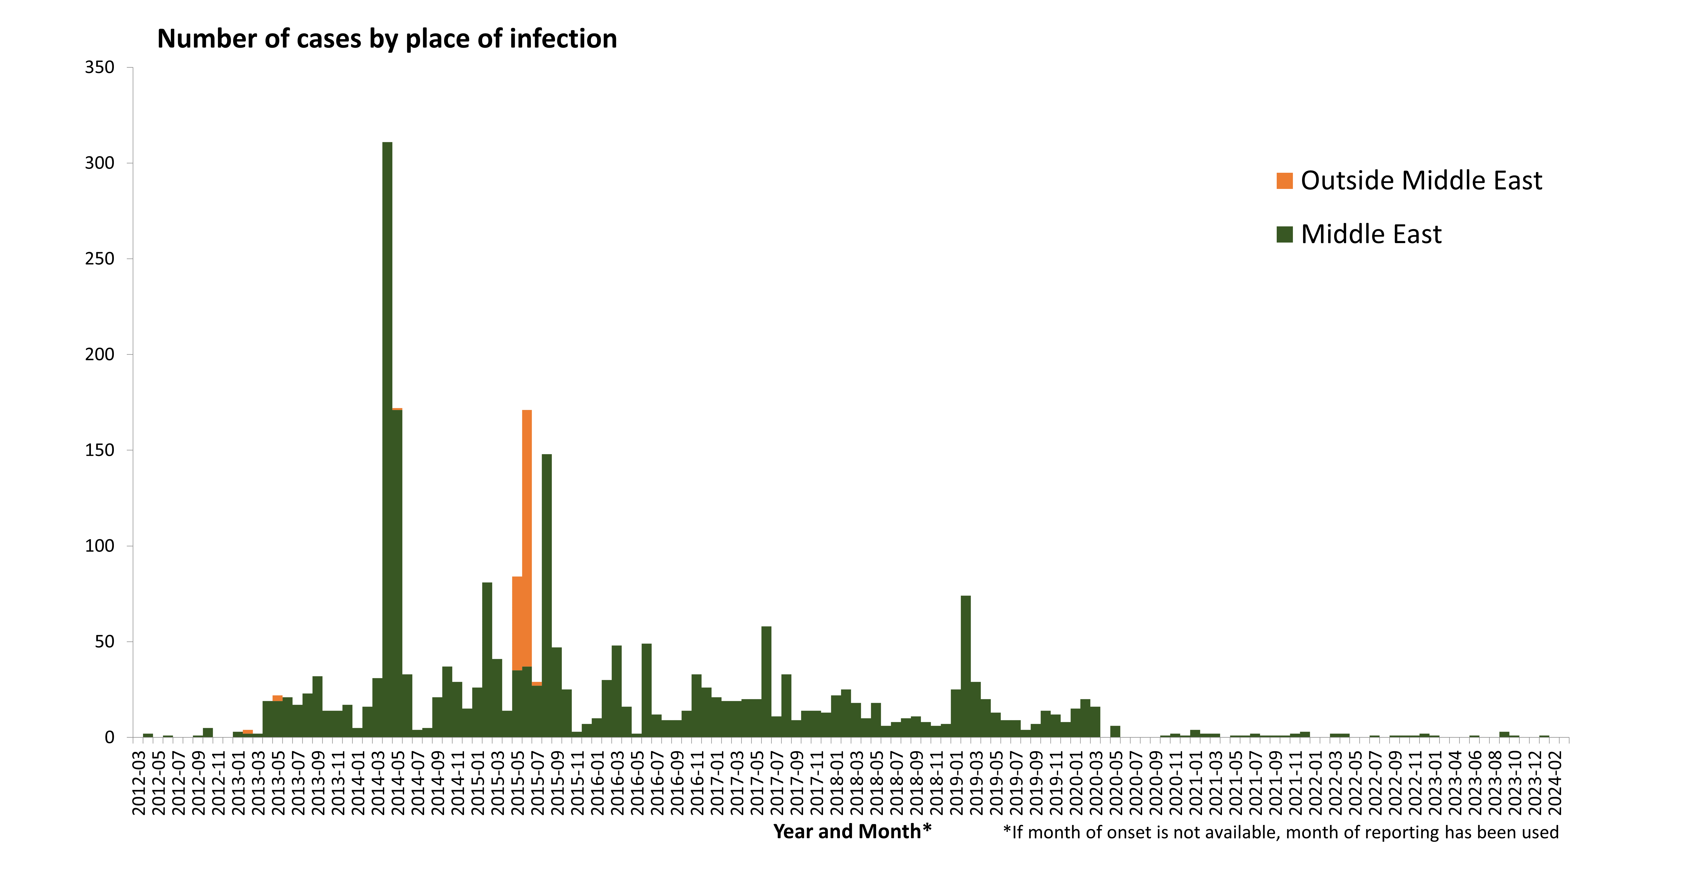
Confirmed cases of MERS by place of infection and month of onset, April 2012 to April 2024

Slide 5
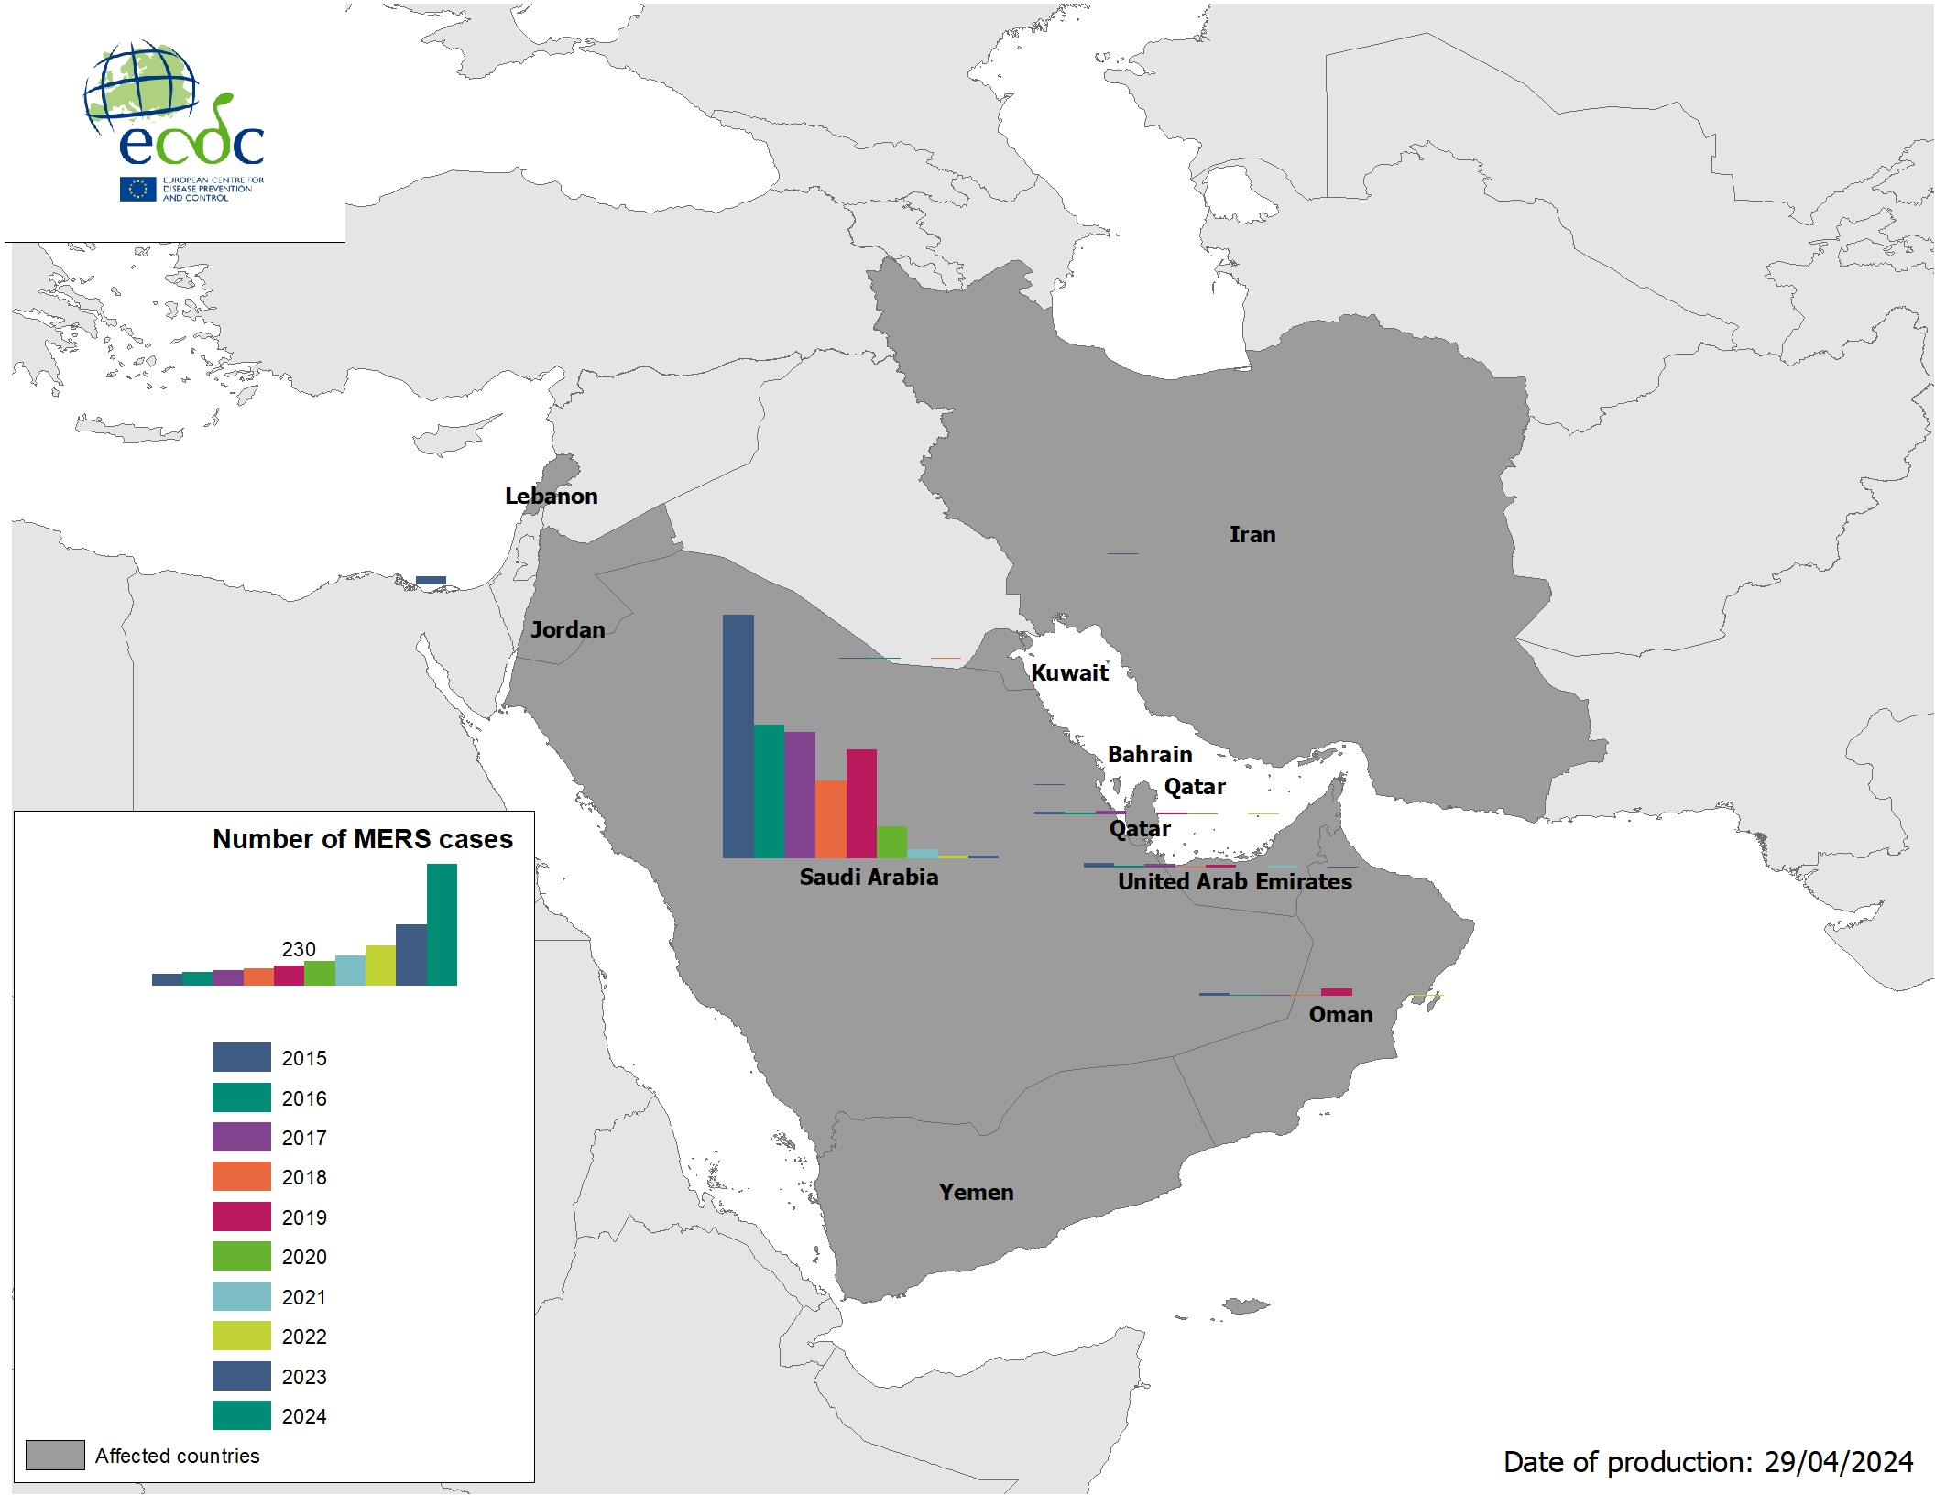
Geographical distribution of confirmed MERS cases by country of infection and year, January 2014 to April 2024

